Slide 1
Global Air Navigation Plan (GANP) – Framework for global planning
H. Sudarshan
SIP/2012/ASBU/Nairobi-WP/7
Workshop on preparations for ANConf/12 − ASBU methodology
(Nairobi, 13-17 August 2012)

Slide 2

Outline
Planning mechanisms
Development of revised GANP
What is new in the revised GANP
What are the policy changes
International agreement at the
ANConf/12

Slide 3
Planning Mechanisms…
Partners | Planning Levels | Deliverables | Guidance
ICAO | Global | Global plan | ICAO policy
Regional planning groups | Regional | Regional plan | Global plan
Subregional/ or Multinational groups | Subregional or Multinational | Subregional plan or Multinational | Regional plan
States | National | National plan | Regional plan

Slide 4
Planning Mechanisms
Partners | Planning Levels | Deliverables | Guidance
Airspace users | Regional, national | User-driven plan | Regional and national plans
Service providers | Global, regional, national | Service-provider plan | Global, regional and national plans
Industry | Global, regional, national | Manufacturer plan | Global, regional and national plans

Slide 5
Global Plan, Regional Plans and National plans
ICAO HQ
GLOBAL
ANP
General
Planning Principles
Online
Interactive
Planning Tools
REGIONAL
ANP
National Plans
Volume I
Basic part of Air Navigation Plan
Volume II
Facilities and Services Implementation Document
Action
Contribution line
Harmonization
STATES
PIRGS
ROs

Slide 6
What is Global Plan?
Strategic Document for regional and national planning for air navigation infrastructure
Serves as global guidance for PIRGs
Maturity process
  First developed as global coordinated plan for CNS/ATM Systems in 1992
  In 1998 the Global Plan for CNS/ATM systems released
  In 2006, the Global Plan for Air Navigation Systems was developed
  In 2012, revised Global Plan will be presented during 12 ANConf that will contain ASBU methodology
Refers to five major disciplines
  ATM, CNS, MET, AIM and AGA

Slide 7
Encompasses Performance Framework
Addresses ANSP, Regulatory and User requirements
Includes ASBU Methodology
Doc 9750
Global Air Navigation Plan, Edition 4
2014-16
GANP History
Doc 9750
Edition 3, 2006
Doc 9750
Edition 2, 2001
Doc 9750
Edition 1, 1998
Doc 9883, 2008
Global Performance Manual
Doc 9882, 2008
ATM System Requirements
Appendix to FANS Report, 1992
Doc 9854, 2005
Global ATM Operational Concept
Related documents

Slide 8

GANP- Contents (DOC 9750)
Global Air Navigation Plan -Outline
EXCUTIVE VIEW
Chapter 1: Global Air Navigation Policy
Chapter 2: Near Term Standardization – ASBU Block 0 and 1
Chapter 3: Continuing Strategic Planning – ASBU Blocks 2 and 3
Chapter 4. Implementation-Turning ideas into action
Chapter 5: Aviation System Performance: Analysis and Reporting
Appendices:
1. GANP Ownership, Overview and Evolution;
2. Hyperlinked Online Support Documentation;
3. Technology Roadmaps; and
4. SARPs Development Planning.

Slide 9
Start: review user needs (e.g. capacity, delays, routes, etc.)
Manage
Assess
Elaborate
Estimate
Implement
Review
Identify homogenous areas/traffic flows/terminal areas/aerodromes
Review National Plans requirements
Estimate new economic parameters
List States/FIRs
IDENTIFY GAPS
Develop implementation mechanisms
Consider current/foreseen traffic population.
Consider forecasts of average and peak aircraft movements.
ASBUs
Set Performance Objectives
Develop consensus with users
Elaborate/refine scenarios
Amend Regional Plans
Survey Aerodrome characteristics, ATM Infrastructure including Human Resource availability
Perform/integrate initial CBA/ sensitivity analysis
Develop human resources plan
Consider civil/military access and SUA requirements
Evaluate acceptance by users
Perform implementation tasks
Performance Metrics
Assess costs & revenue parameters
Estimate human resources requirements
End: Validate and monitor
Air Navigation Reports
End: Validate and monitor
Flow chart for regional and national planning
End: Validate and monitor

Slide 10
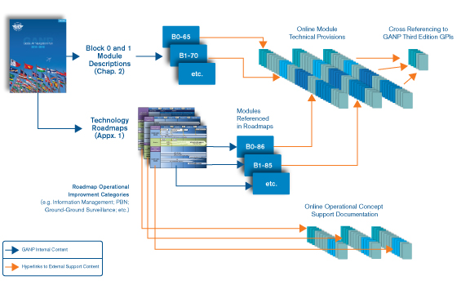
Mapping of the hyperlinked technical content supporting the Block Upgrade Modules and Technology Roadmaps

Slide 11
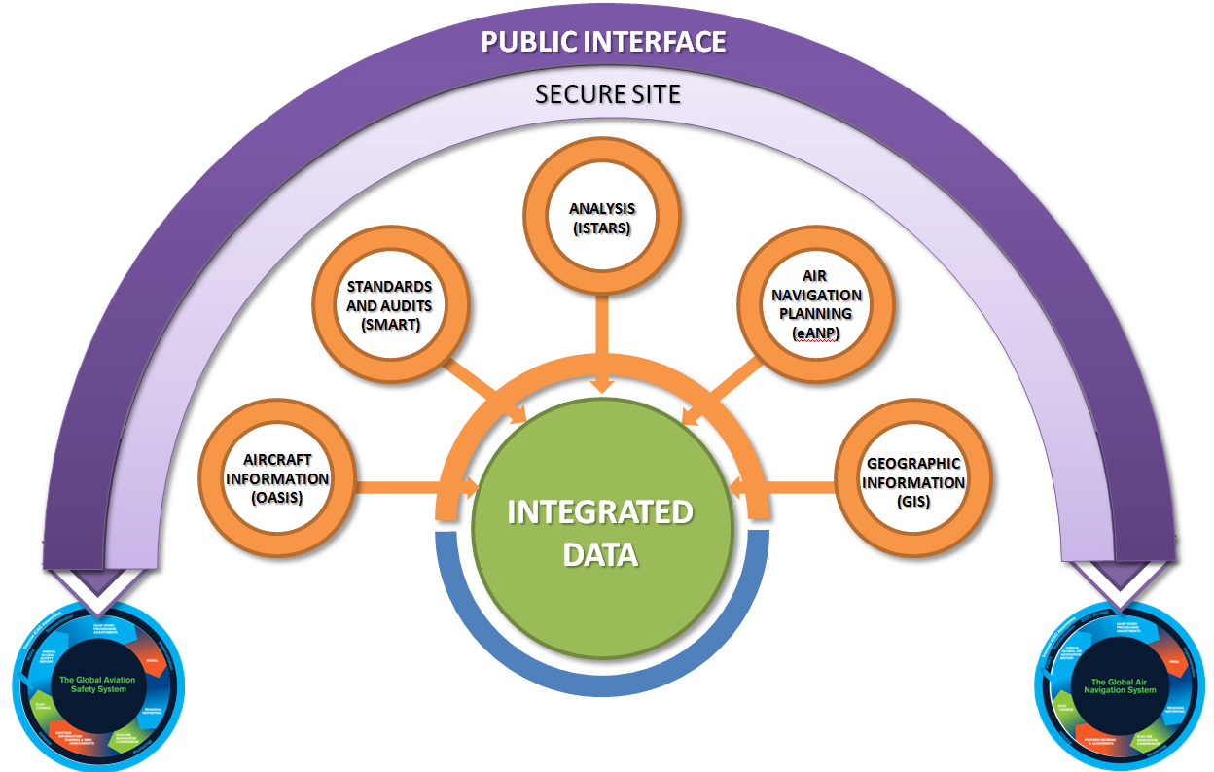
Safety Tools

Slide 12
What is new in the revised Global Plan?
No | Current version (Nov 2006) | Upcoming revised version (Nov 2012)
1 | Scope covers only ground equipment for ANSPs | Scope extends to airspace users and regulators involving Airlines and CAAs
2 | P (paper)–based | E (electronic)–based
ICAO SIP 2012- ASBU workshop

Slide 13
What is new in the revised Global Plan?
No | Current version (Nov 2006) | Upcoming revised version (Nov 2012)
3 | Does not support planning tools for its implementation | Detailed guidance available online on the related website
4 | Addresses individual improvements through GPIs | Addresses a package of improvements through ASBU Modules encompassing all GPIs
ICAO SIP 2012- ASBU workshop

Slide 14
What is new in the revised Global Plan?
No | Current version (Nov 2006) | Upcoming revised version (Nov 2012)
5 | No individual roadmap for enablers | Separate technology roadmaps for C, N, S and IM
6 | Aircraft equipage not specified | Avionics roadmap included
ICAO SIP 2012- ASBU workshop

Slide 15
What is new in the revised Global Plan?
No | Current version (Nov 2006) | Upcoming revised version (Nov 2012)
9 | Global plan was not presented to Industry forum | Global Plan reviewed by GANIS
10 | Implementation was based on near term and medium terms | Implementation is based on near, medium and long terms through Blocks 0, 1, 2 and 3 timeframes
ICAO SIP 2012- ASBU workshop

Slide 16
What is new in the revised Global Plan?
No | Current version (Nov 2006) | Upcoming revised version (Nov 2012)
11 | Supported by paper based Regional ANPs | Supported by web based Regional ANPs, called eANPs
12 | Quantification of fuel savings and corresponding environmental benefits are not available | ICAO Fuel Savings Estimation Tool (IFSET) will be a part of the revised global plan
ICAO SIP 2012- ASBU workshop

Slide 17
Regional Agreement
Regulators will now be part of regional and national air navigation planning process by supporting required regulatory needs for ASBU modules
Regional agreement for the implementation of ASBUs will be reflected in the respective regional air navigation plans through PIRG process
National planning will also follow ASBU methodology thus deriving all benefits for all the entities
The FASID part of the regional plans is now needed to reflect ground systems as well as avionics to implement the respective ASBU modules. This process ensures commitment by all States, Users and ANS providers for the implementation work programme.

Slide 18
Revised GANP -International Agreement at AN-Conf/12
AN-Conf/12 in Montréal, 19-30 November 2012
Global Air Navigation Plan (Global ANP) revision
  Available on ICAO Website: ANConf/12-WP3
  First Global Air Navigation Report planned for 2014
Regional Air Navigation Plan (online format known as eANP) revision – 2012
  ICAO is progressing towards development of online version of Regional Plans, called e-ANPs for all the regions and will include ASBU methodology. The Regional e-ANPs will be an online interactive plan with access rights to States, International organizations and Regional offices and will be made available at the AN-Conf/12.

Slide 19
Synergies between GANP and GASP
Combined Synergies between GANP and Global Aviation Safety Plan (GASP)
  A 4 page document describes System of systems
  Explains development of Safety and Air Navigation Reports
  Informs update process for both GANP and GASP

Slide 20

Notes:
Thank you!

