Slide 1
AIM - implementation
SIP/2012/ASBU/Nairobi-WP/17
Saulo Da Silva
Workshop on preparations for ANConf/12 − ASBU methodology
(Nairobi, 13-17 August 2012)

Slide 2
Overview
What we have been doing
What we are doing
What will we be doing next

Slide 3
What we have been doing…..
  2008
  NextGen / SESAR Conference in Montreal
  AIS-AIMSG/1
2009
  Gap Analysis of NextGen/SESAR/ICAO
  AIS-AIMSG/2
  AIS to AIM transition roadmap
2010
  Harmonisation of NextGen and SESAR
  Introduction of CARATS
  AIS-AIMSG/3
  Amendment 36 to Annex 15

Slide 4
What we have been doing…..
2011
  AIS-AIMSG/4
  Development of Amendment 37 to Annex 15
  GANIS
  Initiate work to integrate AIM into Global ATM
    AIM Operational Concept
    SWIM integration

Slide 5
AIS to AIM Roadmap - 3 Phases
Consolidation
Going Digital
Information Management

Slide 6
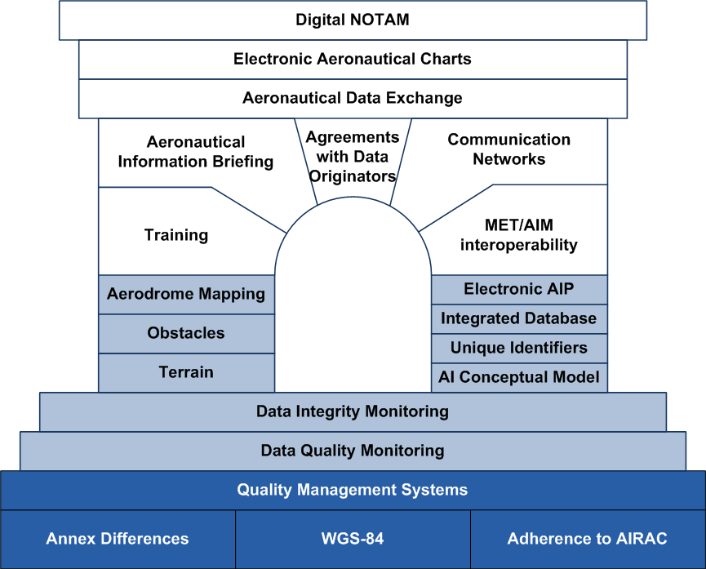
AIS to AIM Roadmap
- 21 interrelated steps
Notes:
The roadmap comprises 21 interrelated steps that will establish the foundation for a SWIM, from implementation and use of current provisions until the integration of the flight and flow of information in a collaborative environment.

Slide 7

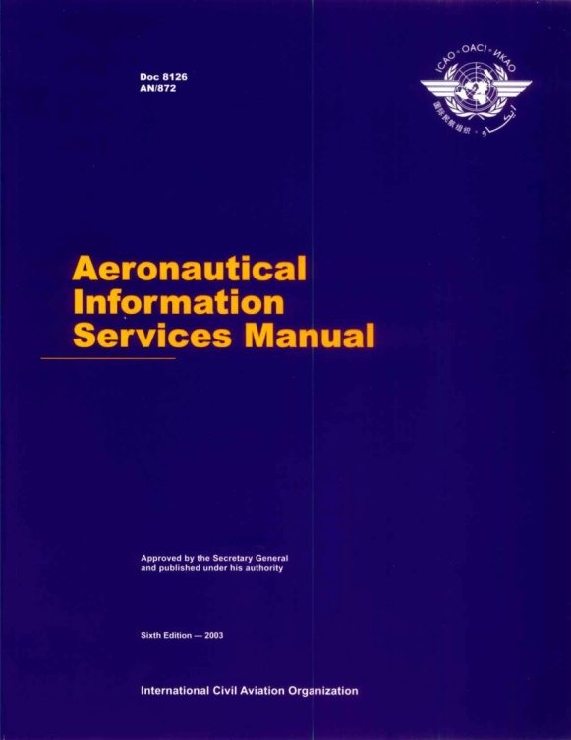
Current ICAO Provisions
SARPS
Guidance Material

Slide 8
Annex 15
Requirements | Detailed specifications
General Requirements | AIP Format
AIP | SNOWTAM Format
NOTAM | ASHTAM Format
AIRAC | AIRAC Contents
AIC | NOTAM Distribution System
Pre and post flight information | NOTAM Format
Telecommunication Requirements | Data Quality
eTOD | Terrain and Obstacle data

Slide 9
PANS-AIM
Contents might include
Provisions, procedures, practices and formats applicable to:
AIP
NOTAM, SNOWTAM, ASHTAM
AIRAC
Data acquisition
Data quality
Integrated briefing
Inter-service communication

Slide 10
Developing the AIM Framework
Annex 15:
  Amendment 37 (2013)
    Introduce AIM elements
  Amendment 38 (2016)
    Fully restructured
Global AIM Operational Concept
IM Roadmap GANP
PANS-AIM (2016)

Slide 11
AIM Provisions Framework
Document | Function and Content | Primary Audience
Annex 15 | Requirements and performance specifications | States
PANS-AIM | Procedures, processes, formats, technical specifications | States and service delivery organizations
AIS (AIM) Manual | Best practices; guidance on application and implementation | Service delivery organizations

Slide 12
Structural Implementations –
The bigger picture
Global ATM Operational Concept has a target implementation horizon of 2020-2025
ATM requirements expand the OC and provide the basis for ATM development

Slide 13
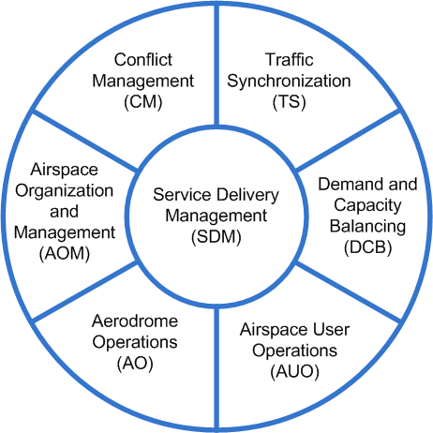
ATM Operational Concept
7 inter-related concept components
Describes a “vision of achievable benefits”
Information is a overarching dimension linking all components
CDM is a key process

Slide 14
Information is the key enabler
The delivery of timely, quality assured information as needed across:
Multiple Domains
Multiple Providers
Multiple users
Multiple applications
Multiple communication modes
Multiple Modernization Programs

Slide 15



Planning and development is underway
A number of planned implementations……

Slide 16





Aviation System Block Upgrades
Global Build 1
Global Build 2
Global Build 3
Operational Demonstration Validations
2011
2020
Notes:
The foundation of the blocks originates from existing, near term implementations, and access to the benefits that already exist in many regions of the world. The intent is to apply key capabilities and performance improvements across other regional and local environments with the same level of performance and associated benefits worldwide. The block upgrades will allow a structured approach to meet the needs of the individual aviation communities worldwide, while considering the associated business cases.

Slide 17
Possible AIM integration….
Performance Improvement Areas
Block 0
(2013)
Block 1
(2018)
Block 2
(2023)
Block 3
(2028 & >)
Globally Interoperable Systems and Data
Information Management Based on AIXM
Improved Information Management
Full FF-ICE
System Wide Information Management (SWIM)
Airborne Access to SWIM
Ground-Ground Integration Through ATS Inter-facility Data Communication (AIDC)
Ground-Ground Integration Through Advanced ATS AIDC and FF-ICE/1 Before Departure
Ground-Ground Integration: (FF-ICE/1 and Flight Object, SWIM)
etc.
etc.
etc.
etc.
Notes:
Here is an example using some of the blocks for one PIA

Slide 18
Possible AIM integration….FPL
Amendment 1 to PANS-ATM 15th Edition - FPL
The changes were announced by ICAO in 25 June 2008 and will become applicable on 15 November 2012
Necessary to allow ATM systems to make optimum use of advanced aircraft capabilities already onboard the aircraft
Is one step towards a completely integration of the aircraft to the ATM system as envisaged in the Global ATM Operational Concept

Slide 19
Possible AIM integration….FPL
Flight planning environment
Transition Strategy
Checklist Tasks
Implementation guidelines
Conversion of new items to present items
Flight Plan Implementation Tracking System
(FITS)

Slide 20
In Summary…..
Current roadmap leads to digital AIS services
New functions, products, and services are in the process of identification
New roadmap will extend from the current one and be incorporated into the GANP
Delivery of full IM should allow for flexible applications
New FPL as one step

Slide 21
In summary - Milestones
Date | Event | Milestone
20-23 Sept 2011 | GANIS | Industry feedback on : ASBUs AIM concept with Roadmap and PANS-AIM
15 Nov 2012 | FPL | States/ANSPs/Airlines using ne FPL functions
19-30 Nov 2012 | ANC 12 | Present Global AIM and SWIM concept and outline of ICAO provisions (SARPS and PANS) Agreement of the first series of block upgrades GANP
Nov 2013 |  | Annex 15 Amendment 37
Sept 2014 | MET – AIM Divisional meeting | Present draft PANS-AIM and Annex 15 provisions
Nov 2016 |  | Annex 15 Amendment 38 PANS-AIM 1st edition

Slide 22


