Slide 1
Integrated Meteorological Information
H. Sudarshan
SIP/2012/ASBU/Nairobi-WP/18
Workshop on preparations for ANConf/12 − ASBU methodology
(Nairobi, 13-17 August 2012)

Slide 2
Outline
Does MET matter to ATM efficiency?
MET provision today
MET to support tomorrow’s ATM
MET provision tomorrow

Slide 3
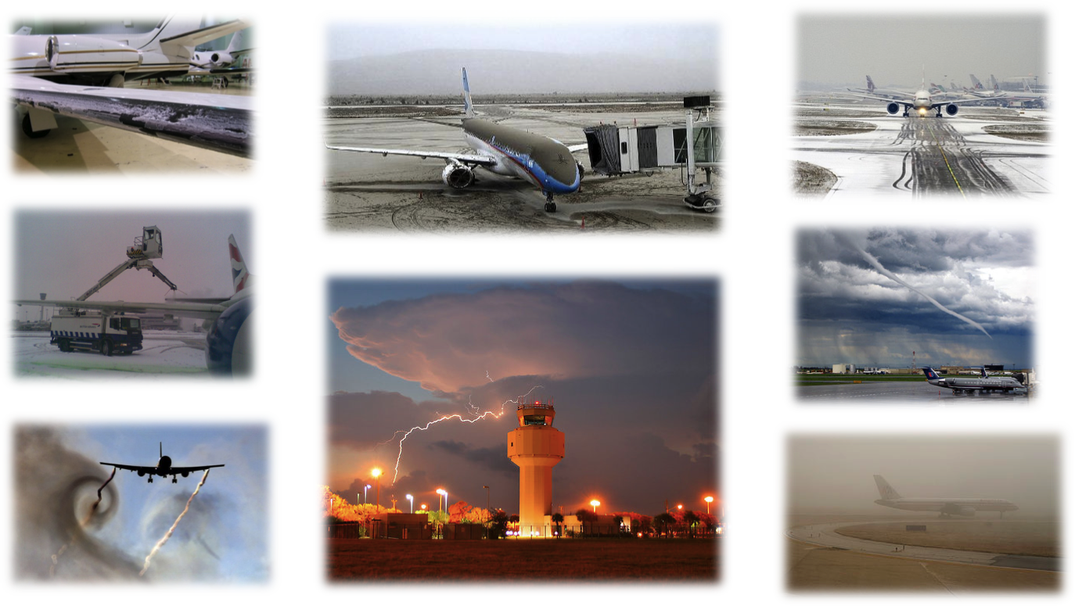
Does MET matter to ATM efficiency?
…absolutely YES
Notes:
Eurocontrol (independent) Performance Review Commission in 2009 estimated the annual cost of disruption to the European ATM system caused by adverse weather to be approximately €900 million
Strategic, pre-tactical and tactical
Gate-to-gate

Slide 4
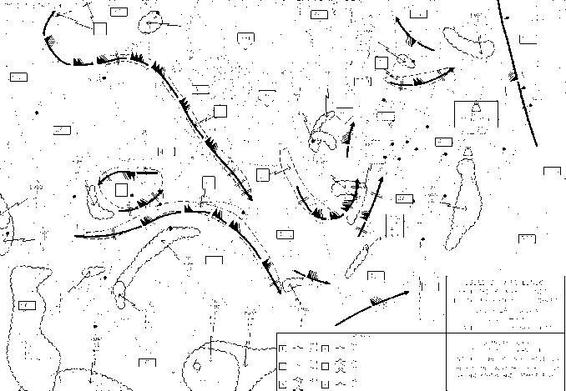
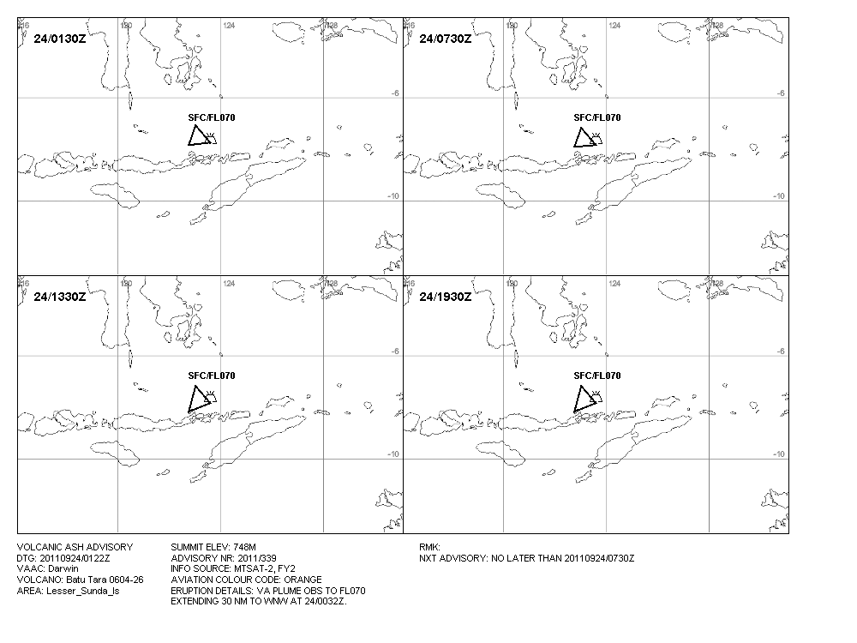
MET provision today
Highly ‘product-centric’
  Text and graphical
  Alphanumeric and digital code forms
Primarily AFTN and AFS delivery to users
Annex 3 SARPS and associated guidance
  ATS/Pilot oriented
  Limited ATM orientation
  Aerodrome, terminal area en-route focus
  Geared towards safe, regular and efficient operations
WSUK31 EGRR 231759
EGTT SIGMET 02 VALID 231830/232230 EGRR-
EGTT LONDON FIR SEV MTW FCST N OF N5330 FL050/150 STNR NC=
TAF EKGF 240600Z 2406/2415 20015KT 9999 SCT015 TEMPO 2406/2415
4000 BR BKN008=

Slide 5
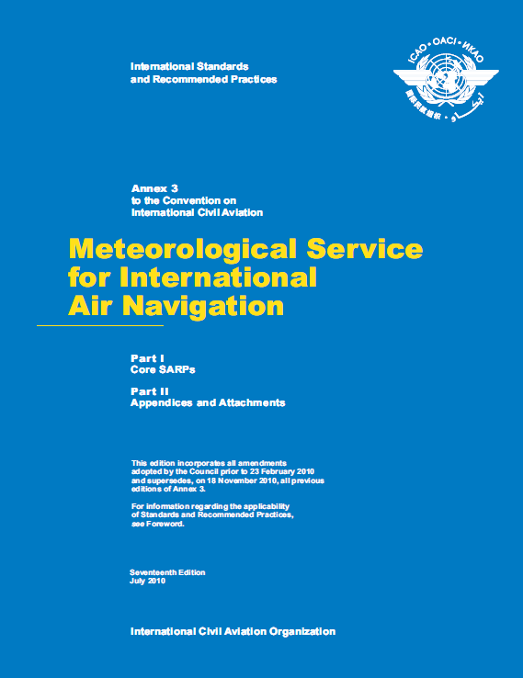
MET provision today
ASBU B0-105
Traditional MET products, services and systems, including:
  World Area Forecast System/World Area Forecast Centres
    Global gridded upper-air forecasts and significant weather (SIGWX) forecasts
  International Airways Volcano Watch/Volcanic Ash Advisory Centres
    Volcanic ash advisories and volcanic ash advisories in graphical format
  State Volcano Observatories
    Volcano observatory notification to aviation
  Tropical Cyclone Watch/Tropical Cyclone Advisory Centres
    Tropical cyclone advisories and tropical cyclone advisories in graphical format
  Aeronautical meteorological stations and reports
  Automatic observing systems
  Aerodrome Meteorological Offices
    Local routine and special meteorological reports, METAR/SPECI, TAF, trend, take-off and landing forecasts, aerodrome warnings, wind shear warnings and alerts, etc
  Meteorological Watch Offices
    SIGMET, AIRMET/GAMET
  Aircraft observations and reports
  ATIS, D-ATIS, VOLMET, D-VOLMET
  Aeronautical climatological information
  Quality management of meteorological information etc
Annex 3
Better use of today’s MET information can result in improved safe and efficient operations

Slide 6
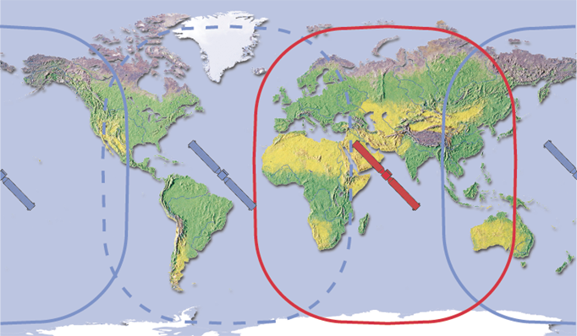
MET provision today
Traditional means of dissemination:
  AFTN
  AFS or public Internet communication (including SADIS and ISCS/WIFS)
  Aeronautical data-link service
  Aeronautical broadcasting service
Supplied to traditional users:
  Operators and flight crew members
  Air traffic service providers
  Meteorological service providers
For use in traditional forms:
  Briefing, consultation and display
  Flight documentation
  Automated pre-flight information systems for briefing, consultation, flight planning and flight documentation
Insert: SADIS (red) and ISCS (blue) satellite footprints

Slide 7

MET to support tomorrow’s ATM
Doc 9854 (Global ATM Operational Concept)
  Service delivery and benefits for airspace users by 2025
  Network-based (net-centric) environment that is globally interoperable
  Fusing MET information with aeronautical information and flight information
Transition of MET products into MET information supporting
  collaborative, knowledge-based, decision making through free-flowing information exchange
  trajectory/performance based operations

Slide 8
MET to support tomorrow’s ATM
List of Models:
WXCM (Weather information exchange conceptual model)
WXXM (Weather information exchange model)
WXXS (Weather information exchange scheme)
Metadata (An essential component towards the data-oriented environment )
AIRM (ATM Information Reference Model
AIXM (aeronautical information exchange model)
FIXM (flight information exchange model
Availability of shared, timely, high-quality MET information
  Foundation for effective management of the (future) air traffic system
WXXM
Meta data
WXCM
WXXS
AIXM
FIXM
AIRM
WXXM
Notes:
WXCM (Weather information exchange conceptual model)
High-level view of concepts and packages that make up the data model - Annex 3, ISO 19100, etc
Plain text and object-oriented software engineering (UML)
Implementation independent
Domain neutral data (not MET or aviation specific) ➔Domain specific data types (general weather domain and aeronautical MET specific)
WXXM (Weather information exchange model)
Exchange model associated with the information model - The ‘logical data model’
Takes the high-level WXCM packages to produce coherent models (exchange considerations)
The lowest level of detail required to develop and implement the physical exchange of data
WXXS (Weather information exchange schema)
Mapping of the logical data model to a physical representation
The ‘physical data model’
The XML schema
Geospatial aspects of WXXS implemented using GML
Implementation dependent
Metadata
An essential component towards the data-oriented environment
An approved mechanism to convey Quality of Service (QoS) information - Data about data
ATM Information Reference Model (AIRM)
The ‘glue’ between the interoperable (data domain specific) information exchange solutions, including AIXM (aeronautical information exchange model), FIXM (flight information exchange model) and WXXM (weather information exchange model).

Slide 9

MET to support tomorrow’s ATM
Publish a major release of:
- WXXM
- specification for METAR/SPECI, TAF and SIGMET exchange in digital form
Develop and publish first iteration specification for MET information exchange (excluding METAR/SPECI, TAF and SIGMET) in digital form
Publish a major release of metadata profile for METAR/SPECI, TAF and SIGMET exchange
Develop and publish first iteration metadata profile for MET information exchange (excluding METAR/SPECI, TAF and SIGMET)
Amendment 77 to Annex 3
2019
Publish major release of WXXM
Publish a major release specification for MET information exchange in digital form
Publish a major release metadata profile for MET information exchange
Amendment 78 to Annex 3
2016
Develop and publish:
- first iteration WXXM
- first iteration for METAR/SPECI, TAF and SIGMET exchange in digital form
- first iteration metadata profile for METAR/SPECI, TAF and SIGMET exchange
Amendment 76 to Annex 3
2013
Evolutionary steps
…the MET Roadmap

Slide 10
MET to support tomorrow’s ATM
Enhanced decision-making capability through improved accuracy, capability, availability and use of meteorological information
  The reliable identification of applicable ATM solutions when meteorological conditions are impacting or are forecast to impact aerodromes or airspace
Full ATM-MET integration is necessary
  Meteorological information included in the logic of a decision process or aid
ASBU Module No. B1-105
ATM OPERATIONAL REQUIREMENT
MET INFORMATION FUSED WITH OTHER AERONAUTICAL INFORMATION
AIRSPACE CONTRAINTS AND AERODROME EVENTS
ATM IMPACT CONVERSION
ATM DECISION SUPPORT

Slide 11

MET provision tomorrow
WXCM, WXXM and WXXS are designed to enable:
  platform independent
  harmonized
  Interoperable MET information exchange covering all the needs of the air transport industry
Through shared, timely, high-quality MET information
Major benefits include:
  Single representation/ common view
  Alignment with ISO standards and OGC best practices for geospatial information
  Modularity to support future requirements
MET information at the right time and the right place

Slide 12

Notes:
Thank you!

