Slide 1
Collaborative Decision Making
(CDM)
Saulo Da Silva
SIP/2012/ASBU/Nairobi-WP/22
Workshop on preparations for ANConf/12 − ASBU methodology
(Nairobi, 13-17 August 2012)

Slide 2

Objective
Introduce the steps for the application of the CDM concept.

Slide 3
Overview
The need
What is CDM
Requirements
Articulating a CDM process
Development and operation
Benefits

Slide 4

The need
Global ATM Operational Concept
evolution to a holistic, cooperative and collaborative decision-making environment
expectations of the members of the ATM community would be balanced to achieve the best outcome based on equity and access.

Slide 5
The need
Come to an agreed vision on the expected results
Ensure that everyone delivers their part of (their contribution to) the required performance
Ensure that everyone uses a compatible approach, method and terminology
Ensure that everyone’s data can be integrated and aggregated to calculate overall indicators and assess system performance at a higher aggregation level.

Slide 6
What is CDM?
A supporting process always applied to other activities such as Demand/Capacity Balancing
It is not an objective but a way to reach the performance objectives of the processes it supports
Allows all members of the ATM community to participate in ATM decisions that affect them
Any member can propose a solution

Slide 7
What is CDM?
Is not limited to any specific domain such as airport or En Route
May apply to all layers of decision from longer-term planning activities through to real-time operations
Requires pre-defined and agreed procedures and rules to ensure that collaborative decisions will be made expeditiously and equitably.

Slide 8
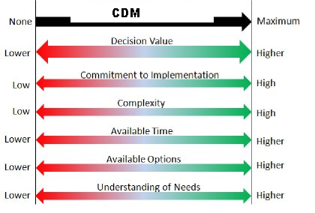
What is CDM?
Increase level of collaboration when commitment to implementation or understanding of needs has to be high.
High decision value and complexity are clear pointers toward more collaboration.

Slide 9
ATM Requirements
Ensure that airspace users are included in all aspects of airspace management via the collaborative decision making process [R15]
Manage all airspace, and where necessary, be responsible for amending priorities relating to access and equity that may have been established for particular volumes of airspace. Where such authority is exercised, it shall be subject to rules or procedures established through collaborative decision making [R18]

Slide 10
ATM Requirements
Establish a collaborative process to allow for efficient management of the air traffic flow through use of information on system wide air traffic flow, weather, and assets [ R112]
Modify the airspace user’s preferred trajectory: when required to achieve overall ATM system performance requirements; and/or collaboratively with the airspace user, in a manner that recognizes the airspace user’s need for single-flight efficiencies [R203].

Slide 11
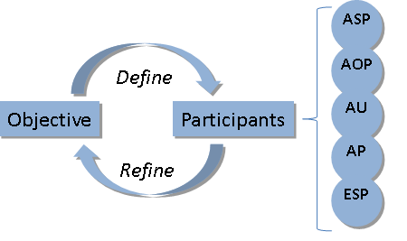
Articulating a CDM PROCESS
Identification of:
  Actors – who is participating in the collaboration?
  Roles & responsibilities – what functions do the actors perform and how do they interact?
  Information requirements – description of requirements and standards imposed on information exchanged as part of the above interactions
  Making the Decision – how is a decision made?
  Rules – what are some rules constraining the behavior?

Slide 12
Development and operation of a CDM
Follows the following typical phases:
CDM need identification
CDM analysis
CDM specification and verification
CDM Performance Case
CDM Implementation and validation
CDM operation, maintenance and improvement (continuous)

Slide 13
CDM need identification
Ability to influence performance in all 11 KPA
Provides a mechanism specifically well-suited to addressing Access and Equity and Participation by the ATM Community frequently difficult to quantify.

Slide 14
CDM analysis
Should make clear what decisions are to be made
Which community members are involved (or affected)
Which information is used in support of taking the decision(s)
Which process(es) are followed
How and through which means the decision making process can be improved and
How such an improvement could contribute to a better performance.

Slide 15
CDM specification and verification
The decisions to be taken, how they are reached and finalized
The community members involved and their roles/responsibilities in the decision(s)
Agreement on objectives (e.g., resolve congestion while minimizing impact to my operation)
Decision making rules, processes and principles
Information requirements including data standards, quality, frequency and deadlines.

Slide 16

CDM Performance Case
Justify the decision to implement the CDM process and to make the necessary investments
It should clearly specify what the costs are and the benefits (in the relevant KPA’s) that will result from the operation of CDM.

Slide 17
CDM Implementation and validation
Includes all steps to bring CDM into operation
Includes training and informing staff
Implementation/adaptation of systems and information networks, etc.

Slide 18
CDM operation, maintenance and improvement
Continuous and shared review, maintenance and improvement process.

Slide 19
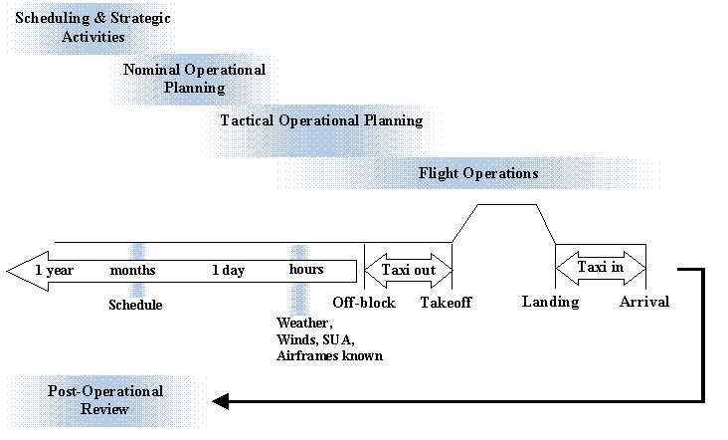
Areas of application

Slide 20
References
Global ATM Operational Concept, ICAO Doc. 9854, 1st Edition 2005
Manual on Air Traffic Management System Requirements, ICAO Doc. 9882, 1st Edition 2007
Manual on Global Performance of the Air Navigation System, Part I – Global Performance and Part II- Performance-Based Transition Guidelines, ICAO Doc. 9883, 1st Edition 2008
Manual on Flight and Flow Information for a Collaborative Environment (FF-ICE), ICAO Doc 9965
CDM Manual (under review)

Slide 21


