Slide 1
Trajectory-Based Operations(TBO)
Saulo Da Silva
SIP/2012/ASBU/Nairobi-WP/25
Workshop on preparations for ANConf/12 − ASBU methodology
(Nairobi, 13-17 August 2012)

Slide 2
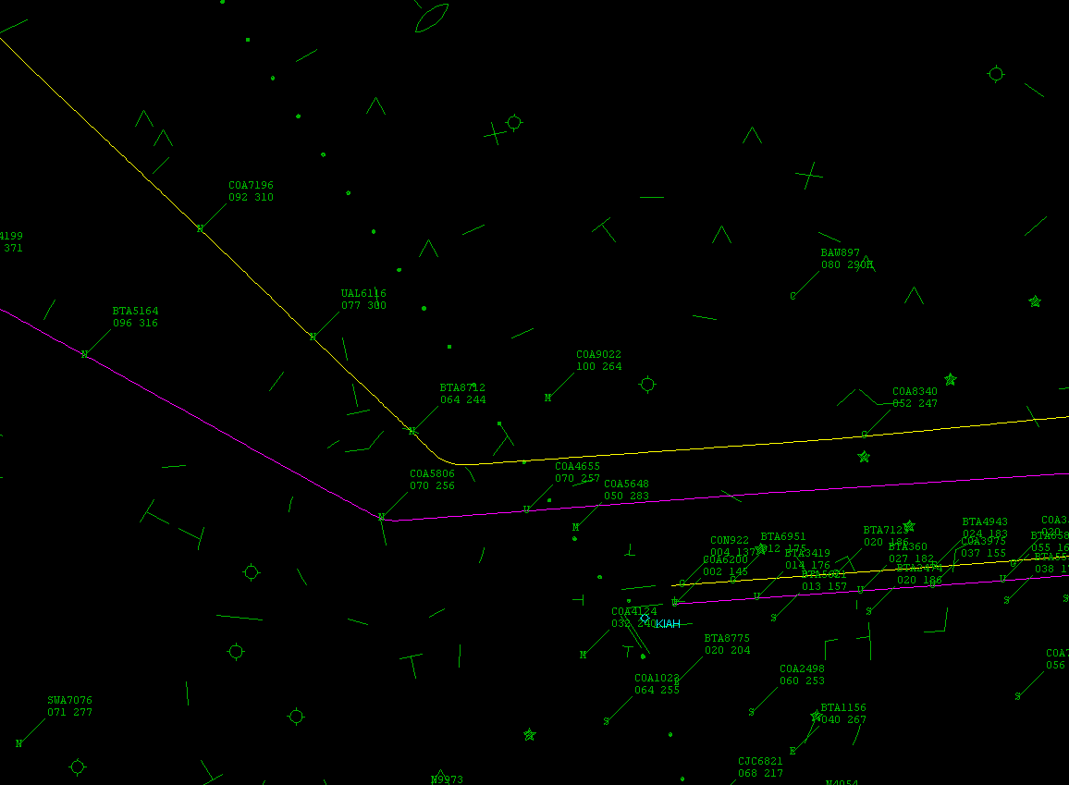
OVERVIEW
Context
Baseline
Concept
Applicability
Capabilities
Why TBO
Procedures
Checklist
Dependencies

Slide 3
Context
Traffic Synchronisation
CM and DCB integrated
Organized flow of traffic
Flexible capacity management
Adjustments in capacity to variations in demand
Delegation of separation to flight deck reducing ground system workload
Information rich environment.

Slide 4
Baseline
Information rich environment
Aerodrome
Operator
Management
Communications
ATM
Service provider
Navigation
Aircraft
operations
Surveillance
People
Systems
Maintenance
Engineering
Concept components
Aerodrome
operations
Airspace user
operations
Airspace User
Demand capacity
balancing
ATM service delivery
management
Traffic synchronisation
Conflict Management
Airspace
organization
and Management

Slide 5
Baseline
Shared four-dimensional trajectory
Up-to-date information system wide
Decision support tools
Global ATM decision-making
Procedures and automation capabilities, both ground-based and aircraft-based
Accurate trajectories to benefit the system.

Slide 6
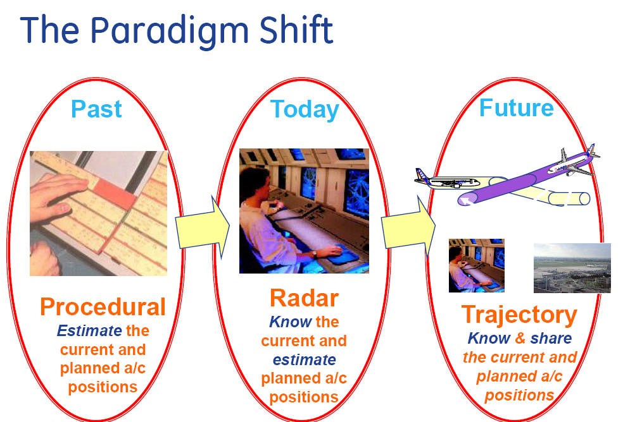
Concept

Slide 7
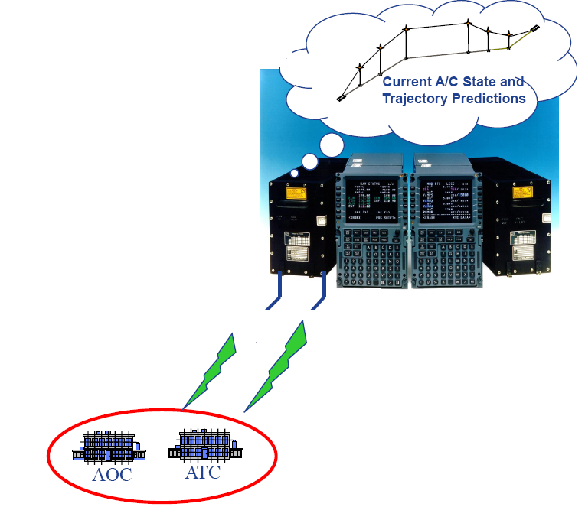
Concept
4 dimensional continuum flight path based on points in time from gate-to-gate
Ability of cockpit automation to fly the aircraft more precisely and predictably reduces routine tasks of controllers.

Slide 8
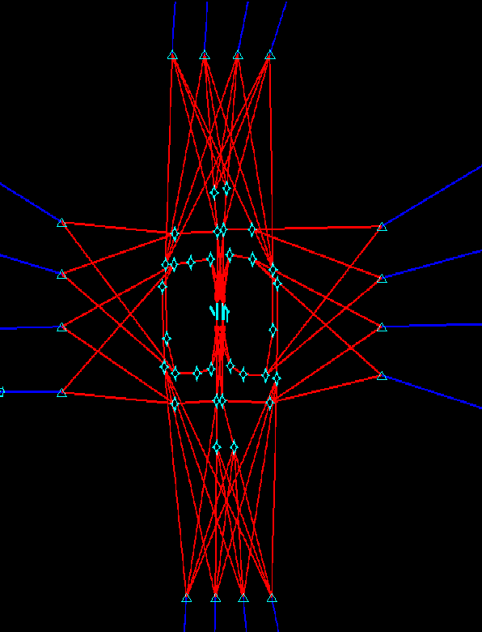
Applicability
Air traffic flow planning
En-route operations
Terminal operations (arrival/departure)
aircraft equipage is assumed in the areas of:
ADS-B/CDTI
data communication and advanced navigation capabilities.

Slide 9
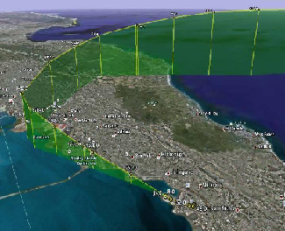
Capabilities
Advance Aircraft Capabilities
Problem Detection and Resolution
Traffic Flow Management and Time-Based Metering

Slide 10
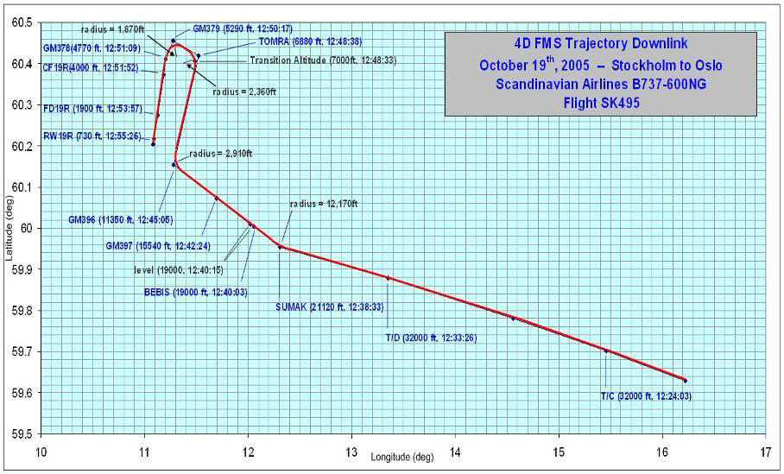
Capabilities

Slide 11
Why TBO
Greater capacity
Better efficiency
Improved safety
Reduced fuel burn and CO2 emissions

Slide 12
Why TBO
Increased flexibility
Better predictability
Leverages the best of the ground automation and the performance of the aircraft.

Slide 13
Procedures
Use of ADS-B/CDTI
Other cockpit capabilities to support aircraft avoidance
Is still a research topic and will necessitate procedures development
Including the roles of ANSPs

Slide 14
Procedures
Decision support automation
Automation-to-automation negotiation
Information on accurate trajectory

Slide 15
Procedures
Human Factor Considerations
Training and Qualifications Requirements
Regulatory/Standardisation needs and Approval Plan (Air & Ground).

Slide 16
Checklist
Standards Readiness - 2025
Avionics Availability - 2028
Ground Systems Availability - 2028
Procedures available - 2028
Operations Approval - 2028

Slide 17
Main dependencies
Data Link En-Route
Free routing
FF-ICE
Traffic Synchronization..

Slide 18


