Slide 1
Continuous Descent Operations
(CDO)
Saulo Da Silva
SIP/2012/ASBU/Nairobi-WP/26
Workshop on preparations for ANConf/12 − ASBU methodology
(Nairobi, 13-17 August 2012)

Slide 2
Intended Audience
  Intended audience:
  Airspace and procedure designers
  Air traffic managers and controllers
  Service providers (Airports and Air Navigation Service Providers (ANSP))
  Pilots
  Military authorities
  Environmental

Slide 3
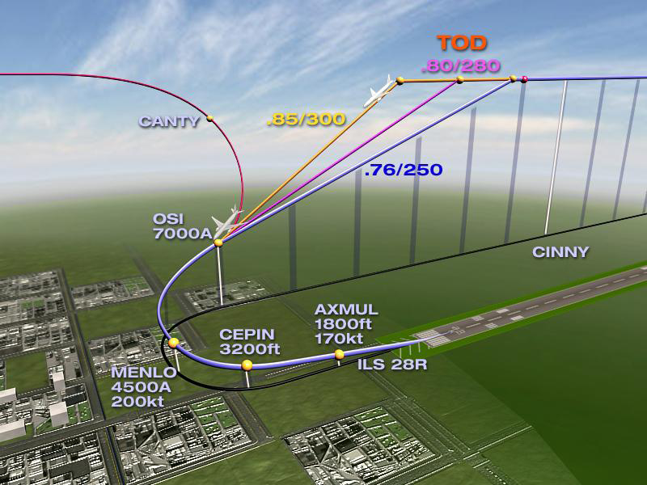
Objectives
Understanding Continuous Descent Operations procedures and profiles.

Slide 4
Understanding Continuous Descent Operations procedures and profiles.
What is a CDO?
Differences in profiles
Idle descent
Benefits

Slide 5
Continuous Descent Operations
A CDO should always be considered when implementing new PBN approach or arrival.

Slide 6
Understanding Continuous Descent Operations (CDO)
Continuous Descent Operations:
Are enabled by airspace design, procedure design and ATC facilitation
Where the aircraft descends continuously
Employing minimum engine thrust, in a low drag configuration
Usable by 85% of the aircraft, 85% of the time

Slide 7
Optimum CDO
An optimum CDO starts from the Top of Descent
Reducing:
ATC/Pilot communication
segments of level flight
noise
fuel burn
emissions
While Increasing:
predictability to ATC/Pilots
flight stability.

Slide 8
Optimum Vertical Path
The optimum vertical path angle will vary depending on:
type of aircraft
its actual weight
the wind
air temperature
atmospheric pressure
icing conditions
and other dynamic considerations
The maximum benefit is achieved by keeping the aircraft as high as possible until it reaches the optimum descent point determined by the onboard flight management computer.

Slide 9
Step-down vs. CDO
Conventional Step-down
Continuous Descent Operations
Top of Descent
Top of Descent
Approach Segment
Level flight segments
Optimized Segment(s)

Slide 10
Benefits
CDO offer the following advantages:
a) more efficient use of airspace;
b) more consistent flight paths and stabilized approach paths;
c) reduction in both pilot and controller workload;
d) reduction in the number of required radio transmissions;
e) cost savings and environmental benefits through reduced fuel burn;
f) reducing the incidence of controlled flight into terrain (CFIT);
g) operations authorized where noise limitations would result in operations being curtailed or restricted.

Slide 11
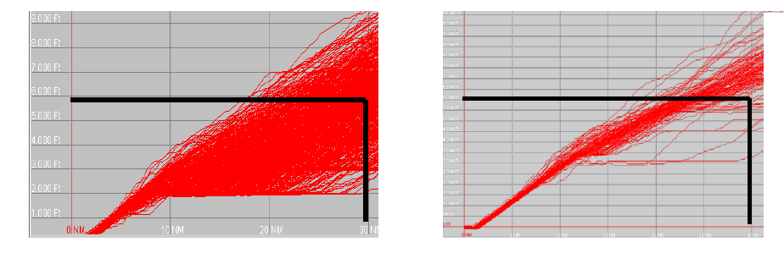
Actual CDO Operation
Flight tracks before CDO
Flight tracks after CDO

Slide 12
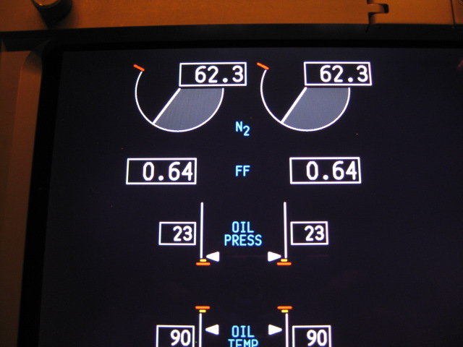
Importance of an Idle Descent
Idle Descent
640 lbs/hr/engine
1280 lbs/hr
3.2 gal/min

Slide 13
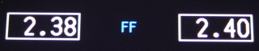
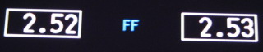
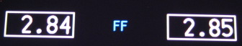
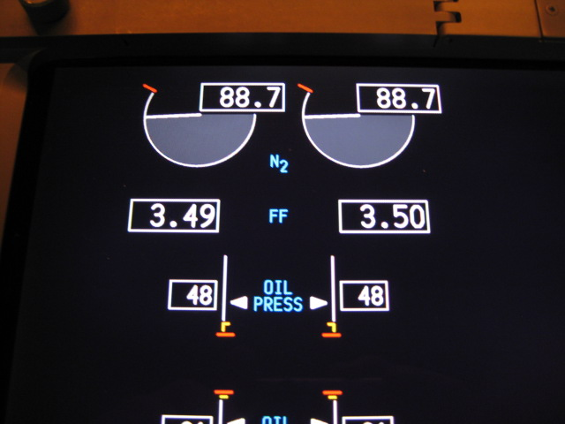
Level-offs Use 4 to 5 Times More Fuel
Than a Idle Descent!
x 3.7=
Level, 210 kt, flaps up
Idle Descent
x 4.0=
Level, 180 kt, flaps 5
x 4.4=
Level, 170 kt flaps 10
x 5.5=
Level, 160 kt, flaps 15

Slide 14
Concepts of operation
CDO can enable specific strategic objectives and should be considered for inclusion within any airspace concept or redesign
Objectives are usually identified by airspace users, ANSPs, airport operators as well as by government policy and may involve local communities, planning authorities and local government.

Slide 15


