Slide 1
Regional Air Navigation Plan - Planning Methodologies and Tools
H. Sudarshan
SIP/2012/ASBU/Nairobi-WP/30
Workshop on preparations for ANConf/12 − ASBU methodology
(Nairobi, 13-17 August 2012)

Slide 2

Outline
Background – Basic ANP/FASID
Regional Air Navigation Plans
  Current paper based format
  New online format
Progress to date
Monitoring and Reporting
Endorsement by ANConf/12

Slide 3
Global Plan, Regional Plans and National plans
ICAO HQ
GLOBAL
ANP
General
Planning Principles
Online
Interactive
Planning Tools
REGIONAL
ANP
National Plans
Volume I
Basic part of Air Navigation Plan
Volume II
Facilities and Services Implementation Document
Action
Contribution line
Harmonization
STATES
PIRGS
ROs

Slide 4
What is Regional ANP?
The Regional Air Navigation Plans (ANPs) set forth in detail the facilities, services and procedures required for international air navigation within a specified geographical area.
The development of these regional plans is undertaken by ICAO’s six planning and implementation regional groups (PIRGs) in coordination with States and supported by ICAO’s Regional Offices and the Air Navigation Bureau.

Slide 5
Regional ANPs -Documents
PIRG | ANP Document
APANPIRG | Asia/Pacific Region (Doc 9673)
APIRG | Africa-Indian Ocean Region (Doc 7474)
EANPG | European Region (Doc 7754)
GREPECAS | Caribbean and South American Regions (Doc 8733)
MIDANPIRG | Middle East Region (Doc 9708)
NAT SPG | North Atlantic Region (Doc 9634/9635)

Slide 6
Regional ANPs- current paper based format
In February 1997, the Council decided that the ANPs should be published in two volumes, a basic ANP as volume I and facilities and services implementation document (FASID) as volume II.
The intent was to simplify amendment process to ensure currency of information.
Amendments to Basic ANP, the stable document, require a time-consuming approval process by the governing bodies whereas the FASID requires frequent updates through coordination within the Secretariat.
Effective July 2011, the amendment process was automated to further reduce the time reviewed within ICAO headquarters.
But despite all these improvements, the challenge remained to keep the paper-based Regional ANPs updated.

Slide 7
Regional ANPs- Approach to update
Three phased approach
  Phase 1: Keep the present paper based Regional ANPs (Basic ANP/FASID)up to date and publish in PDF as well as GIS format – available at http://gis.icao.int; Until 1 July 2013
  Phase 2: As an alternative to paper based Regional ANP, develop an online format called regional eANPs that includes uniform format for all FASID tables. Align Regional eANPs with ASBU methodology. Available from 31 October 2012 to 1 July 2013 at http://gis.icao.int
  Phase 3: Translate eANPs and seek approval of States through pfa. Subsequently to be approved by HQ by 1 July 2013
  Phase 4: online eANPs will be available for operational use from 1 July 2013

Slide 8
Regional ANPs -New online format
To reduce time to process the ANPs and to avoid duplication and rework, it is necessary to transition the paper based ANPs to new online format
However, this evolution should allow the air navigation planner to use the data or tools for their daily work.
Consequently, ICAO has developed a plan to transition to the eANP by using it as an alternative to the paper- based ANPs
All PIRGs upon review of the online system, or components thereof, are encouraged to transition any part of the ANPs that contains the same information to the electronic format.

Slide 9
Regional eANPs -What are the new features?
It will be a user-friendly, robust, web-based planning and editing tool to ensure centralization and currency of data
The full text and tables of ATS Routes of Volume I of all Basic ANPs will be updated
The CNS, AIM, AOP and MET tables in FASID/Volume II of all ANPs will be available in new format with updated data. These FASID tables will be standardized and harmonized across all regions.
All FASID tables will be mapped to ASBU methodology. Where necessary, new FASID tables will be added to reflect ASBUs not covered in the current ANPs.
A new Chapter will be included in FASID /volume II of all ANPs covering performance based approach and air navigation report form template for all 18 Block 0 Modules

Slide 10
Regional eANPs –Progress to-date
July 2012
Volume I (Basic ANP)
  Text in Basic ANP of all Regional Plans has been updated and being endorsed by respective PIRGs
  Route tables format will be the same with updated information
Volume II (FASID)
  AIM tables are in new format. Data needs to be entered and updated
  MET tables migrated to new eANP and data has been updated
  AOP tables are being developed in new format. Data needs to be updated
  CNS tables are being developed in new format. Data needs to be updated

Slide 11
Regional eANPs –Progress to-date
All developments related to eANPs are shared on on-going basis on the ICAO Safety Tools User Group (STUG) web site
Access available on request. https://portal.icao.int/stug/Pages/Homepage.aspx

Slide 12
How GIS will assist in regional and national planning
  Go to http://gis.icao.int
  Contains current paper version of Regional ANPs. Data being updated.
  growing gallery of interactive maps that provides an overview of the implementation status of global and regional priorities
  an online tool for managing location indicators and other air navigation data not contained in the regional ANPs

Slide 13
ICAO Booth For Exhibition Of Online Planning Tools
  Product live demonstration:
  These ICAO online planning tools will be demonstrated in the exhibition area during the ANConf/12
  one-page training aid will also be available both online as well as disseminated during the Conference

Slide 14
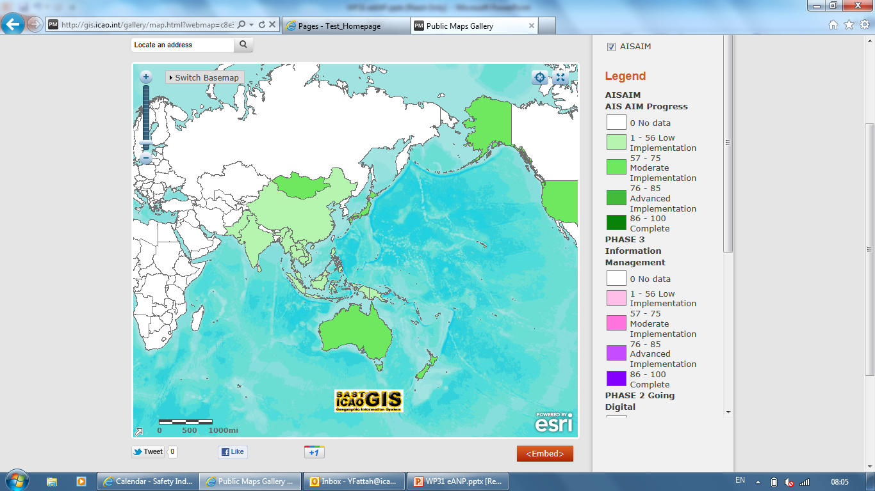
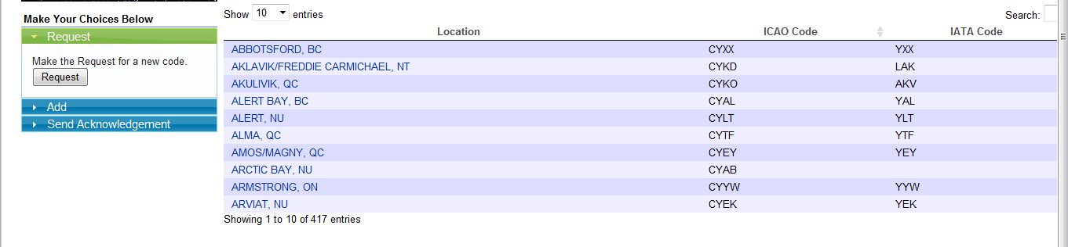
FASID Tables sample
GIS MAP to provide transparency in a format that provide a high-level overview of the status of implementation
Action options
Tabular view of information

Slide 15
Air Navigation Implementation Reporting- ANRF
The current PFF has been redesigned and aligned with ASBU framework and called the Air Navigation Report Form (ANRF)
ANRF will be the basis for performance monitoring of the ASBU implementation
The ANRF templates for all the 18 Modules of ASBU Block 0 will be available in Volume II – FASID of each Regional eANP

Slide 16
PFF re-designated as ANRF

Slide 17
PFF re-designated as ANRF
ASBU B0-10: Performance Monitoring and Measurement
Main Key Performance Areas | Performance Metrics
Access & Equity
Capacity
Efficiency
Environment
Safety

Slide 18
Next Steps: A Global Air Navigation Report – Why?
Effective 2014, on annual basis a Global Air Navigation Report will be released
  The Regional Air Navigation Reports (ANRF) that provide data for shared review will be utilized in developing the annual Global Air Navigation Report.
  The spirit of such a global review is to assist in understanding which areas requires special attention and effectively improve air navigation performance in the future
  This review also provides an opportunity for world civil aviation community to compare the progress across different ICAO regions in the establishment of air navigation infrastructure.

Slide 19
Next Steps: A Global Air Navigation Report – How?
States to focus on the gathering information related to the highest priorities first, which are: PBN, CDO CCO
States may use IFSET to calculate the fuel/CO₂ saved for any of the operational improvements
ICAO Regional office will be provided with its own regional GIS webpage
ICAO Regional office to coordinate data input from States for its regional GIS webpage
When all regions provide data on respective GIS webpage, it results in Global AN Report
The GIS is illustrated in next few slides

Slide 20
Next Steps: A Global Air Navigation Report – When?
Reporting will be primarily GIS based derived from regional information: suggested time table
  Dec 2012 - Regional Offices will have Region Specific GIS Map System
  May 2013 - First set of information will be aggregated
  May 2014 - PIRGs to submit their newly aligned plans
  Dec 2014 -First Air Navigation REPORT planned

Slide 21
Regional GIS webpage -How to input the data?
An illustration

Slide 22

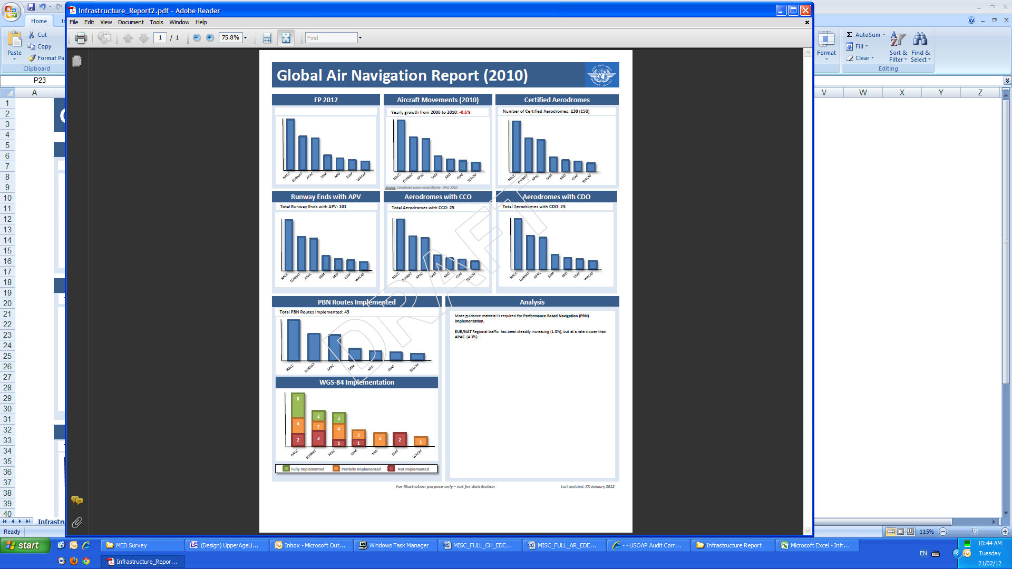
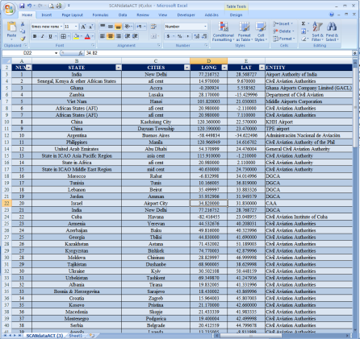
Current Reporting Lifecycle
REPORTS
DATA
ANALYSIS
PAPER
ELECTRONIC / PAPER
ELECTRONIC / PAPER

Slide 23
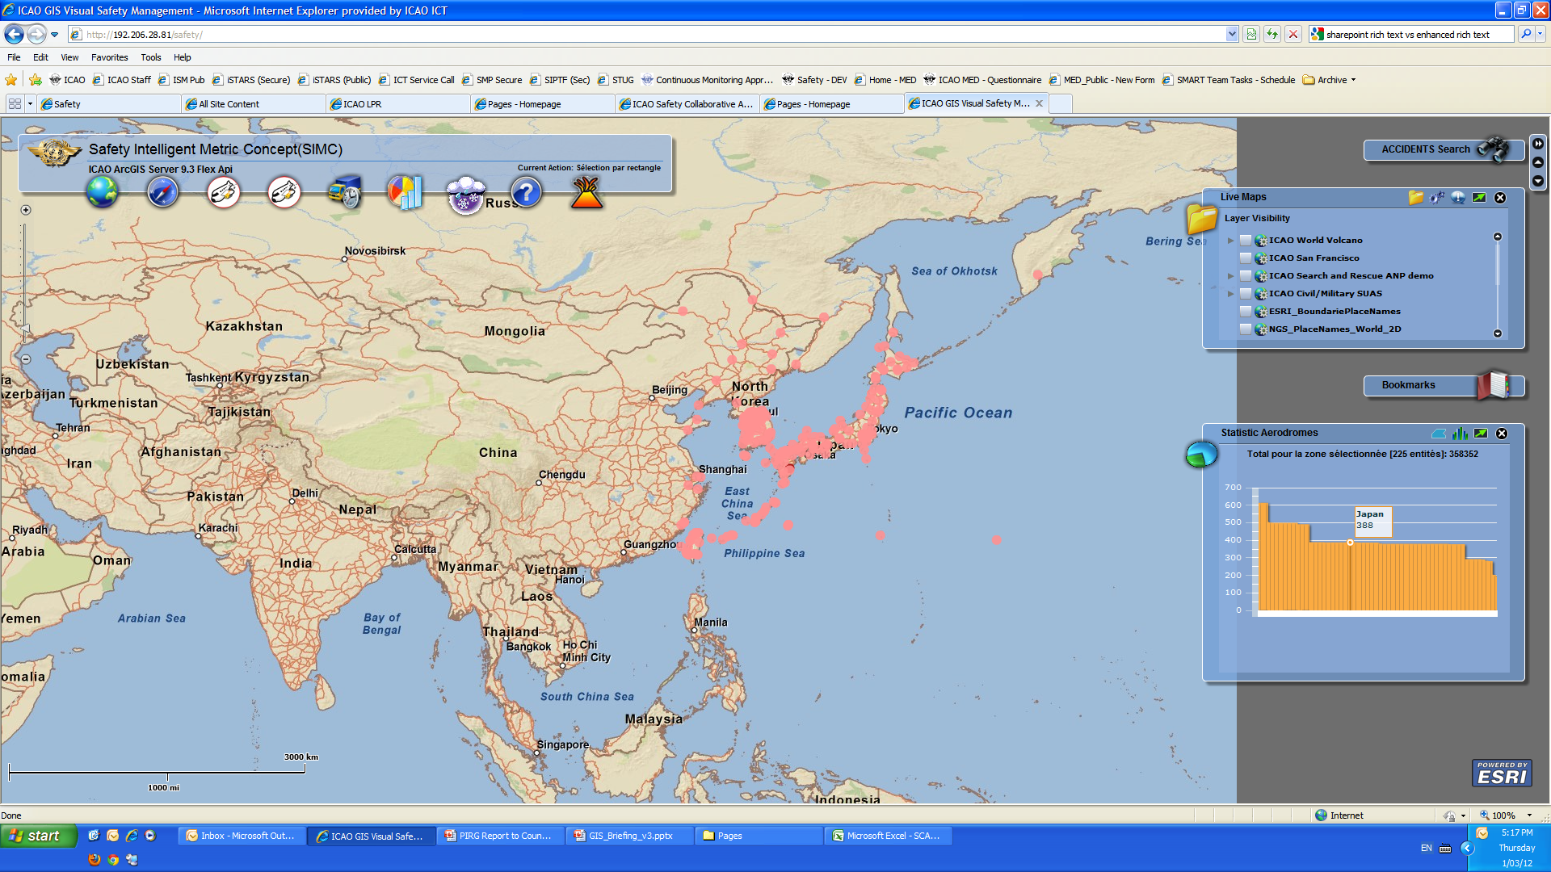
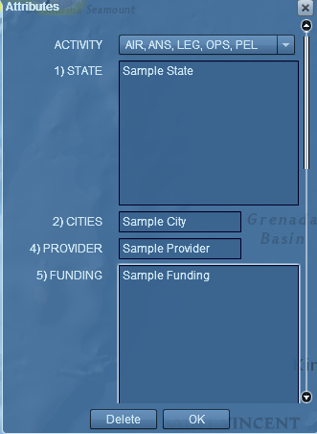
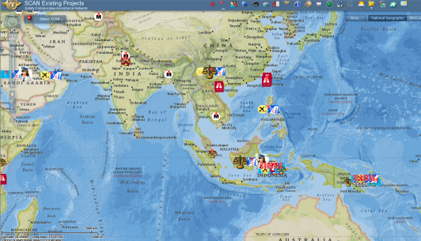
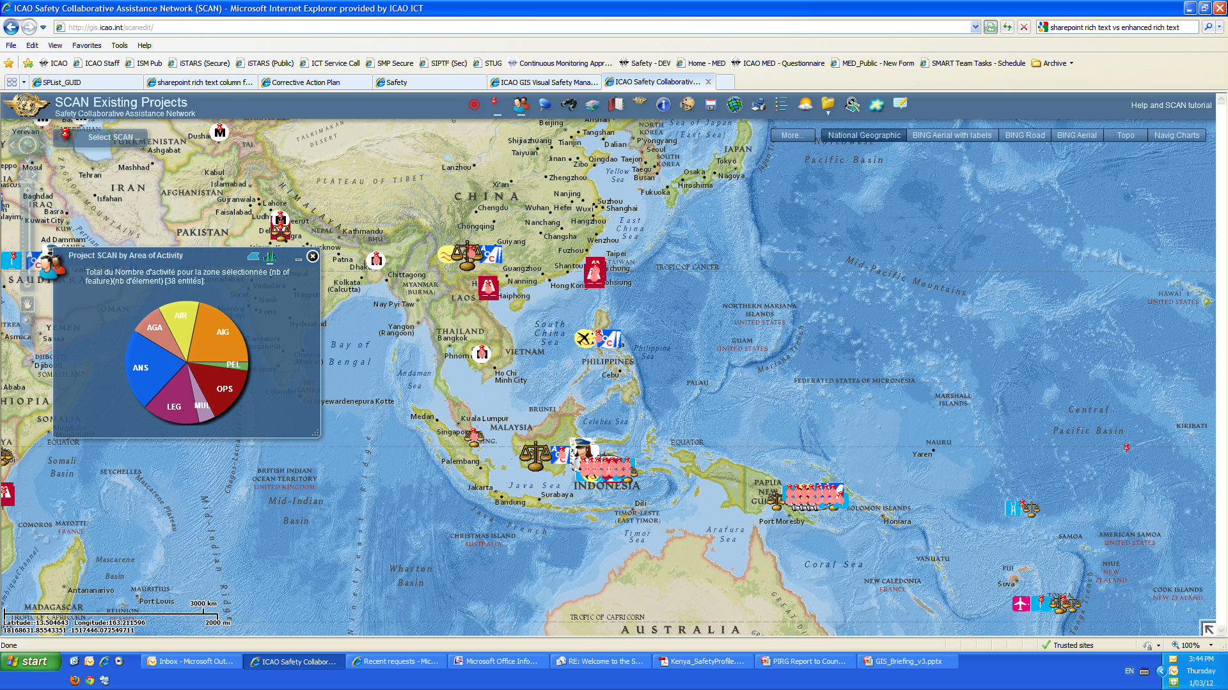
Online Reporting Cycle
REPORTS
DATA
ANALYSIS
ONLINE
DATABASE
PAPER
ONLINE
PAPER / PAPER
ELECTRONIC / PAPER
ONLINE
ONLINE

Slide 24
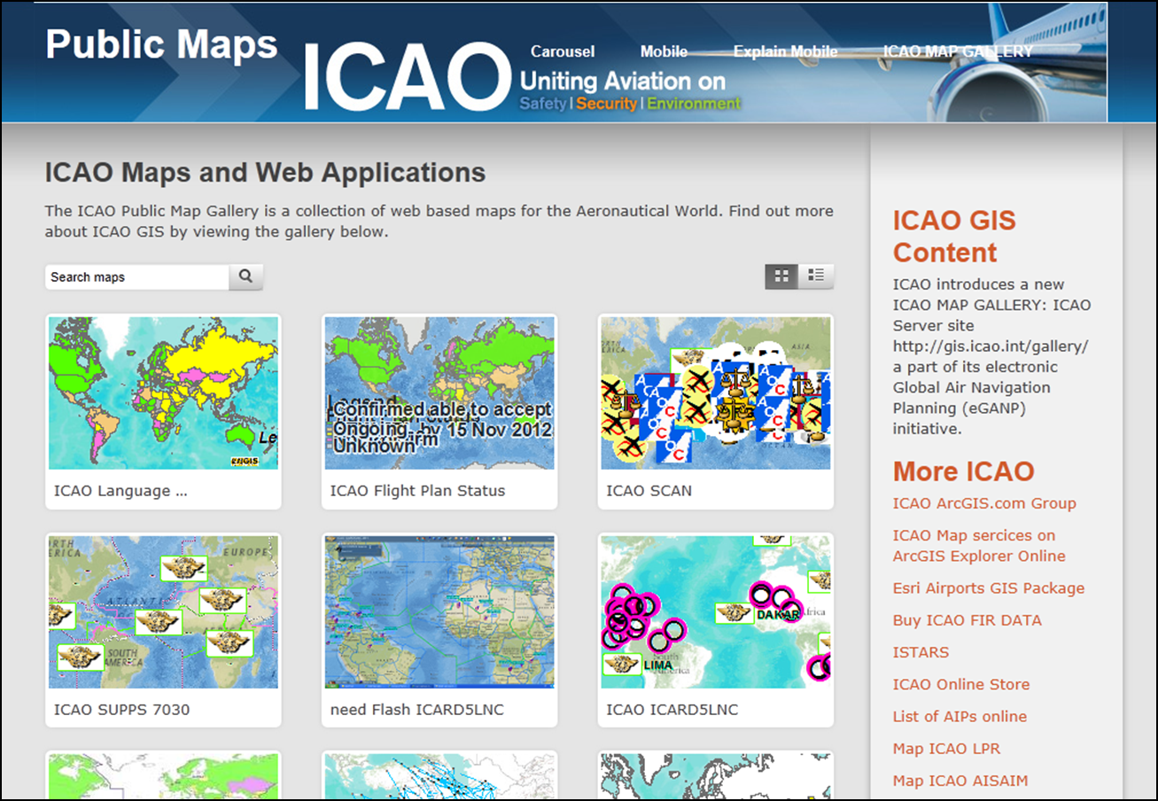


One Common Interface
http://gis.icao.int

Slide 25
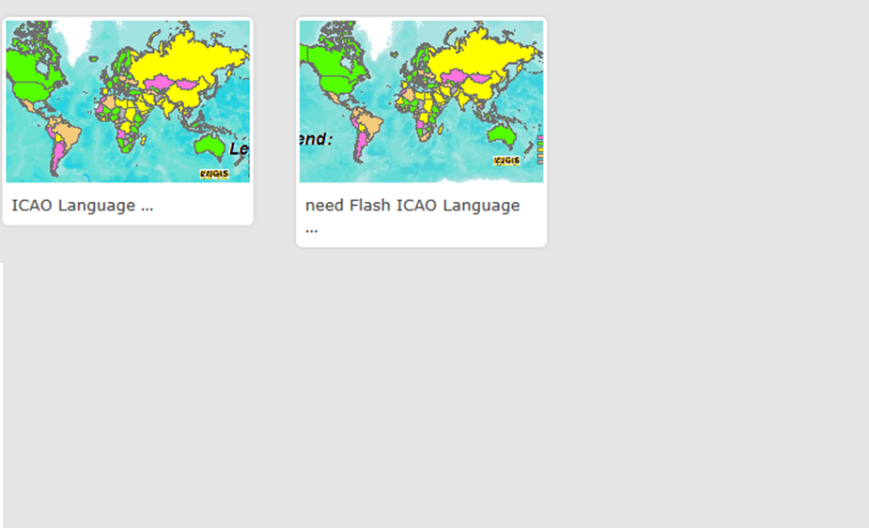
A Gallery of Information
LPR

Slide 26
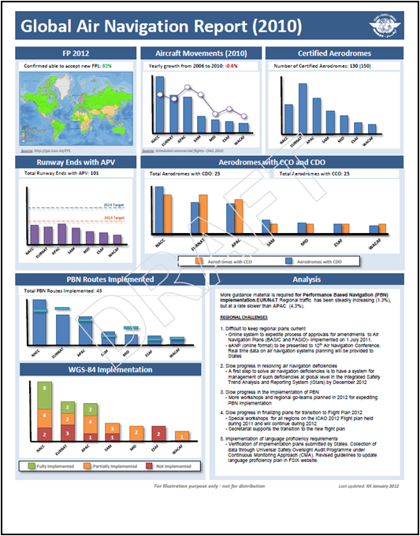
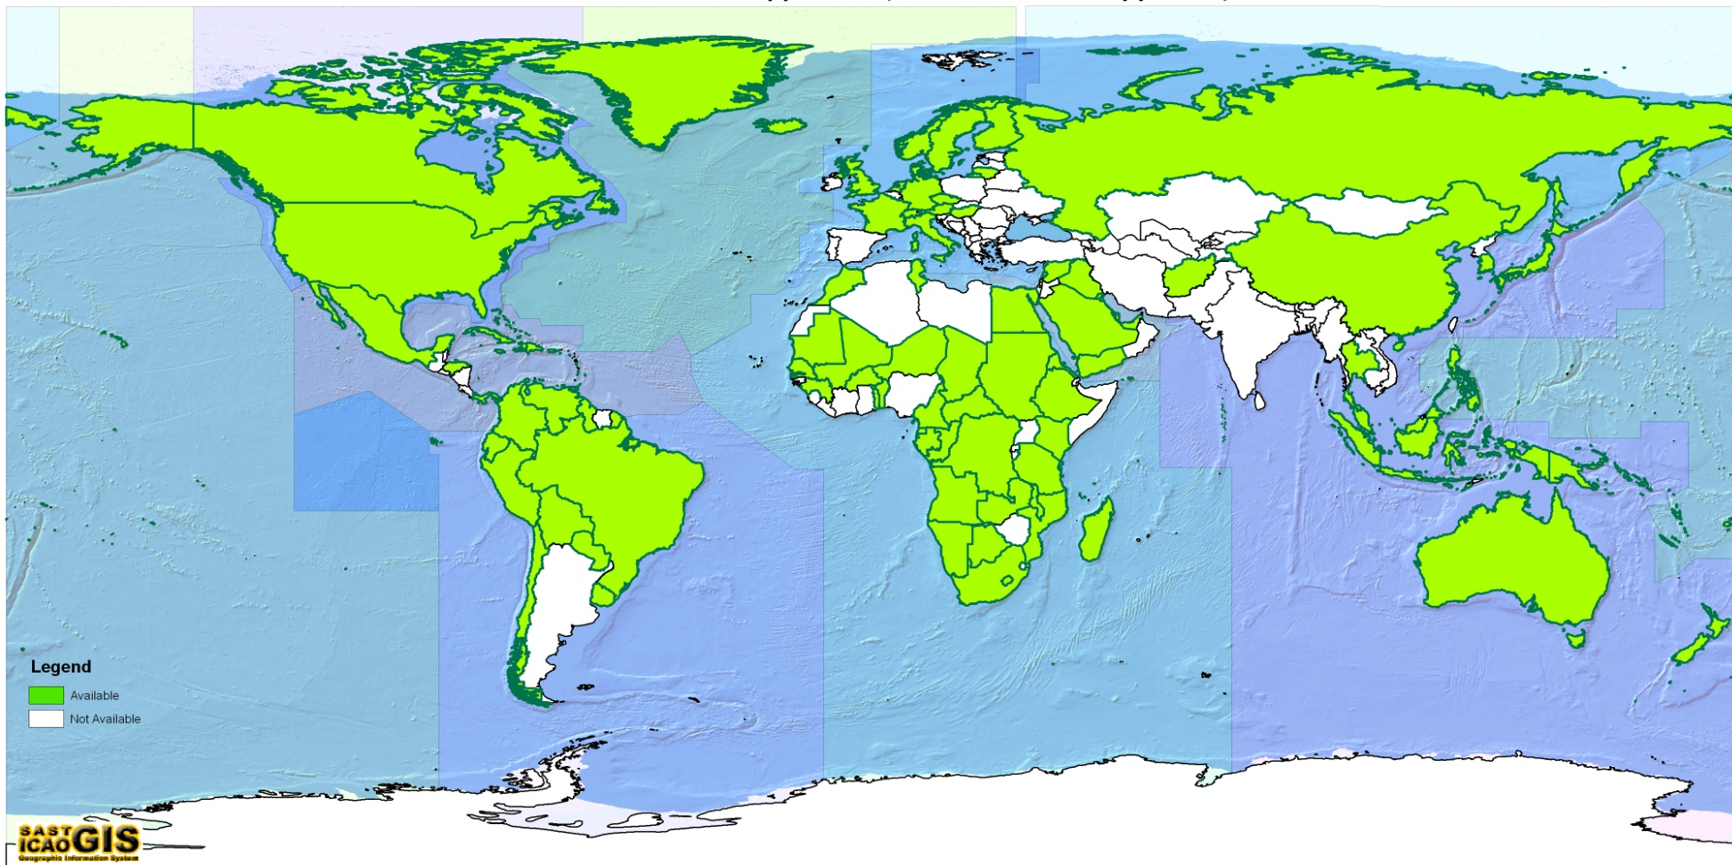
Future Tools:
States with at least 1 PBN Approach

Slide 27
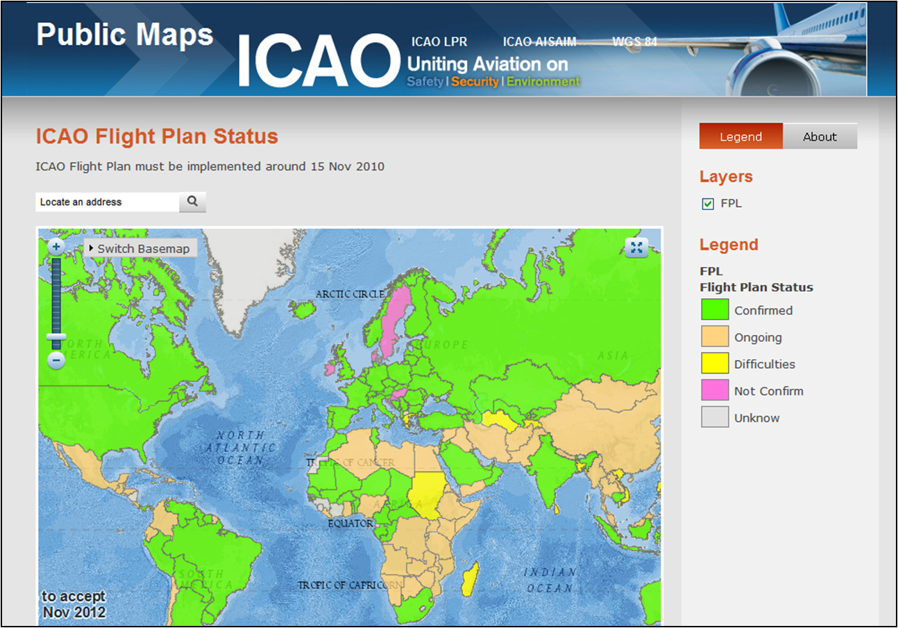
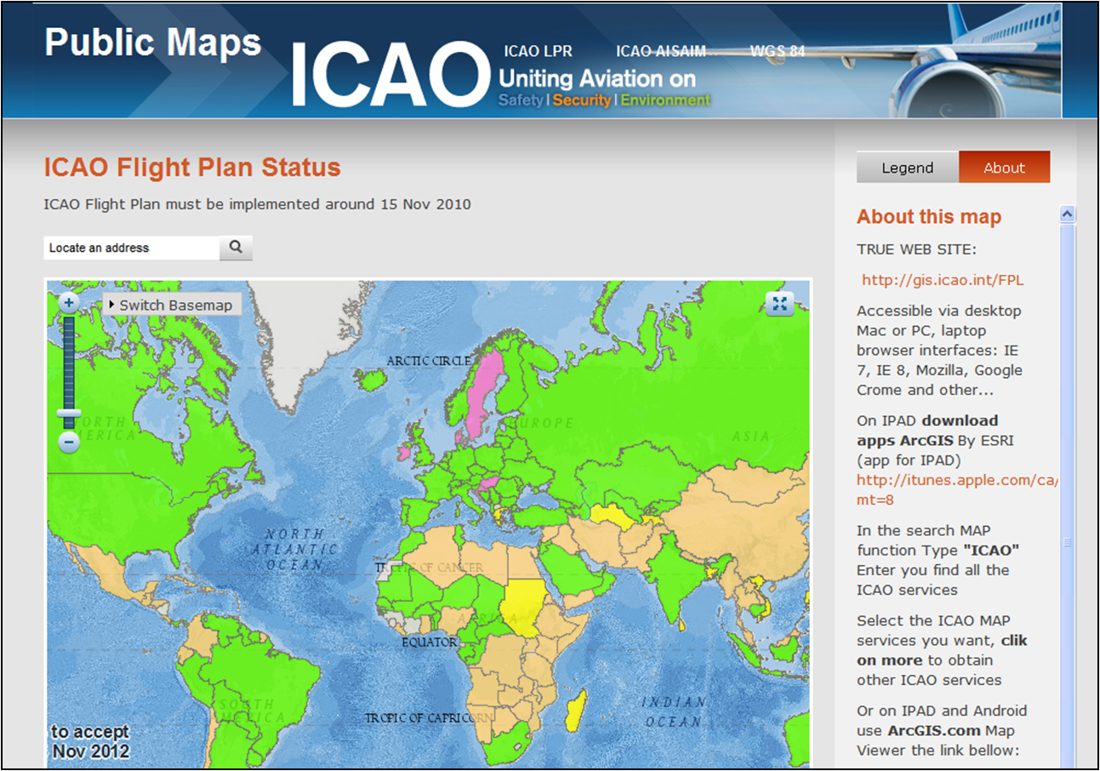
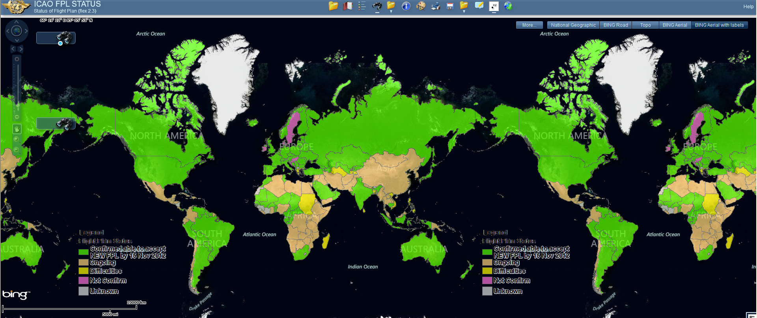
Near Real-Time Transparent Results
Full Featured Map (Desktop)

Slide 28
Seek endorsement by AN-Conf/12
Montréal, 19-30 November 2012
Regional eAir Navigation Plans (Regional eANPs)
  ICAO is progressing towards development of Regional e-ANPs for all the regions and will include ASBU methodology. The Regional e-ANPs will be an online interactive plan with access rights to States, International organizations and Regional offices and will be made available for AN-Conf/12.

Slide 29

Notes:
Thank you!

