Slide 1
African
Flight Procedure Programme
Programme Document
Frédéric Legrand - AFPP Programme Manager - 20 November 2014
Notes:
AFI overview and objectives

Slide 2
Summary
Background
References
Presentation to States
Programme Document
  Member Status
  Resources Requirements
Human Resources
State Contribution
Partner Support
Detailed Activities
  Status and activities
  Activities Organization
ICAO Documentation
Starting Operations
  African FPP Initial MIilestones
  African Organigram
  2014 African FPP Activities
An African FPP customized for Africa by Africa

Slide 3
Background
The PBN Flight Procedure Programme for Africa (AFPP) is an ICAO pan-African programme to develop States 'capability in instrument flight procedures domain focusing on PBN operations
  ICAO Assembly A37-11 Resolution, October 2010, concerning PBN (Performance Based Navigation) procedures
  Letter of Intent signed by ICAO, ASECNA and DGCA, France in November 2012
  Letter sent to States by ICAO General Secretary in February 2013
  Initial duration is 3 years with option of renewal for a second three-year term
  The office is hosted by ASECNA and based in Dakar, Senegal
  It is a not-for-profit programme of excellence
  It is supported by ICAO ESAF and WACAF regional offices
  Initial operations for PBN procedures in terminal and approach areas

Slide 4
References
  APIRG/19 Group approved the conclusion 19/17 that “AFI States are invited to indicate their needs for PBN procedure design to the AFI FPP and participate actively in the AFI-FPP activities by providing financial and/or in-kind support”.
      This conclusion 19/17 was approved by DGCA/5 meeting Group.
The 37th ICAO General Assembly approved the following clause in the Resolution A38/7, point 12 in the AFI Plan:
  “Urges Member States of the AFI Region to support the establishment of the AFI Flight Procedure Programme (FPP) Office with seconded personnel and financial assistance as a matter of urgency to expedite the implementation of PBN in the Region …”.
Notes:
PBN Concept is now Mature, it is ripe for implementation.
PBN SG completed a comprehensive amendment to the PBN concept to include new navigation specifications and regulatory guidance material.

Slide 5
Presentation to States
The African FPP was presented to African States representatives during:
  ATM/AIM/SAR SG/13 meeting in Nairobi, held in September 2013
  APIRG/19 and DGCA/5 meetings in Dakar, held in October 2013
  PBN TF/4 meeting, Dakar, December 2013
Notes:
In 2008 the PBN manual was published which provides the framework for PBN implementation:
Volume 1 of this manual describes the concepts, the processes to be followed and short descriptions of all required stakeholders
Volume 2 provides the navigation specifications which are the basis for operational requirements and ops approval for aircraft. These ops requirements are also the basis for the navigation applications such as flight procedures and separation and route spacing requirements. This linkage is very important, because now we can make the airspace design fit the fleet capability and not the other way around.
Since the introduction of the PBN manual, the ICAO Annexes have been amended to support the PBN concept, procedures have been amended to support obstacle clearance and separation requirements and a host of new guidance in the form of new manuals.
The original PBN manual contained globally harmonized requirements that were based on specifications that already pre-existed on a national or Rgional level. [CLICK] Now, the latest is the new PBN manual which includes new navspecs, such as Advanced RNP, RNP 2, RNP 0.3 for helis and RF legs. For sure this will be discussed in more detail later in the sessions.

Slide 6
Programme Document
The African FPP Programme Document (ProDoc) was presented to States during a seminar held in Dakar, Senegal, March 2014.
  Operational concept and implementation strategy
  Institutional Framework (participants, steering committee), and participant roles
  Phase I (2014-2017) Programme review, monitoring and reporting
  Work Programme
  Global Budget
Notes:
In 2008 the PBN manual was published which provides the framework for PBN implementation:
Volume 1 of this manual describes the concepts, the processes to be followed and short descriptions of all required stakeholders
Volume 2 provides the navigation specifications which are the basis for operational requirements and ops approval for aircraft. These ops requirements are also the basis for the navigation applications such as flight procedures and separation and route spacing requirements. This linkage is very important, because now we can make the airspace design fit the fleet capability and not the other way around.
Since the introduction of the PBN manual, the ICAO Annexes have been amended to support the PBN concept, procedures have been amended to support obstacle clearance and separation requirements and a host of new guidance in the form of new manuals.
The original PBN manual contained globally harmonized requirements that were based on specifications that already pre-existed on a national or Rgional level. [CLICK] Now, the latest is the new PBN manual which includes new navspecs, such as Advanced RNP, RNP 2, RNP 0.3 for helis and RF legs. For sure this will be discussed in more detail later in the sessions.

Slide 7
Member Status
The different African FPP participant status
  Active Participating State (APS)
    African State
    Annual financial contribution
    Steering Committee member
    Free participation to courses including OJT
    Assistance/support for activities, free/fee-based according to assistance/support type
  User State (US)
    African State
    No Annual financial contribution
    Free participation to courses. OJT is fee-based
    Charged assistance/support for activities related to flight procedures, fee-based
  Observer State (OS)
    Non African State
    similar US
  (amendment) Donor State (DS)
An African FPP customized for Africa by Africa

Slide 8
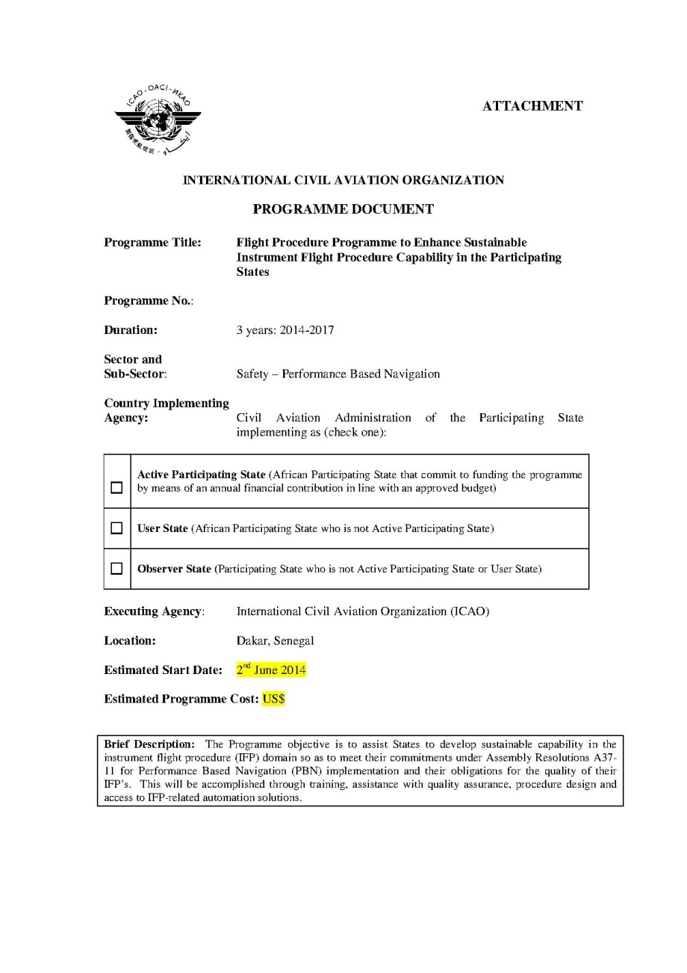
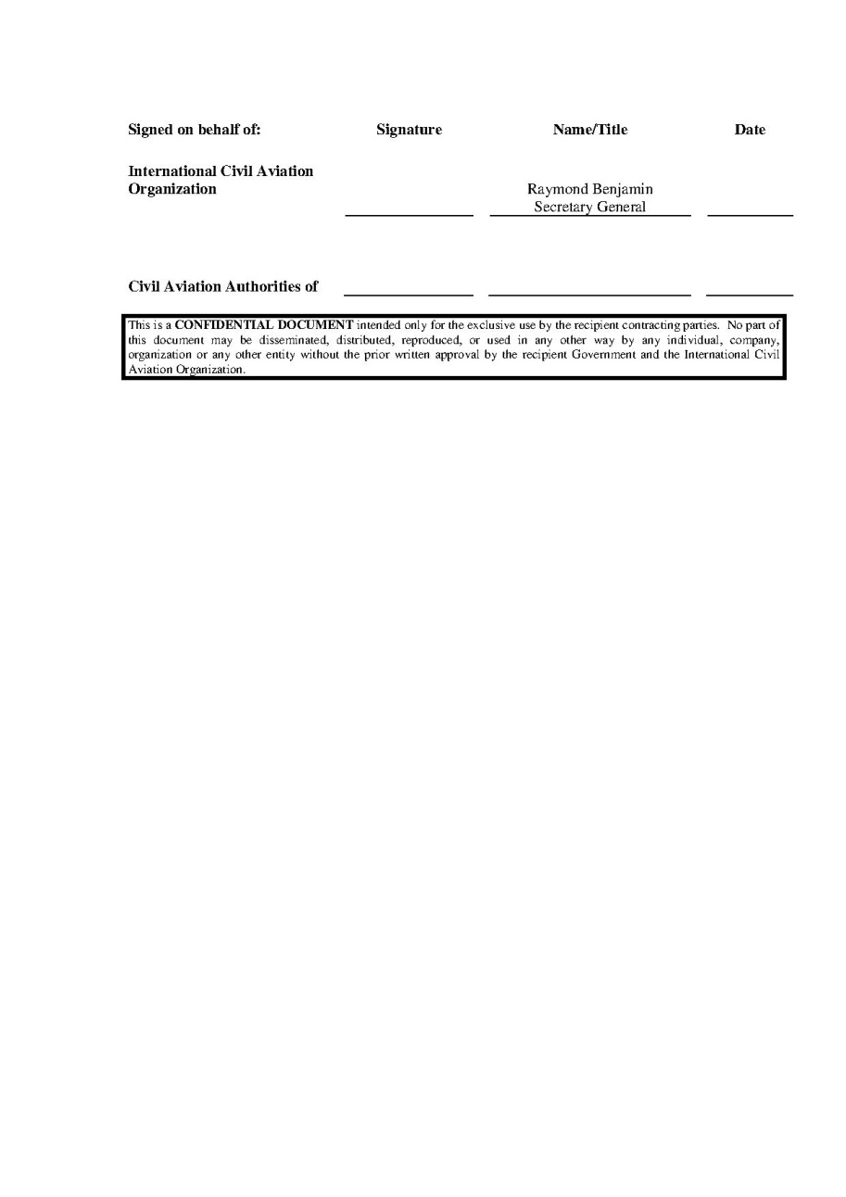
State signature
An African FPP customized for Africa by Africa

Slide 9
Resource Requirements
At the initial stage, the AFPP resources were provided by DGAC France and ASECNA
  Next step resources to be provided by States/Organizations in Africa:
  Financial contribution
  In-kind contribution with expert secondment
Others partners from aviation community or involved in aviation safety improvement are welcome for participation and financial support
An African FPP customized for Africa by Africa

Slide 10
Human Resources
Human resources, seconded:
  AFPP Manager, appointed by ICAO
  Chief Procedure Designers, seconded by ASECNA
Others human resources, to be seconded:
  Chief Operational Training
  Aeronautical Data Specialist
  Procedure Designers
    Tanzania(1) and Nigeria(1) will second flight procedure designers
  Instructors
    ASECNA, Tanzania and Nigeria seconded flight procedure designers to be trained Instructors
ASECNA will second:
  Administrative support staff
  Information Technology staff
An African FPP customized for Africa by Africa

Slide 11
Internal Organization
AFI-FPP Manager
Frederic Legrand (ICAO)
Administrative support
ASECNA
Information Technology
ASECNA
Chief of Flight Procedure Designers
Alexandre Damiba (ASECNA)
Chief Operational Training
Participating State
Aeronautical Data Specialist
Participating State
Procedure Designer
Nigeria
Procedure Designer
Tanzania
Procedure Designer
ASECNA/participating State
Procedure Designer
ASECNA/participating State
Procedure Designer
ASECNA/participating State
Procedure Designer
ASECNA/participating State
An African FPP customized for Africa by Africa

Slide 12
State Contribution
Financial contribution
      Annual Financial Contribution per APS States (10,000 USD for 2015)
      Contribution includes participation fee to training sessions
      Contribution includes partial costs for procedure design activities and related activities
    In-kind contribution
    Seconded experts
    Expert job descriptions provided by AFPP Office
      Seconded expert selection done in coordination between AFPP Manager and ICAO Regional Offices
      Expert activity under the responsibility of the AFPP Manager
      Experts are based in Dakar or in their operational country
    Steering Committee
      Composed of Active Participating States, ASECNA (Host Administration) and ICAO
        Amendment for Donor States

Slide 13
Partner Support
Possible partners
  Economical communities and Financial organizations
  Airlines, Airports and Air Navigation organizations and operators
  Aircraft manufacturers
  Aeronautical data providers
  Others organizations or private companies involved in aeronautical domains
AFI-FPP office activities requiring financial support
  Training and workshop sessions organization
  Aeronautical data provision
  Procedure design
  Participation to regulatory approbation process training sessions
  Participation to ATC/ATM staff operational training, procedure operational validation training sessions
  Operational approval sessions for aircraft operators
  Regular contacts with African CAA

Slide 14
Detailed Activities
Activities for PBN procedures design for each domain concerned:
Aeronautical Data collection and validation
Airspace and PBN procedure design
Safety case
Quality assurance process
Operational validation
Regulatory process for procedure approbation
PBN procedure operational training for ATC and ATM staff
Operational approval for aircraft operators
Design of PBN procedure on States’ request
Activities will be:
  Developed through workshops/seminars, training sessions, assistance and support actions
  Supported by qualified AFPP office experts
  Approved by ICAO Air Navigation Bureau
An African FPP customized for Africa by Africa

Slide 15
Member Status
The different African FPP participant status
  Active Participating State (APS)
    African State
    Annual financial contribution
    Steering Committee member
    Free participation to courses including OJT
    Assistance/support for activities, free/fee-based according to assistance/support type
  User State (US)
    African State
    No Annual financial contribution
    Free participation to courses. OJT is fee-based
    Charged assistance/support for activities related to flight procedures, fee-based
  Observer State (OS)
    Non African State
    similar US
  (amendment) Donor State (DS)
An African FPP customized for Africa by Africa

Slide 16
Status and Activities
AFPP Programme Document, section 2,2,3
free of charge for Active Participating Members as included in the annual financial contribution
assist State procedure and airspace designers in developing their procedures with priority for PBN procedures;
assist State with Quality Assurance (QA) including flight procedure regulatory approval
provide training course, refresher course and OJT to procedure designers, remotely, on-site or at the AFPP location;
provide training course and OJT for QA including flight procedure regulatory approval;
provide training course and OJT for operators approval for PBN operations
charged as per a fee schedule in accordance with ICAO Policy
assist State for PBN Plan implementation through operational assessment, business case, and activity planning for PBN Implementation
assist State in developing PBN-related regulations
develop procedures implementation for States that have no procedure design capability;
assist State with data origination
assist State with ground and flight validation;
assist State in operators approval for PBN operations
provide training course and OJT for ATC/ATM and operators about PBN flight procedures operations
provide State with any other associated assistance as required.
An African FPP customized for Africa by Africa

Slide 17
Activities Organization
Workshop/Seminar:
  Flight procedures programme objectives
  Support and training activities in details
Training session in each domain of PBN procedure design:
  Training contents approved by ICAO Air Navigation Bureau and regulatory authorities
  Trainee qualification to be approved by regulatory authorities
Assistance:
  Provide additional information for PBN procedure design
  Process to be approved by regulatory authorities
Support action:
  Flight procedures design and related activities
  Process to be approved by regulatory authorities
An African FPP customized for Africa by Africa

Slide 18
ICAO Documentation
All activities are determined in reference to ICAO regulations and PBN documents
  Doc 8168 Aircraft Operations (vol 2, construction of flight procedure)
  Doc 9613 PBN Manual
  Doc 9674 World Geodetic System Manual
  Doc 9859 Safety Management Manual
  Doc 9881 Guidelines for Electronic Terrain, Obstacle and Aerodrome Mapping Information
  Doc 9905 Manual for RNP-AR procedure design
  Doc 9906 Quality Assurance Manual for Flight Procedure Design (quality assurance system, procedure designer training, software validation, procedure design construction, procedure validation, pilot training and evaluation)
  Doc 9931 Continuous Descent Operations Manual
  Doc 9992 Manual on Use of PBN in Airspace Design
  Doc 9993 Continuous Climb operations Manual
  Doc 9997 PBN Operational Approval Manual
An African FPP customized for Africa by Africa

Slide 19
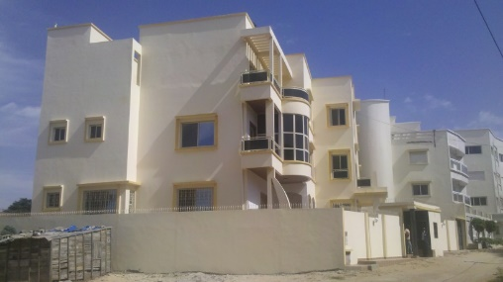
Starting Operations
AFPP was officially launched on 27 May 2014, during the AFI Aviation Safety Symposium, Dakar, Senegal
  20 African States signed the Programme Document to be Participating State
  19 States as Active Participating States (APS)
  1 State as User State (US)
Operations started on 2 June 2014, in the AFPP Office, Les Almadies, Dakar, Senegal
An African FPP customized for Africa by Africa

Slide 20
Initial Milestones
The AFPP activity plan detailed during workshops
  Flight procedures programme objectives
  Support and training activities in details
Were invited
  Civil Aviation Authorities and Air Navigation Service Providers
  Economical communities and financial organizations
  Airlines, Airport and Air Navigation organizations and operators
  Aircraft manufacturers
  Air traffic controllers and pilots associations
  Organizations and private companies involved in aviation safety improvement
  Workshop locations, dates and duration
  WACAF, Dakar (Senegal), March 2014
  ESAF, Addis Ababa (Ethiopia), November 2014
An African FPP customized for Africa by Africa

Slide 21
2014 Activities (1)
Integration of seconded personnel to the AFPP team
Participating States (APS, US)
  Determination of their needs
  Understanding of their demands
  Planning for action
Training sessions activities
  Determination of domains for training
  Planning for action
Start of procedure design by the Office team
  Determination of the location
  Determination of all necessary actions
  Design planning
  Development of a Web page under WACAF and ESAF websites
  www.icao.int/WACAF/African-FPP/Pages/default.aspx
Dakar
WACAF
An African FPP customized for Africa by Africa

Slide 22
2014 Activities (2)
Workshops
  24-26 June 2014, PBN Implementation National Plan (ICAO/AFCAC)
    Dakar, Senegal
    Partners: CAFAC et AIRBUS
  14-16 October 2014, PBN Operational Approval for Air Operators
    Dar Es Salaam, Tanzania
    Partners: AIRBUS, DGAC France
  20-21 November 2014, AFPP presentation to ESAF States
    Addis Ababa, Ethiopia
    Training Course
  27 October – 14 November 2014, PANS OPS Flight Procedure Design Initial Course
    Dakar, Senegal (moved to Toulouse, France)
    Partners: DGAC France (ENAC)
    Flight Procedure Design
  Ivory Coast, November 2013 – June 2014: PBN procedures for 5 domestic airports
  Cameroon, under study: conventional and PBN procedures, 1 airport
Dakar
WACAF
An African FPP customized for Africa by Africa

