Slide 1
African
Flight Procedure Programme
2015 Work Plan
Frédéric Legrand - AFPP Programme Manager - 20 November 2014
Notes:
AFI overview and objectives

Slide 2
Summary
Activities
Member Status
Member States
Services
2015 Work Plan

Slide 3
Activities
Activities for PBN procedures design for each domain concerned:
Aeronautical Data collection and validation
Airspace and PBN procedure design
Safety case
Quality assurance process
Operational validation
Regulatory process for procedure approbation
PBN procedure operational training for ATC and ATM staff
Operational approval for aircraft operators
Design of PBN procedure on States’ request
Activities will be:
  Developed through workshops/seminars, training sessions, assistance and support actions
  Supported by qualified AFPP office experts
  Approved by ICAO Air Navigation Bureau

Slide 4
Member Status
The different African FPP participant status
  Active Participating State (APS)
    African State
    Annual financial contribution
    Steering Committee member
    Free participation to courses including OJT
    Assistance/support for activities, free/fee-based according to assistance/support type
  User State (US)
    African State
    No Annual financial contribution
    Free participation to courses. OJT is fee-based
    Charged assistance/support for activities related to flight procedures, fee-based
  Observer State (OS)
    Non African State
    similar US
An African FPP customized for Africa by Africa

Slide 5
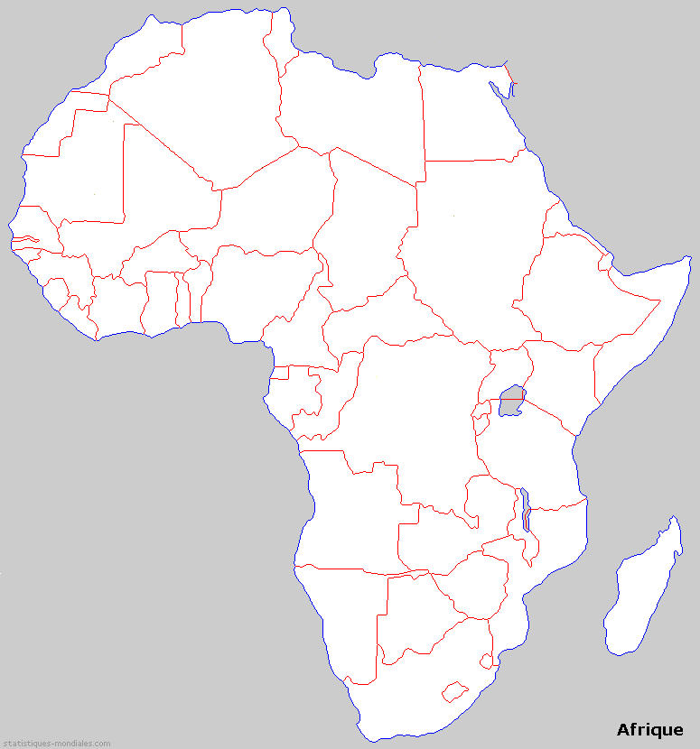
Member States
Host Administration
  ASECNA Dakar, Senegal
Programme Document
  signed 27 May 2014
  ICAO / ASECNA
  ICAO / Participants States
Active Participating States (APS)
  To date, 19
  Pending*, 5
User States (US)
  To date, 2
  Pending*, 1
Partners
  France, AFCAC, AIRBUS
AFPP APS in WACAF area
AFPP US
Mauritanie
Mali
Niger
Senegal
Guinee
Burkina
Faso
Djibouti
Cote
d’Ivoire
Nigeria
Ghana
Togo
*Cameroon
Cabo Verde
Uganda
*Kenya
Gambia
Congo
Gabon
DRC
Guinea Bissau
*Rwanda
Tanzania
*Angola
Comores
*Mozambique
*Zimbabwe
Madagascar
AFPP APS in ESAF area
AFPP US

Slide 6
AFPP Services
AFPP Programme Document, section 2,2,3
free of charge for Active Participating Members as included in the annual financial contribution
assist State procedure and airspace designers in developing their procedures with priority for PBN procedures;
assist State with Quality Assurance (QA) including flight procedure regulatory approval
provide training course, refresher course and OJT to procedure designers, remotely, on-site or at the AFPP location;
provide training course and OJT for QA including flight procedure regulatory approval;
provide training course and OJT for operators approval for PBN operations
charged as per a fee schedule in accordance with ICAO Policy
assist State for PBN Plan implementation through operational assessment, business case, and activity planning for PBN Implementation
assist State in developing PBN-related regulations
develop procedures implementation for States that have no procedure design capability;
assist State with data origination
assist State with ground and flight validation;
assist State in operators approval for PBN operations
provide training course and OJT for ATC/ATM and operators about PBN flight procedures operations
provide State with any other associated assistance as required.
An African FPP customized for Africa by Africa

Slide 7
2015 Work Plan
What activity provided by AFPP in 2015?
Training courses
Workshops
Assistance/Support
An African FPP customized for Africa by Africa

Slide 8
2015 Work Plan
What activity provided by AFPP in 2015?
Training courses
  PBN design Course in 2nd Quarter 2015
  Initial and PBN design Course in 1st and 3rd Quarter 2015
  OJT
  Airspace design, including CCO/CDO
  ATC/ATM training for PBN
An African FPP customized for Africa by Africa

Slide 9
2015 Work Plan
What activity provided by AFPP in 2015?
Workshops
  PBN Implementation National Plan
  Quality Assurance
  Flight procedure ground and flight validation
  Flight procedure regulatory approval
  PBN Operational approval for air operators
An African FPP customized for Africa by Africa

Slide 10
2015 Work Plan
What activity provided by AFPP in 2015?
Assistance and support as requested by States, based on AFPP Programme Document , section 2.2.3
An African FPP customized for Africa by Africa

