Slide 1
AFRICAN FLIGHT PROCEDURE PROGRAMME (AFPP)
Seminar/ Workshop
FPP Concept, Background and Establishment of AFPP
Seboseso Machobane RO/ATM
ESAF Regional Office
Addis Ababa
November 20-21, 2014
Erwin Lassooij - PBN Programme Manager - 28 March 2014

Slide 2
Presentation Outline
Needs for a Sustainable, Regional Solution for PBN Implementation
Introduction of the FPP
FPP Structure and Governance
Scope and Services of the FPP
Work Plan and Expected Deliverables for 2014
African FPP Seminar/Workshop – Addis Ababa 20-21 November 2014

Slide 3

Needs for the Region – Why are we here?
African FPP Seminar/Workshop – Addis Ababa 20-21 November 2014

Slide 4
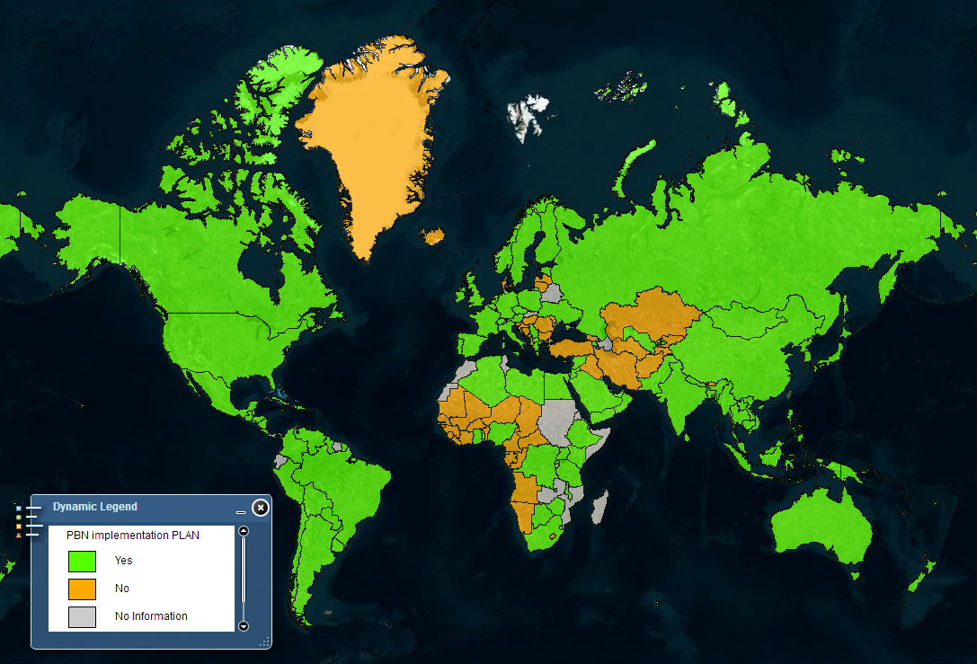
Capo Verde
Nile
0°
Seychelles
Comoros
Reunion
Mauritius
20°
20°

Slide 5
A37-11 Targets - AFI
% 0f Countries meeting Target
African FPP Seminar/Workshop – Addis Ababa 20-21 November 2014

Slide 6
African States must have:
a regional, sustainable solution for:
PBN and IFP Procedure Design Capability
Proper PBN Ops Approval Process
Efficient integration of PBN into African airspace infrastructure
African FPP Seminar/Workshop – Addis Ababa 20-21 November 2014

Slide 7
Introduction of the FPP
African FPP Seminar/Workshop – Addis Ababa 20-21 November 2014

Slide 8
Flight Procedures Programme (FPP)
“the Regional Centre of Excellence in procedure/airspace implementation, focusing on PBN”
To provide
  Direct design and implementation support as needed
  Necessary Capacity building for States and other stakeholders for sustainable development
African FPP Seminar/Workshop – Addis Ababa 20-21 November 2014

Slide 9

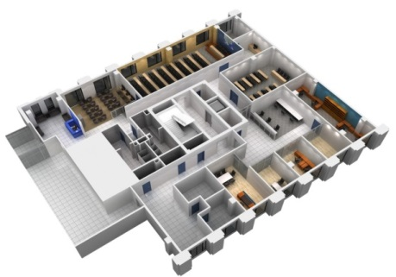
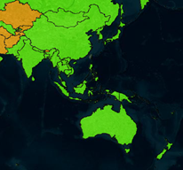
Flight Procedures Programme (FPP)
Based on a proven solution
Asia and Pacific FPP
  Operations since 2009 in Beijing, China
  20+ Member States and increasing
  Conducted training for more than 1000 participants from 20+ States
  On-going supports for PBN implementation projects/ capacity building in more than 15 States
APAC FPP
African FPP Seminar/Workshop – Addis Ababa 20-21 November 2014

Slide 10
An African FPP customized for Africa
by Africa
Supported by the AFI RAN in 2008
Re-energized at the recent Assembly Resolution A38-7:
  “States are urged to support the establishment of the AFI Flight Procedures Programme (FPP) Office with seconded personnel and financial assistance as a matter of urgency to expedite the implementation of PBN in the region.”
African FPP Seminar/Workshop – Addis Ababa 20-21 November 2014

Slide 11
An African FPP customized for Africa
by Africa
Formula:
Run by ICAO ESAF/WACAF
Seconded Personnel from ESAF and WACAF areas
Contributions from States and Donors
Governed by African Steering Committee
African FPP Seminar/Workshop – Addis Ababa 20-21 November 2014

Slide 12
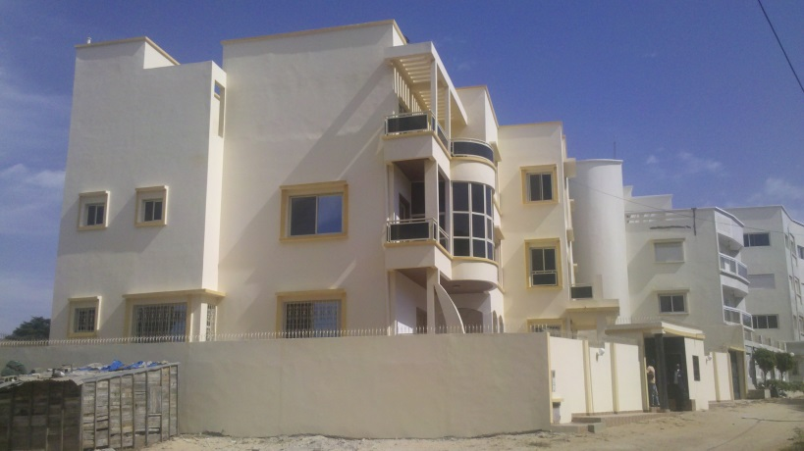
An African FPP customized for Africa
by Africa
Open for business - 2 June 2014
Initial 3-year duration, renewable
Dakar, Senegal, hosted by ASECNA
Dakar
WACAF
African FPP Seminar/Workshop – Addis Ababa 20-21 November 2014

Slide 13
FPP Structure and Governance
African FPP Seminar/Workshop – Addis Ababa 20-21 November 2014

Slide 14
Participation in the FPP
Host Administration
  ASECNA
  Signatory to Programme Document with ICAO
  Does not constitue State participations
Participating States
  Signature onto attachment of Programme Document
  Active Participating States
    African State
    Part of Programme Steering Commitee
    Commitment to funding the Programme with Annual financial contribution
      May be waived through in-kind contribution under agreement by Steering Commitee
  User States
    African State
    No commitment to funding the Programme; some free services, other services by service fee
  Observer States
    Participating State not necessarily African
    No commitment to funding the Programme; services by service fee
Donor
Eligible Steering Committee Members
African FPP Seminar/Workshop – Addis Ababa 20-21 November 2014

Slide 15

Governance
The Steering Committee (SC) is the governing body of the AFI-FPP
The Members of the SC include a representative from :
  ICAO;
  each Active Participating States (APS); and
  Host Administration (ASECNA)
African FPP Seminar/Workshop – Addis Ababa 20-21 November 2014

Slide 16
Steering Committee role and responsibilities
Role and responsibilities
  Review & approve Annual work programme;
  Review & approve Annual budget;
  Review & approve Annual financial contribution for APS; and
    Considering request for waiver of financial contribution in lieu of in-kind contribution
  And,
  Review of Performance of Programme;
  Review of Programme document, as necessary; and
  In consultation with ICAO Policy,
    Review and approve fee schedule for services and trainings
African FPP Seminar/Workshop – Addis Ababa 20-21 November 2014

Slide 17
ICAO Oversight
    ICAO assistance to the Programme
      monitor implementation of the programme
      provide technical support to its experts in the performance of their duties; and
      provide financial account management;
African FPP Seminar/Workshop – Addis Ababa 20-21 November 2014

Slide 18
Scope and Services of the FPP
African FPP Seminar/Workshop – Addis Ababa 20-21 November 2014

Slide 19
2014 Work Plan and Deliverables
African FPP Seminar/Workshop – Addis Ababa 20-21 November 2014

Slide 20
An African FPP customized for Africa by Africa

