Slide 1
AFRICAN FLIGHT PROCEDURE PROGRAMME AFPP
Seminar/ Workshop
PBN implementation, Developments, Targets and progress
Seboseso Machobane RO/ATM
ESAF Regional Office
Addis Ababa
November 20-21, 2014

Slide 2
Overview
Historical aspects
PBN Implementation planning
  Status of national plans
Details of the Regional PBN Implementation Plan
Progress in States
Conclusion

Slide 3
Assembly Resolutions
2007 - A36-23:
  Introduction of PBN
  PBN Implementation Plans required by 2009 to meet global implementation goals
  Highlight-Approaches with vertical guidance
  Emphasis on VNAV (vertical guidance)
2010 – A37-11:
  Complete a PBN implementation plan as a matter of urgency
  Included LNAV to emphasis
  Superseded A36-23

Slide 4
APIRG Framework
2007 (Nov.) – APIRG 16
Concl. 16/2
  Establishment of PBN Task Force – charged to develop Regional Plan
Concl. 16/3
  Development of State PBN implementation plans harmonized with Regional Plan
Concl. 16/4
  National focal points for PBN implementation

Slide 5
APIRG Framework
2009
  Workshop and guidance on development of Plans & Implementation Action Plans, templates provided
  Examples of PBN Implementation Action & Action Plans
2010 – APIRG 17
Concl. 17/47
  Provided template for State PBN Implementation Plan
  Urged completion as soon as possible
  Feedback to Regional Offices by 30 Oct. 2010
Concl. 17/48
  Implementation tools provided: Action Plan Templates, project management; reference to others.

Slide 6
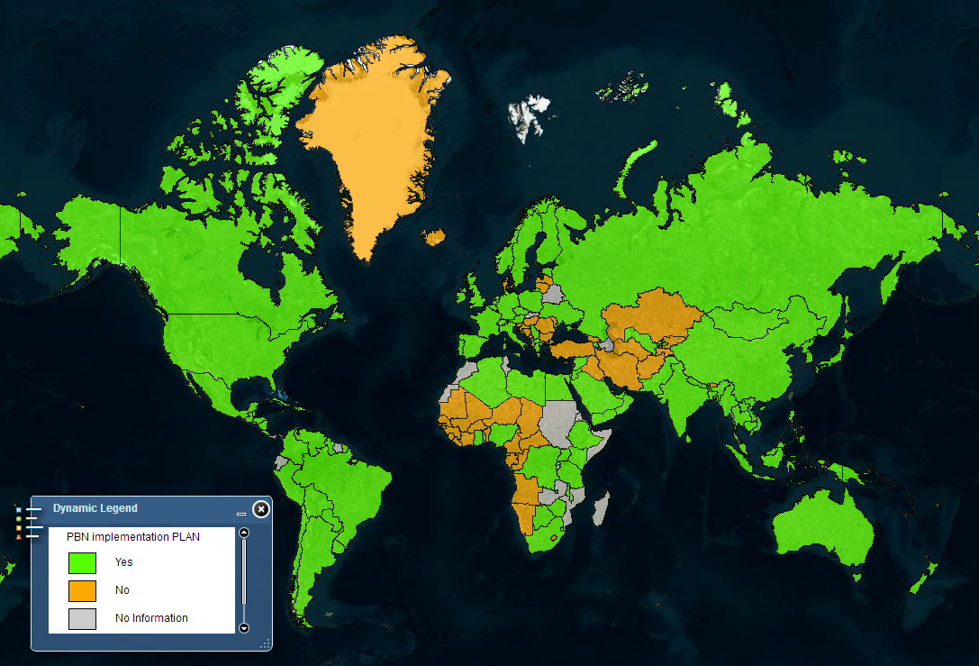
Capo Verde
Nile
0°
Seychelles
Comoros
Reunion
Mauritius
20°
20°

Slide 7
Regional Goals, Near Term (2008-2012)
Airspace | Nav. Specifications | Nav. Specifications where Operationally Required
En-Route Oceanic | RNAV 10 | RNP 4
En-Route Remote Continental | RNAV 10 | RNP 4
En-Route Continental | RNAV 5 | RNAV 1/2
TMA-Arrival/Departure | RNAV 1 in a surveillance environment
 | Basic RNP 1 in non-surveillance
Approach | RNP APCH (with Baro-VNAV) OR RNP APCH (LNAV only). Also See Note RNP AR APCH if required
Note: Where altimeter setting does not exist or aircraft of maximum certificated take-off mass of 5700kg or more, using an aerodrome are not suitably equipped for APV operations.
AFRICAN FLIGHT PROCEDURE PROGRAMME SEMINAR/WORKSHOP ADDIS NOV. 2014

Slide 8
Near term- 2008-2012 Implementation targets
RNP APCH (with Baro-VNAV) in 30% of instrument runways by 2010 and 50% by 2012 and priority given to airports with operational benefits. Each instrument runway will have an associated RNP APCH (LNAV only)
Straight-in LNAV only procedures for instrument runways where there is no local altimeter setting available & where aircraft MTOM 5 700 kg or more are not suitably equipped for APV operations
RNAV 1 SID/STAR for 30% of international airports by 2010 and 50% by 2012 and priority given to airports with RNP Approach.
Review existing conventional and RNAV routes to transition to PBN RNAV 5 or where operationally required RNAV 2/1 by 2012.

Slide 9
Regional Goals, Mid Term (2013-2016)
Airspace | Nav. Specifications | Nav. Specifications where Operationally Required
En-Route Oceanic | RNAV 10, | RNP 4
En-Route Remote Continental | RNAV 10, | RNP 4
En-Route Continental | RNAV 2, RNAV 5 | RNAV 1
TMA Arrival/Departure | Expand RNAV 1, or RNP-1 application High density TMAs Mandate RNAV 1, or RNP-1
Approach | Expand RNP APCH with ( Baro-VNAV or Augmented GNSS), Supplemented with LNAV only procedures. Also see note Implement RNP AR APCH where there are operational benefits
Note: In addition, where altimeter setting does not exist or aircraft of maximum certificated take-off mass of 5700kg or more, using an aerodrome are not suitably equipped for APV.

Slide 10
Mid term- 2013-2016 Implementation targets
RNP APCH (APV) (Baro-VNAV or Augmented GNSS) in 100% of instrument runways where practical, by 2016.
RNP APCH (LNAV only minima) in 70% of instrument runways by 2014, 100% by 2016
Straight-in LNAV only procedures for instrument runways where there is no local altimeter setting available & where aircraft MTOM 5 700 kg or more are not suitably equipped for APV operations
RNAV 1 or RNP 1 SID/STAR for 100% of international airports by 2016.
RNAV 1 or RNP 1 SID/STAR for 70% of busy domestic airports where there are operational benefits.
Implementation of additional RNAV/RNP Routes as required.

Slide 11
State’s progress -Terminal (on desktop)
C | D | E | F | G | H | I | J | K | L | M
STATE ICAO DESIGNATOR | COUNTRY | NO OF INT'L AIRPORTS | NO OF RWYS | NO OF INST RWYS | NO OF RNP APCH | NO OF RNAV APCH | NO OF RNAV/RNP SID | NO OF RNAV/RNP STAR | NO OF DOMESTIC AIRPORTS | NO OF RWYS | NO OF INST RWYS | NO OF RNP APCH | NO OF RNAV APCH | NO OF RNAV/RNP SID | NO OF RNAV/RNP STAR | Published GNSS Procs
DAAG | ALGERIA* | 20 | 40 | 33 |  |  |  |  |  |  |  |  |  |  |  | Yes
FNLU | ANGOLA* | 3 | 6 | 4 |  |  |  |  |  |  |  |  |  |  |  | Yes
DBBB | BENIN | 2 | 4 | 4 | 2 |  |  | 2 |  |  |  |  |  |  |  | Yes
FBSK | BOTSWANA | 4 | 8 | 6 |  |  | 3 | 3 |  |  |  |  |  |  |  | Yes
DFFD | BURKINA FASO | 2 | 4 | 4 | 4 |  |  | 4 |  |  |  |  |  |  |  | Yes
HBBA | BURUNDI* | 1 | 2 | 2
FKYS | CAMEROON | 3 | 6 | 6 | 2 |  |  | 2 | 1 | 2 | 2 |  |  |  |  | Yes
GVAC | CAPE VERDE* | 3 | 6 | 3
FEFF | CENTRAL AFRICAN REP | 1 | 2 | 2 | 2 |  |  | 2 | 1 | 2 |  |  |  |  |  | Yes
FTTJ | CHAD* | 1 | 2 | 2 |  |  |  |  |  |  |  |  |  |  |  | Yes
FMCH | COMOROS | 1 | 2 | 2 |  |  |  |  |  |  |  |  |  |  |  | Yes
FCBB | CONGO | 2 | 4 | 4 | 2 | 2 |  | 2 | 5 | 10 |  |  |  |  |  | Yes
DIAP | COTE D'IVOIRE | 1 | 2 | 2 | 2 |  |  | 2 | 6 | 12 | 2 | 2 |  |  | 2 | Yes
FZAA | D R CONGO* | 5 | 10 | 8 |  |  |  |  |  |  |  |  |  |  |  | Yes
HDAM | DJIBOUTI* | 1 | 2 | 2 |  |  |  |  |  |  |  |  |  |  |  | Yes
HECA | EGYPT* | 16 | 32 | 25 |  |  |  |  |  |  |  |  |  |  |  | Yes
FGSL | EQUAT GUINEA* | 1 | 2 | 2 |  |  |  |  |  |  |  |  |  |  |  | Yes
HHAS | ERITREA* | 3 | 6 | 3 |  |  |  |  |  |  |  |  |  |  |  | Yes
HAAB | ETHIOPIA | 4 | 10 | 10 |  | 6 | 1 | 6 | 14 | 28 | 4 |  | 2 | 2 | 2 | Yes
FOOL | GABON | 3 | 6 | 6 | 3 |  | 2 | 2 | 1 | 2 |  |  |  |  |  | Yes
GBYD | GAMBIA* | 1 | 2 | 2 |  |  |  |  |  |  |  |  |  |  |  | Yes
DGAA | GHANA* | 3 | 6 | 6
GUCY | GUINEA* | 4 | 8 | 4 |  |  |  |  |  |  |  |  |  |  |  | Yes
GGOV | GUINEA-BISSAU | 1 | 2 | 2 |  |  |  |  |  |  |  |  |  |  |  | Yes
HKJK | KENYA | 8 | 22 | 3 |  | 9 | 6 | 6 | 28 | 56 |  |  | 6 |  |  | Yes
FXMM | LESOTHO* | 2 | 4 | 1 |  |  |  |  |  |  |  |  |  |  |  | Yes
GLRB | LIBERIA* | 1 | 2 | 2
HLLY | LIBYA* | 6 | 12 | 8
FMMI | MADAGASCAR | 3 | 6 | 6 | 4 |  |  |  | 1 | 2 | 2 |  |  |  |  | Yes
FWKI | MALAWI | 7 | 14 | 4 | 1 |  | 4 | 4 | 13 | 26 |  |  |  |  |  | Yes
GABS | MALI | 2 | 4 | 4 | 4 |  |  | 2 | 4 | 8 | 8 |  |  |  |  | Yes
GQPP | MAURITANIA | 2 | 4 | 4 | 4 |  |  | 4 |  |  |  |  |  |  |  | Yes
FIMP | MAURITIUS | 1 | 2 | 2 |  |  | 2 |  | 1 | 2 | 2 |  |  |  |  | Yes
GMMN | MOROCCO* | 12 | 24 | 24 |  |  |  |  |  |  |  |  |  |  |  | Yes
FQBR | MOZAMBIQUE* | 3 | 6 | 4 |  |  |  |  |  |  |  |  |  |  |  | Yes
FYWH | NAMIBIA* | 6 | 12 | 6 |  |  |  |  |  |  |  |  |  |  |  | Yes
DRRN | NIGER | 3 | 6 | 6 | 6 |  |  |  | 3 | 6 |  |  |  |  |  | Yes
DNAA | NIGERIA* | 11 | 22 | 20
FMEE | REUNION (FRA)* |  |  |  |  |  |  |  |  |  |  |  |  |  |  | Yes
HRYR | RWANDA | 2 | 4 | 2 |  |  | 4 | 4 | 1 | 2 |  |  |  | 1 | 1 | Yes
FPST | SAO TOME & PRINCIPE* | 1 | 2 | 2
GOOY | SENEGAL | 2 | 4 | 4 | 2 |  | 2 | 4 | 3 | 6 | 4 |  |  |  |  | Yes
FSIA | SEYCHELLES | 1 | 2 | 2 | 4 |  | 4 | 4 | 4 | 8 | 2 | 2 |  |  |  | Yes
GFLL | SIERRA LEONE* | 1 | 2 | 2
HCMM | SOMALIA* | 5 | 10 | 6
FAJS | SOUTH AFRICA | 10 | 36 | 18 | 8 |  | 8 | 8 | 8 | 22 | 12 | 14 |  | 4 | 4 | Yes
HSSS | SUDAN* | 4 | 8 | 5 |  |  |  |  |  |  |  |  |  |  |  | Yes
FDMS | SWAZILAND* | 1 | 2 | 1
DXXX | TOGO | 2 | 4 | 4 | 2 |  | 2 | 2 |  |  |  |  |  |  |  | Yes
DTTA | TUNISIA* | 8 | 16 | 16 |  |  |  |  |  |  |  |  |  |  |  | Yes
HUEN | UGANDA | 1 | 2 | 1 | 2 |  | 2 | 2 | 14 | 28 |  |  |  |  |  | Yes
 | UK (BIOT)*
 | UK (ST. HELENA & ASCENSION)*
HTDA | UNITED REPUBLIC OF TANZANIA* | 3 | 6 | 5 |  |  |  |  |  |  |  |  |  |  |  | Yes
FLLS | ZAMBIA* | 6 | 12 | 8 |  |  |  |  |  |  |  |  |  |  |  | Yes
FVHA | ZIMBABWE | 11 | 22 | 8 | 4 |  | 4 | 4
 |  | TOTAL NO OF INT'L AIRPORTS | TOTAL NO OF RWYS | TOTAL NO OF INST RWYS | TOTAL NO OF RNP APCH | TOTAL NO OF RNAV APCH | TOTAL NO OF RNAV/RNP SID | TOTAL NO OF RNAV/RNP STAR | TOTAL NO OF DOMESTIC AIRPORTS | TOTAL NO OF RWYS | TOTAL NO OF INST RWYS | TOTAL NO OF RNP APCH | TOTAL NO OF RNAV APCH | TOTAL NO OF RNAV/RNP SID | TOTAL NO OF RNAV/RNP STAR
 |  | 211 | 446 | 322 | 58 | 17 | 44 | 69 | 108 | 222 | 38 | 18 | 8 | 7 | 9

Slide 12
En-route progress
Over 80 trajectories facilitated by ICAO and IATA (and member airlines) agreed since 2010
  Most implemented
  Challenges include
    Differences in coordinates of same way point at FIR boundaries, jagged segment
    Lack of confidence, lack of training, preference of starburst route system
    Limitations in understanding: on issues like PBN itself, safety assessments and regulatory implications
Now working on tracks to facilitate flexibility and provide transition to UPR/Free routing

Slide 13
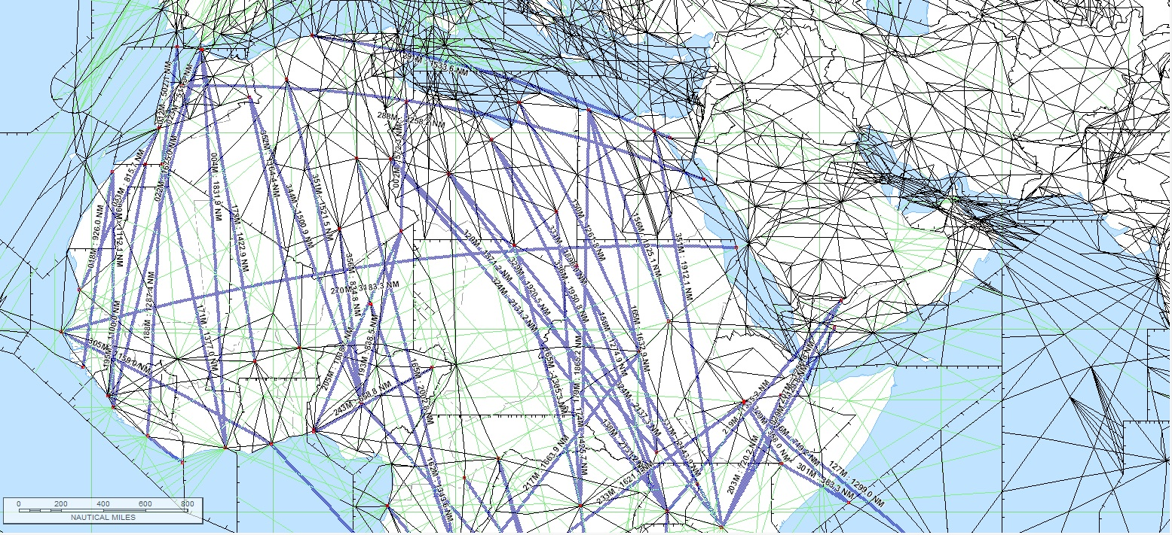
En-route progress

Slide 14
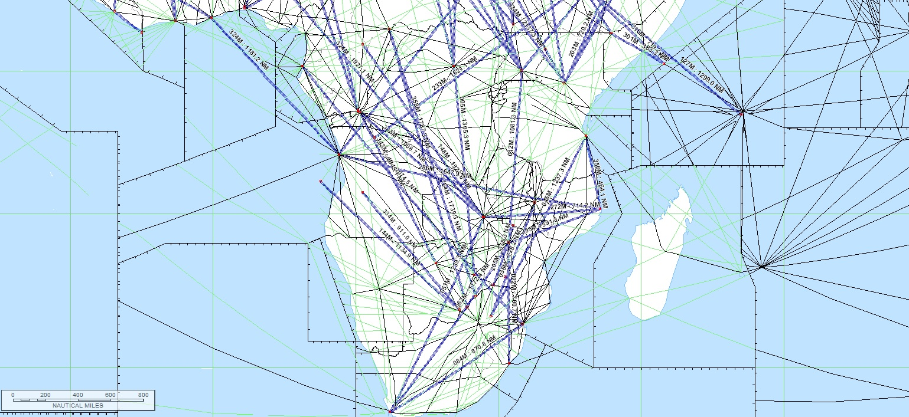
En-route progress

Slide 15
Conclusion
Nearly 7 years since 36th Assembly Session
No more than 14 States have developed national PBN implementation plans
Of the 14, most are without implementation action plans which form part of corporate plans, and/or plans are not part of corporate performance
Despite support provided by IATA and member airlines, implementation targets far from being met
Bottom line – Lots of ground to cover

Slide 16


