Slide 1
Introduction to Forecasting Analysis
ICAO Strategic Objective: Economic Development of Air Transport
ICAO Aviation Data Analyses Seminar
Middle East (MID) Regional Office
27-29 October
Economic Analysis and Policy (EAP) Section
Air Transport Bureau (ATB)

Slide 2

Long-Term Air Traffic Forecasts: “GATO”
Past decade air transport trends
Demand drivers analysis
  Economic growth
  Liberalization
  Low Cost Carriers
  Improving technologies
Challenges for air traffic development
  Fuel prices
  Airport/ANSPs capacity constraints
  Competition and inter-modality
Forecasts
  Structure and methodology
  Passenger and cargo
  Results and analysis by route group
PASSENGERS
AND CARGO TRAFFIC
Available at:
www.icao.int

Slide 3

Background
Assembly Resolution A38-14
Appendix C : Forecasting, planning and economic analyses
The Assembly:
Requests the Council to prepare and maintain, as necessary, forecasts of future trends and developments in civil aviation of both a general and a specific kind, including, where possible, local and regional as well as global data, and to make these available to Contracting States and support data needs of safety, security, environment and efficiency
Requests the Council to develop one single set of long term traffic forecast, from which customized or more detailed forecasts can be produced for various purposes, such as air navigation systems planning and environmental analysis

Slide 4
Main terms and definitions used in forecasting analysis

Slide 5

Types of Data
Data can be broadly divided into the following three types:
- Time series data consist of data that are collected, recorded, or observed over successive increments of time.
- Cross-sectional data are observations collected at a single point in time.
- Panel data are cross-sectional measurements that are repeated over time, such as yearly passengers carried for a sample of airlines.
Of the three types of data, time series data is the most extensively used in traffic forecasts.

Slide 6

Forecasting Timeframe
Short-term Forecasts
Short-term forecasts generally involve some form of scheduling which may include for example the seasons of the year for planning purposes.
The cyclical and seasonal factors are more important in these situations.
Such forecasts are usually prepared every 6 months or on a more frequent basis.
Some airport operators undertake ‘ultra short term’ forecasts for (e.g.) the next month in order to provide for specific requirement such as adequate staffing in the peaks.

Slide 7

Forecasting Timeframe
Medium-term Forecasts
Medium-term forecasts are generally prepared for planning, scheduling, budgeting and resource requirements purposes.
The trend factor, as well as the cyclical component, plays a key role in the medium-term forecast as the year to year variations in traffic growth are an important element in the planning process

Slide 8
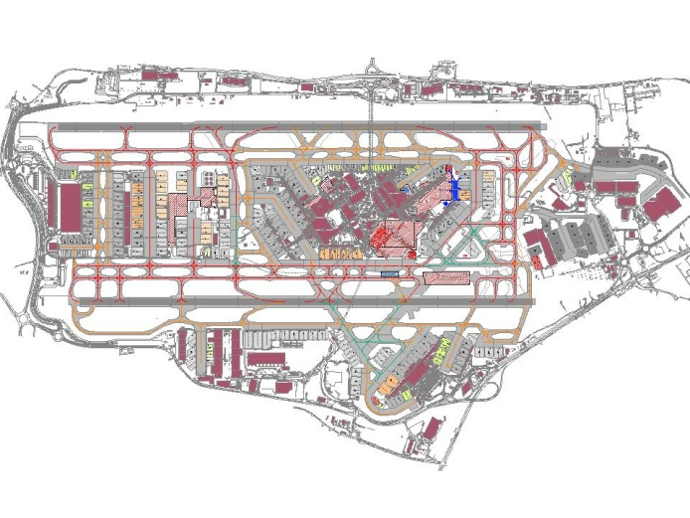
Forecasting Timeframe
Long-term Forecasts
Long-term forecasts are used mostly in connection with strategic planning to determine the level and direction of capital expenditures and to decide on ways in which goals can be accomplished.
The trend element generally dominates long term situations and must be considered in the determination of any long-run decisions.
It is also important that since the time span of the forecast horizon is long, forecasts should be calibrated and revised at periodic intervals (every two or three years depending on the situation).
The methods generally found to be most appropriate in long-term situations are econometric analysis and life‑cycle analysis.

Slide 9
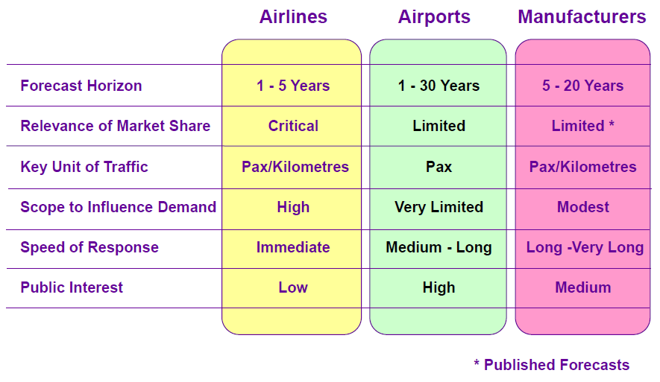
Forecasting Timeframe
Forecasts Horizons
In some cases, the aviation industry forecasts call for much longer time horizons, up to 25‑30 years.
This is particularly relevant for large airport infrastructure projects and for aircraft manufacturers, for example, when considering next generation of aircraft.
When looking at a 30-year horizon, it is advisable to consider a forecast scenario rather than a forecast itself, because of the uncertainty associated with such a longer-term forecast.
Such longer-term outlooks should take into account mega trends and the market maturity likely to occur over the period.
Source: BAA (2011)

Slide 10
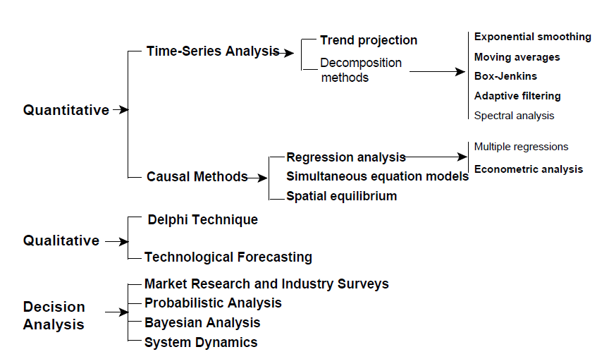
Alternative Forecasting Techniques
Source: ICAO Manual on Air Traffic Forecasting

Slide 11
ICAO forecasting methodogy
Bottom-up approach
Historical Traffic
Model development and selection
Explanatory variables assumptions
Traffic Forecasts
World
=
RG #1
econometric model #1
RG #1
+
+
RG #2
econometric model # 2
RG #2
+
+
RG #3
econometric model # 3
RG #3
+
+
.
.
.
.
.
.
.
.
World
=
+
+
RG #n-1
econometric model # n-1
RG #n-1
+
+
RG #n
econometric model # n
RG #n
Bottom-up approach

Slide 12
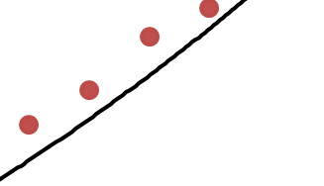


Basic Principle
In order to generate a forecast from a time series, a mathematical equation is to be found to replicate the historical actual data with modelled data.
Modelled values
Actual Observations
$Y$ = actual value or $\hat{Y}=$modelled value
Difference actual vs. modelled data
$$time$$

Slide 13
Some Definitions
Error
The validity of a forecasting method would depend on how accurately predictions can be made using that method. One approach to estimating accuracy is to compare the difference between an actual observed value and its modelled value.
Where
= the error in time period t
= the actual value in time period t
= the modelled value for time period t

Slide 14
Some Definitions
Sample (Arithmetic) Mean
Given a set of n values , the arithmetic mean is
That is, the sum of the observations is divided by the number of values included.

Slide 15

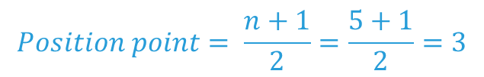

Median Calculation
Calculation of the Median
Example 1:
Raw Data: 24.1 22.6 21.5 23.7 22.6
Ordered: 21.5 22.6 22.6 23.7 24.1
Position: 1 2 3 4 5
$$Position point= \frac{n+1}{2}=\frac{5+1}{2}=3$$
Median = 22.6
Example 2:
Raw Data: 10.3 4.9 8.9 11.7 6.3 7.7
Ordered: 4.9 6.3 7.7 8.9 10.3 11.7
Position: 1 2 3 4 5 6
Median $=\frac{7.7+8.9}{2}=8.3$
$Position point= \frac{n+1}{2}=\frac{6+1}{2}=$3.5

Slide 16

Some Definitions
Deviation from the Mean:
$$d_{i}=Y_{i}− \overline{Y}$$

Slide 17
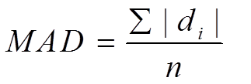
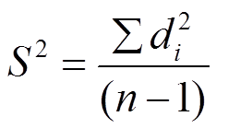
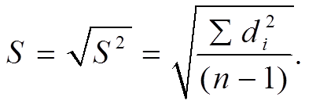
Some Definitions
The mean absolute deviation is the average of the deviations about the mean, irrespective of the sign:
The variance is an average of the squared deviations about the mean:
The standard deviation is the square root of the variance:

Slide 18
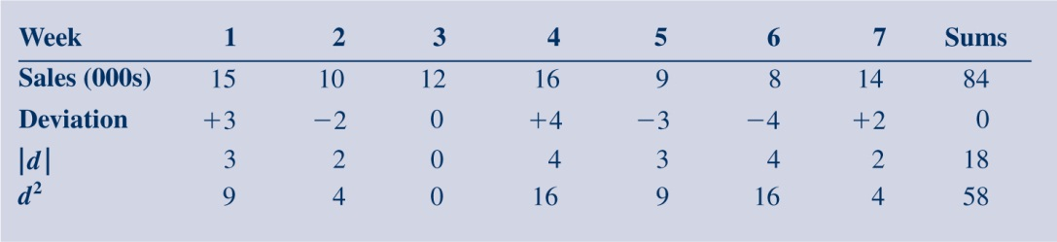
Example
Mean is
From the table, we have

Slide 19
Some Definitions
Differences and Growth Rates
The (first) difference of a time series is given by:
The growth rate for a time series is given by:

Slide 20
Some Definitions
The log transform may be written as:
The (first) difference in logarithms becomes:
The inverse transformation is:

Slide 21
Some Definitions
Source: Song, Witt and Li (2009) The Advanced Econometrics of Tourism Demand,
London: Routledge.

Slide 22
Practical Example of Time Series Models with Excel

Slide 23
Linear Trend
A Forecasting Model – linear trend
β₀ and β₁ are the level and slope (or trend) parameters, respectively
ε denotes a random error term corresponding to the part of the series that cannot be described by the model.
If we make appropriate assumptions about the nature of the error term, we can estimate the unknown parameters β₀ and β₁.
Statistical (forecasting) model:
  Plus assumptions about the distribution of the random error term.
  The estimated model provides the forecast function, along with the framework to make statements about model uncertainty.
Notes:
We might formulate a simple trend model for a time series as the equation presented here, where Y_{t} denotes the time series being studies; β₀ and β₁ are the level and slope (or trend) parameters, respectively; and ε denotes a random error term corresponding to the part of the series that cannot be described by the linear trend.
If we make appropriate assumptions about the nature of the error term, we can estimate the unknown parameters β₀ and β₁.
The resulting estimates are typically written as b₀ and b₁. Thus, the forecasting model gives rise to a forecast function, whose estimate version may be written as the second equation on the right where F denotes a forecast for time period, b₀ is the (estimated) intercept that represents the value at time zero, and b₁ is the (estimated) slope (or trend), which represents the increase in forecast values from one period to the next.

Slide 24
Linear Trend
Practical Example
Dataset →

Slide 25

Linear Trend
Scatter Plot
The first step is to draw a scatter plot. The scatter plot seems to suggest that the data follows a linear trend.
$$Passengers$$
$$time$$

Slide 26
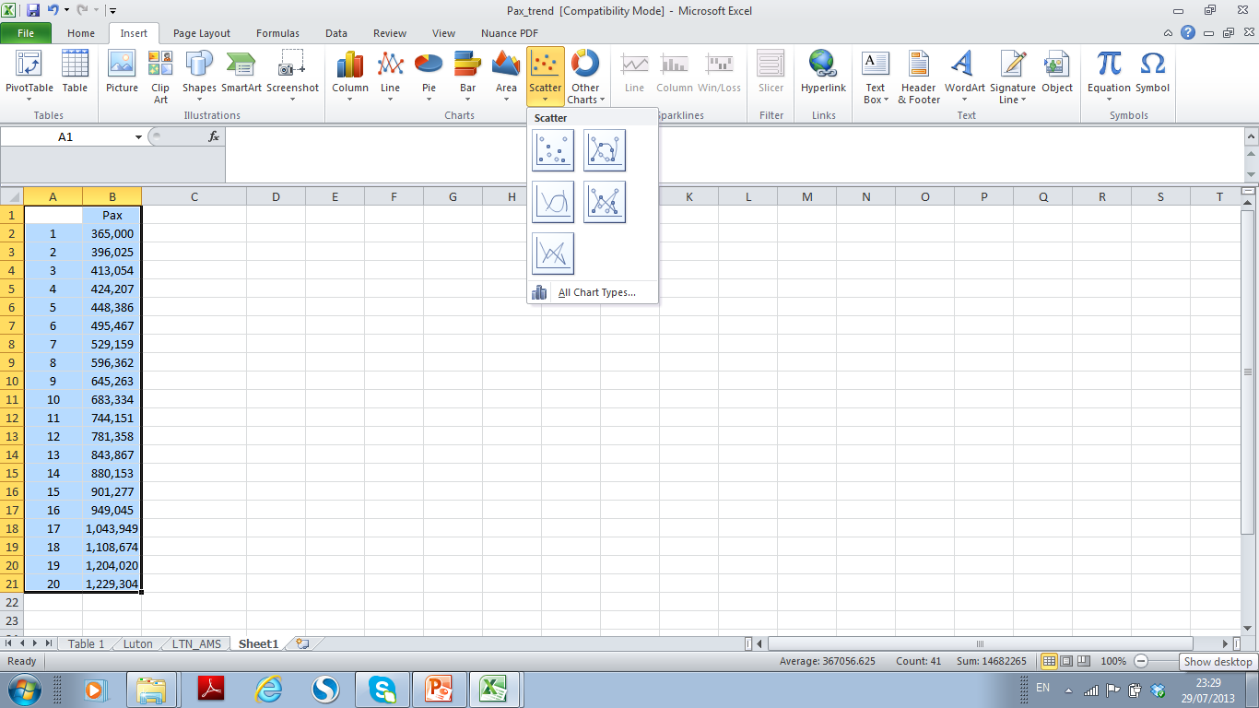
Linear Trend
Excel Illustration
EXCEL can be used for trend analysis.
First, highlight Columns A and B as illustrated on the right.
Then, go to Insert → Scatter
and select the first one

Slide 27
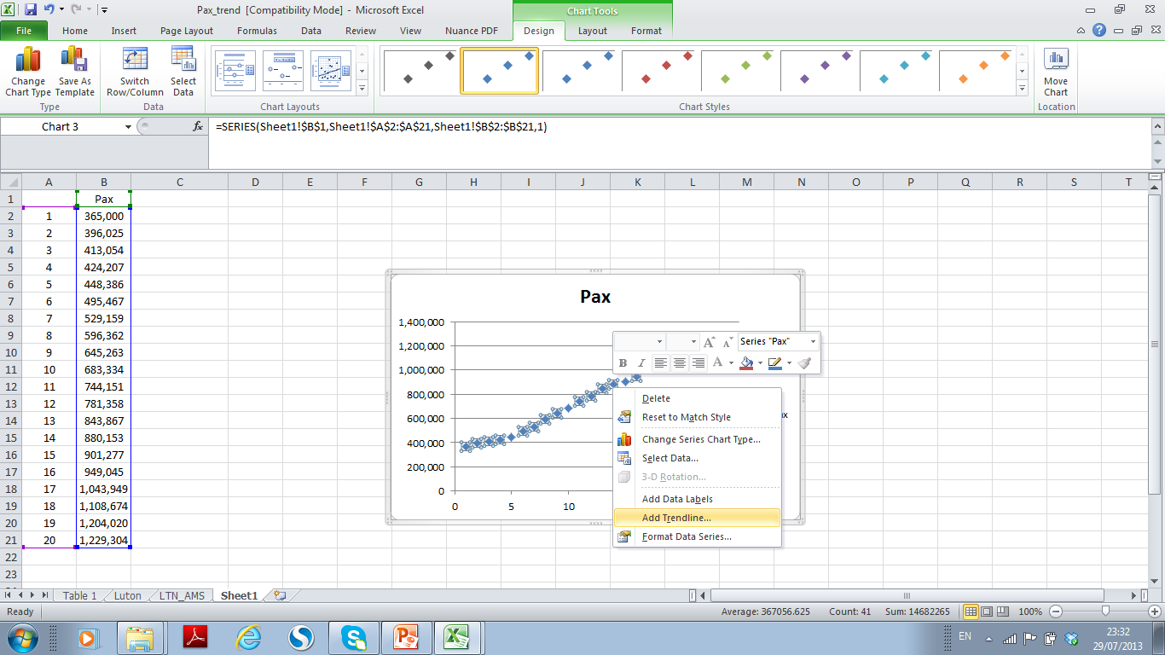
Linear Trend
Excel Illustration
Excel will then automatically generate a scatter plot.
Put the cursor on the scatter and right click on the mouth, select add trendline as shown in the screen shot on the right.

Slide 28
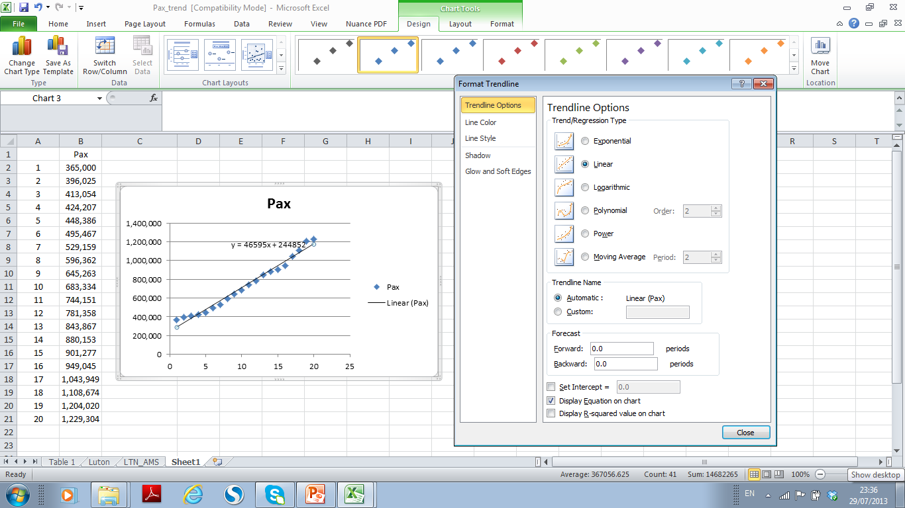
Linear Trend
Excel Illustration
Then select
“Linear”
and
“Display Equation on chart”
as shown on the right.

Slide 29
Linear Trend
The figure besides show that the data fit the model reasonably well. The equation is also presented.
$$Passengers$$
$$time$$

Slide 30
Linear Trend
Generating Forecasts
After a trend curve that appears to fit the data is established, the forecaster can then simply extend the visually fitted trend curve to the future period for which the forecast is desired.
For example, to forecast passenger numbers at period 21, we simply plug 21 into the equation. This is considered to be a simple linear extrapolation of the data
Pax_{t=21} = 46,595 x (21) + 244,852 = 1,223,347

Slide 31
Exponential Trend Analysis
Existing trend is exponential if it increases at a steady percentage per time period.
If a trend is stable in percentage terms (exponential growth) , it can be expressed as:
Y=a(1+b)^{T}
or
ln(Y) = ln(a) + T x ln(1+b)
By taking logarithms, the exponential formulation can be converted to a linear formulation.
$$Passengers$$
$$time$$

Slide 32
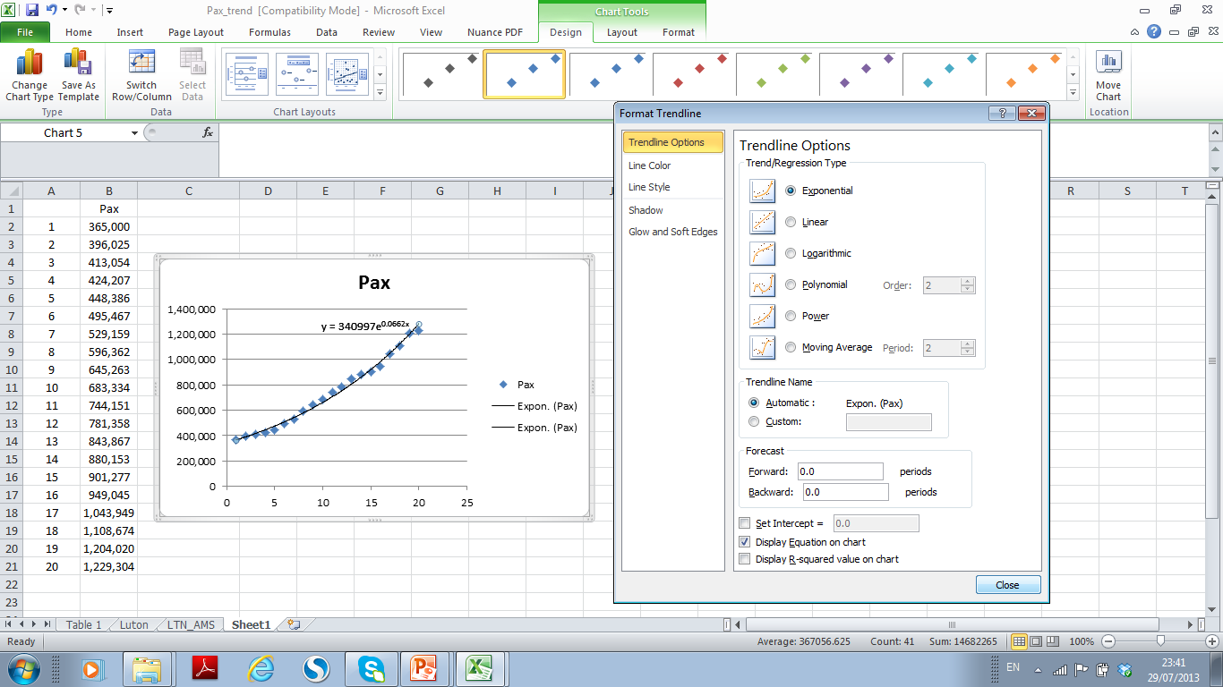
Exponential Trend Analysis
To select exponential trend analysis in EXCEL, we simply tick the box for
“Exponential”
and
“Display Equation”
as illustrated on the right.

Slide 33
Polynomial Trend Analysis
The figure on the right shows terminal passenger data from London Luton airport to Amsterdam Schipol airport from 1995 to 2009.
Traffic data in this case can be modelled by parabolic trend:
Y= a + bT + cT²
With three constants, this family of curves covers a wide variety of shapes (either concave or convex).

Slide 34
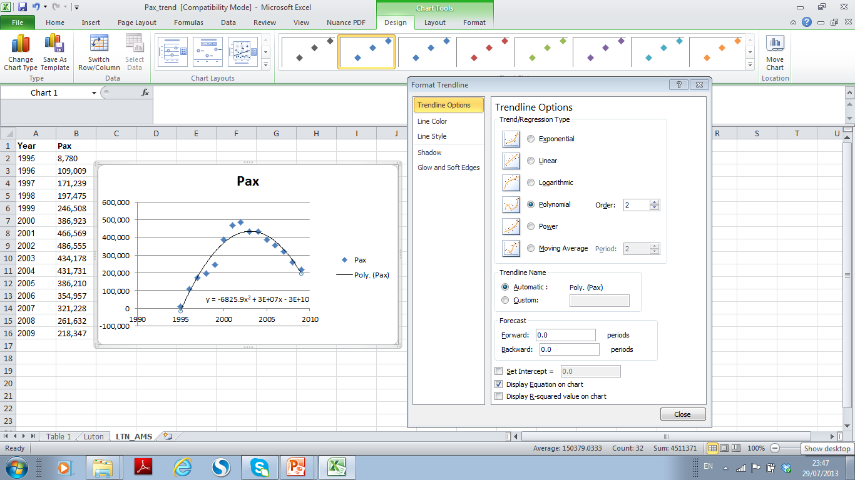
Polynomial Trend Analysis
To select exponential trend analysis, in EXCEL, we simply tick the box for
“Polynomial”
and
“Display Equation”
as illustrated on the right.

Slide 35
Polynomial Trend Analysis
We may have a few points that fall outside of the underlying trend.
Normally it happens with monthly data which may due to
  Strikes, weather, sporting events
  Easter tends to move around
Do nothing if no substantial effects on estimation
May remove them from the data
May ‘adjust’ them to fit in with the underlying trend

Slide 36
Introduction to Regression Analysis

Slide 37
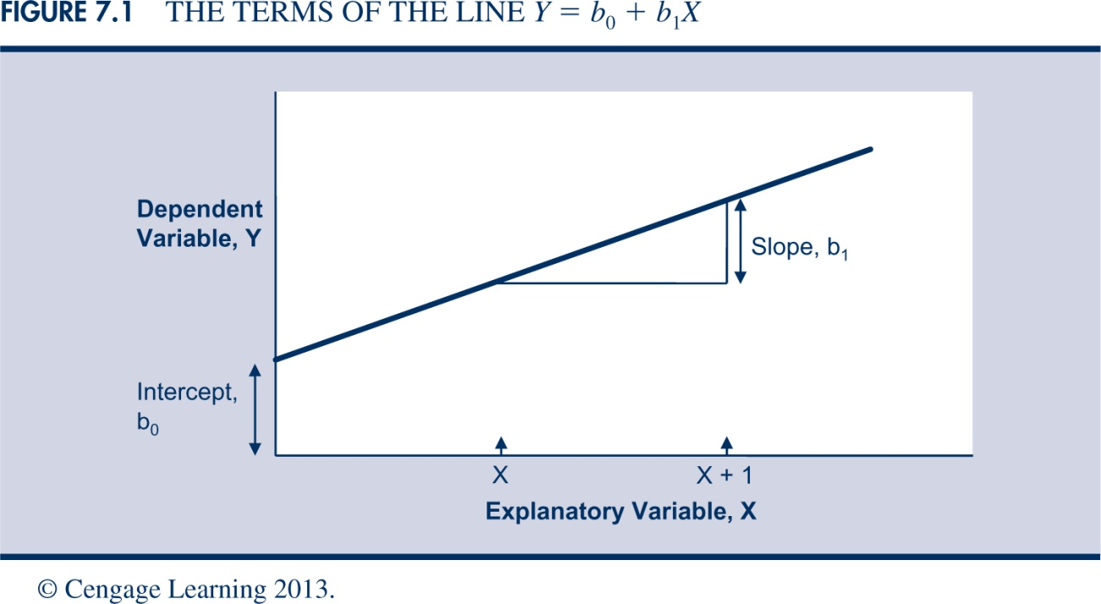
Relationship Between Variables
Regression analysis involves relating the variable of interest (Y), known as the dependent variable, to one or more input (or predictor or explanatory) variables (X).
The regression line represents the expected value of Y, given the value(s) of the inputs.

Slide 38
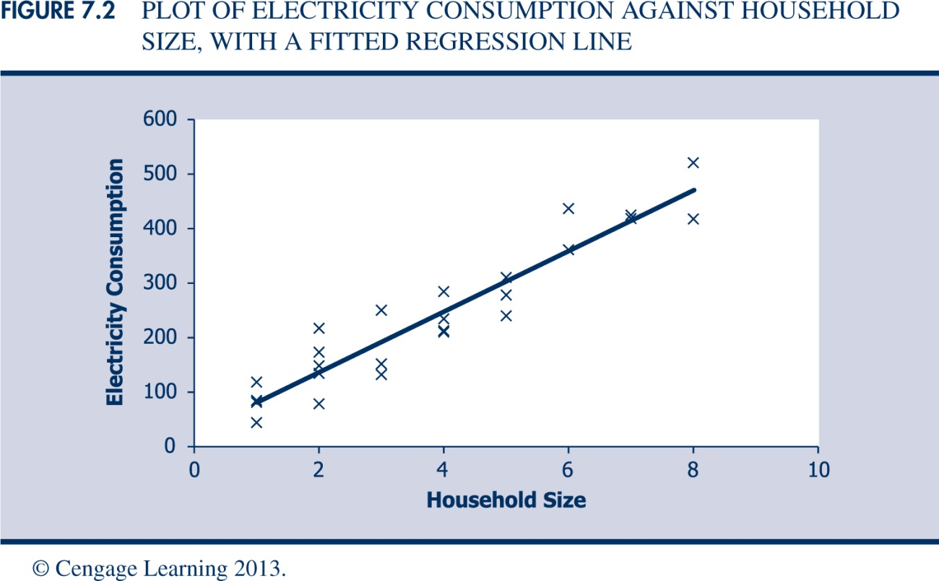
Relationship Between Variables
The regression relationship has a predictable component (the relationship with the inputs) and an unpredictable (random error) component. Thus, the observed values of (X, Y) will not lie on a straight line.

Slide 39
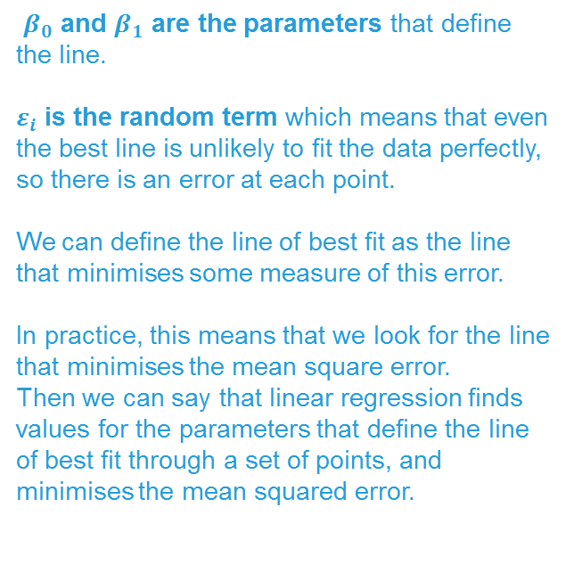
Simple Linear Regression Model
Introduction to
Regression Analysis
Random Error term
$β_{0}$ and $β_{1}$ are the parameters that define the line.
$ε_{i}$ is the random term which means that even the best line is unlikely to fit the data perfectly, so there is an error at each point.
We can define the line of best fit as the line that minimises some measure of this error.
In practice, this means that we look for the line that minimises the mean square error.
Then we can say that linear regression finds values for the parameters that define the line of best fit through a set of points, and minimises the mean squared error.
Slope
Coefficient
Independent Variable
intercept
Linear component
Random Error
component
Dependent Variable
Notes:
In linear regression model, the relationship between independent variable x and dependent variable y is described by a linear function.
$β_{0}$ and $β_{1}$ are the parameters that define the line. $ε_{i}$ is the random term which means that even the best line is unlikely to fit the data perfectly, so there is an error at each point.
We can define the line of best fit as the line that minimises some measure of this error. In practice, this means that we look for the line that minimises the mean square error. Then we can say that linear regression finds values for the parameters that define the line of best fit through a set of points, and minimises the mean squared error.

Slide 40
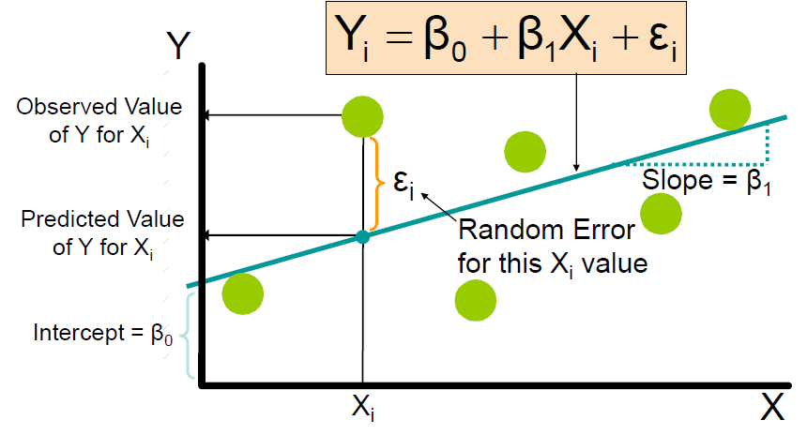
Simple Linear Regression Model
Introduction to
Regression Analysis
For each observed value Xi, an observed value of Yi is generated by the population model.

Slide 41
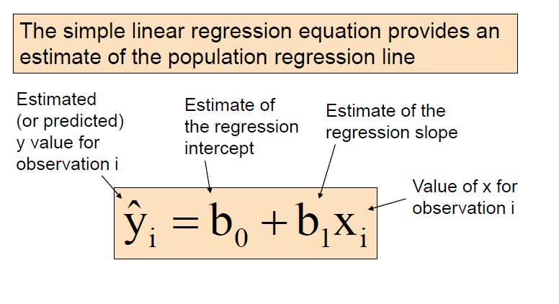
Simple Linear Regression Equation
Introduction to
Regression Analysis
In practice, we will be using sample data to develop a line.
The simple linear regression equation on the right provides an estimate of the population regression line.

Slide 42
Least Square Estimators
To get the best line for predicting y we want to make all of these errors as small as possible.
We use least square principle to determine a regression equation by minimizing the sum of the squares of the vertical distances (SSE) between the actual Y values and the predicted values of Y.

Slide 43
Simple Regression Model
Least Square Estimators
Introduction to
Regression Analysis
The slope coefficient estimator is:
And the constant or y-intercept is:
r is the correlation coefficient:

Slide 44
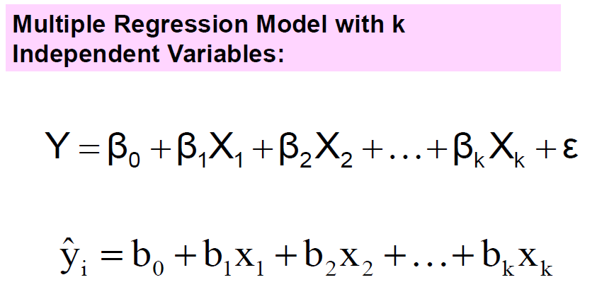
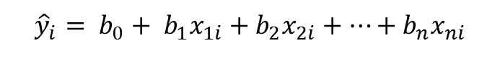
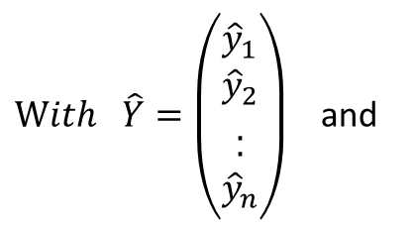
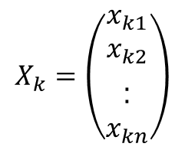
The Multiple Regression Model

Slide 45
Least Squares Estimators for Linear Models with two Independent Variables
Notes:
45

Slide 46
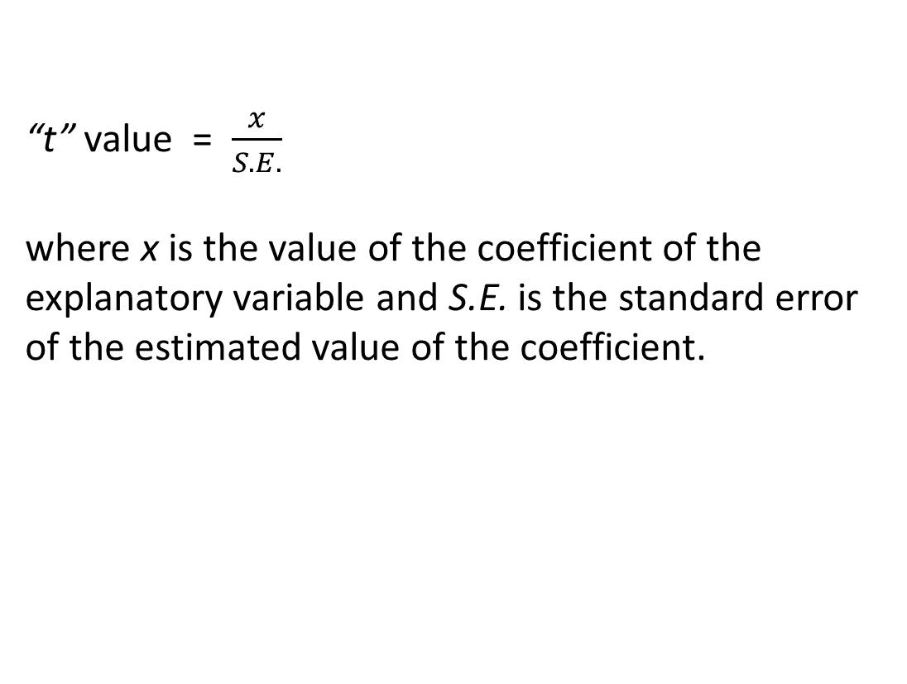
T-value
“t” Value
The “t” statistic corresponding to a particular coefficient estimate is a statistical measure of the confidence that can be placed in the estimate.
Since regression coefficients are estimates of the expected value or the mean value from a normal distribution, they have “standard errors” which can themselves be estimated from the observed data.
The “t” statistic is obtained by dividing the value of the coefficient by its standard error. The larger the magnitude of the “t”, the greater is the statistical significance of the relationship between the explanatory variable and the dependent variable, and the greater is the confidence that can be placed in the estimated value of the corresponding coefficient.
Likewise, the smaller the standard error of the coefficient, a higher confidence can be placed on the validity of the model.

Slide 47
T-value
“t” Value
Most of the computer software packages available for statistical analysis provide the “t” values.
A value of about 2 is usually considered as the critical value of “t”. A “t” value below 2 is considered not significant as much confidence cannot be placed on the precision of the coefficient.

Slide 48
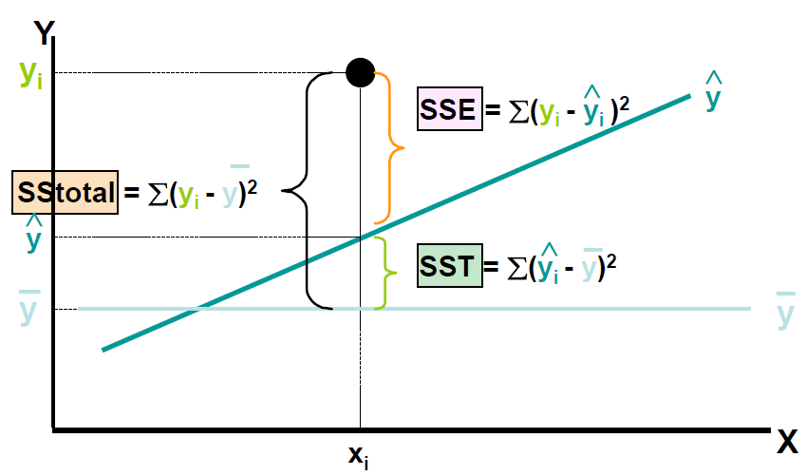
Coefficient of Determination, R²
Suppose we have a number of observations of y_{i} and calculate the mean. Actual value vary around this mean, and we can measure the variation by the total sum of squares (SStotal).
If we look carefully at this SStotal we can separate it into different components – SSE (sum of squares due to error) and SST (sum of squares due to regression).
When we build a regression model we estimate values, So the regression model explains some of the variation of actual observation from the mean.
Notes:
Linear regression finds the line of best fit through a set of data – but we really need to measure how good the fit is. If observations are close to the line, the errors are small and the line is a good fit to the data; but if observations are some way away from the line, errors are large and even the best line is not very good.

Slide 49
Coefficient of Determination, R²
note:
This measure has a value between 0 and 1. If it is near to 1 then most of the variation is explained by the regression line, there is little unexplained variation and the line is a good fit of the data. If the value is near to 0 then most of the variation is unexplained and the line is not a good fit.
Notes:
But there is also error, so the regression model does not explain all the variation and there is some residual left unexplained.
Using a bit of algebra you can find that:
The more of the variation that is explained by the regression, the better the line of best fit. So a measure of the goodness of fit is the proportion of SStotal that is explained by the regression model. This is the coefficient of determination.
This measure has a value between 0 and 1. If it is near to 1 then most of the variation is explained by the regression line, there is little unexplained variation and the line is a good fit of the data. If the value is near to 0 then most of the variation is unexplained and the line is not a good fit.

Slide 50
Multiple Linear Regression
Least Square Estimators
We have to calculate the coefficients for each of the independent variable, but after seeing the arithmetic for multiple regression with two independent variables in the previous slide, you might guess, quite rightly, that the arithmetic is even more messy for a regression with more than two independent variables.
This is why multiple regression is never tackled by hand.
Thankfully, a lot of standard software includes multiple regression as a standard function.
Too
complicated
by hand!
Notes:
16

Slide 51
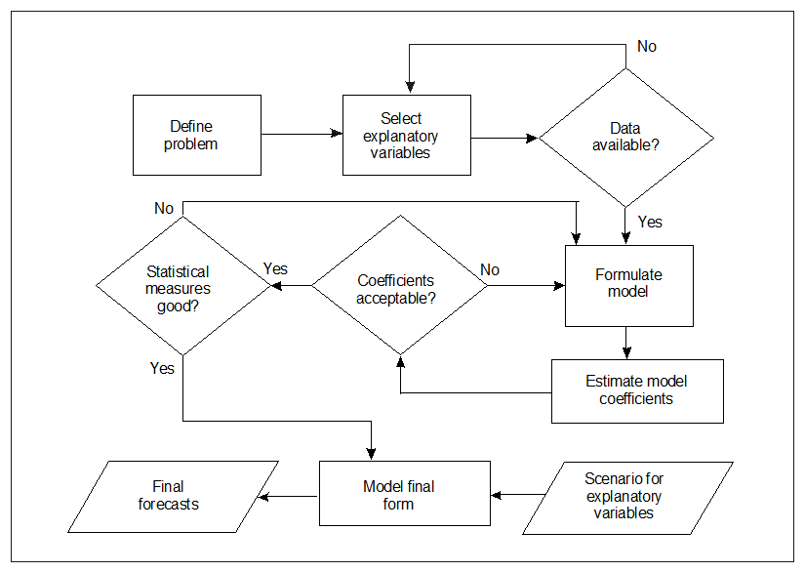
Development of an
Econometric Model

Slide 52
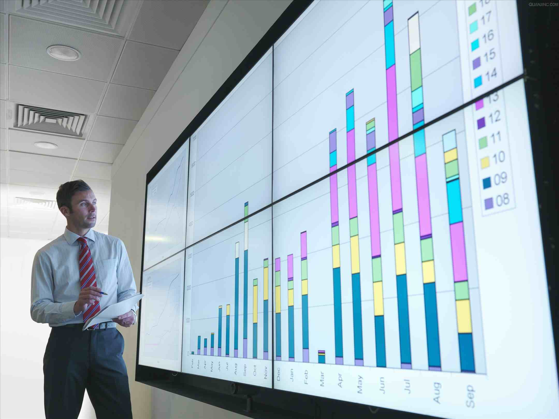
Development of an
Econometric Model
Selection of the Dependent Variable
Demand for air travel is usually measured by:
  Departures
  Number of passengers
  Revenue Passenger Kilometres (RPKs)
  Tonnes of freight
  Freight tonne kilometres (FTKs)
  Therefore, the above indictors are normally used as the dependent variable in the regression analysis.

Slide 53

Polynomial Trend Analysis
Development of an
Econometric Model
Selection of Explanatory Variables
The explanatory variables are expected to represent an important influence on demand in the particular circumstances.
The explanatory variables should be chosen from those that are available from reliable sources.
The explanatory variables should be independently predicted, either by a reliable independent source or by the forecaster

Slide 54
Formulation of the Model
Development of an
Econometric Model
Linear
Y = a + bX₁ + cX₂ + ...zX_{n}
ii) Multiplicative or log-log
Y = aX₁^{b} X₂^{c} ...X_{n}^{z}
log Y = log(a) + b log X₁ + c log X₂ + ...z log X_{n}
iii) Linear‑log
e^{Y} = aX₁^{b} X₂^{c} ... X_{n} ^{z}
Y = log(a) + b log X₁ + c log X₂ + ... z log X_{n}
iv) Log‑linear
log Y = a + bX₁ + cX₂ + ... zX_{n}
Notes:
In order to establish the relationship between the selected independent (explanatory) variables and the dependent variable, i.e. traffic demand, it is necessary to specify the mathematical form of the relationship (model).
The type of functional relationship to be used for an econometric traffic forecast must be developed through judgement, experimentation or through experience and prior knowledge of the market concerned. The validity of the relationship can be established empirically through tests against actual historical data.
Several alternative forms, as suggested beside, should be tested. In each case, Y is traffic, X₁, X₂,…, X_{n} are explanatory variables, and a, b, c... z are constant coefficients.

