Slide 1
State of Air Transport focus on MID Region
ICAO Strategic Objective: Economic Development of Air Transport
ICAO Aviation Data Analyses Seminar
Middle East (MID) Regional Office
27-29 October
Economic Analysis and Policy (EAP) Section
Air Transport Bureau (ATB)

Slide 2
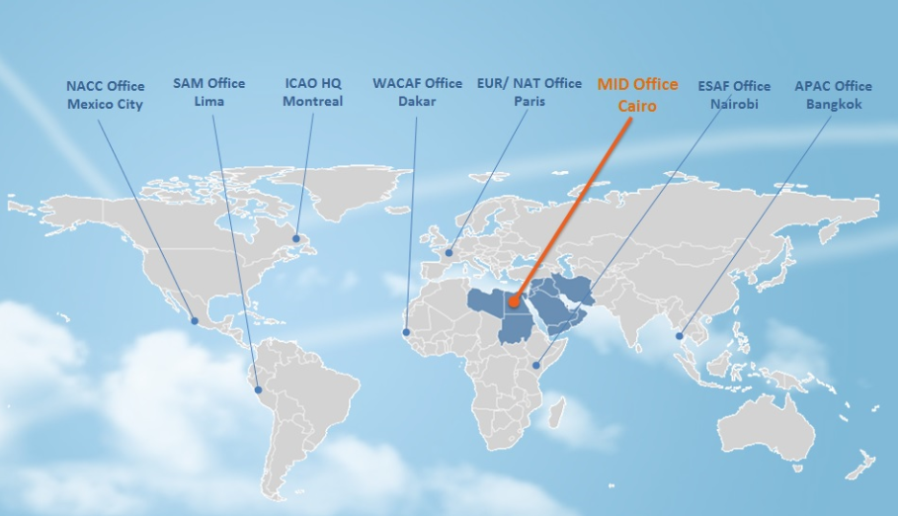
MID Office: 15 ICAO Member States
Bahrain
Egypt
Iran, Islamic Republic of
Iraq
Jordan
Kuwait
Lebanon
Libya
Oman
Qatar
Saudi Arabia
Sudan
Syrian Arab Republic
United Arab Emirates
Yemen​

Slide 3
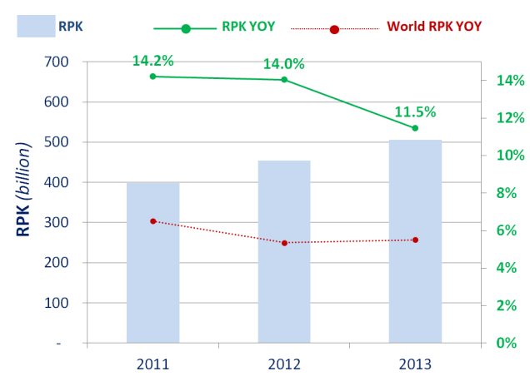
Passenger traffic in MID region in 2013
Revenue Passenger-Kilometres
RPK growth of 11.5% in 2013 supported by the expansion of Emirates (+15.8%), Qatar Airways (+11.0%) and Etihad Airways (+19.0%)
RPK growth is above the world average and the highest in the world
International and domestic scheduled services
Source: ICAO Form A and ICAO estimates

Slide 4
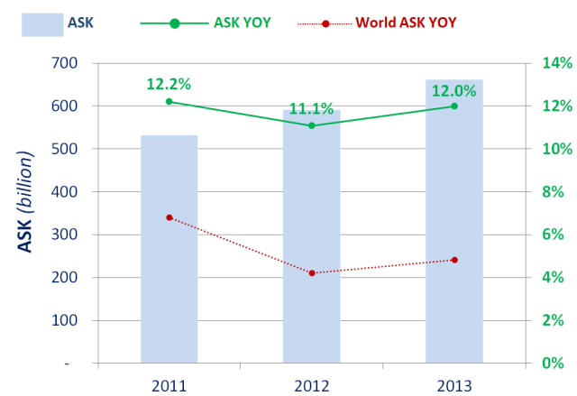
Passenger traffic in MID region in 2013
Available Seat-Kilometres
ASK growth of 12.0% in 2013, + 0.9 percentage point compared to 2012 growth (11.1%)
ASK growth is above the world average
International and domestic scheduled services
Source: ICAO Form A and ICAO estimates

Slide 5
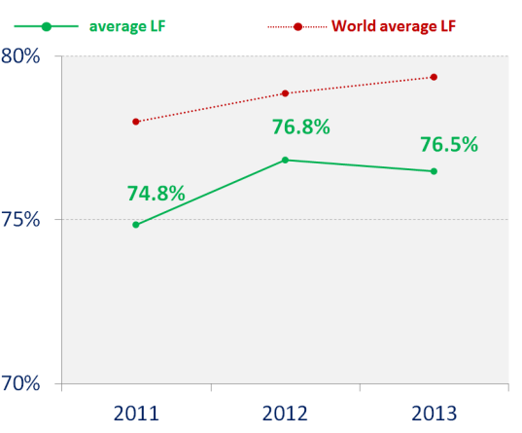
Passenger traffic in MID region in 2013
Passenger Load Factor
The passenger load factor decreased in 2013. It reached 76.5% compared to 76.8% in 2012.
Passenger load factor is below the world average
International and domestic scheduled services
Source: ICAO Form A and ICAO estimates

Slide 6
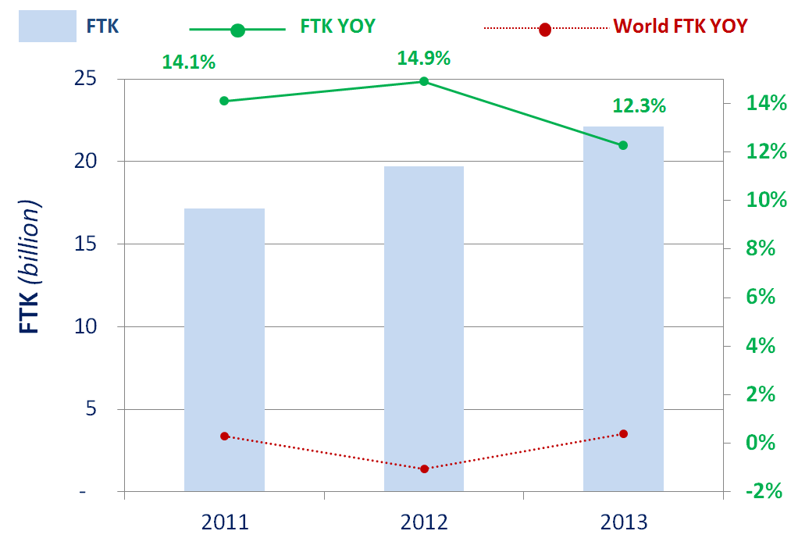
Freight traffic in MID region in 2013
Freight Tonnes-Kilometres
FTK growth of 12.3% in 2013, -2.6 percentage points compared to 2012 growth (14.9%)
FTK growth is lead by Emirates, Qatar Airways and Etihad Airways
The 3 mentioned airlines account for 85.2% of the freight traffic performed by airlines registered in the region.
FTK growth is by far above the world average
Highest FTK growth among world regions
International and domestic scheduled services
Source: ICAO Form A and ICAO estimates

Slide 7
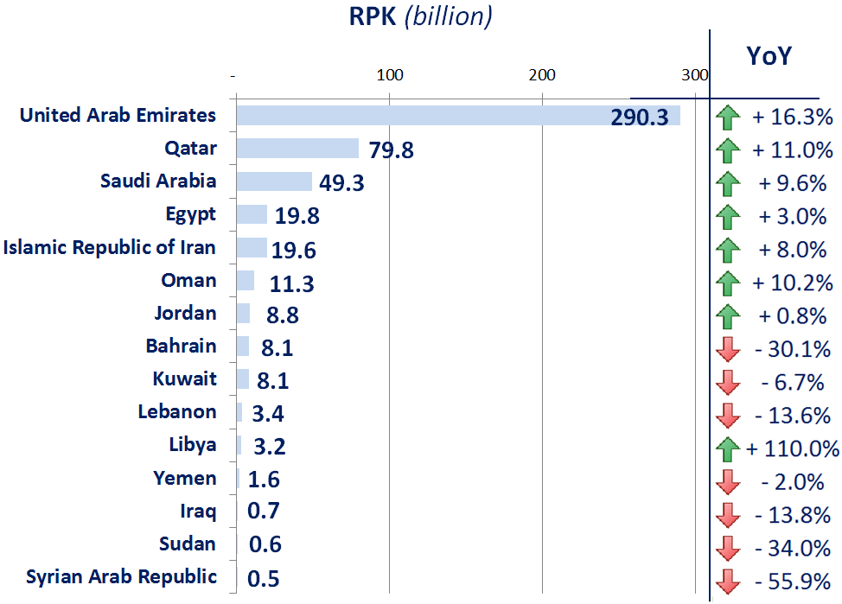
Top 15 States in MID region
Top 15 States
United Arab Emirates is by far the first State ranked by RPK in the MID region
Largest States record strong traffic growth while smaller States’ traffic declines
International and domestic scheduled services
Source: ICAO Form A and ICAO estimates

Slide 8
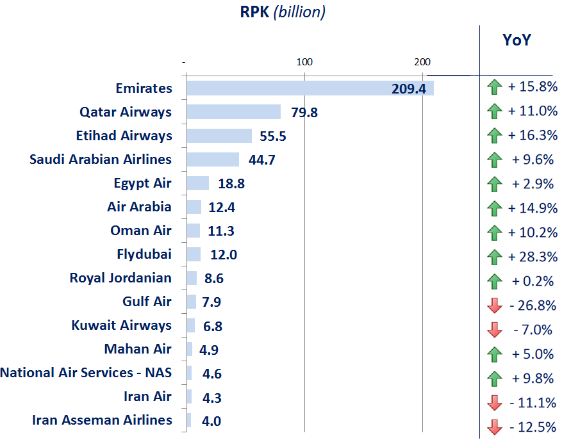
Top 15 airlines in MID region
Top 15 airlines
Emirates, Qatar Airways and Etihad Airways in the top 3 with a double-digit growth
Double-digit growth of LCCs: Air Arabia and Flydubai
International and domestic scheduled services
Source: ICAO Form A and ICAO estimates

Slide 9
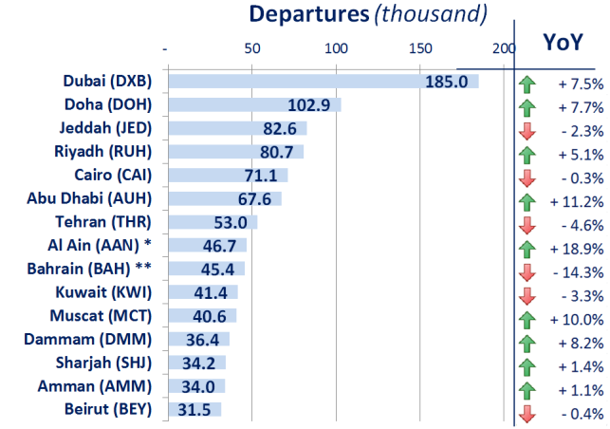
Top 15 airports in MID region 2013
Dubai, Doha and Abu Dhabi recorded respectively 7.5%, 7.7% and 11.2% growths
Abu Dhabi, Al Ain and Muscat recorded double-digit growth in departures in 2013
* Mostly general aviation
** estimate
International and domestic scheduled and non-scheduled services
Source: ACI

Slide 10
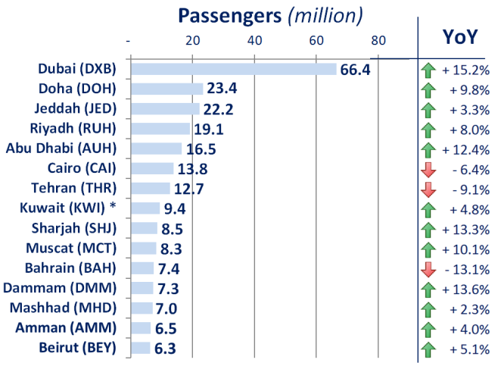
Top 15 airports in MID region 2013
All airports except Cairo, Tehran and Bahrain have recorded a traffic growth in 2013
5 airports recorded a double-digit growth in passenger traffic in 2013: Dubai , Abu Dhabi , Sharjah , Muscat and Dammam.
* estimate
International and domestic scheduled and non-scheduled services
Source: ACI

Slide 11
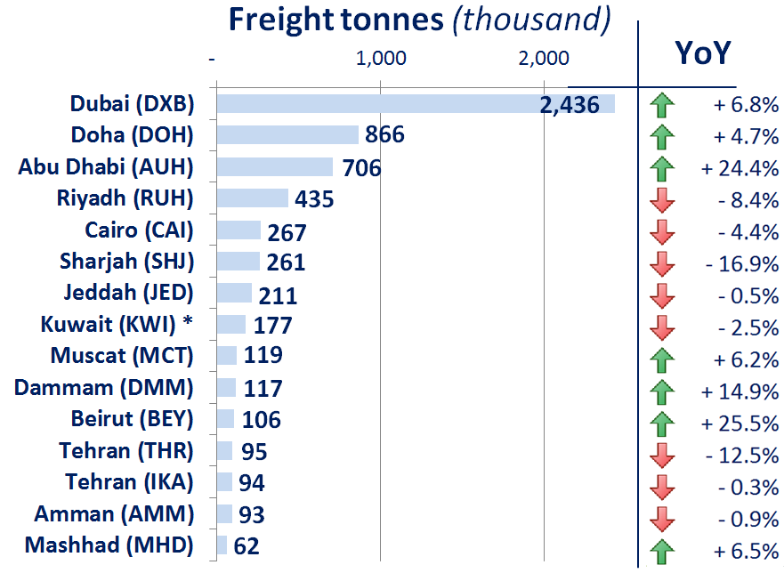
Top 15 airports in MID region 2013
Dubai, Doha and Abu Dhabi are by far the largest airports for cargo operations in the region
Abu Dhabi, Dammam and Beirut recorded a double-digit growth in 2013
* estimate
International and domestic scheduled and non-scheduled services
Source: ACI

Slide 12
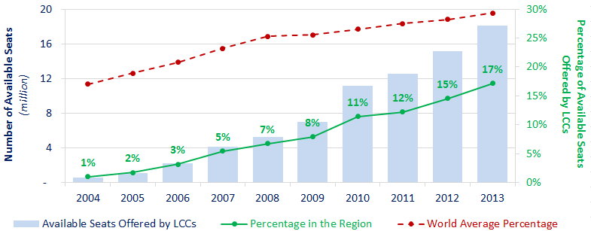
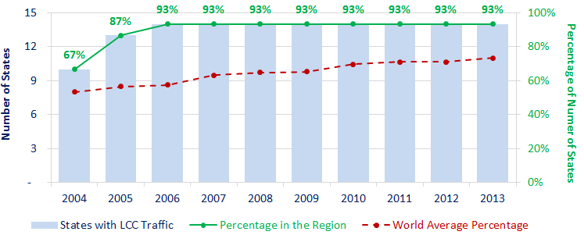
LCC penetration in intra-MID traffic
Seats offered by LCC was only 1% of the total seats offered in 2004
The share of LCC seat grew from 1% in 2004 to 17% in 2013
The share of seats offered by LCC is lower than the world average
LCC offered about 18 million seat to travel within the MID region in 2013
93% of MID States have LCC traffic since 2006 (Only Libya does not have LCC traffic)
Source: ICAO, OAG

Slide 13
© ICAO All rights reserved.
This document and all information contained herein is the sole property of ICAO. No intellectual property rights are granted by the delivery of this document or the disclosure of its content. This document shall not be reproduced or disclosed to a third party without prior permission of ICAO. This document and its content shall not be used for any purpose other than that for which it is supplied.
The statements made herein are based on the mentioned assumptions and are expressed in good faith. Where the supporting grounds for these statements are not shown, ICAO will be pleased to explain the basis thereof.

