Slide 1
Introduction to Air Transport Statistics
ICAO Strategic Objective: Economic Development of Air Transport
ICAO Aviation Data Analyses Seminar
Middle East (MID) Regional Office
27-29 October
Economic Analysis and Policy (EAP) Section
Air Transport Bureau (ATB)

Slide 2
Main terms and definitions used in air transport statistics

Slide 3
Civil Aviation Activities Classification
Civil aviation activities
Commercial air transport services
General aviation (GA)
Airport services
Air navigation services
Civil aviation manufacturing
Regulatory functions
Maintenance and overhaul
Aviation training
Other activities

Slide 4
Civil Aviation Activities
Commercial Air Transport Services
Commercial air transport services
Scheduled
Non-scheduled
Charter
On demand
Others
Air taxis
Commercial business aviation
Others

Slide 5
Scheduled vs. non-scheduled
Distinction very blurry in Europe and North America
May distort annual growth figures
In many other States distinction still exist
Poor reporting of non-scheduled traffic
Non-scheduled traffic difficult to estimate

Slide 6
Some definitions used in
air carriers statistics
  Commercial air transport operator: An operator that, for remuneration, provides scheduled or non-scheduled services of passengers, freight or mail. Also includes small-scale operators, such as air taxis, that provide commercial air transport services.
  Operating carrier: Carrier whose flight number is being used for air navigation control purposes. All operational and traffic items should be reported, including code-shared, franchised, pooled, blocked-off charter, blocked-space arrangements, joint services and leased aircraft services.
  Traffic: For air transport purposes, traffic means the carriage of passengers, freight and mail.

Slide 7
Some definitions used in
air carriers statistics
  Aircraft departures: Number of take-offs of aircraft. For statistical uses, departures are equal to the number of landings made or flight stages flown.
  City-pair: Two cities between which travel is authorized by:
    a passenger ticket or part of a ticket (a flight coupon) or
    a shipment document or a part of it (freight bill or mail delivery bill)

Slide 8
Some definitions used in
air carriers statistics
  Distances: Aerodrome-to-aerodrome great circle distances should be used in all items involving distance
  Great Circle distance is defined as the shortest distance between two points on the surface of the Earth by using the Vincenty distance formula associated with the World Geodesic System – 1984 (WGS 84) adopted by ICAO (Annex 15). The latitude and longitude of aerodromes can be taken from aerodrome data published in Aeronautical Information Publication (AIP).

Slide 9
Flight Stage Definition
Flight Stage: the operation of an aircraft from take-off to its next landing
International when one or both terminals are in the territory of a State, other than the State in which the air carrier has its principal place of business.
Domestic when both terminals are in the territory of the State, where the air carrier has its principal place of business .
  Includes flight stages between the State and the territories belonging to it, and between two such territories. This applies even though a stage may cross international waters or over the territory of another State.

Slide 10
Domestic vs. International
Illustration
Carrier having an AOC from State A
Carrier having an AOC from another State than A
International flight stage
International flight stage
State A
State B
State A
State B
Domestic flight stage
Cabotage = International flight stage

Slide 11
Domestic vs. International
Case for Territories
A territory of State A is considered as being the State A
International flight
International flight
Domestic flight
State A
State B
State A
State B
International flight
Domestic flight
International flight
Territory of State A
Territory of State A
International flight
International flight
Carrier having an AOC from State A
Carrier having an AOC from another State than A

Slide 12
Definition of a Passenger
All forms (except form C)
Form C (only international scheduled traffic)
If the flight coupon includes only international flight stage(s)
Form C is traffic by flight stage:
Each passenger is counted once on each flight stage
If the flight coupon includes only domestic flight stage(s)
1 Passenger = a flight coupon
Enable to compute the
Revenue Passenger-kilometres (RPK)
If the flight coupon includes both domestic and international flight stage(s)
Same rules for the tonnes of freight carried
2 Passengers = a flight coupon
1 counted as domestic, 1 counted as international

Slide 13
Definition of a Passenger
Illustration 1
Flight EK384
1 flight coupon
DXB
BKK
HKG
international stage
international stage
1 flight coupon = 1 international passenger
Note: except for form C definition

Slide 14
Definition of a Passenger
Illustration 2
Flight AA959
1 flight coupon
LAX
NYC
PAR
domestic stage
international stage
1 flight coupon = 1 domestic passenger +1 international passenger
Note: except for form C definition

Slide 15
Definition of a Revenue Passenger
Revenue passenger:
a passenger carried for which the airline receives remuneration
It includes passengers traveling:
  a) under publicly available promotional offers or loyalty programmes
  b) as compensation for denied boarding
  c) on corporate discounts
  d) on preferential fares (government, military, youth, student, etc.)

Slide 16
Definition of a Revenue Passenger
Revenue passenger:
a passenger carried for which the airline receives remuneration
It excludes, for example:
  a) persons travelling free;
  b) persons travelling at a fare or discount available only to employees of air carriers or their agents or only for travel on business for the carriers;
  c) infants who do not occupy a seat

Slide 17
Definition of
Revenue Passenger-Kilometres
Revenue passenger kilometres (RPK) – also called Passenger kilometres perfromed (PKP):
one revenue passenger-kilometre means that one passenger is carried on one kilometre.
RPK for an airline:
Sum of the products obtained by multiplying the number of revenue passengers carried on each flight stage by the corresponding stage distance. The resultant figure is equal to the number of kilometres travelled by all passengers.
$$\sum_{flight stage i}{\left(passengers carried on flight stage i\right)×(distance of flight stage i) }$$
It requires data by flight stage

Slide 18
Revenue Passenger-Kilometres
Illustration
Flight AA959
FRA
LON
NYC
x2
x3
through LON
FRA
NYC
x4
Computation of the RPK: the 1st step is to break down the data by flight stage
FRA
LON
NYC
x2
+
x4
x3
+
x4

Slide 19
Revenue Passenger-Kilometres
Illustration
Flight AA959 (broken down by flight stage)
600 km
5500 km
FRA
LON
NYC
x6
x7
Computation of the RPK: the 2nd step is to multiply the number of passengers by the distance on each flight stage
$$Revenue Passenger−Kilometres = 6×600 + 7×5500 = 42 100$$

Slide 20
Definition of
Available Seat-Kilometres
Available seat-kilometres (ASK):
one available seat-kilometre means that one seat is flown on one kilometre.
ASK for an airline:
The sum of the products obtained by multiplying the number of seats available for sale on each flight stage by the corresponding stage distance. Seats not actually available for the carriage of passengers because of higher amount of fuel required or other payload/operational restrictions should be excluded from the calculations.
$$\sum_{flight stage i}{\left(seats available on flight stage i\right)×(distance of flight stage i) }$$

Slide 21
Available Seat-Kilometres
Illustration
Flight AA959
600 km
5500 km
FRA
LON
NYC
x10
x10
Computation of the ASK: multiply the number of seats by the distance on each flight stage
$$Available Seat−Kilometres=10×600 +10×5500 =61 000$$

Slide 22

Definition of
Passenger Load Factor
Passenger Load Factor (PLF):
the revenue passenger-kilometres as a percentage of the available seat-kilometres
$$PLF= \frac{RPK}{ASK}$$

Slide 23
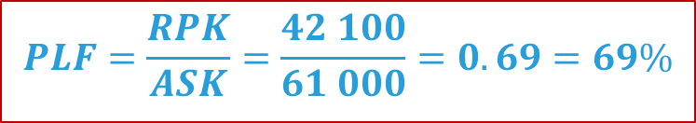
Passenger Load Factor
Illustration
Flight AA959
600 km
5500 km
FRA
LON
NYC
x6
x7
x10
x10
$$PLF=\frac{RPK}{ASK}=\frac{42 100}{61 000}=0.69=69\%$$

Slide 24
Definition of
Passenger Tonne-Kilometre
Passenger tonne-kilometres for an airline:
sum of the products obtained by multiplying the number of tonnes of passenger revenue load carried on each flight stage by the corresponding stage distance.
$$\sum_{flight stage i}{\left(passenger revenue load on flight stage i\right)×(distance of flight stage i) }$$
Example for the calculation of the revenue load for 1 revenue passenger:
Passenger revenue load = weight of the Passenger + weight of its checked baggage
= 70 kg + 30 kg
= 100 kg
= 0.1 tonne
When no data is available, 0.1 tonne is the standard weight suggested by ICAO
for a passenger plus its baggage

Slide 25
Definition of
Passenger Tonne-Kilometre
Example for the calculation of the Passenger Tonne-Kilometre:
600 km
5500 km
FRA
LON
NYC
x6
x7
$$passenger tonne−kilometres= 6×0.1×600 + 7×0.1×5500 = 4210$$
It is also equal to:
$$passenger tonne−kilometres=average revenue load ×RPK =0.1 ×42 100=4210$$

Slide 26
Definition of
Freight Tonne-Kilometre
Freight tonne-kilometres:
$$\sum_{flight stage i}{\left(freight tonnes carried on flight stage i\right)×(distance of flight stage i) }$$
Example for the calculation of the Freight Tonne-Kilometre:
600 km
5500 km
FRA
LON
NYC
0.5 tonnes of freight
0.7 tonnes
of freight
$$Freight tonne−kilometres= 0.5×600 +0.7×5500 =4 150$$

Slide 27
Total capacity available or
Payload Capacity
On each flight stage:
Payload capacity for passengers = A = Number of seats available x average passenger revenue load
Payload capacity for cargo = B = Volume available for cargo x cargo density
Total Payload Capacity = C = A + B
Recommendations:
    average passenger revenue load = Passengers mass + baggage = 100 Kg (ICAO/IATA)
    cargo density = 161 Kg / m3 (ICAO/IATA)
Payload Capacity refers to the capacity available for sale taking into consideration:
Payload restrictions
Operational restrictions
Marketing considerations

Slide 28
Definition of
Available Tonne-Kilometre
Available Tonne-Kilometre:
$$\sum_{flight stage i}{\left(total capacity on flight stage i\right)×(distance of flight stage i) }$$
Example for the calculation of the Available tonne-kilometre:
600 km
5500 km
FRA
LON
NYC
Total Payload Capacity =
2 tonnes
Total Payload Capacity =
2 tonnes
$$Available tonne−kilometres=2×600 +2×5500 =12 200$$

Slide 29

Definition of Weight Load Factor
Weight Load Factor (WLF):
the total revenue tonne-kilometres as a percentage of the available tonne-kilometres
$$WLF= \frac{passenger tonne kilometres + freight tonne kilometres + mail tonne kilometres}{available tonne kilometres}$$
$$WLF= \frac{total tonne kilometres }{available tonne kilometres}$$

Slide 30
Weight Load Factor
Illustration
Flight AA959
600 km
5500 km
FRA
LON
NYC
0.6 tonnes of passenger revenue load
0.7 tonnes of passenger revenue load
Payload
0.5 tonnes of freight
0.7 tonnes of freight
Capacity
Total Payload Capacity = 2 tonnes
Total Payload Capacity = 2 tonnes
$$WLF=\frac{\left(0.6+0.5\right)×600+(0.7+0.7)×5500}{2×600+2×5500}=\frac{8 360}{12 200}=0.69=69\%$$

Slide 31

Aircraft Kilometres
Illustration
Aircraft Kilometres:
$$\sum_{flight stage i}{\left(departures for flight stage i\right)×(distance of flight stage i) }$$
Example for the calculation of the aircraft kilometres:
600 km
5500 km
FRA
LON
NYC
2 departures
2 departures
$$aircraft kilometres=2×600+2×5500=12 200$$

Slide 32

Aircraft hours
Airborne hours
Take-off
Landing
Block hours
First movement of the aircraft
Parking position

Slide 33

Some definitions used in
air carriers statistics
  MCTOM: Maximum certificated take-off mass (MCTOM) (metric tonnes) according to the certificate of airworthiness, the flight manual or other official documents.
  Passenger revenue per traffic-unit (passenger yield): financial measurement which relates the passenger revenues with the passenger traffic.
$$passenger yield= \frac{passenger revenues}{revenue passenger−kilometres}$$

Slide 34


Some definitions used in
air carriers statistics
  Speed flown:
  Stage distance flown per aircraft:
$$speed flown= \frac{aircraft kilometres}{airborne hours}$$
$$average block speed= \frac{aircraft kilometres}{block hours}$$
$$average stage distance flown per aircraft= \frac{aircraft kilometres}{number of departures}$$

Slide 35
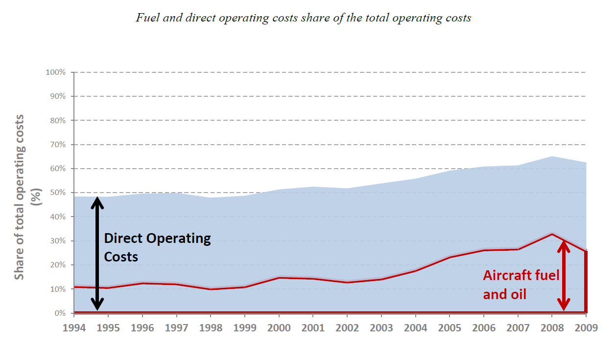
Direct operating costs (DOC)
DOC Definition
Between 1994 and 2009, the world average share of fuel increased from 11% to over 25% of total operating costs.
Source: ICAO (ATConf/6 - WP/22, App. C)
Flight crew salaries and expenses
Aircraft fuel and oil
Flight equipment insurance & uninsured losses
Maintenance & overhaul
Depreciation & amortization (aircraft)
Landing and associated airport charges
Route facility charges

