Slide 1
Air Transport Reporting Forms for Air Carriers
Part I
ICAO Strategic Objective: Economic Development of Air Transport
ICAO Aviation Data Analyses Seminar
Middle East (MID) Regional Office
27-29 October
Economic Analysis and Policy (EAP) Section
Air Transport Bureau (ATB)

Slide 2
List of Air Transport Reporting Forms for Air Carriers
Form | Title
A | Traffic - Commercial air carriers
B | On-Flight Origin and Destination
C | Traffic by Flight Stage
D | Fleet and Personnel – commercial air carriers
E-F | Financial Data – commercial air carriers
M | Fuel Consumption and Traffic
-- | Quarterly Survey on Financial Parameters of Air Carriers
Blank forms and instructions available at: http://www.icao.int/sustainability/Pages/eap-sta-excel.aspx

Slide 3

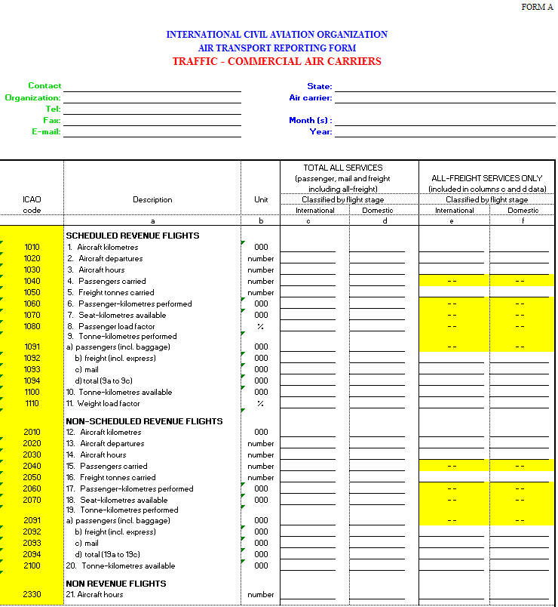
Form A
Commercial Air Carrier Traffic
Form A
Carrier information
Contact information
Period information

Slide 4
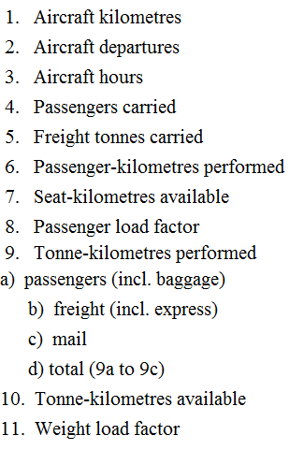
Form A
Commercial Air Carrier Traffic
Form A
For international and domestic services of scheduled and non-scheduled operators:
Operational data
Traffic data
Capacity data

Slide 5
Commercial air carrier traffic
Form A (monthly or annual)
Form A
Who Reports and When?
Who reports monthly?
Each of a State’s carriers having combined traffic of at least 90% of the total tonne-kilometres perfromed (TKP) by the air carriers of that State
AND
Each of a State’s carrier having a total traffic of at least 100 million TKP per year.
Each of a State’s remaining air carriers
  Filed within two months of the end of the reporting month
Who reports annually?
When?

Slide 6
List of Air Transport Reporting Forms for Air Carriers
Form | Title
A | Traffic - Commercial air carriers
B | On-Flight Origin and Destination
C | Traffic by Flight Stage
D | Fleet and Personnel – commercial air carriers
E-F | Financial Data – commercial air carriers
M | Fuel Consumption and Traffic
-- | Quarterly Survey on Financial Parameters of Air Carriers
Blank forms and instructions available at: http://www.icao.int/sustainability/Pages/eap-sta-excel.aspx

Slide 7
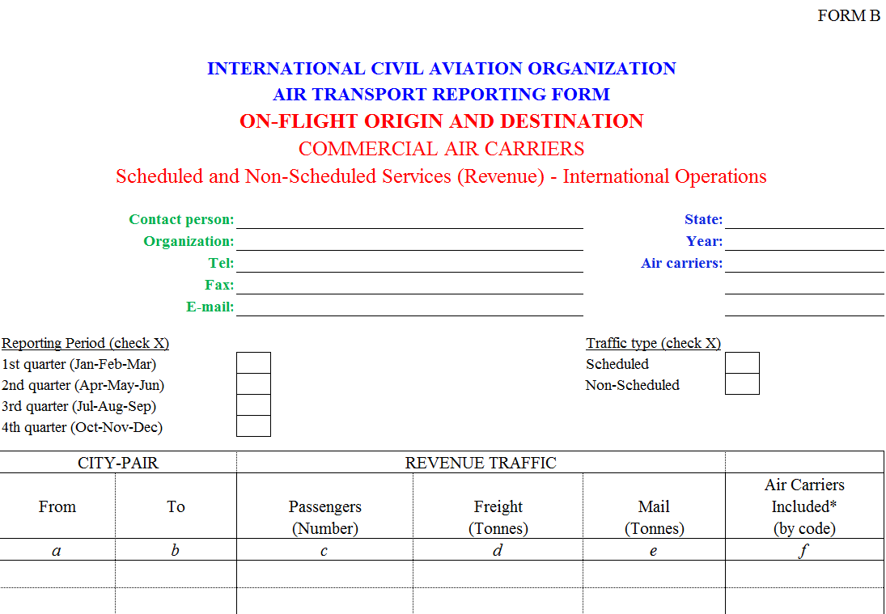
Form B
On-Flight Origin and Destination
Form B (OFOD)
Only international services
Usual information (State, carrier, contact)
Quarterly reporting
Scheduled and non-scheduled services
By city-pair
Traffic data

Slide 8
Form B
On-Flight Origin and Destination
A passenger who bought a coupon from NYC to FRA with a stop in PAR (same flight number) should be reported as NYC -> FRA only
Example:
NYC
PAR
Real itinerary
FRA
NYC
FRA
1
0
0
Form B data

Slide 9
On-Flight Origin and Destination
Form B (quarterly)
Form B
Who Reports and When?
Who reports?
All airlines offering international scheduled and non-scheduled services
  Filed within two months of the end of the reporting month
When?

Slide 10
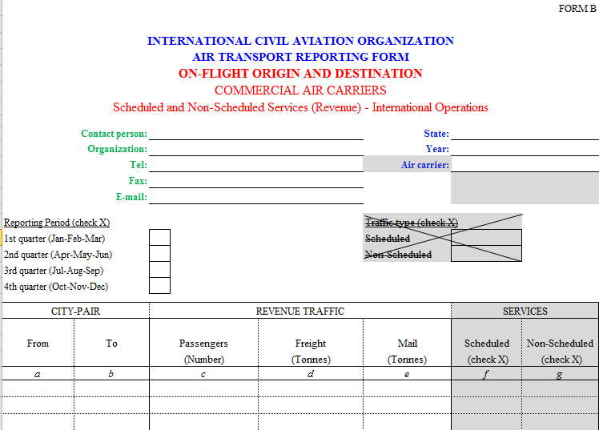
Form B
ADAP Recommandations
A slight modification will be introduce next year:
No need to send two forms anymore
(1 for scheduled, 1 for non-scheduled)
New columns to identify scheduled and non-scheduled at the city-pair level

Slide 11
List of Air Transport Reporting Forms for Air Carriers
Form | Title
A | Traffic - Commercial air carriers
B | On-Flight Origin and Destination
C | Traffic by Flight Stage
D | Fleet and Personnel – commercial air carriers
E-F | Financial Data – commercial air carriers
M | Fuel Consumption and Traffic
-- | Quarterly Survey on Financial Parameters of Air Carriers
Blank forms and instructions available at: http://www.icao.int/sustainability/Pages/eap-sta-excel.aspx

Slide 12
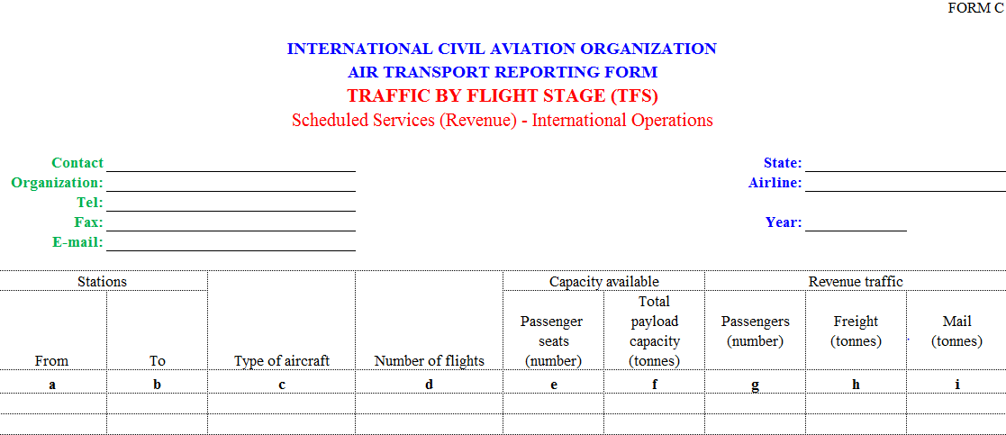
Form C
Traffic by Flight Stage (TFS)
Form C
Only scheduled services
Only international services
By city-pair
By aircraft type
Operational data
Capacity data
Traffic data

Slide 13
Form C
Traffic by Flight Stage
A passenger who bought a coupon from NYC to FRA with a stop in PAR (same flight number) should be reported as:
Example:
NYC
PAR
Real itinerary = Form C data
FRA
NYC
PAR
1
xx
xx
1
xx
xx
PAR
FRA
1
xx
xx
1
xx
xx

Slide 14
Traffic by Flight Stage
Form C (annual)
Form C
Who Reports and When?
Who reports?
All airlines offering international scheduled services
  Filed within two months of the end of the reporting month
When?

Slide 15
List of Air Transport Reporting Forms for Air Carriers
Form | Title
A | Traffic - Commercial air carriers
B | On-Flight Origin and Destination
C | Traffic by Flight Stage
D | Fleet and Personnel – commercial air carriers
E-F | Financial Data – commercial air carriers
M | Fuel Consumption and Traffic
-- | Quarterly Survey on Financial Parameters of Air Carriers
Blank forms and instructions available at: http://www.icao.int/sustainability/Pages/eap-sta-excel.aspx

Slide 16
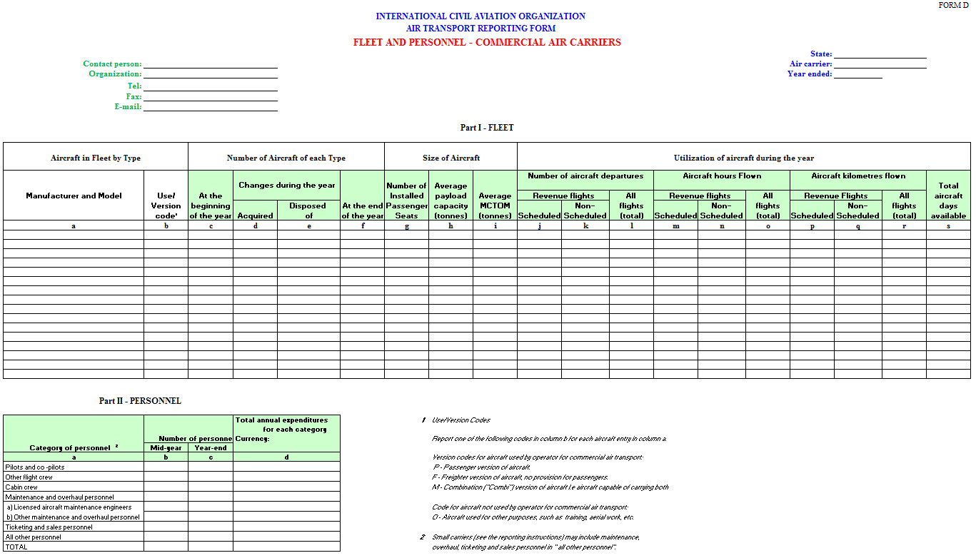
Form D
Fleet and Personnel
Form D
Fleet data
Personnel data

Slide 17
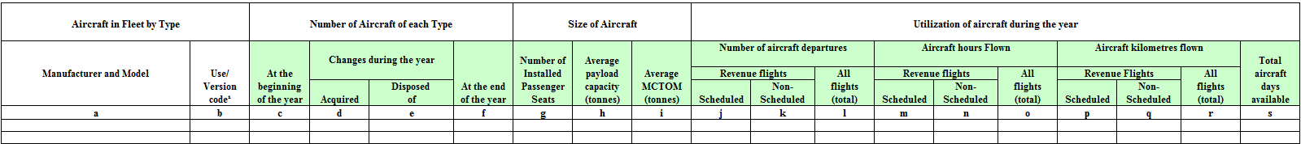
Form D
Fleet and Personnel
Part I - Fleet
Aircraft type
Fleet size
Aircraft info
Aircraft utilization information
Departures
Hours flown
Aircraft Kilometres
Scheduled and non-scheduled

Slide 18
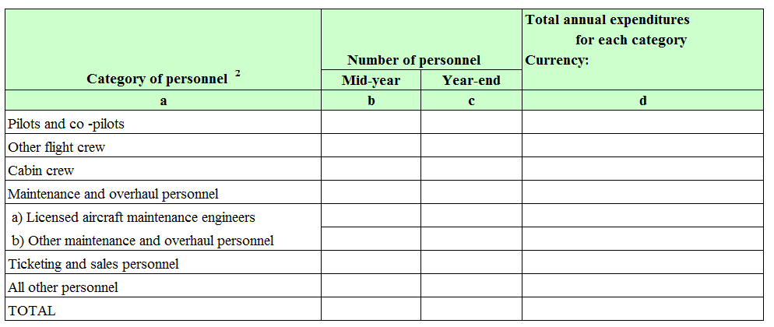
Form D
Fleet and Personnel
Part II - Personnel
Category of personnel
Number of personnel
Cost of personnel

Slide 19
Fleet and Personnel
Form D (annual)
Form D
Who Reports and When?
Who reports?
All airlines offering scheduled and non-scheduled services
  Filed within four months of the end of the reporting month
When?

Slide 20
List of Air Transport Reporting Forms for Air Carriers
Form | Title
A | Traffic - Commercial air carriers
B | On-Flight Origin and Destination
C | Traffic by Flight Stage
D | Fleet and Personnel – commercial air carriers
E-F | Financial Data – commercial air carriers
M | Fuel Consumption and Traffic
-- | Quarterly Survey on Financial Parameters of Air Carriers
Blank forms and instructions available at: http://www.icao.int/sustainability/Pages/eap-sta-excel.aspx

Slide 21
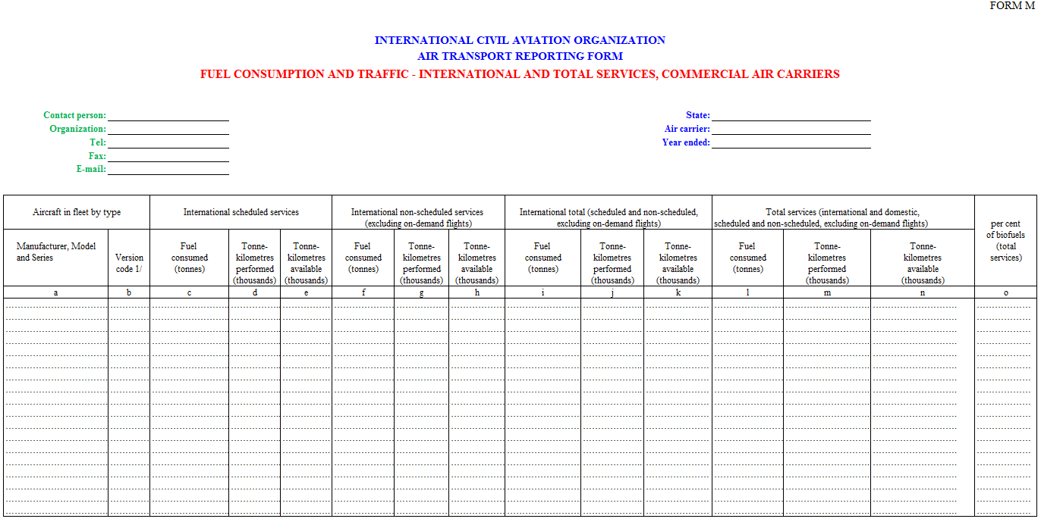
Form M
Traffic and Fuel Consumption
Form M
By aircraft type
Traffic, capacity and fuel data for international
(scheduled and non-scheduled)
Traffic, capacity and fuel data for total services
(scheduled and non-scheduled)
Bio Fuel share

Slide 22
Traffic and Fuel Consumption
Form M (annual)
Form M
Who Reports and When?
Who reports?
All airlines offering scheduled and non-scheduled services
  Filed within two months of the end of the reporting month
When?

Slide 23
Commercial air carrier statistics
What are they used for?
Market analysis
Traffic forecasting
Benchmarking
Bilateral negotiations
Calculating aircraft accident rates

