Slide 1
Air Transport Reporting Forms for Air Carriers
Part II
ICAO Strategic Objective: Economic Development of Air Transport
ICAO Aviation Data Analyses Seminar
Middle East (MID) Regional Office
27-29 October
Economic Analysis and Policy (EAP) Section
Air Transport Bureau (ATB)

Slide 2
List of Air Transport Reporting Forms for Air Carriers
Form | Title
A | Traffic - Commercial air carriers
B | On-Flight Origin and Destination
C | Traffic by Flight Stage
D | Fleet and Personnel – commercial air carriers
E-F | Financial Data – commercial air carriers
M | Fuel Consumption and Traffic
-- | Quarterly Survey on Financial Parameters of Air Carriers
Blank forms and instructions available at: http://www.icao.int/sustainability/Pages/eap-sta-excel.aspx

Slide 3
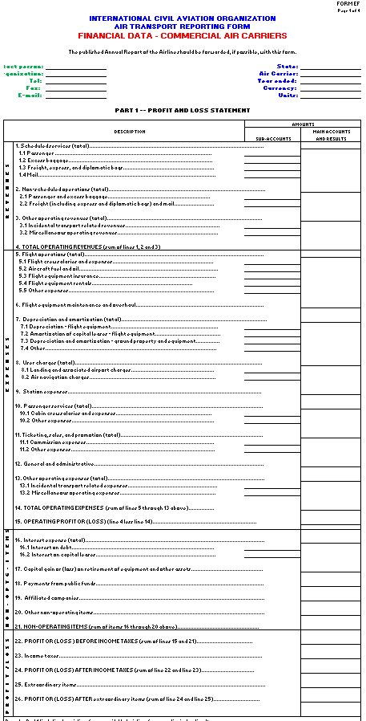
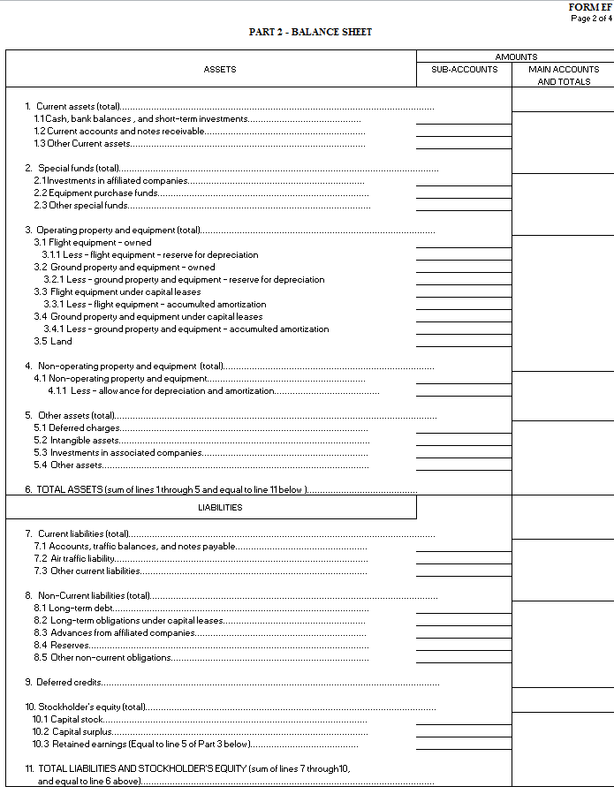
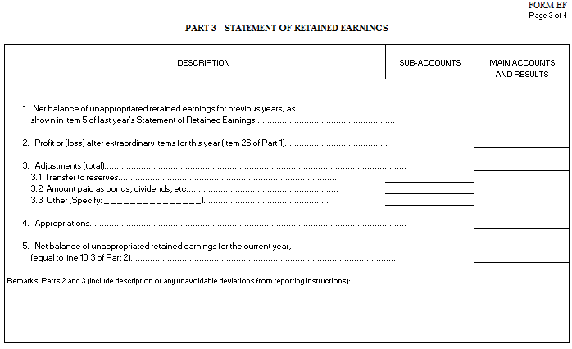
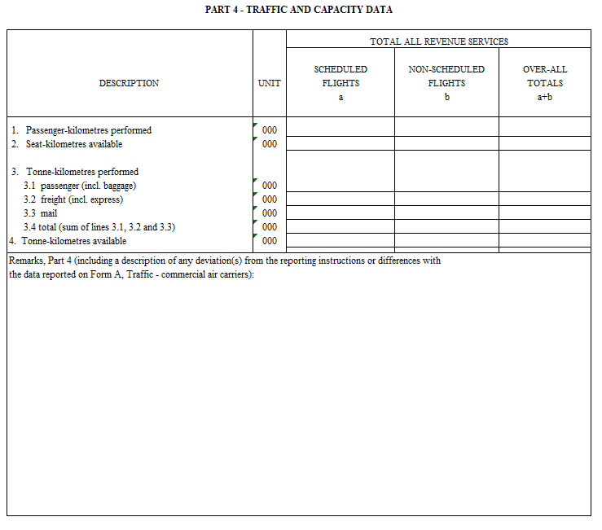
Form E-F
Financial Data
PART III
Statement of retained earnings
Form E-F
PART I
Profit and loss statement
PART II
Balance sheet
PART IV
Traffic and capacity data

Slide 4
Form E-F
Financial Data
Part I - Profit and Loss
Operating revenues by item
(e.g. passenger, freight and mail revenues, etc.)
Operating expenses by item
(e.g. flight operations, station expenses, user charges, etc.)
Non-operating items by item
(e.g. interest expenses, capital gains, etc.)
Extraordinary items

Slide 5
Form E-F
Financial Data
Part II - Balance Sheet
Assets
(e.g. current assets, operating property and equipments, etc.)
Liabilities
(e.g. current and non-current liabilities, stockholder’s equity)

Slide 6
Form E-F
Financial Data
Part III - Retained Earnings
Current and previous year net balance of unappropriated earnings
Appropriations
Adjustments

Slide 7
Form E-F
Financial Data
Part IV - Traffic and capacity data
Traffic and capacity data for the operations corresponding to the revenues and expenses reported in Part I
Need to be consistent with traffic reported in form A

Slide 8
Financial data
Form E-F (annual)
Form E-F
Who Reports and When?
Who reports?
All airlines offering scheduled and non-scheduled services which are required to submit a monthly Form A
  Filed within six months of the end of the reporting month
When?

Slide 9
List of Air Transport Reporting Forms for Air Carriers
Form | Title
A | Traffic - Commercial air carriers
B | On-Flight Origin and Destination
C | Traffic by Flight Stage
D | Fleet and Personnel – commercial air carriers
E-F | Financial Data – commercial air carriers
M | Fuel Consumption and Traffic
-- | Quarterly Survey on Financial Parameters of Air Carriers
Blank forms and instructions available at: http://www.icao.int/sustainability/Pages/eap-sta-excel.aspx

Slide 10
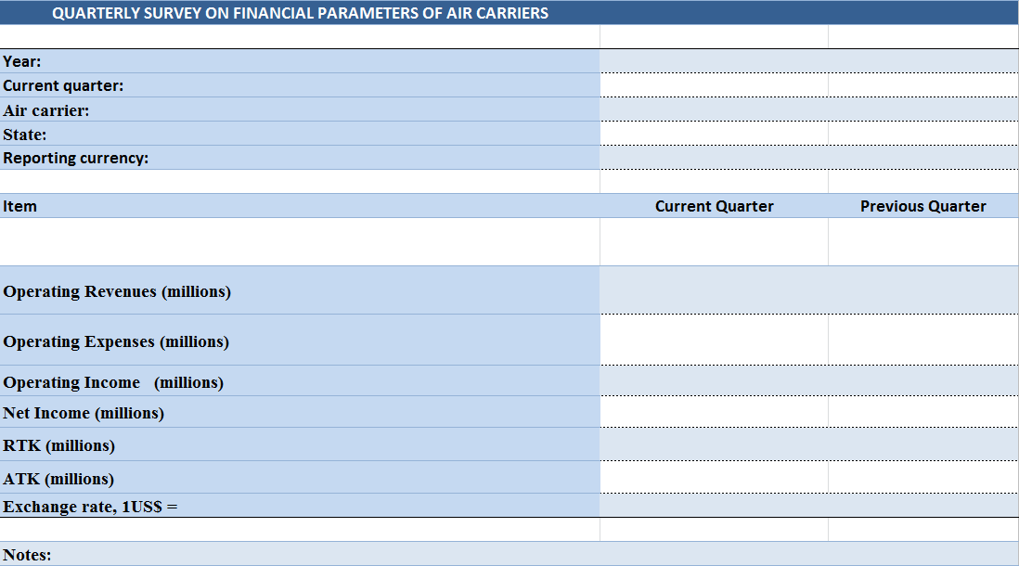
Quarterly Survey on Financial Parameters of Air Carriers
Financial parameters
Traffic and capacity data

Slide 11
Quarterly Survey on Financial Parameters of Air Carriers
Who reports?
All airlines offering scheduled and non-scheduled services
  Filed within six months of the end of the reporting month
When?

