Slide 1
Verification and Validation of
Forms for Air Carriers
ICAO Strategic Objective: Economic Development of Air Transport
ICAO Aviation Data Analyses Seminar
Middle East (MID) Regional Office
27-29 October
Economic Analysis and Policy (EAP) Section
Air Transport Bureau (ATB)

Slide 2
Verification of Form Consistency

Slide 3
Form A
Derived Parameters
Total Services, all-freight services
passenger only services
$$Avg. stage lenght \left(km\right)= \frac{aircraft kilometres}{departures}$$
Total Services, all-freight services
passenger only services
$$Avg. speed \left(km/hour\right)= \frac{aircraft kilometres}{hours flown}$$
Total Services, all-freight services
passenger only services
$$Avg. flight time \left(hour\right)= \frac{hours flown}{departures}$$
$$Avg. passenger mass incl. baggage (kg)= \frac{Passenger tonne kilometres}{Passenger kilometres performed}$$
Total Services,
passenger only services
Passenger only services
$$Avg. number of passenger per departure= \frac{number of passengers}{departures}$$
Total Services, all-freight services
passenger only services
$$Avg. frieght tonnes by departure = \frac{freight tonnes carried}{departures}$$

Slide 4
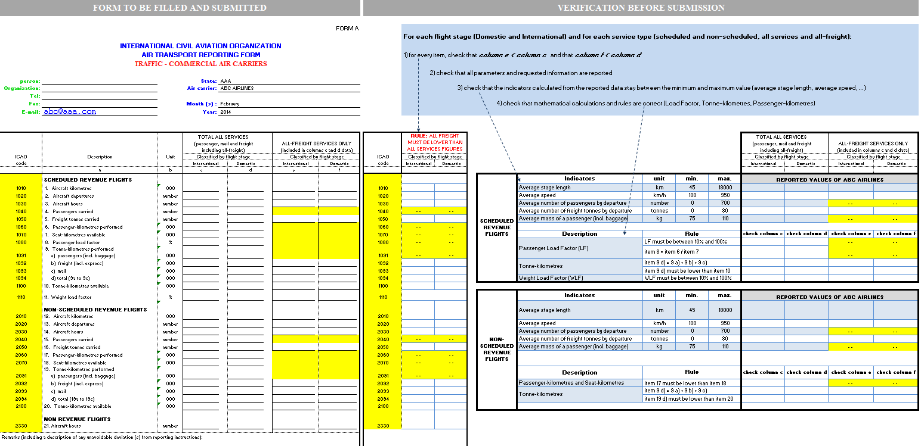
Smart Forms
FORM A
VERIFICATION
INSTRUCTION BOX
Check All-freight
Derived indicators and formulas

Slide 5
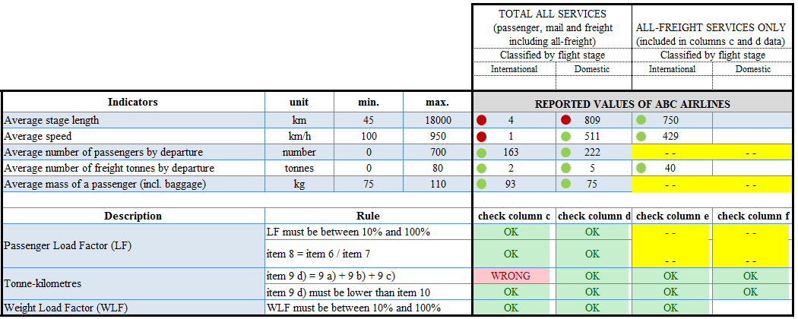
Smart Forms
VERIFICATION BEFORE SUBMISSION
Indicator
Expected value range
Or mathematical rule
Reported values

Slide 6
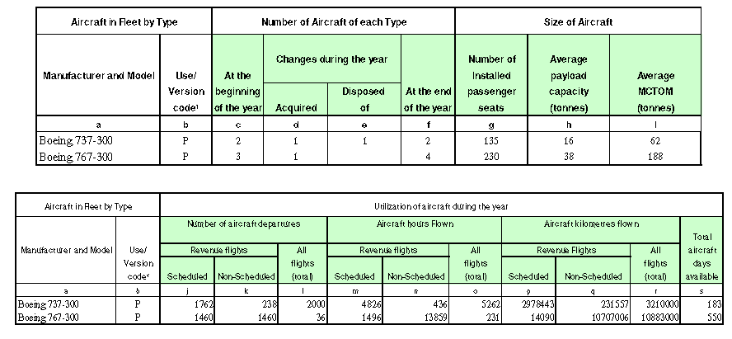
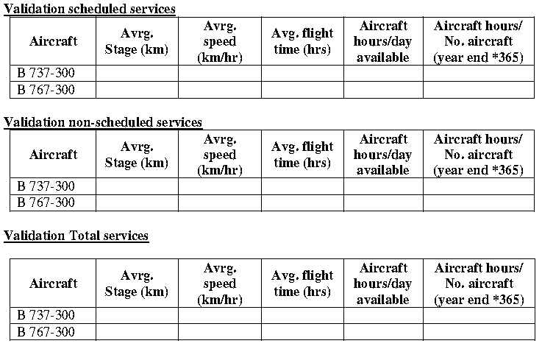
Form D
Derived Parameters
Reported Data – Form D
Derived Indicators
Enable to check the consistency within the form

Slide 7
Relationship Between Forms for Air Carriers

Slide 8
Form A and Form B
Scope: international scheduled and international non-scheduled (form B scope)
Example for international scheduled: for each carrier and for the same period of reporting
$$\sum_{city−pair i}{Passengers numbers on city pair i = Passengers carried }$$
Form B
Form A
$$\sum_{city−pair i}{freight tonnes on city pair i = Freight tonnes carried }$$

Slide 9





Form A and Form C
Scope: international scheduled (form C scope)
For each carrier and for the same period of reporting
$$\sum_{city−pair i}{departures on city pair i = departures}$$
$$\sum_{city−pair i}{departures on city pair i ×distance of city pair i = aircraft kilometres}$$
$$\sum_{city−pair i}{passengers on city pair i ×distance of city pair i = revenue passenger kilometres}$$
$$\sum_{city−pair i}{freight tonnes on city pair i ×distance of city pair i = freight tonne kilometres}$$
$$\sum_{city−pair i}{mail tonnes on city pair i ×distance of city pair i = mail tonne kilometres}$$
Form C
Form A

Slide 10
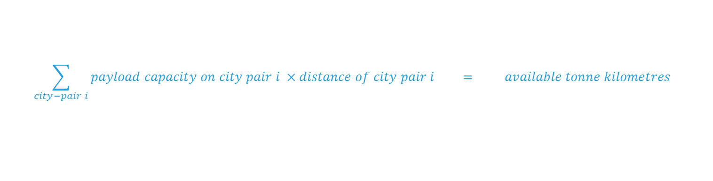
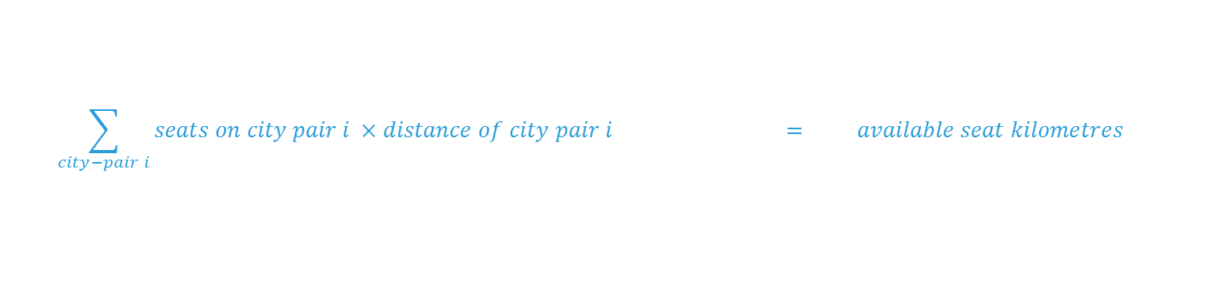
Form A and Form C
Scope: international scheduled (form C scope)
For each carrier and for the same period of reporting
$$\sum_{city−pair i}{seats on city pair i ×distance of city pair i = available seat kilometres}$$
$$\sum_{city−pair i}{payload capacity on city pair i ×distance of city pair i = available tonne kilometres}$$
Form C
Form A

Slide 11

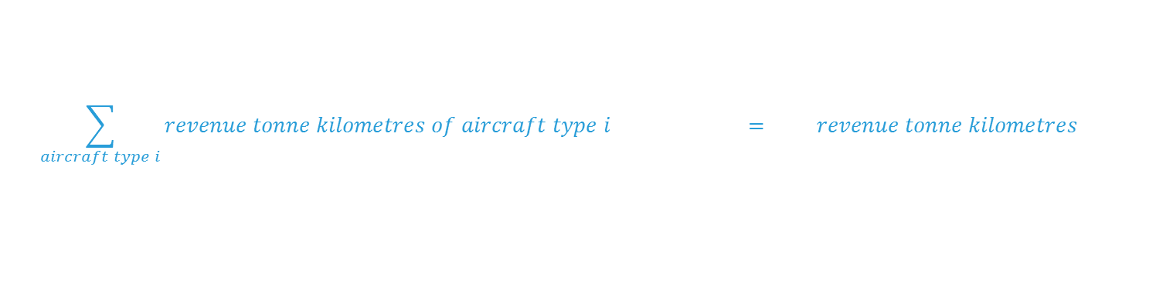
Form A and Form M
Scope: international scheduled, international non-scheduled, total (domestic and international) scheduled and non-scheduled (form M scope)
Example for international scheduled: For each carrier and for the same period of reporting
$$\sum_{aircraft type i}{revenue tonne kilometres of aircraft type i = revenue tonne kilometres}$$
$$\sum_{aircraft type i}{available tonne kilometres of aircraft type i = available tonne kilometres}$$
Form M
Form A

Slide 12
Form A and Form D
Scope: total (domestic and international) scheduled and total non-scheduled (form D scope)
Example for total scheduled: For each carrier and for the same period of reporting
Departures = Departures
Aircraft hours = Aircraft hours
Aircraft kilometres = Aircraft kilometres
Form D
Form A

Slide 13
Example of Validation Tools and Analysis of the ICAO Statistics Programme

Slide 14
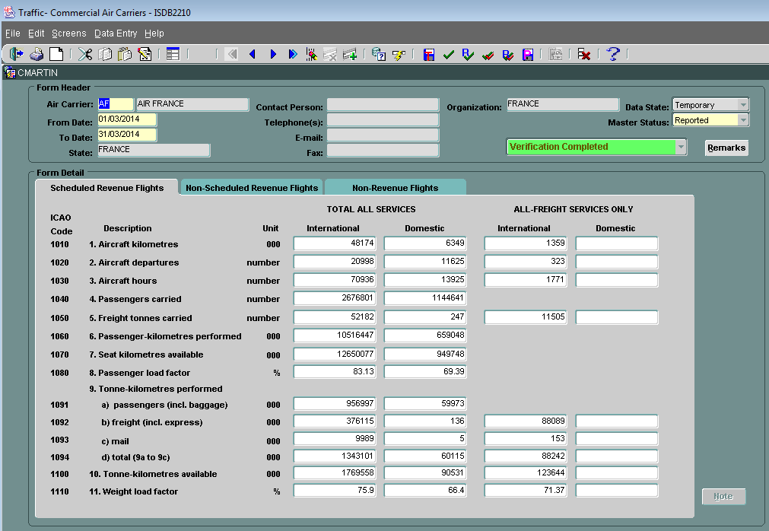
ISDB – Oracle System
USER INTERFACE
Limited data manipulation
One form/airline/period at a time

Slide 15
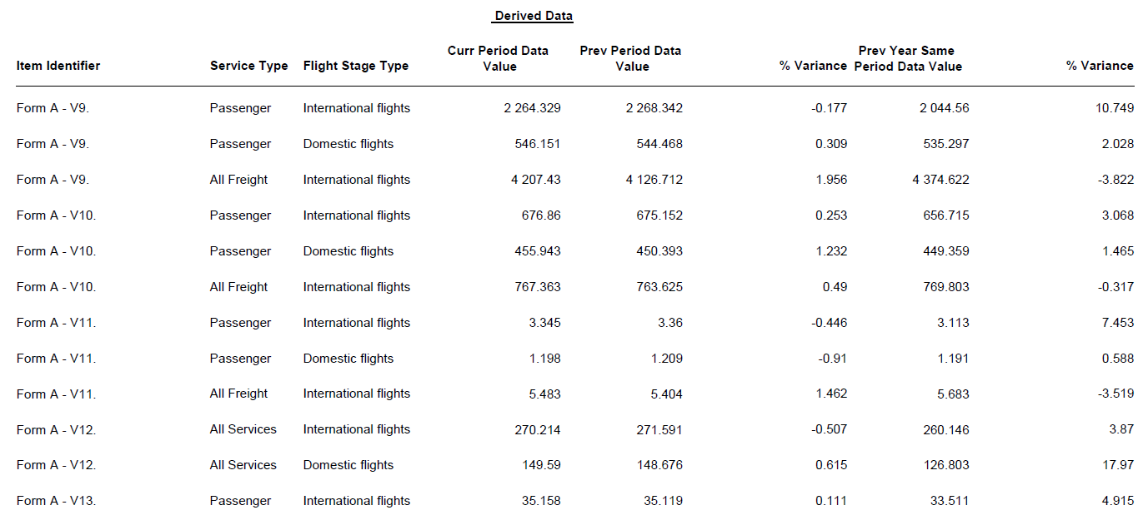
ISDB – Oracle System
VALIDATION REPORTS

Slide 16
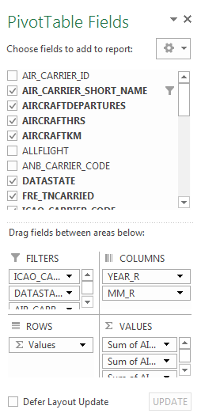
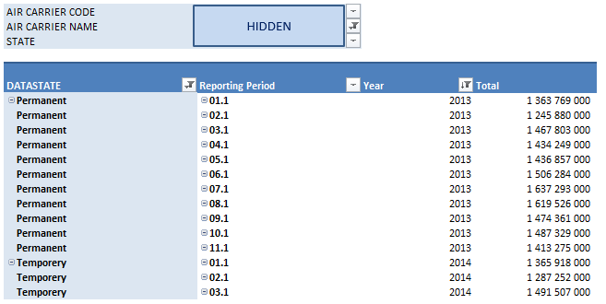
Pivot tables linked to ISDB
DIRECT ACCES TO DATA ON EXCEL

Slide 17
ISDB data through pivot tables
CHARACTERISTICS
→ Raw data from ISDB
→ Can be refreshed in few seconds
BENEFITS
→ Easy manipulation of the data on excel
1) Management of forms received/temorary/validated
2) Analysis of the data
a) Derived indicators : growth rates, average indicators
b) Graphical vizualization of the data and indicators
c) Integration of other sources through BI excel tool
EXAMPLES

Slide 18
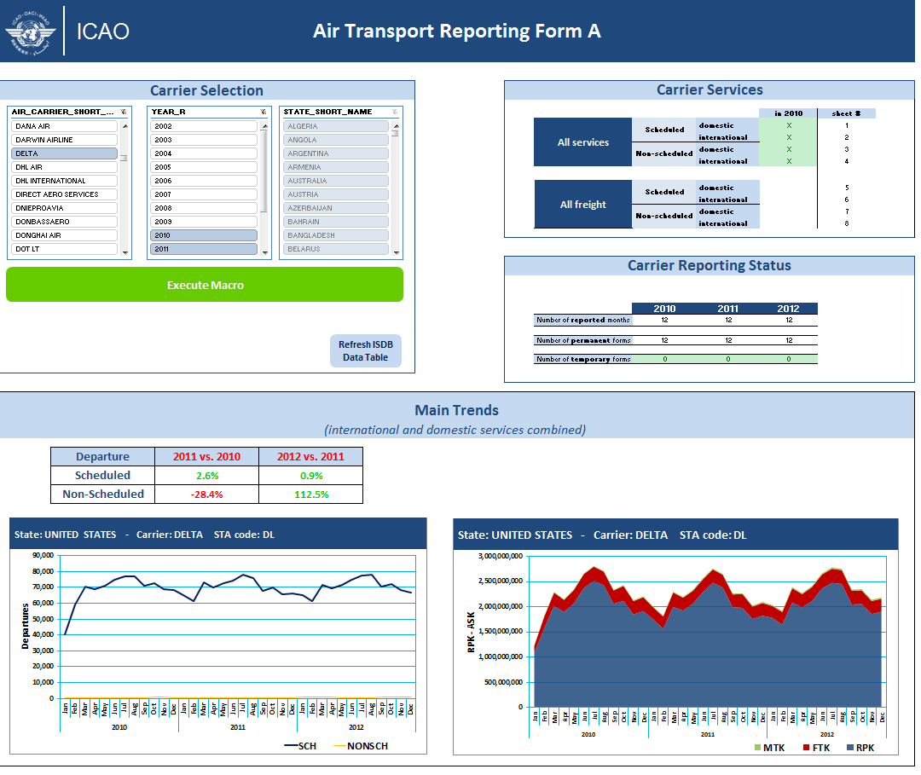
Internal Analysis Tools
Dashboard
linked to Oracle database
Enable to manage forms and get quick information

Slide 19
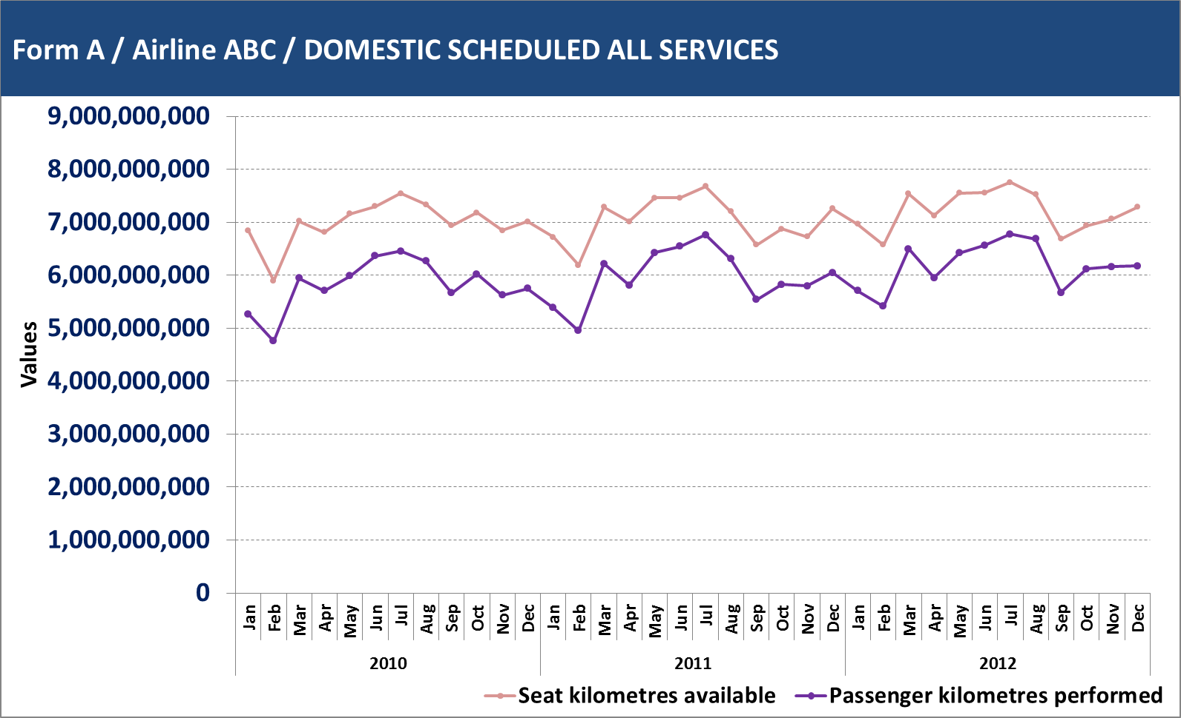
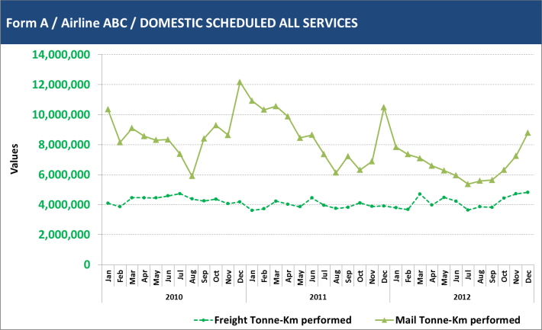
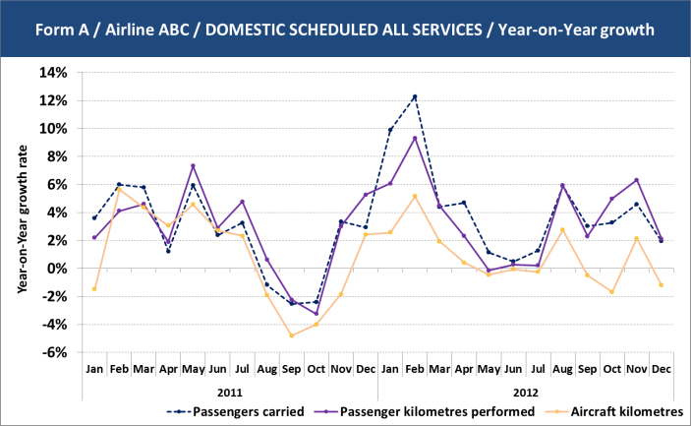
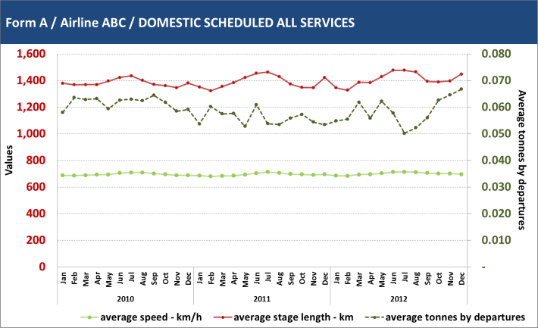
Internal Analysis Tools
GROWTH RATES
REPORTED DATA
Validation: Cross-check against historical data
Analysis of trends and seasonality
Detection of missing data
DERIVED INDICATORS

Slide 20
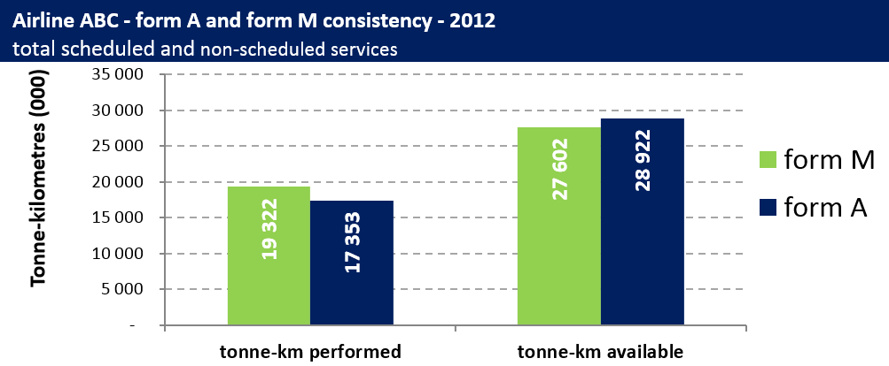
Cross-check with Internal Sources
Cross form validation
Issue of consistency between forms

Slide 21
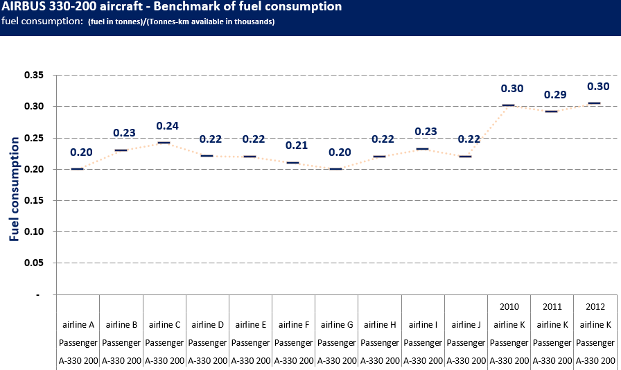
Cross-check Across Airlines
Benchmarking Analysis
Issues of consistency within a form and across airlines

Slide 22
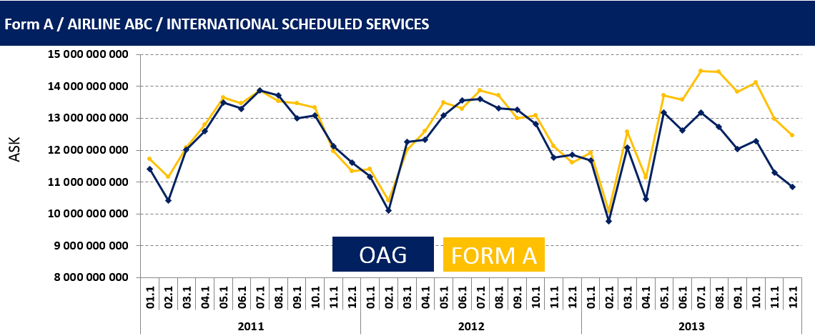
Cross-check with External Sources
Consistency with OAG
Detection of issues

