Slide 1
Air Transport Reporting Form K for ANSPs
ICAO Strategic Objective: Economic Development of Air Transport
ICAO Aviation Data Analyses Seminar
Middle East (MID) Regional Office
27-29 October
Economic Analysis and Policy (EAP) Section
Air Transport Bureau (ATB)

Slide 2
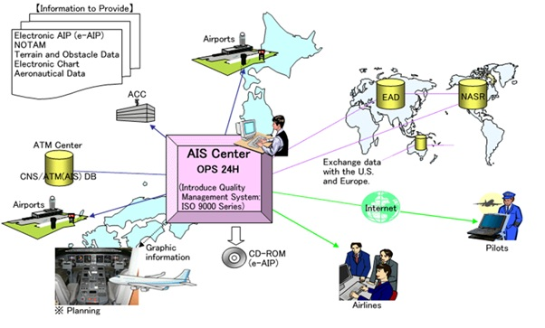
Some definitions used in
ANSP Statistics
  AIS (aeronautical information services) provides information on the availability of air navigation services and their associated procedures necessary for the safety, regularity and efficiency of air navigation (i.e. AIP, AIC, NOTAM, etc.).

Slide 3

Some definitions used in
ANSP Statistics
  ATM (air traffic management) provides air traffic services (ATS), air traffic flow management and airspace management.
  ATS comprises:
    - Air traffic control service (area control service, approach control service, or aerodrome control service)
    - Flight information service (including air traffic advisory service) and
    - Alerting service.

Slide 4
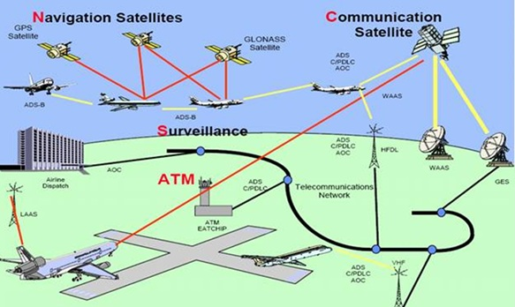
Some definitions used in
ANSP Statistics
  CNS (communications, navigation and surveillance) includes communication facilities, navigation services and surveillance systems. Communication facilities (two main categories: aeronautical fixed service and aeronautical mobile service).

Slide 5
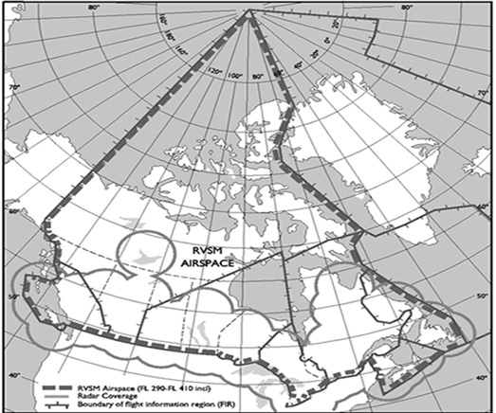
Some definitions used in
ANSP Statistics
  FIR/UIR: Flight information region/upper flight information region.

Slide 6
Some definitions used in
ANSP Statistics
  Flight: The movement of an aircraft during its en-route phase through the airspace of an FIR/UIR.
    Each such movement following a landing within the FIR/UIR is to be counted as a separate flight.

Slide 7
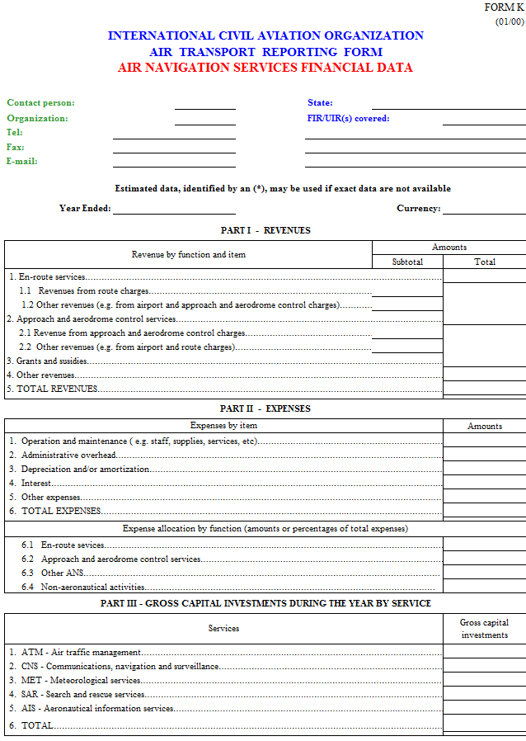

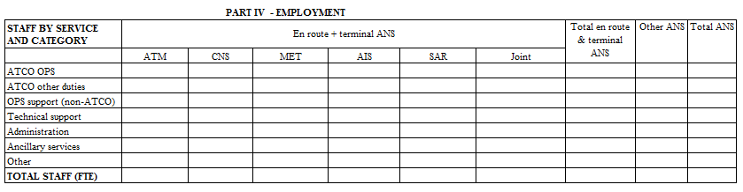
Form K
ANSP Financial Data
FIR, State, contact and reporting period information
Part I - Revenues
Part II - Expenses
Part III - Investment
Part IV - Employment

Slide 8
Ansp Financial Data
Form K (annualy)
Form K
Who Reports and When?
Who reports monthly?
Each entity which provides air navigation services in a State
  Filed within six months of the end of the reporting period
When?

