Slide 1

SCC - Service Control Center

Slide 2
SCC - Responsibilities
Incident Management
- Single Point of Contact
- Interface to Second Level
First Level Support
- Monitoring & Control of Equipment and Services
- Incident troubleshooting
- Operating of Message Switching Systems

Slide 3
SCC - Domains
MET
CNS
Com Nav Surveillance
ATM
Air Traffic Management
AIM
Aeronautical
Information M.

Slide 4
CNS
Communication Navigation Surveillance
COM
Voice
Surveillance
Monitoring
Equipment
NAV
Support

Slide 5
ATM
Air Traffic Management
Flight
Data
Prozessor
Radar
Tracker
Monitoring
Equipent
Support
Equipment
Data
Storage

Slide 6
AIM & MET
COM Centre
ROC / IROG
RTH
Home-
briefing
Monitoring
Equipment
Support
Equipment
AIM Service
MET Service
Notes:
AFTN: Aeronautical Fixed Telecommunikation Center = CIDIN- Center

Slide 7
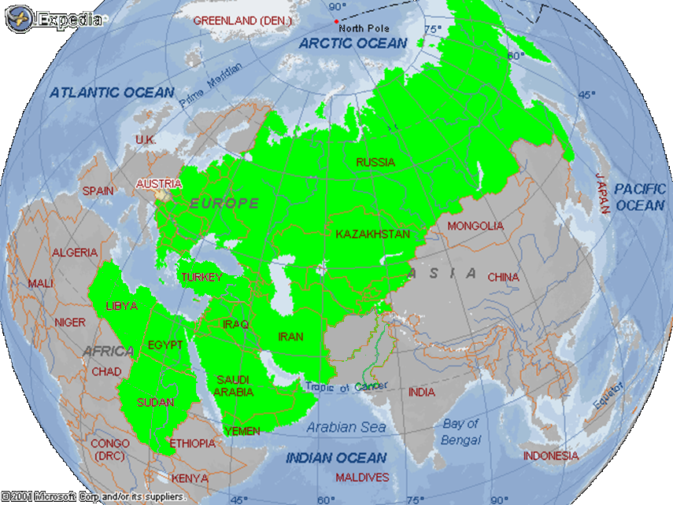
Vienna ROC & IROG – Area of Responsibilty

Slide 8
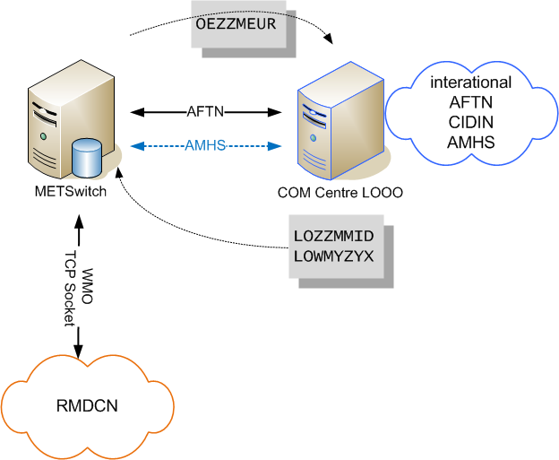
Vienna ROC - Connections

Slide 9
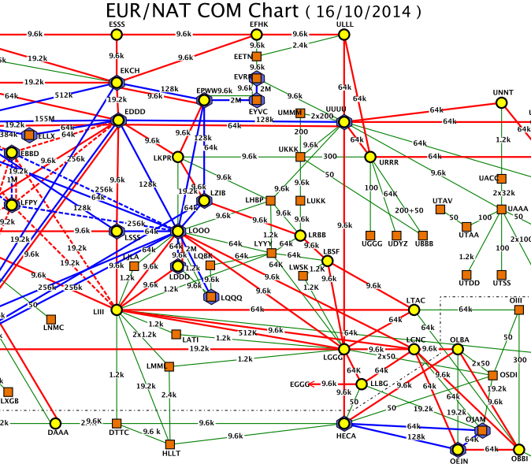
Vienna COM Centre - Connections

Slide 10
Service Control Center Staff
Manager
Mr. Ernst Trauner
Support
5 staff
AIM, MET & ATM
14 staff
CNS & Incident Mgr
8 staff
office hours
2 persons 24/7
1 person 17-07h
2 persons 07-17h

Slide 11
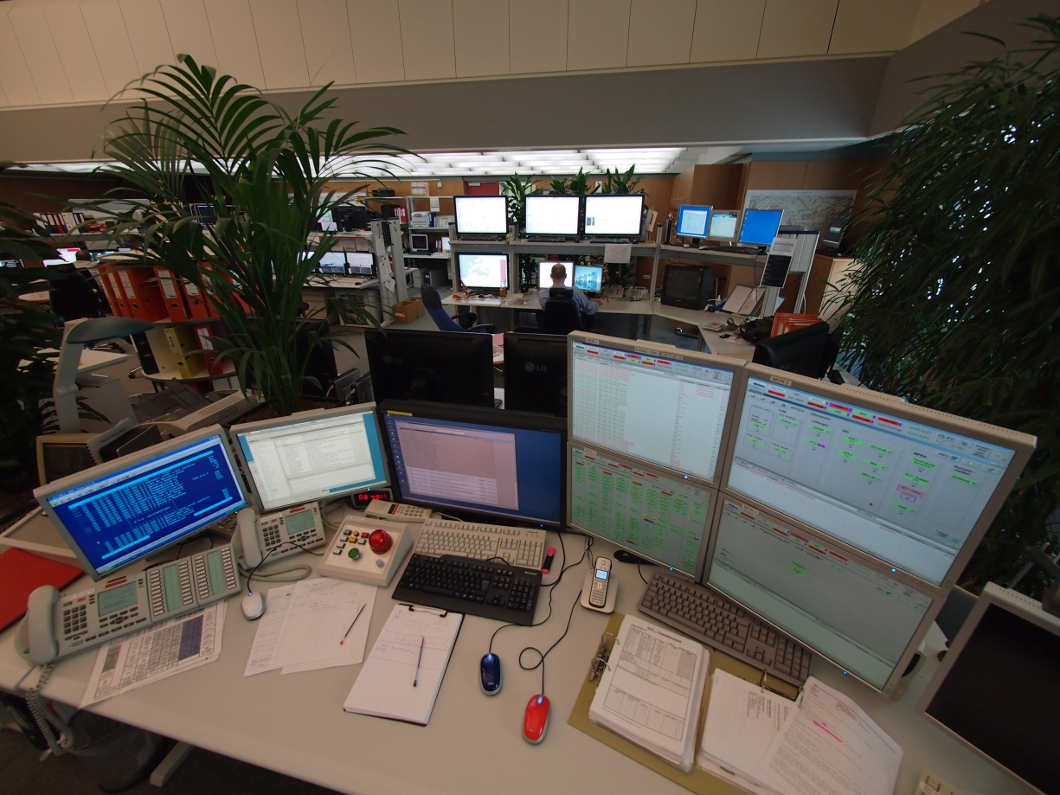
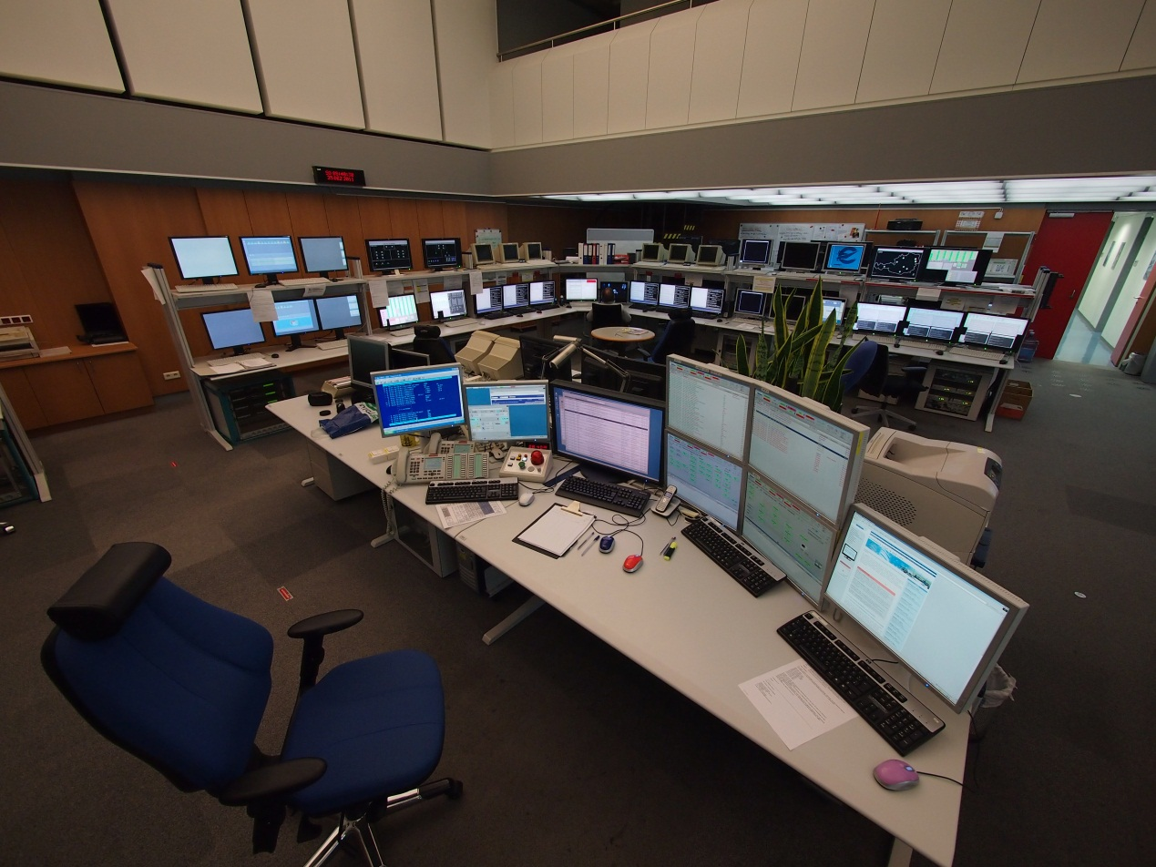
END

