Slide 2
Betim Bekteshi
UN Air Cargo Transportation
Unmanned Aircraft Cargo Project
Aviation Quality Assurance and Standards Officer United Nations Secretariat
Department of Operational Support
Notes:
Good Day to All.
My name is Betim Bekteshi, and I work at the UN Secretariat as an Aviation Quality Assurance and Standards Officer and today I am representing the United Nations UAS/RPAS and Airborne ISR Team.
Today, I’d like to share some key insights on UN air cargo transportation and focus on how we see the evolving role of unmanned aircraft systems (UAS) in our logistics operations.

Slide 3

UN Secretariat Air Cargo/ UAS Facts and Figures
UN Cargo Types
Planned
Crisis Response
Sensitive cargo (DG Class 1, Comms/ IT)
COE quick reaction/ surge capacity
Specialized cargo (helicopters/ planes)
Time constraints
Ground constraints (terrain, security)
Relief cargo (humanitarian)
Logistics re-supply
Air Cargo Movements
2023:
18,275 MT (all)
475 MT (air)
2024:
14,960 MT (all)
5,054 MT (air)
$ 44,942,473.70
$ 62,471,788.71
UN UAS Contracts (2016-2023)
Commercial UAS services (ISR, transport & logistics)
$ 155.3M
Military UAS services (ISR, transport & logistics)
$ 202.23M
TOTAL
$ 395.5 M
Commercial Airborne ISR RW/FW
$ 38M
Total: 51 Contracts awarded for $ 151,243,783.10
Projected 40% increase by end of 2025:
Estimated $553.7 M
Notes:
To use the opportunity, and in the framework of this Summit, I would like to start with some statistics on the UN Cargo movements.
From SC perspective, we classify Cargo Operations in two types: Planned and Crisis Response.
If you look at cargo numbers: In 2023, the UN transported over 18,000 metric tons of cargo, with 475 metric tons via air and in 2024, air cargo has significantly grown, reaching over 5,000 metric tons out of a total 14,960 metric tons moved.
This increase reflects growing reliance on air cargo solutions, particularly for remote and high-risk environments.
We’ve awarded 51 air cargo contracts totaling over $151 million.
In the broader UN context, contracts for UAS/RPAS services — both commercial and military ISR, transport and logistics — total to nearly $395 million from 2016 to 2023. We are projecting a 40% growth by the end of 2025, with total spend estimated to exceed $550 million.

Slide 4
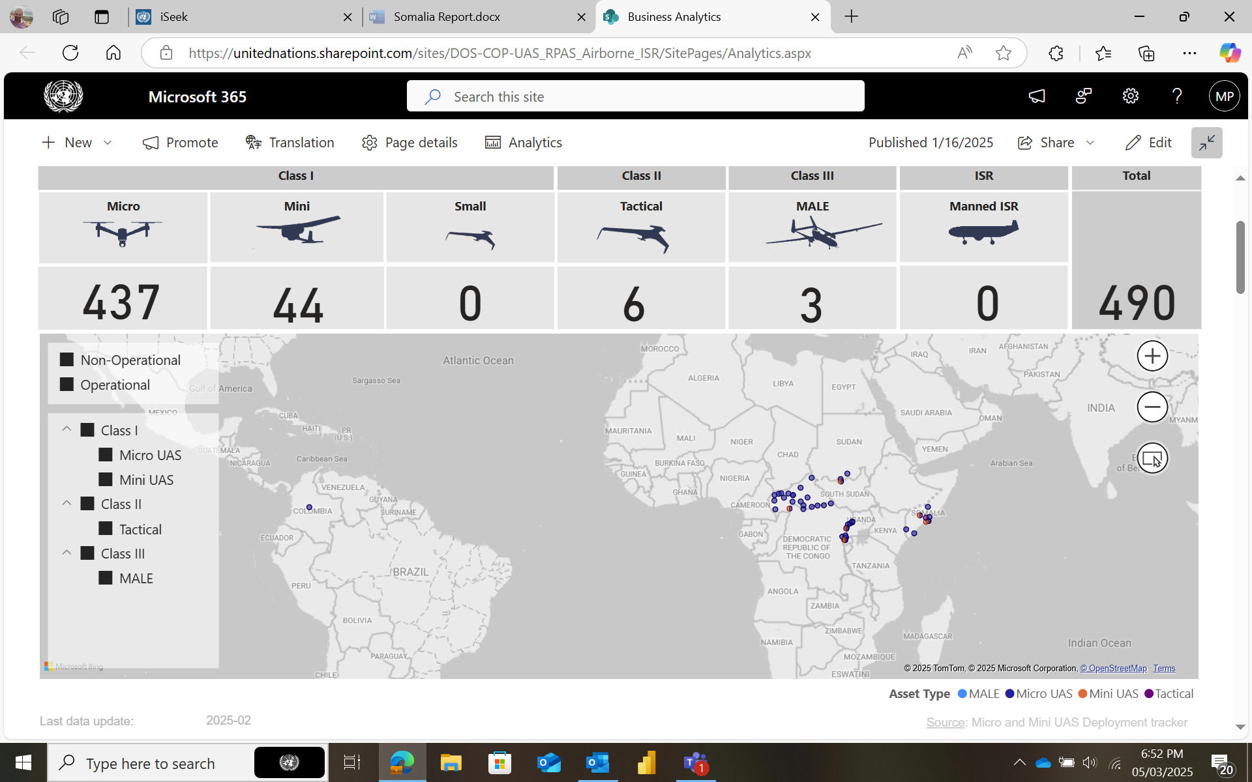





UN Secretariat UAS Programme
UAS Fleet
UAS Programme Pillars
Regulatory framework
Operations and Capacity building
Generation and sourcing
AVSEC, SMS and Compliance
Partnership
Notes:
Our UAS program is structured around five key pillars:
Regulatory framework — working closely with ICAO and national authorities for safe integration.
Operations and capacity building — ensuring UN missions have the necessary training and procedures.
Generation and sourcing — identifying innovative technology solutions.
SMS, Compliance and AVSEC — applying rigorous safety, compliance and security oversight.
Partnership — fostering collaboration between the UN, industry and regulatory bodies.
Additionally, I just wanted to show out current UAS Fleet for reference (it fluctuates between 450-550 aircraft).

Slide 5
UN Secretariat UAS Projects
UN Somalia Mission Case
UN Somalia UAS Project
Limited use of surface transportation in the supply chain
40% of UN Owned Equipment was delivered to Mogadishu by sea (60% arrived by air) and only 22% of all cargo was transported within the Mission by surface – sea and road.
Heavy reliance on air transportation for within-Mission movements
Total of 77,860 passengers (100%) and 16,956,178 kgs of cargo (77%) were transported by air.
CASEVAC support is a critical service to the mission
40% of CASEVACs are conducted at night.
UAS CARGO
15-50kg (Phase 1)
UAS MEDICAL SUPPLY
Emergency response support (MEDEVAC)
UAS MISSION SUPPORT
Engineering Aerial Surveillance support
Blood transport
Vaccines transport
Medical supply transport
Telemedicine/ Remote triage
3D Mapping/ Precision LIDAR
Precision Agriculture/ Spray/ Seedlings
UTM/ Airspace Management
IED/ Mines Detection
50-200kg (Phase 2)
Dangerous goods inclusion
Sling/ Air Drop
Final Target 2 Tons (not included in the phase 1 and 2)
Notes:
The UN Somalia UAS Project is a flagship example of how unmanned cargo transport can transform UN mission operations in complex environments.
Somalia presents unique challenges — remote areas, security risks, poor infrastructure and rapidly shifting needs on the ground.
Traditional cargo delivery methods, particularly overland or manned air transport, are often slow, expensive and exposed to security threats.
With above in mind, we are planning to start the introduction of UAS cargo operations in Somalia that will allow for:
Rapid, reliable delivery of critical supplies such as medical equipment, humanitarian aid, spare parts and communications gear to isolated locations.
Reduced risk to personnel, by minimizing exposure to conflict zones and reducing reliance on vulnerable convoys.
Greater operational flexibility, with the ability to adapt flight routes and delivery schedules based on changing security conditions and urgent needs.
Enhanced ISR capabilities, supporting both logistics planning and situational awareness.
This project, which will be published in the market in few weeks, will also serve as a live testing ground for operational frameworks, safety management systems and compliance protocols that are now being refined for broader UN use. Furthermore, we will leverage the Somalia experience to:
Strengthen regulatory coordination with host state.
Build local capacity and training programs.
Inform the development of future UAS fleet acquisition and contracting models.
Overall, the UAS project shall demonstrate that UAS is not just a technology experiment — it’s a practical, mission-enhancing tool already delivering measurable results.

Slide 6
Notes:
In closing, I would like to emphasize that the air cargo and unmanned aircraft systems are increasingly vital for the UN’s operations.
With growing demand and investment, our focus remains on safety, innovation and partnership.
Thank you for your attention. I look forward to continuing these discussions.

