Slide 2
Lynn McGuigan
CARGO SAFETY: AN ICAO PERSPECTIVE

Slide 3
Air cargo safety: Dangerous goods transport
1
Regulatory framework
2
Lithium batteries
3
Managing risk: Operator role
4
Managing risk: State role

Slide 4

ICAO
1
Regulatory framework for dangerous goods

Slide 5
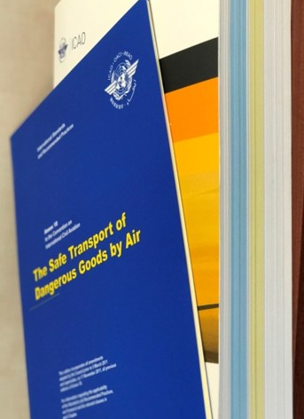
Annex 18
The Safe Transport of Dangerous Goods by Air
Standards and Recommended Practices (SARPs) applicable to all international operations of civil aircraft
  “Each Contracting State shall take the necessary measures to achieve compliance with the detailed provisions contained in the Technical Instructions” (Standard 2.2.1)
Notes:
Heard of A9 facilitation and a19 on security,
An18
Think
Standard … TIs

Slide 6

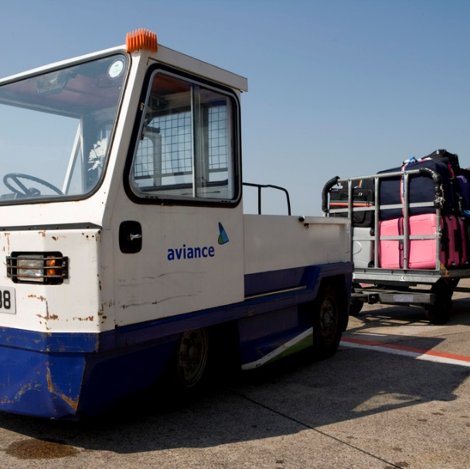

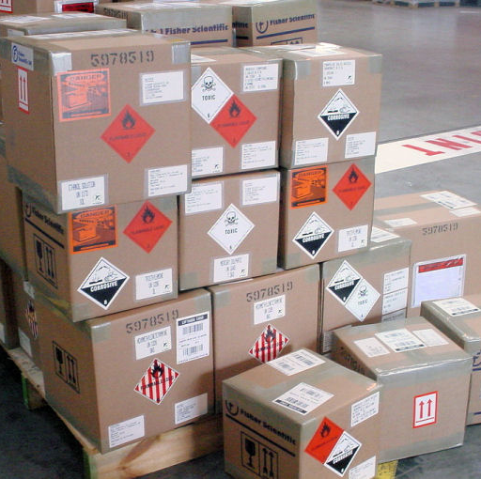
Dangerous goods on aircraft
Necessary to meet airworthiness and operational requirements
Carried by passengers and crew
Airmail
Cargo

Slide 7



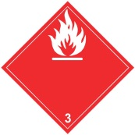






Managing safety risk through
Technical Instructions
Hazards are identified
Hazards are described
Risks associated with the hazards mitigated at package level through quantity limitations, packing and packaging requirements
Dangerous goods are forbidden for transport if risk cannot be mitigated to an acceptable level
Hazards and handling information communicated to supply chain
Risks are further mitigated through operator acceptance, loading and stowage procedures
Notes:
The first step in a safety risk management process is the identification of hazards. Technical Instructions address hazard identification through a system that divides hazards into 9 general classes, with some of these classes further divided into divisions and some further divided into the degree of danger they pose. The nine classes cover
CLICK Explosives,
CLICK Flammable gases,
CLICK Flammable liquids,
CLICK Flammable solids,
Substances liable to spontaneous combustion and
Substances which, in contact with water, emit flammable gases
CLICK Oxidizing substances and organic peroxides
CLICK Toxic and infectious substances
CLICK Radioactive material
CLICK Corrosive substances.
CLICK Miscellaneous dangerous goods, which are goods that do not meet the
classification criteria of any of the classes. This includes environmentally
hazardous substances are assigned to this class

Slide 8
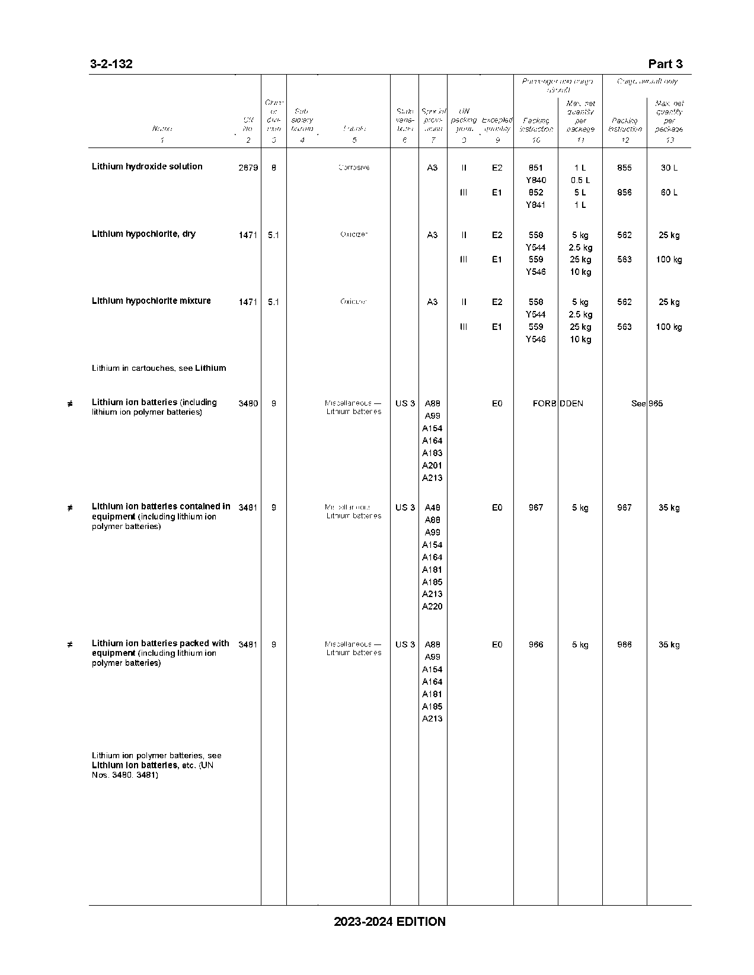
Managing risk through
Technical Instructions
Hazards are identified
Hazards are described
Risks associated with the hazards mitigated at package level through quantity limitations, packing and packaging requirements
Hazards and handling information communicated to supply chain
Risks are further mitigated through operator acceptance, loading and stowage procedures
Notes:
Once the hazards are identified, they need to be described in a way that’s understood by everyone handling the dangerous goods throughout the transport supply chain. Part 3 of the Technical Instructions contains a list of over 3000 dangerous goods commonly transported from which a dangerous goods description is derived. The basic description includes what is known as a proper shipping name, a UN number, the primary hazard, any subsidiary hazards and, for some dangerous goods, a packing group which identifies one of three levels of danger. From this description, a shipper can determine whether or not the specific dangerous goods can be transported by air, in what quantities, what specific packing requirements need to be applied, what labels need to be applied to the package, and what other special provisions may need to be applied.

Slide 9
Managing risk through
Technical Instructions
Hazards are identified
Hazards are described
Risks associated with the hazards mitigated at package level through quantity limitations, packing and packaging requirements
Hazards and handling information communicated to supply chain
Risks are further mitigated through operator acceptance, loading and stowage procedures
4G/Y/25/S/06/GB/XXX
Notes:
Once the hazards have been identified and described, package level mitigation measures can applied.
There are general packing requirements that apply to all dangerous goods and around 150 packing instructions that apply to specific dangerous goods. The packing instructions are numbered and assigned to specific dangerous goods contained in the list in Part 3.
There are also requirements for packaging to be subject to performance tests aimed at ensuring the packaging can contain its contents under normal transport conditions. Specific marks must be applied to the package to indicate that the packaging design type has been successfully tested.

Slide 10
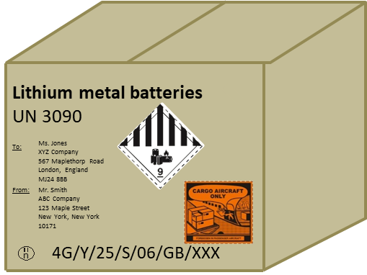
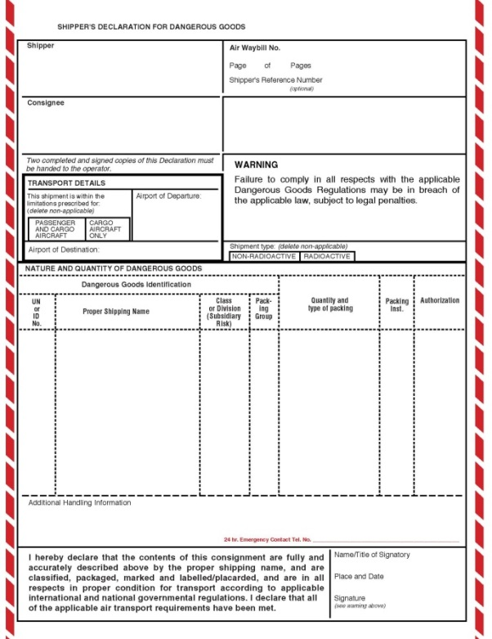
Managing risk through
Technical Instructions
Hazards are identified
Hazards are described
Risks associated with the hazards mitigated at package level through quantity limitations, packing and packaging requirements
Hazards and handling information communicated to supply chain
Risks are further mitigated through operator acceptance, loading and stowage procedures
Notes:
Part 5 of the Technical Instructions contains requirements for hazards and handling information to be communicated to the airline operator and any other entity handling the dangerous goods during transport.
This is done on the package and through information provided to the operator either electronically or on a paper document.
The hazard information on the package includes the hazard labels that we saw when we looked at hazard identification, handling labels, the marks indicating that the packaging design type has successfully passed required tests, the proper shipping name and UN number of the goods contained in the package, and shipper and consignee identification.
The information required to be provided either electronically or on a paper document include the name and address of the shipper and consignee, dangerous goods description, the number and type of packages, the quantity of dangerous goods within, and specific handling. This is the basic information required, there may be more depending on the type of dangerous goods being transported.
The information on the package and in the transport document helps ensure that the dangerous goods are handled and stowed on the aircraft safely, and also helps the operator verify that the contents described are packed safely in accordance with the regulations.

Slide 11
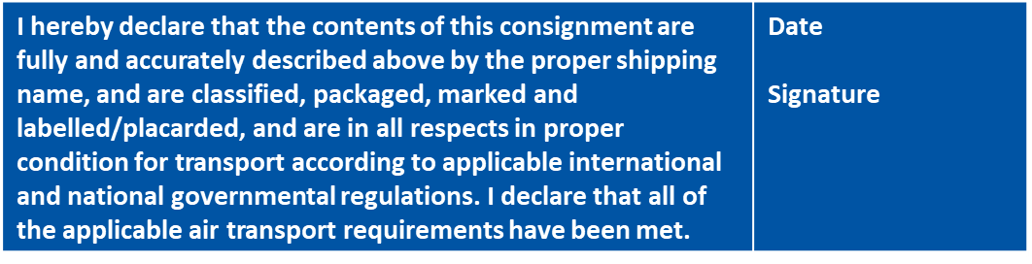
Role in achieving goal
Part 5
Shipper’s Responsibilities
Hazards are identified
Hazards are described
Risks associated with the hazards mitigated at package level through quantity limitations, packing and packaging requirements
Hazards and handling information communicated to supply chain
Shipper declares compliance
Notes:
Along with the information the shipper must provide to the operator is a declaration that the contents of the consignment are fully and accurately described and that the hazards associated with the dangerous goods have been classified, packaged, marked and labelled in accordance with the regulations. This emphasizes the legal responsibility of the shipper and also provides a level of confidence to the operator that the dangerous goods consignment is safe for transport.

Slide 12
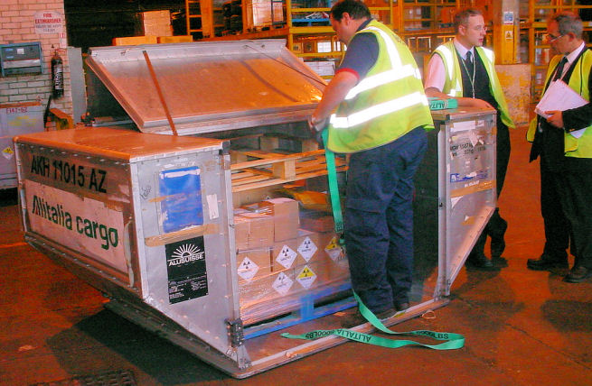
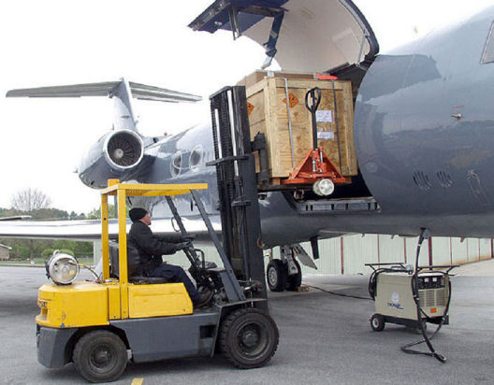
Managing risk through
Technical Instructions
Hazards are identified
Hazards are described
Risks associated with the hazards mitigated at package level through quantity limitations, packing and packaging requirements
Hazards and handling information communicated to supply chain
Shipper declares compliance
Risks are further mitigated through operator acceptance, loading and stowage procedures
Measures to aid in reducing severity of the consequences of a dangerous goods incident are implemented
Safety data is provided to States to assist with their safety risk management responsibilities
Personnel are competent to perform any function for which they are responsible prior to performing it
Notes:
So the shipper is responsible for identifying the hazards, describing them, ensuring they are not forbidden for transport by air, mitigating the risks associated with the dangerous goods at the package level, communicating the hazards to the operator, and declaring that they have complied with all applicable regulations.
Now the operator has responsibilities to further mitigate risks through an operator acceptance check and the loading and stowage of the dangerous goods on the aircraft. The operator acceptance check helps to reduce the likelihood of non-compliant dangerous goods entering the air transport, but this can only be done when the shipper declares that a consignment contains dangerous goods. The Technical Instructions therefore requires the operator to take measures to reduce the likelihood of this happening by displaying notices about dangerous goods at cargo acceptance points and providing information to assist in detecting and preventing undeclared dangerous goods from being offered for transport to cargo reservations, sale and cargo acceptance staff. The operator also has responsibilities for ensuring its employees are competent to perform their functions and have the information they need to fulfill their responsibilities.
All of these requirements are contained in Part 7 of the Technical Instructions.

Slide 13
Objective of Technical Instructions
“… intended to facilitate transport while giving a level of safety such that dangerous goods can be carried without placing an aircraft or its occupants at risk, providing all the requirements are fulfilled. They try to ensure that should an incident occur it cannot lead to an accident.” (Foreword)
Notes:
The objective of the Technical Instructions is written in the Foreword and shown on this slide, and that is that they are
READ FROM SLIDE
There are two words highlighted on this slide, facilitate and safety. Now obviously not allowing any dangerous goods on an aircraft would guarantee safety, but aviation speed and reliability are a key factor in the delivery of urgently needed cargo, including dangerous goods, and it enables businesses, organizations and individuals, regardless of where they are in the world, to efficiently connect to distant markets and global supply chains.
So we need to facilitate transport, but mitigating risks associated with transport of dangerous goods by air is really the ultimate goal of the Technical Instructions.

Slide 14

Lithium batteries
2

Slide 15
Lithium Batteries
15
The potential for lithium batteries to catch fire and emit gases that create an explosive atmosphere poses significant risks to aircraft during transport.
A fire involving significant quantities of lithium batteries can exceed the aircraft’s safety protection features.
Accidents and incidents involving lithium batteries
Internal cell failure
Damage
Thermal runaway
Over-charging
Heat
FIRE
SMOKE
EXPLOSION
Notes:
Lithium batteries pose a unique hazard to air transport because they provide both a source of fuel for a fire and an ignition source.
Contain flammable electrolytes and are capable of thermal runaway.
Thermal runaway is a chemical reaction within a cell that results in an uncontrolled temperature rise and increased pressure within the cell.
This results in the cell expelling its contents, including the flammable electrolytes, which can be ignited by the hot cell case or burning packaging.
The heat from one cell in thermal runaway can cause adjacent cells to go into thermal runaway.
Typical packaging material used for dangerous goods can’t stop this propagation.
This chain reaction poses a significant risk to aircraft when there are large quantities of cells or cells with a high energy density in the cargo compartment.
Airframe manufacturers have advised that a fire involving significant quantities of lithium batteries can exceed the aircraft’s safety protection features.
Thermal runway can be initiated under several different circumstances including an internal cell failure, heating (exposure to an external fire), physical abuse, rapid discharge, over-charging, or a manufacturing defect. Thermal runaway is more likely when they are poorly designed, poorly manufactured or if they are damaged or misused.
UPS-6
Boeing 747-400F
UPS Airlines Flight 6 was a scheduled international cargo flight operated by UPS. On September 3, 2010, the Boeing 747-400F flying the route between Dubai, United Arab Emirates, and Cologne, Germany, developed an in-flight fire, which caused the aircraft to crash, killing both crew members, the only people on board. The accident prompted a re-evaluation of safety procedures protecting airliners from cockpit smoke.
The accident report indicated that the fire was caused by the autoignition of the contents of a cargo pallet that contained more than 81,000 lithium batteries and other combustible materials
The accident board issued several safety recommendations relative to this accident. The recommendations are found in Chapter 4 of the accident final report and involve the following:
Changes to fire protection requirements in the FAA and EASA Airworthiness Standards
Changes to aircraft and critical systems related to protection of critical systems from large cargo fires
Changes to hazardous materials regulations related to lithium-type batteries and cells
Changes involving aircraft design and pilot training related to smoke in the flight deck
Testing by government agencies related to lithium-type batteries to determine safe limits for air carriage
Reviews and changes within ICAO related to hazardous material classification, packaging, and carriage of lithium type batteries and cells, as well as flight deck improvements
GCAA changes to air traffic control and air navigation services for in-flight emergency response

Slide 16

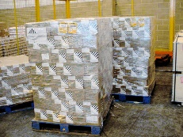

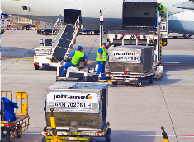
Lithium batteries
Technical Instructions
Assumptions
Reality
Hazards classified as miscellaneous dangerous goods
“Miscellaneous” does not describe actual hazard, which may vary depending on cell or battery type
Some cells or batteries my be very benign, others too hazardous for air transport
Hazards are accurately identified
Packaging mitigation does not prevent propagation of thermal runaway to adjacent packages
Quantity in cargo compartment increases risk
Package level mitigation is sufficient
Increasingly complex supply chain, cargo growth, changing battery technology, increased energy density outpace prescriptive SARPs
Cannot rely on trust
Compliance with prescriptive regulations and trust
Aircraft safety systems and containment equipment can mitigate against a severe outcome
A fire involving lithium batteries can overwhelm cargo compartment and containment equipment protection features
Notes:
The Technical Instructions are very prescriptive regulations that have allowed dangerous goods to be transported safely all over the world. This has been done with a trust that everyone involved in their transport has complied with the regulations, with the assumption that package level safety was sufficient, and the assumption that the aircraft’s safety features could prevent an incident from turning into an accident. We continue to rely on the Technical Instructions to provide safety, but we can’t depend on them on their own. We need to proactively manage safety risk.
When the Technical Instructions were first published in the early 1980s, when dangerous goods made up a very small percentage of cargo. These were often pure chemicals shipped by people with knowledge of hazards they presented. The types and quantities of dangerous goods has changed dramatically since then, and so has the complexity of the supply chain. Today there are estimates of dangerous goods making up 80 percent of cargo on some aircraft, a large number of these goods being lithium batteries. Lithium batteries are hazardous because they are capable of thermal runaway, particularly when they are defective, damaged, improperly manufactured or improperly packaged. Thermal runaway is a chemical reaction within a cell that results in an uncontrolled temperature rise and increased pressure within the cell that results in the release of flammable electrolytes. These can be ignited by the heat of the hot cells or burning packaging ignited by hot cells and the heat from one cell in thermal runaway can cause adjacent cells to go into thermal runaway. This chain reaction poses a significant risk to aircraft when there are large quantities of cells or cells with a high energy density in the cargo compartment. We know that the Technical Instructions mitigate risk at the package level, and historically this was considered sufficient, but it may not be sufficient when it comes to lithium batteries. Airframe manufacturers have advised that a fire involving significant quantities of lithium batteries can exceed the safety protection features on the aircraft.
Another complicating factor is the supply chain. In the early days there was a more direct relationship between the shipper and the operator. Today a consignment can pass through several entities before being loaded on an aircraft and when transiting from one aircraft to anther on the way to its destination. Shippers of lithium batteries can be anyone including battery manufacturers, component manufacturers, electronic device manufacturers, retailers and consumers. They many not understand or appreciate the risk lithium batteries pose to aircraft. So ensuring compliance throughout the supply chain is a challenge. The number of consumer articles and industrial applications which require lithium batteries is continually increasing as is the demand for longer lasting batteries. The growth in e-commerce has provided a major boost to economies and in our consumer needs, but it has also provided an increased risk of non-compliance.
I am focusing on lithium batteries because they are our real challenge right now. But new commodities may introduce new challenges in managing risks in the future.
All of this highlights the importance of safety management principles. The Technical Instructions are very prescriptive regulations that have allowed dangerous goods to be transported safely all over the world. This has been done with a trust that everyone involved in their transport has complied with the regulations and with the assumption that package level safety was sufficient. We continue to rely on the Technical Instructions to provide safety, but we can’t depend on them on their own. We need to proactively manage safety risk.

Slide 17
Managing risk
Operator role
Notes:
As we move forward, unwavering commitment to the highest levels of safety will of course remain key.
I know everyone here shares this priority, and so on that topic, I’d like to focus on dangerous goods for a moment.

Slide 18
Cargo compartment safety Standards
Hazards of items to be transported
Capabilities of the operator
Operational considerations
Capabilities of the aeroplane and its systems
Containment characteristics of ULDs
Packing and packaging
Quantity and distribution of dangerous goods
Cargo compartment safety
  Policy and procedures that address items to be transported in the cargo compartment including specific safety risk assessment
  Cargo compartment fire protection capabilities in the aeroplane flight manual or other documentation supporting the operation of the aeroplane
  Policies and procedures to ensure with reasonable certainty, that a fire involving items in cargo compartment can be detected and sufficiently supressed
Supply chain for items transported
Notes:
I will very briefly go over the new cargo compartment safety SARPs in Annex 6.
They require the State of the Operator to ensure that operators establish policies and procedures for the transport of items in the cargo compartment, which include the conduct of a specific safety risk assessment. It requires operators to include at least the items listed on the right of the screen in their safety risks assessment. These are:
Hazard identification
Capabilities of the operator
This relates to whether or not the operator has the knowledge, skills and resources to implement and oversee the systems and processes required to support its operations
Operational considerations
The risk associated with dangerous goods may be different depending on what routes are flown. A short haul flight may be much less risky than a long haul depending on the distance to a suitable landing aerodrome in the event of an emergency
The length of time that a fire may need to be suppressed until safe landing and the characteristics of the operator’s cargo compartments would need to be taken into account when assessing the risk.
The capabilities of the aeroplane and its systems. These need to be taken into account when considering the consequences of an incident and what can be done to mitigate against the severity of them. Can the aircraft’s system detect a fire? How quickly? Can the systems contain the fire involving items in the cargo compartment ? For how long?
the new provisions in Annex 6 include an associated Standard requiring these capabilities to be outlined in the aeroplane flight manual or which document supports the operation of the aeroplane. Defined in the aeroplane flight manual or other documentation supporting operation of the aeroplanes
The new provisions also contain an associated SARP requiring the operator to establish policies and procedures to address items to be transported in the cargo compartment and to ensure with reasonable certainty that a fire involving them can be detected and sufficiently suppressed.
Containment characteristics of Unit load devices, or ULDs for short
ULDs are devices used for grouping, transferring and restraining cargo, baggage or mail for transport. It is important for operators to understand the role ULDs can play in both mitigating risk, in certain circumstances, and potentially contributing to the risk in other circumstances. Some ULDs containers can provide a layer of protection to its contents and limit the severity of a external to it. It can also help in suppressing a fire originating within it through oxygen starvation. Some even contain built-in fire suppression systems. However, under certain circumstances, ULDs may have a detrimental effect. There may be potential for a delay in the detection of fire and subsequent alerting of the flight crew if it originates within the ULD. It may also restrict the penetration of fire suppressant agent into the ULD to fight the fire. Gases from a lithium batteries in thermal runaway can accumulate in restricted spaces in the ULD along an explosive mixture to be created. There have been a lot of developments with the protection features of ULDs and their ability to protect the aircraft from fire and specifically for a lithium battery event. There have also been a lot of developments with protection features of fire containment covers. But the bottom line is the operator needs to take all of this into account when conducting their safety risk assessment.
Packing and packaging
We know that the Technical Instructions contain a lot of requirements that the shipper implements when it comes to packing and packaging. The operator needs to be confident that shippers complies with these requirements and then must ensure that packages containing dangerous goods are not loaded on an aircraft or into a ULD if there is evidence of leakage or damaged.
Supply chain
Earlier we looked at the supply chain and how complex it can be. Managing risks that can be introduced at any point throughout it can be very challenging. It is difficult for an operator to identify all shippers, freight forwarders and other entities involved given the often multiple layers of the supply chain. But it is critical for the operator to evaluate and quantify the risk and determine how best to mitigate it. This may involve working directly with entities in the supply chain to determine and define appropriate risk control strategies. Controls for ensuring that undeclared dangerous goods are not offered for air transport should be present throughout the supply chain and when receiving cargo.
Quantity and distribution of items
We know that the Technical Instructions limit the quantities of dangerous goods that can be in a package, but it does not limit the quantity of packages that can be loaded on an aeroplane. Normally the quantity will not affect the probability of fire starting, but the items can affect the outcome a fire if it does start. This is because although most items provide fuel for a fire, they are not an ignition source. But special consideration should be given to some items based on their specific properties, including lithium batteries. Lithium batteries can directly affect the risk level because they provide fuel and also have the potential to self ignite. The greater the number of batteries, the greater the likelihood of ignition, and the greater the number of batteries involved in a fire the greater the severity of that fire. So the operator should give consideration to potential mitigation measures against identified hazards that could be achieved by restricting quantity or defining the distribution on the aeroplane.
So this is all that will be said about the large cargo system of which dangerous goods is a part of. The rest of the course will focus on the more detailed content of the Technical Instructions.

Slide 19
Managing risk
State role
Notes:
As we move forward, unwavering commitment to the highest levels of safety will of course remain key.
I know everyone here shares this priority, and so on that topic, I’d like to focus on dangerous goods for a moment.

Slide 20
Clarifying States’ responsibilities in Annex 18
What is expected of entities throughout the supply chain
Dangerous goods are an integral part of the State’s safety programme (SSP)
What an operator needs to demonstrate with respect to dangerous goods to be granted air operator certificate
What the State needs to do to manage safety throughout supply chain

Slide 21
Managing supply chain risks
State responsibilities
Preventing non-compliant dangerous goods in cargo, mail or baggage as part of its safety risk management activities
Ensure entities in the supply chain have processes and procedures in place to identify non-compliant dangerous goods in cargo or mail and prevent them from being loaded on an aircraft
Establish measures to improve safety awareness and improve safety culture throughout the supply chain
Collection of robust data to assess risk and resolve identified safety issues
Cooperate with States to resolve identified safety issues

Slide 22

Rules? What Rules?

Slide 23
The risk starts long before goods are loaded on an aircraft
Safety is everyone’s responsibility

