Slide 1




UL Standards & Engagement Thermal Runaway Incident Program
1
Program overview
2
2024 Data summary
3
Wrap-around research
4
Get involved

Slide 2
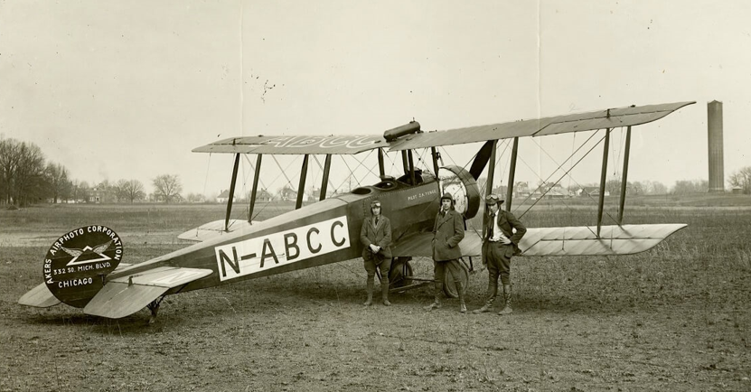
UL Standards & Engagement is a safety advocacy organization focused on achieving tangible results on pressing safety issues.
Involved in aviation since the 1920’s, UL registered aircraft and pilots in the United States before the US Federal Aviation Administration’s formation.

Slide 3
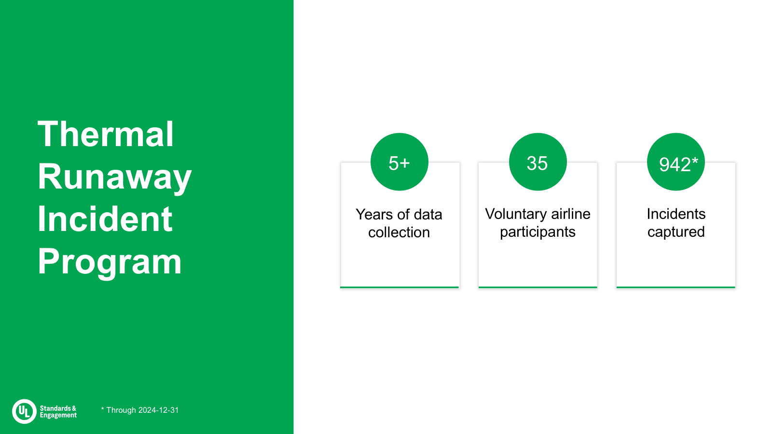
*includes unstructured reports from 2006-2019
Limitations and constraints: Our airline participants are a limited subset of the aviation industry, primarily headquartered in North America. The data is not globally representative.

Slide 4
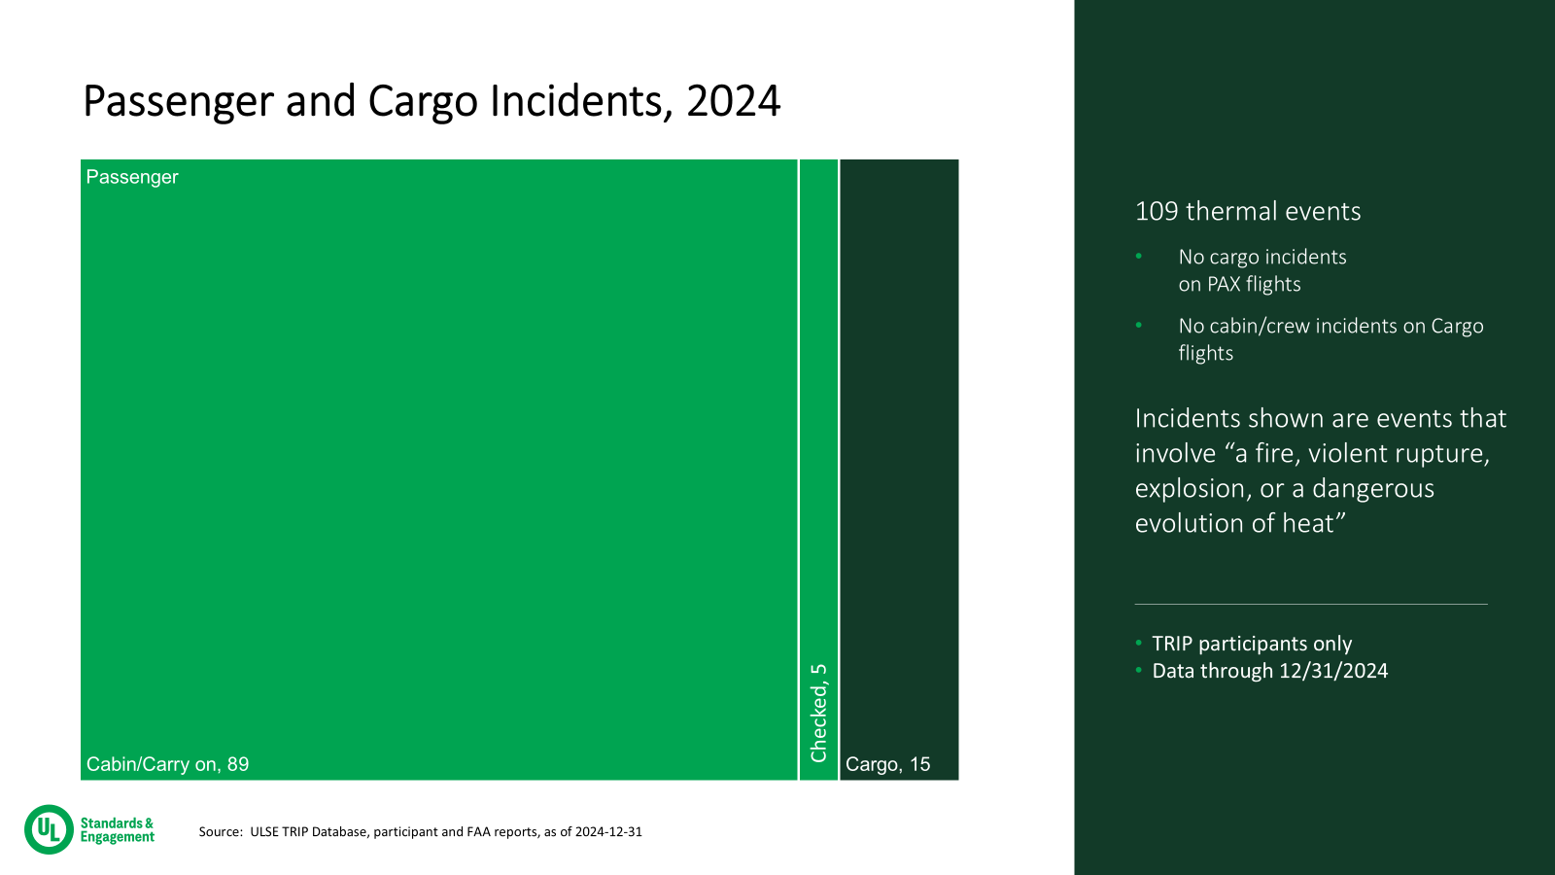

Slide 5
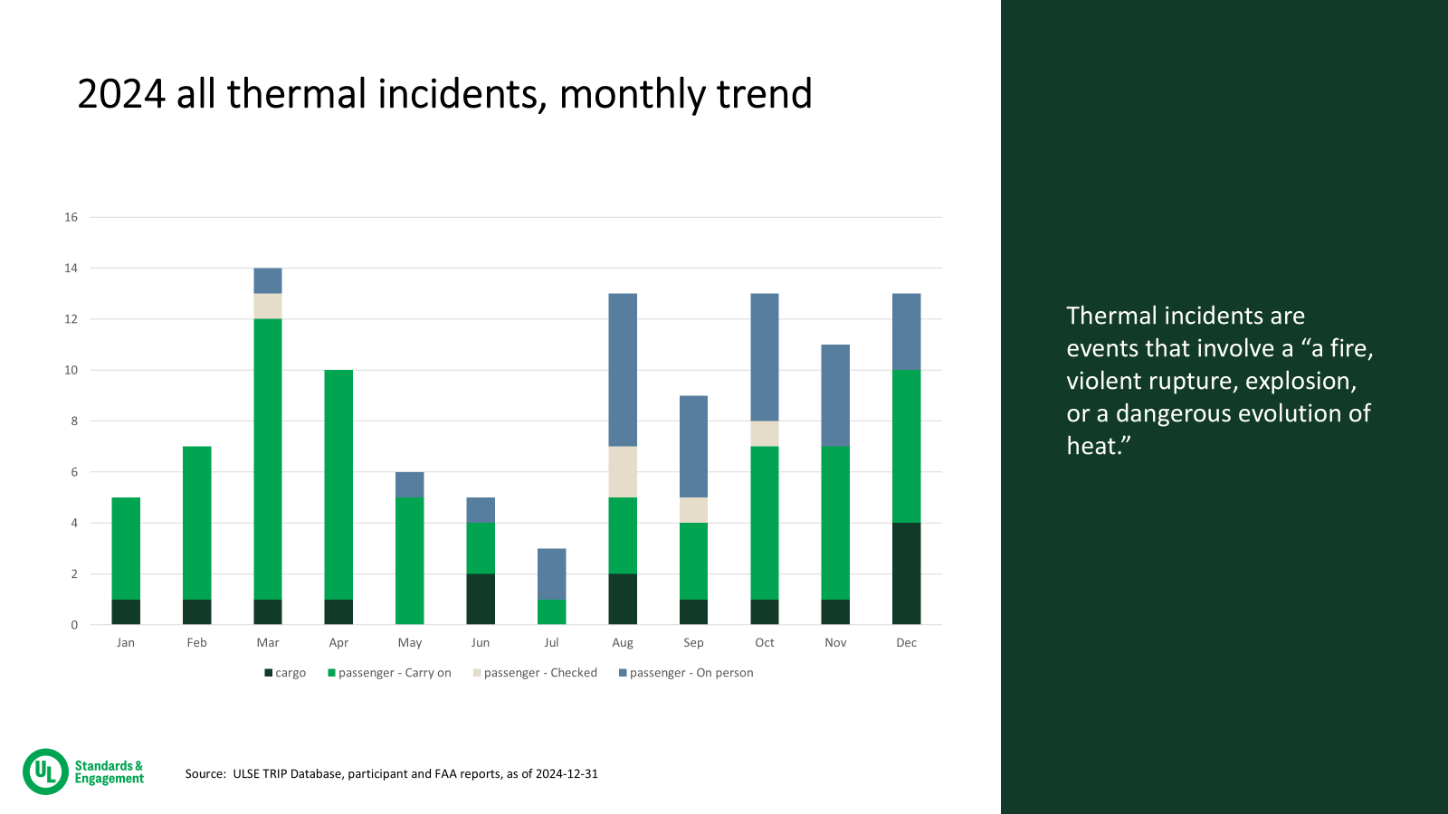

Slide 6
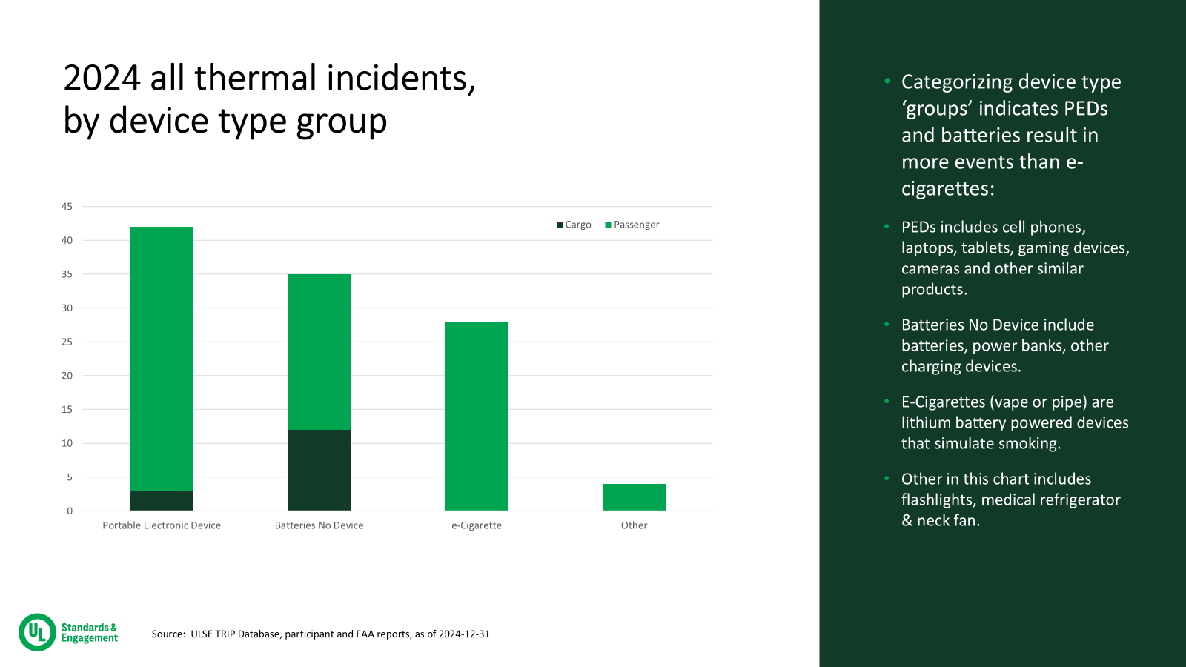

Slide 7
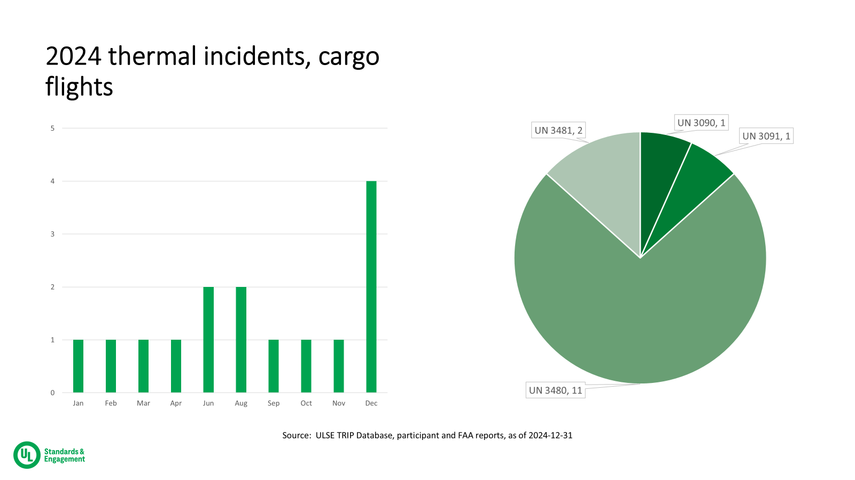

Slide 8
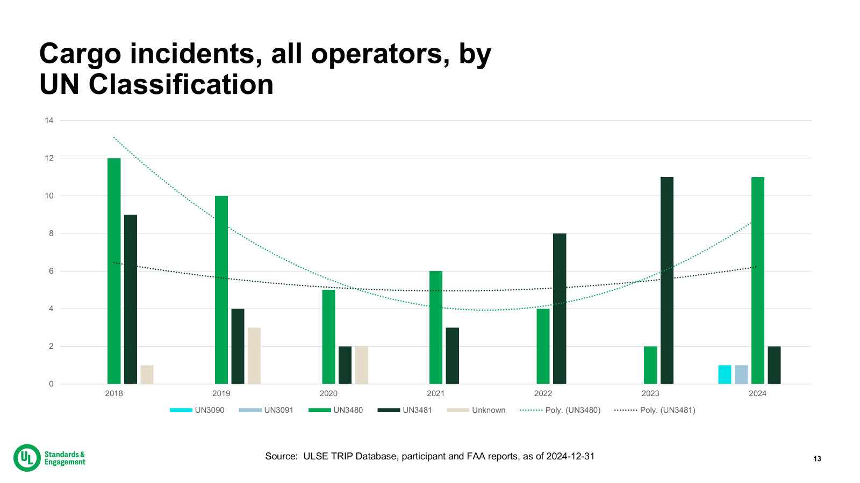

Slide 9
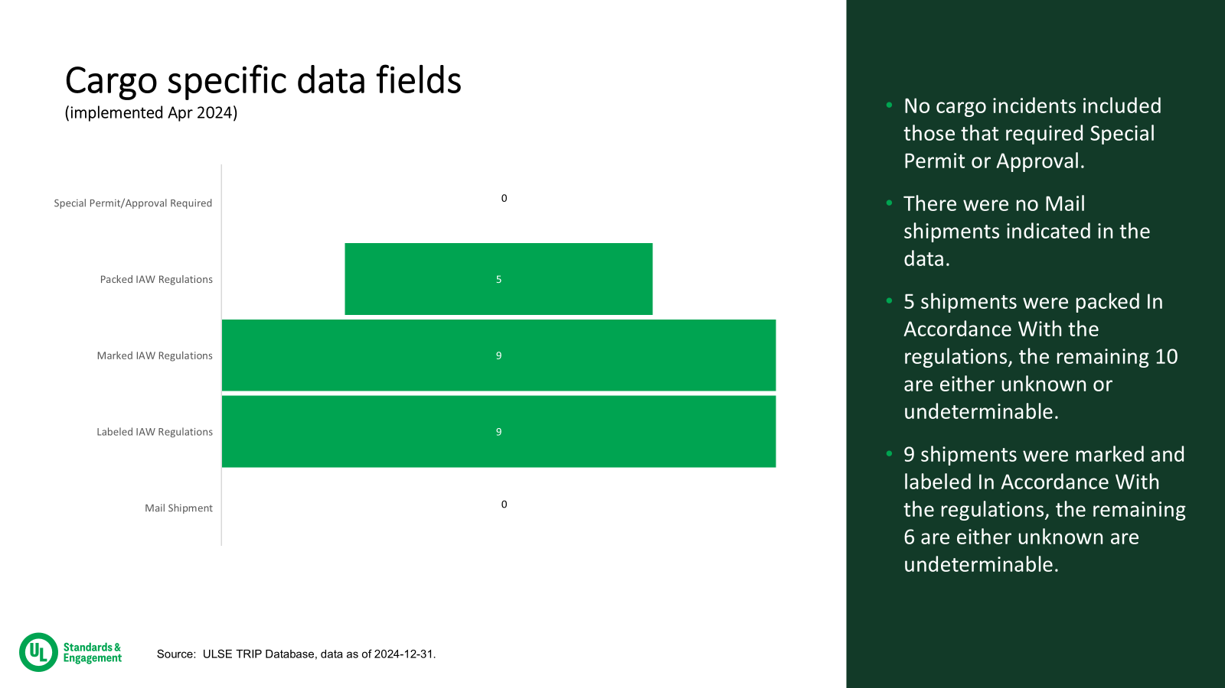

Slide 10
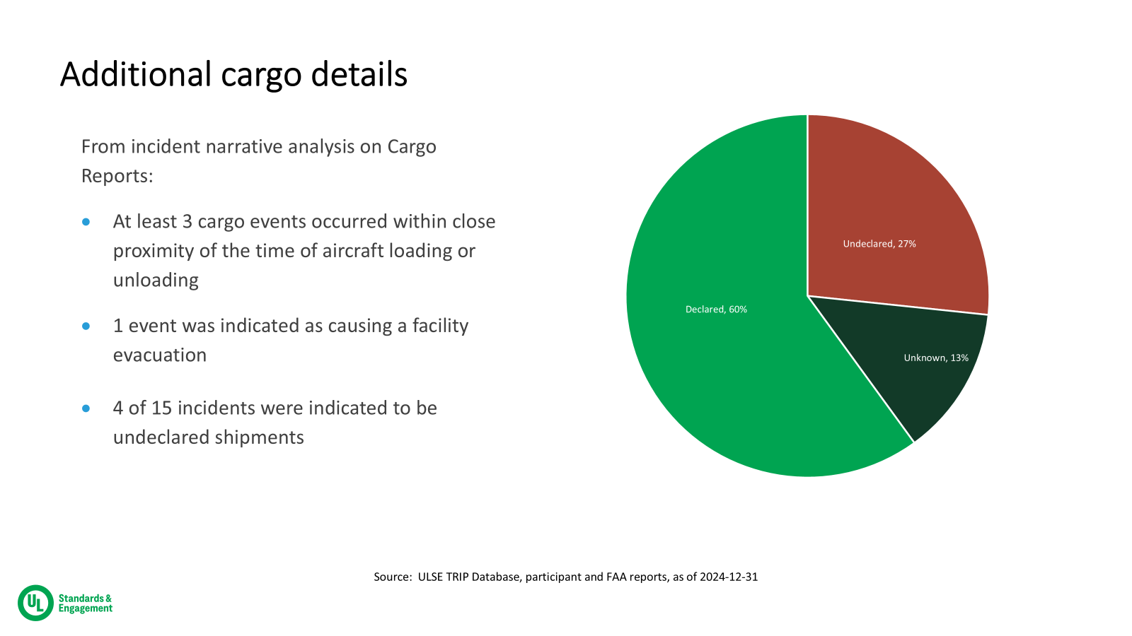

Slide 11
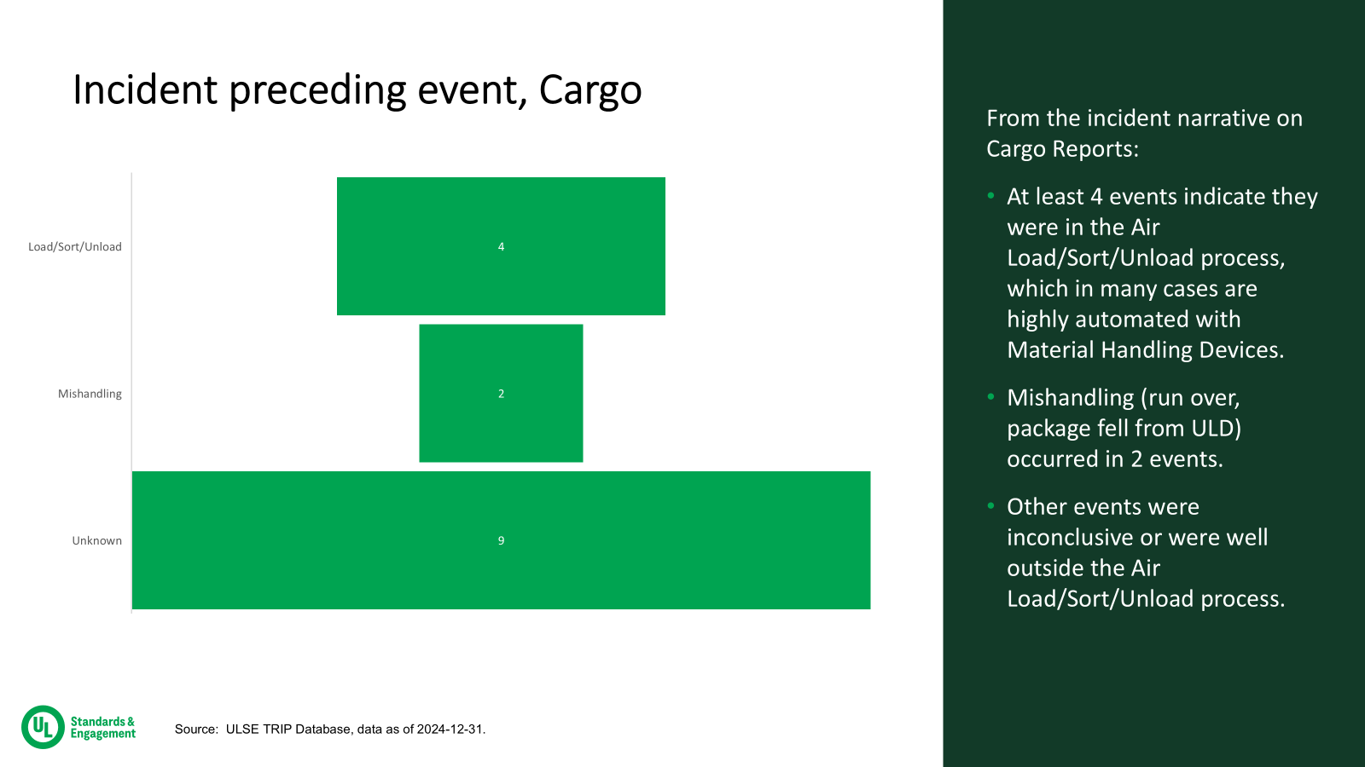

Slide 12
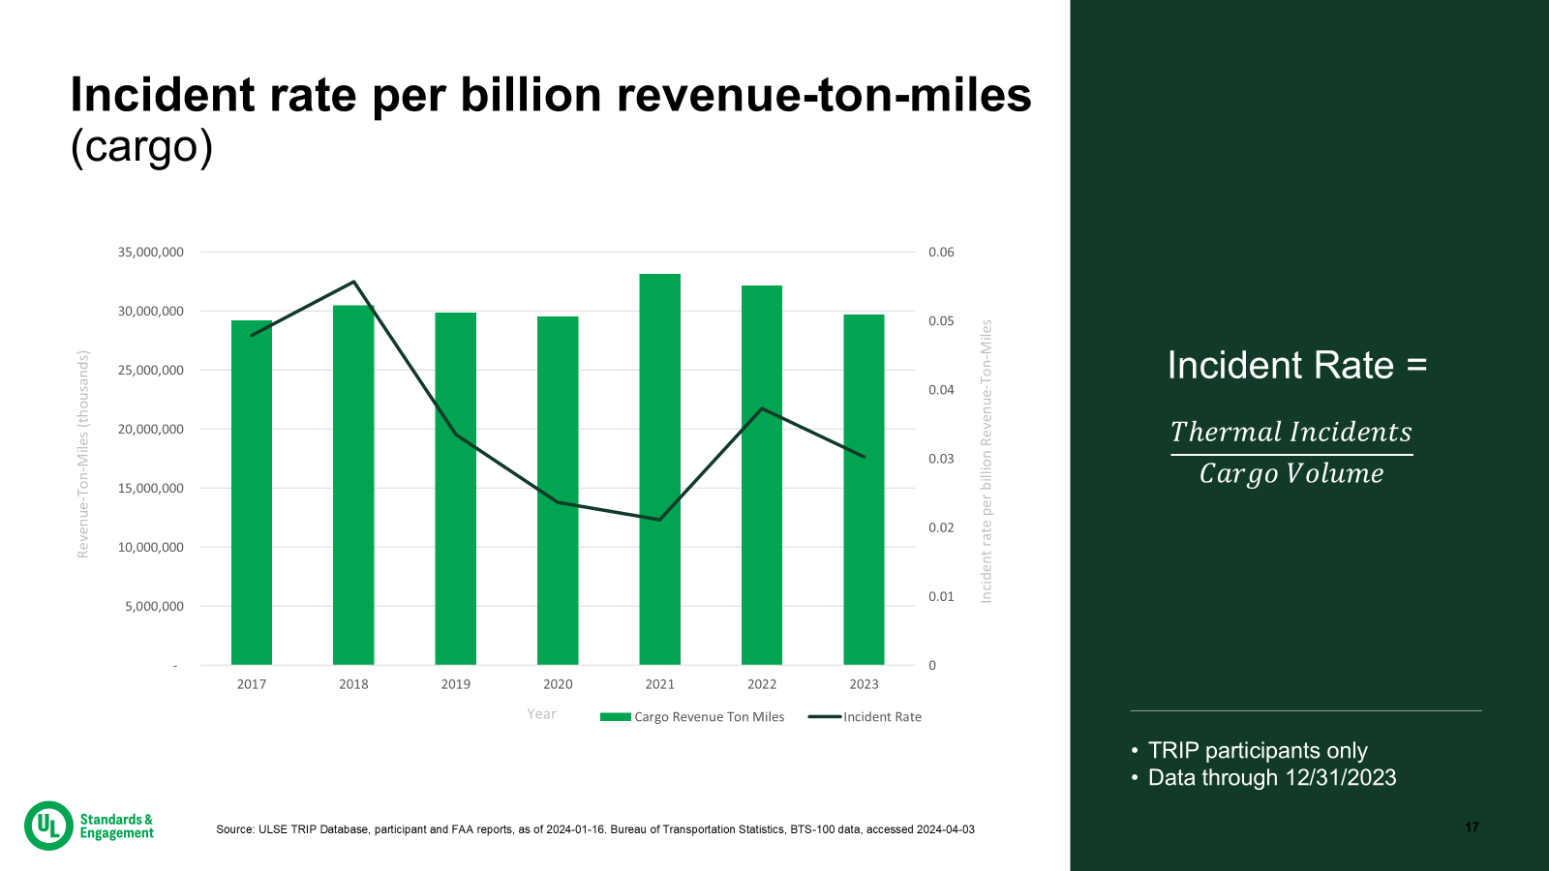

Slide 13
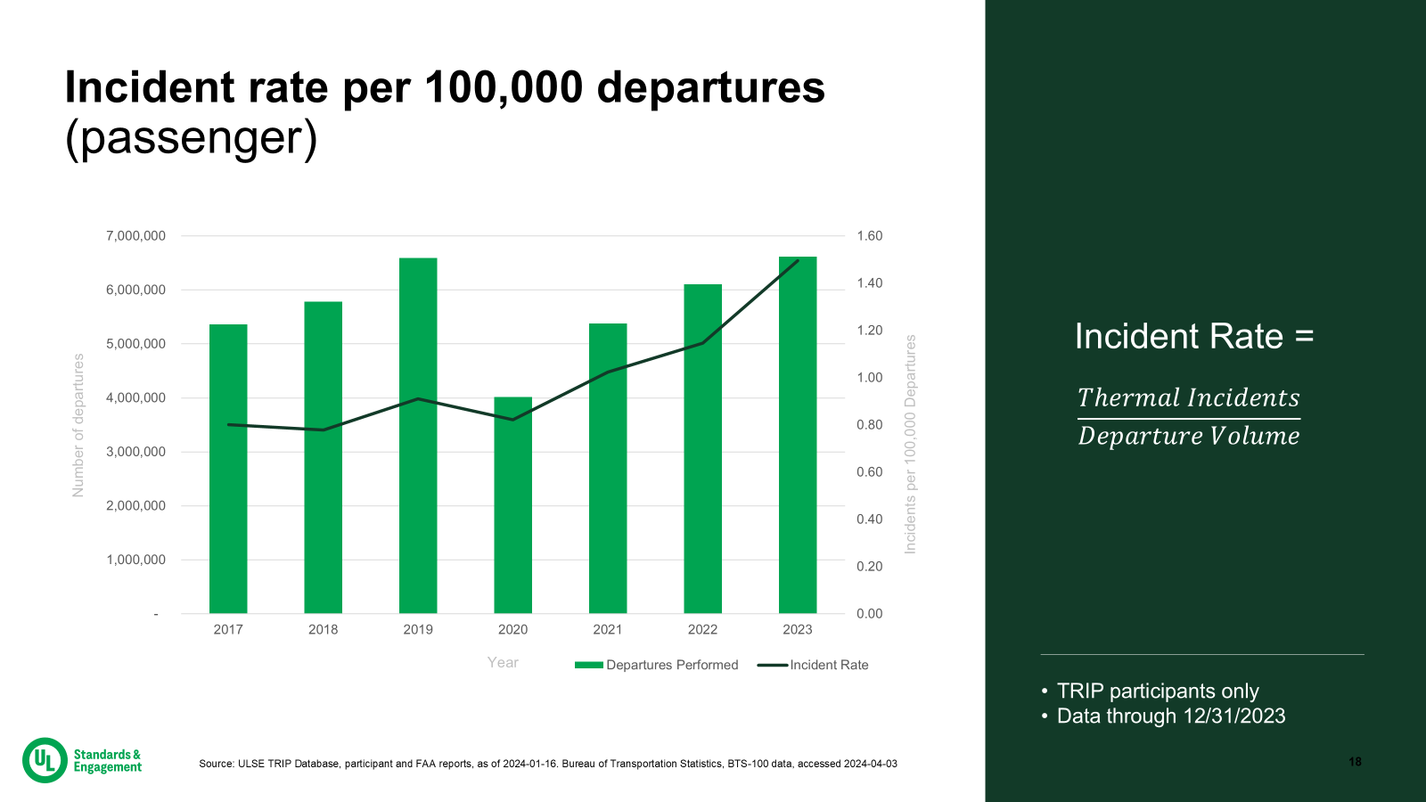

Slide 14
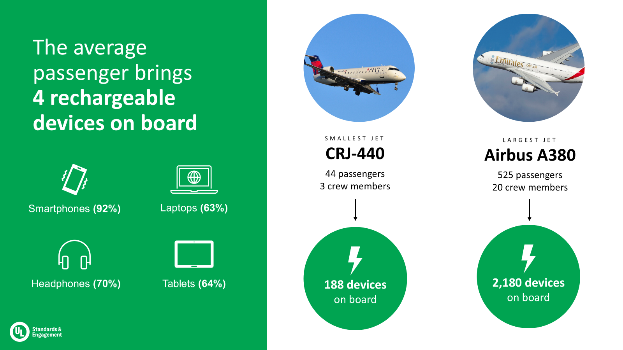

Slide 15
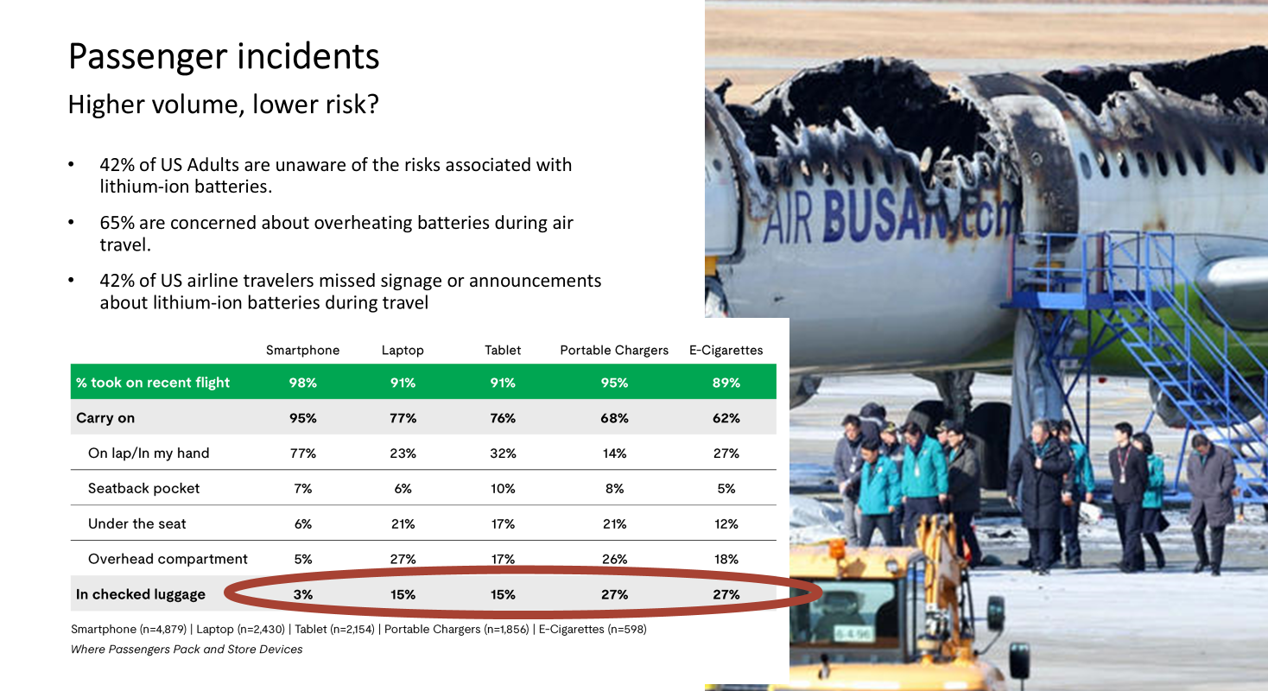

Slide 16
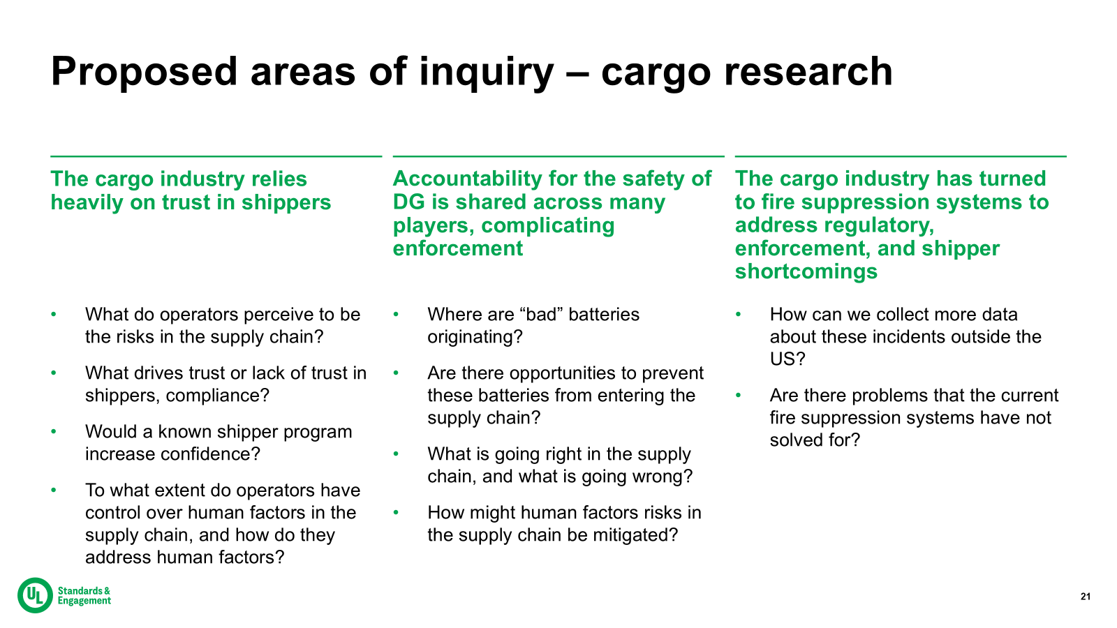

Slide 17
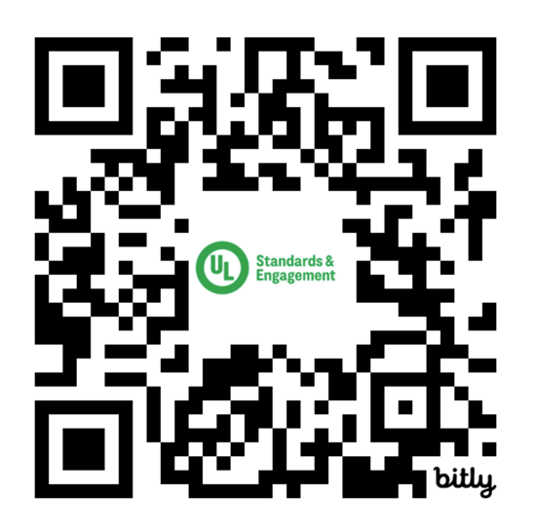
Get involved with TRIP
Become a TRIP Participant
Send an email to TRIP@ul.org to schedule time with us to learn more.
Attend a TRIP Summit
2025 TRIP Summit Singapore, May 6 - 8,2025
2025 TRIP Summit Chicago, Oct 7 - 9, 2025
Download our research
Access reports on passenger awareness, cabin crew readiness, and more.

Slide 18


