Slide 2
Dawit Woubishet
Chairperson – FIATA Air Freight Institute (AFI)
President – Ethiopian Freight Forwarders and Shipping Agents Association (EFFSAA)

Slide 3
Presentation Overview
01
Why Automation, Why Now?
02
Technology Drivers of Cargo Automation
Understanding the urgency driving automation in air cargo
What’s transforming air cargo today?
03
FIATA’s Role in the Digital Transition
04
Africa’s Digital Leap: Opportunities & Progress
How emerging markets can lead through digital adoption
How FIATA is enabling secure, standardized, and global adoption of automation
05
Compliance & Collaboration in the Age of Automation
06
Roadmap and Recommendations
Automation must align with safety, security, and legal readiness
What must we do—together—to enable a digitally connected future?

Slide 4

"The future of air cargo is digital, interoperable, and multimodal."
This transformation is not a luxury—it’s a necessity. In the face of growing e-commerce, geopolitical uncertainty, sustainability demands, and capacity pressures, automation offers the most viable path to efficiency, resilience, and compliance.

Slide 5
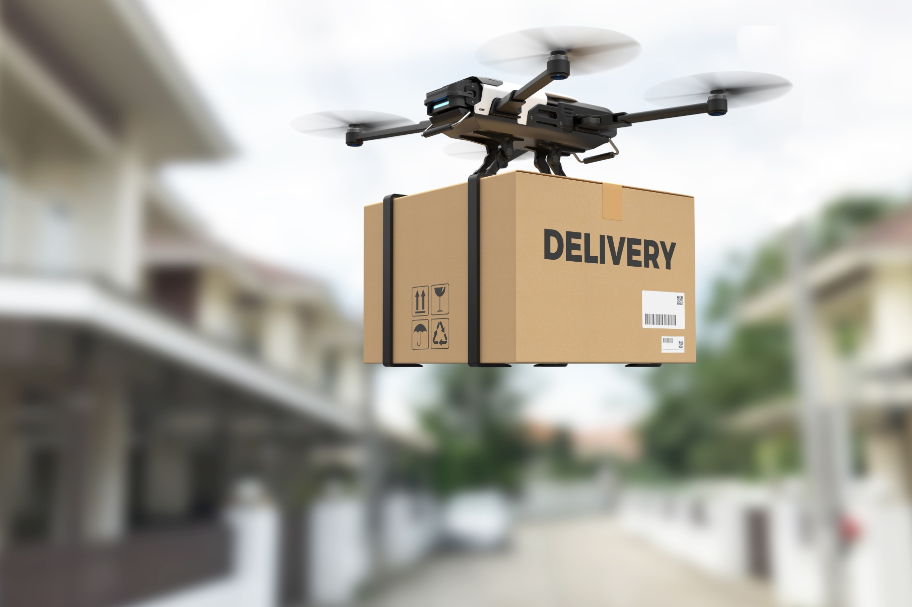
Why Automation, Why
Now?
01

Slide 6

Pressure Points in Modern Air Cargo
Global supply chains are increasingly burdened by complex regulatory demands and growing customer expectations for speed, reliability, and transparency.
Air cargo plays a critical role in the movement of time-sensitive, high-value goods—yet outdated, manual systems hinder responsiveness.
Disconnected documentation and legacy processes lead to inefficiencies, delays, and regulatory compliance challenges.

Slide 7

Freight Forwarders at a Crossroads
The freight forwarder is evolving—from transactional intermediaries to strategic, data-driven logistics partners.
Digital tools such as API integrations, electronic documents, and real-time visibility enable forwarders to be proactive rather than reactive.
Embracing automation is now both a competitive imperative and a compliance necessity.

Slide 8

Technology Drivers of Cargo Automation
02

Slide 9
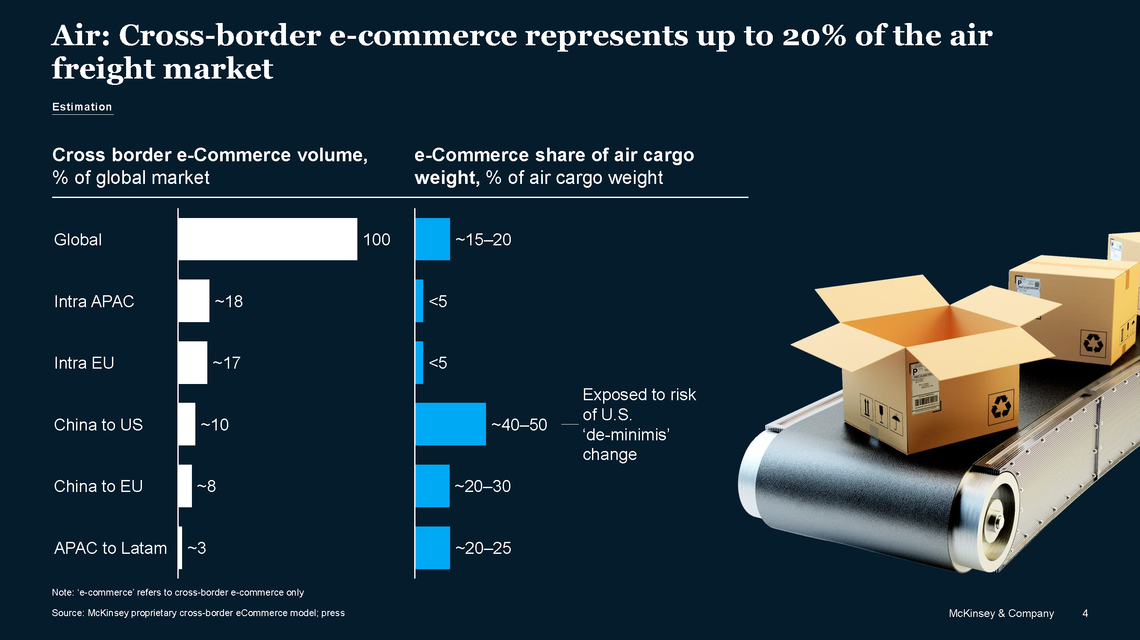

Slide 10

The Core Technologies Fueling Change
Artificial Intelligence (AI): Enhances load optimization, demand forecasting, and anomaly detection.
Internet of Things (IoT): Enables real-time tracking of temperature, movement, and cargo conditions.
Blockchain: Provides tamper-proof documentation and streamlines customs through smart contracts.
Robotics & Automation: Accelerate warehouse handling, reduce errors, and support ULD safety compliance.
APIs & Standards: Platforms like IATA ONE Record ensure seamless and standardized data sharing.

Slide 11

Technology in Action
Etihad Cargo: Uses AI for dynamic load balancing and route efficiency.
BLR Airport: Deploys robotics and IoT to safeguard pharmaceutical logistics.
Global Compliance: PLACI, ACAS, and ICS2 rely on automated pre-loading data submission.
Starship Robotics & Drone Delivery: Pushing the frontier of last-mile automation.

Slide 12

FIATA’s Role in the Digital Transition
03

Slide 13

Setting Global Standards and Capacity Building
FIATA collaborates with IATA under the Global Air Cargo Programme, aligning safety and efficiency across borders.
Core deliverables include:
  Cargo Handling Manual
  Dangerous Goods Training
  PLACI compliance frameworks
FIATA advocates for freight forwarders as essential facilitators in global logistics policymaking.

Slide 14
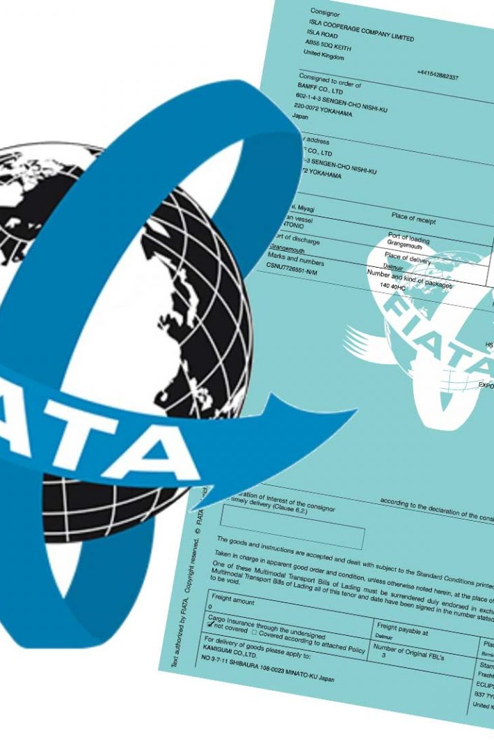
eFBL – The Cornerstone of Digital Multimodal Trade
The FIATA eFBL is a legally recognized, blockchain-compatible electronic Bill of Lading.
Adopted by 23 countries and integrated into 34 software providers.
Facilitates secure, paperless, and multimodal trade with enhanced traceability and trust.

Slide 15

Africa’s Digital Leap: Opportunities & Progress
04

Slide 16
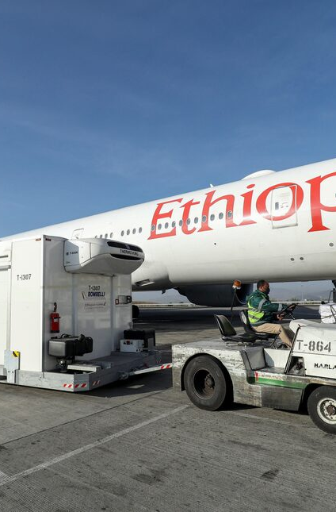
Ethiopia's Model and Regional Momentum
COOL ADDIS: A pilot initiative blending cold chain infrastructure with advanced customs integration.
Ethiopia is investing in automation for risk-based clearance, aiming to lead in time-critical sectors like pharmaceuticals and perishables.
The country’s air cargo growth is anchored in digital readiness and multimodal alignment.

Slide 17
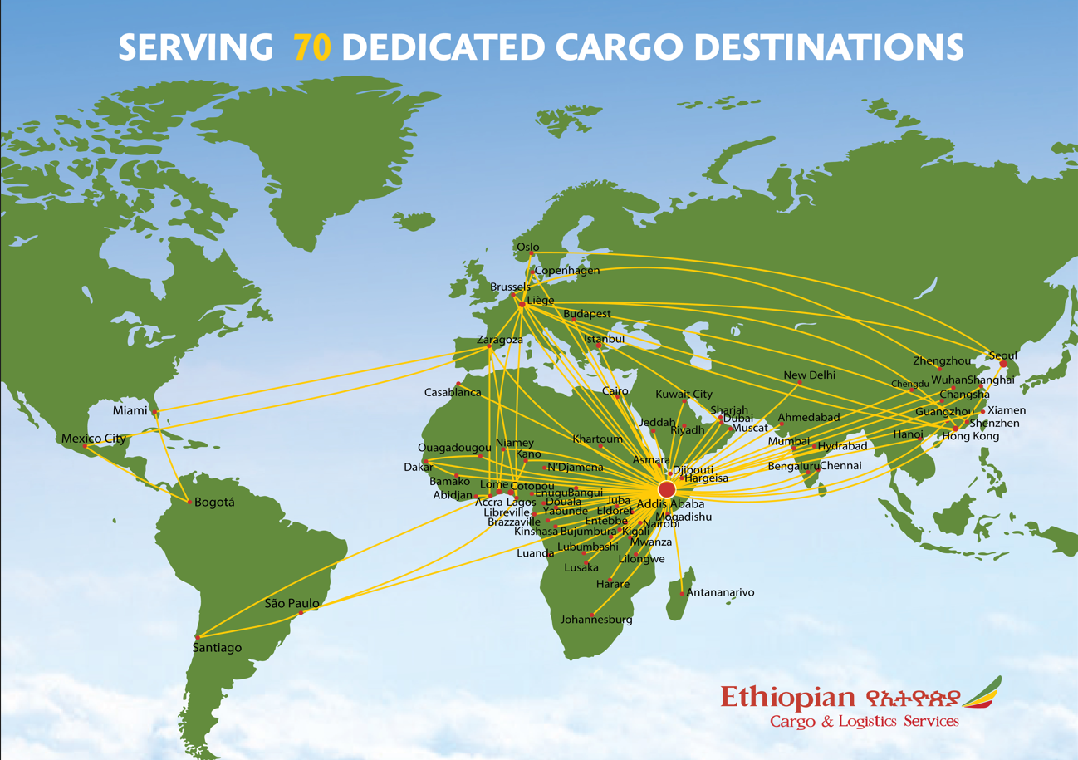

Slide 18
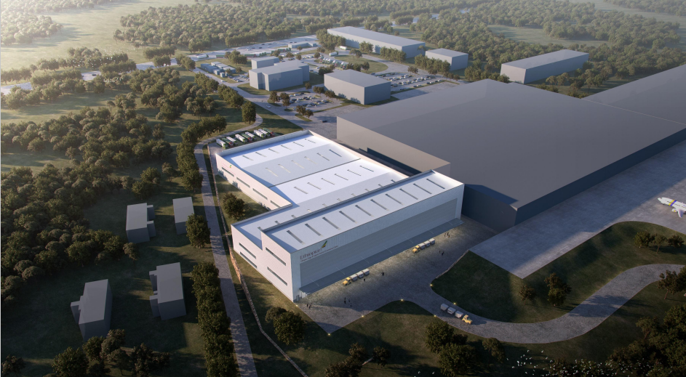

Infrastructure
Dedicated eCommerce Logistics Facility constructed on 15,000m2 area, equipped with automated ETV and sorting machine with over 1 million parcel sorting capability per day.

Slide 19





Service Offerings
ET-Mail
On Demand Fulfillment
1
2
3
4
ET-Courier
ET-eCOM

Slide 20

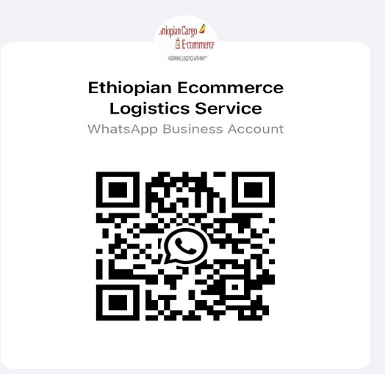
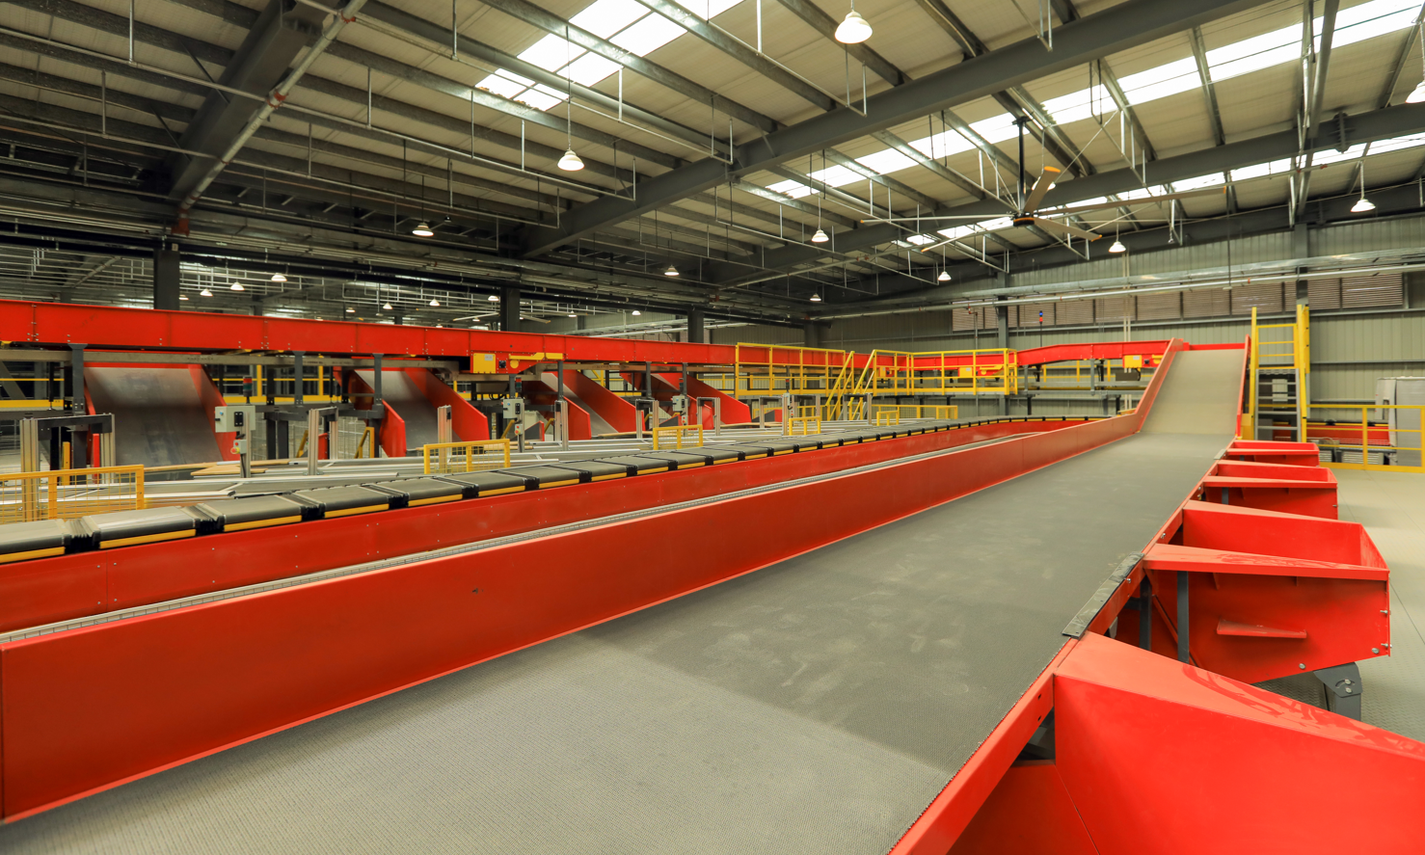
We look forward to collaborating with you across the glob to connect the world better than before!!!
-Ethiopian Ecommerce ,Courier & Mail Logistic Services Team
Contact :
  E-commerce, Courier & Mail Hub ecmhub@ethiopianairlines.com
  +251115174905
  +251-948-33-46-45
  Addis Ababa , Ethiopia

Slide 21

Capacity Development and Corridor Strategy
EFFSAA, in partnership with FIATA, launched the continent’s first Advanced Diploma in Supply Chain Management.
Ongoing “train-the-trainer” programs will upskill public and private logistics actors across the region.
Africa’s logistics leapfrog lies in digitized multimodal corridors (e.g. Djibouti–Addis, Lamu Port, Mombasa) and smart PPPs.
Others: Rwanda Air and Qatar Airways; Kenya Airways to Mpesa; South Africa digital transformation

Slide 22

Compliance & Collaboration in the Age of Automation
05

Slide 23

Ensuring Digital Compliance and Safety
AI-driven systems are improving safety through predictive alerts and automated ULD integrity checks.
Blockchain-based smart contracts are expediting customs and ensuring shipment authenticity.
Governments must adapt legal frameworks to accept and regulate digital logistics processes.

Slide 24

Inclusion, Trust, and Data Governance
Automation must be inclusive: SMEs need affordable, interoperable platforms (e.g., FIATA eFBL mobile apps).
Cybersecurity protocols (GDPR, ISO27001) must be embedded in freight systems from design phase.
Multilateral collaboration is essential for shared data ownership, platform trust, and end-to-end compliance.

Slide 25

Roadmap and Recommendations
06

Slide 26
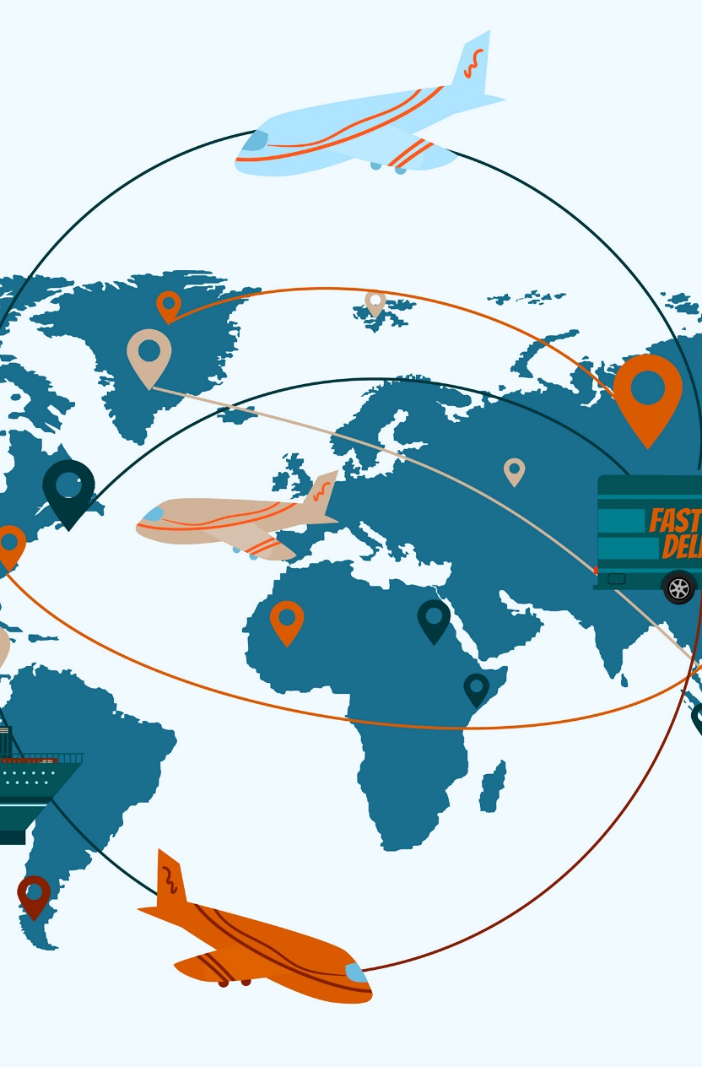
Creating an Interoperable Logistics Ecosystem
Harmonize global standards across platforms (IATA ONE Record, CargoXML, eFBL).
Invest in Public-Private Partnerships (PPPs) to close infrastructure and tech gaps.
Adopt digital identity and KYC frameworks for freight actors to enable secure, verified movement.

Slide 27

What’s Next – Strategic Priorities
Scale up digital training in freight forwarding, multimodal logistics, and compliance.
Support open access knowledge platforms for SMEs and customs authorities.
Formulate governance structures to oversee cybersecurity, interoperability, and regulatory innovation.

Slide 28
አመሰግናለሁ!

