Slide 2
Scholastica Opiyo
Manager, Dangerous Goods Standards
International Air Transport Association (IATA)
opiyos@iata.org
+41 76 783 33 92

Slide 3


Transporting Lithium Batteries

Slide 4
Transporting Lithium Batteries
01
Properties of Lithium cells and lithium batteries
02
Potential Risks
with Batteries
03
Increasing number of lithium battery incidents
04
An increasing trend in battery production
05
Incident causes
06
Risk Mitigation

Slide 5
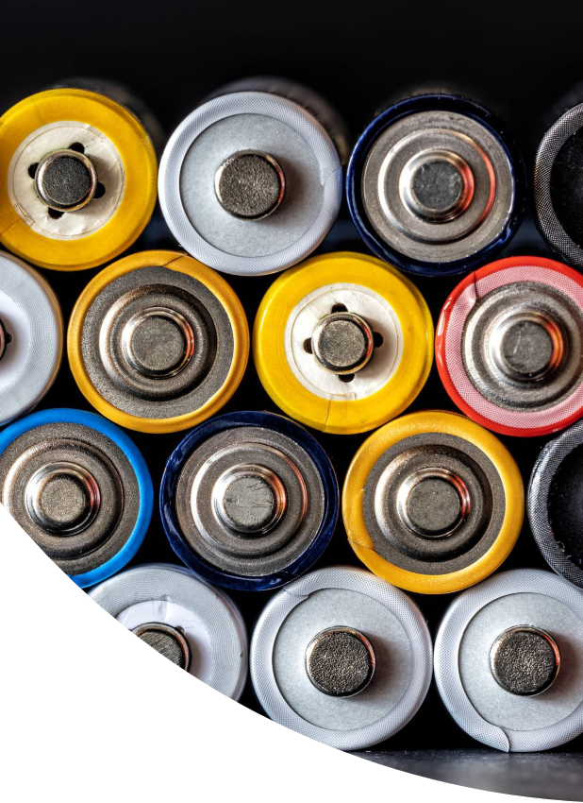
Properties of Lithium cells (or single cell battery) and lithium batteries :
Higher Specific Energy
Higher Energy Density
Higher Energy Efficiency
Longer cycle life (Rechargeable Lithium Ion)
Longer calendar life
Light in weight
High current delivery from small battery forms
Very long shelf life (Lithium metal)

Slide 6
Potential Risks with Batteries
Cells triggering heating of other nearby cells
05
01
03
04
Release of toxic gases
leading to air that is toxic to people
02
Release of flammable liquid electrolyte leading to combustion of nearby materials
Short circuit (or other internal failure)
leading to overheating
Release of flammable gases
leading to build-up and gas explosion
Pressure build up inside the battery casing leading to explosion

Slide 7
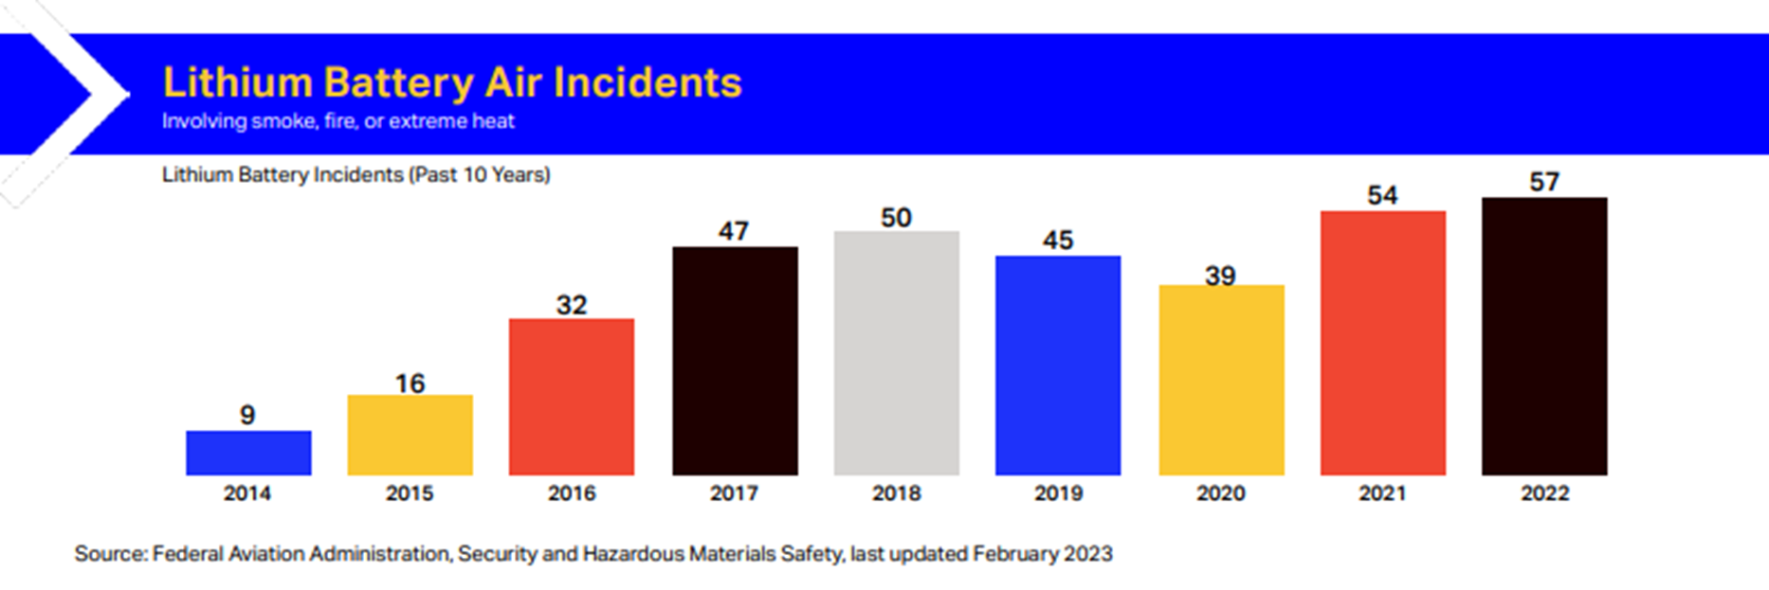
Increasing number of lithium battery incidents

Slide 8
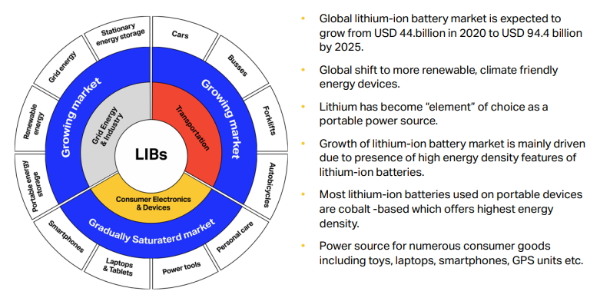
An increasing trend in battery production

Slide 9
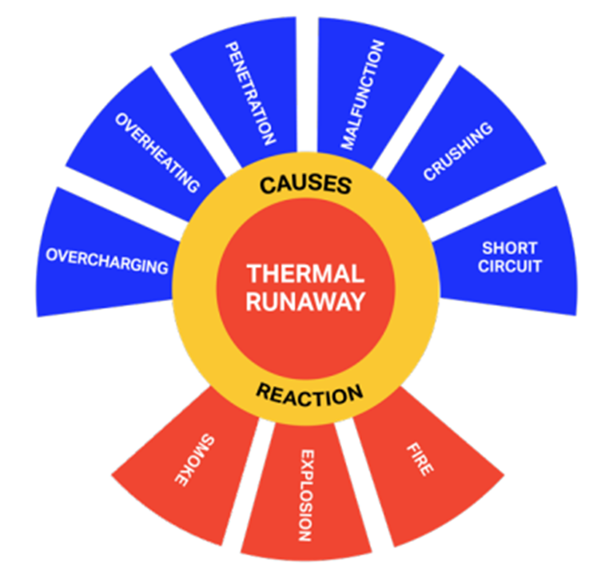
Incident causes include:
Increasing production of counterfeit lithium batteries with sub-standard safety features
Undeclared battery consignments.
Misuse of refurbished lithium batteries in products.
Packaging disguised as genuine articles.
Non-compliance with international regulations when manufactured.
Poor handling or damage during transportation
Lack of proper safety management systems (SMS).
Inadequate or insufficient training.

Slide 10
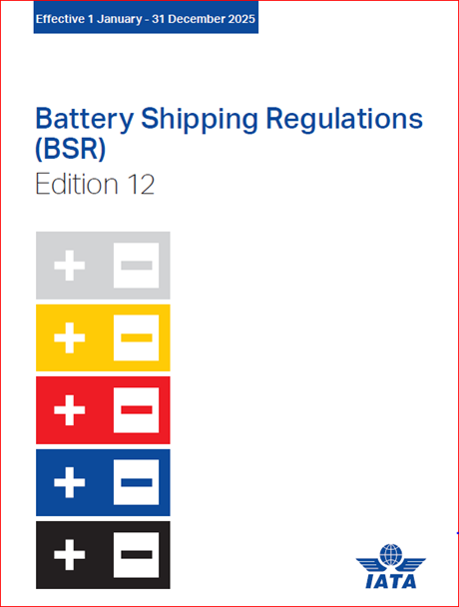
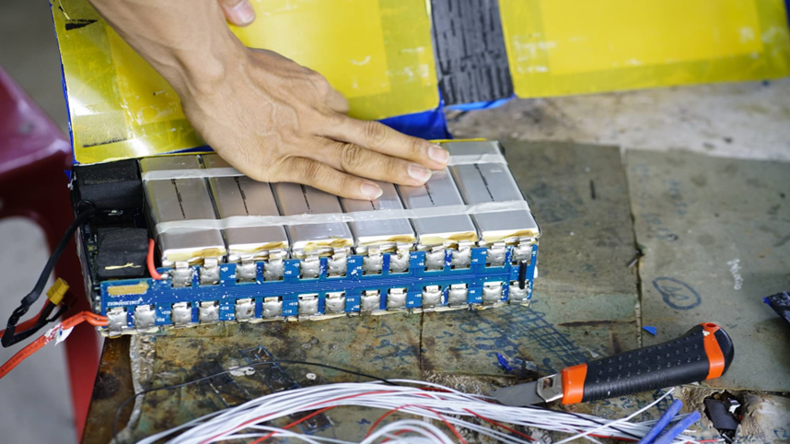
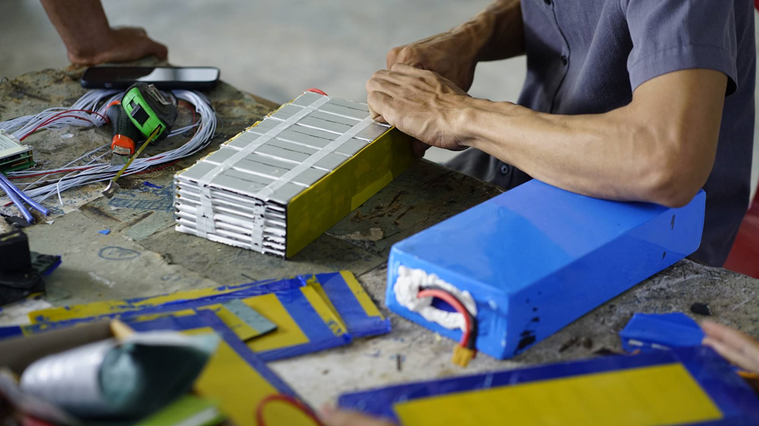
Risk Mitigation
www.iata.org/BSR
Regulations
Manufacture
Testing

Slide 11
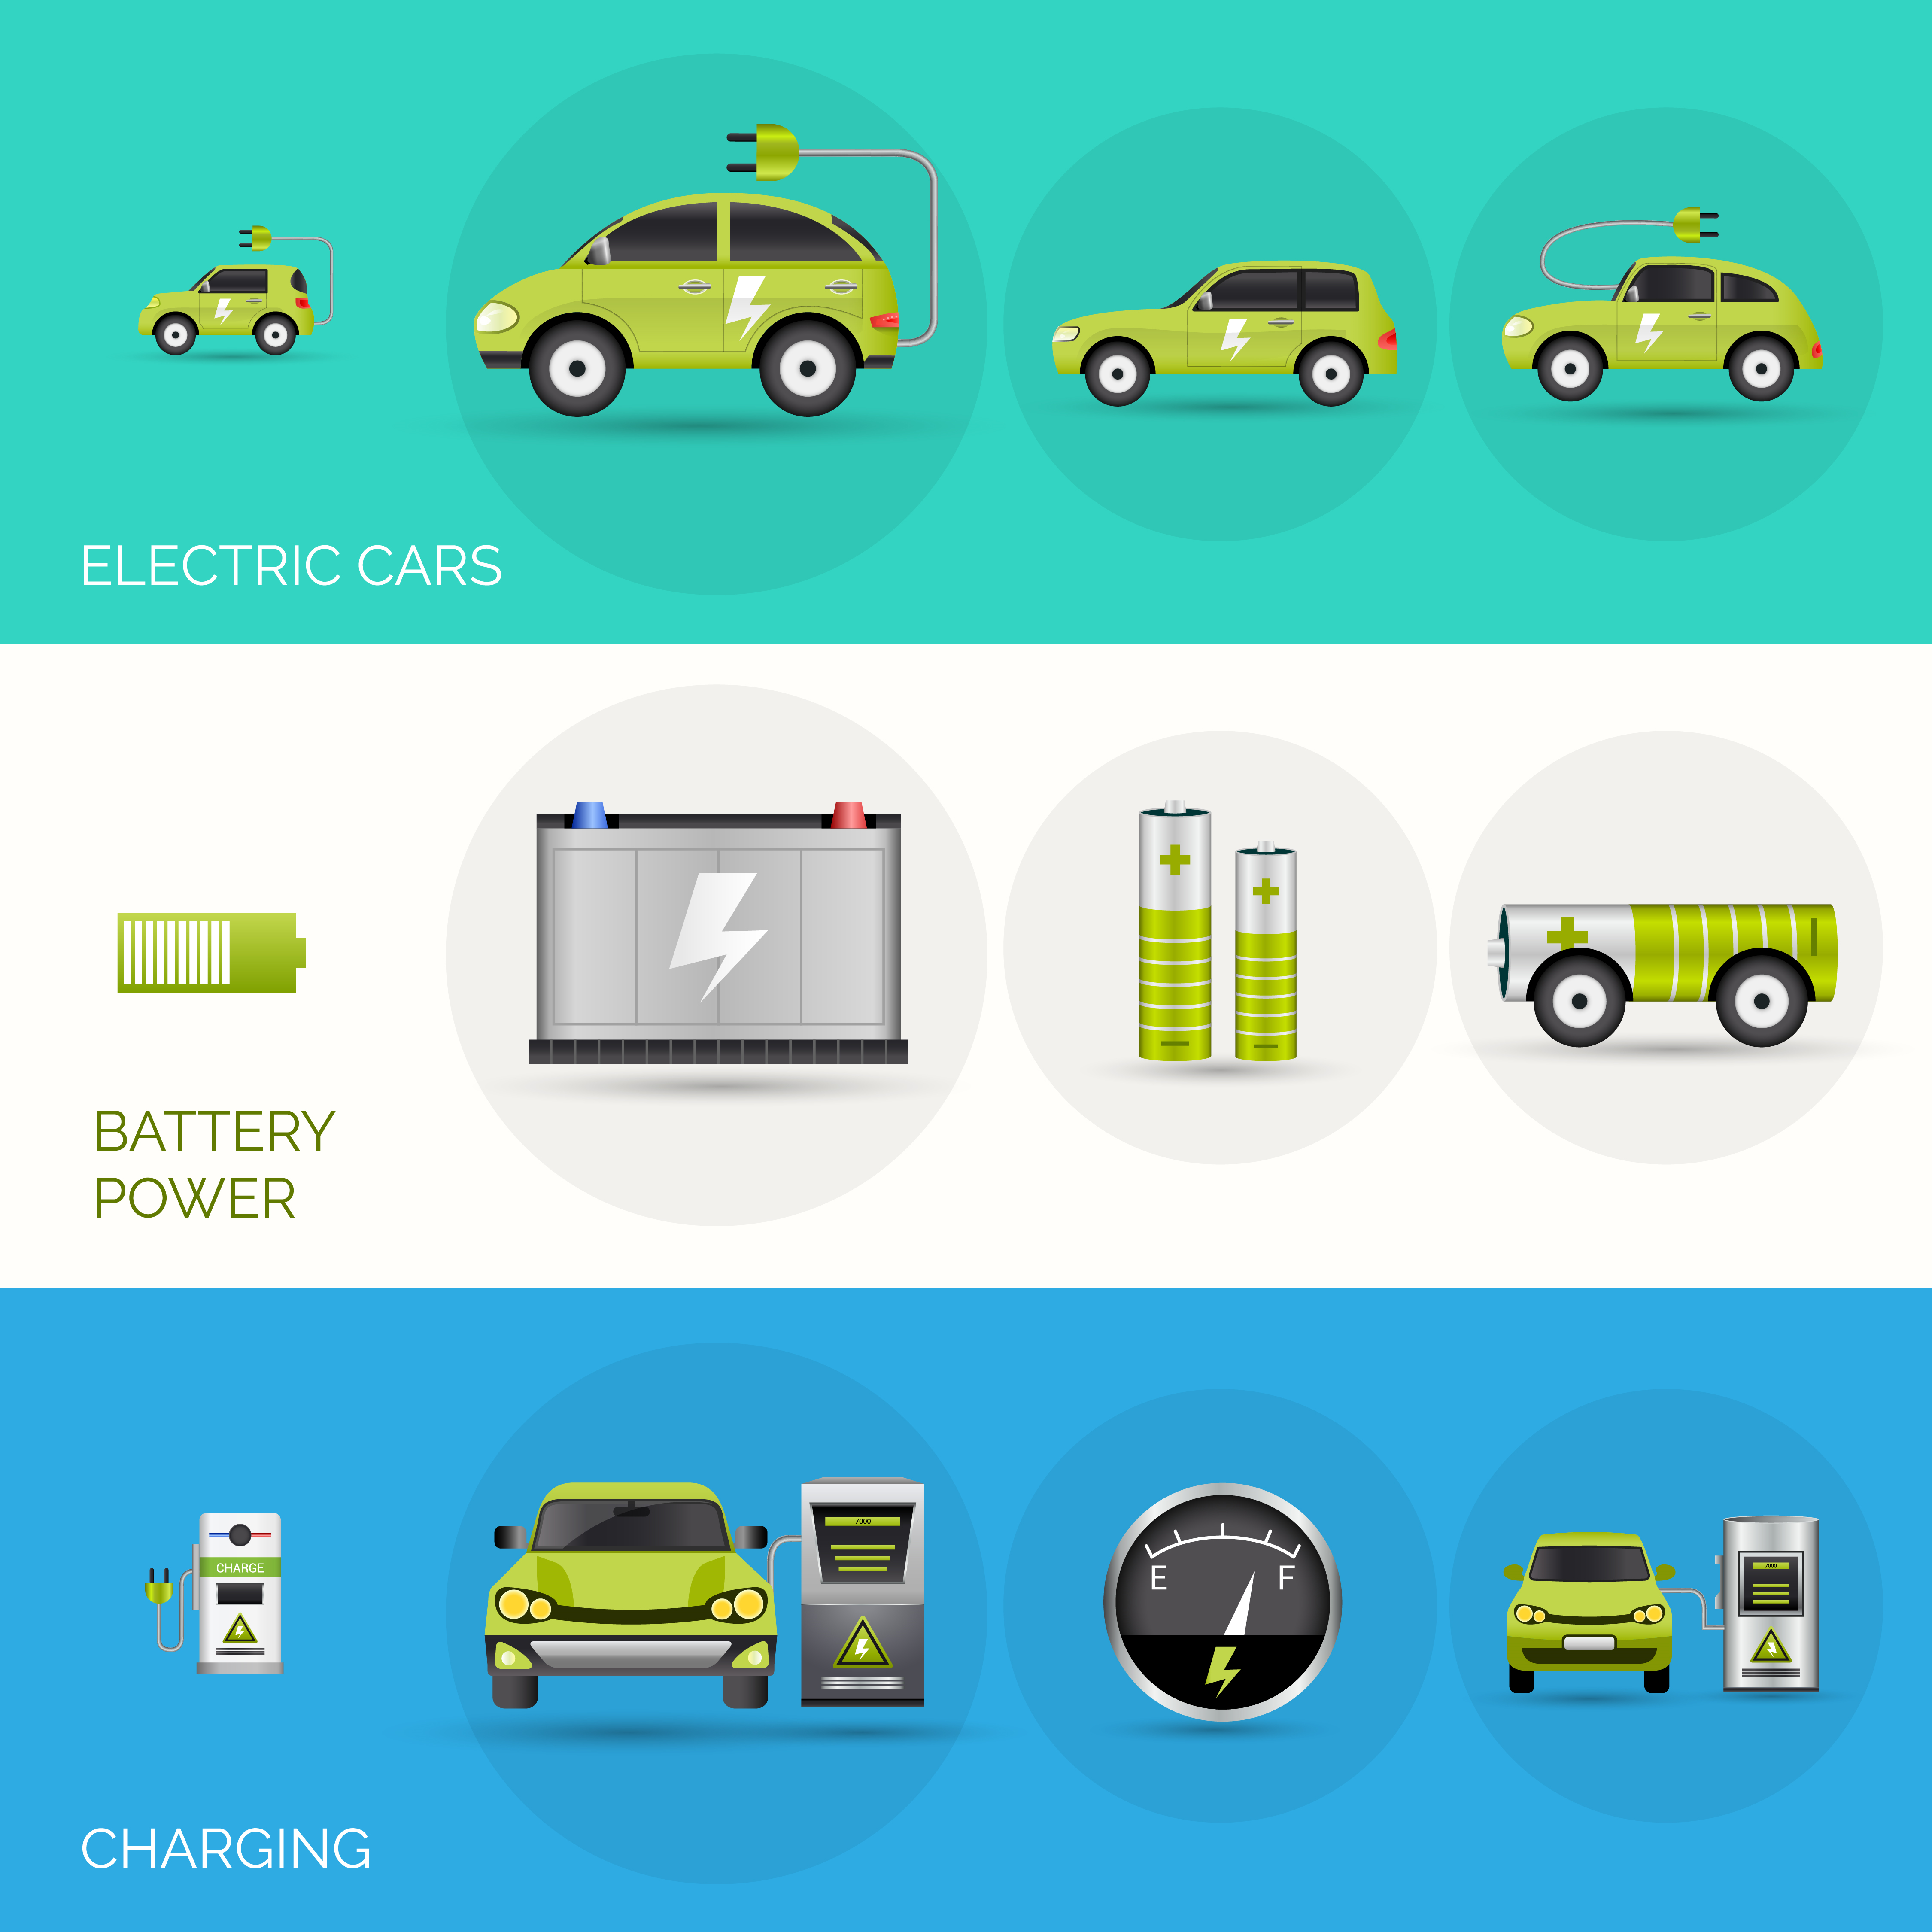
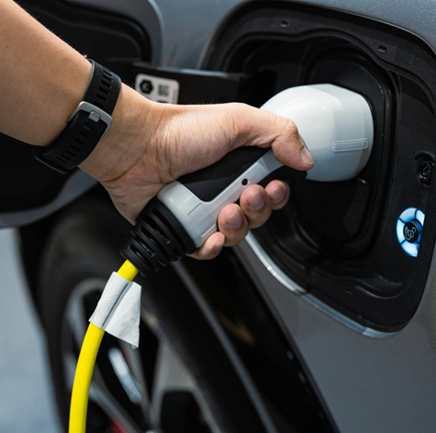
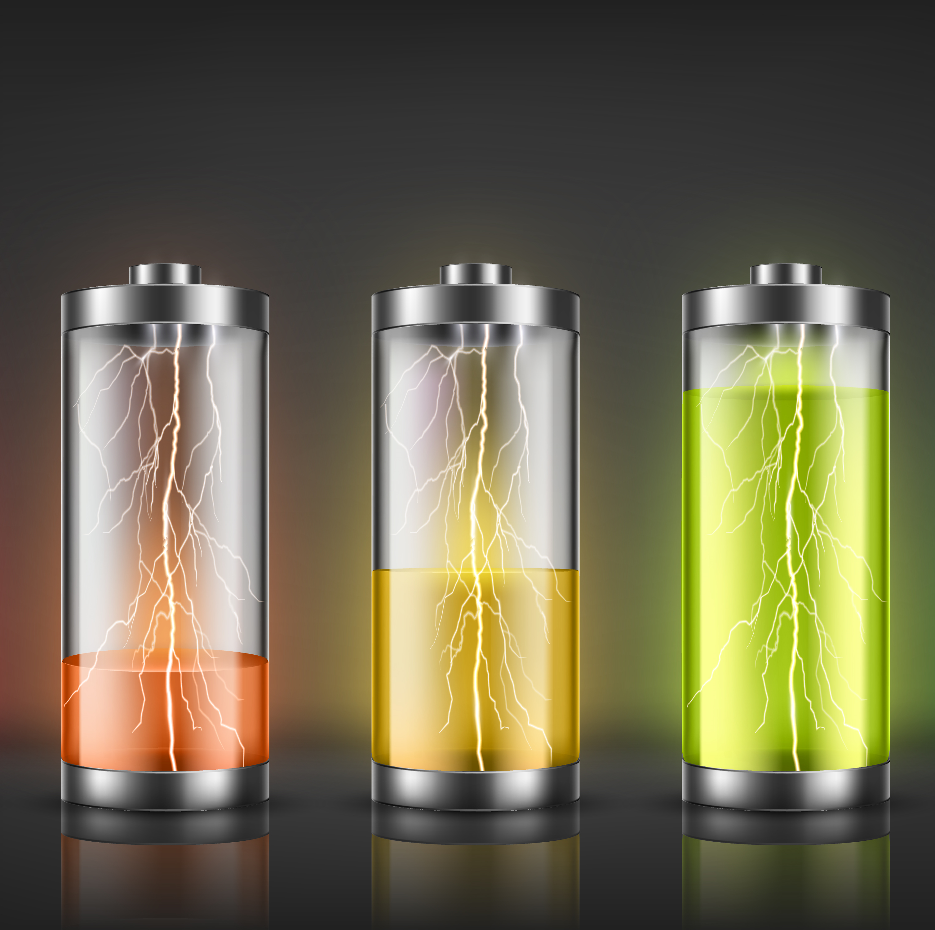
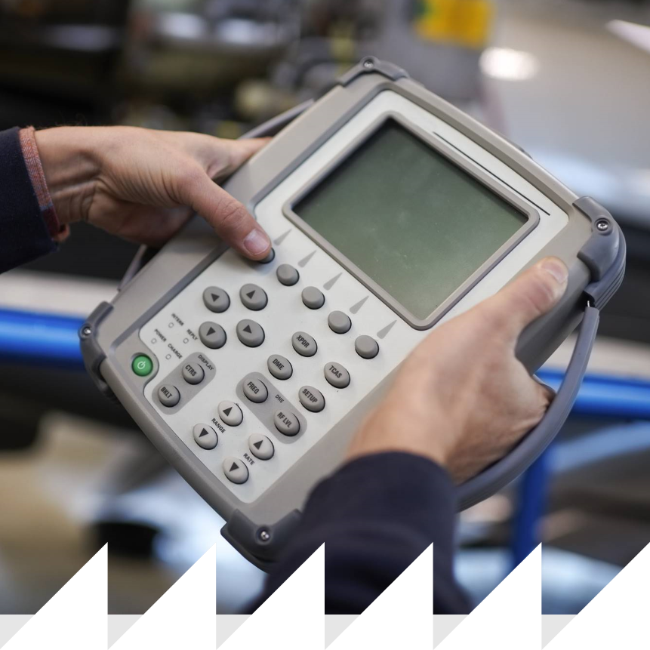
Risk Mitigation
30%
State of Charge
or…
25%
Indicated Battery Capacity

Slide 12
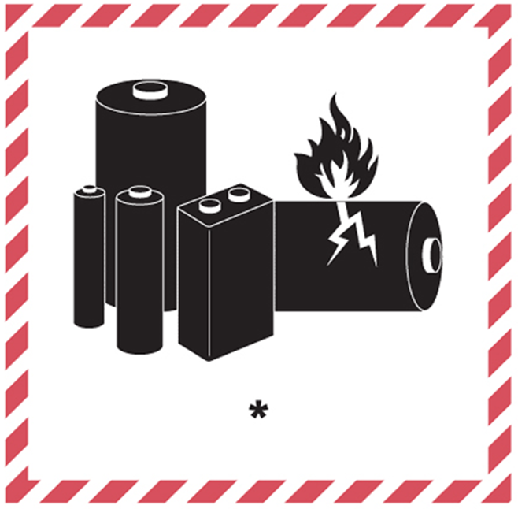

Hazard Labelling
Package Marking

Slide 13
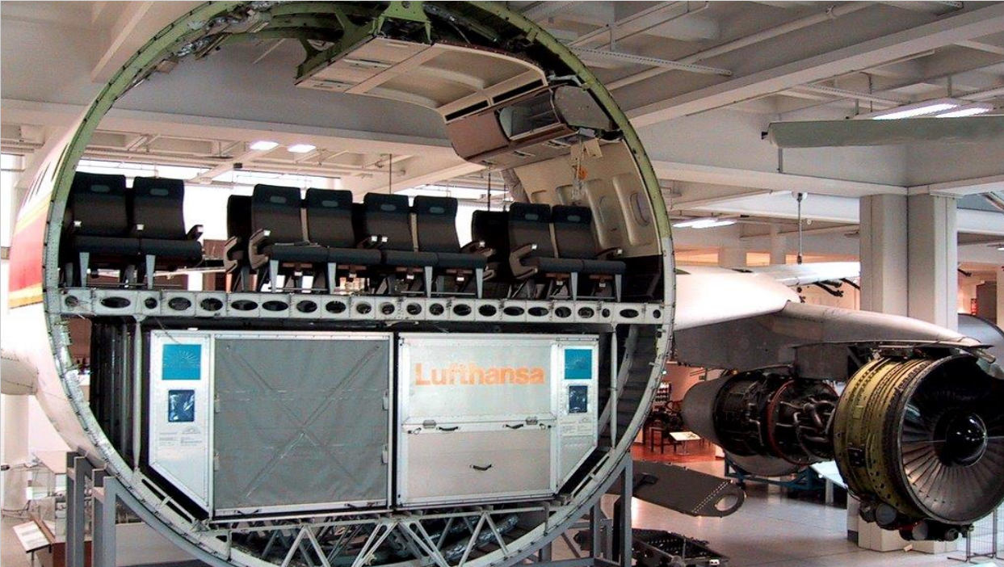
Developing New Fire Resistance Standards
For individual packaging and aircraft containers

Slide 14
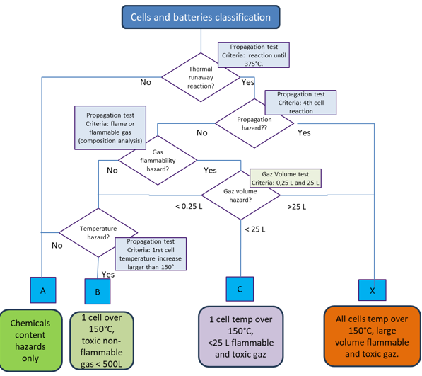
Additional Classification Criteria for Lithium and Sodium ion Batteries?
Increasing Risk….

