Slide 1
Notes:
Copyright © Airbus SAS. 2025 All rights reserved.

Slide 2

SAF & Beyond
Technology innovations towards the decarbonisation of aviation
Danielle Vanderwalker
Marketing Manager, Environment & Sustainability
AIRBUS
Notes:
Copyright © Airbus SAS. 2025 All rights reserved.

Slide 3
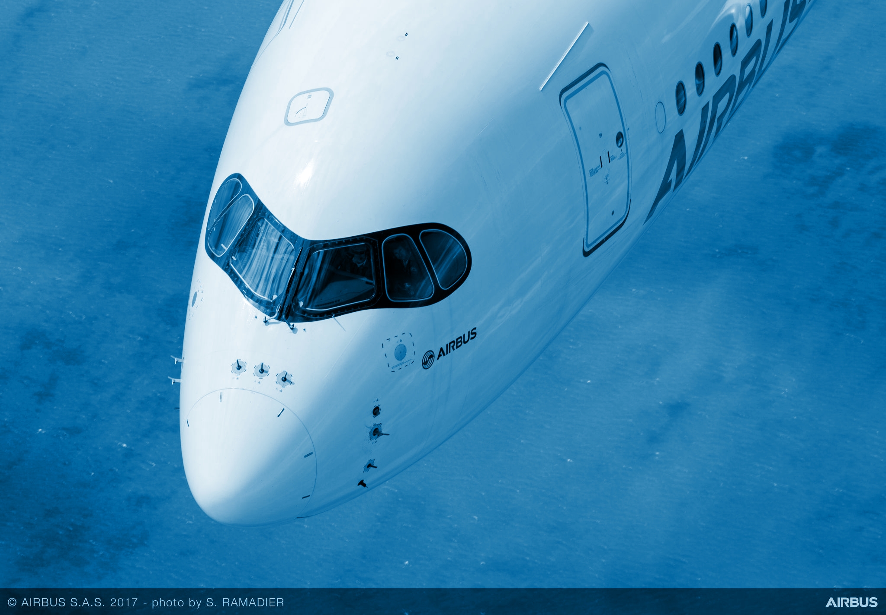
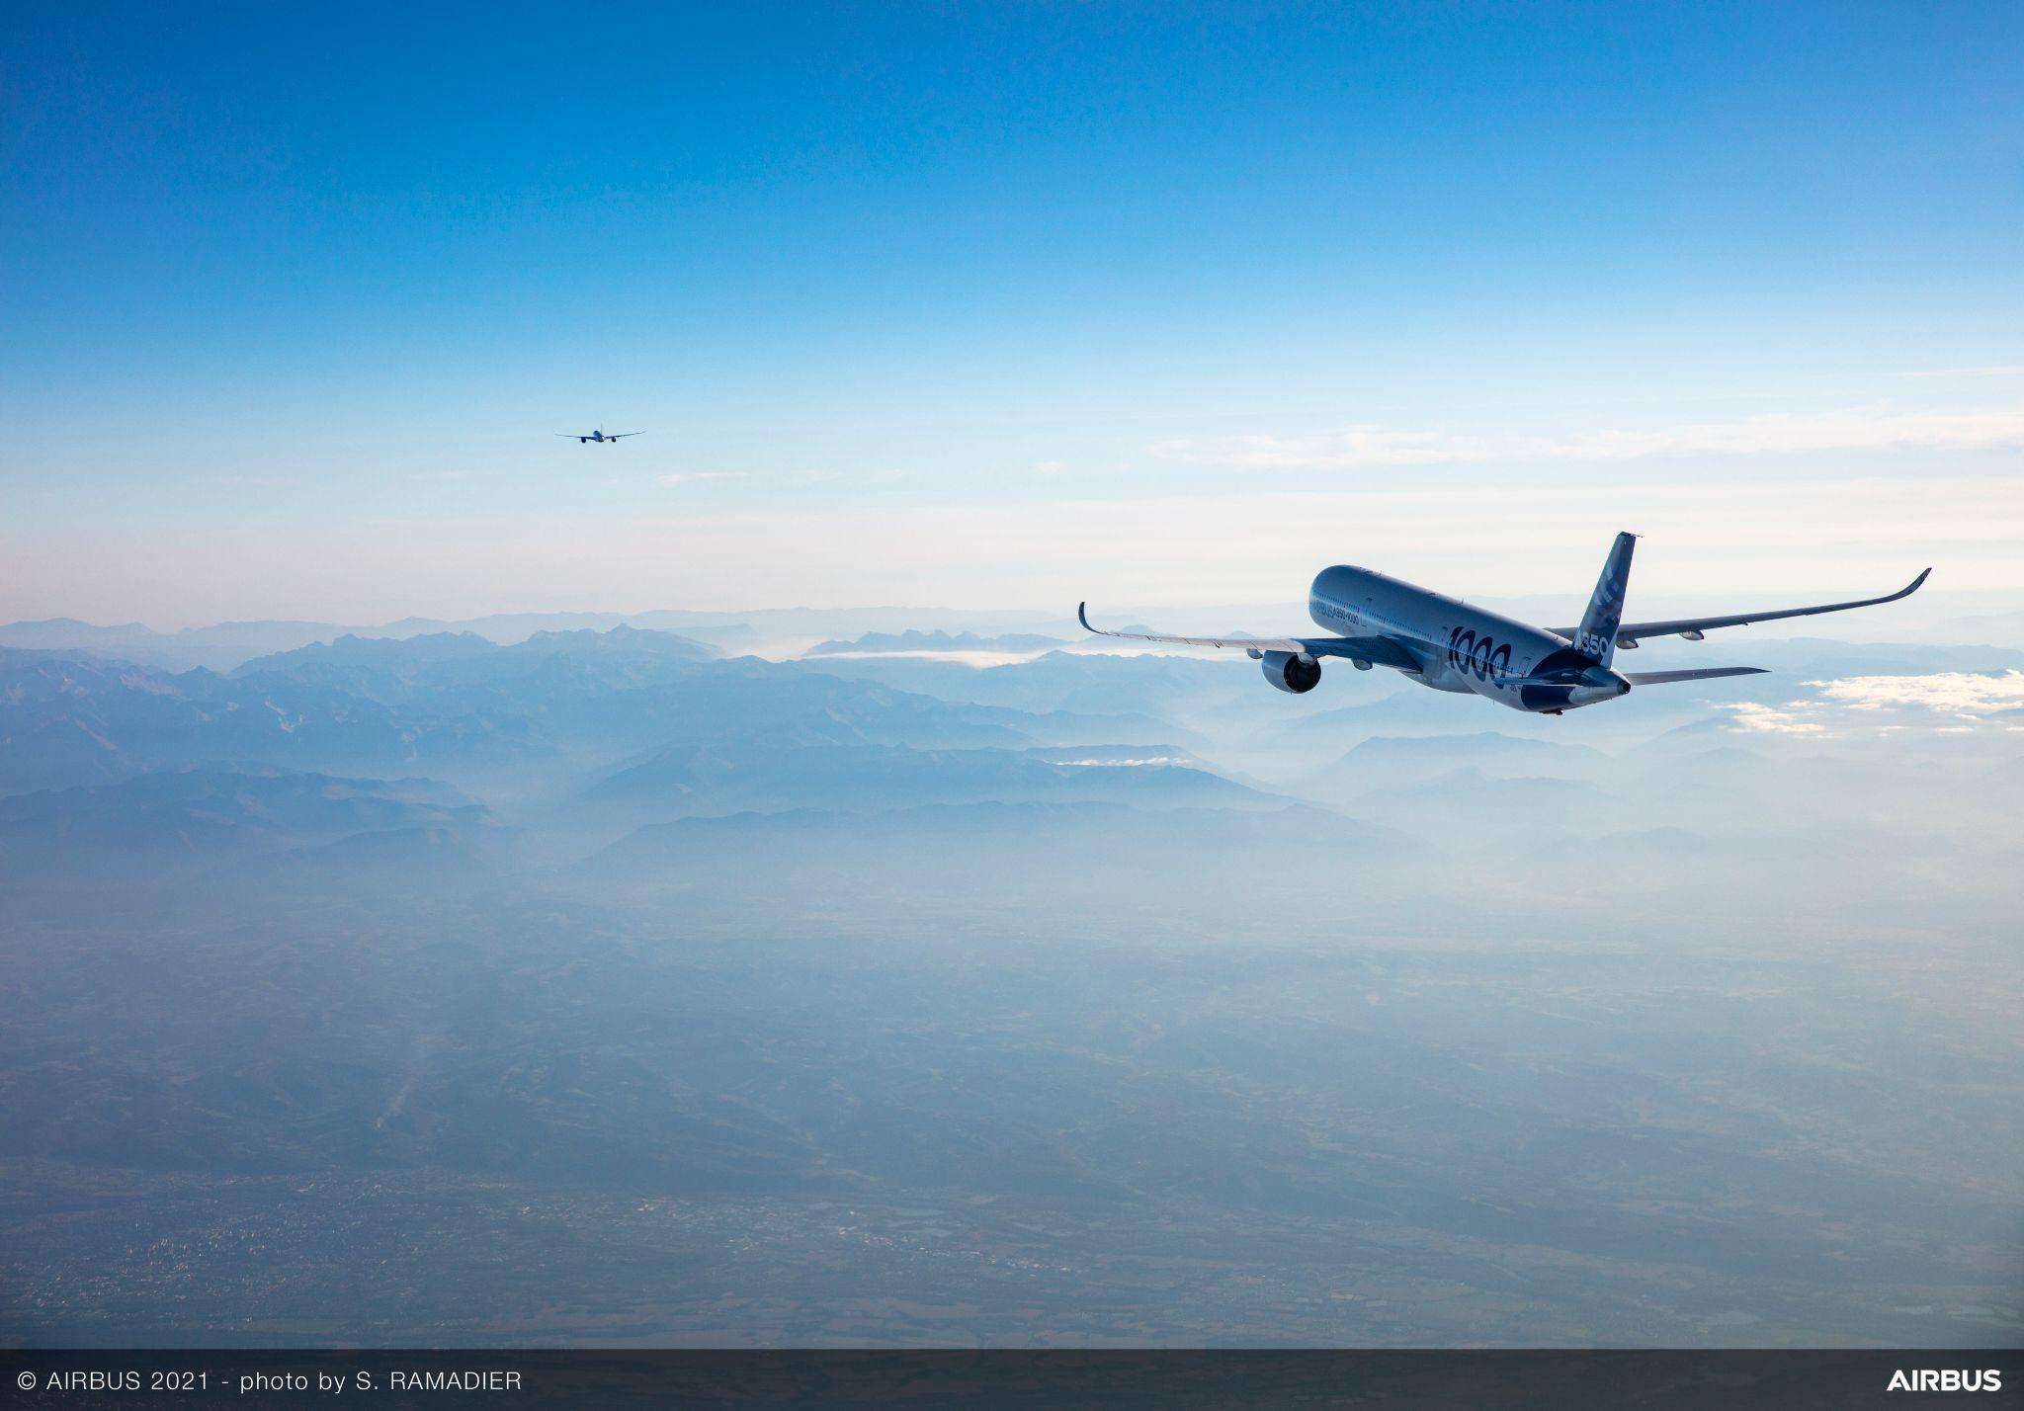

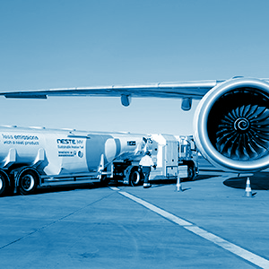
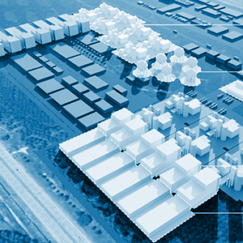
Aviation’s decarbonisation roadmap
A portfolio of levers and a hierarchy of actions
LATEST AIRCRAFT
& UPGRADES
OPERATIONS &
INFRASTRUCTURES
DISRUPTIVE
TECHNOLOGIES
AVOID
REDUCE
SUSTAINABLE AVIATION FUELS
COMPENSATE
CARBON OFFSETTING & REMOVAL
Notes:
Copyright © Airbus SAS. 2025 All rights reserved.

Slide 4



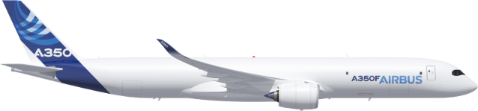
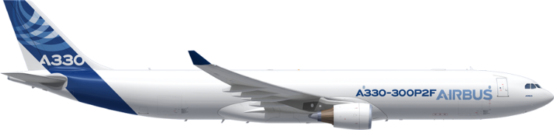

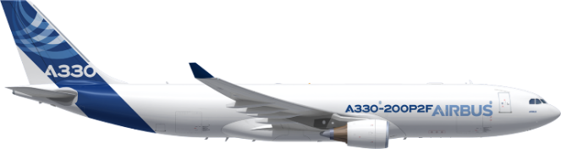

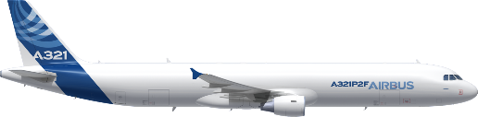


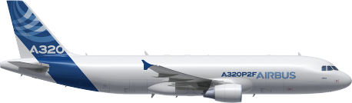
Large
AVOID > Latest aircraft & upgrades
Up to 111t - 4,700nm - EIS 2027
Airbus freighter portfolio
Unique features
Full Market Coverage
2-deck ULD capability
Fly-by-wire benefits
One pool of pilots
Medium
Up to 62t – 3,700nm – EIS 2017
Up to 60t - 4,200nm – EIS 2018
Small
Up to 28t - 2,100nm – EIS 2020
Up to 21t - 1,900nm - EIS 2022
Notes:
Copyright © Airbus SAS. 2025 All rights reserved.

Slide 5

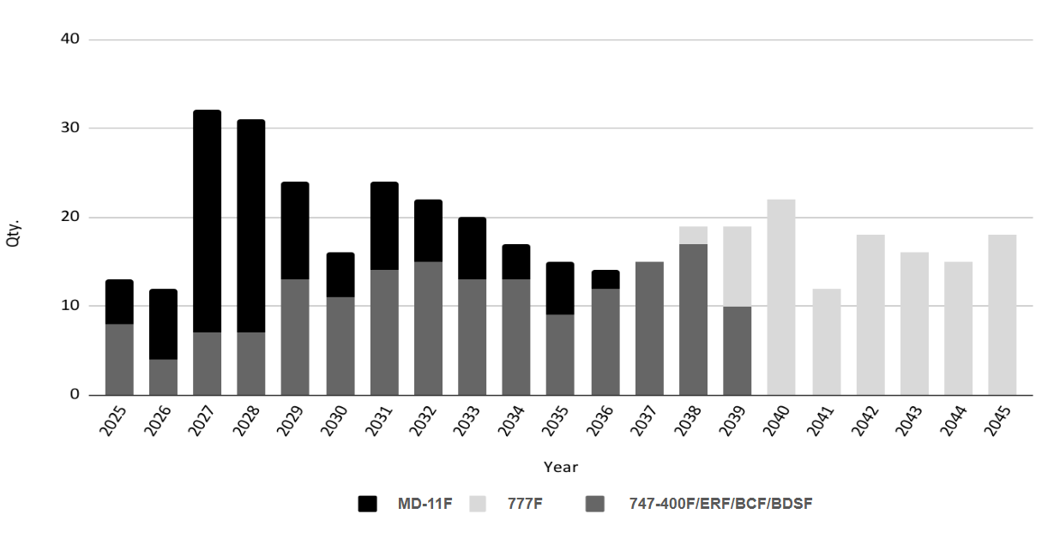

A350F
head of the wave
  Over 100 747-400 turning 30 in 2029-2039
2027: EIS of A350F
End 2027: new ICAO CO₂ standard
A350F ideally placed to replace in-service 747F, MD-11 & 777F
Data source: Cirium March 2025
In-service & Stored freight & cargo aircraft
747-400F, ERF & conversions, 777-200LRF, MD11F & conversions
Notes:
Copyright © Airbus SAS. 2025 All rights reserved.

Slide 6
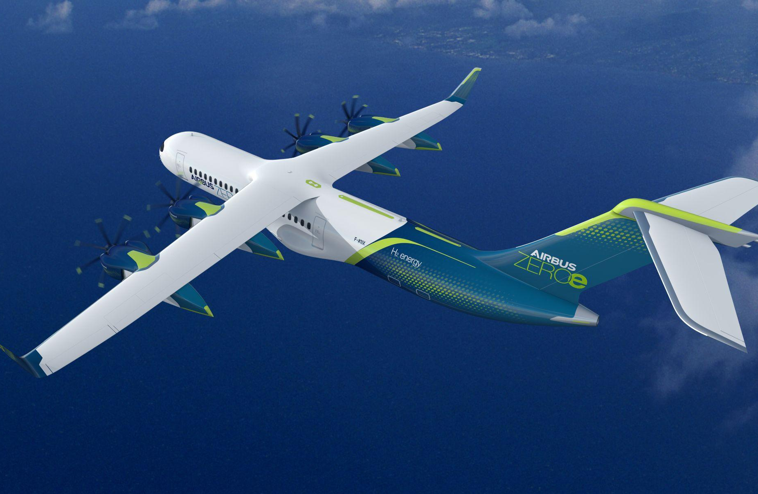
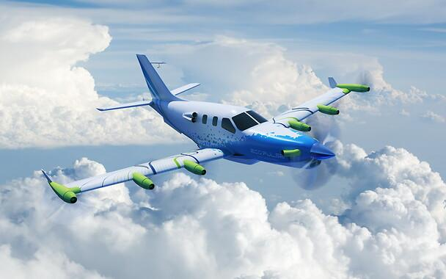
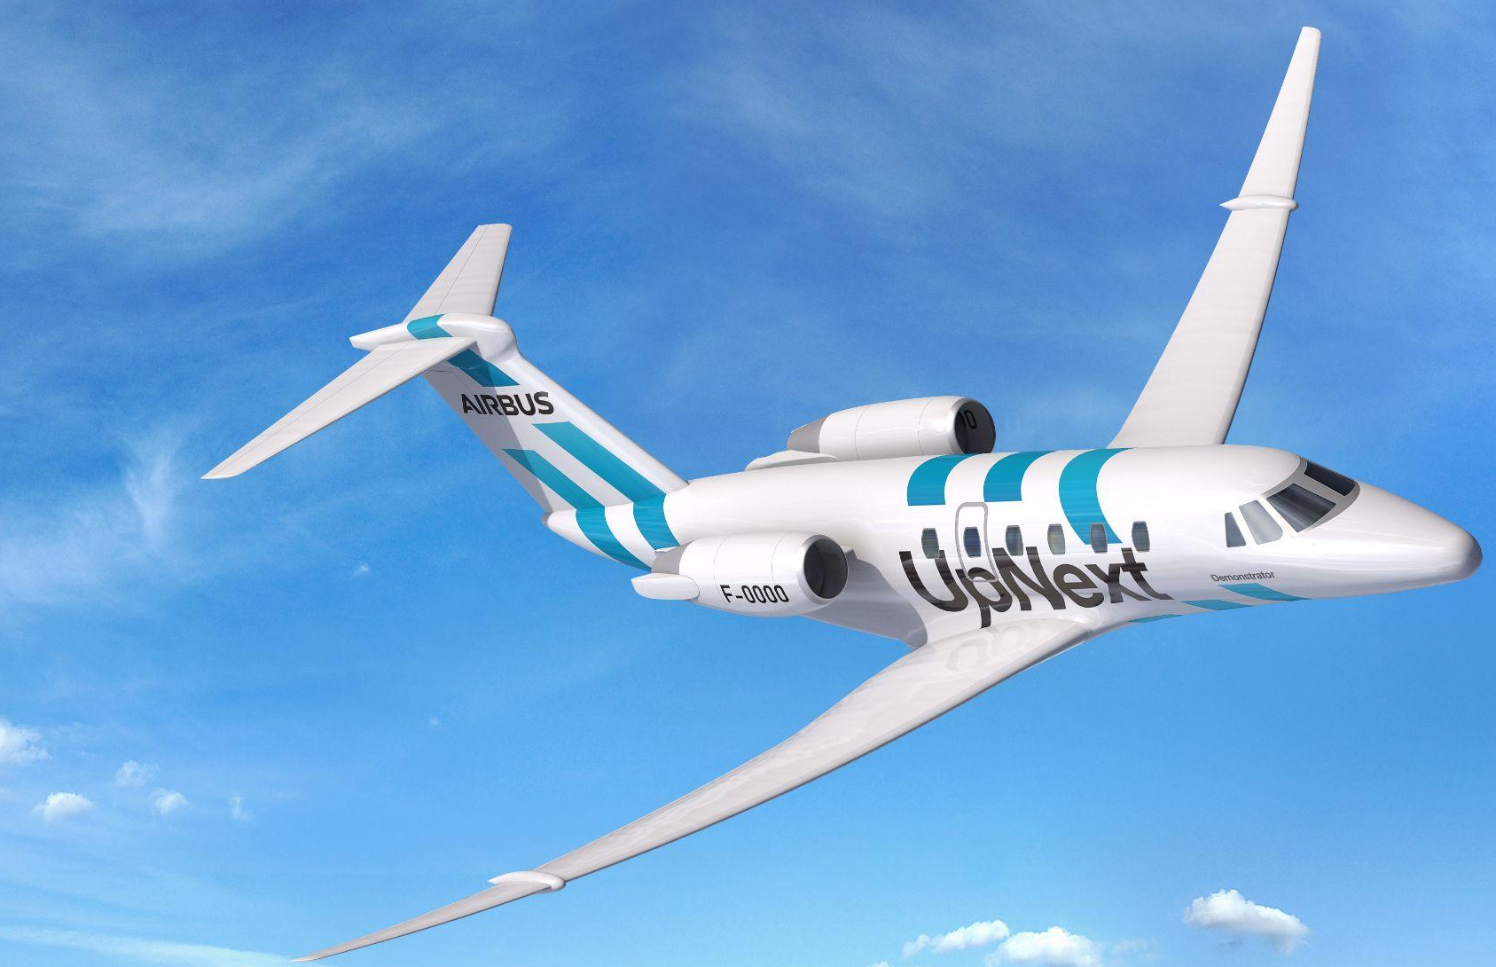
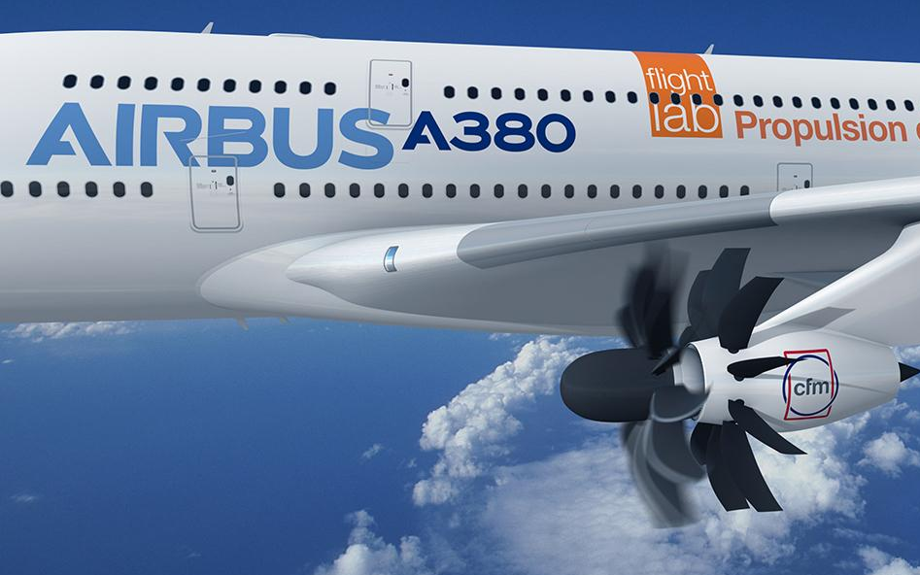
AVOID > Development, testing and maturity-based deployment of disruptive technologies
Advanced solutions for all aircraft (aerodynamics / airframe / propulsion / hybridization / hydrogen)
Notes:
Copyright © Airbus SAS. 2025 All rights reserved.

Slide 7
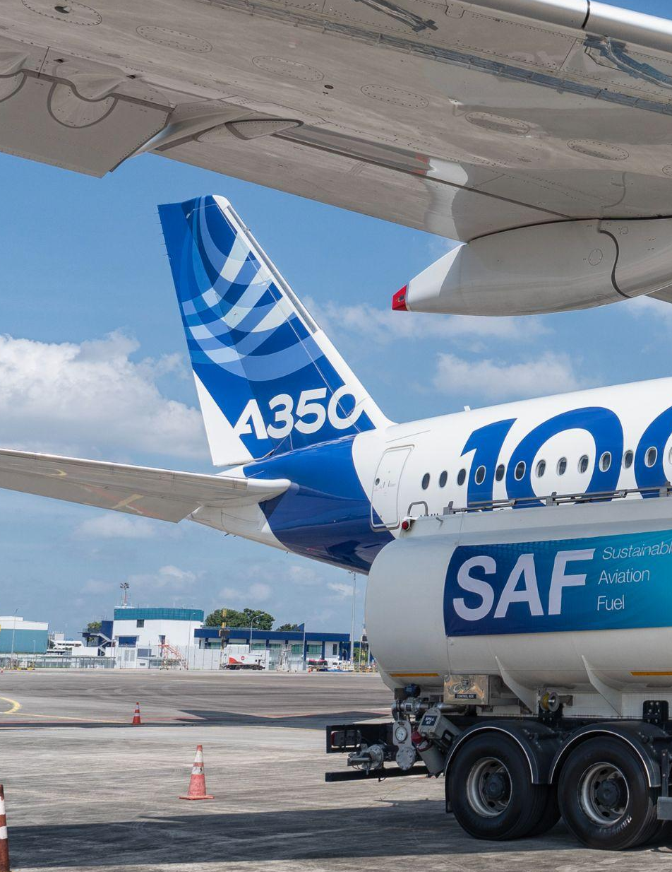
REDUCE > Sustainable Aviation Fuels (SAF)
Four levers to progress the global SAF agenda
Efforts with regulatory bodies and industry associations to develop consistent frameworks for SAF developments
Advocacy
SAF Technical Leadership
Support of SAF production pathways approval and use in aircraft
Demand Aggregation
Intermediary role, consolidating SAF demand from customers to match SAF supply, using Airbus unique positioning in the value chain
Investment
Financial participation in SAF projects and/or companies
Notes:
Copyright © Airbus SAS. 2025 All rights reserved.

Slide 8
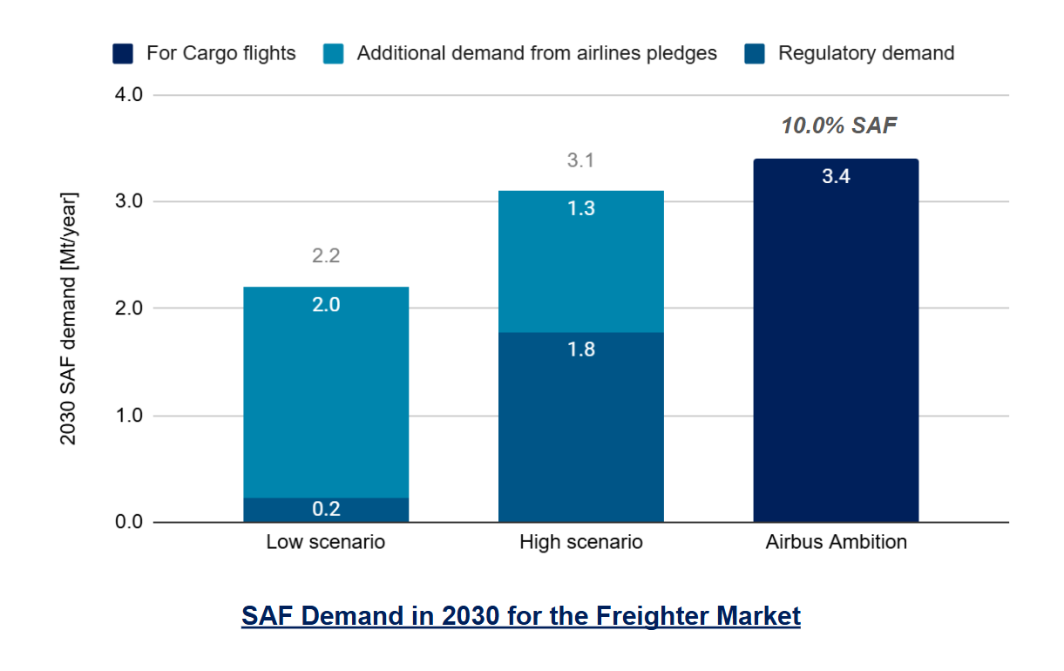
Voluntary demand is key to achieve 10% SAF in 2030
The A350F: the First New Generation Freighter
Low scenario = EU27 (6%) + Brazil (3%) + Indonesia (5%) + Japan (10%) + Malaysia (3%) + Norway (30%) + Singapore (5%) + UK (10%) .
High scenario = Low scenario + Australia (10%) + China (5%) + India (5%) + New Zealand (7.5%) + Switzerland (6%) + Turkey (5%) + UAE (1%) + US (15%)
Nota:
Regulatory demand includes demand from mandates and some local targets supported by dedicated regulation (e.g Japan).
Estimation based on Airbus Global Market Forecast 2023, on internal knowledge of mandates and Airlines pledges.
X% SAF: corresponds to the share of SAF compared to total cargo fuel needs, based on Airbus Global Market Forecast 2023.
Notes:
Copyright © Airbus SAS. 2025 All rights reserved.

Slide 9
COMPENSATE > Carbon offsetting & removal
Compensation will play an important role for hard to-to-abate sectors like aviation
LATEST AIRCRAFT
& UPGRADES
OPERATIONS &
INFRASTRUCTURES
DISRUPTIVE
TECHNOLOGIES
AVOID
REDUCE
SUSTAINABLE AVIATION FUELS
COMPENSATE
CARBON OFFSETTING & REMOVAL
Notes:
Copyright © Airbus SAS. 2025 All rights reserved.

Slide 10


Airbus is leading aviation decarbonisation
2050+
Today
Fleet renewal
Continuous incremental improvement
CO₂ Offsetting & Capture
→ 25% CO2 reduction compared to previous generation passenger aircraft, up to 40% for large freighters
Services portfolio
Expanding upgrades / performance & trajectory optimisation
Disruptive technology
→ improving aircraft operational efficiency → opencargolab →Connected aircraft → Fello’Fly
Up to 50% SAF capability
Moving from 50 to 100% capability by 2030
Sustainable Aviation Fuel
Developing disruptive aerodynamics / airframe / propulsion / energy
Operations
→ eXtra Performance Wing
→ Next Generation Single Aisle / ZEROe
Supporting CORSIA & carbon removals
Latest generation aircraft
→ DACCS scale-up and advocacy
Notes:
Copyright © Airbus SAS. 2025 All rights reserved.

Slide 12


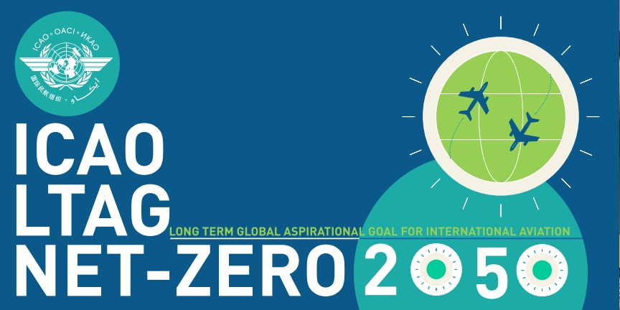
IATA – ATAG – ICAO moving forward to decarbonise
Airline commitment to Net Zero 2050
ICAO sets -5% carbon intensity goal by 2030 for aviation fuel
2022
2050
2021
2023
ICAO adopt 2050 net-zero carbon emissions goal
Aviation’s
Net-Zero ambition
Notes:
Copyright © Airbus SAS. 2025 All rights reserved.

Slide 13
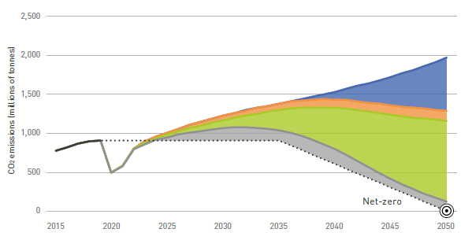
Aviation’s decarbonisation roadmap
For each lever, technology and collaboration are essential
Airbus supports the ATAG most ambitious technology scenario
Latest Generation Aircraft
Frozen 2019 fleet efficiency
Avoid
Disruptive Technology
Operations & Infrastructures
Sustainable Aviation Fuels
Reduce
Carbon offsetting & removal
Compensate
Notes:
Copyright © Airbus SAS. 2025 All rights reserved.

Slide 14


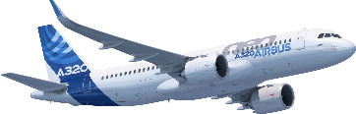

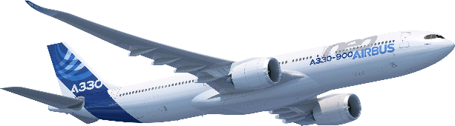

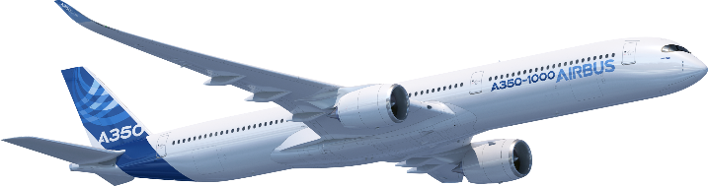

34% of world passenger fleet are latest generation aircraft
Our latest generation
passenger family of aircraft offer
around 25% greater efficiency
compared to previous generations
Fuel / CO₂ efficiency per seat / tonne based on following aircraft parameters:
A220-300 PW1521G, 141 seats vs A319-100, V2522-A5, 124 seats
A320neo PW1127G, 165 seats vs 737-800, CFM56-7B24E 159 seats
A330-900 Trent 7000-72, 187 seats vs 777-200ER, Trent 892, 291 seats
A350-1000 Trent-97, XWB, 400 seats vs 777-300ER, GE90-115B, 406 seats
A350F Trent-97 XWB, 111t gross payload vs 747-400F, CF6-80C2B1, 116t gross payload
Source (fleet data): Cirium, Airbus
January 2025 status
Notes:
Copyright © Airbus SAS. 2025 All rights reserved.

Slide 15
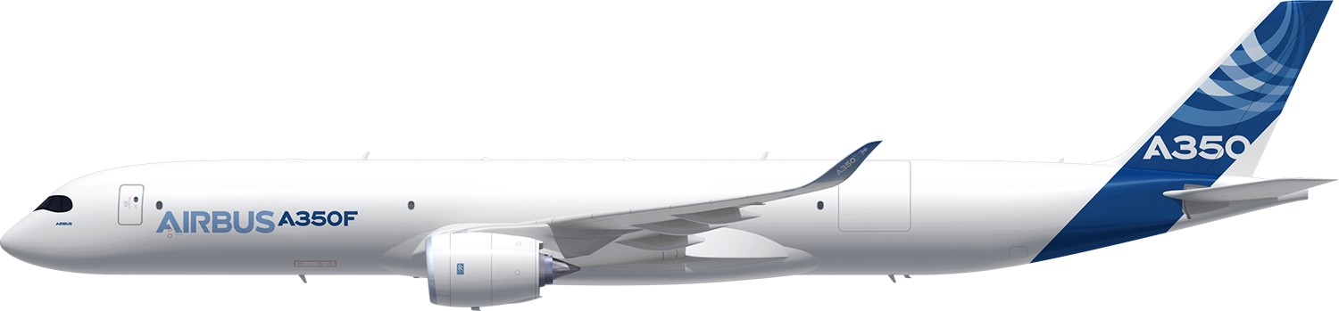

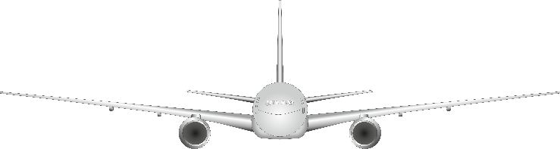
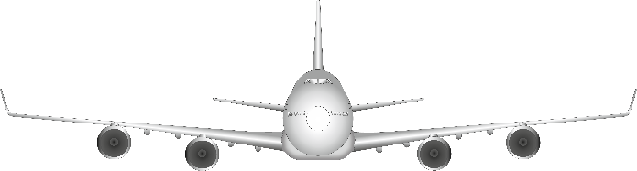
AVOID > Step Change Fuel Burn and CO2 Emissions
The A350F: the First New Generation Freighter
777F
20% lower
747-400F
40% lower
Fuel / CO₂ efficiency per tonne based on following aircraft parameters:
A350F Trent-97 XWB, 111t gross payload vs
747-400F, CF6-80C2B1 116t gross payload
777F, GE90-110B, 106t gross payload
Notes:
Copyright © Airbus SAS. 2025 All rights reserved.

Slide 16


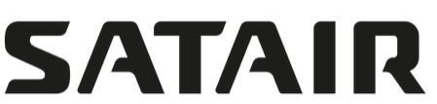
AVOID > Flight and ground operational optimisation
Airbus services sustainable offer
DPO:
Standard: A320/A330NEO
Retrofit: A320CEO
Standard: A320/A330NEO
Retrofit: A320CEO
AMF - Air management function
SMARTFILL
DPO - Descent Profile Optimization
IDLE - Factor Optimizer
SHARKLET
retrofit
Performance noise studies
VORTEX Generator
CDA - Continuous Descent Approach
SETWA - Single Engine Taxi Without APU
RNP - Required Navigation Performance
Taxibot
TTPC - Tow Truck Power Connector
ESG - Extended Services Goal
Additive Manufacturing & 3D PRINTING
USM - Used Serviceable parts & services
FHS-COMPONENTS in circular economy
Aircraft DISMANTLING & recycling
OPTIMIZE - Performance Factor Optimizer & IDLE Factor Optimizer TRAINING & CONSULTING - Fuel & Flight Efficiency
Mission+ Electronic Flight Assistant
AIRSPACE Design
*1KG fuel burn = 3.16 CO2 emission
Notes:
Copyright © Airbus SAS. 2025 All rights reserved.

Slide 17
REDUCE > Creating a SAF ecosystem
Regulators
Governments
Industry bodies and alliances
Mandate / Incentive
Advocacy
Advocacy
Mandate / Incentive
Demand
Supply
Deliveries
Air operators
Actors of the supply chain
Corporate end-customers
Offtake
Notes:
Copyright © Airbus SAS. 2025 All rights reserved.

Slide 18

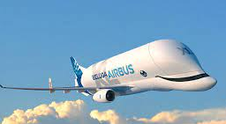
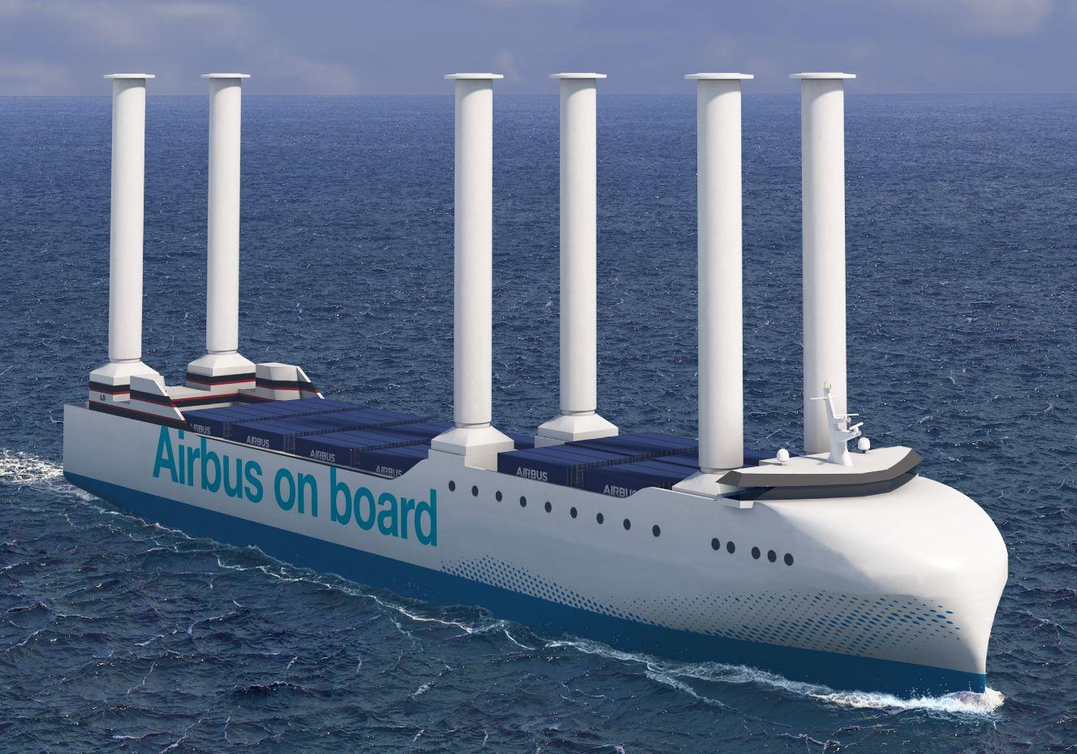

REDUCE > Airbus decarbonisation targets
Supporting long term sectoral ambition Net zero by 2050
Scope 1 & 2 emissions targets aligned with a 1.5°C trajectory
Mid-term targets
validated
2030
-63%
vs 2015
Shifting to decarbonized electricity
Increasing our SAF usage
> Beluga and other
flight operations
Pioneering innovative solutions for our logistics
Scope 3 emissions: connecting technology efforts with sectoral approach
Mid-term targets
validated
2035
-46%
vs 2015
R&D requiring Investments
Full value chain collaboration
Cooperation and partnerships
CO₂ intensity
Notes:
Copyright © Airbus SAS. 2025 All rights reserved.

