Slide 1
Multimodal Data Exchange in Digital Corridors. Package of UN/CEFACT standards: connect to air cargo data and
Türkiye as a link between EU (eFTI Regulation) and the Trans-Caspian corridor
Mario Apostolov,
UNECE Regional Adviser
mario.apostolov@un.org

Slide 2
Ready standards | Key documents accompanying goods (B2B)
1. Standardized data exchanges (business requirement specification plus executive guide; business name structure; subset; CCL structure; XLS guideline structure; XSD schema; UML diagram; HTML index, using as a model the e-CMR standard) https://unece.org/uncefact/mainstandards.html, already prepared for the following documents: | 3. Standardized data exchanges to support cross-modal cargo transfers
eCMR Cross Industry Invoice Cross Industry Delivery Cross Industry Catalogue Cross Industry Quotation Cross Industry Remittance Advice Cross Industry Scheduling Cross Industry Ordering Process Material Safety Data Sheet Details (MSDS) Contract Financial Execution Management Market Research Information Verified Gross Mass (VERMAS) documents International Forwarding and Transfer documents Smart container information Several agricultural certificates, accounting and other documents | Inland water transport contract document: IWT “Bill of Lading”; CMNI consignment note; etc. Maritime waybill. CIM/SMGS and SMGS Consignment Note; CIM/SMGS Wagon List (+ Commercial Act, etc.) eCERT (sanitary-phytosanitary certificates and basis for other certificates): aligned to the Buy-Ship-Pay Reference Data Model
2. Standardized data exchanges published in October 2020, making information already in the MMT-RDM more easily discoverable | 4. Air cargo and dangerous goods documents:
Provisional booking Firm booking Booking confirmation Shipping instructions Waybill Status report Status request Packing list RASFF (Rapid Alert for Security of Food and Feed) (published at www.unttc.org and https://unece.org/trade/uncefact/mainstandards.html) | airwaybill, dangerous goods declaration, & consignment security declaration
 | FIATA multimodal Bill of Lading + other (3) FIATA docs
Common foundation for all multimodal data & e-docs based on UN/CEFACT standards & reference data models – stakeholder agencies retain control over their documents and legal frameworks. EU’s eFTI and Maritime SW Regulations use MMT RDM

Slide 3
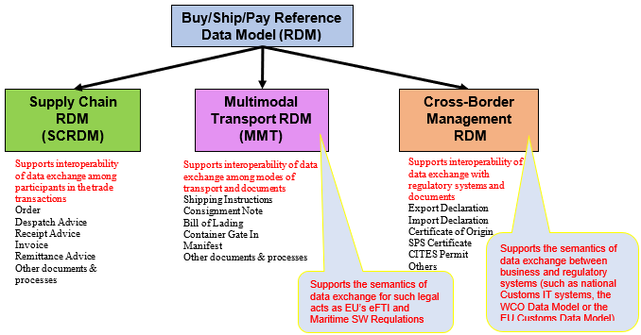
Standards and a family of reference data models to insure interoperability in the supply chain
Multimodal solutions are better than modal ones, global solutions better than local ones.
No replacement of existing standards (e.g., IATA’s e-Airwaybill)
Data mapping to MMT RDM provides interoperability
Now, looking forward to pilot implementation projects

Slide 4

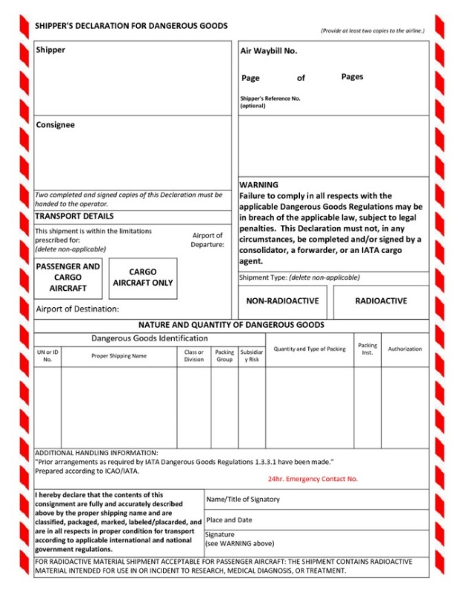
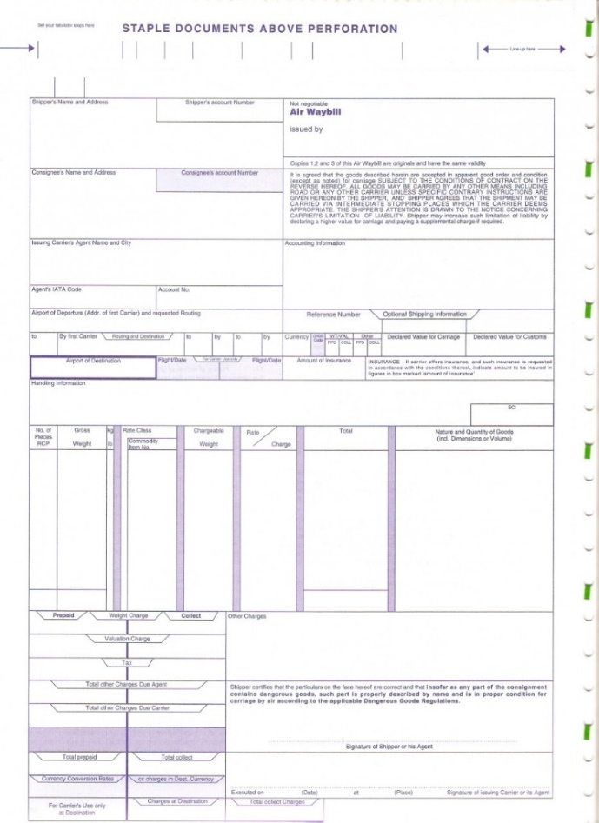
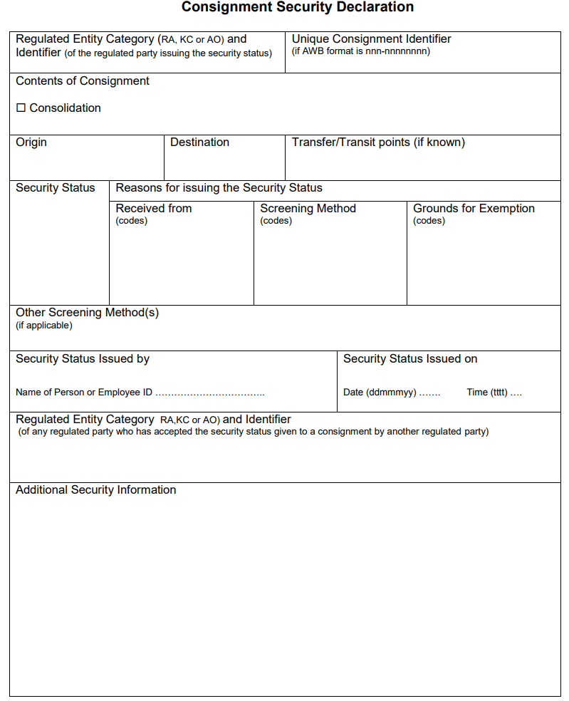
Air cargo: core mappings
AWB
DGD
CSD
Common Data Elements exchange on air cargo
No replacement of existing standards (e.g., IATA’s e-Airwaybill), just using the UN/CEFACT semantic standards and MMT TDM as a common foundation for data exchange

Slide 5
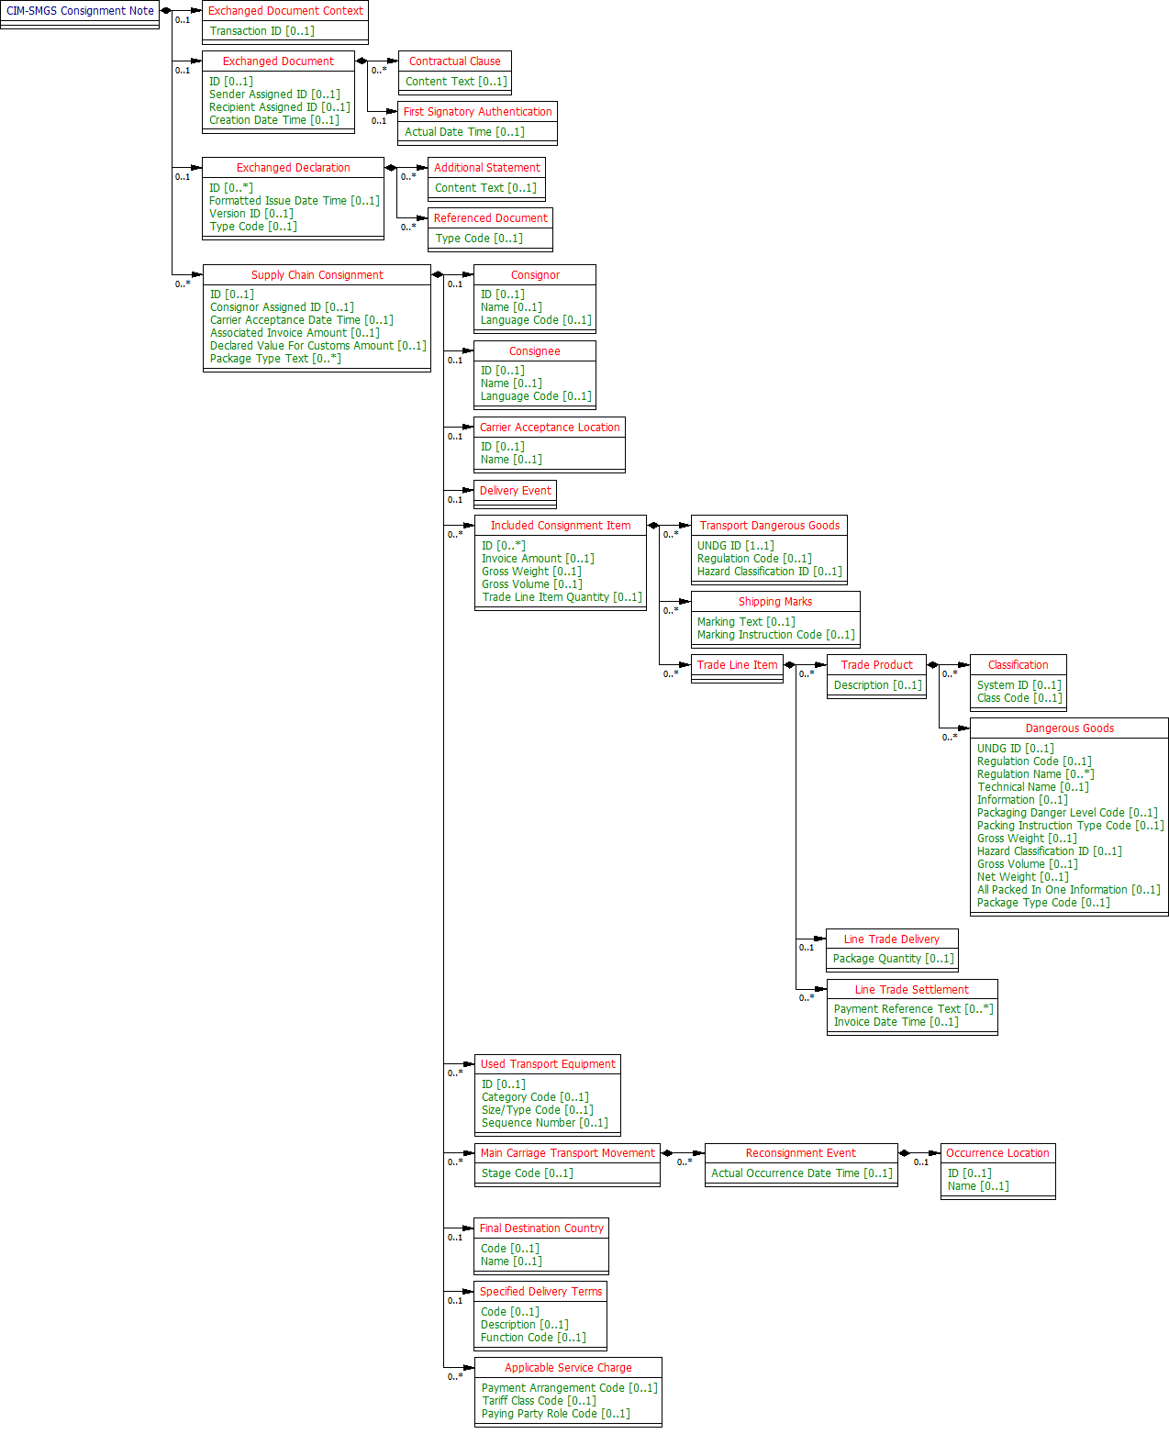
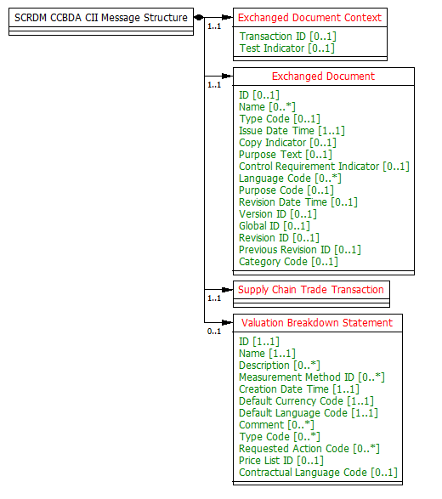
For example: the CIM-SMGS railway consignment note referenced to the UN/CEFACT Multi-Modal Transport Reference Data Model, according to the prepared XML schema for CIM-SMGS
Subsets for the CIM-SMGS consignment note and the consignment note under UNECE’s work on the Unified Railway Law (URL) developed
MS Excel and UML diagram, XSDs and html publication prepared
Standards for CIM/SMGS wagon list finalized
Transport data and documents can and are exchanged between modes and with other sectors
https://service.unece.org/trade/uncefact/publication/Transport and Logistics/CIM-SMGS Consignment Note/HTML/001.htm

Slide 6








Interoperability of information flows is a priority: goods cannot move faster than the information about them
Flow of information/documents in a supply/transport chain
House Waybill, CoO
1
CMR
AWB, packing list, invoice, DGD
Bill of Lading
2
4
8
ADR
ADN
IFTDGN
3
5
9
Origin
Road
Intermodal
Airport terminal
Voyage 1
Voyage 2
Sea
Port
Sea
Destination
6
7
Country 1
Country 2
Country 3
Country 4

Slide 7
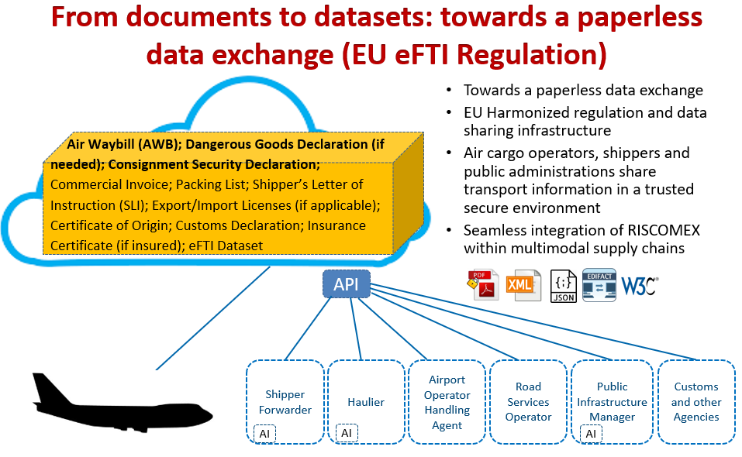

Slide 8
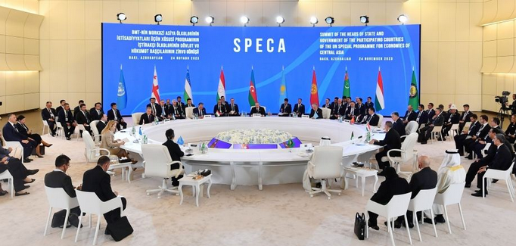
Roadmap for the Digitalization of Multimodal Data and Document Exchange along the Trans-Caspian Corridor Using United Nations Legal Instrument and Standards
https://unece.org/speca/speca-digitalization-roadmap
Vision statement: From 2027 onwards, economic operators and all competent authorities in the SPECA participating States will start to use electronic freight transport data from economic operators in line with relevant United Nations legal instruments and standards, including the UN/CEFACT package of standards. Data will be interoperable between sectors and the relevant modes of transport along the trans-Caspian transport corridor, with a view to increasing the efficiency of data exchange and the movement of goods across borders.
SPECA Summit in Baku adopted the digitalization Roadmap on 24 Nov.2023.
See video at:
https://www.euronews.com/video/2023/12/01/speca-central-asia-reaffirms-its-key-role-in-international-transport

Slide 9
Information chain in a digital corridor
UA
GE
AZ
KZ
UZ
KG
EU
Black Sea
S. Caucasus
Caspian Sea
Central Asia
CN
eFTI
TR
TM
TJ
Customs SW
data pipeline
Business systems
EU multimodal
EU eFTI Regulation
All info on cargo on rail, road, air, inland water modes inside the EU to be multimodal and electronic
Maritime SW Regulation
Common transit Conv. NCTS
Road
CMR Convention
eCMR
TIR Convention
eTIR
Rail
COTIF & OSJD conventions, URL
CIM/SMGS, SMGS, CIM & URL consignment notes
Maritime
IMO FAL
Hague Visby Rules
Non-negotiable and negotiable Bill of Lading, IMO FAL documents
Air
Montreal and Warsaw Conventions
e-Airwaybill
Dangerous Goods Decl.,
Consignment Security Declaration
Alignment of data in modal dangerous goods declarations to the UN/CEFACT MMT RDM

Slide 10
Thanks!
Further Information:
On the project web site (unttc.org) - information on the standards and tools at https://unttc.org/stream/electronic-trade-and-transport-documents-and-data
A streamlined web presentation of the UN/CEFACT standards can be found at https://unece.org/trade/uncefact/standards
Information on the UN/CEFACT projects: https://uncefact.unece.org/display/uncefactpublic/Transport+Modal+Views+of+MMT
Mario Apostolov, Regional Advisor
UNECE Economic Cooperation and Trade Division: mario.apostolov@un.org,
Теl. +41 22 9171134 or +41 79 2790936

