Slide 2
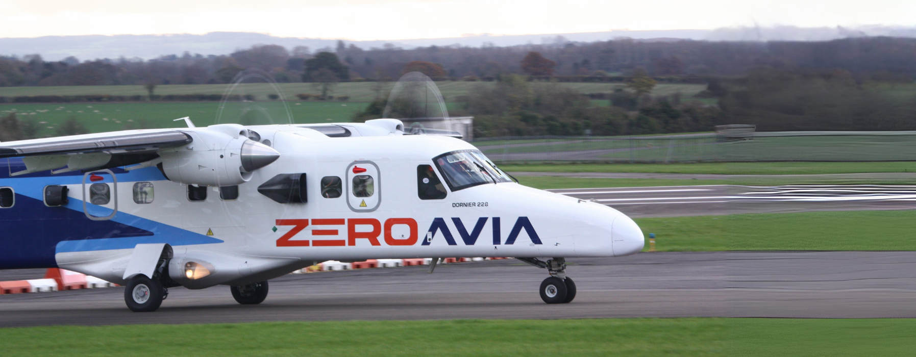
Oli Henstridge
VP Sales & Business Development - ZeroAvia

Slide 3
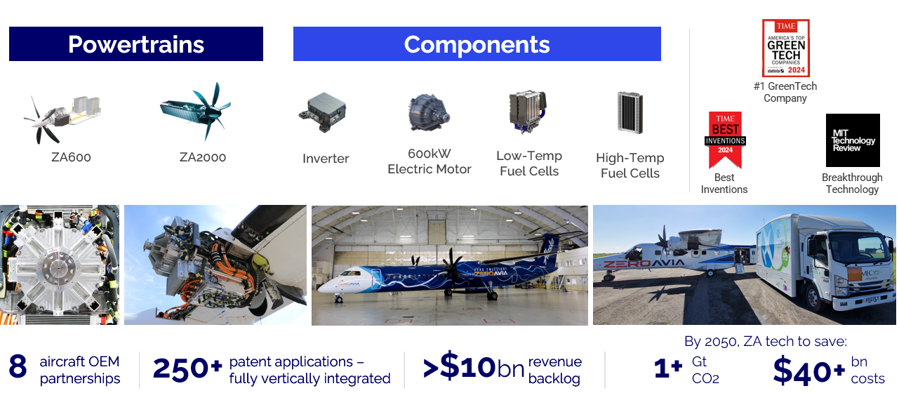
Delivering the Clean Future of Flight for the Entirety of Aviation
Enabling electric, zero-emission propulsion through a vertically integrated business model

Slide 4
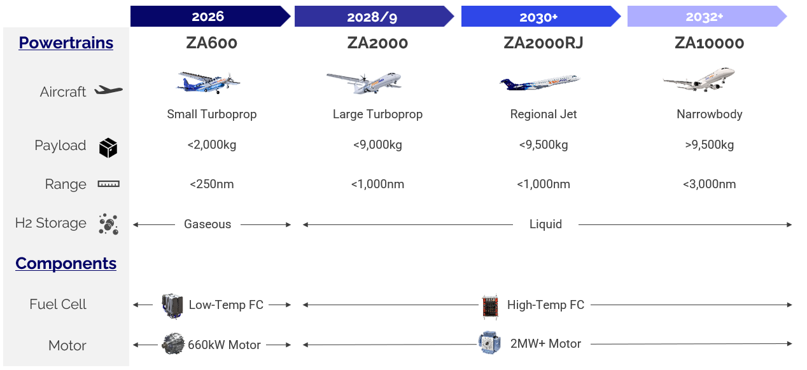
In-House Technology Capable To Power All Aircraft

Slide 5
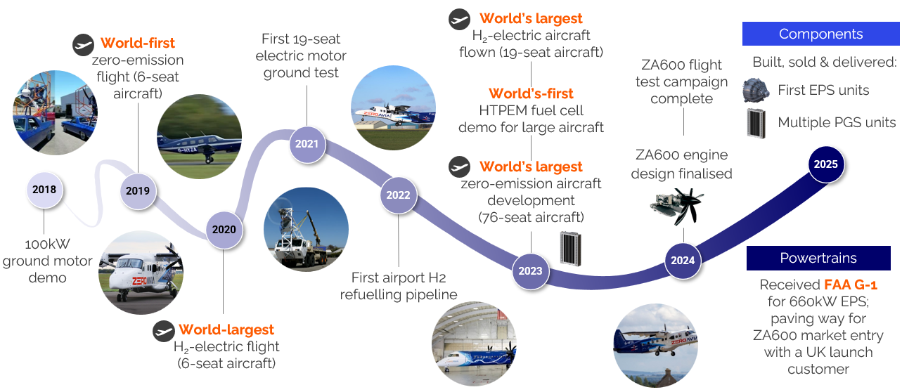
Track Record of Delivering World-First Milestones

Slide 6
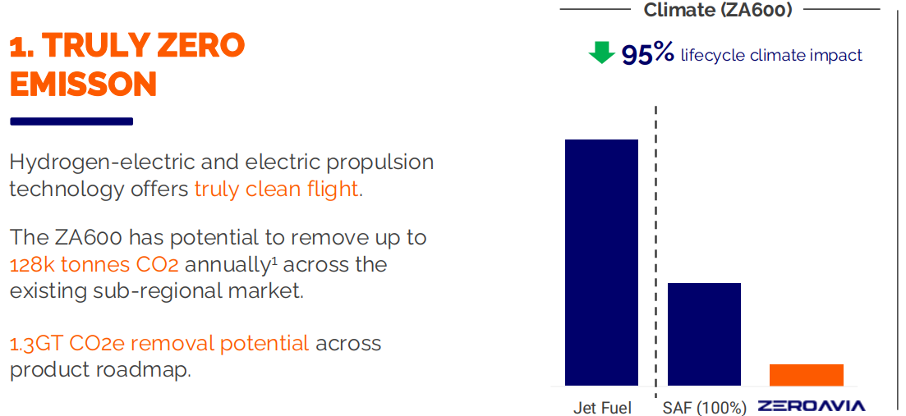
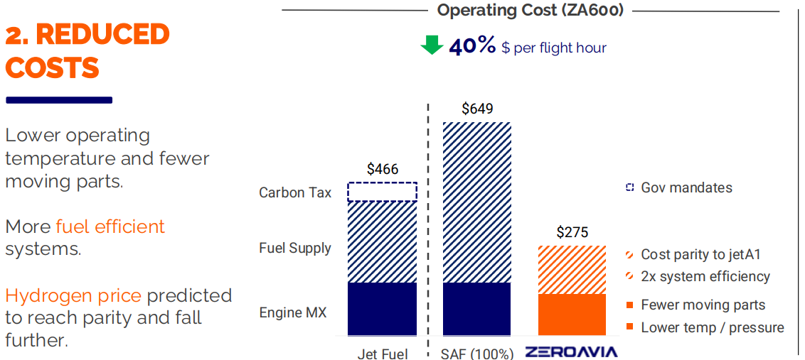
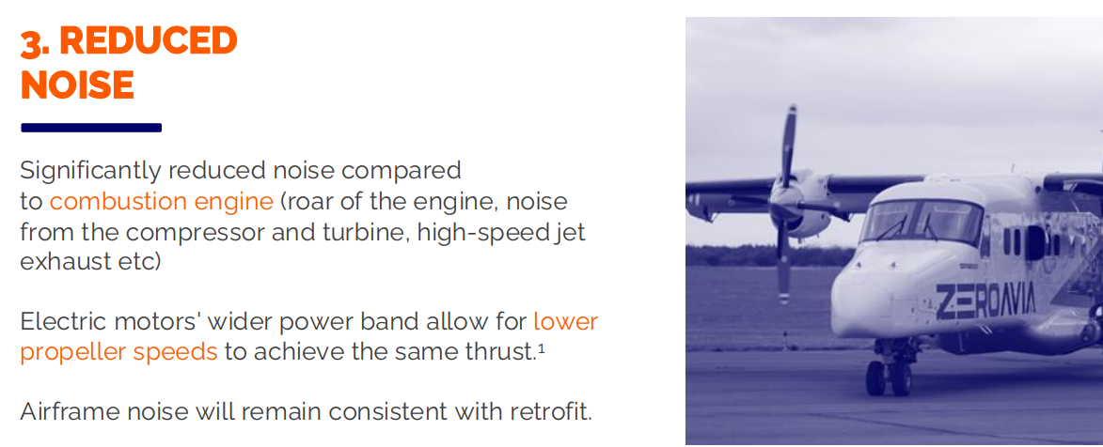
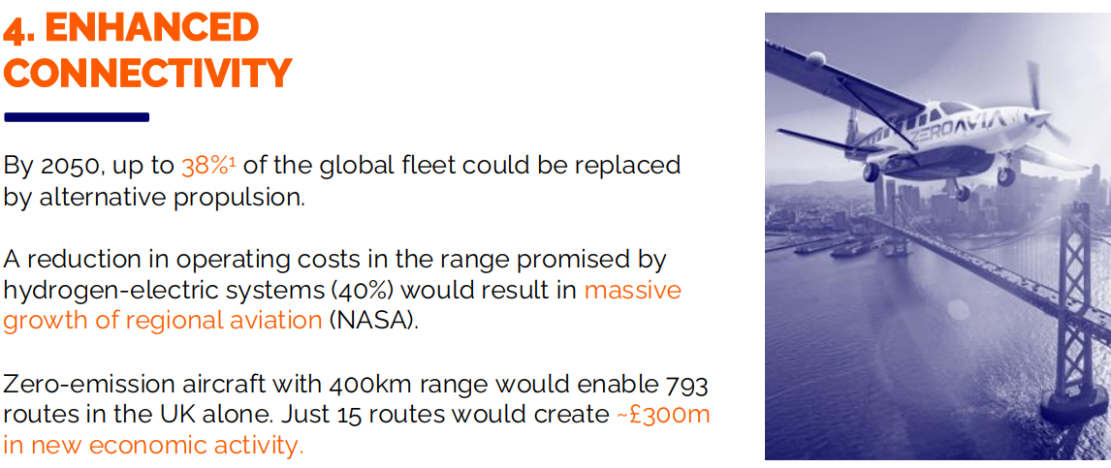
The Impact of Our Technology

