Slide 2
Deniz DAŞTAN
Corporate Sustainability Manager
Turkish Airlines

Slide 3

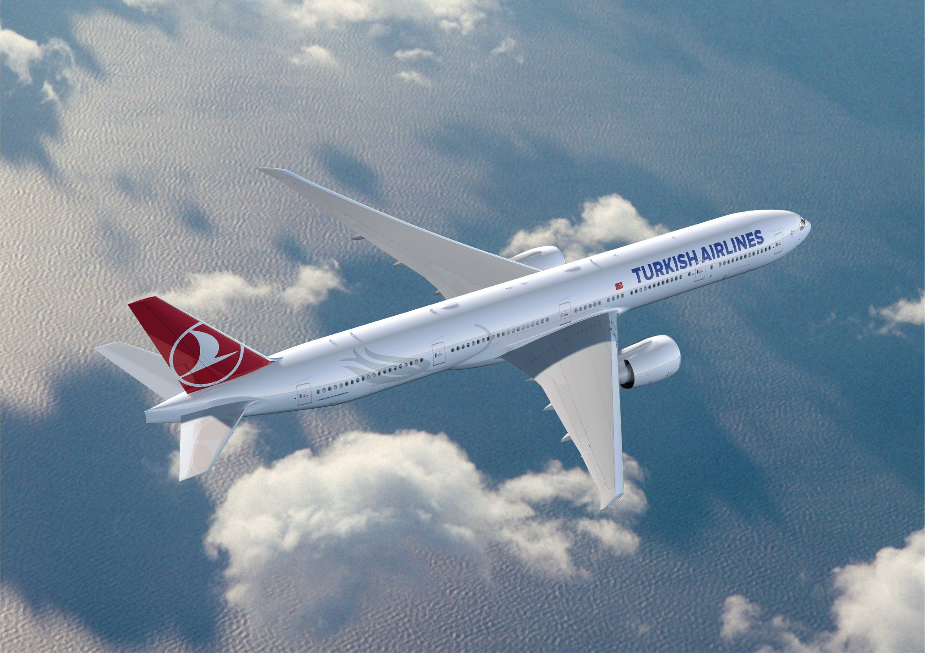




131 Countries
2023 | INDICATORS | 2024 | CHANGE
83.4 Million | Passenger Carried | 85.2 Million | 2.1%
1.66 Million | Freight Ton Carried | 2.00 Million | 20.6%
82.6% | Passenger Load Factor | 82.2% | -0.4 pt
55,884 | Total Employees | 63,455 | 13.5%
352
Destinations
481 Aircraft
9.9 Fleet Age

Slide 4

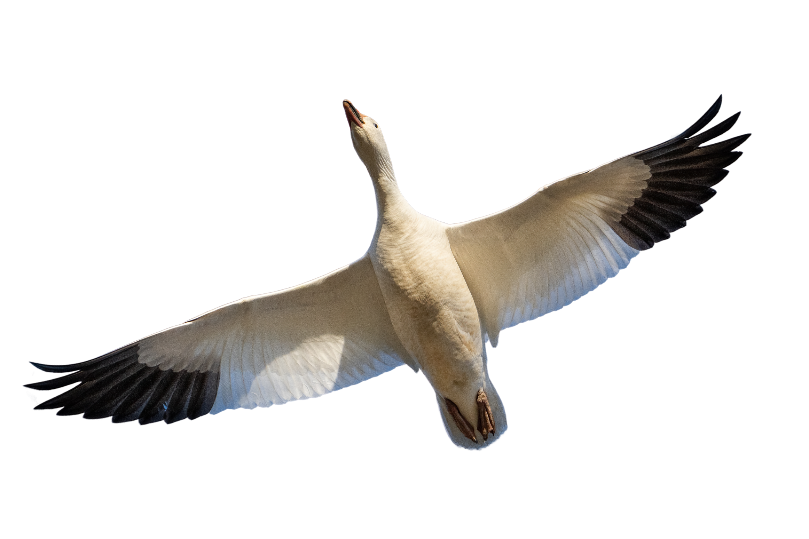

  APEX World Class 2023 “Five Star Global Airline” Award
  Launch of CO₂mission Voluntary Carbon Offset Program
  First Airline to directly achieve IEnvA Stage 2 Certification
  Joining the UN Global Compact
  Global SAF Declaration Signatory
  Green Class Flight
  Ecovadis Silver Medal
  The first and only airline in the BIST Sustainablity 25 Index
  Ranking first among 47 airlines in Refinitiv Evaluation
  CAPA "Airline of the Year for Sustainability Innovation"
Sustainability Milestones
  The First Air Cargo Carrier in the World with IATA CEIV Certificate in Three Areas ‘Pharmaceutical, Livestock And Fresh’
  Establishing the Corporate Sustainability Management Department
  LACP (League of American Communications Professionals) Award on our Sustainability Report
  IEnvA Program Partnership
  Securing First Sustainability linked Loan
  World Finance 2024 Sustainability Award
  Publication of the First Climate Transition Plan
  Ecovadis Silver Medal
  LACP Award in 6 Different Categories for Sustainability Report
Disclosure of the Sustainability Vision
Release of the first Sustainability Report
Changeover to Sustainable Practices in Service Concept
2006
2009
2013
2014
2016
2017
2018
2020
2021
2022
2023
2024
ISO 9001
Certification
  ISO 14001 & 18001 Certification
  Investment in R&D Activities Related to Sustainable Biofuels
  Verification of GHG through ISO 14064-1
  LACP (League of American Communications Professionals) Award on our 2016 Sustainability Report
  Support to the Zero
  Waste Project Award
  Establishment of the Sustainability Committee
  Joining the «IATA 25by2025» Initiative
  LACP (League of American Communications Professionals) Award on our 2020 Sustainability Report
  Participation in CDP Climate Change Programme
  Ecovadis Bronze Medal
  Travel Plus 2021 Gold Award for our projects consisting of biodegradable packaging and environmentally friendly toys
  «A-» score in CDP Leadership category
  Supporting Task Force on Climate-Related Financial Disclosures (TCFD)
  Ecovadis Silver Medal
  World Finance 2023 Sustainability Award
  Joining up Türkiye Sustainable Aviation Platform

Slide 5
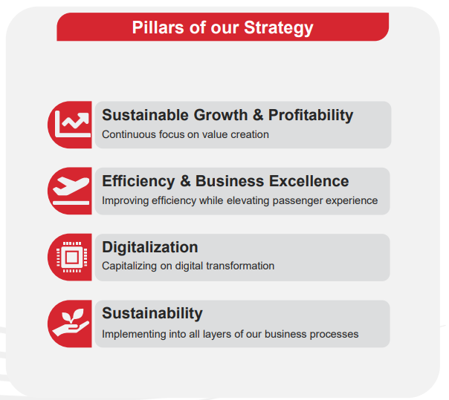


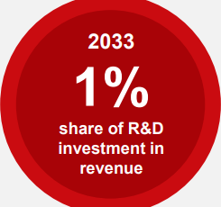

Turkish Airlines 2033 Strategy
As the airline flying to most countries in the world, we carry out our operations with a sense of responsibility towards the environment and society aligned with our sustainability strategy.
While we plan to doubled our capacity to by reaching over 800 aircraft in 2033, Sustainability is one of the main pillar in our 10 years strategy.
Pillars of our Strategy
2033 Expectations
800+
Aircraft
400+
Destinations
170+ mn
Passengers
140+ bn (USD)
Added Value to
Türkiye’s Economy
Digital Leader in our industry within 3 years

Slide 6

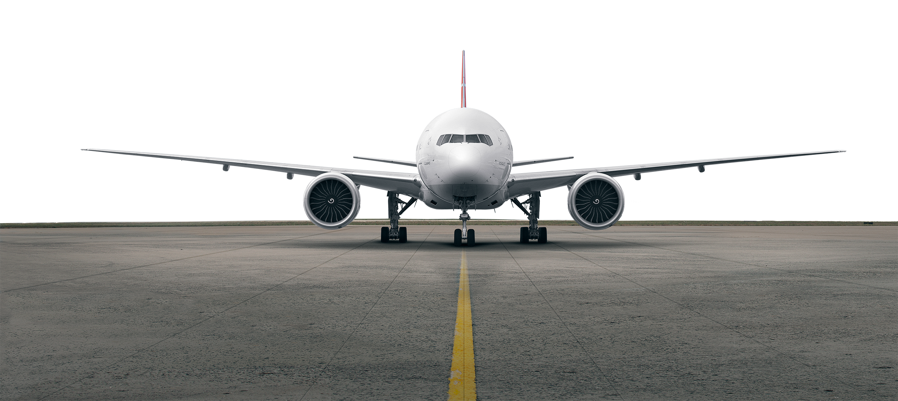
Turkish Airlines
Carbon Neutral Airline in 2050
New Generation Aircraft | SAF Consumption | Operational Improvements | Carbon Offset | Renewable Energy
In 2033, next-generation aircraft in our fleet will constitute at least 95% of the total fleet. With our next-generation aircraft, we will reduce carbon emissions by 15-20% compared to older generation aircraft. | We use Sustainable Aviation Fuel (SAF) in our flights. We will enter into long-term SAF offtake agreements to support SAF production in our country using different production technologies. | Through operational improvements to be made by 2033, we will save a total of 1,192,632 tons of fuel. | We are evaluating project investments that generate carbon emission reduction credits. We will voluntarily offset our emissions in line with regulations and our company's targets. | We aim meet at least 5% of the energy needs in our new buildings from renewable sources. Most of our new buildings are LEED certified. We plan to invest in Solar Power Projects that can meet and/or compensate for the energy needs of our Incorporation.

Slide 7





Combating Climate Change
CO₂
100
70,046
220,645
813,309
2,561,923
More than
Operational
Optimization and Configuration Projects
Tonnes Fuel Saving
2024
Tonnes CO2 Prevented
2024
Tonnes Fuel Saving
2008-2024
Tonnes CO2 Prevented
2008-2024
457
24
9.9
2033
Passenger Aircraft
Freighter Aircraft
Fleet Age
By 2033, at least 90% of Our Fleet will be Comprised of New Generation Aircraft with 15-20 % Low Fuel Consumption

Slide 8
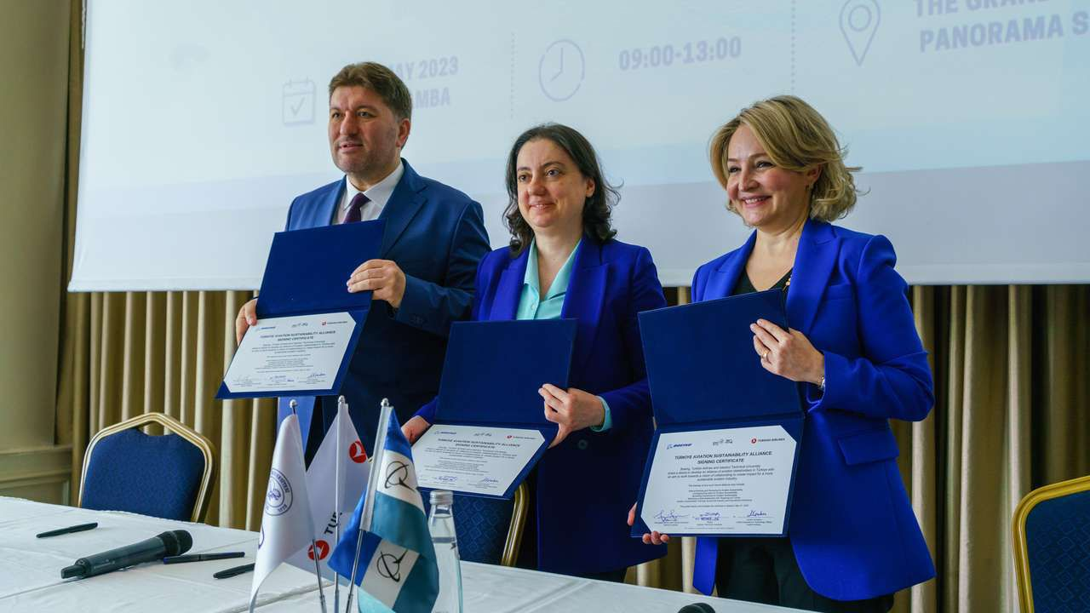
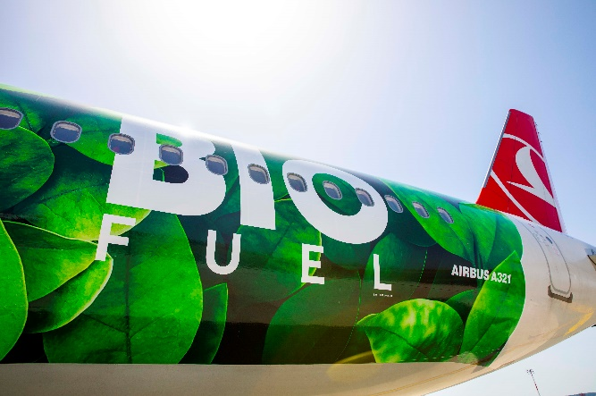

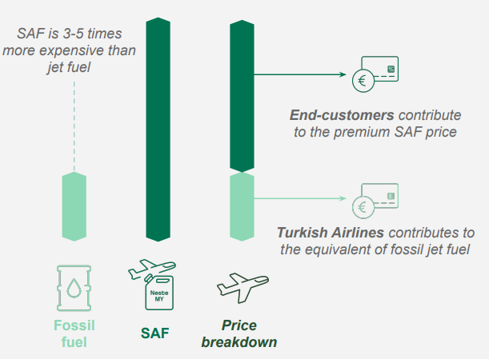
Sustainable Aviation Fuel (SAF)
We designed the Corporate SAF Program for our corporate customers, where they can offset their emissions resulting from business travel or cargo transportation with the use of SAF.
We plan to start this program with our cargo key customers soon.
We use SAF regularly since 2022.
We aim to continue SAF usage on increasing frequencies and destinations.
Active engagement with SAF suppliers
Long-term offtake agreements.
Committed to supporting domestic SAF producers and technologies to bolster SAF production in Türkiye
Started a Project for determining short-medium and long term SAF Strategy.
In 2023, we became one of the founding members of the
Türkiye Sustainable Aviation Alliance,
which was established with Istanbul Technical University and Boeing Turkey to support the transition to sustainable aviation.
Aims to increase knowledge and awareness in sustainability through training programs and social activities.
18 key players from across the sector—airlines, public institutions, manufacturers, airports, and academia-
One of the main priorities is to develop Turkiye's Sustainable Aviation Fuel - SAF roadmap.

Slide 9

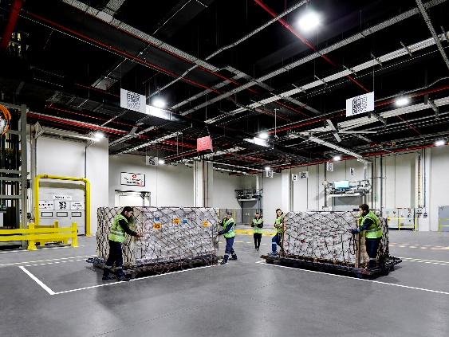
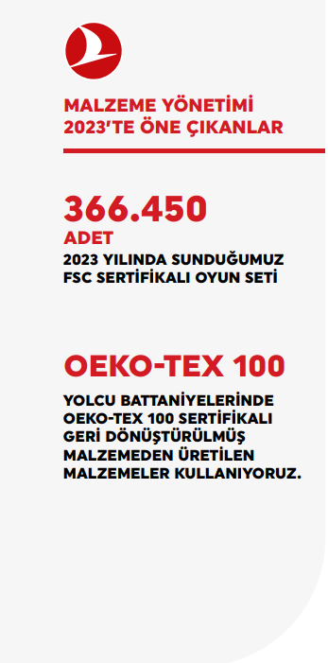
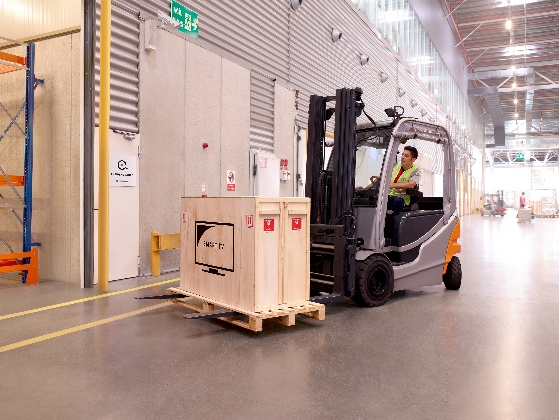

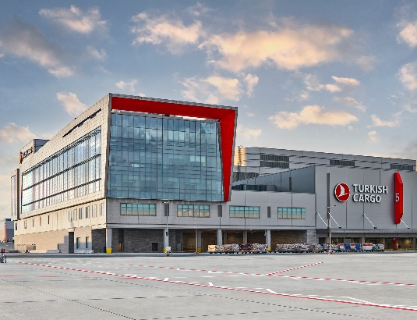
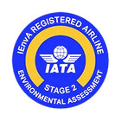
Sustainability On Cargo
How we integrate sustainability to our operations
What we achieved in 2024?
289,2 tons of single-use plastic consumption prevented by using biodegradable and compostable packaging
236.7 tons of plastic pallet cover sheets was prevented
1.426,66 tons of plastic packaging was prevented
Less nylon sheets are used to cover pallets.
The wooden materials used for fixing the cargo items are upcycled in the carpentry workshop to produce wooden transport pallets used in cargo operations.
Becoming the first airline in the world to receiveIEnvA Energy Module Certification in 2025
Attaining IEnvA Illegal Wildlife Trade (IWT) certification further demonstrated our commitment to combating illegal wildlife trade
LEAN LEED V4 BD+C Certificate for SMARTIST Cargo Terminal

Slide 10


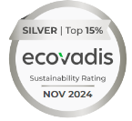


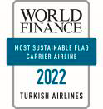
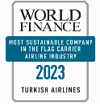
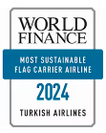




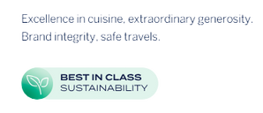




Turkish Airlines Sustainability Awards
WORLD FINANCE 22&23&24
Most Sustainable Flag Carrier
Airline
ECOVADIS
Silver Medal in Sustainability
Performance Assessment
LACP
Sustainability Report
Platinum
& Technical Achievement
Award
FREIGHTWEEK SUSTAINABILITY AWARDS 2022
Best Air Cargo Brand in Europe In the Field of Sustainability
STAT TIMES International Award
Excellence in Air Cargo - Air Cargo India Awards
Air Cargo Brand of the Year-2022
Innovative International Cargo Airline of the Year-2024
Innovative Logistics Solutions in Air Cargo-2024
ASIA-PACIFIC BIOPROCESSING AWARDS
Remarkable Air Cargo Brand
APEX 2023
World Class Airline
5 Star Global Airline
Europe’s Best Inflight
Entertainment Award
Europe’s Best Food and
Beverage Award
BRAND FINANCE
8th Most Strongest Airline
Türkiye’s Most Valuable Brand
Leadership in Türkiye
Sustainability Perception
Value Ranking
AIR CARGO INDIA 2024
Innovative International
Air Cargo Brand of the Year
ASIAN FREIGHT LOGISTICS & SUPPLY CHAIN (AFLAS)
Europe’s Best Air Cargo Brand
NIPPON EXPRESS
Top Airline Partner Award
WOF-EXPO AWARDS
Air Cargo Excellence

