Slide 2
Mateusz Kotlinski
RPAS, UAS, AAM considerations
ICAO’s role
Remotely Piloted Aircraft Systems Technical Officer
Air Navigation Bureau, ICAO

Slide 3
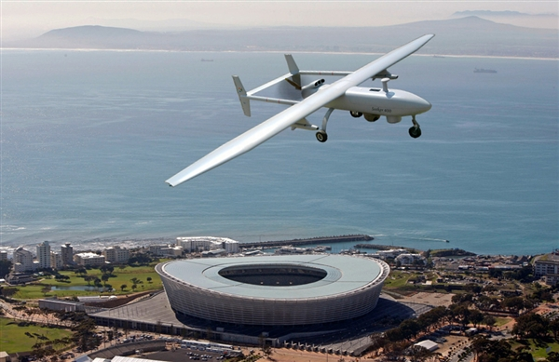
RPAS, UAS and AAM Considerations – ICAO’s mandate and scope
Multiple Assemblies and Divisional-type meetings have called on ICAO to address unmanned aviation
RPAS Panel
Serve as a focal point ensuring global interoperability
Develop RPAS regulatory concept and guidance material
Review and coordinate development of ICAO SARPs
Scope:
International IFR operations, controlled airspace and aerodromes
Notes:
Mission
• Serve as the focal point and coordinator of all ICAO RPAS-related work, ensuring global interoperability and harmonization
• Develop an RPAS regulatory concept and associated guidance material to support States
• Review ICAO SARPs (Annexes to the Chicago Convention and PANS), proposing amendments and coordinating the development of RPAS SARPs with other ICAO expert groups
There are different SARPs packages

Slide 4
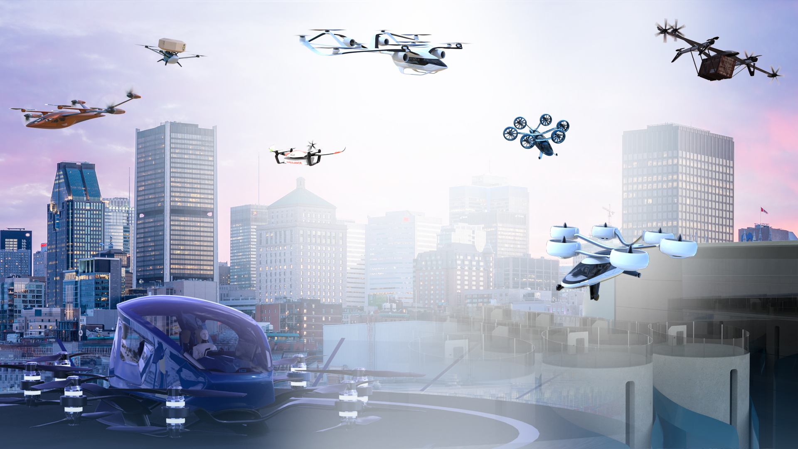
Advanced Air Mobility

Slide 5

Unmanned Aircraft Systems and Advanced Air Mobility
The 41s Session of the ICAO Assembly recognized that the rapidly evolving AAM ecosystem calls for work to be undertaken by ICAO, as well as the potential need for a globally harmonized operational and regulatory framework and guidance
New Entrants/ AAM have been approved by the ICAO Council as one of the Priority Focus Areas
AAM Study Group
AAM VISION
UAS Traffic Management (UTM) Guidance Material
UAS Regulatory Gap Analysis
Early eVTOL integration in current ATM system
Notes:
ICAO is supporting Advanced Air Mobility (AAM), unmanned aircraft systems (UAS) and UAS Traffic Management (UTM) considerations through the Advanced Air Mobility Study Group
-AAM Vision document which will depict the expected evolution of the AAM ecosystem in phases
-UAS Regulatory Gap Analysis that will inform the revision of UAS Model Regulations
-UAS Traffic Management (UTM) Guidance Material
-early eVTOL integration in the current ATM system Guidance Material

Slide 6
UAS Air Cargo transport – possibilities and challenges
Possibilities
Challenges
Unmanned aircraft systems and eVTOLS can be utilized to support multiple services:
Cargo transport (e-commerce), delivery of packages in urban/ suburban environments
Delivery of medical goods supporting humanitarian or disaster relief operations
Need for robust fit-for-purpose regulatory framework supporting safe deployments of those capabilities
Aircraft airworthiness and certification
Operational approvals and oversight
Ground infrastructure (such as Vertiports)
Flight Rules, airspace and digital information management
Automation and Autonomy and shifting role of the human
Societal Acceptance

