Slide 2

Trevor Caswell
General Manager, ZVL – Edmonton Airports
INNOVATING
COMMERCIAL DRONE DELIVERY

Slide 4
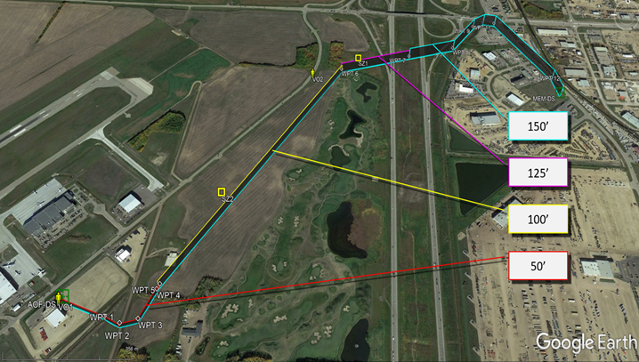
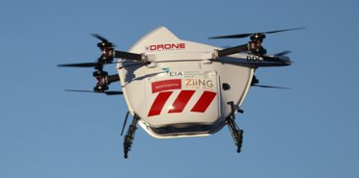
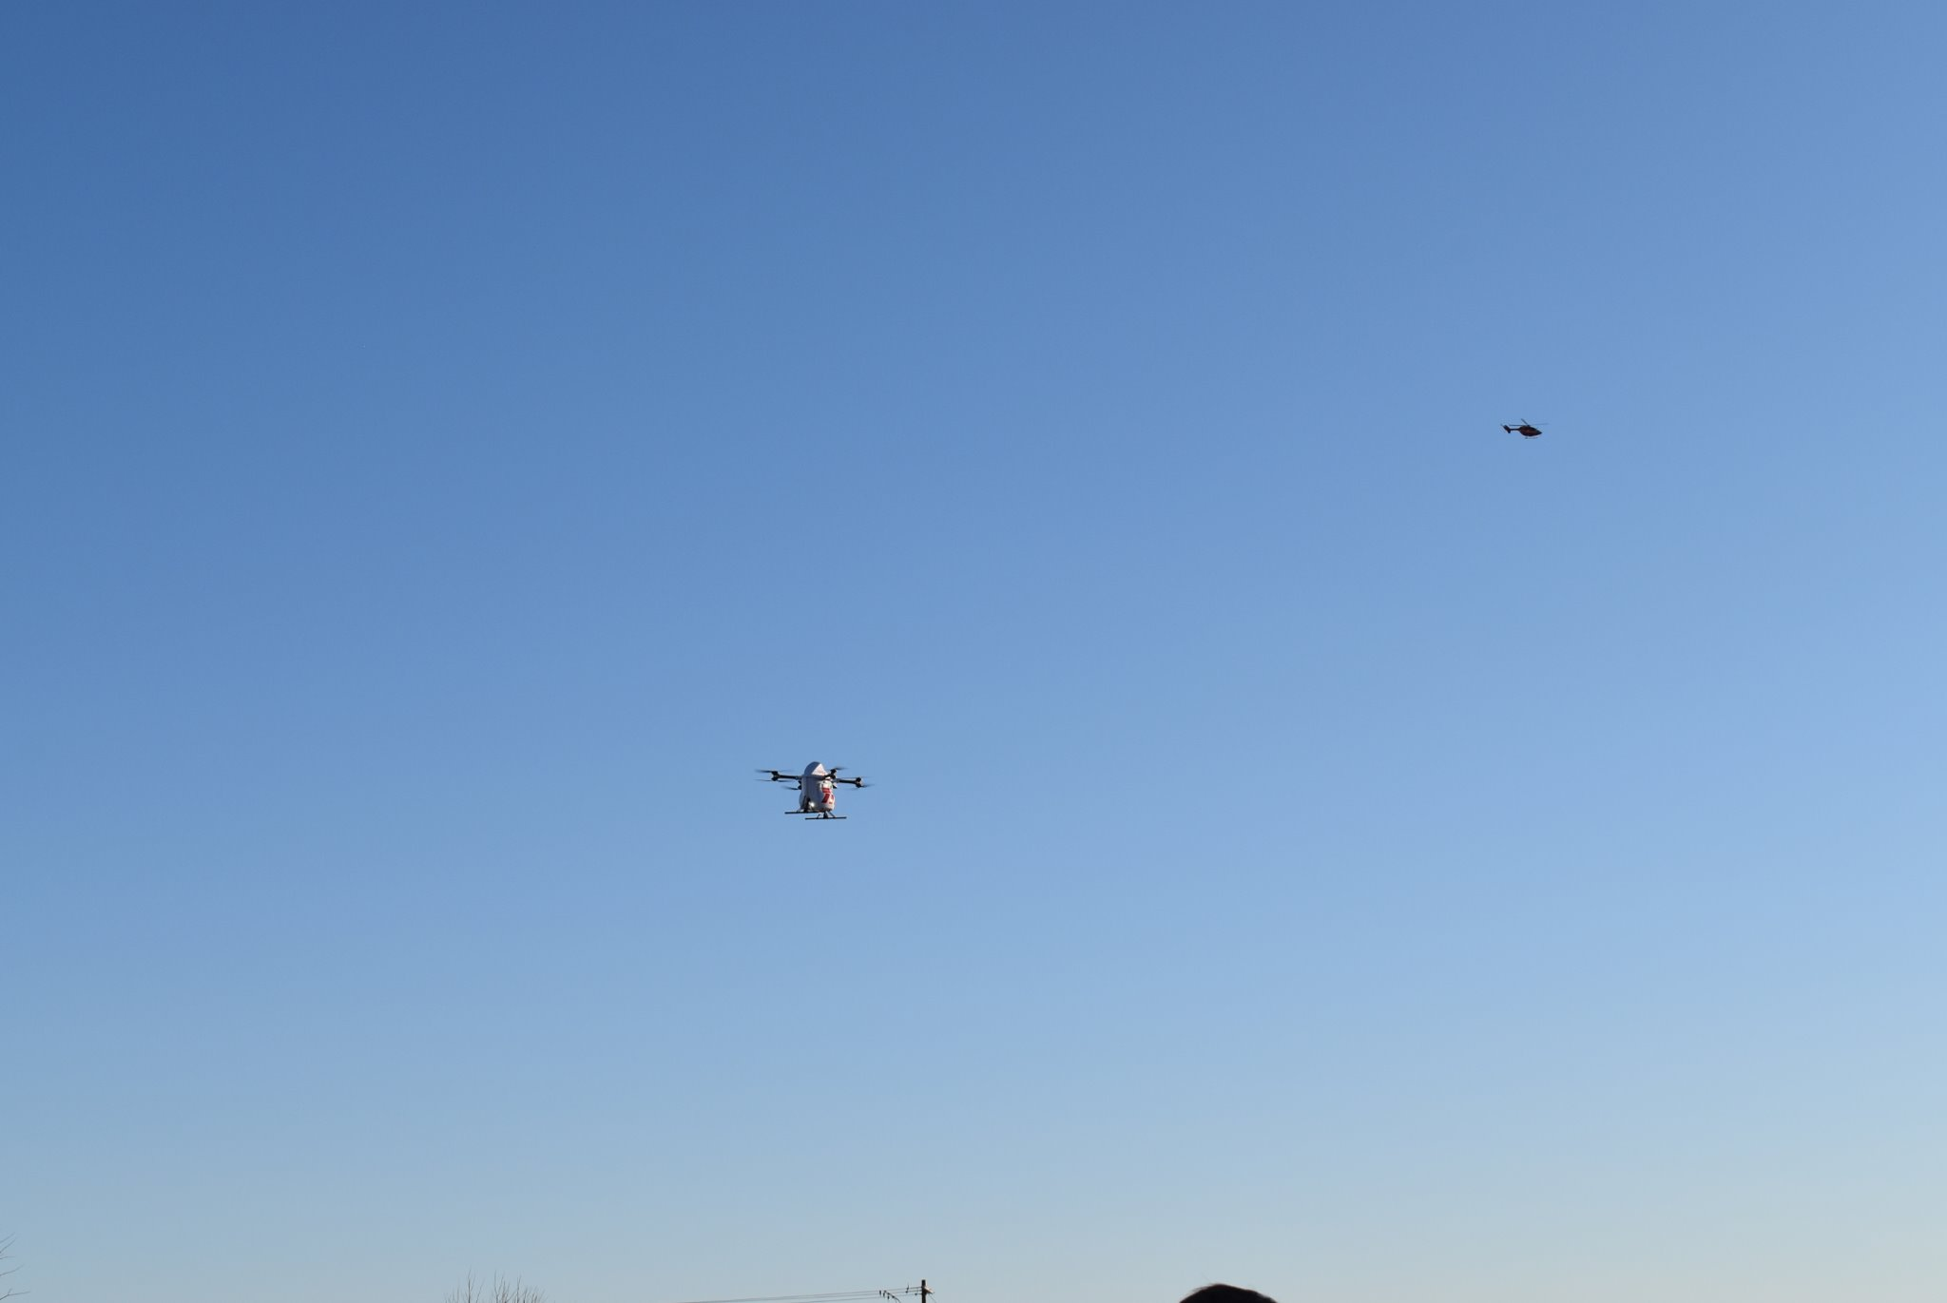
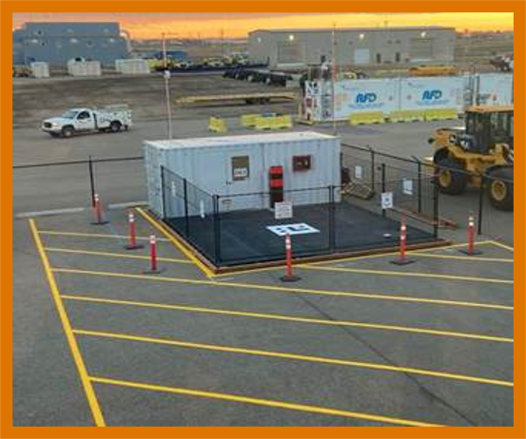
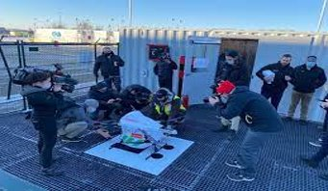
SUSTAINABLE COMMERCIAL
DRONE ROUTES
Phase 1
First Canadian commercial drone route in controlled air space, 2021
Scheduled B2B hourly commercial cargo services from YEG, 2022
NAV Canada & Transport Canada approved transport
Over 3000 commercial flights and 8400 kms flown safely

Slide 5

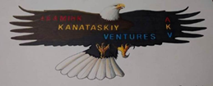



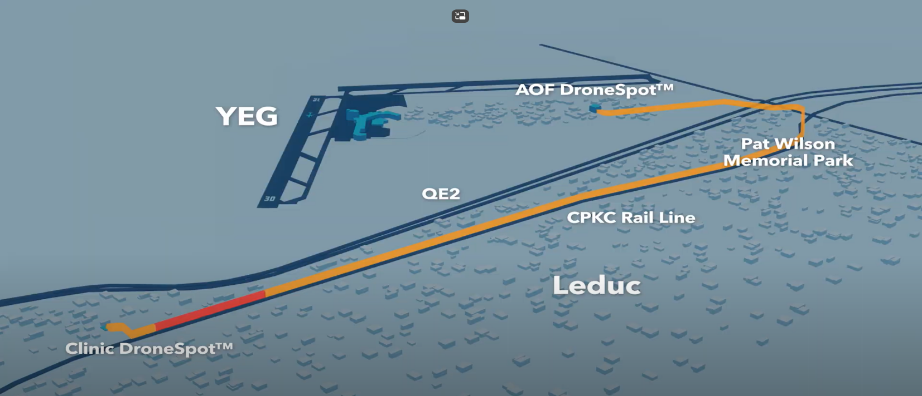
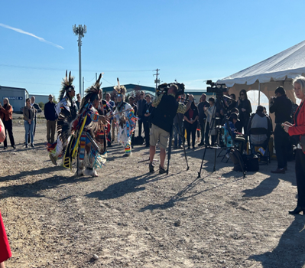
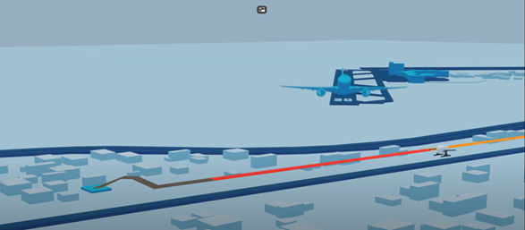


SUSTAINABLE COMMERCIAL
DRONE ROUTES
Phase 2
First to safely intersect the runway departures path in Canada, 2024
First commercial route to safely deploy time sensitive product while mid-route
Over 10 kms route in controlled air space and drone corridor over a national railway line
Scheduled hourly commercial cargo services, that provide integration modelling for rural and urban markets, 2025

Slide 6
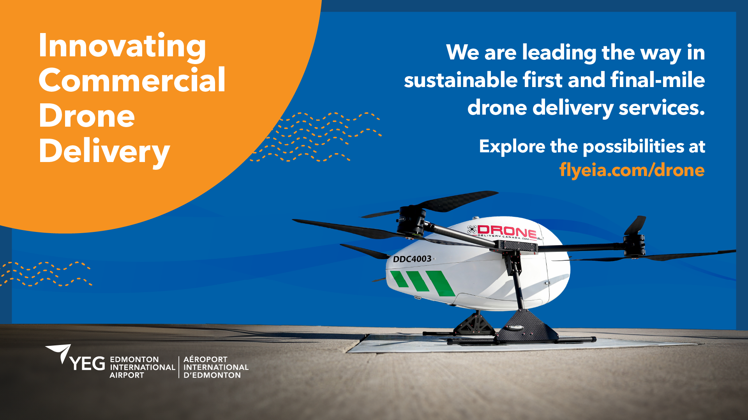

tcaswell@flyeia.com

