Slide 1

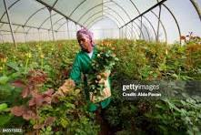

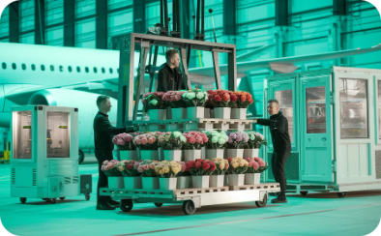

From Farm to Table: The Journey of Flowers
Kenya: Where It Begins
Cold Chain Preservation
Global Distribution
Final Destination
24-hour journey from farm to market. Global air transportation connects growers to markets
Flowers transform ordinary moments into special occasions
Vast farms near equator - perfect growing conditions
Airport cold chain facilities preserve delicate petals

Slide 2
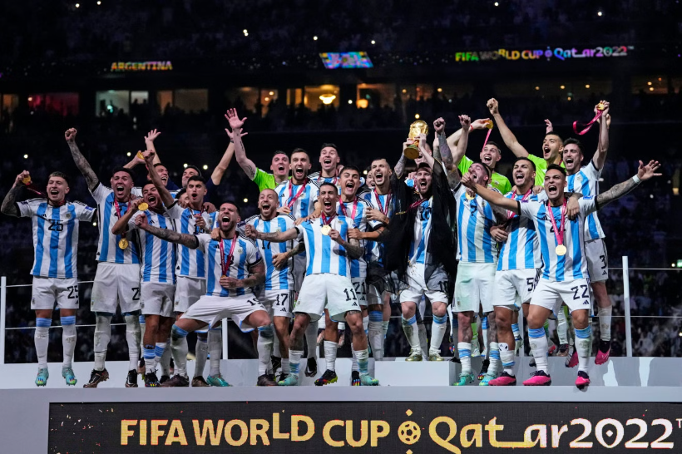
Argentina: 2022 World Cup Champions
Led by legend Lionel Messi to glory
Defeated France in thrilling final
First title since 1986
Emotional victory for football-mad nation

