Slide 2
Serkan Eren
Ground Operations Director
MNG AIRLINES

Slide 3
Outlook to Air Cargo Business
Key Challenges Driving Automation
Key Areas Of Automation PLACI in Air Cargo Business
Key Advancement Cases In Air Cargo Operations
Adaptation and Strategic Investments in Technology & Processes
Automation Case Study – MNG AIRLINES

Slide 4






The air cargo industry is undergoing rapid transformation, driven by globalization, e-commerce, and changing consumer expectations. Automation plays a key role in meeting these demands by optimizing processes, reducing costs, and enhancing compliance.
01
Outlook to Air Cargo Business
Key Drivers of Change
Industry Insights
E-commerce boom
Increasing demand
Post-pandemic e-commerce
surge +14% YoY growth
in demand (IATA, 2023)
requiring faster and more
frequent shipments.
In 2024, global air cargo demand Increased by 11.3% compared to 2023, marking a new record high.
Global Value
Labor shortages
Air cargo handles 35% of
global trade value.
prompting the need
for automated alternatives.
Regulatory Complexities
Delays
demanding more accurate
and transparent processes
with new layers such as
ICS2, PACT, ACAS, NAIC2 etc..
Manual processes cause
20-30% delays (Boeing Report, 2022)
Notes:
IATA (2023): The air cargo industry faces a 15-20% shortfall in skilled workers, including cargo handlers, customs brokers, and logistics managers.
Boeing 2022 Workforce Forecast: By 2030, the global aviation industry (including cargo) will need 2.3 million new personnel, with cargo-specific roles accounting for ~30% of this demand.
DHL Global Air Cargo Report (2023): 65% of air cargo companies cite labor shortages as a "critical bottleneck" in meeting customer demand.

Slide 5

Key Challenges Driving Automation
02
Rapid Growth in
E-commerce
Data Fragmentation and Siloed Systems
Surge in small, high-frequency shipments is stressing traditional cargo operations.
Requires faster processing and real-time visibility that manual systems struggle to provide.
06
Legacy IT systems often don't communicate with each other. Cargo IMP still used dominantly although not meeting current data requirements.
Limits end-to-end cargo visibility, delaying decision-making.
Regulatory Complexity
Limited Infrastructure and Space
Increasing global compliance requirements (e.g., ICS2, ACAS, cargo screening mandates).
Manual processing leads to higher error rates and penalties.
02
01
05
Cargo hubs, especially in urban areas, have space constraints.
Automation (e.g., high-density Automated Storage and Retrieval Systems) helps optimize space utilization.
04
Security and Safety Risks
03
Labor Shortages
Manual screening is slow and subject to human error.
Modern threats (e.g., cyber and biosecurity) require smarter, automated countermeasures.
Ground handling and cargo operations are facing a skilled labor gap.
High turnover and training costs further reduce operational resilience.
Compliance in automation PLACI
Notes:
Challenges to Address
High Initial Costs: Automation requires 2M–2M–10M+ investment per hub.
Data Privacy: 60% of firms cite cybersecurity as a top concern (McKinsey, 2023).
Workforce Adaptation: Reskilling programs critical for 45% of roles (ICAO, 2022)

Slide 6




03
CHALLANGES FOR PLACI
PLACI systems produce various challenges according to system requirements and work flows. Local applications differentiate software capabilities, actions to provide additional information and security screening applications.
Compliance Costs
Data Accuracy
Sofware Invesments
Hardware upgrading
Trainings, workshops and certifications for data Management and procedures
Conservative approach of shippers to share data
Cut-off performance to provide data
Communication patterns with exporters requiring 7/24 connection.
Integration Complexity
Security Concerns
Cyber Security Concerns
Personal Data Protection
Commercial Data Leakage
Different data structures of vairous custom authotiries
Messaging systems
Multiple filing integrity with carriers

Slide 7

are the
consequences
What
of
non-compliance?
■ Sanctions on carriers, incl. financial
penalties
■ Cargo will be stopped at the border
■ No customs clearance of goods
■ Unnecessary interventions
■ Rejection of poor-quality declarations

Slide 8
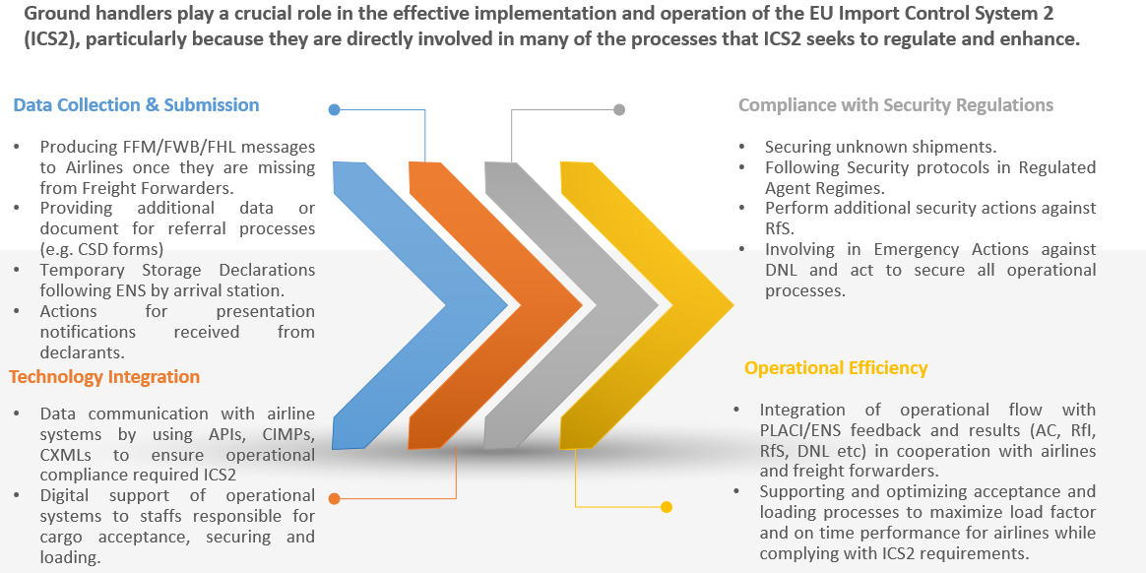
Advancements in Automation of Air Cargo Operations
04
Impacts of Advance Cargo Information Systems

Slide 9








05
ADAPTATION & STRATEGIC INVESTMENT IN TECHNOLOGY AND PROCESSES
Investment in Compliance Technology
01
Software systems specifically designed to collect, manage, and transmit advance cargo information to customs authorities
Cybersecurity Measures
Implementing firewalls, encryption protocols, intrusion detection systems, and regular security audits to ensure compliance with data protection regulations.
02
Data Management and Accuracy
03
Data validation algorithms, implementing quality control measures, and establishing protocols for data verification and reconciliation.
Process Optimization and Automation
04
Deploying workflow automation tools, adopting electronic document management systems, and integrating risk assessment processes with other logistics and supply chain management systems for seamless data flow and real-time visibility.
IT Infrastructure Upgrades
Investing in hardware upgrades, such as servers and network equipment, as well as software upgrades to ensure compatibility with standards and protocols.
05
06
Partnership and Collaboration
Training and Skill Development
Participating in industry forums, joint initiatives, and information-sharing platforms dedicated to compliance and best practices.
07
Providing training on regulatory requirements, data management best practices, and the use of compliance technology tools

Slide 10
Key Advancement Cases in Air Cargo Automation
Digital Booking Platforms
Blockchain for Compliance
Flexport’s platform reduces processing time by 40%.
IBM-Maersk TradeLens reduces documentation time by 40%
Automated Warehousing
AI/ML Predictive Analytics
Cargotec’s AutoGate cuts cargo processing time by 50%.
DHL’s AI tools improve demand forecasting accuracy by 25%

Slide 11

06
Automation and Efficiency Case Study of
MNG Airlines
Solution
Process
Weighing ULDs after completing build up shipments and add weight information in UWS and ULD Tags.
Utilize IoT capable scales and enable scale to communicate data to Warehouse Management System to convey weight values without human intervene.
.
Challenge
Weight Data Transmission to Flight
Automation
Manual process to record weight data of ULD.
Human errors to read correct value on scale screen
Paperwork consuming to create weight records.
Slow and inefficient communication to related parties for ULD weight data.
Unit Weight Statements and ULD Tag are directly produced digitally between scales and warehouse software and have digital footprints without papers. FUM (Freight Unit Message) is transmitted to Airlines system automatically.
Efficiency
Risks
Negative affect on safety due to weight and balance calculation of flight due to mis-writing of weight value from scales.
Zero deviation from actual ULD weight. Weight results of scales are captured on UWS and ULD Tag on %100 accuracy. Data communication between warehouse operator and airline is performed on digital channel by eliminating traditional communications (e-mail, phone ) and accelerate flight preparation processes.

Slide 12
KEY PRIORITIES FOR THE WAY FORWARD
Increased worldwide communication
Regional and targeted workshops with EOs
Easy-to-understand high-level information on risk assessments and its impact
Increased involvement within WCO, ICAO, IATA,FIATA etc.. to promote harmonisation on security regimes , data requirements for air cargo clearance process and automations.
Targeted communication to shippers, forwarders especially on accuracy of the data and data quality Alignment, harmonisation and digitalisation of documents in international trade to overall efficiency of the movement of goods across borders
WE ARE NOT ONLY CARRYING CARGO, WE ARE ALSO CARRYING DATA

