Slide 1
Aviation insight through analysis
ICAN World Statistics Day,
20th October 2015
James Wiltshire, Senior Economist www.iata.org/economics
In one year of commercial aviation…

Slide 2
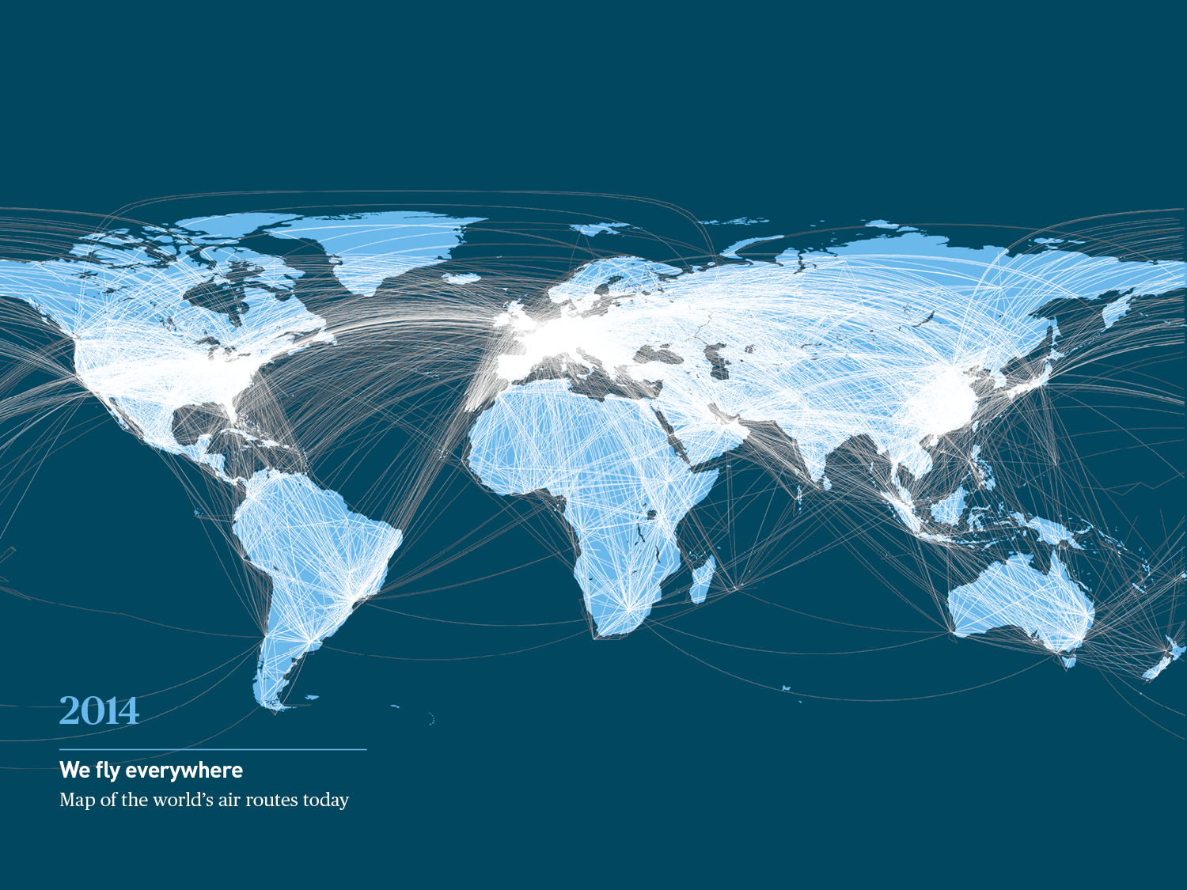



The real world wide web?
2
Notes:
Today…
we see 49,000 routes operated around the world,
Over 40,000 city pairs connect people and businesses worldwide
Air transport connects nearly 4,000 airports through 1,500 airlines covering every country on the planet
Every 60 seconds:
52 aircraft take off
$12.1 million worth of cargo is delivered
5,700 passengers will board aircraft somewhere in the world
The global fleet crosses over 70,000km

Slide 3

In one year of commercial aviation…
3.3 billion
passengers
33.6 million
flights
6.2 million
passenger kilometres
16.485 cities
connected directly
3
Notes:
And in just one year, over 3.1 billion passengers fly on 36.4 million flights, a distance of some 5.7 trillion passenger kilometres (that’s nearly 20 million return trips to the sun)
On average, every day more than 8 million people fly. In 2013 total passenger numbers were 3.1 billion—surpassing the 3 billion mark for the first time ever. That number is expected to grow to 3.3 billion in 2014 (equivalent to 44% of the world’s population).
For 2014 the forecast is 37.4 million commercial flights worldwide (in 2013, there were 36.4 million). Counting just scheduled airlines, there were 31 million flights in 2012
5.7 trillion passenger kilometres flown in 2013
49.871 routes served globally

Slide 4
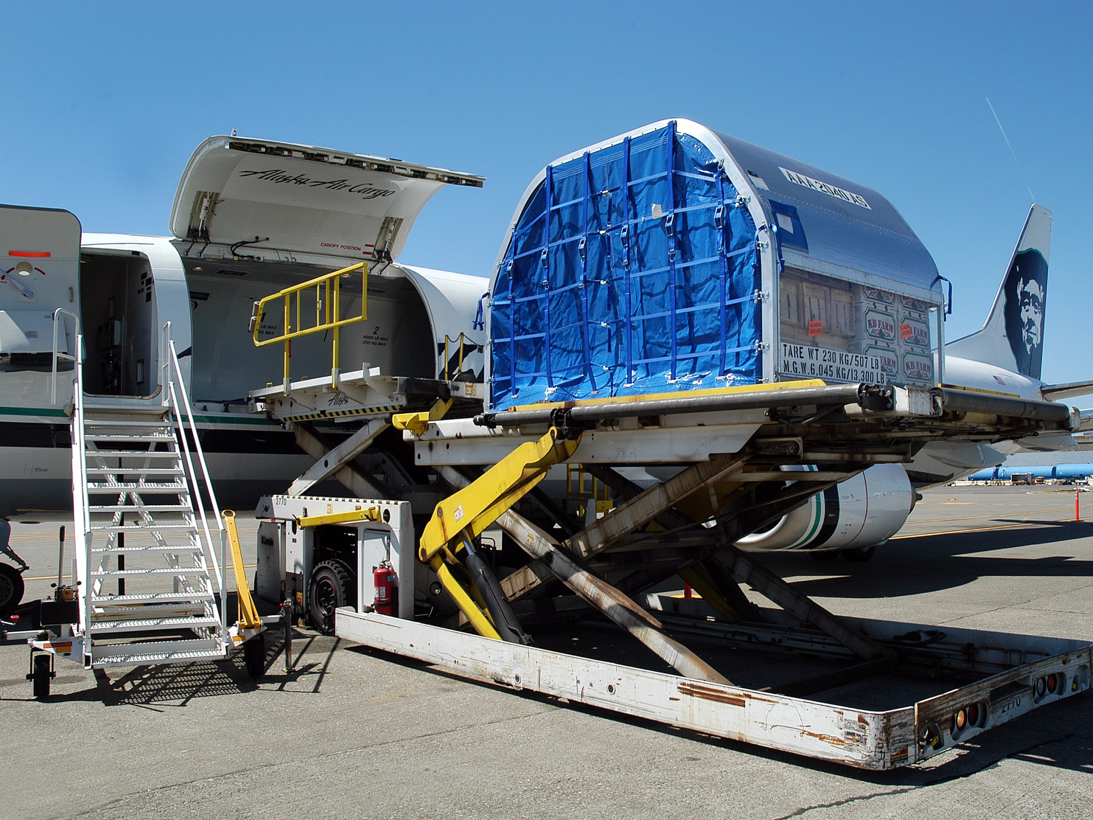

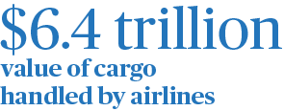
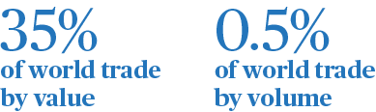
Aviation: world trade
4
Notes:
Air transport facilitates world trade, helping countries participate in the global economy by increasing access to international markets and allowing globalisation of production.
Air freight is mostly used to deliver goods that are light, compact, perishable and have a high unit value.
Therefore, while accounting for less than 0.5% of the tonnage of global trade, air freight makes up over a third of the value of international trade. The total value of goods transported by air represents 35% of all international trade.
$6.4 trillion of goods were transported internationally by air in 2012.

Slide 5

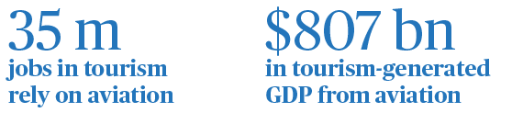
Aviation and tourism
53%
of international tourists travel by air
Notes:
Aviation is indispensable for tourism, which is a major engine of economic growth, particularly in developing economies. Globally, 53% of international tourists travel by air.
Including direct, indirect, and induced effects, air transport supports 35 million jobs within tourism, contributing around $807 billion a year to world GDP.

Slide 6
City-pairs doubled – transport costs halved
Source: IATA, ICAO, OAG
Notes:
The two key enablers of this unique economic benefit from connectivity are the physical city pair connections through the scheduled service and the cost of transport
Over the past 20 years the number of unique city pair connections has doubled
The real cost of air transport (i.e. relative to other consumer prices) has halved.
Both of these trends will have given a dramatic stimulus to the economic flows (people, goods, investment, ideas) that generate wider economic value for the cities and countries connected by air transport

Slide 7
Air travel boom continues

Slide 8
Business travel also linked to trade activity
Source: IATA, CPB Netherlands

Slide 9
Propensity to travel increases with income

Slide 10
Demand for air travel to double over 20 years
Source: IATA/Tourism Economics ‘Air Passenger Forecasts’
Notes:
Anyone using forecasts must be aware that they are usually wrong!
Economic and transport system are complex and this makes accurate forecasting difficult if not impossible.
The implication for those investing in long-lived airport or ATM assets is that construction should be modular and flexible.
But decisions have to take some view of the future into account and so forecasts have to be used….carefully.
One thing to do is to explore the bounds of some of the uncertainties by using scenarios.
We do this above: one scenario takes and optimistic view of economic and transport policies while the other is a more pessimistic view of closing borders and protectionism. The scenario in the middle is a continuation of current policies.
This produces a range of outcomes for passenger travel market size: an expansion of between 1.8x and 2.8x.
This allows the decision maker to see whether their planned investment works throughout the range of potential outcomes.
NB The demand is there, if a country looses the momentum to attract airlines to fly there, airlines will go somewhere else where there is infrastructure friendly business environment and they can offer competitive prices

Slide 11
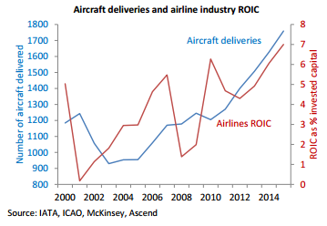
Which will require significant investment
Notes:
NB COMPARE WITH OTHER INDUSTRIES ROIC
Airlines need to invest in fleet to meet demand and environmental commitments (emissions reduction etc).

Slide 12
Paying investors (for 1st time!)
Source: IATA, McKinsey

Slide 13
But only some airlines are paying investors
Average cost of capital
Source: The Airline Analyst, IATA

Slide 14
The industry remains fragmented
Market share of top-4 airlines/JVs
Source: SRS Analyser
Notes:
Airline profitability recently has been strongest in the US and for some European airlines, particularly those with exposure to the N Atlantic market.
These markets are the most consolidated, by domestic merger in the US and metal-neutral immunized JVs in the N Atlantic. These cooperative arrangement have allowed airlines to consolidate passenger flows and achieve economies of density, cutting costs and improving returns.
In most other regions markets remain very fragmented.

Slide 15
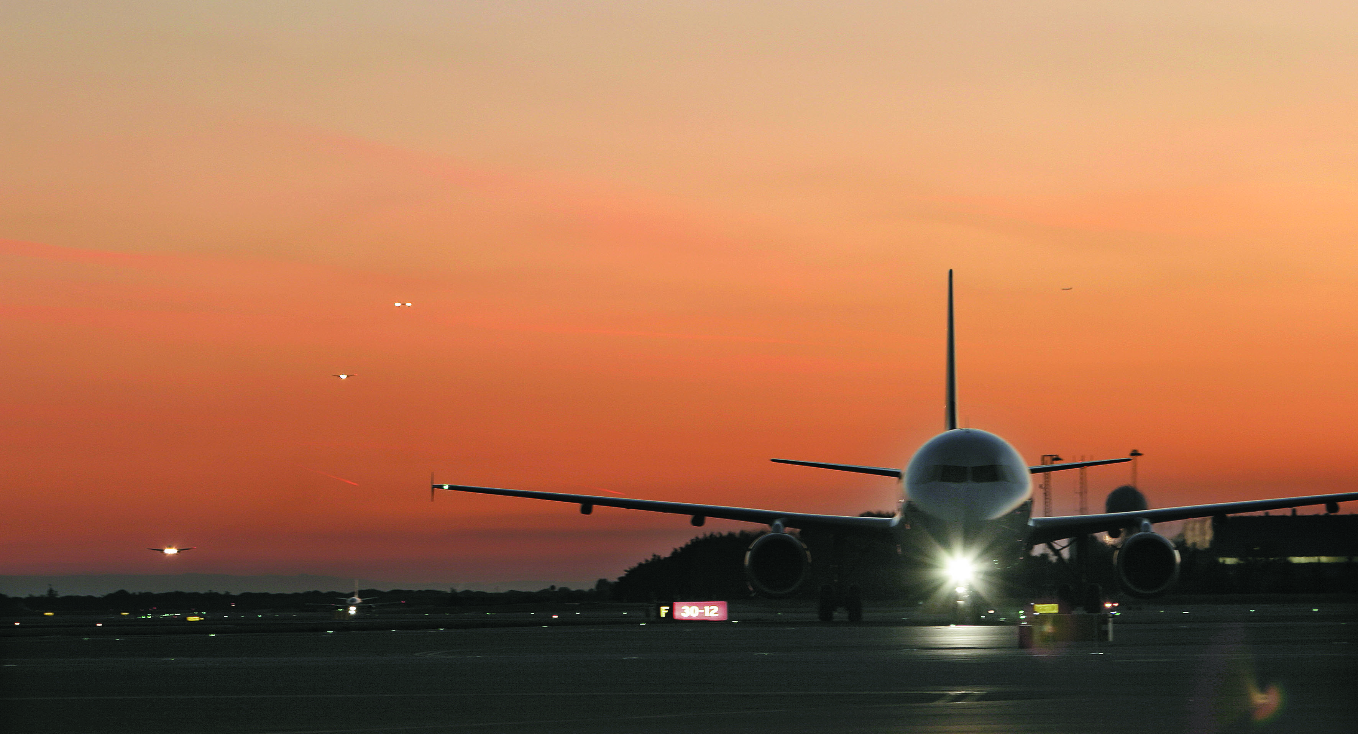
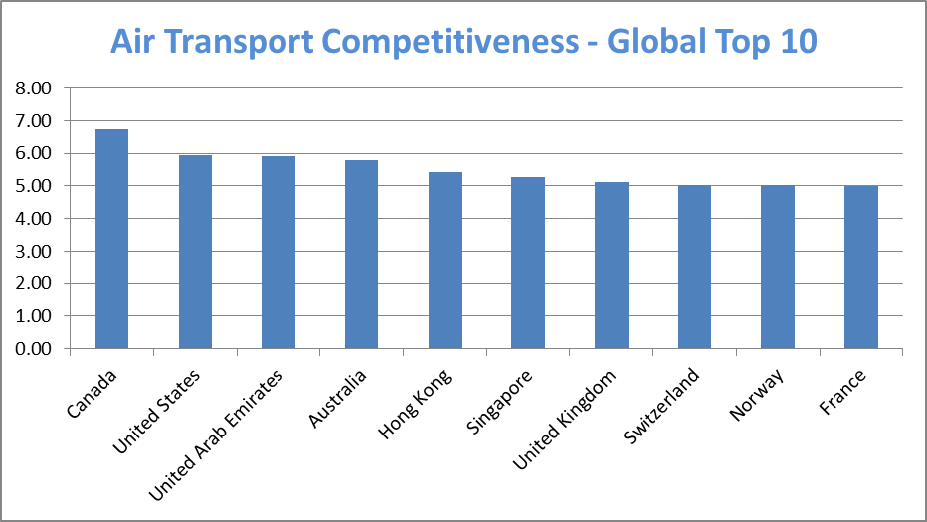
Competitiveness: A global challenge
Source: World Economic Forum Travel & Tourism Competitiveness Index
15
Notes:
As we said when discussing the demand forecasts, there are countries who have a proactive strategy towards attracting aviation, and these are well placed to benefit from growth.
Who are these countries? Well, the World Economic Forum constructs a Travel and Tourism Competititiveness Index covering 140 countries. One of the pillars is Air Transport.
As you can see, none of the top 5 are in Europe and only 4 of the top 10 are. Countries in Middle-East and Asia Pacific are stealing a march….
The index covers Network, connectivity, infrastructure

Slide 16
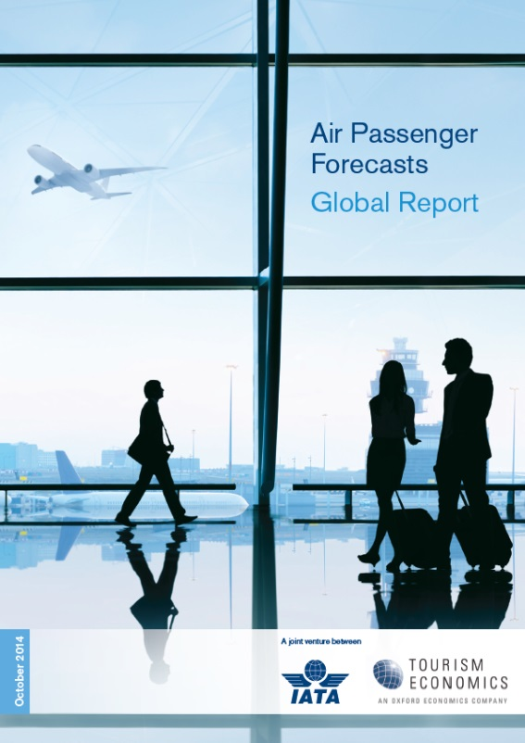


Thank you!
www.iata.org/economics
Check out our new passenger forecast service:
A joint partnership between:
www.iata.org/pax-forecast

