Slide 1

Powering global economic growth, employment, trade links, tourism and support for sustainable development through air transport
Preserving the value of aviation
Paul Steele
Senior Vice President, Member and External Relations
October 2015

Slide 2
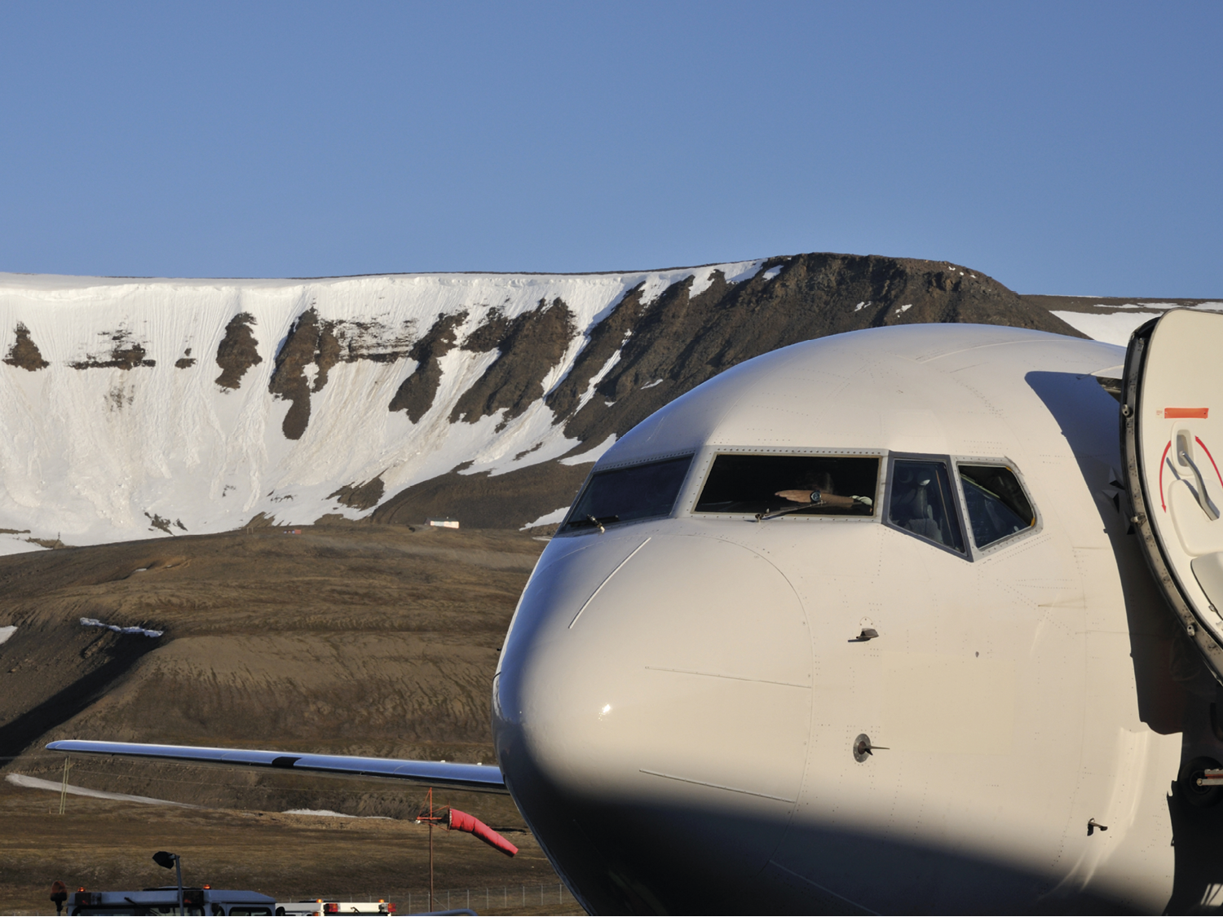


Commercial aviation:
2
Notes:
The four cornerstones of aviation – airlines, airports, aircraft and air traffic management.

Slide 3


In one year of commercial aviation…
3
Notes:
In 2013, over 3.1 billion passengers flew on 36.4 million flights, flying some 5.7 trillion passenger kilometres (that’s nearly 20 million return trips to the sun) over nearly 50,000 routes

Slide 4
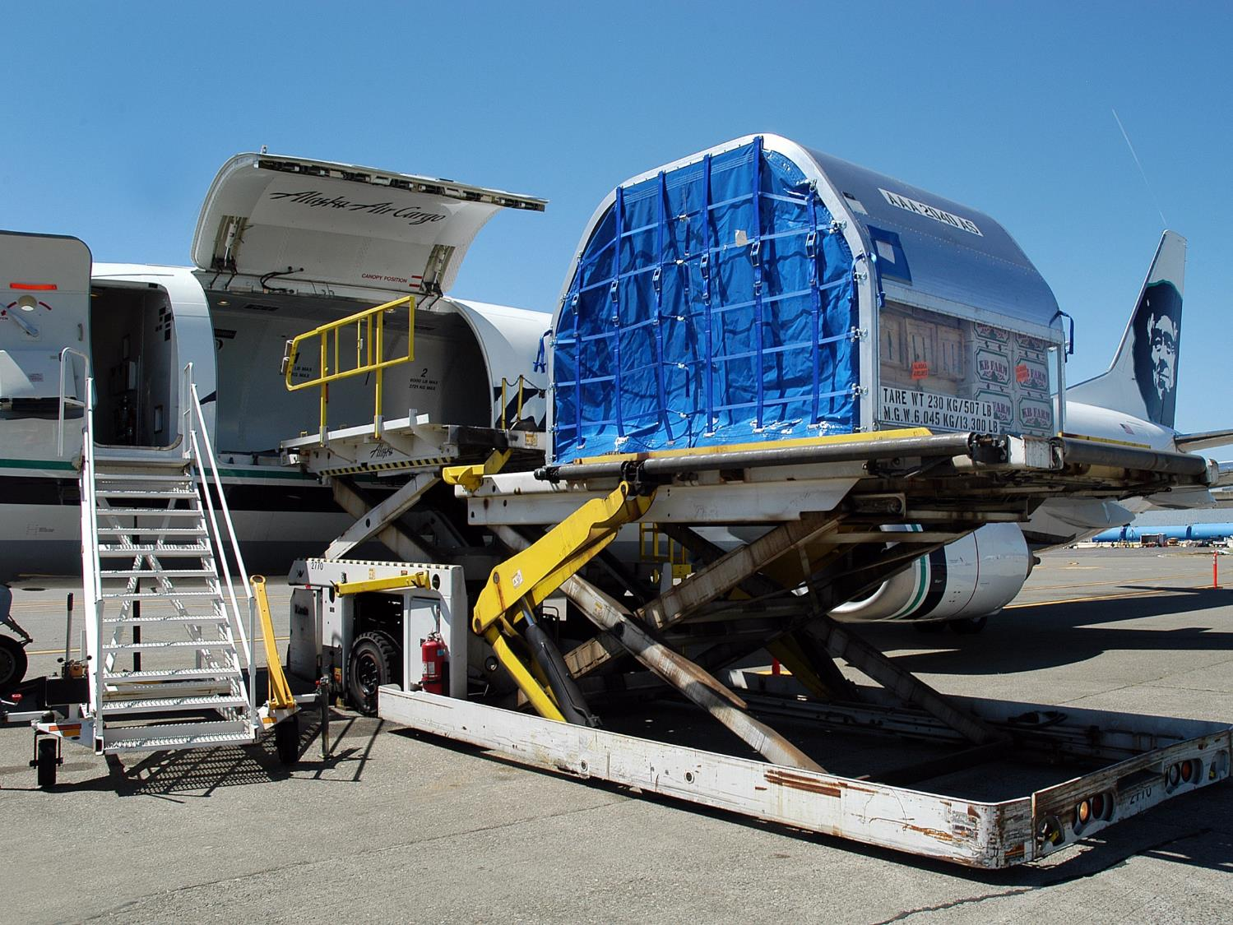


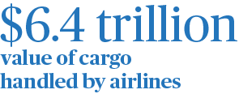
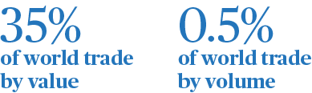


Aviation: world trade
4

Slide 5
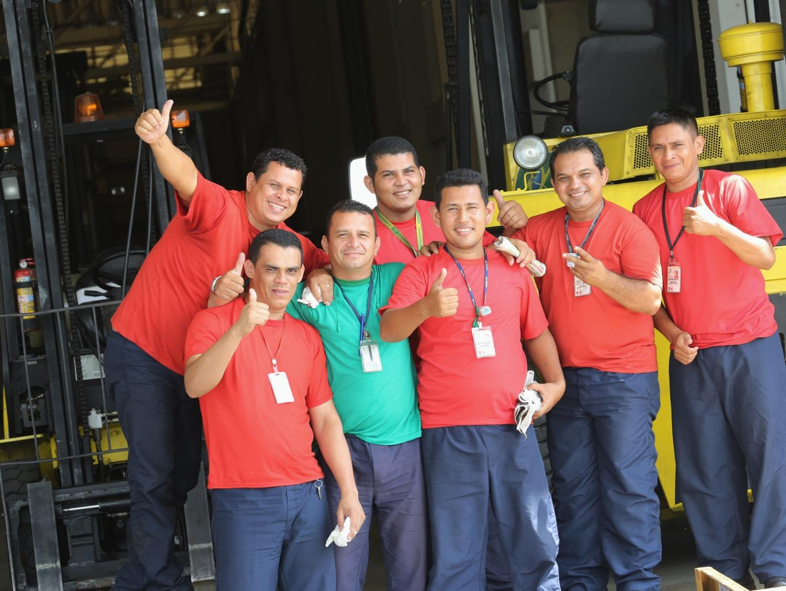
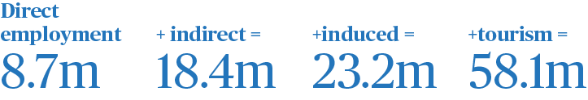
Aviation: employment supported
5

Slide 6

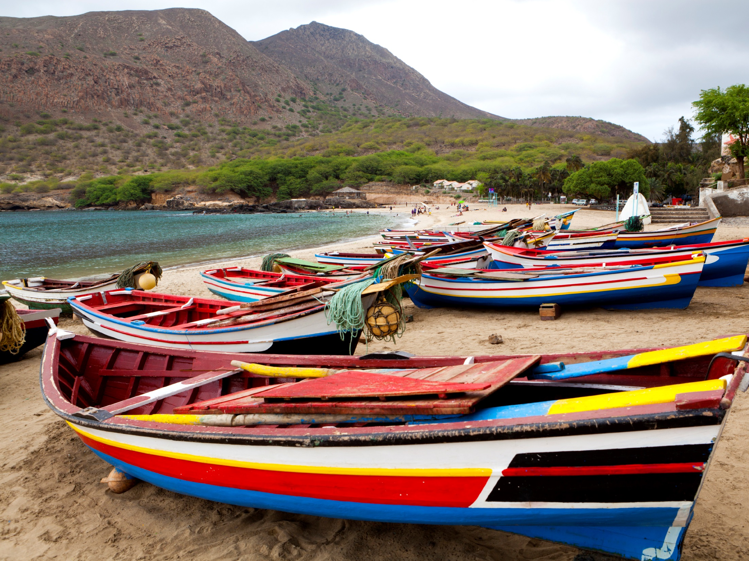
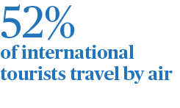
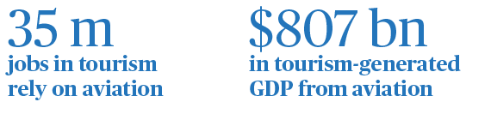

Aviation and tourism

Slide 7
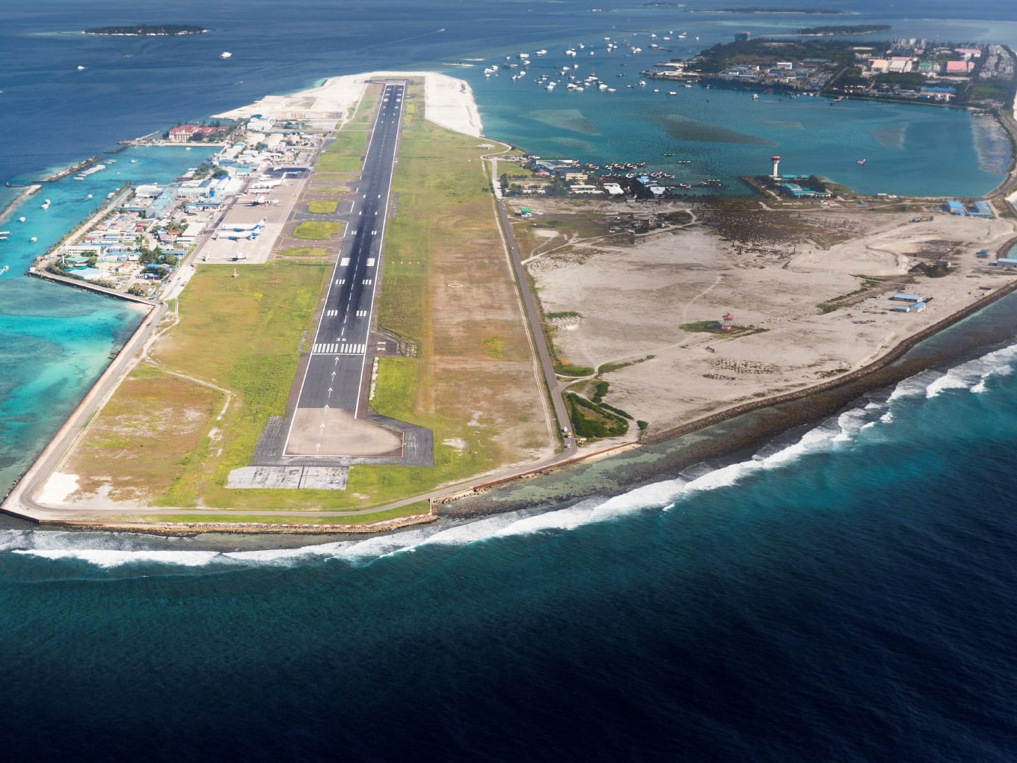

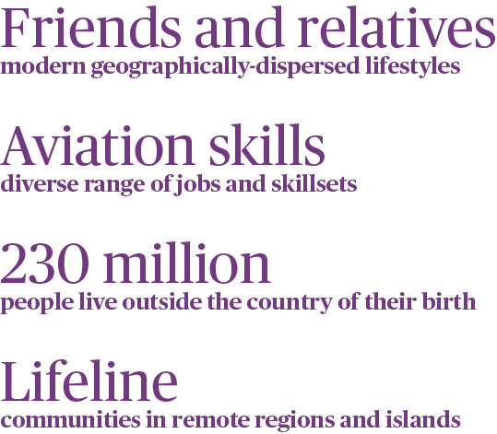
Aviation: social benefits
7

Slide 8


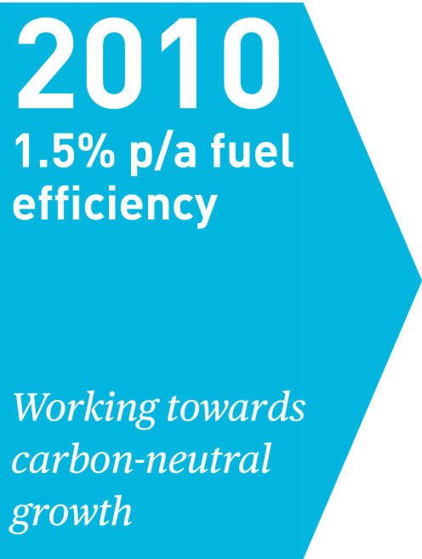


Aviation: climate action
8

Slide 9

Obstacles to Delivering This Value
Notes:
But there are some obstacles
For example, a lack of available connectivity by air:
Focus of our ‘value of aviation’ campaign in Africa.
At the heart of today’s discussion.
Potential lack of infrastructure development needed to meet demand growth:
Focus of campaigns in Latin America and Asia Pacific
Proliferation of taxes on aviation:
Something else we will be looking at in LATM in the context of the value of aviation
Inefficient use of airspace. Leading to:
unnecessary delays and costs for businesses and individuals
unnecessary emissions
Focus of upcoming campaign in Europe

Slide 10

‘Smarter Regulation’
Policy design
Regulatory Process
Not the same as ‘less’ regulation
Notes:
So how do we remove these obstacles?
Answer: Work collaboratively with governments to ensure they take a Smarter Regulation approach. Many governments have launched smarter or better regulation initiatives
Policy design:
Consistency and clarity
Proportionality
Targeted at risk
Regulatory Process:
Clear objectives
Consultative
Impact analysis
Regular review
‘Smarter Regulation’ is not the same as LESS regulation
If governments take such an approach to our industry, they will create an environment where aviation is free to deliver its full value

Slide 11
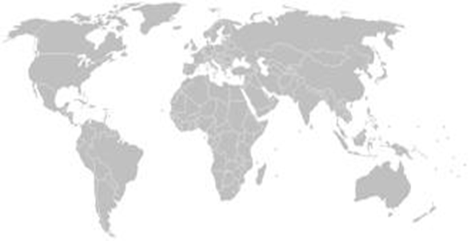
SMARTer REGULATION
MC 99 Ratification
New Distribution Capability
Passenger Data and Border Control
Passenger Rights
Safety
Security
Slots & Infrastructure
Taxation
Unruly Passengers

Slide 12
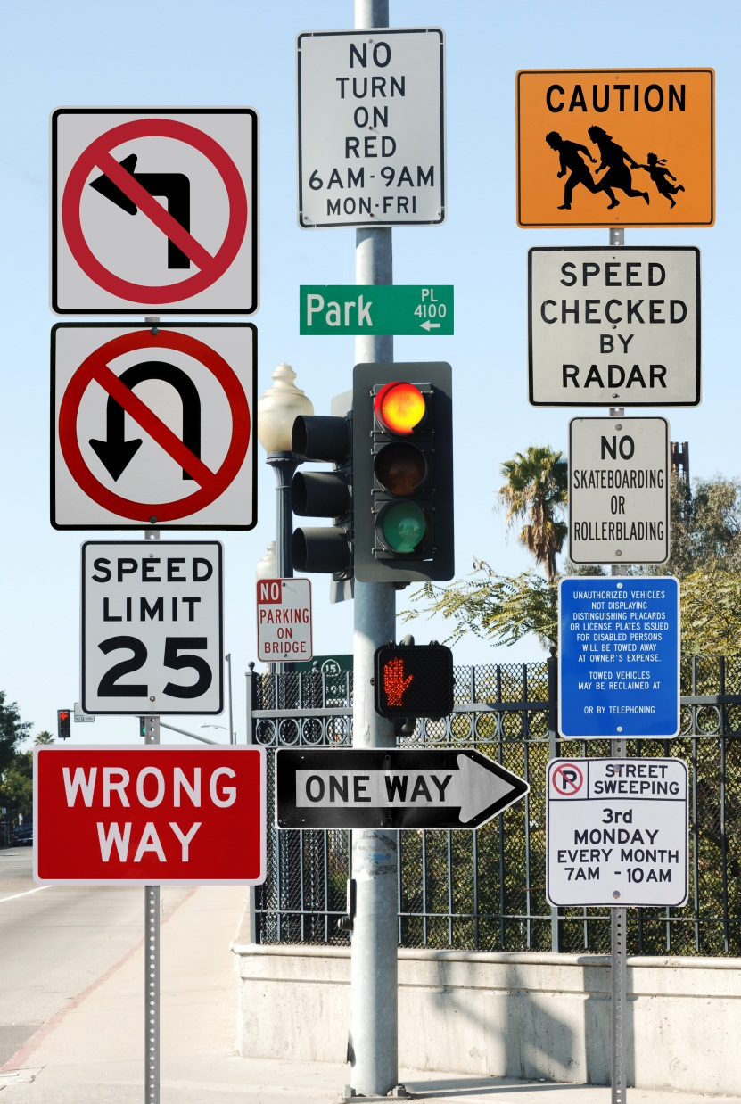
Some ‘Not-So-Good’ Examples
Passenger Rights
Commercial & Operational Licensing
Climate Change
Notes:
Passenger Rights:
Over 60 countries have aviation-specific regimes in place today – and these are not coordinated.
NOT consistent, not clear, not SMART.
We hope the recently published ICAO policy guidance will bring about a more coherent approach for the benefit of both passengers and airlines
Commercial & Operational Licensing:
One of the main reasons for being here this week is to negotiate traffic rights
But that is only the start of the process for the airlines
When routes are available, airlines then need to secure licenses to operate
But many obstacles: many documents to be translated and reviewed, onsite inspections, public hearings, and legal declarations.
And all vary by State, and not always in a reciprocal manner.
Again, not clear, not coherent, not proportional, not SMART.
Climate Change:
A patchwork of national and regional ‘solutions’ to a global problem is not SMART.

Slide 13

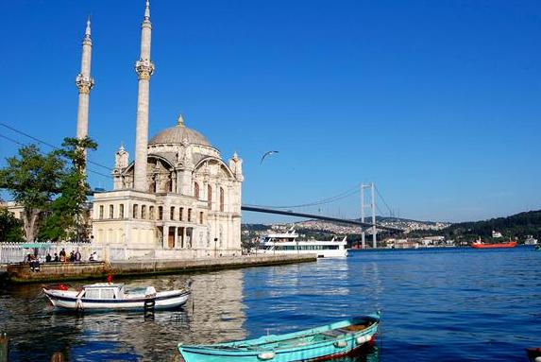
National View: Turkey
Strategic priority of the Turkish government
Simplified processes for visas
Embraces international standards
Notes:
Turkish aviation market is booming in the last 12 years. Turkish government supported the growth of aviation by liberalizing the domestic market.
A country with almost 80 million population , more than 65% economically active with a median age of 30.
The country’s unique geographical position is a key contributor for the making of the Istanbul airport an international Hub. Additionally, the massive domestic market of country also plays a significant role. However the airport capacity remains a challenge for rapid growth.
Turkish Government supports aviation ; 3rd/new airport would aim to be the largest airport in the world. It is a giant investment for Turkish aviation
The growth of GDP, tourism and trade: The government simplified processes such as Visa requirements to support the tourism, but it takes long to simplify the processes for Cargo…
International standards: TK is a country that embraces international aviation standards such as IOSA safety audit, ISAGO and Secure Freight. 7 out of 13 carriers are IATA members.
Qualified personnel: government and aviation stakeholders have invested in training. It remains another challenge together with the airport capacity and the infrastructure.

Slide 14

The Importance of Working Together
Notes:
Not just about airlines, or governments or infrastructure providers working in isolation
We all need to work together
Great to see all of the different stakeholder groups represented on this panel
That is a good sign
Because if we work together
We all help deliver the full value of aviation
And we all benefit from it

Slide 15
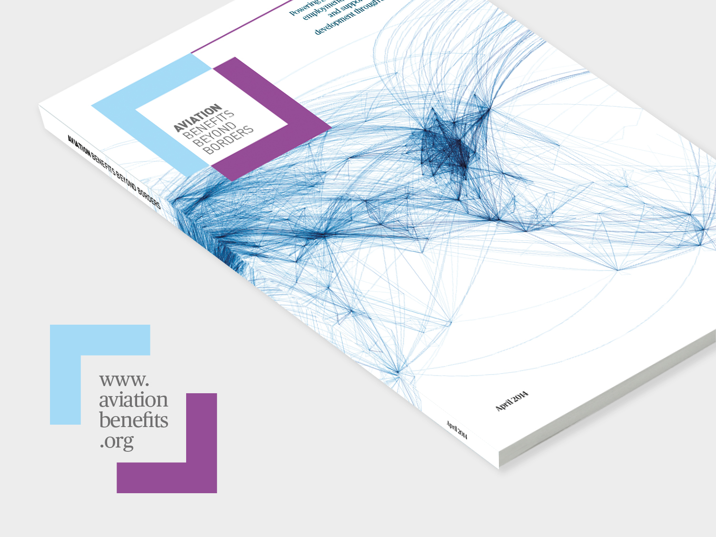

Slide 16
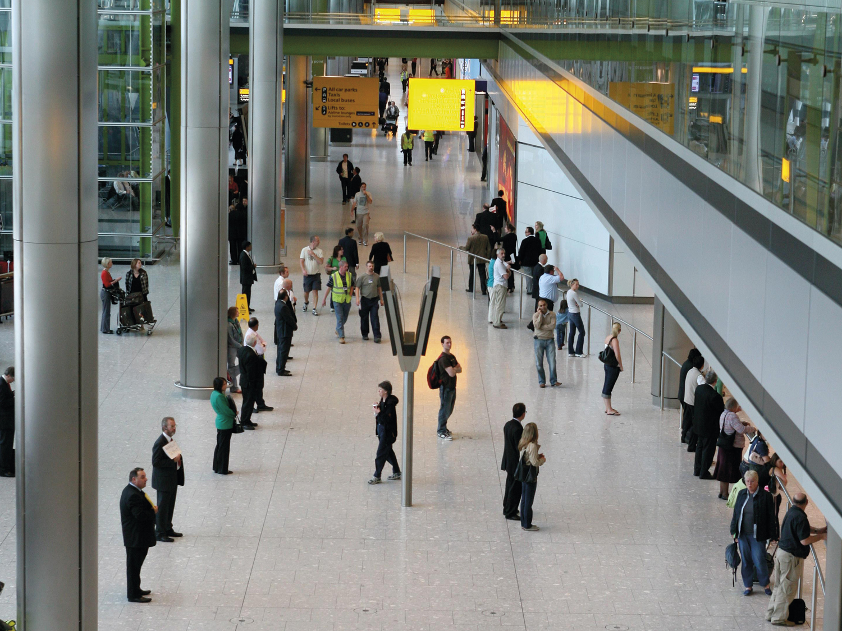

Thank You!
Paul Steele
IATA
Senior Vice President Member and External Relations & Corporate Secretary
16
Notes:
It’s sometimes good to step back and consider the scope of the aviation sector
Aviation has the ability to generate tremendous value for a whole range of people and organizations
It drives economic development
It facilitates the export of goods to new markets
It makes humanitarian programs and disaster relief possible
It drives tourism, which leads to the discovery and understanding of new
And it does something as ‘simple’ as re-uniting grandparents with their grandchildren
So this value is enjoyed by governments, businesses, humanitarian bodies and us…as individuals
It is truly a force for good
Turkey as a good example:
Forward thinking government
And an airline that now has more destinations than any other airline

