Slide 1
- SETTING THE SCENE -
The State of Air Transport and
Regulatory Developments
Boubacar Djibo
Director, Air Transport Bureau, ICAO
ICAN 2015
Antalya, Turkey, 19 October 2015

Slide 2

CHICAGO CONVENTION
Preamble THEREFORE, the undersigned governments having agreed on certain principles and arrangements in order that international civil aviation may be developed in a safe and orderly manner and that international air transport services may be established on the basis of equality of opportunity and operated soundly and economically;

Slide 3
Sustainability
-
Sixth Worldwide Air Transport Conference (ATConf/6)
(Montréal - 18 March 2013)
Opening remarks by the President of the Council
“By sustainable, we mean safe, secure and environmentally friendly operations, for both passenger and cargo traffic, that provide airlines, airports, air navigation service providers (ANSPs) and other partners of the air transport value chain with a reasonable expectation of profitability. It also means supporting competitive economies and promoting balanced regional development.”

Slide 4
INDUSTRY FACTS AND FIGURES

Slide 5
The air transport industry continues to:
- Create direct and indirect employment;
- Support tourism and local businesses;
- Stimulate foreign investment and international trade;
- Contribute to sustainable development; and
- Support small and remote communities.
The industry has become an engine and a catalyst for socio-economic growth and development.

Slide 6

The size of the industry as at 2014
3.3 billion passengers
50 million tonnes of freight
Over 1 000 scheduled airlines
26 700 aircraft in service
More than 4 000 airports
170 air navigation centres
Traffic is for scheduled services
| ICAO UNITING AVIATION NO COUNTRY LEFT BEHIND

Slide 7
The size of the industry as at 2014
Air Traffic continues to Grow
-
Note: world total scheduled services
*preliminary figures
| ICAO UNITING AVIATION NO COUNTRY LEFT BEHIND

Slide 8

BY YEAR 2030
Air Traffic is expected to continue to grow
Passenger traffic by 4.6% per annum.
Freight by 5.3% each year.
Passenger traffic will double to 6.6billion by 2030
-
| ICAO UNITING AVIATION NO COUNTRY LEFT BEHIND

Slide 9
Passenger traffic: Worldwide distribution
Analysis
Since 2010:
Asia/Pacific ranks 1st
Since 2012:
Europe ranks 2nd
Middle East has remained the fastest growing region since 2007
Source: ICAO Annual Reports of the Council
Scheduled commercial traffic
Total (international and domestic) services

Slide 10
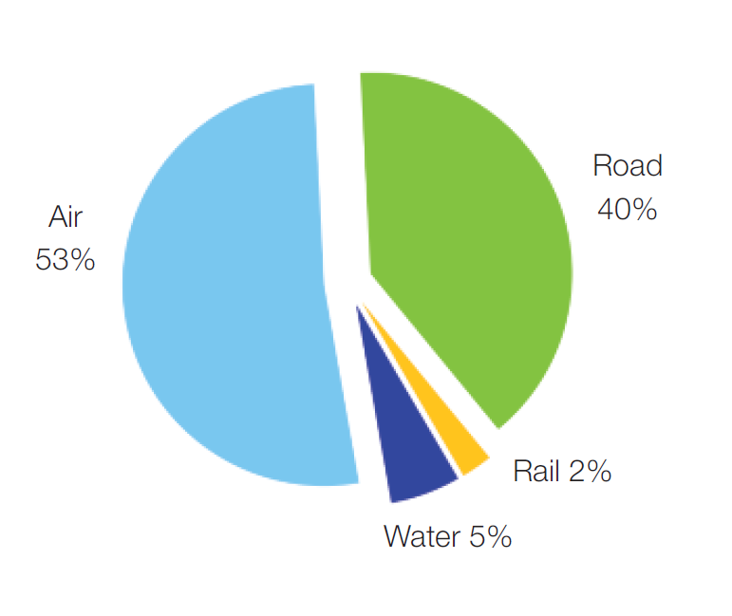
.
More than half of International tourists arrive by air
Tourism expansion relies heavily on air transport.
Harmonious sectorial policies on air transport and tourism will facilitate the development of travel and tourism
Inbound tourism by mode of transport
| ICAO UNITING AVIATION NO COUNTRY LEFT BEHIND
Source: World Tourism Organization (UNWTO)

Slide 11
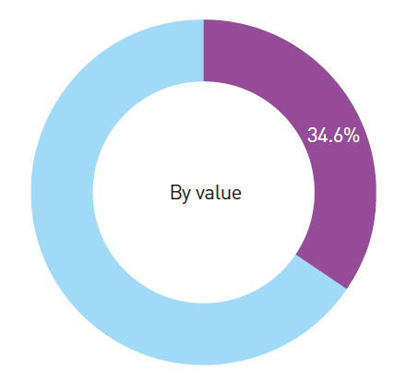
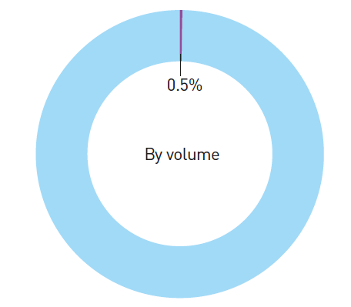
World international cargo shipment
Volume of world international cargo shipment
Value of world international cargo shipment
Aviation
Surface modes
Aviation
Surface modes
Source: Air Transport Action Group (ATAG), 2014
| ICAO UNITING AVIATION NO COUNTRY LEFT BEHIND
Notes:
While accounting for less than 0.5% of the tonnage of global trade, air freight makes up over a third of the value of international trade.
As an important facilitator of international trade, aviation promotes global economic growth and development.

Slide 12
2014 AIR TRANSPORT RESULTS
| ICAO UNITING AVIATION NO COUNTRY LEFT BEHIND

Slide 13
.
World of Air Transport
3.3billion
33 million
+5.5%
vs. 2013
+2.1%
vs. 2013
-
Passengers carried
Commercial flights performed
6.1trillion
+5.8%
vs. 2013
194billion
+4.9%
vs. 2013
Freight Tonne-Kilometres
Revenue Passenger-Kilometres
| ICAO UNITING AVIATION NO COUNTRY LEFT BEHIND
Source: ICAO Annual Report of the Council
Scheduled commercial traffic. Total (international and domestic) services

Slide 14
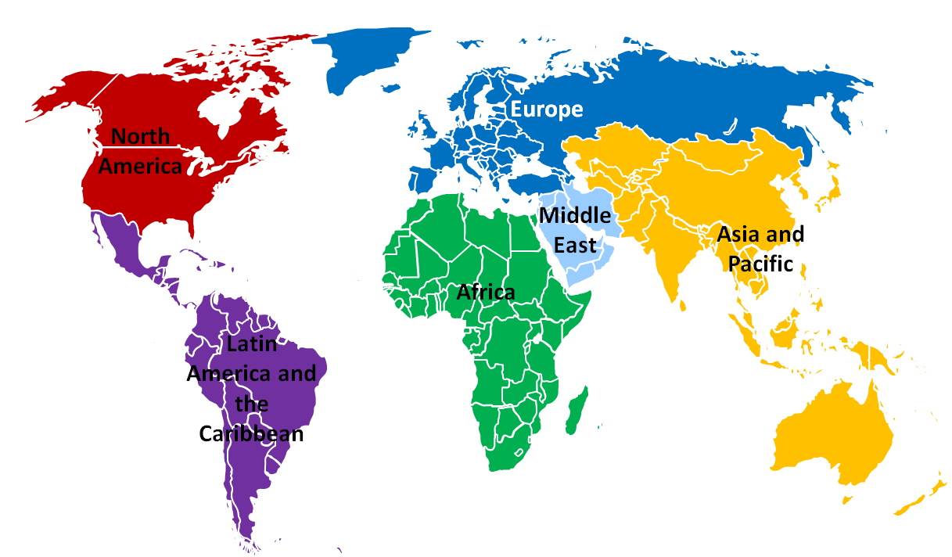
.
Air Transport By Region
-
Europe
+6.0% RPK
+2.0 FTK
North America
+3.0% RPK
+3.2 FTK
Asia and Pacific
+7.0% RPK
+5.5 FTK
Middle East
+11.3% RPK
+12.2 FTK
Latin America and the Caribbean
+5.3% RPK
+1.2 FTK
Africa
+0.8% RPK
+6.0 FTK
| ICAO UNITING AVIATION NO COUNTRY LEFT BEHIND

Slide 15
.
Air Transport By Region
Aircraft departures (million)
Passengers carried (million)
-
-0.9%
-0.2%
+7.4%
+5.7%
+3.2%
+5.7%
+3.9%
+0.6%
+8.6%
+10.1%
-1.5%
+2.9%
Revenue Passenger-Kilometres (billion)
Freight Tonne-Kilometres (billion)
+0.8%
+6.0%
+7.0%
+5.5%
+6.0%
+2.0%
+5.3%
+1.2%
+11.3%
+12.2%
+3.0%
+3.2%
| ICAO UNITING AVIATION NO COUNTRY LEFT BEHIND

Slide 16
Passenger traffic: Worldwide distribution
Distribution in Revenue Passenger-Kilometres
1st: North America
2nd: Asia/Pacific
3rd: Europe
1st: Asia/Pacific
2nd: Europe
3rd: North America
-
2007
2014
| ICAO UNITING AVIATION NO COUNTRY LEFT BEHIND

Slide 17
Freight traffic: Worldwide distribution
Distribution in Freight Tonne-Kilometres
2007
1st: Asia/Pacific
2nd: North America
3rd: Europe
2014
1st: Asia/Pacific
2nd: Europe
3rd: North America
-
| ICAO UNITING AVIATION NO COUNTRY LEFT BEHIND

Slide 18
.
Penetration of low-cost carriers (LCCs)
In 2014, LCCs carried 900 million passengers out of 3.3 billion passengers up 10.3% over 2013
-
Share of passenger carried on LCCs in each region*
Africa | 11%
Asia/Pacific | 25%
Europe | 31%
Latin America/ Caribbean | 36%
Middle East | 11%
North America | 28%
World | 27%
* Based on air carrier registration
| ICAO UNITING AVIATION NO COUNTRY LEFT BEHIND

Slide 19
.
Commercial air transport fleet
-
2014:
Turbojets: 89% of world fleet ; this share increased every year since 2005
Turboprop: 11% of world fleet
1 600 aircraft deliveries
More than 3 000 aircraft net orders for the world’s major aircraft manufacturers
Number of aircraft*
89%
86%
*Active and parked aircraft are included; aircraft having a maximum take-off mass of less than 9 000 kg (20 000 lbs) are not included
Source: Reed Business Information (RBI), aircraft manufacturer websites
| ICAO UNITING AVIATION NO COUNTRY LEFT BEHIND

Slide 20
.
International tourism trend
2014
-
Tourist arrivals by region
+48 million
Vs. 2013
International Tourist Arrivals
(million)
1,135million
International tourist arrivals
| ICAO UNITING AVIATION NO COUNTRY LEFT BEHIND
Source: World Tourism Organization (UNWTO)

Slide 21
FOCUSS ON TURKEY

Slide 22
Airline Ranking in European Region
-
*2014 vs. 2013
All airline of the Top 5 but Lufthansa recorded an increase
Turkish Airlines:
  +16.3% growth : Network expansion in 2014
  5th largest airline in the European Region in 2014
Paris and Frankfurt airports recorded each a decrease
| ICAO UNITING AVIATION NO COUNTRY LEFT BEHIND

Slide 23
Airport Ranking in European Region
-
Note: scheduled and non-scheduled services
Source: ACI
| ICAO UNITING AVIATION NO COUNTRY LEFT BEHIND

Slide 24
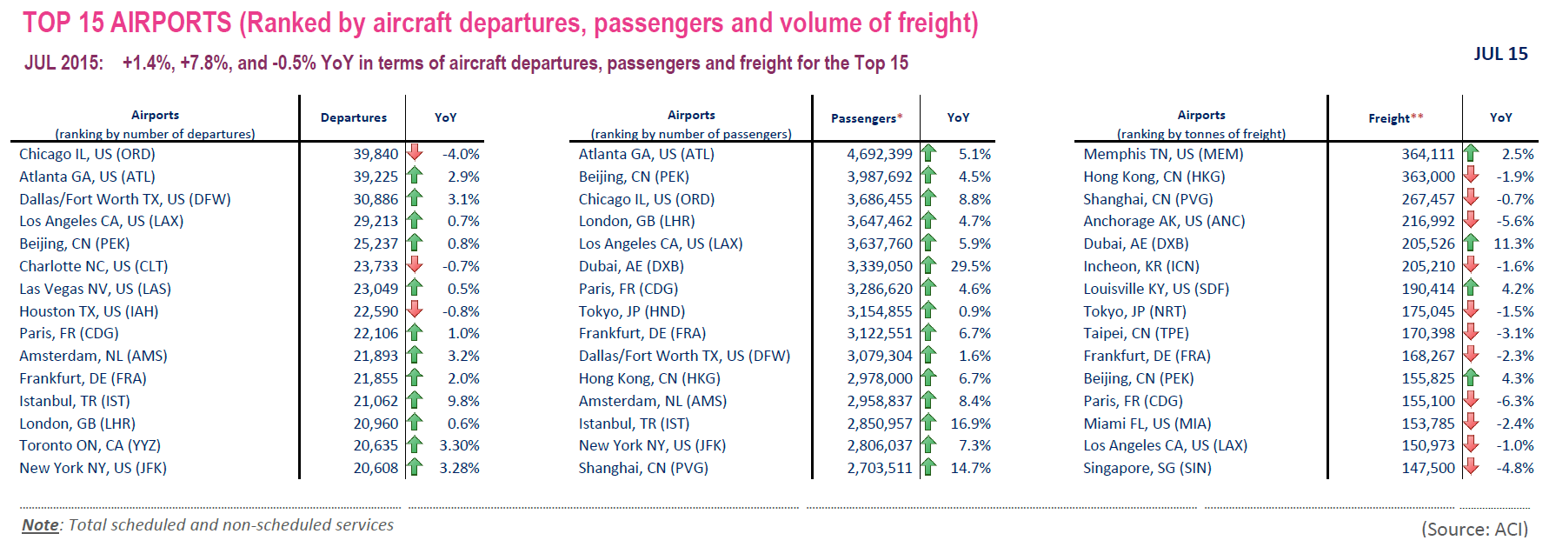
Top 15 Airports in July 2015:
Istanbul is in the ranking in departures and passengers
-
| ICAO UNITING AVIATION NO COUNTRY LEFT BEHIND

Slide 25
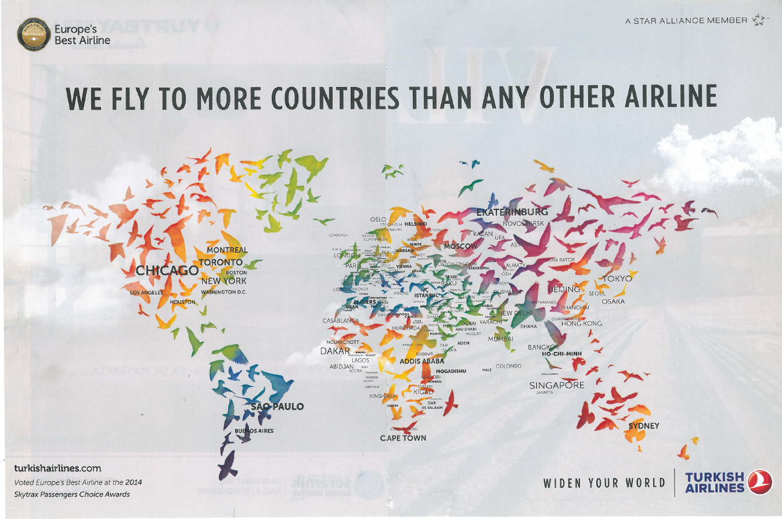
.
Turkish Airlines
-
| ICAO UNITING AVIATION NO COUNTRY LEFT BEHIND

Slide 26
EMERGING ISSUES
AIR CONNECTIVITY
UN SUSTAINABLE DEVELOPMENT GOALS
REGULATORY DEVELOPMENT

Slide 27
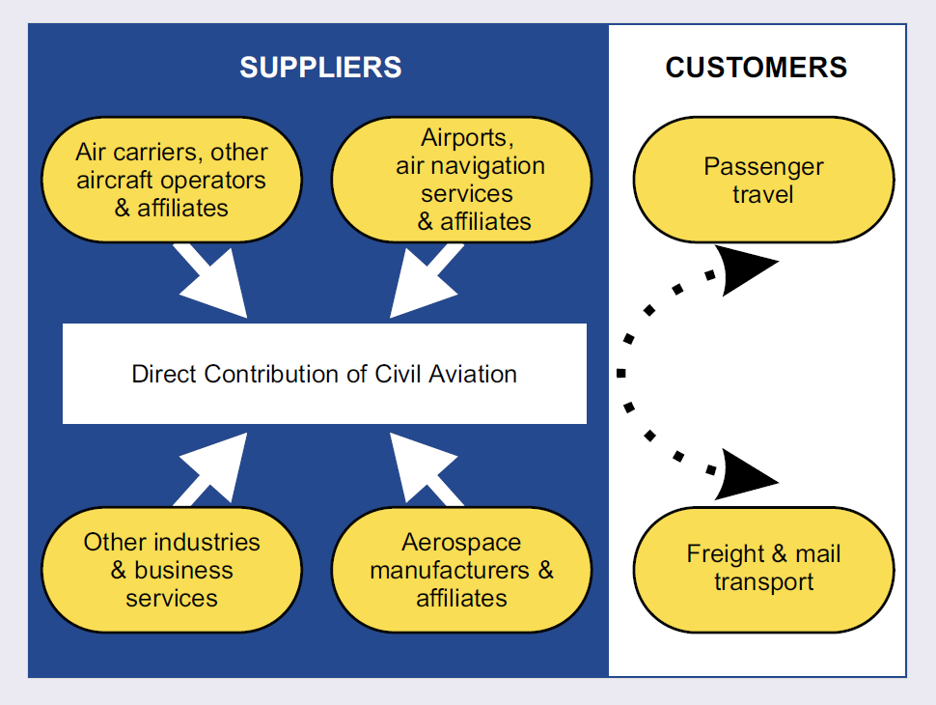

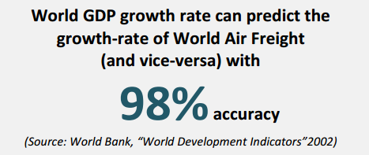
.
Air transport connectivity
A catalyst for economic development
-
Airports, air navigation services and affiliates
Aerospace and other manufacturing industries
Air carriers, other aircraft operators and affiliates
| ICAO UNITING AVIATION NO COUNTRY LEFT BEHIND

Slide 28
.
Economic contribution OF Air Connectivity
-
Direct economic impacts of aviation sector
Direct, indirect, induced and tourism economic impacts of aviation sector
8.5million
58.1million
Direct jobs supported by aviation worldwide
Jobs supported by aviation worldwide
$700 billion
$2.4 trillion
Direct Global economic impact
Global economic impact
2014 data
2012 data
Source: ICAO, Economic Contribution of Civil Aviation and ATAG
| ICAO UNITING AVIATION NO COUNTRY LEFT BEHIND
28

Slide 29


.
Economic Impact OF Air Connectivity
-
Business aviation: efficient, flexible and cost-effective access to global markets worldwide and destinations to small and rural communities
flight
Economic impact caused by Nepal earthquake's disruption of air connectivity
| ICAO UNITING AVIATION NO COUNTRY LEFT BEHIND

Slide 30
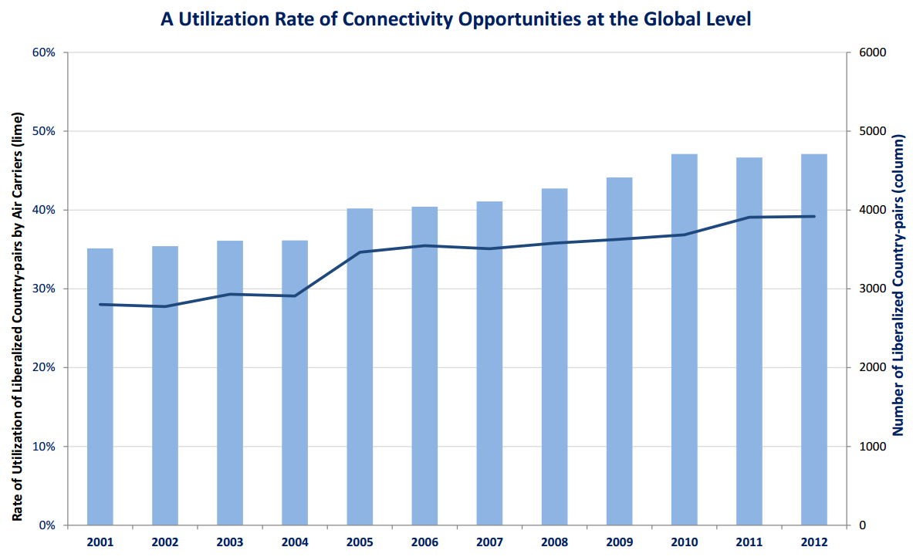
.
UN Sustainable Dev. Goals (SDG)
-
SDG Goal 8. Promote sustained, inclusive and sustainable economic growth, full and productive employment and decent work for all
Connectivity Indicator to compare number of markets made available by air transport liberalization (“available” or “reserved” connectivity) with the number of markets having actual air services (“real” connectivity)
Facilitate States in meeting Target 8.9: By 2030, devise and implement policies to promote sustainable tourism that creates jobs and promotes local culture and products
Help States to determine the loss of economic growth potential
| ICAO UNITING AVIATION NO COUNTRY LEFT BEHIND

Slide 31
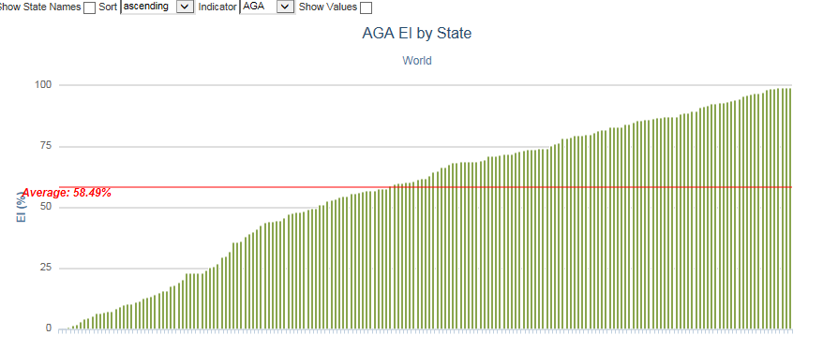
.
UN Sustainable Dev. Goals (SDG)
-
SDG Goal 9. Build resilient infrastructure, promote inclusive and sustainable industrialization and foster innovation
Percentage of effective implementation (EI) in the infrastructure development of aerodromes and ground aids (AGA)
Facilitate States in meeting Target 9.1: Develop quality, reliable, sustainable and resilient infrastructure, including regional and trans-border infrastructure, to support economic development and human well-being, with a focus on affordable and equitable access for all.
| ICAO UNITING AVIATION NO COUNTRY LEFT BEHIND

Slide 32
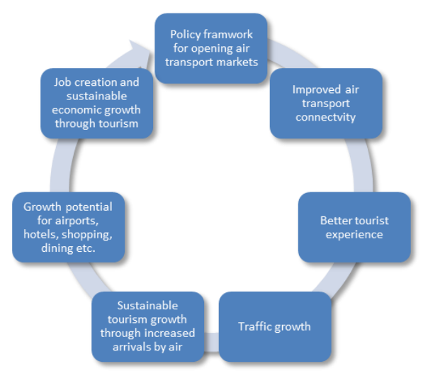
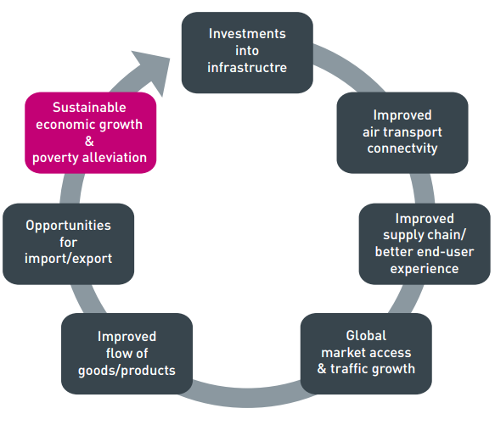
.
Air connectivity and UN SDGs
Connectivity directly impacts UN Sustainable Development Goals (SDGs)
-
Tourism -
Passenger
Cargo-Freight
| ICAO UNITING AVIATION NO COUNTRY LEFT BEHIND

Slide 33
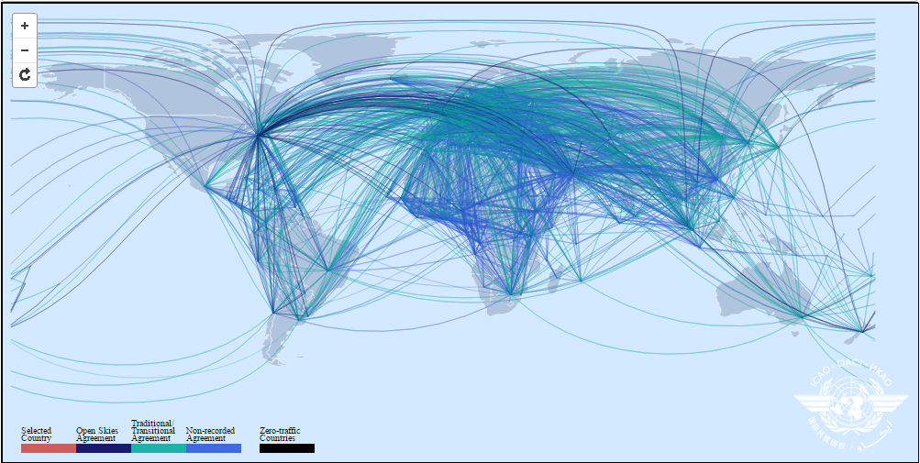
.
Regulatory Developments
(Market Access is becoming more open)
-
Web of Bilateral Air Services Agreements.
| ICAO UNITING AVIATION NO COUNTRY LEFT BEHIND
Source: ICAO WASA Map Tool

Slide 34
.
Regulatory Developments
Regional Liberalization: Most world regions now have liberalization programs
-
Full liberalization arrangements (ASEAN, CARICOM, EU, LACAC. Trans-Tasman cooperation)
Gradual liberalization arrangements (Yamoussoukro Decision, Damascus Agreement signatory states, South Pacific Islands)
| ICAO UNITING AVIATION NO COUNTRY LEFT BEHIND

Slide 35
.
Regulatory Developments
Bilateral Open Skies (as of June 2015)
States which signed open skies agreements with both the US and third countries
-
States which signed open skies agreements with the US only
States which signed open skies agreements with the third countries only
Over 400 Open Skies Agreements involving
146 States
| ICAO UNITING AVIATION NO COUNTRY LEFT BEHIND

Slide 36
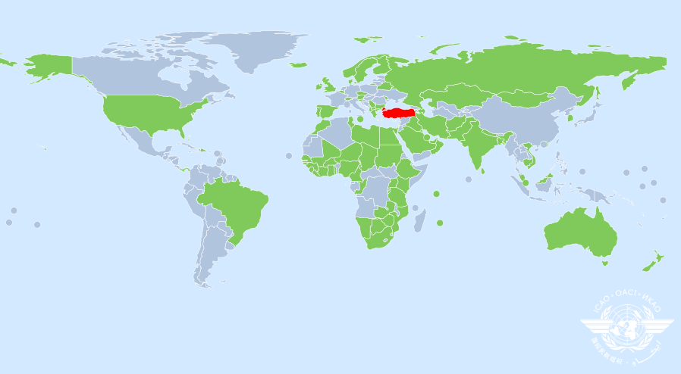
.
ICAN 2015: SUMMARY OF PARTICIPANTS
States/Territories Organisations General Public/Industry
94 5 60
| ICAO UNITING AVIATION NO COUNTRY LEFT BEHIND

Slide 37
AIR TRANSPORT
FUTURE TRENDS

Slide 38
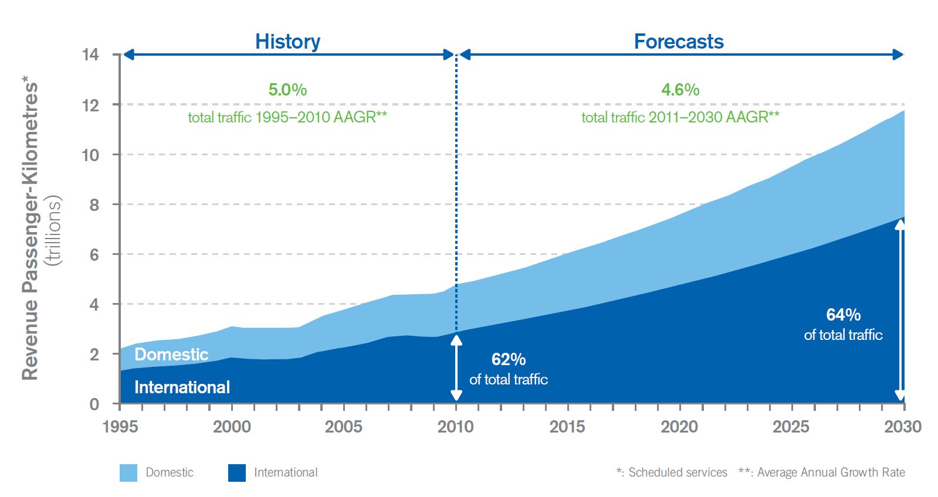
World long-term air traffic forecasts scheduled passenger traffic
Source: Cir 333, Global Air Transport Outlook to 2030 - GATO
| ICAO UNITING AVIATION NO COUNTRY LEFT BEHIND

Slide 39
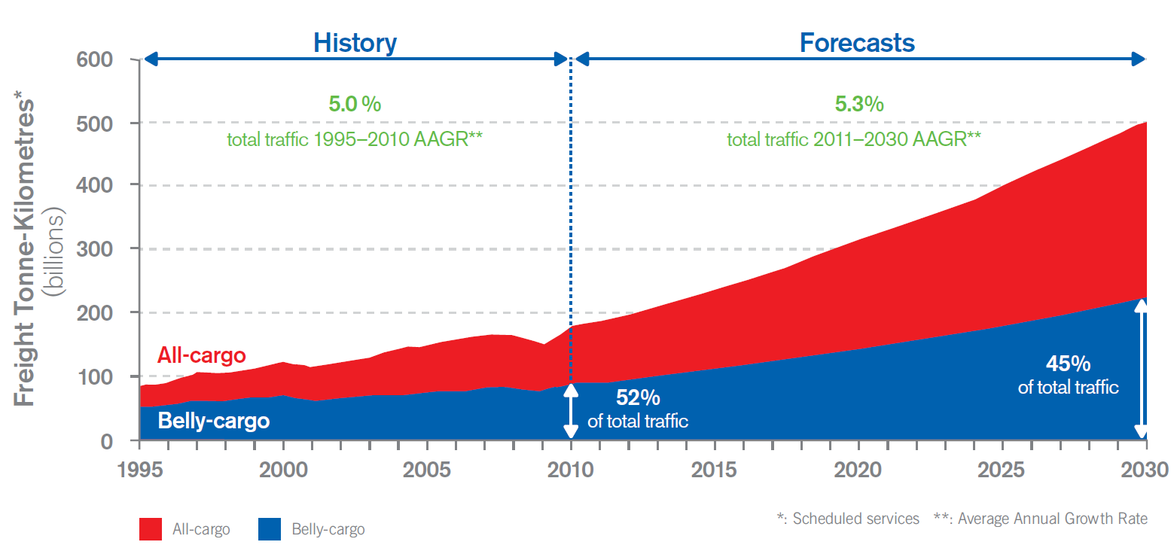
World Long-term air traffic forecasts scheduled freight traffic
Source: Cir 333, Global Air Transport Outlook to 2030 - GATO
| ICAO UNITING AVIATION NO COUNTRY LEFT BEHIND

Slide 40
FUTURE TRENDS
Air traffic will continue to grow, but vulnerable to impacts.
Competition among airlines will be intensified.
Demands from consumers for better services will increase.
Call for better regulatory and operating environment will escalate.

Slide 41
THE ROLE OF ICAO
ICAO will continue to provide the required leadership by putting in place appropriate regulatory framework, policies and assistance for the sustainable development of air transport in member States.

Slide 42

.
ICAO UP COMING EVENT
-
ICAO World Aviation Forum
Aviation Partnerships for Sustainable Development
Date: 23 - 25 November 2015
Location: Montréal, Canada
Venue: ICAO HQ, 999 Robert-Bourassa Boulevard
| ICAO UNITING AVIATION NO COUNTRY LEFT BEHIND

Slide 43
Thank You
Merci
Gracias
Спасибо, Spasiba
شكرا , Shukran
谢谢

