Slide 1
Air Liberalisation for Tourism
Alain Lumbroso
ICAN Conference, Antalya , Oct 19 2015 alaın.lumbroso@oecd.org

Slide 2
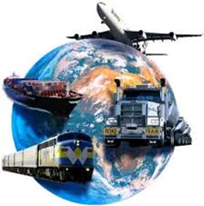
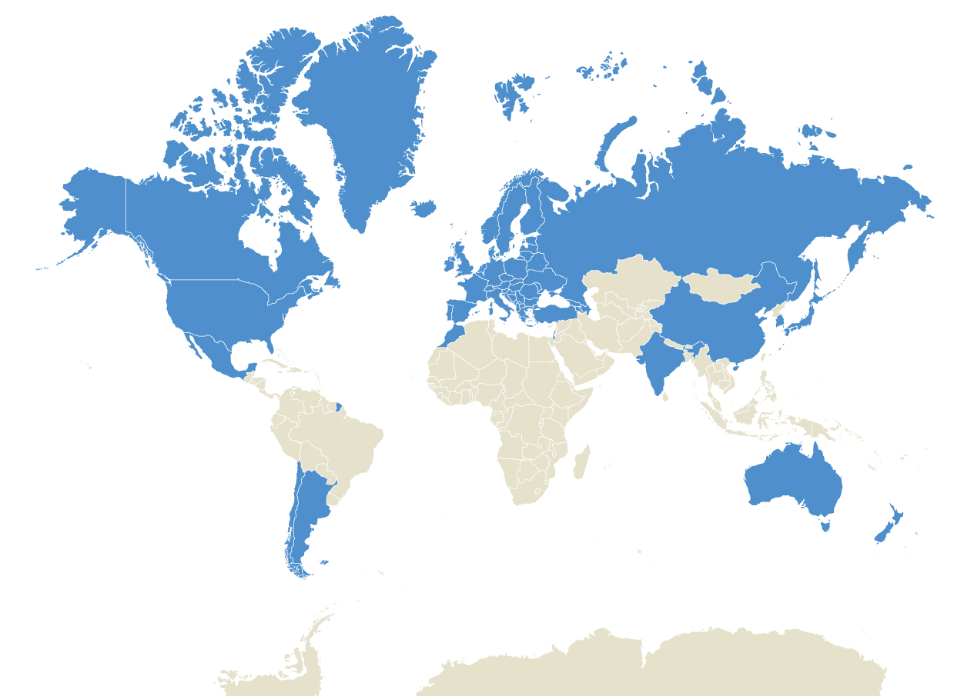

What is the ITF?
57 member countries
(34 OECD + 23 non-OECD)
Active in all modes of transportation
Housed at the OECD
Council of Ministers of Transport, rotating annual presidency
Legal instruments: European
Multilateral Quota System
Presently preparing for expansion of membership

Slide 3
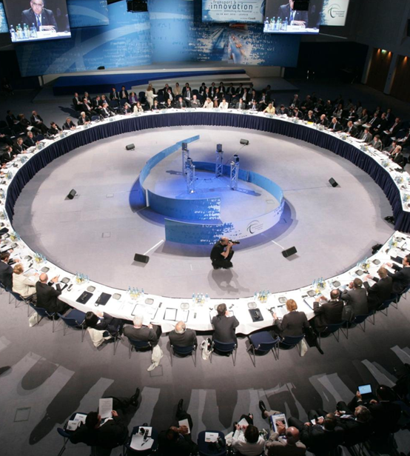
Annual Summit
Ministerial Meeting and
Declaration from Ministers
Ministers’ Roundtables
Panel Discussions with Ministers, Industry, Research, Civil Society
Bilaterals and Networking
Exhibition
1100 participants (2015)
2015 Summit theme: Tourism, Trade and Transportation

Slide 4
What is a Tourist?
Tourism is travel for recreation, leisure, religious, family or business purposes, usually for a limited duration -- Wikipedia
In other words, except for migration, all air passengers are tourists!
Tourism is growing worldwide because:
  Income growth in develloping and emerging economies;
  Lower air fares;
  Better connectivity;
  Ease of travel

Slide 5
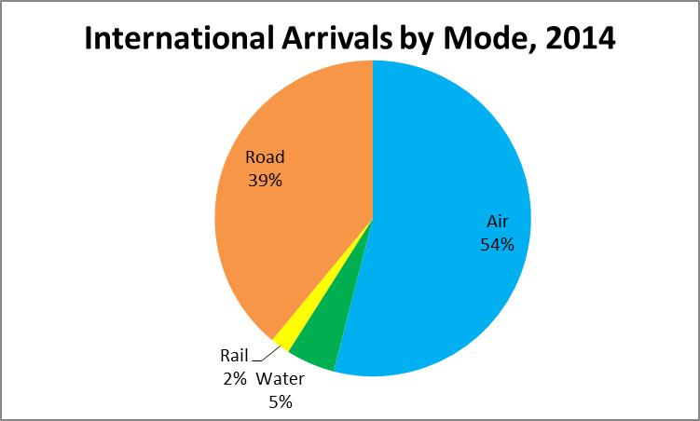
Tourism: Does it matter?
Hint: yes!!!
In 2012, it represented in the OECD:
  4.7% of GDP (direct);
  9% of GDP (direct + indirect + induced) – globally: 10%
  6% of employment - globally: 9%
  21% of exports of services
  1.1 B arrivals in 2014 to 1.4B in 2020 and 1.8B in 2030 (UNWTO);
  Air’s market share
  expected to grow to
  65% by 2030.

Slide 6
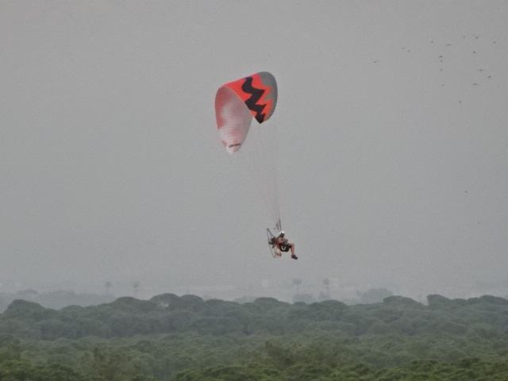
What is the tourist looking for?
Freedom!
Tourists are looking for the freedom to:
  Fly when they want;
  Fly from where they want;
  Fly to where they want;
  Fly with whom they want;
  Trade price for quality;
Whilst enjoying the highest levels of safety
There is only one freedom for tourists:
Freedom to fly!
Freedom!!

Slide 7
How does aviation compare to other tourism services?
 | Aviation (Not OSA) | Hotel | Restaurant | Commercial Attractions | National Monument
State-Managed Capacity | Yes | No | No | No | Yes
State approval of prices | Yes | No | No | No | Yes
Foreign ownership allowed | Limited | Yes | Yes | Yes | No
Foreign control allowed | No | Yes | Yes | Yes | No
Foreign fırm on domestic market | No | Yes | Yes | Yes | N.A.
Subsidised | Yes | No | No | No | Yes
Air transport still seen as a State-owned asset -Traffic rights belong to States

Slide 8
Air transport liberalisation and policy goals
Tourism development is one policy goal; there are others!!
Tourism must compete with other priorities;
Weak voice for outbound tourism;
Challenge for policy-makers is aligning several diverging and conflicting policy goals;
A tourism lens applied to aviation liberalisation is very demand-centric; what about the supply side?

Slide 9
Research in Aviation Liberalisation
Examined the issue of liberalised air markets from a wide variety of angles;
Contracted 4 papers, formed a global working group, one discussion paper, one major research paper;
Researched looked at all aspects of liberalisation, including traffic rights, ownership and control, subsidies, labour and the environment;
Presentation of our research tomorrow afternoon.

Slide 10
Some fındıngs with respect to tourism
Liberalisation has always had a neutral or positive impact on demand;
Demand driven more by price (LCC) than capacity;
Markets with liberalised policy stance (US, UK, New Zealand, Morocco, Finland) all saw clear benefits to open markets;
Once markets are open, little desire to close them.

Slide 11

Morocco – A Case Study ın Lıberalısatıon
Tourism oriented aviation policy as part of Vision 2010- Vision 2020;
Target: grow intl arrivals from 4.3M to 20M 2000->2020;
Open skies (with limited 5th) with EU in 2006;
70 new routes, 20 new carriers traffic grew from 6.6M to 11M 2006->2011;
Increase in week-end tourism and repeat visits;
RAM saw a drop in market share but increase in traffic;
Morocco now #3 for flights to the EU

Slide 12
Parting Thoughts
Can’t grow tourism if tourists can’t get there!
Connectivity is key for economic development. Includes also land access (last mile);
We have yet to find a counter-example where liberalisation hurt the tourism market;
Liberalisation not just with source country but also transit countries;
Liberalisation starts at traffic rights but doesn’t end there!

