Slide 1

TURKISH TOURISM DEVELOPMENT PROCESS AND DIVERSIFICATION OF TOURISM ACTIVITIES

Slide 2
CONTENT
1- TURKISH TOURISM DEVELOPMENT PROCESS
- 1st PERIOD- BEFORE 1980s
- 2 nd PERIOD – 1980-2003
- 3 rd PERIOD – AFTER 2003
2- STUDIES FOR DIVERSIFICATION OF TOURISM ACTIVITIES
-TURKISH TOURISM STRATEGY 2023
-ALTERNATIVE TOURISM TYPES
-INTEGRATED TOURISM DESTINATIONS

Slide 3
DEVELOPMENT OF TURKISH TOURISM SECTOR
1st PERIOD (1923-1982)
EVENT BASED INITIATIVES OF ASSOCIATIONS UNTILL 1950 s
FORMATION OF TOURISM BANK FOR FINANCING TOURISM INVESTMENTS (1955)
BEGINNING OF PLANNED ECONOMIC DEVELOPMENT (1963)
FORMATION OF MINISTRY OF TOURISM AND PROMOTION (1963)
STATE ORIENTED PIONEERING PROJECTS FOR TOURISM DEVELOPMENT (SOUTH ANTALYA TOURISM DEVELOPMENT PROJECT-SİDE ETC.)
FIRST LEGISLATIVE REGULATIONS FOR STANDRDISATION OF ESTABLISHMENTS AND CERTIFICATION OF ACCOMMODATION FACILITIES

Slide 4
DEVELOPMENT OF TURKISH TOURISM SECTOR
2nd PERIOD (1982-2003)
  TOURISM INCENTIVE LAW #2634 (1982)
  CREATING NEW TOURISM DESTINATIONS (DETECTION AND ANNOUNCEMENT OF TOURISM CENTERS AND REGIONS BY THE DECISION OF COUNCIL OF MINISTERS)
  AUTHORIZATION IN TOURISM LAND USE PLANNING (PLACE-ORIENTED IMPLEMENTATION PLANS OF 1/1000 SCALE)
  ALLOCATION OF PUBLIC LAND TO TOURISM INVESTORS FOR 49 YEARS
  INCENTIVES FOR TOURISM INVESTMENTS (FINANCIAL SUPPORT, TAX ADVANCES,)
  INFRASTRUCTURE INVESTMENTS OF STATE IN TOURISM CENTERS
  STANDARDIZATION AND CONTROL OF ESTABLISHMENTS
  EDUCATING QUALIFIED TOURISM STAFF

Slide 5
DEVELOPMENT OF TURKISH TOURISM SECTOR
3rd PERIOD (2003- )
AMENDMENTS IN TOURISM INCENTIVE LAW (NO:4957/2634)
AUTHORIZATION IN TOURISM PLANNING INCLUDING ALL SCALES
1/25.000, 1/5000 & 1/1000 – REGIONAL PLANNING
DIVERSIFICATION OF TOURISM ACTIVITIES (GOLF, THERMAL-HEALTH, WINTER, CULTURE-RELIGIOUS TOURISM ETC…)
DETECTION AND ANNOUNCEMENT OF TOURISM CENTERS AND CULTURE AND TOURISM PROTECTION AND DEVELOPMENT REGIONS
RESEARCH FOR NEW LAND ALLOCATION METHODS
TURKEY TOURISM STRATEGY 2023 (2007)
THERMAL TOURISM MASTER PLAN (2007)
DESTINATION BASED PLANNING – PROJECTS FOR ALTERNATIVE TOURISM TYPES

Slide 6
THE MAJOR AIM IS DIVERSIFICATION OF TOURISM ACTIVITIES AND EXPANDING TOURISM SEASON TO 12 MONTHS
AND THE VISION IS TO MAKE TOURISM A HEADING SECTOR FOR INCRESING EMPLOYMENT AND REGIONAL DEVELOPMENT AND TO MAKE TURKEY AN INTERNATIONAL BRAND AMONG THE FIRST 5 COUNTRIES IN THE GLOBAL TOURISM MARKET ACCORDING TO TOURIST NUMBERS AND TOURISM REVENUE UNTIL 2023.
Notes:
The aims and reasons for this study:
Concentration of tourism sector on spesific regions, on summer session and on a specific tourism type,
Resources’ presenting high level potential for tourism such as thermal, winter, culture and eco-tourism, not taking place in the tourism cycle
The considerably low rate of the foregin capital in tourism sector
Effect of globalization on tourism,
Shifting of investment sizes from parcel scale (~ 30 millions $) to regional scale(~1 billion $),
Undertaking of infrastructures by the private sector using new financial models,
New methods of advetisement and marketing being effective in tourism sector make a necessity for the restructuring.

Slide 7
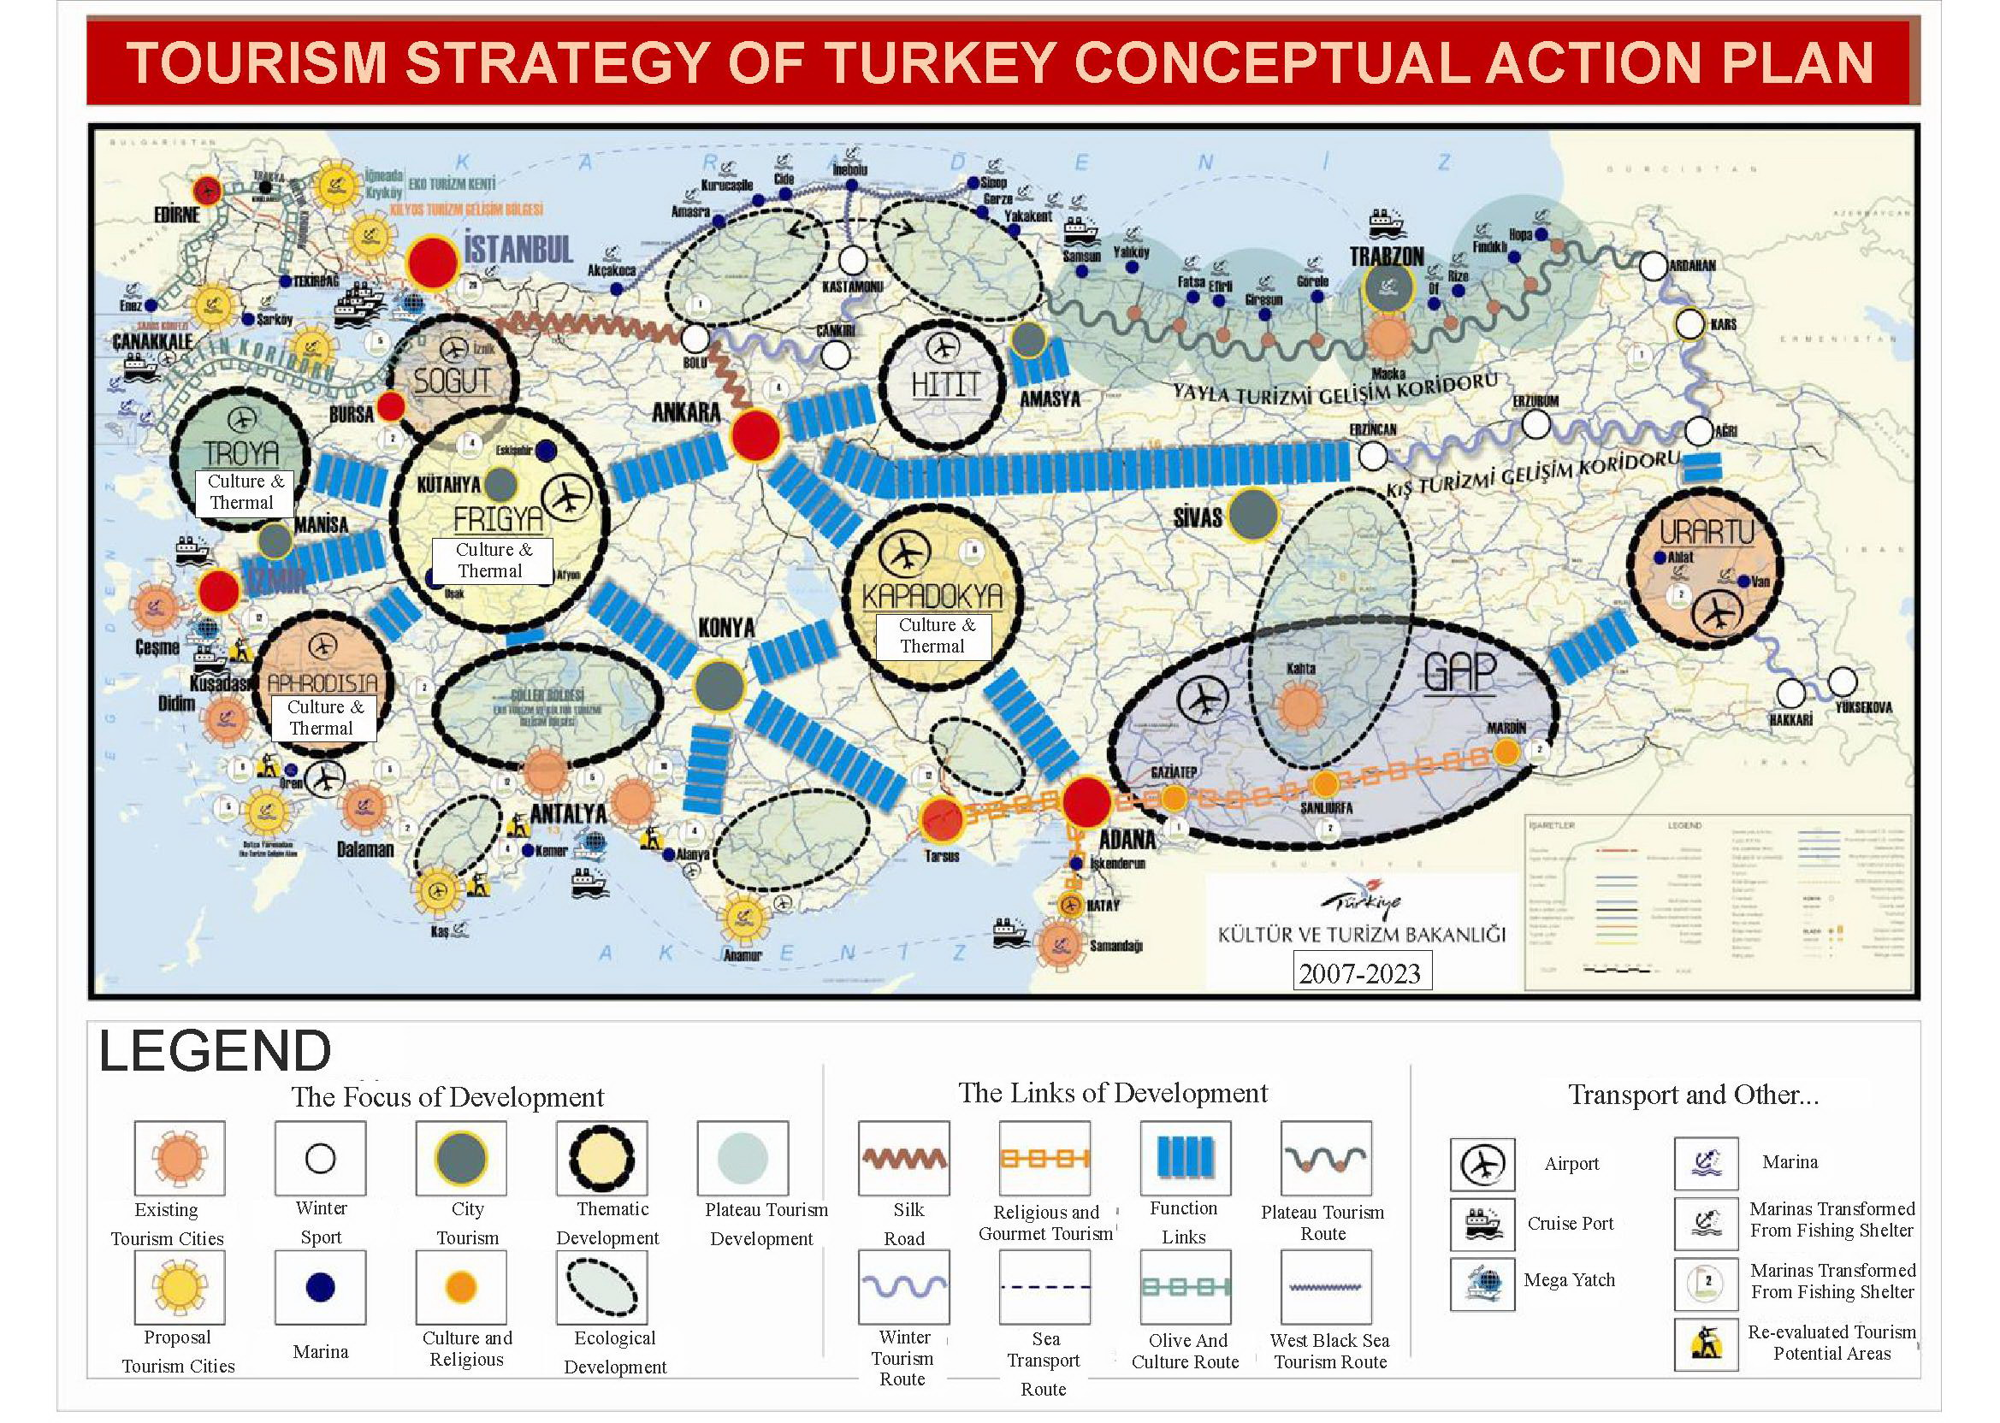
VISION OF TOURISM STRATEGY
IS TO MAKE TOURISM A HEADING SECTOR FOR INCRESING EMPLOYMENT AND REGIONAL DEVELOPMENT AND TO MAKE TURKEY AN INTERNATIONAL BRAND AMONG THE FIRST 5 COUNTRIES IN THE GLOBAL TOURISM MARKET ACCORDING TO TOURIST NUMBERS AND TOURISM REVENUE UNTIL 2023.

Slide 8
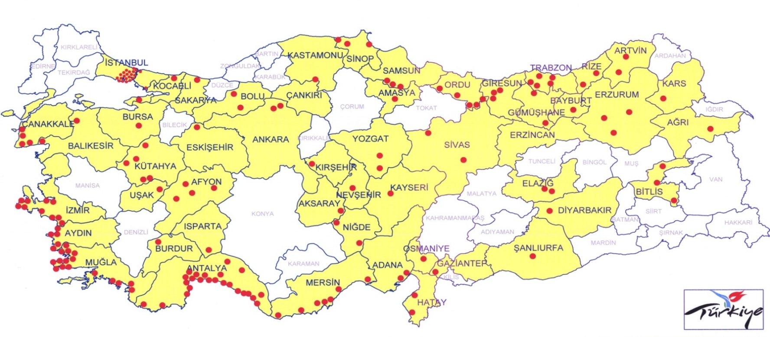
ANNONCED TOURISM CENTERS AND CULTURE AND TOURISM PROTECTION AND DEVELOPMENT REGIONS
ARDAHAN
DÜZCE
TOKAT
BİNGÖL
MANİSA
KONYA
DENİZLİ

Slide 9
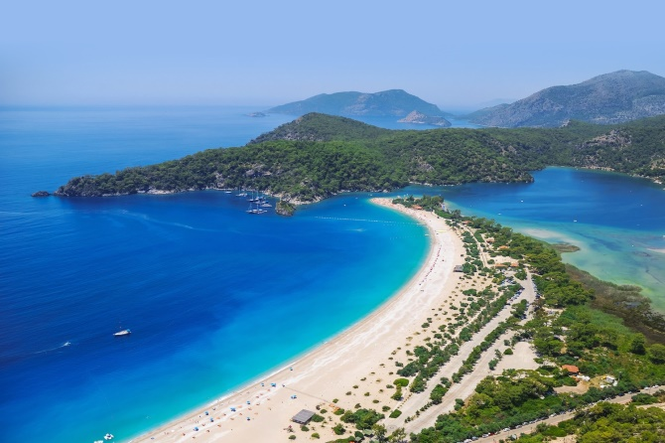
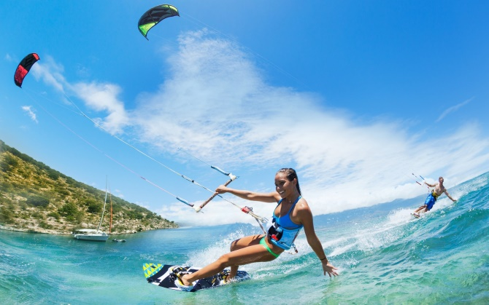
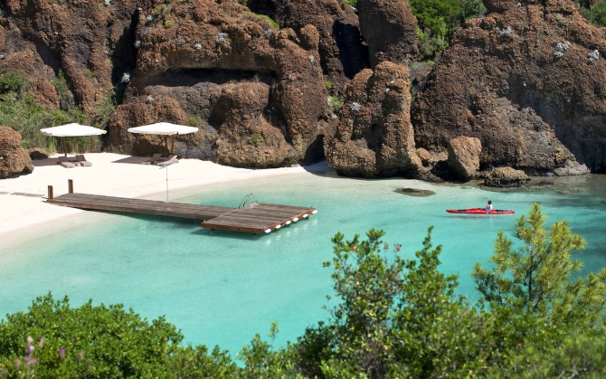
PRESENT COASTAL TOURISM DESTINATIONS
ANTALYA (Kemer, Belek, Alanya, Side, Manavgat)
MUGLA (Bodrum, Marmaris, Dalaman, Fethiye)
IZMIR (Cesme)
AYDIN (Kusadasi)

Slide 10
ALTERNATIVE TOURISM TYPES

Slide 11
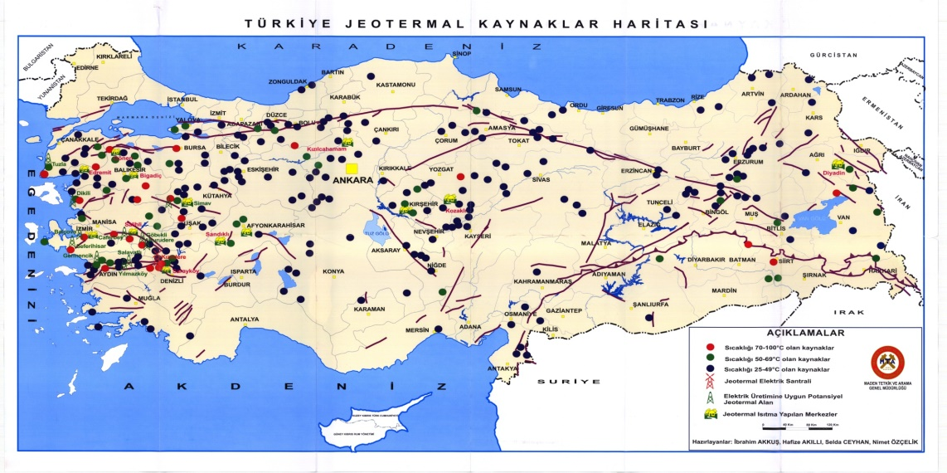
THERMAL AND HEALTH TOURISM
Thermal Tourism (Cure treatment, Spa&Wellness, aquatherapy etc.)
There are approximately 1300 geothermal resources with water flow rates between 2 - 500 liter/second in Turkey.
Turkey is among the first seven countries in the World for its potential hot mineral resources.
Turkey is the third country in Europe with 240 thermal spas having hot mineral springs. Comes after Italy(300 spas) and Germany (with 260 spas).
THERMAL TOURISM MASTER PLAN WAS PREPARED IN 2007 TO DEVELOP TURKEY’S GEOTHERMAL POTENTIAL

Slide 12
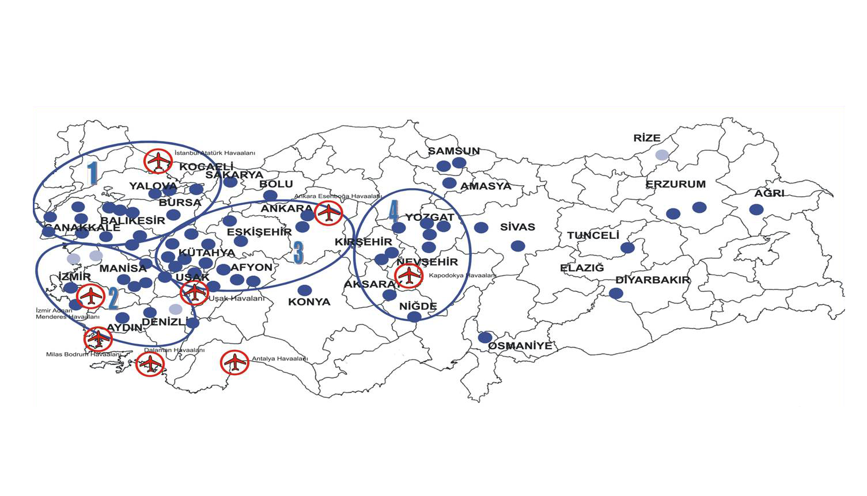
THERMAL TOURISM CENTERS
Regions of Thermal Tourism Master Plan
Thermal CTPDR (4)
1
South Marmara: Balikesir, Çanakkale, Yalova
Thermal TC (74)
2
South Agean: Aydın, Denizli, İzmir, Manisa
3
Phrigya: Afyonkarahisar, Ankara, Eskişehir, Kütahya, Uşak
4
Middle Anatolian: Aksaray, Kırşehir, Nevşehir, Niğde, Yozgat
Notes:
12

Slide 13
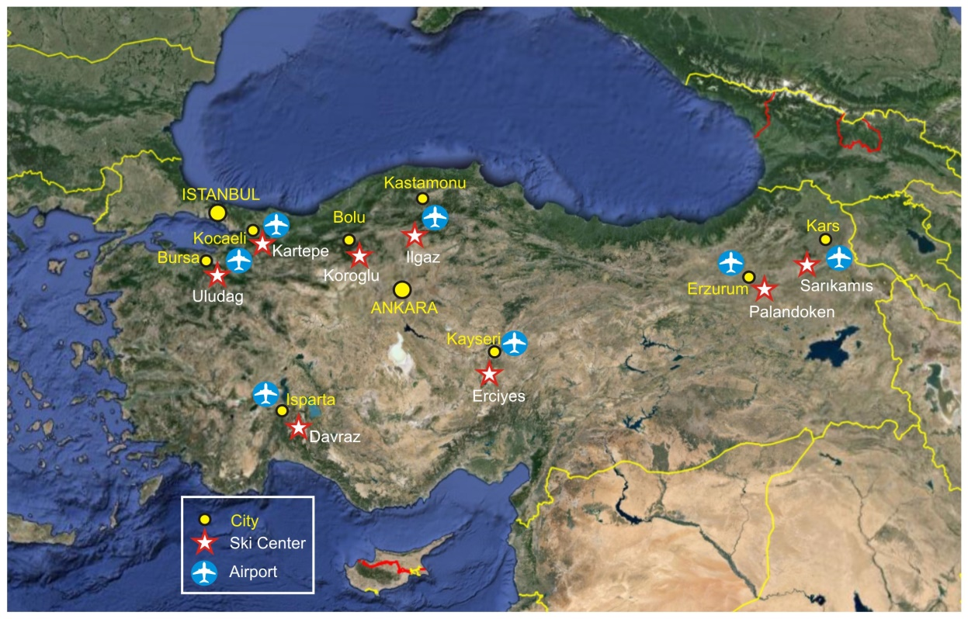
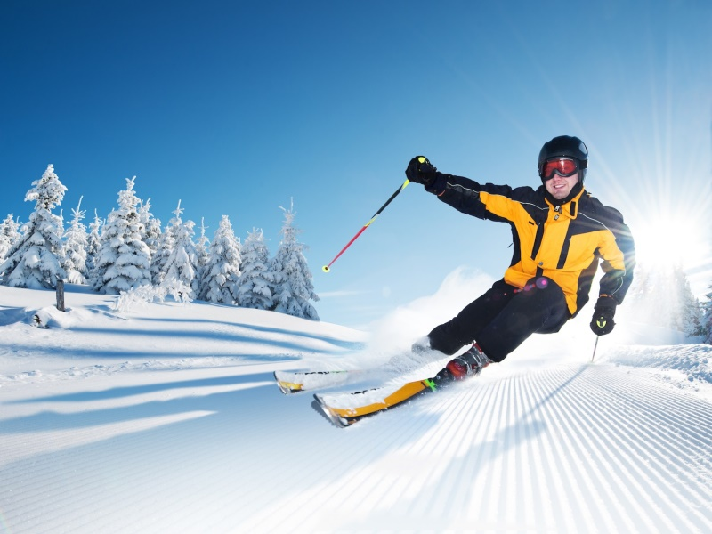
WINTER TOURISM
 | Bed Capacity | Planned Bed Number
Palandoken | 2466 | 8850
Uludag | 1750 | 3500
Koroglu | 1713 | 4000
Erciyes | 920 | 6000
Ilgaz | 917 | 1300
Kartepe | 800 | 1000
Sarikamis | 639 | 12000
Isparta-Davraz | 467 | 1600
Active Ski Center : 8
Partly Active Ski Center : 8
New Project : 12
Total Bed Capacity : 10023
Planned Bed Number : 79000

Slide 14
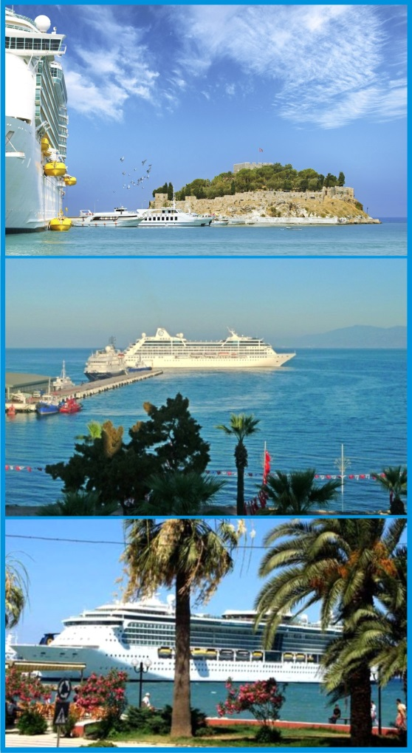
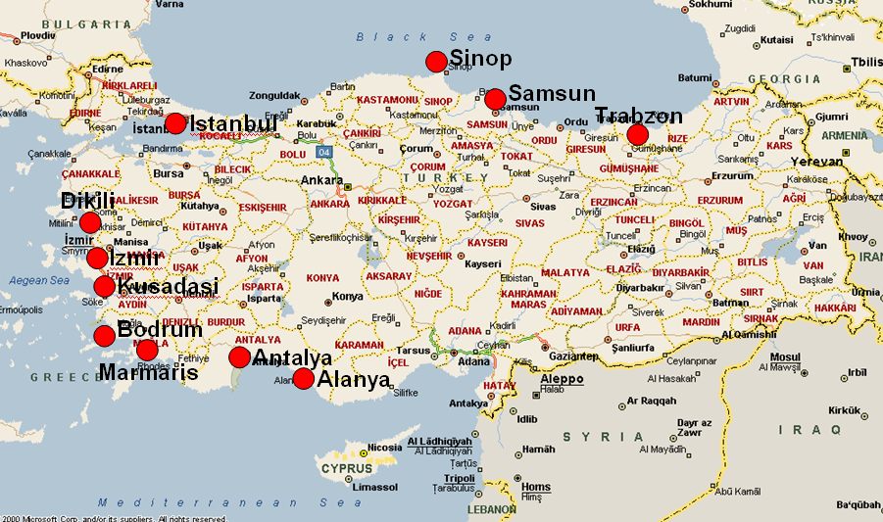
YACHT AND CRUISE TOURISM
ISTANBUL
ANTALYA
ALANYA
BODRUM
MARMARIS
IZMIR
KUSADASI

Slide 15
TARGETS FOR YACHT AND CRUISE INVESTMENTS

Slide 16
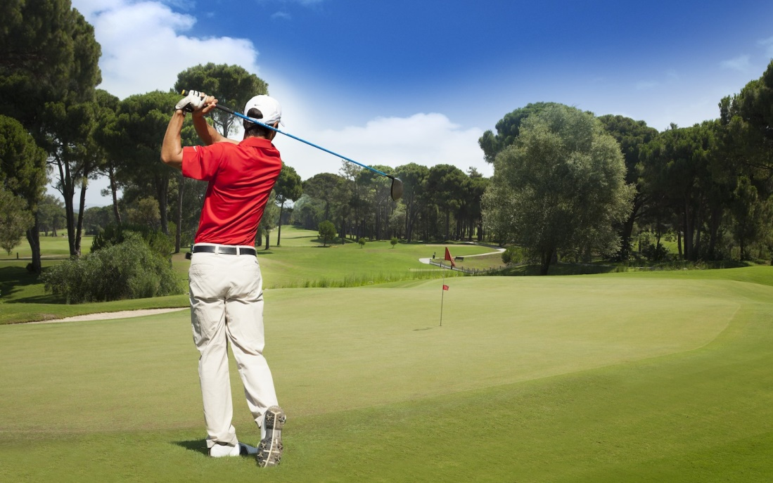
GOLF TOURISM
Turkey has 28 golf courses. Antalya 21 courses is the most important golf destination of Turkey.
Zone | Course | Number of Courses
Istanbul | Kemer | 2
Istanbul | Klassis | 2
Antalya | Carya | 1
Antalya | Cornelia Courses | 3
Antalya | Gloria Courses | 7
Antalya | Kaya Palazzo | 1
Antalya | Montgomorie | 1
Antalya | National | 2
Antalya | Nobilis | 1
Antalya | Sueno Courses | 2
Antalya | Titanic Golf Courses | 3
Bodrum | Bodrum Golf | 1
Aydin | Kusadasi International Golf | 1
Ankara | Ankara Golf | 1
_{Antalya – Belek voted the}
“Best Golf Destination in Europe 2008” by the IAGTO
(International Association of Golf Tour Operators)

Slide 17
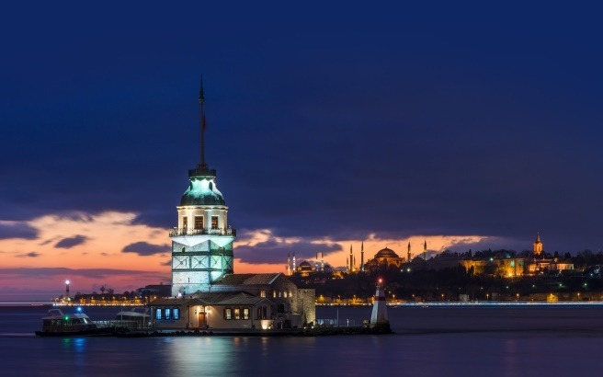

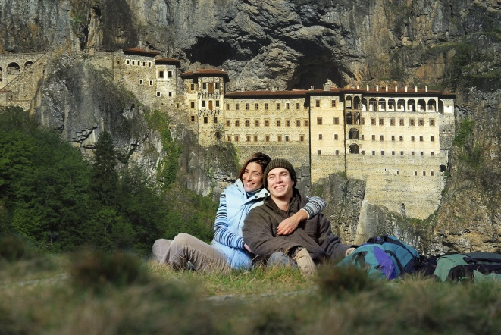
CULTURAL AND RELIGIOUS TOURISM
ISTANBUL
CAPPADOCIA
MARDIN
SANLIURFA
HATAY
GAZIANTEP
TRABZON
PAMUKKALE
EPHESUS
DEMRE

Slide 18
INTEGRATED TOURISM DESTINATIONS

Slide 19
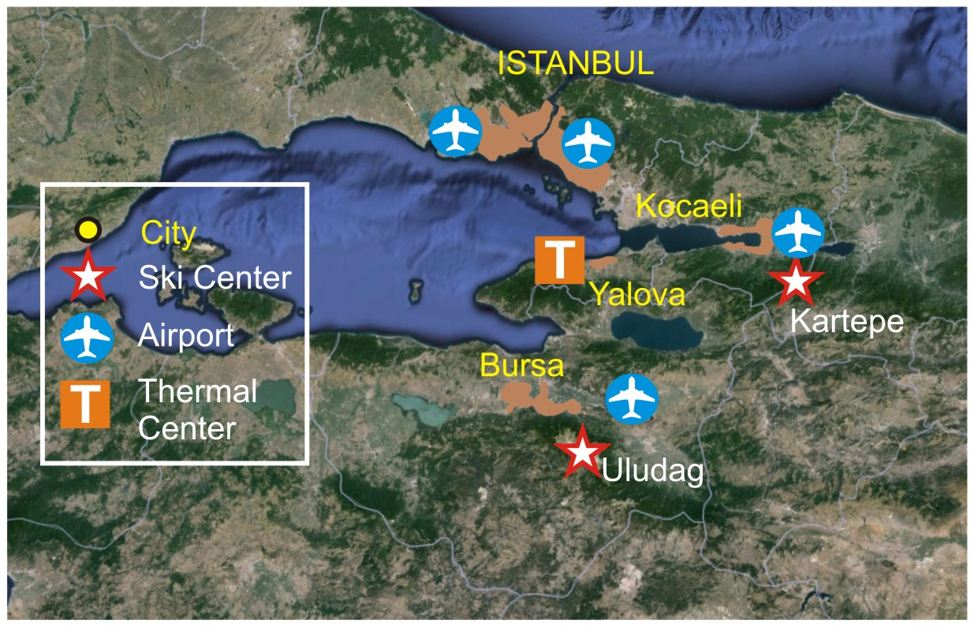
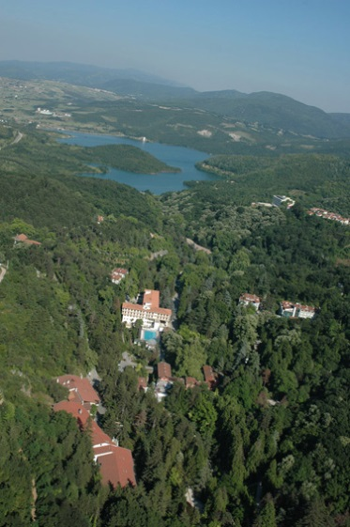
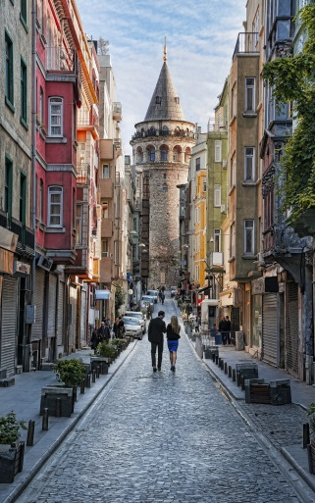
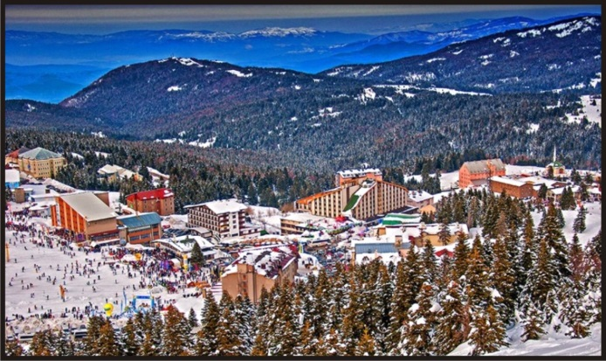
TOURISM DESTINATIONS - MARMARA
Yalova Thermal
Istanbul
Uludag
YALOVA THERMAL
ULUDAG SKI CENTER
KARTEPE SKI CENTER
Thermal Facilities : 8
Bed Capacitiy : 1.287
Mechanical Facilities : 22
Bed Capacity : 1.750
Planned Bed Number : 3.500
Mechanical Facilities : 4
Bed Capacitiy : 800
Planned Bed Number :1.000

Slide 20
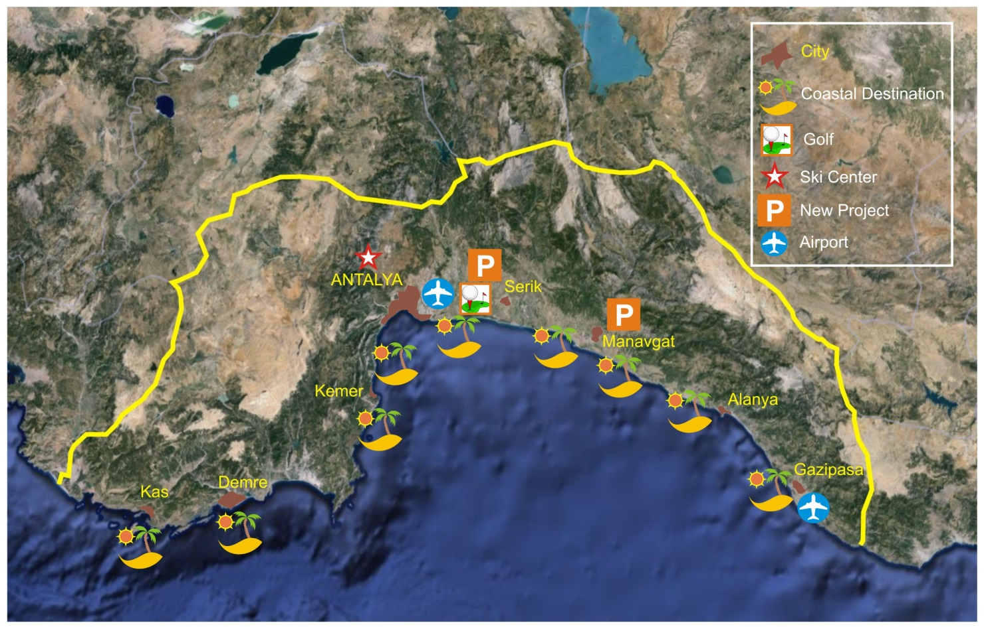
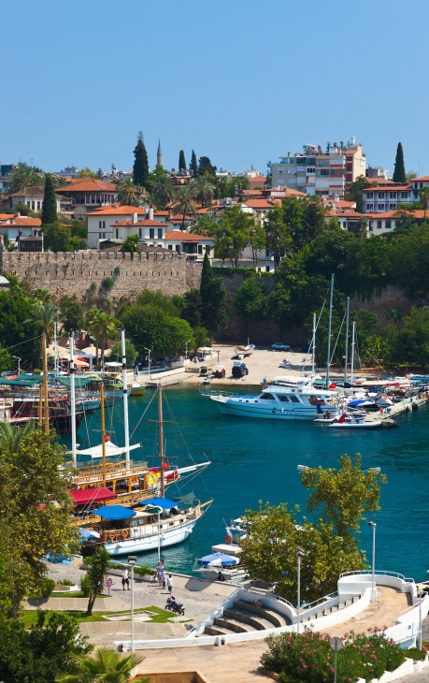
TOURISM DESTINATIONS - ANTALYA
More than 600.000 touristic beds and every year more than 11 million tourists, Antalya is one of the best tourism destinations in the world.
Antalya
There are two new tourism projects in Antalya : Oymapinar and Gebiz. Each project consists of golf tourism and ecotourism goals.

Slide 21
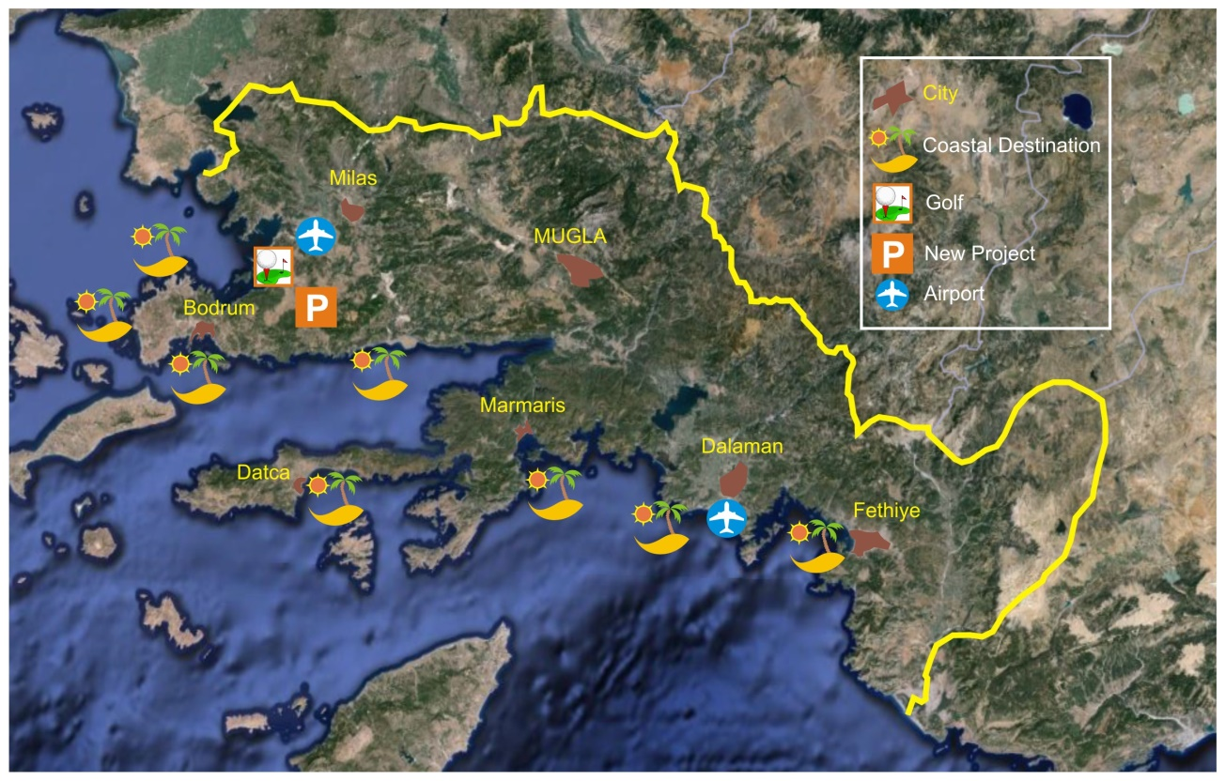
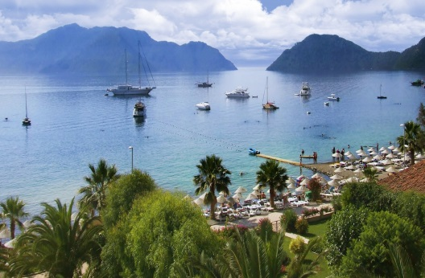

TOURISM DESTINATIONS - MUGLA
More than 250.000 touristic beds and every year more than 3 million tourists, Mugla is one of the best tourism destination in the Europe.
Marmaris
New tourism project zone Feslegen including golf tourism and ecotourism will support coastal tourism centers.
Oludeniz

Slide 22
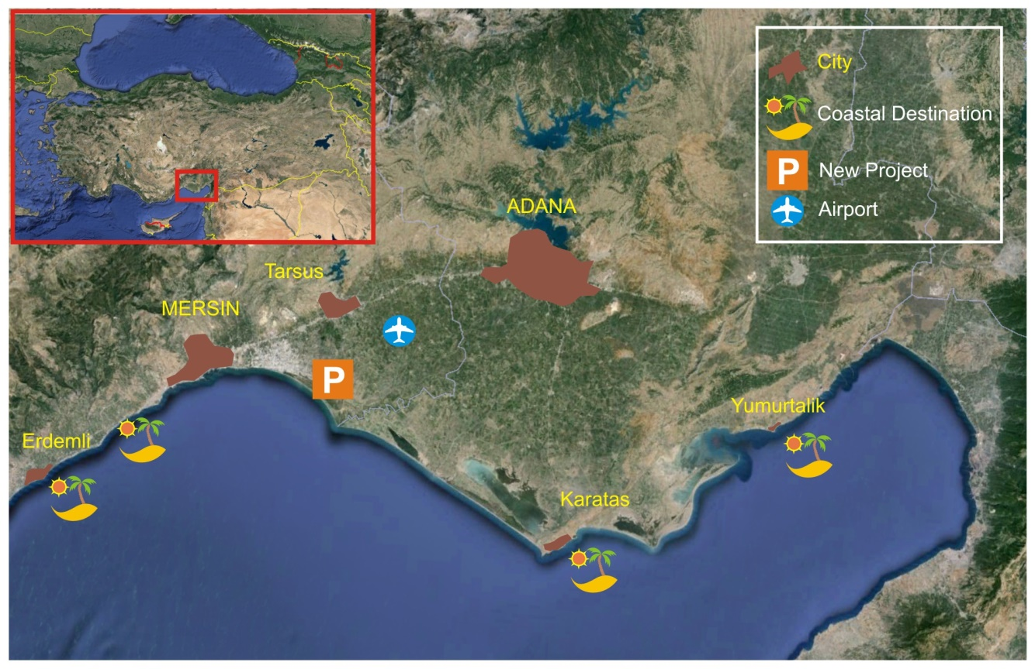
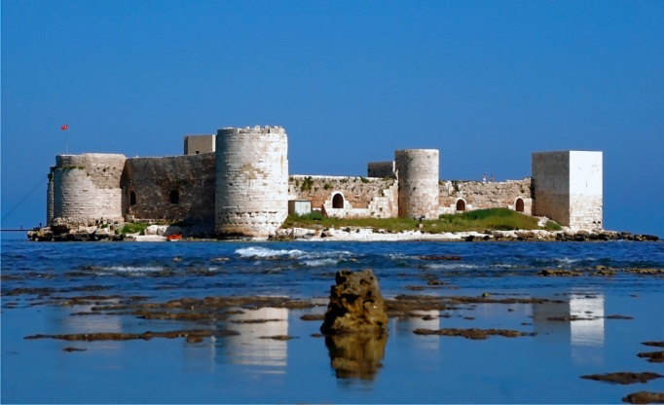
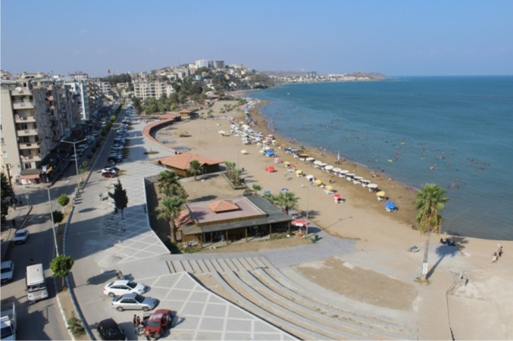
TOURISM DESTINATIONS - CUKUROVA
Erdemli
Yumurtalık
New tourism project zone Tarsus including coastal tourism resorts and golf courses will be a rising destination in the region of Cukurova.

Slide 23
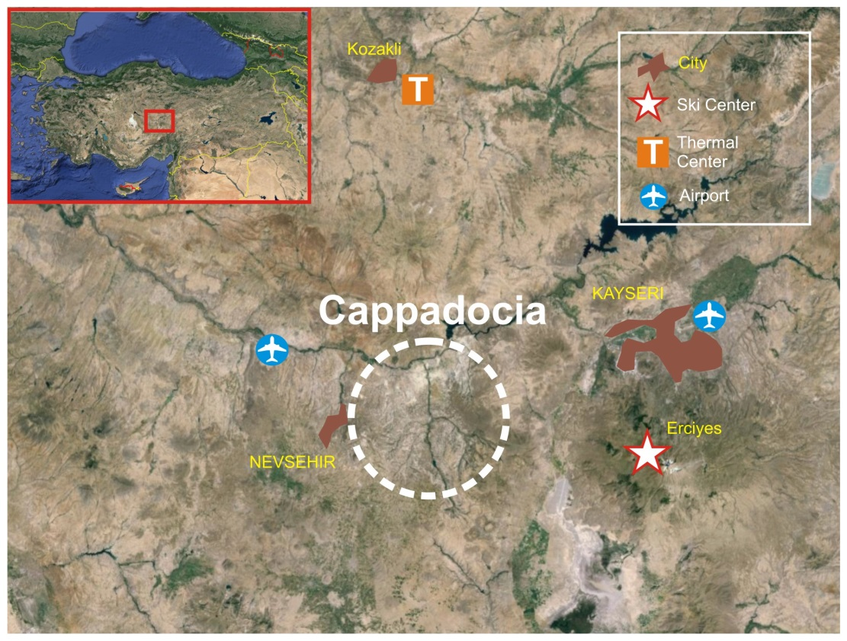

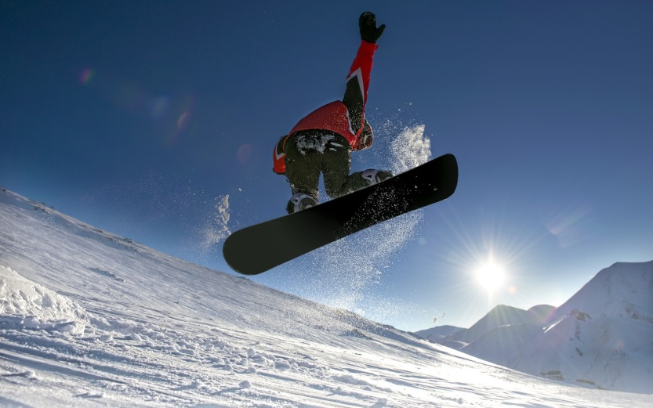
TOURISM DESTINATIONS – CENTRAL ANATOLIA
Cappadocia, Erciyes Ski Center and Kozakli Thermal Center form triangle tourism destination of Central Anatolia.
Cappadocia
Erciyes
Cappadocia with its unique moon-like landscape, underground cities, cave churches and houses carved in the rocks is one of the most well-known touristic and cultural value of the world.

Slide 24
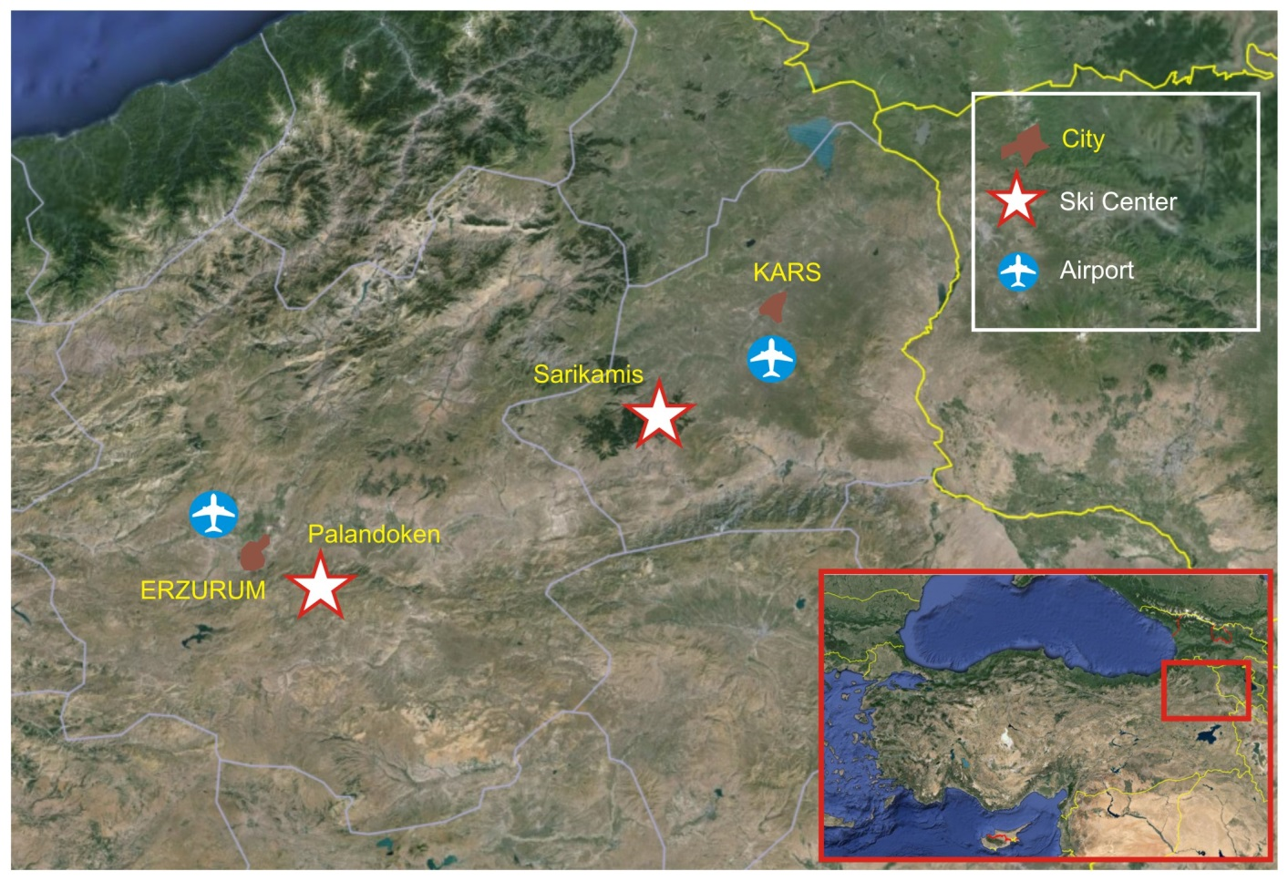
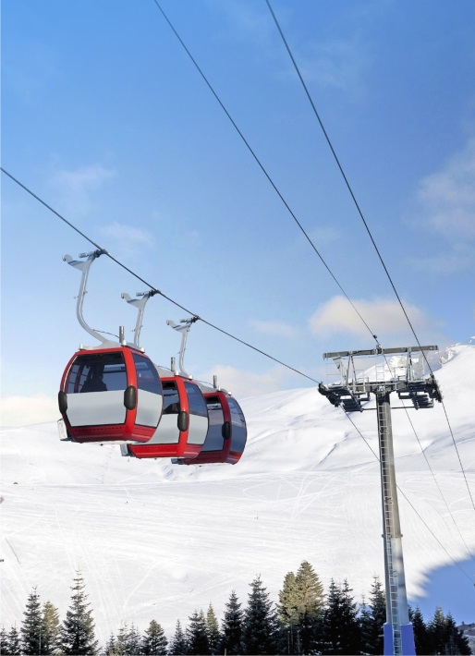
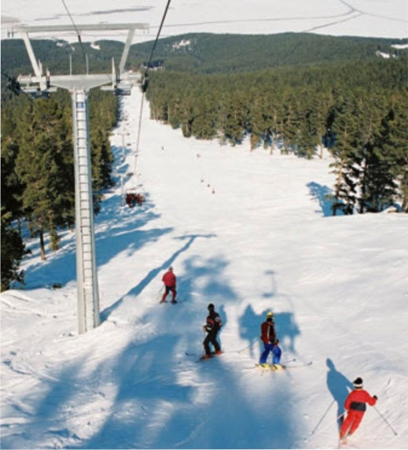
TOURISM DESTINATIONS – EASTERN ANATOLIA
Palandoken
Sarikamis
PALANDOKEN SKI CENTER
SARIKAMIS SKI CENTER
Mechanical Facilities : 19
Bed Capacitiy : 2.466
Planned Bed Number : 8.850
Mechanical Facilities : 4
Bed Capacitiy : 639
Planned Bed Number : 12.000

Slide 25

THANK YOU
FOR MORE INFORMATION PLEASE CONTACT WITH:
REPUBLIC OF TURKEY
MINISTRY OF CULTURE AND TOURISM
GENERAL DIRECTORATE OF INVESTMENT AND ESTABLISHMENTS
Phone: +90.312.212 83 74 Fax: +90.312.212 83 97
e-mail:yatirimisletme@kulturturizm.gov.tr
Web: www.kulturturizm.gov.tr

