Slide 1
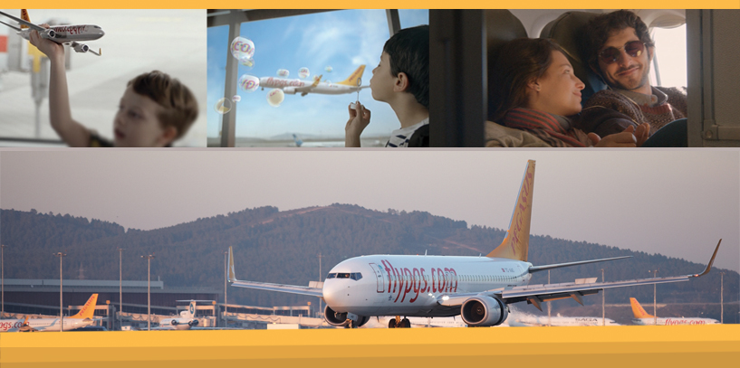

PEGASUS AIRLINES

Slide 2
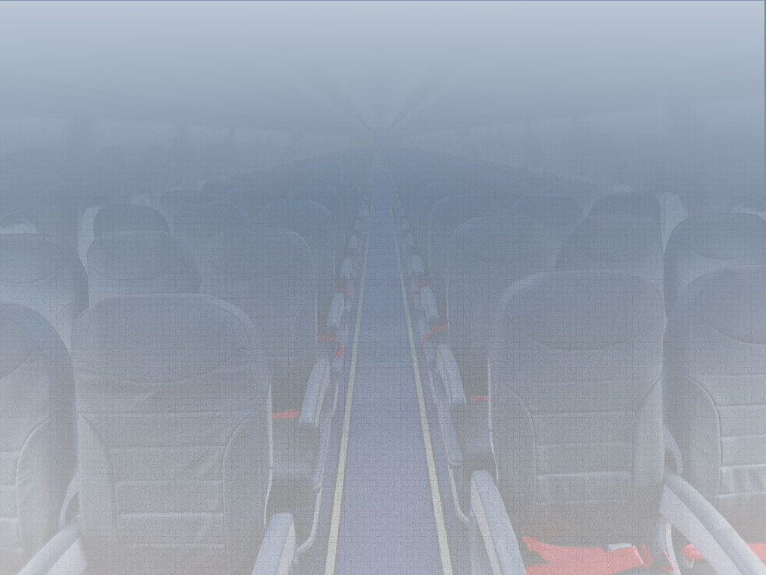
Consumers have benefited…
From the liberalisation of domestic routes in 2003
From | To | 2002 | 2015 | Converted to 2002 TL prices
Istanbul | Izmir | 130 TL | 49 TL | 13 TL
 | Ankara | 130 TL | 49 TL | 13 TL
 | Antalya | 140 TL | 52 TL | 14 TL
* 2002 prices listed are the competitor’s prices for the year 2002.
      * 2015 ticket prices are the lowest prices listed on www.flypgs.com for October
* The prices on the right hand-side column have been converted to 2002 prices based on the inflation rates between 2002 and 2014.

Slide 3
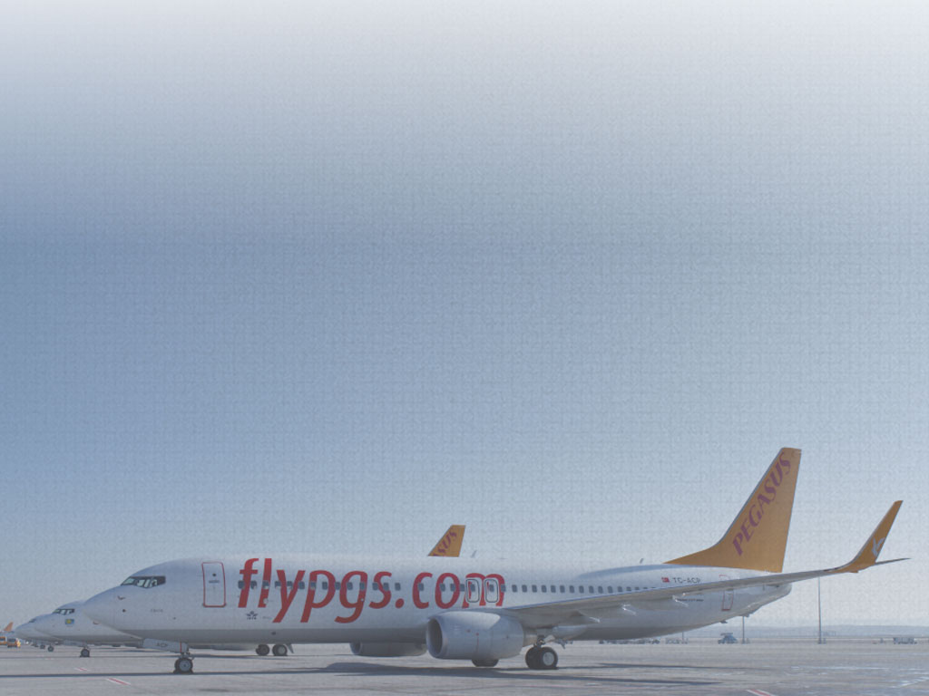
If liberalisation takes place on international routes…
The consumer would benefit again
From | To | 2002 | 2015 | Converted to 2002 TL prices
Istanbul | Amsterdam | 400 TL | 396 TL | 107 TL
 | Dusseldorf | 370 TL | 343 TL | 93 TL
 | Copenhagen | 430 TL | 425 TL | 115 TL
* 2002 prices listed are the competitor’s prices for the year 2002.
      * 2015 ticket prices are the lowest prices listed on www.flypgs.com for October
* The prices on the right hand-side column have been converted to 2002 prices based on the inflation rates between 2002 and 2014.

Slide 4
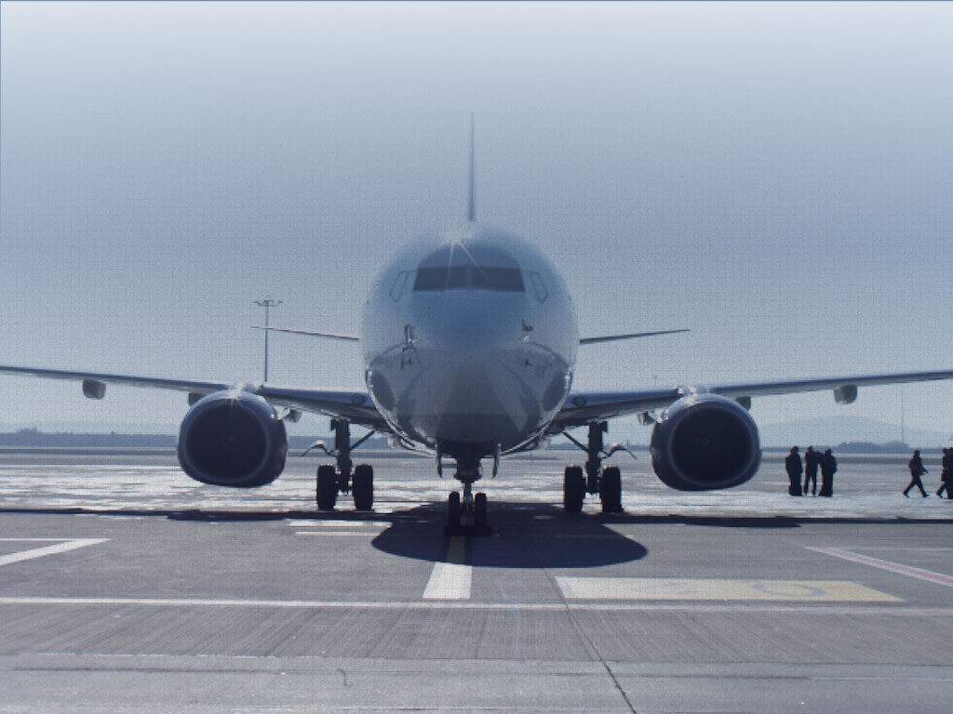
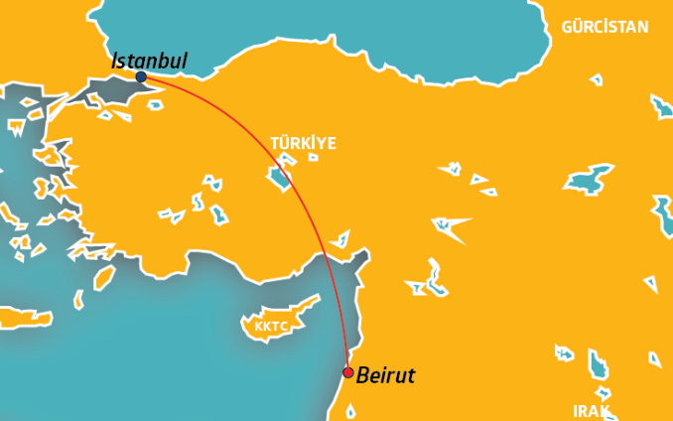
Istanbul - Beirut

Slide 5

Pegasus Airlines launched Beirut – Istanbul flights
 | Before Pegasus (2010) |  | After Pegasus (2011)
Airlines | Number of Guests | Share of Traffic | Number of Guests | Share of Traffic
Pegasus Airlines | 19,464 | 7% | 98,212 | 21%
X Airlines | 86,101 | 31% | 130,327 | 28%
Y Airlines | 170,136 | 62% | 235,575 | 51%
TOTAL | 275,701 | - | 464,114 | -
68% increase

Slide 6
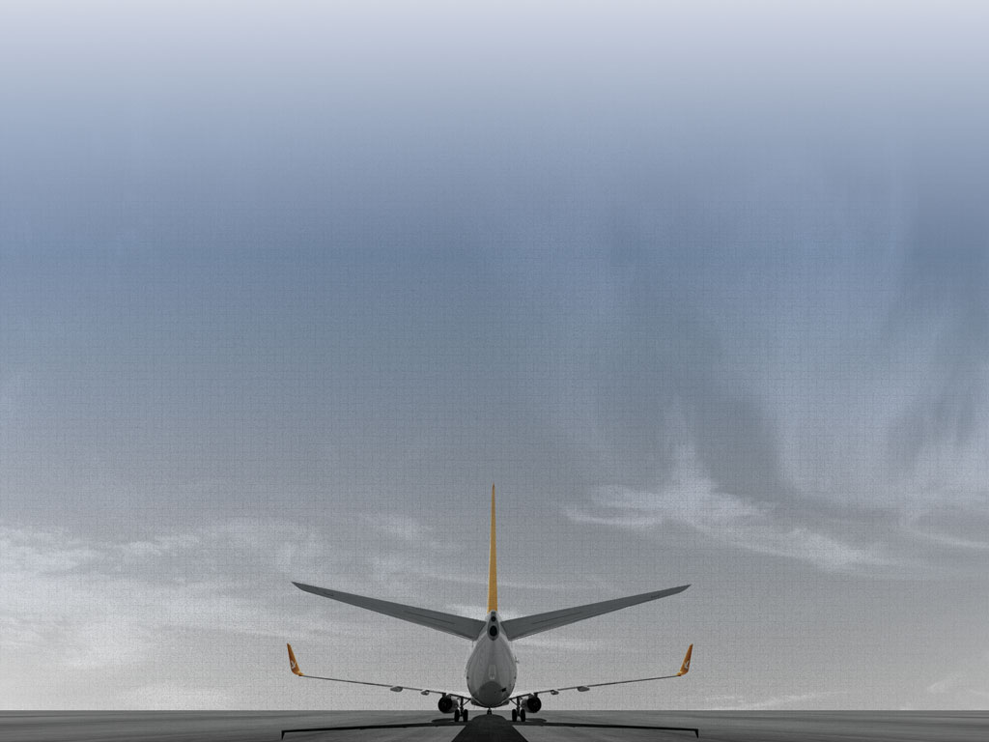
International routes where there is no competition
Flight Hours | No Competition | Competition | Difference | %
0-2 hours | €176 | €170 | 6 | 3%
2-3 hours | €315 | €189 | 126 | 40%
3-4 hours | €379 | €197 | 183 | 48%
4-6 hours | €448 | €279 | 170 | 38%
Average |  | 113 | 134 | 36%

Slide 7
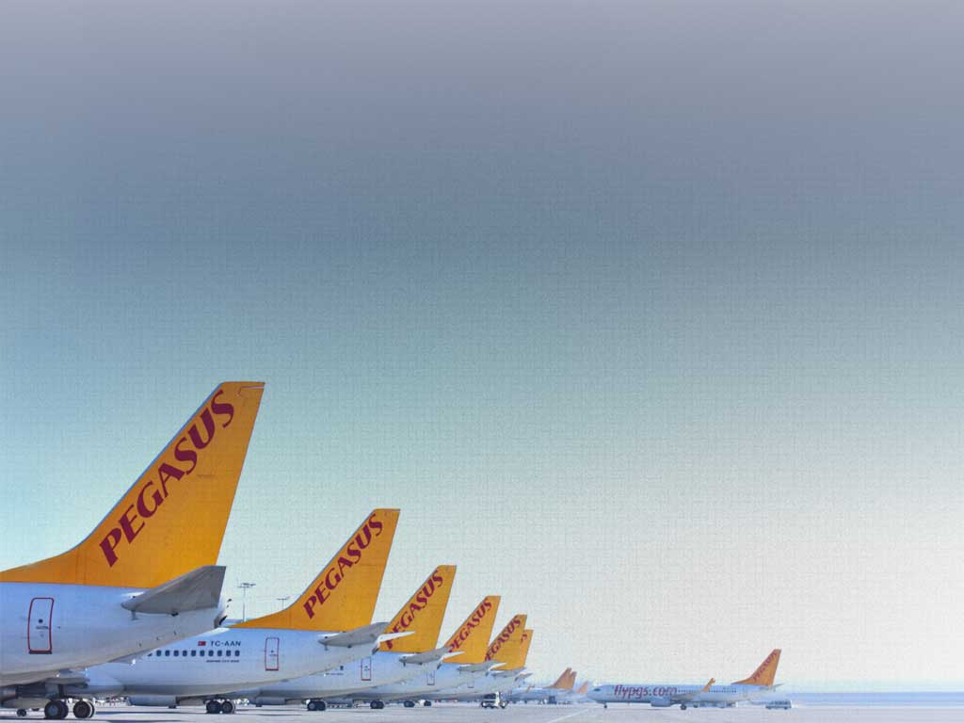
We didn’t start aviation in Turkey,
but
our region
we transformed it!
Thank you !

