Slide 1

Importance of Air Connectivity
and Airport Investments
ICAO Air Services Negotiation Event
Antalya, October 2015

Slide 2

Aviation has a high multiplier effect in the economy

Slide 3

  Every $1 spent in the aviation sector
  creates an economic activity worth $3.25
  due to being at the heart of tourism industry
  whereas each dollar generates much less activity in other sectors
  Finance: 1.4
  Construction: 2.3
  Automotive: 2.9

Slide 4

10% increase
in global air connectivity
$55 billion increase
in global outputs each year

Slide 5
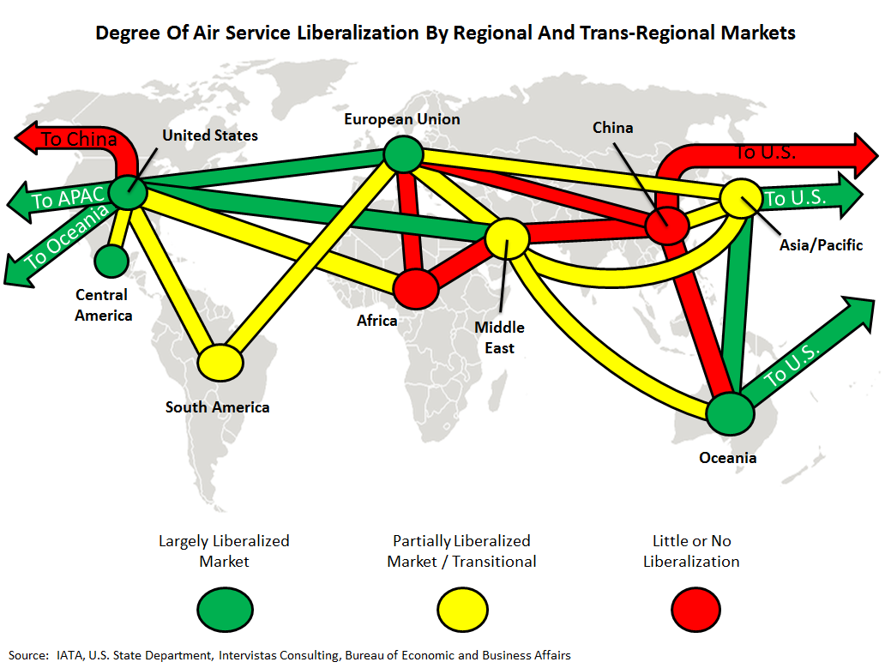
Asia and Africa need to open up their skies

Slide 6
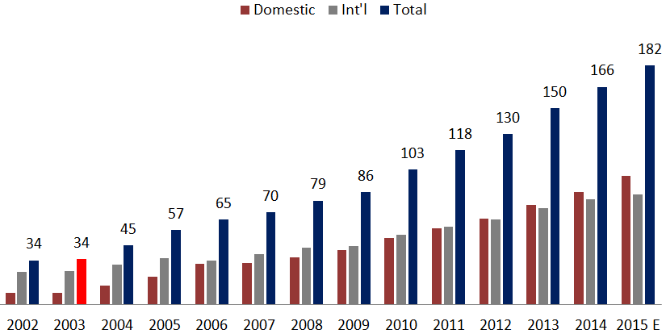
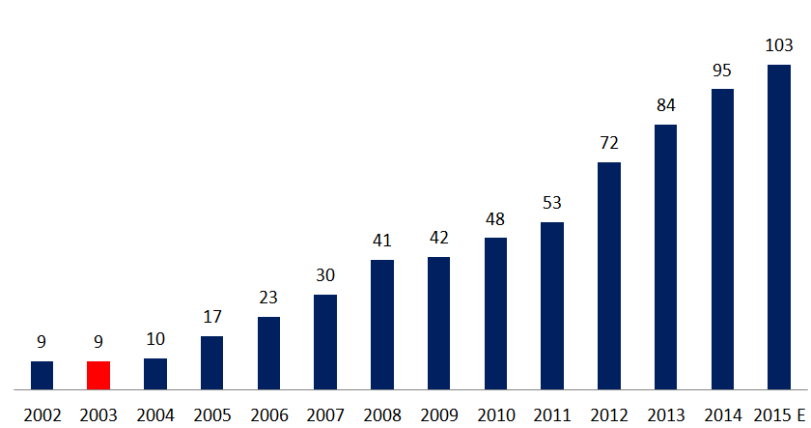
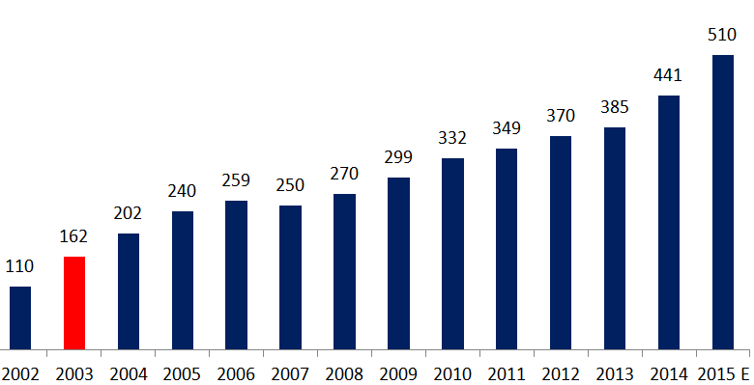
Growth of the Turkish Aviation Market and TAV Airports
Turkish Aviation Market (mPax)
TAV Airports Passenger Traffic (mPax)
CAGR (2002-15E)
14%
CAGR (2002-15E)
21%
Number of Aircraft in Turkey
Privatization of airports followed by the deregulation of domestic market in 2003
was the turning point of the phenomenal growth in Turkish aviation industry
CAGR (2002-15E)
13%

Slide 7

If global airport capacity fails to keep up with travel demand,
2 million jobs, 225 million pax, $110 billion revenue
will be lost by 2035

Slide 8

How to Invest in Airports?
Privatizing airports through BOT model becoming a world-wide common practice
due to many advantages it brings

Slide 9

BUILD
OPERATE
TRANSFER
Advantages of Airport Privatization:
Increases operational efficiency
Enables scientific management
Supports innovative approach
Brings higher revenues to the State
Prevents political interference
Has easier funding options (Project Finance)
Enables State to allocate funds to other areas such as education, health & housing

Slide 10
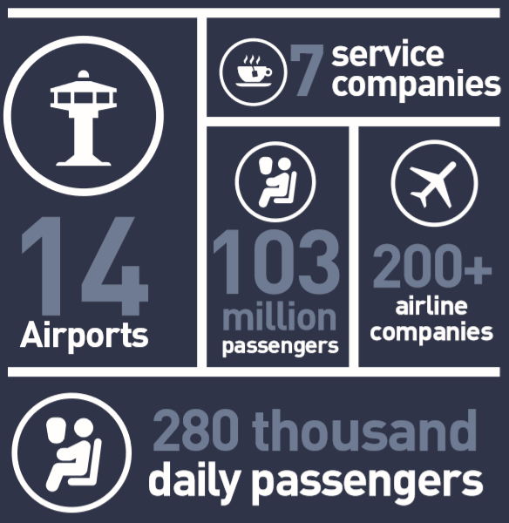
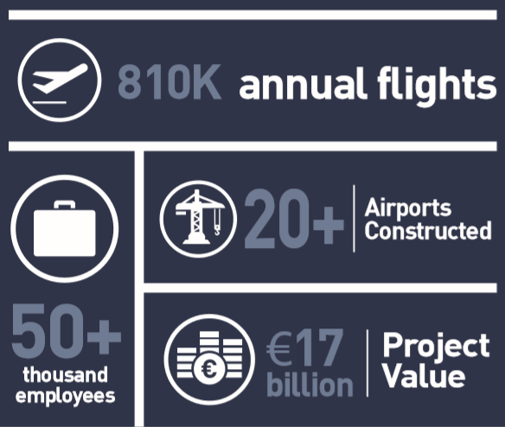
TAV at a Glance
$19 billion airport development projects by TAV

Slide 11












TAV Corporate Structure
TAV Airports Holding Co.
Airport Companies
Service Companies
Ataturk (100%)
ATU (50%)
Esenboga (100%)
BTA (67%)
Adnan Menderes (100%)
TGS (50%)
Havas Europe (67%)
Havas (100%)
Gazipasa Alanya (100%)
Milas Bodrum (100%)
Medinah (33%)
Tbilisi (80%) & Batumi (76%)
OS (100%)
Monastir & Enfidha (67%)
IT (100%)
Skopje & Ohrid (100%)
Security (100%)
Latvia (100%)
Zagreb (15%)
Academy (100%)

Slide 12
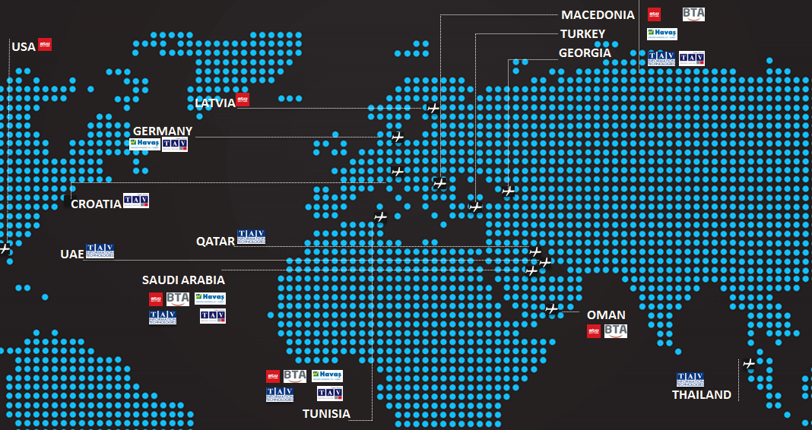
TAV’s Global Presence with Service Companies
13 Countries, 64 Airports

Slide 13
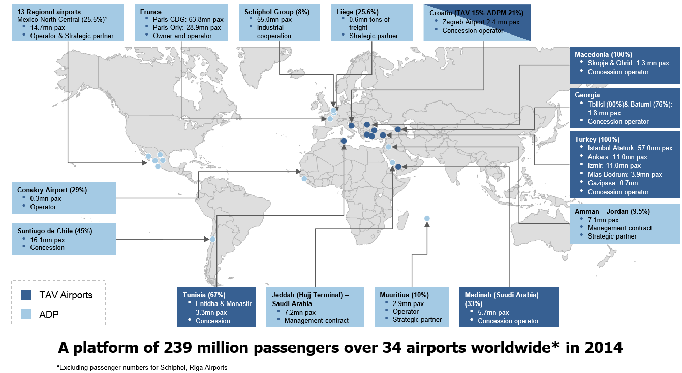
TAV & ADP together create a platform of 239M passengers in 34 airports worldwide

