Slide 1
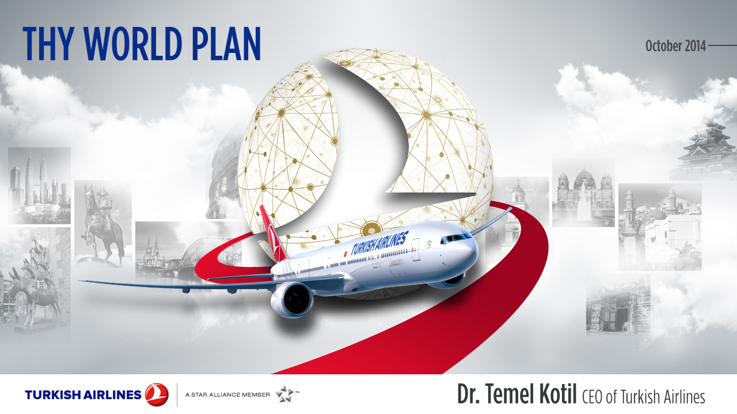













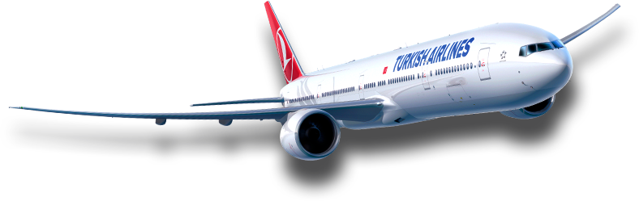





New Understandings & Approaches In Airline Business
October 2015
ICAN 2015
World Statictics Day Workshop
Levent Konukcu,
SVP of Investment Management

Slide 2



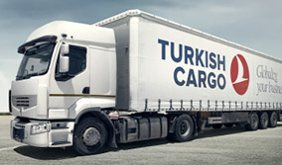



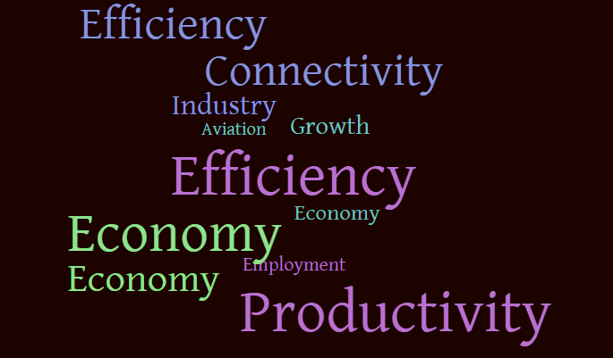

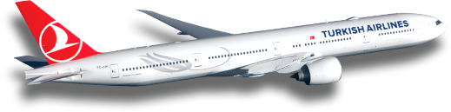
Aviation, An Industry With A Significant Impact
3.4% of GDP,
Larger impact for some countries
3.3 billion
air passengers
51.5 million freight tons
58 million jobs
Aviation widens markets
Improves efficiency & productivity
Encourages investment
Source: ATAG

Slide 3


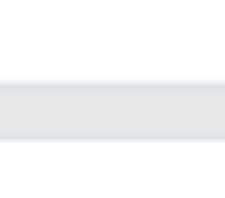

Tourism & Aviation
4.7% growth
1.138 billions
İnternational tourists
(2014)
More than 50% prefer air travel
Tourism supports
261 million jobs
6.6 trillion USD GDP
Aviation contributes
35 million jobs (13%)
807 billion USD GDP (12%)
within tourism
13%
12%
Source: WTTC and Aviaiton Benefits Beyond Borders

Slide 4















Growing Industry
Total Scheduled Revenue Passenger-Kilometers
To/From and Intra Regions (Trillions)
2014
Europe
2034
North America
Middle East
Asia Pacific
Africa
Latin America
2034
7.3 billion pax
x2.2 of today
Source: Boeing Current Market Outlook 2015, IATA

Slide 5






Industry Has Been Changing and Will Continue to
Market Share in RPK By Airline Domicile
Customers has been changing
Competition has been changing
1971
1991
2011
2031
1981
2001
2021
Source: Airbus Global Market Forecast 2012, IATA, Airbus 2014 GMF, internal analysis.

Slide 6

Customer Experience vs. Competitive Advantage
Superior customer experience
As the ability of a company to provide customer value increases so as its competitive advantage.
Ability to provide customer value
Also, be aware of changing customer’s EXPECTATIONS, BEHAVIOURS
& NEEDS
Competitive Advantage / Differantiation

Slide 7






Knowing the Customer
Know your customer. Each customer has different VALUE, BEHAVIOUR
& NEEDS
%35
long-haul
Long-Haul
Low price sensitive
Time sensitive
High service levels
Travel Distance
Price sensitive
Low time sensitivity
Medium service levels
Business Travel %30
%40-50 Of Revenue
Personal Travel %70
%50-60 Of Revenue
Travel Purpose
Price sensitive
Extremely time sensitive
Some cross-over to LCC
Highly price sensitive
Time sensitive
Minimal service levels
%65
short-haul
Short-Haul
Source: Boeing

Slide 8


Customer Satisfaction in Aviation Sector
Customer is in focus & in center
Industry regulations, strategies, products and technology has been shaped and will change based on customer expectations
Passenger
Expectations
Technology
Infrastructure
Regulatory
Environment
Airline and
Industry Strategies

Slide 9

Key For True Customer Loyalty
Understanding the customer
Improve customer experience
CUSTOMER SATISFACTION &
TRUE CUSTOMER LOYALTY
Customized Service, Marketing,
Care & Communications
Source:IATA Industry Financial Outlook December 2014

Slide 10
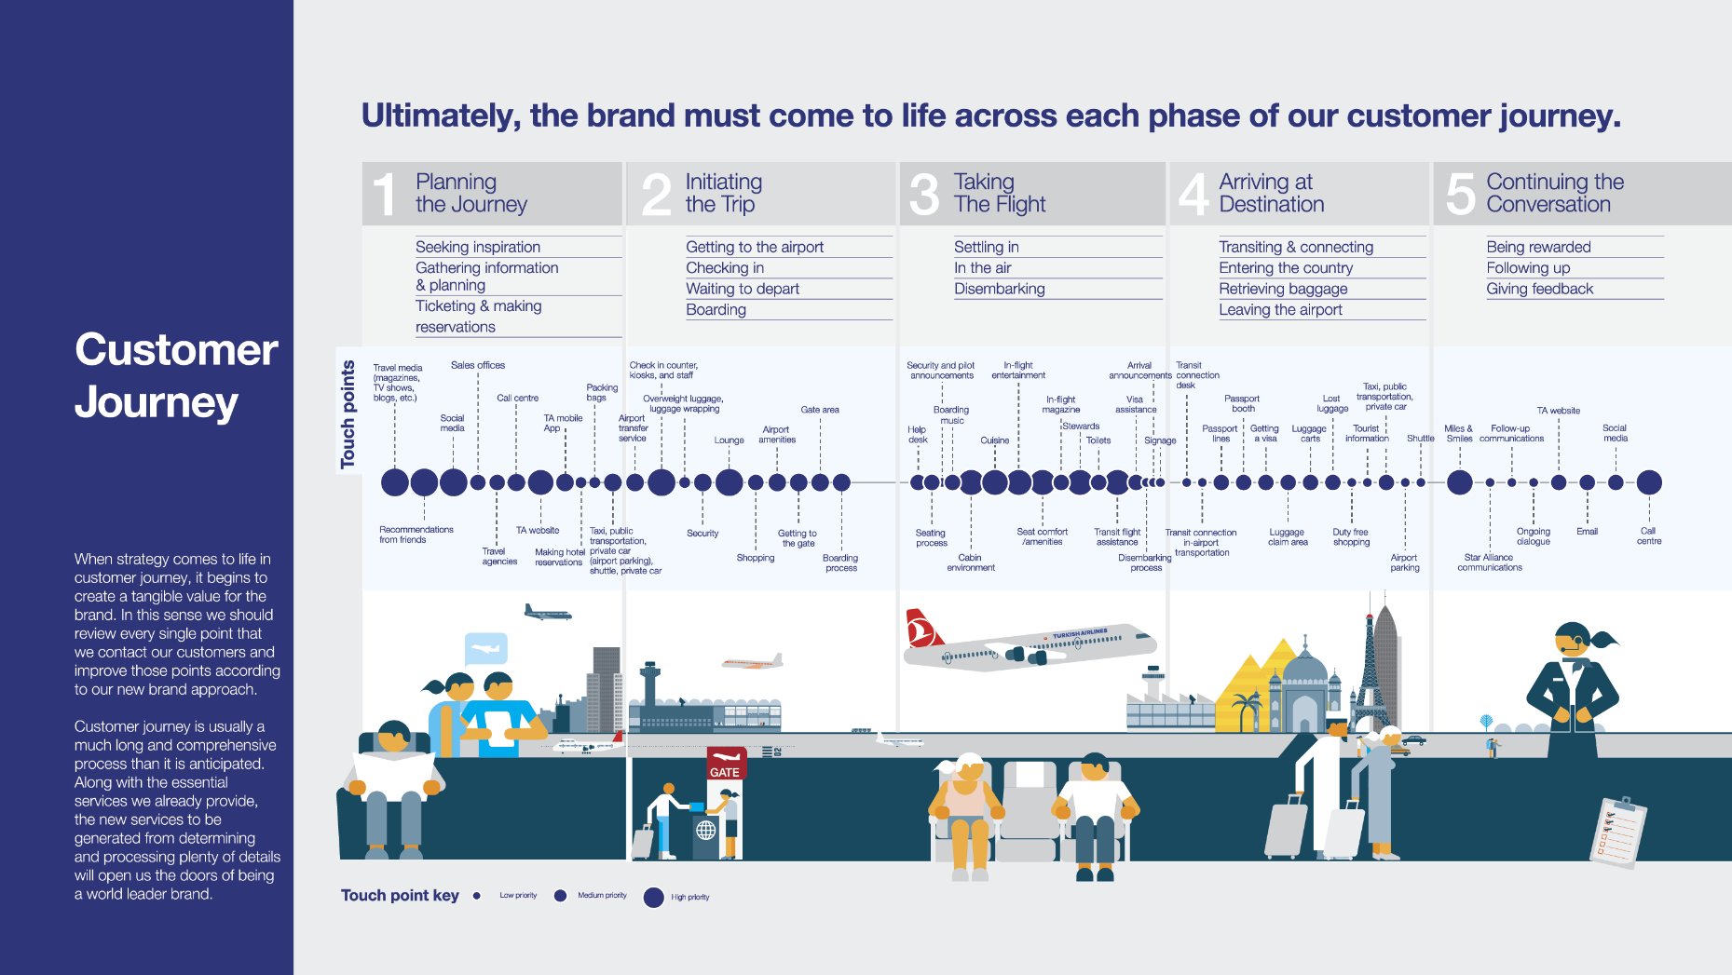

Research touchpoints & imrpove quality of services and efficiency of processes

Slide 11

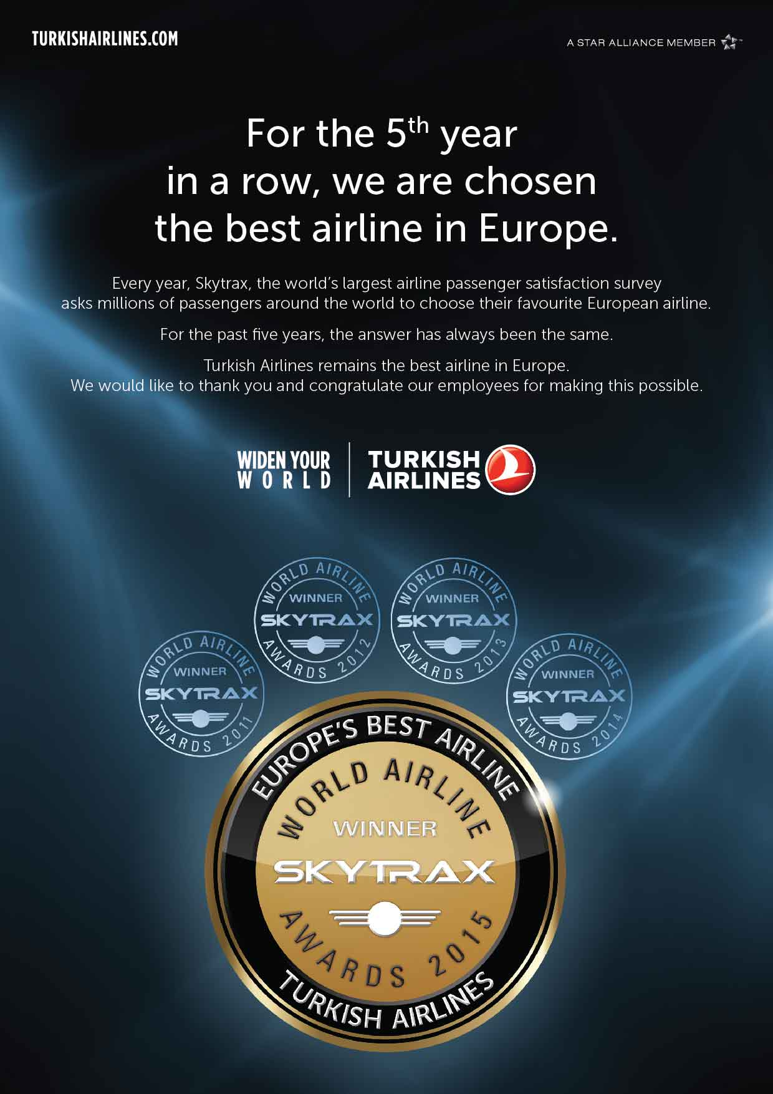




Consistent High Standards Of Customer Service
Best Business Class Catering In Lounge
Best Business Class Catering in the world
Source: Skytrax 2015

Slide 12
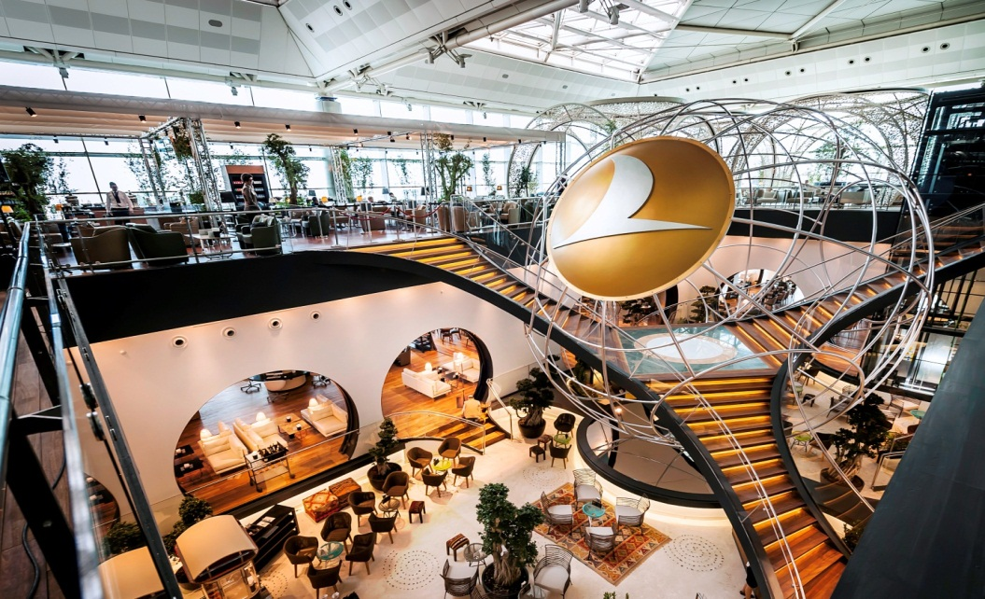
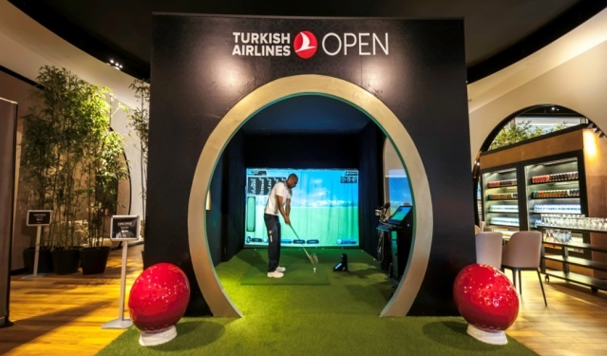


Lounges With Different Concepts and At Different Locations

Slide 13


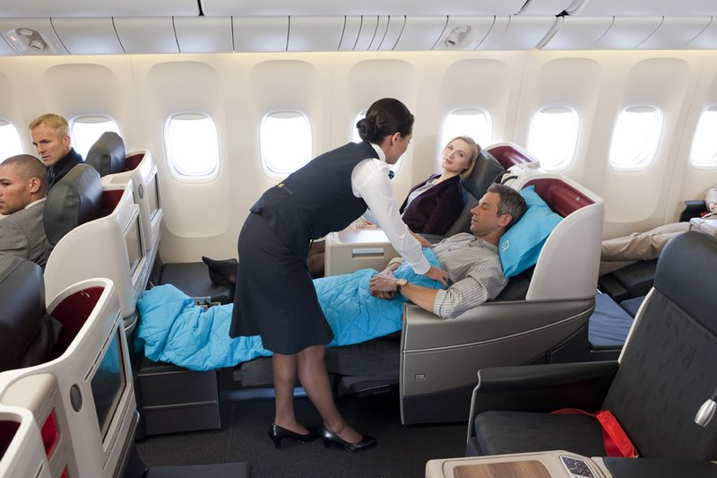
Product Is Being Enhanced In All Aspects
Excellence in flight food & service
Rich and Suprising IFE Contents
Live Tv, Live Shows & Wi-Fi
Seat Configurations
Amenity Kits
Customized service for kids
Multi-lingual service desks
Technological advancements for pre-flight services

Slide 14

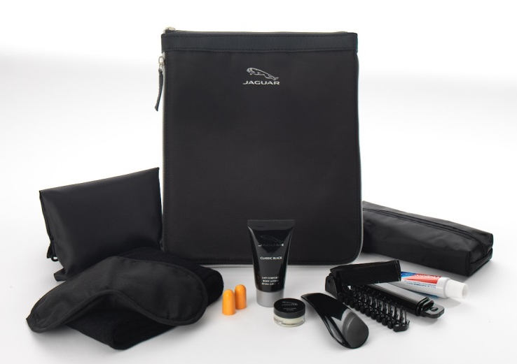
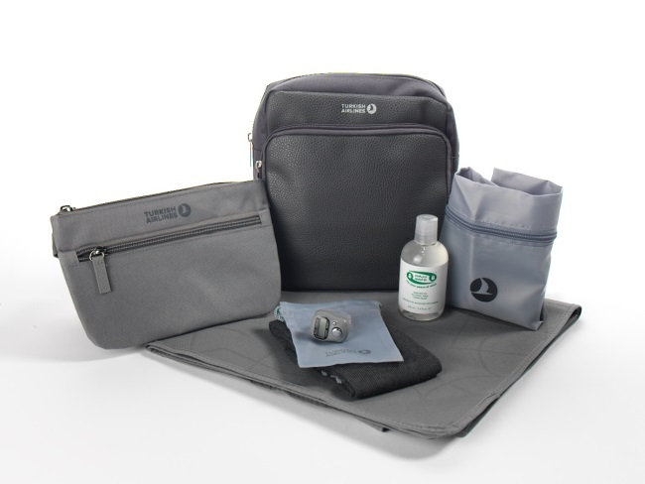
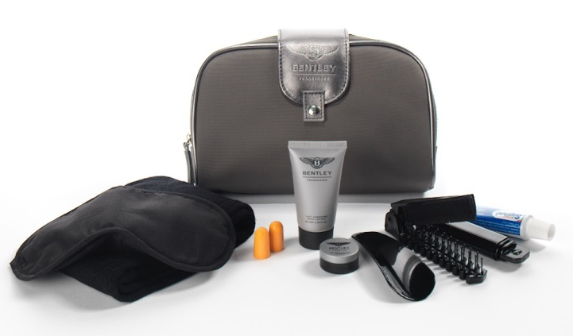
New Amenity and Relax Kits Designed by Famous Designers
New luxury Amenity kits and Relax Sets, designed by the world famous design brands as JAGUAR, CERRUTI, BENTLEY, CHOPARD, INSTITUT KARITE and FURLA, together the universally recognized skincare brand.

Slide 15
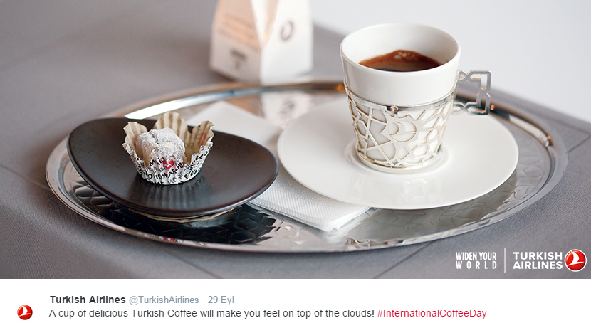

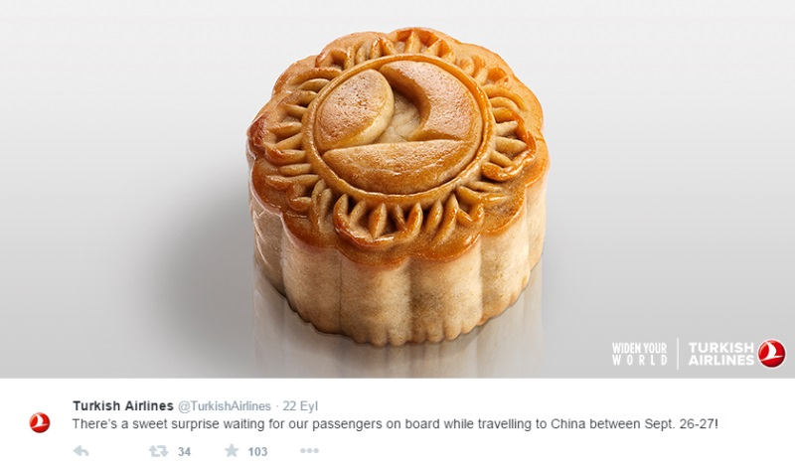
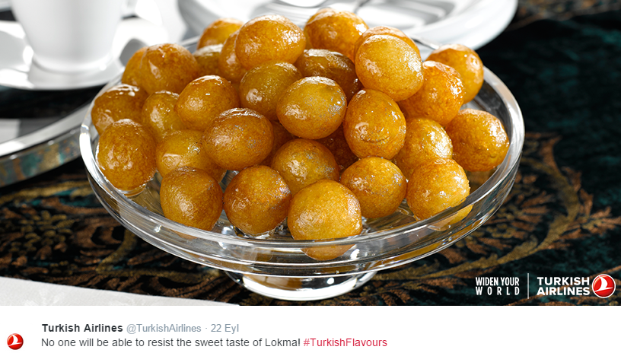
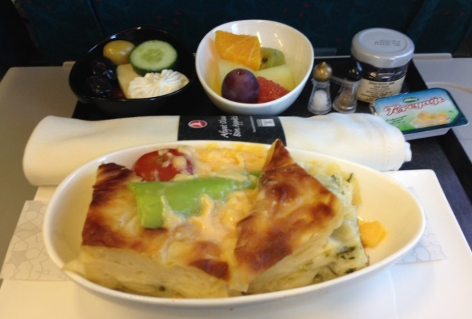
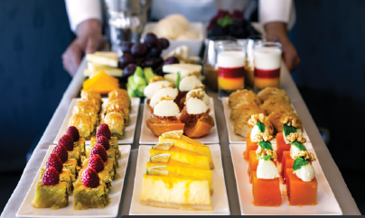
Execellence In Customer Satisfaction: Suprises & Customization
Specially designed herbal tea menu
Mooncake suprise
Turkish Cafe
Cultural tastes from world cuisine

Slide 16

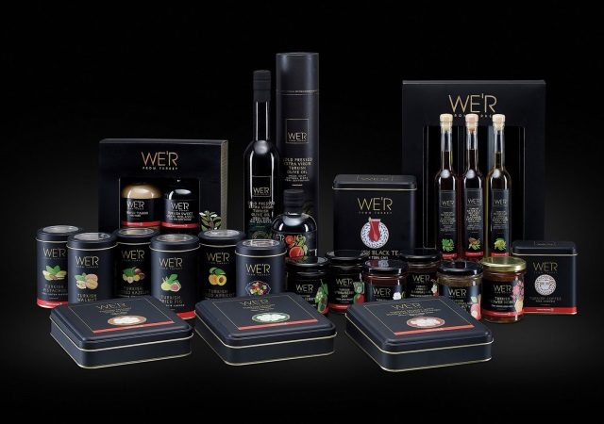
Different Sectors Related To Business: WE’R FROM TURKEY

Slide 17
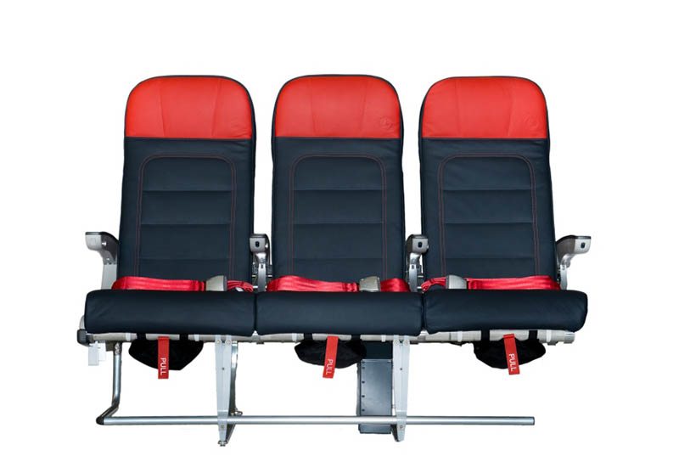
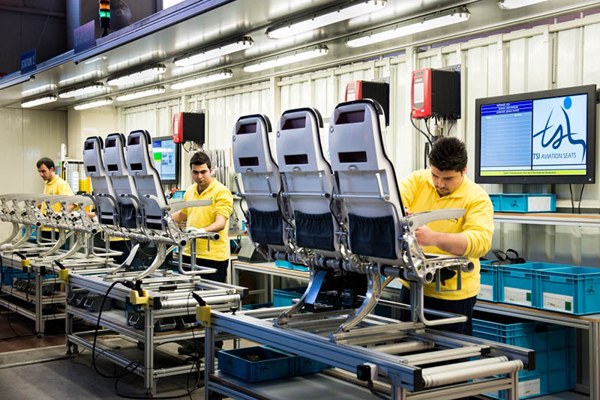
Different Sectors Related To Business: Turkish Seat Industries
The first aircraft seat designed and built in Turkey

Slide 18
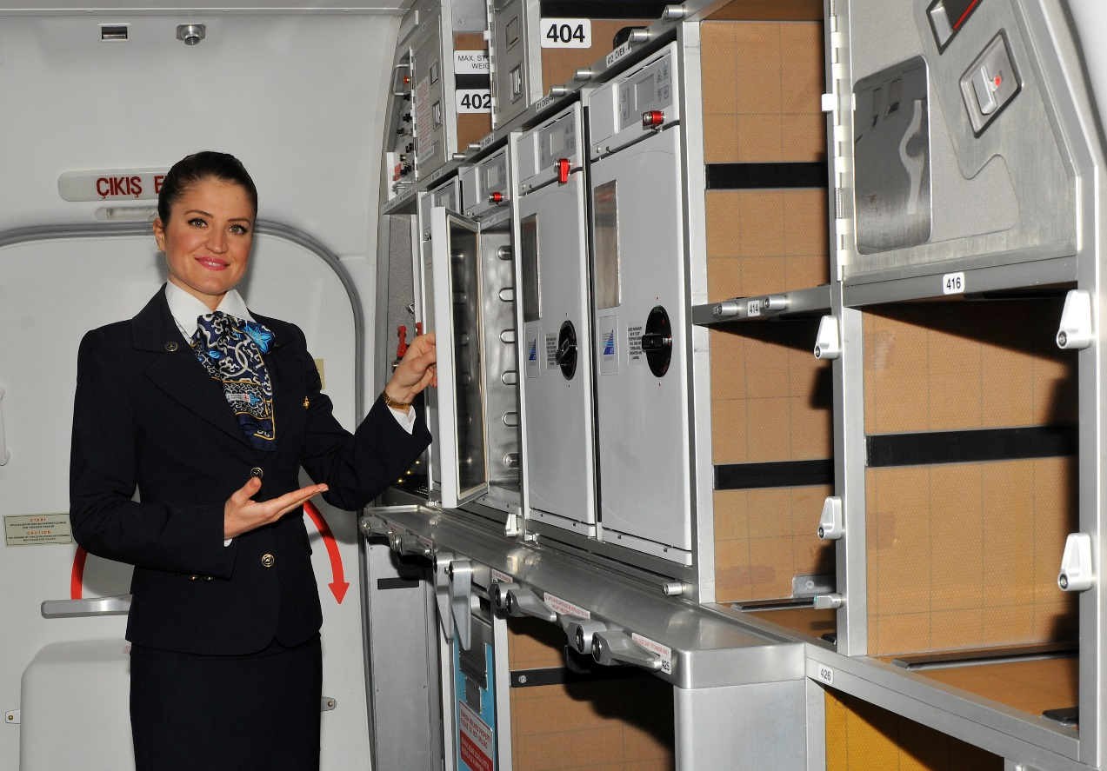
Different Sectors: Turkish Cabin Interior Systems Industries
Turkish Airlines flies B737-800 outfitted with first TCI galleys

Slide 19


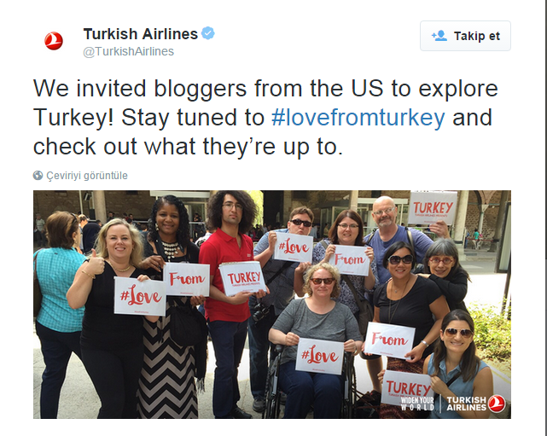
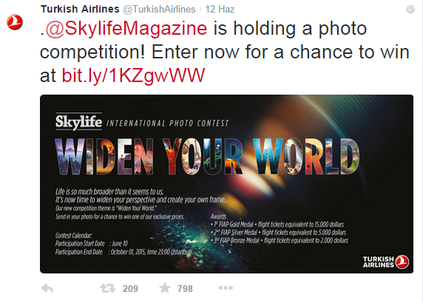

Resounding, Surprising & High Value Projects to Improve Brand Awareness

Slide 20


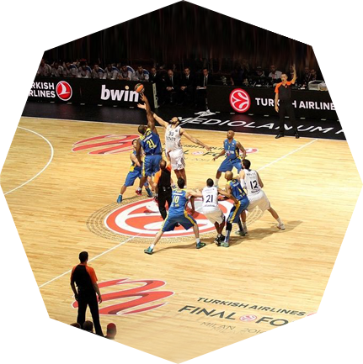

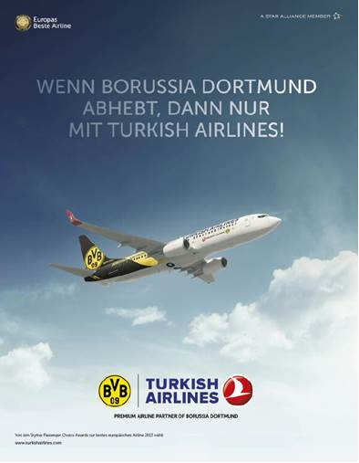
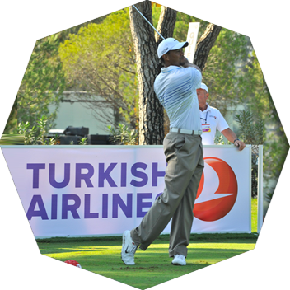




Sponsorships and Brand Ambassadors Are
DIDIER DROGBA
EUROLEAGUE
BORUSSIA DORTMUND
OLYMPIQUE DE MARSEILLE
TURKISH AIRLINES OPEN
CHIO AACHEN

Slide 21
Industry is More Price Sensitive: Yields Have Been Reducing
Strategic actions for:
Fuel efficiency
Labor efficiency
Capacity management
Restructuring of network & operations
Enhancing Operating Model
Changes In Organizational structure
Changes In Group Structure
Distribution Systems
Evaluating Suppliers
Sector became more cost oriented!
Cost reduction strategies have been executed aggresively
Financial Stability Is Important for sustainable growth!
Source: ATAG

Slide 22
Industry is More Labour & Fuel Efficient
%5 more efficient
%9 more efficient
Source: IATA Economic Performance Of Airline Industry Reports

Slide 23
Financial Performance Of Turkish
%2.2 - Industry net profit margin
%7.6 - TK net profit margin
Revenue Market Share
6x
%1.4 2013
%1.5
2014
%4.5
%0.5
%2.6
Personel Efficiency improvement
A/C utilization improvement
Unit cost improvement
Revenue $11 billions
EBITDAR margin 18.5%
Operating Profit $638 million

Slide 24
Turkish Airlines Has Been Improving Operating Efficiency
Personnel Efficiency
Average Daily Flight Utilization (hrs)
* THY Technic, THY Habom and THY Aydın Çıldır Personnel is included.
Fuel Efficiency
281%
Efficiency Gain
216%

Slide 25
Turkish Airlines Is One Of the Most Efficient
PAX Per Personnel (2014)
Cost Per ASK (Usc) 2014
* Lufthansa Passenger Airlines
Source: Calculated based on public company reports.

Slide 26
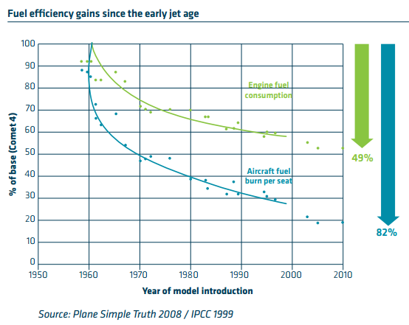
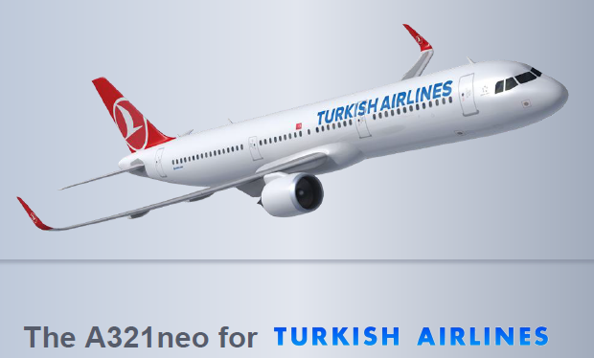
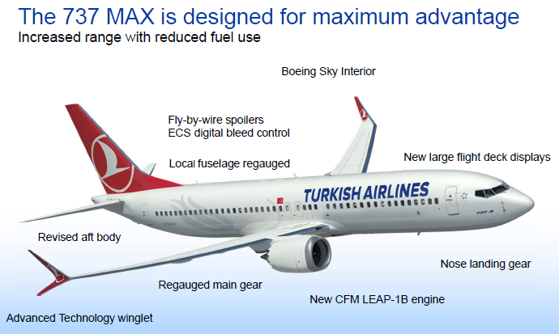
New Generation Aircraft Are More Fuel Efficient
Picture Source: ATAG

Slide 27
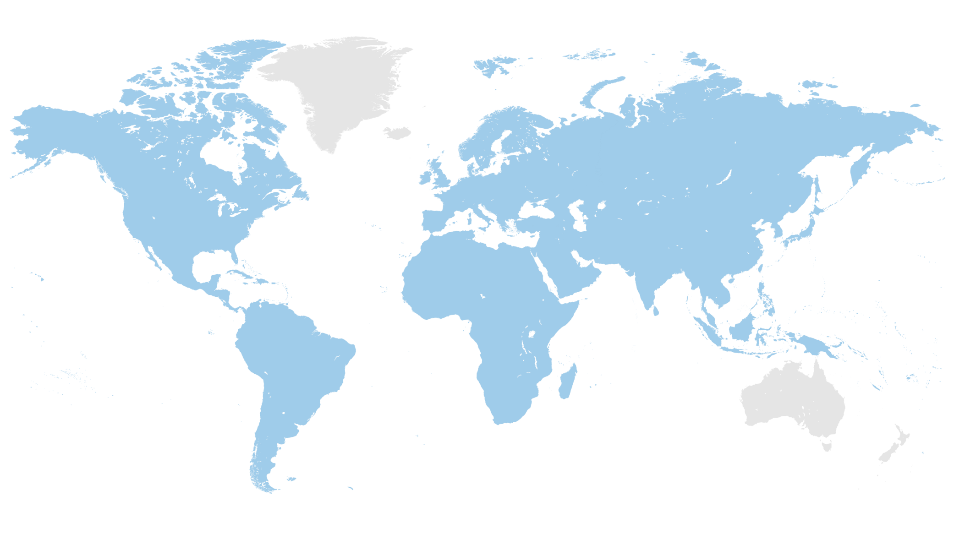


Capacity Management & Fleet Strategy
2002 - 2015
NB increase 307%
2002 - 2015
WB increase 592%
Within narrow body range:
70% of international destinations,
More than 55 countries
OSLO
HELSINKI
Detour advantage
YEKATERINBURG
MONTREAL
MANCHESTER
MOSCOW
UFA
ASTANA
ULAAN BATAAR
SAN FRANCISCO
CHICAGO
BOSTON
WASHINGTON
LISBON
%10
BEIJING
SEOUL
LOS ANGELES
ATLANTA
ORAN
MASHAD
OSAKA
HOUSTON
MIAMI
CASABLANCA
SHANGHAI
HAVANA
NAUKCHETE
SEBHA
%6
HANOI
%17
ASMARA
MUSCAT
MUMBAI
DHAKA
HONG KONG
MEXICO CITY
DAKAR
HO CHI MINH CITY
BOGOTA
ABIDJAN
MALE
SINGAPORE
KIGALI
JAKARTA
CASK (Cost per Avai. Seat km)
LUANDA
DAR ES SALAAM
ANTANANARIVO
SAO PAULO
JOHANNESBURG
MAPUTO
NB has been increasing to exploit the geographical advantage.
WB rate has been increasing to globalize the network
DURBAN
BUENOS AIRES
CAPE TOWN
Flight Time
1 2 3 4 5 6 7 8 9 10 11 12

Slide 28



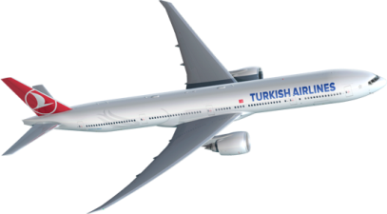
Fleet Strategy
Fleet Group | Aircraft | Order
Wide Body | A330 | 5
 | B777 | 11
220 aircraft orders
Narrow Body | A320 CEO/NEO | 106
 | B737 NG/MAX | 95
Cargo | A330-200F | 3
13th largest fleet in the world
49 Aircraft (15 Wide Bodies)
Entered to fleet in 9 months of 2015
We will exceed 450 A/C by 2021
6.8 fleet age
Young Fleet!
Source: Ranking from IATA Wats 2014.

Slide 29







Turkish Airlines - Global Network Size
1
more countries than any other in the world
110
COUNTRIES
1
more international destinations than any other
DESTINATIONS
OSLO
HELSINKI
280
YEKATERINBURG
MONTREAL
MANCHESTER
MOSCOW
UFA
ASTANA
SAN FRANCISCO
BOSTON
ULAN BATUR
CHOCAGO
WASHINGTON
LISBON
BEIJING
LOS ANGELES
ORAN
MASHAD
SEUL
OSAKA
INTERNATIONAL
DESTINATIONS
ATLANTA
CASABLANCA
SHANGHAI
230
HAVANA
NAUKCHETE
SEBHA
ASMARA
MUSCAT
DHAKA
HONG KONG
MEXICO CITY
DAKAR
MUMBAI
ABIDJAN
MALE
HO CHI MINH CITY
BOGOTA
SINGAPORE
LUANDA
KIGALI
JAKARTA
DAR ES SALAAM
SAO PAULO
MAPUTO
JOHANNESBURG
BUENOS AIRES
CAPE TOWN
4
4th largest network in the world
Source: Rankings are based on OAG December 2014 data

Slide 30


Turkish Airlines Today
Continious & ambitious increase in capacity market share
% of World Passenger Capacity (ASK)
7.
7th largest carrier in terms of international passenger numbers¹
11.
13th largest carrier in terms of capacity (available seat kilometers)²
10.
10th largest carrier in operating profit³
2015 Budget
299 Aircraft
61.7 million pax
156 billion ASK
+%15
+%13
+%15
1 and 3: Rankings based on 2014 values (IATA Wats), 2: Rankings based on 2015 January-April values (internal analysis results)

Slide 31


Slide 32
Disclaimer
Türk Hava Yolları A.O. (the “Incorporation” or ‘’Turkish Airlines’’) has prepared this presentation for the sole purpose of providing information about its business, operations, operational and financial results. The information in this presentation is subject to updating, revision and amendment. This presentation is not, and does not support to be comprehensive and to contain all information related to Turkish Airlines.
This presentation does not constitute or form part of any offer or invitation to sell or issue, or any solicitation of any offer to purchase or subscribe for, any securities of Turkish Airlines nor any of its subsidiaries or their respective affiliates nor should it or any part of it or the fact of its distribution form the basis of, or be relied on in connection with, any contract or investment decision in relation thereto. This presentation is not intended for distribution to, or use by, any person or entity in any jurisdiction or country where such distribution would be contrary to law or regulation. The information contained in this presentation has not been subject to any independent audit or review and may contain forward-looking statements, estimates and projections. Statements herein, other than statements of historical fact, regarding future events or prospects, are forward-looking statements. Although Turkish Airlines believes that the estimates and projections reflected in the forward-looking statements are reasonable, they may prove materially incorrect, and actual results may materially differ. As a result, you should not rely on these forward-looking statements. Turkish Airlines undertakes no obligation to update or revise any forward-looking statements, whether as a result of new information, future events or otherwise, except to the extent required by law. Any forward-looking statement in this presentation speaks only as of the date on which it is made, and Turkish Airlines undertakes no obligation to update any forward-looking statement to reflect events or circumstances after the date on which the statement is made or to reflect the occurrence of unanticipated events, except to the extent required by law.
Industry, market and competitive data and certain industry forecasts used in this presentation were obtained from internal research, market research, publicly available information and industry publications and other market commentaries. Industry publications generally state that the information contained therein has been obtained from sources believed to be reliable at the relevant time, but that the accuracy and completeness of such information is not guaranteed. Similarly, internal research, market research, industry publications and other publicly available information, while believed to be reliable, have not been independently verified, and Turkish Airlines does not make any representation as to the completeness or accuracy of such information.
No representation, warranty or undertaking, expressed or implied, is or will be made by Turkish Airlines or its shareholders, affiliates, advisors or representatives or any other person as to, and no reliance should be placed on, the fairness, accuracy, completeness or correctness of the information or the opinions contained in this presentation (or whether any information has been omitted from this presentation). Turkish Airlines, to the extent permitted by law, and each of its respective directors, officers, employees, affiliates, advisors or representatives disclaims all liability whatsoever (in negligence or otherwise) for any loss however arising, directly or indirectly, from any use of this presentation or its contents or otherwise arising in connection with this presentation.
This presentation should not be construed as financial, legal, tax, accounting, investment or other advice or a recommendation with respect to any investment. Under no circumstances is this information and material to be construed as a prospectus, supplement, offering memorandum or advertisement, and neither any part of this presentation nor any information or statement contained herein shall form the basis of or be relied upon in connection with any contract, commitment or investment decision.
By reading this presentation or attending or listening to any relevant meeting, conference call or webcast organized by the Company, you agree to be bound by the above provisions.

Slide 33


THANK YOU

