Slide 1

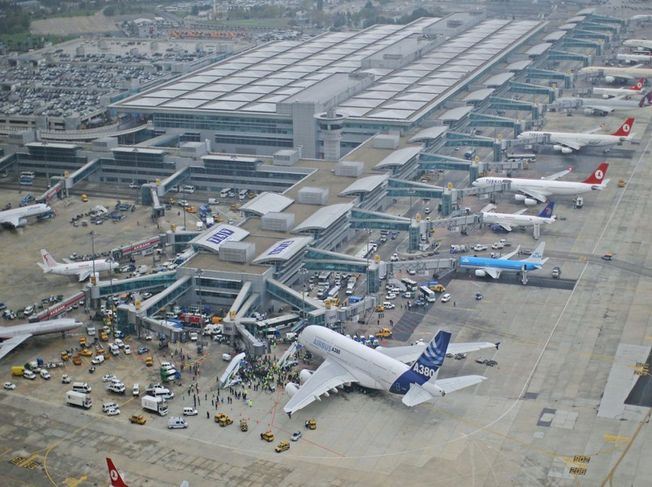
World Statistics Day 20 October 2015
Erkan ERŞEN TurkStat

Slide 2

Air Transport Statistics
Official Statistics Programme of Turkey
Cooperations for air transport statistics
National:
State Airports Authority,
Directorate General of Civil Aviation
Ministry of Transport, Maritime Affairs and Communication
International:
Eurostat, UNECE and OECD
Notes:
State Airports Authority (for air traffic data),
General Directorate of Civil Aviation (for aircraft registration and seat data)
Ministry of Transport (safety data).
International level: Eurostat, UNECE and OECD to harmonise coverage, methodology and punctuality for the production and dissemination of official aviation data.

Slide 3
Turkey: Population
Turkey: GDP

Slide 4
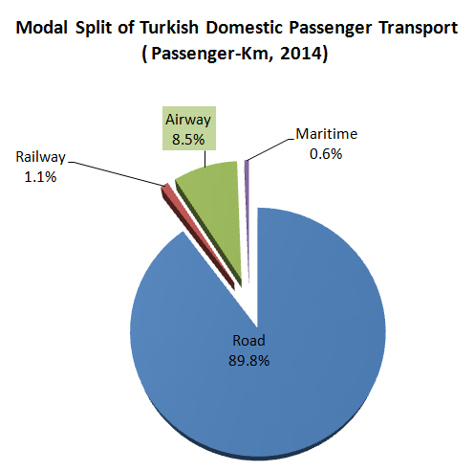
Air Transport In Turkey

Slide 5
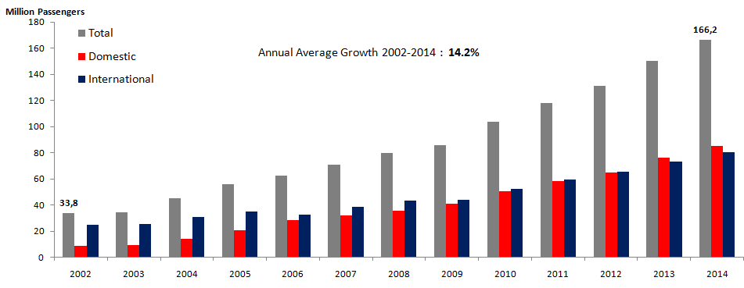
Air Passenger Traffic In Turkey

Slide 7
Source: Directorate General of Civil Aviation

Slide 8
Top 10 Airlines By International Passenger Traffic (2014)
Source: IATA

Slide 9
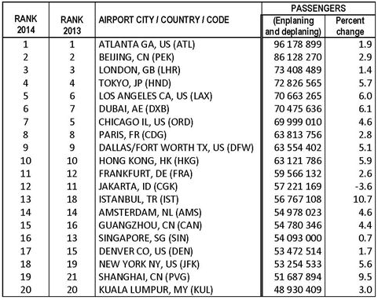
World Airport Rankings: Total Passengers (2013 & 2014)
Source: ACI

Slide 10
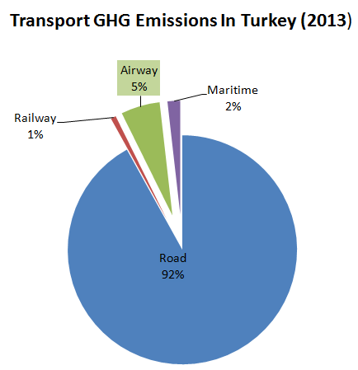
Air Transport GHG Emissions In Turkey
  Total GHG Emissions In Turkey: 451,9 million-tonne CO₂ Equivalent
  Transport GHG Emissions: 68,3 million-tonne CO₂ Eq. (15% of total)
  Air Transport GHG Emissions: 3,7 million-tonne CO2 Eq. (0,8% of total)

Slide 11
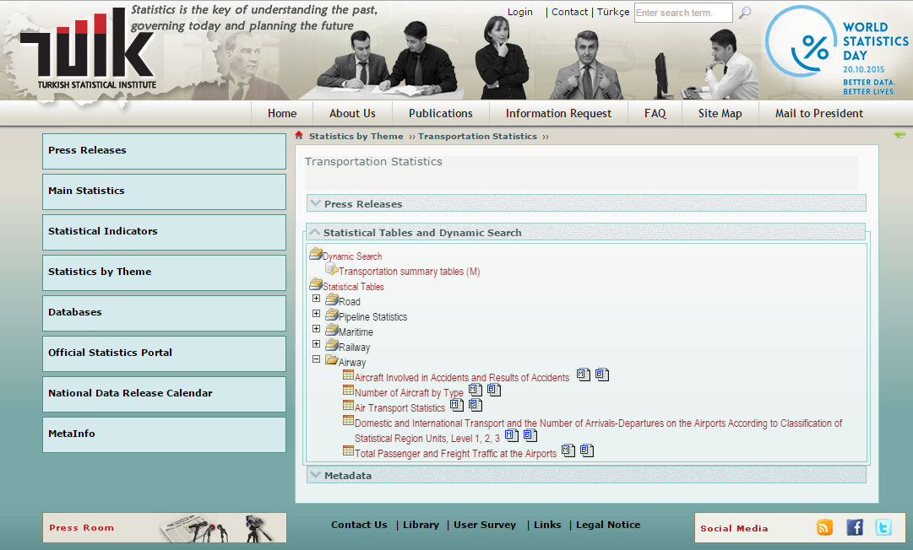
TurkStat Air Transport Data
http://www.turkstat.gov.tr/PreTablo.do?alt_id=1051

Slide 12
…Thank you…

