Slide 1
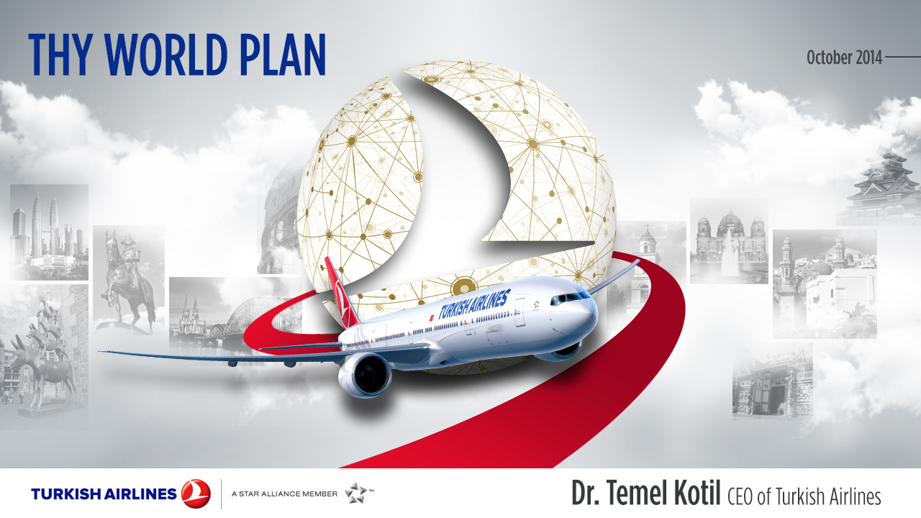



















Development of Airline Business &
Turkish Airlines
October 2015
Temel Kotil, Ph.D., CEO of Turkish Airlines

Slide 2











Air Passenger Numbers
x2.2
x2.7
1994
1.2 billion
2014
3.3 billion
2034
7.3 billion
WORLD
TURKEY
19.6 million
123 million
381 million
X3.1
X6.3
Source: IATA, DHMI, internal analysis

Slide 3













Passenger Flow Development
Total Scheduled Revenue Passenger-Kilometers
To/From and Intra Regions (Trillions)
2014
Europe
2034
North America
Middle East
Asia Pacific
Africa
Latin America
2034
2014
Source: Boeing Current Market Outlook 2015
Notes:
Ek pay chart gelecek

Slide 4








Driving The Center Of Gravity Of Traffic To The South And East
Geographic center of gravity of departing/arriving/connecting passengers per city
1971
1991
2011
2031
1981
2001
2021
Source: Airbus Global Market Forecast 2012

Slide 5



International Passenger Growth
Regional International Passenger Growth (2013 - 2033)
Asia & Pasific & Middle East is expected to grow faster
Europe will still be the driver of international traffic
*The diameter of spheres show extra passenger number in 2033 compared to 2013
Source: ACI 2012-2031 Traffic Forecast, ACI 2013 year end report, internal analysis

Slide 6



Economic Benefits Of Aviaiton
Today
In 20 Years
58 million jobs
2.4 trillion USD GDP
X1.8
105 million jobs
6 trillion USD GDP
WORLD
X2.5
3.4% of World GDP
4.1% of World GDP
5.9% of Turkey GDP
7% of Turkey GDP
TURKEY
Source: ATAG, *Total (direct, indirect, induced) effect, Turkey GDP percentages are forecasted. Today values are 2012 values.

Slide 7


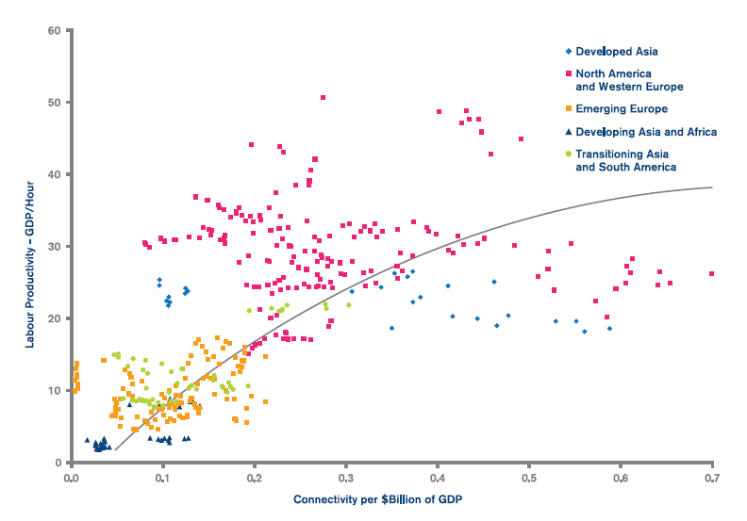
Impact Of Connectivity
Connectivity can boost the productivity and growth of economies
Connectivity
& Network development
Improves efficiency & productivity
Widens markets
Encourages
investment
Today,
we are more connected
Labor Productivity vs Connectivity
Developed Asia
North America and Western Europe
Emerging Europe
Labour Productivity – GDP/Hour
Developing Asia and Africa
Transitioning Asia and South America
Connectivity per $ Billion of GDP
Source: IATA economic performance 2014

Slide 8







Network Today & Tomorrow
42 Mega Cities
2013
> 50,000 daily long-haul passengers
> 20,000 daily long-haul passengers
> 10,000 daily long-haul passengers
Source: Airbus 2014 GMF

Slide 9

Network Today & Tomorrow
91 Mega Cities
2033
> 50,000 daily long-haul passengers
> 20,000 daily long-haul passengers
> 10,000 daily long-haul passengers
Source: Airbus 2014 GMF

Slide 10

Picture of Today and Tomorrow
Airport Growths
Millions
About 160 million
1.
2013 Passenger Number
High volume
3.
2.
4th in the world
about 120 million
4.
Low volume
Low growth
High growth
2008-2013
Annual Passenger Growth (CAGR)
Africa
Asia Pasific
Europe
L. America
Middle East
N. America
Buble width: Forecasted 2025 airport passengers
Growth rates are forecast by our analyst team based on ACI 2012 country passenger forecast, last 10 year growth rate of airports, regional growth expectations of Airbus & Boeing

Slide 11

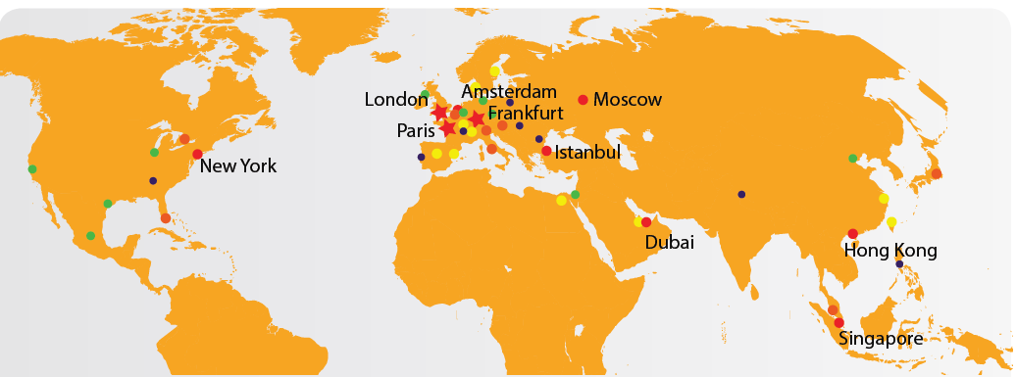

Cities With Highest Connectivity
Istanbul has the largest connectivity growth in last 5 years
İstanbul
is the 5th most connected city
Source: Mater Card Global Destionation Cities Index 2014, 2015

Slide 12


İstanbul
3rd
favorite in Europe
5th favorite in the world
About 13 million internation al overnight visitors
Source: Mater Card Global Destionation Cities Index 2015

Slide 13

Customer Satisfaction in Aviation Sector
Each customer has different VALUE, BEHAVIOUR & NEEDS
CUSTOMIZATION
Passenger
Expectations
Facilities
Employees
CUSTOMER
SATISFACTION
Assuarance
Flight
Patterns
Technology
Infrastructure
Regulatory
Environment
Airline and
Industry Strategies
Reliability
Responsiveness
Kaynak: Boeing

Slide 14


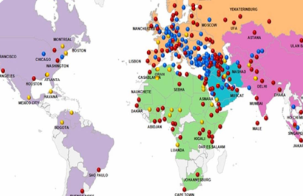
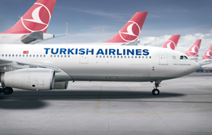







Who We Are
Network
Aircraft
Aviation
Human Capital
Passenger / Our Boss
Notes:
Human capital için yeni foto gelsin

Slide 15

Turkish Aviation Market Growth
Total Passenger Numbers (millions)
(million)
131
2004 - 2014
CAGR = 13%
123
111
98
89
79
63
65
50
54
44
30
36
Source: General Directorate of State Airports Authority (DHMI)

Slide 16


Turkish Sivil Aviation Development
Number of countries
with bilateral air service agreement
2003
81 countries
2015
164 countries
2 times
Source: Turkish Civil Aviation Autorities

Slide 17


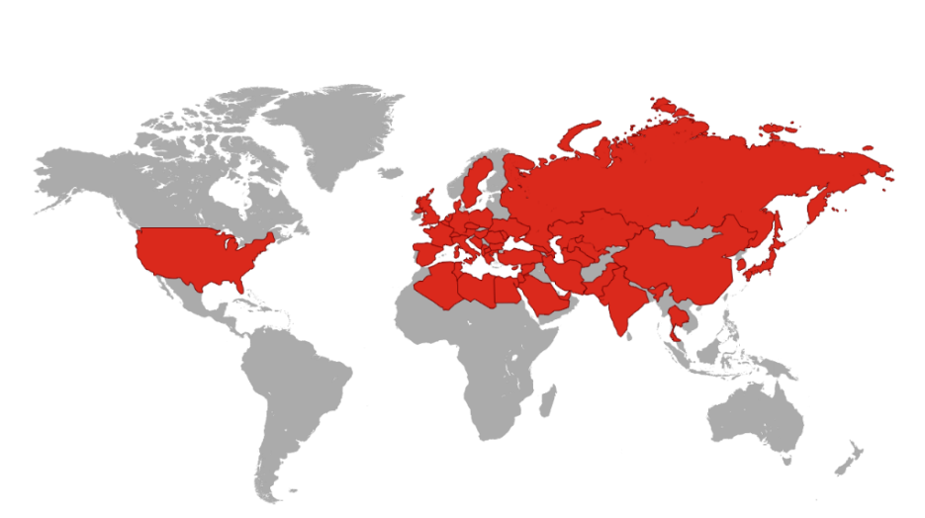



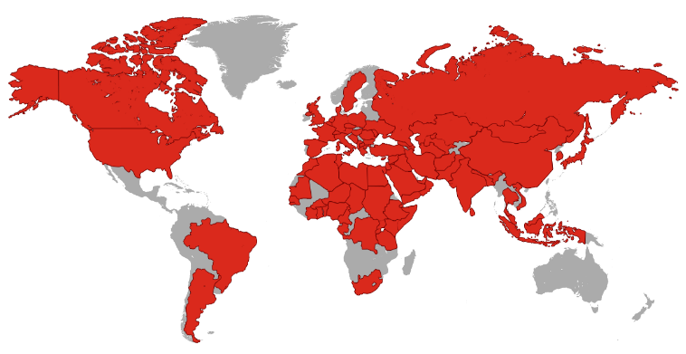


Aviation in Turkey
Network Coverage
# of Aircraft:
2003
Revenue:
2003: 162
2003: $2.2 billion
2015: 482
2014T: $27 billion
Increased 3x
Increased 12x
2014
Increased 3x
International Passenger
# of Airports:
Domestic Passenger
2003: 26
2003: 25 M
2003: 5 M
2015: 55
2014: 80 M
2014: 43 M
Increased 2x
Increased 3.2x
Increased 9x

Slide 18
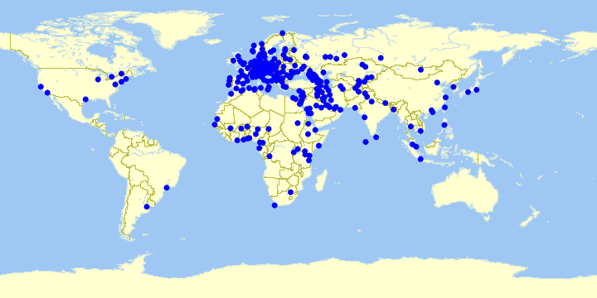
International Destinations Of Turkish Carriers
Turkey is ranked the 3rd for the # of international destinations offered by its registered
airliens
# of unique international destinations flown by Turkish Carriers
2003
60 destinations
2015
268 destinations
  Today 96 international airlines flies to Turkey
4.5 times
Source: OAG, Turkish DGCA

Slide 19






Turkish Civil Aviation’s Current Roles in Industry
Turkey is a Candidate For ICAO Council in 2016
Directorate General of Civil Aviation (DGCA)
  Member of ICAO
  Vice President of ECAC
  Vice President of ICAO EUR-NAT Regional Aviation Safety Group (RASG)
  President of Eurocontrol Provisional Council and VP of the SRC Safety Regulation Commission
  Vice President of D-8 Aviation Council
  Member of Board and Vice President of JAA-TO
Dr. Temel Kotil, CEO of Turkish Airlines, president of AEA
Source: Turkish DGCA

Slide 20





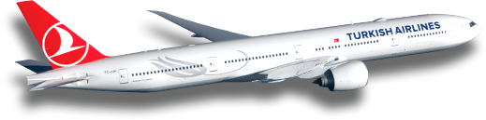

Turkey To Africa
2.6 mil.
280
Passenger Numbers
Frequency Per Week
20
238k

Slide 21

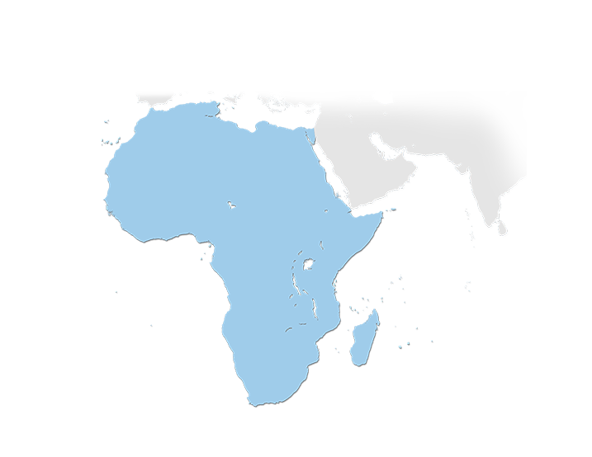



Network
ORAN
ALGIERS
TUNIS
Largest network in Africa among foreign carriers
TLEMCEN
BATNA
CONSTANTINE
ALEXANDRIA
CASABLANCA
TRIPOLI
MISURATA
BENGHAZI
CAIRO
LUXOR
ASWAN
9 new destinations
planned
28 Countries
BAMAKO
CONAKRY
Durban – 5 Nov.
Conakry
Luanda
Juba
Maputo – 28 Oct.
Aswan
Luxor Antananarivo Mauritius
ABUJA
JUBA
DOUALA
LIBREVILLE
LUANDA
44 Destinations
2002 THY Network (4 Destinations)
ANTANANARIVO
2003 - Current (40 New Destinations)
MAURITIUS
MAPUTO
Planned (9 Destinations)
DURBAN

Slide 22





Origin & Destination Opportunities
We offer the largest number of O&D’s
O&D options more than 10000
Carry Africa to World with strongest network and best airline
Africa | O&D Pair
Africa – Europe | 4664
Africa – Domestic | 2200
Africa – Middle East | 1496
Africa – Far East | 1452
Africa – America | 484
Africa – Total | 10296

Slide 23
Turkish Airlines’ Passenger Volume Development
Turkish Airlines’ Passenger Numbers (in millions)
2004 - 2014
CAGR = 17%
Grew more than 3 times faster than the world

Slide 24
Annual Revenue Passenger Km Growth (RPK)
%
Turkish Airlines Vs. World Revenue Passenger km Growth %
10p
Source: World RPK growth values are from IATA.

Slide 25
World Passenger Capacity Share Development - ASK
Available Seat Km (Capacity) Market Share
TK is forecasted to be the 11th largest airline
4.9%
4.4%
4.3%
3.9%
3%
2.8%
2.4%
2.2%
2.1%
2.0%
1.9%
1.9%
Turkish Airlines’ ASK Market Share
Notes: For US carriers only the mainland traffic is taken into consideration. 100 % owned companies are included. 2015 forecast is based on 5 August 2015 OAG data. Source: 2002 ICAO, 2003- 2014 IATA, 2015F based on OAG, 2015 company reports, ranked based on 2015F market share.

Slide 26


International To International Transfer Passengers
%43 of international passenger is transfer
Passenger Breakdown (2014)
17%
Int’l-Int’l
Transfer
Int’l-Dom
Transfer
2000 - 2005
CAGR = 8%
Int’l-Direct
2005 - 2014
CAGR = 33%
Domestic

Slide 27

Achieving Multi-Dimensional Growth
Turkish Airlines # of Landings, Destinations & Passengers
2014
55 m
Number of Landings
Number of Destinations
Number of Passengers
2013
48m
2012
39m
2011
33m
2015B
61.7 million pax
2010
29m
2008
23m
2009
25m
2007
20m
2006
17m
2003
2004
10m
2005
14m
The size of the bubles illustrates total annual passenger numbers

Slide 28









Global Rankings
7.
7th largest carrier in terms of international passenger numbers¹
13.
13th largest carrier in terms of capacity (available seat kilometers)²
13.
13th largest carrier in operating revenue³
10th largest in operating profit³
10.
1 and 3: Rankings based on 2014 values (IATA Wats), 2: Rankings based on 2014 January-December values (internal analysis results)

Slide 29
Global Rankings - Network Size
1
more countries than any other in the world
110 Country
1
more international destinations than any other in the world
230 International
Destinations
4
4th largest network in the world
280 Destinations
Source: OAG August 2015

Slide 30
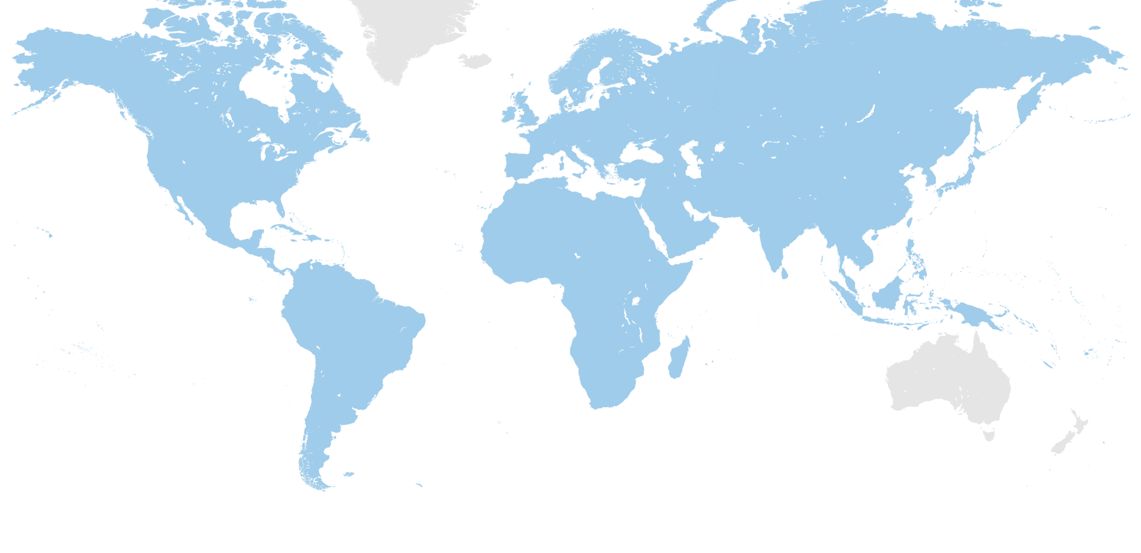


Turkish Airlines’ World
Europe
42 Countries
107 Destinations
North America
2 Countries
9 Destinations
OSLO
HELSINKI
EKATERINBURG
MONTREAL
MANCHESTER
MOSCOW
UFA
ASTANA
ULAAN BAATAR
SAN FRANCISCO
CHICAGO
BOSTON
WASHINGTON
LISBON
BEIJING
SEOUL
Far East
22 Countries
34 Destinations
LOS ANGELES
ATLANTA
ORAN
MASHAD
OSAKA
HOUSTON
MIAMI
CASABLANCA
SHANGHAI
HAVANA
NOUAKCHOTT
SEBHA
ASMARA
MUSCAT
DHAKA
HANOI
HONG KONG
MEXICO CITY
South America
2 Countries
2 Destinations
MUMBAI
DAKAR
HO CHI MINH CITY
BOGOTA
ABIDJAN
MALE
SINGAPORE
KIGALI
Middle East
13 Countries
34 Destinations
LUANDA
DAR ES SALAAM
JAKARTA
110
COUNTRIES
ANTANANARIVO
SAO PAULO
MAPUTO
JOHANNESBURG
DURBAN
2002 TK Network
BUENOS AIRES
CAPE TOWN
Africa
28 Countries
44 Destinations
Destinations opened between 2003 - Now
280
DESTINATIONS
Planned

Slide 31
Destinations in Turkey
KASTAMONU
SİNOP
TEKİRDAĞ
SAMSUN
İSTANBUL
KOCAELİ
MERZİFON
ORDU-GİRESUN
TRABZON
KARS
ÇANAKKALE
TOKAT
BURSA
ANKARA
ERZURUM
IĞDIR
BALIKESİR
SİVAS
ERZİNCAN
AĞRI
ESKİŞEHİR
KÜTAHYA
BİNGÖL
MUŞ
İZMİR
UŞAK
NEVŞEHİR
KAYSERİ
MALATYA
ELAZIĞ
VAN
ISPARTA
KONYA
DİYARBAKIR
DENİZLİ
K.MARAŞ
BATMAN
HAKKARİ
ADIYAMAN
ŞIRNAK
BODRUM
ADANA
MARDİN
ANTALYA
G.ANTEP
ŞANLIURFA
DALAMAN
HATAY

Slide 32








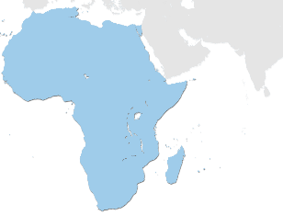


Africa
ORAN
ALGIERS
TUNIS
TLEMCEN
BATNA
CONSTANTINE
ALEXANDRIA
CASABLANCA
TRIPOLI
BENGHAZI
MISURATA
CAIRO
LUXOR
ASWAN
BAMAKO
CONAKRY
ABUJA
JUBA
DOUALA
LIBREVILLE
LUANDA
ANTANANARIVO
2002 THY Network (4 Destinations)
MAURITIUS
2003 - Current (40 New Destinations)
MAPUTO
Planned (9 Destinations)
DURBAN

Slide 33
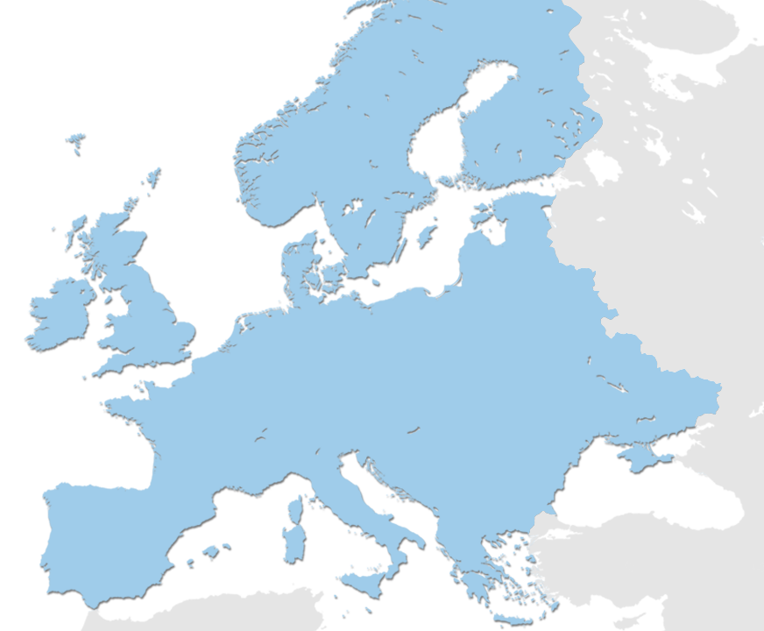
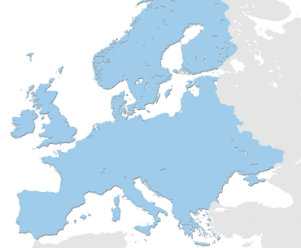
Europe
GOTHENBURG
BREMEN
HANOVER
BERLIN
MUNSTER
LEIPZIG
BRUSSEL
KASSEL
DUSSELDORF
PRAGUE
KRAKOW
KHARKIV
COLOGNE
FRANKFURT
NUREMBERG
DNEPROPETROVSK
NANTES
PARIS
BADEN-BADEN
STUTGARD
ZAPORIZHIA
LJUBLIJANA
GRAZ
MILAN
VENICE
BELGRADE
LA CORUNA
GENOA
CONSTANTA
2002 TK Network (40 Destinations)
NICE
PODGORICA
SOFIA
BILBAO
PORTO
VARNA
2003 - Current (48 New Destinations)
NAPLES
BARI
Planned (6 Destinations)

Slide 34
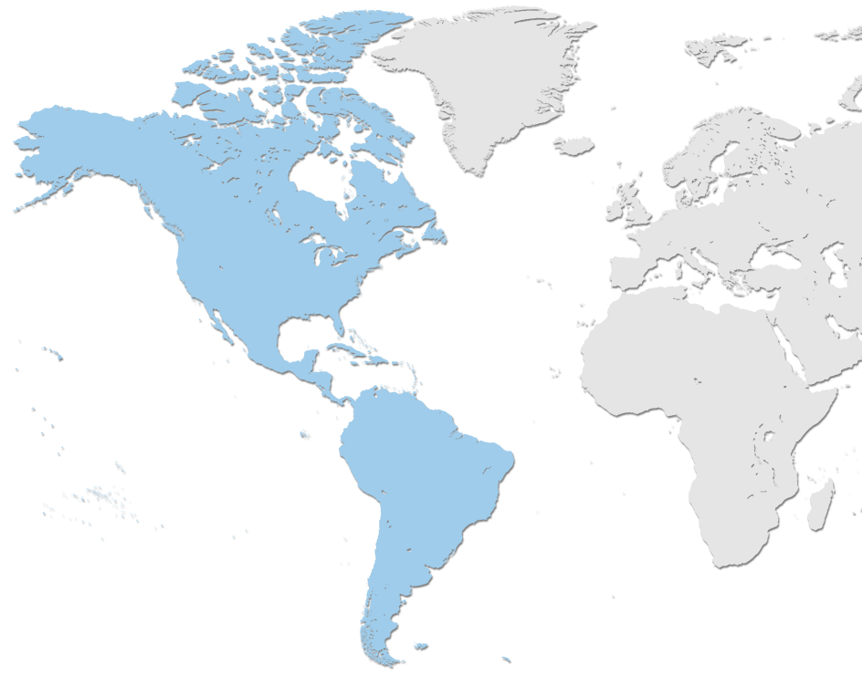
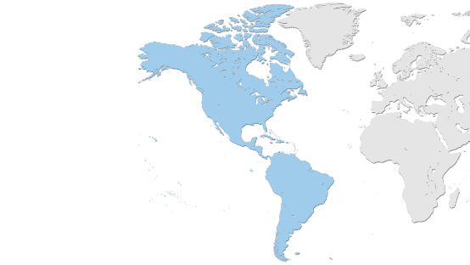
America
MONTREAL
TORONTO
SAN FRANCISCO
CHICAGO
BOSTON
NEW YORK
ATLANTA
WASHINGTON
LOS ANGELES
HOUSTON
MIAMI
HAVANA
MEXICO CITY
CARACAS
BOGOTA
2002 THY Network (2 Destinations)
SAO PAULO
2003 - Current (9 New Destinations)
BUENOS AIRES
Planned (6 Destinations)

Slide 35
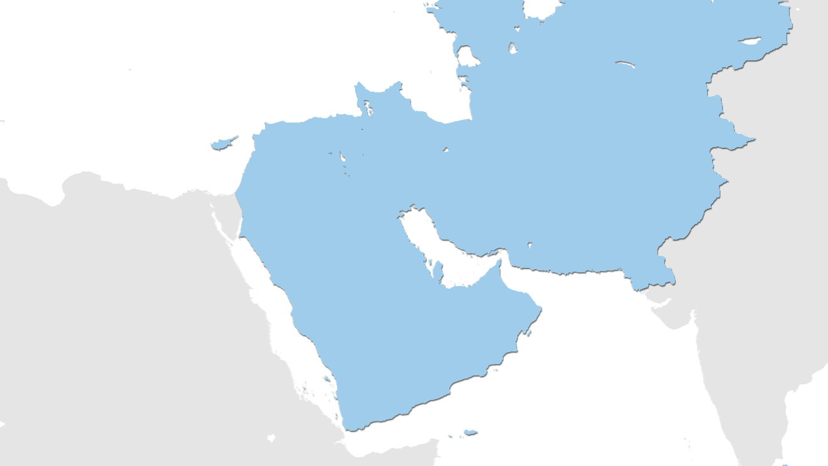
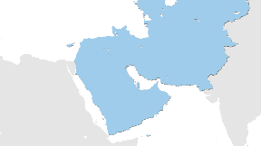
Middle East
ALMATY
BISHKEK
TASHKENT
TABRIZ
LEFKOSA
ASHGABAD
ALEPPO
MOSUL
ERBIL
SULAYMANIYAH
BEIRUT
BAGHDAD
KERMANSHAH
TEHRAN
DAMASCUS
TEL AVIV
AMMAN
NAJAF
ISFAHAN
BASRAH
AHVAZ
AQABA
KUWAIT
SHIRAZ
EL QASSIM
DAMMAM
MADINAH
BAHRAIN
DUBAI
KARACHI
YANBU
RIYADH
DOHA
ABU DHABI
MUSCAT
JEDDAH
TAIF
2002 THY Network (11 Destinations)
ABHA
2003 - Current (23 New Destinations)
SANAA
Planned (1 Destination)
ADEN

Slide 36
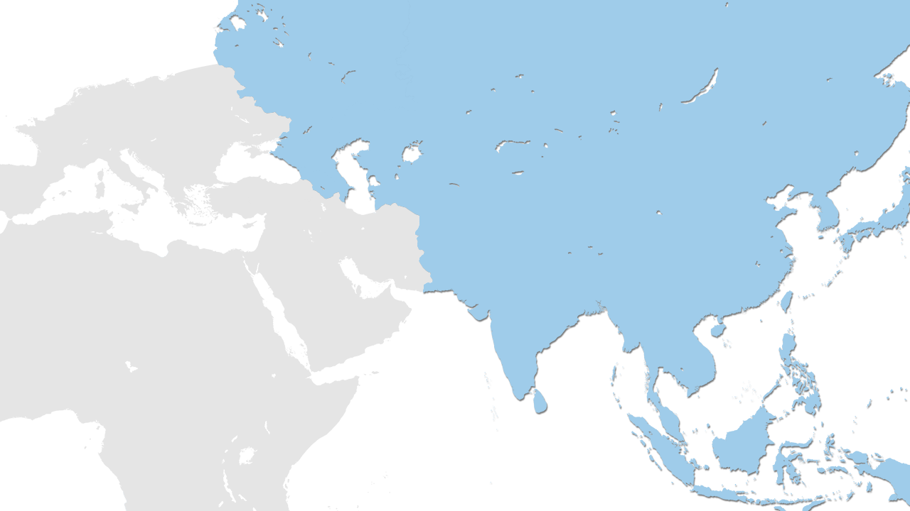
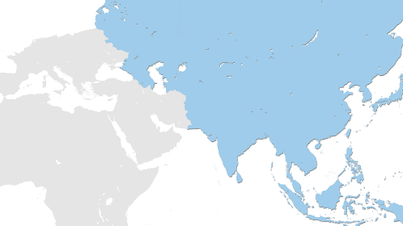
Far East
ST. PETERSBURG
EKATERINBURG
KAZAN
NOVOSIBIRSK
MOSCOW
UFA
ASTANA
ROSTOV
ASTRAKHAN
ULAAN BAATAR
SOCHI
STAVROPOL
MAKHACHKALA
TBILISI
TASHKENT
ALMATY
BATUMI
GANJA
KHUJAND
BISHKEK
SEOUL
BAKU
DUSHANBE
OSH
BEIJING
NAKHCHIVAN
LANKARAN
ASHGABAD
MAZAR-I SHARIF
KABUL
TOKYO
ISLAMABAD
SHANGHAI
OSAKA
LAHORE
NEW DELHI
KATHMANDU
KARACHI
TAIPEI
DHAKA
GUANGZHOU
HANOI
HONG KONG
MUMBAI
BANGKOK
MANILA
COLOMBO
HO CHI MINH
2002 THY Network (15 Destinations)
MALE
KUALA LUMPUR
2003 - Current (31 New Destinations)
SINGAPORE
Planned (3 Destinations)
JAKARTA

Slide 37



Origin & Destination Opportunities
Africa
Middle East
Asia & Pasific
We offer the largest number of O&D’s
We offer the largest number of O&D’s
We offer the second largest number of O&D’s
Africa | O&D Pair
Africa – Europe | 4664
Africa – Domestic | 2200
Africa – Middle East | 1496
Africa – Far East | 1452
Africa – America | 484
Africa – Total | 10296
Middle East | O&D Pair
Middle East – Europe | 3604
Middle East – Domestic | 1700
Middle East – Africa | 1496
Middle East – Far East | 1122
Middle East – America | 374
Middle East – Total | 8296
Asia & Pasific | O&D Pair
Far East – Europe | 3498
Far East – Domestic | 1650
Far East – Africa | 1452
Far East – Middle East | 1122
Far East – America | 363
Far East – Total | 8085
Source: Rankings are based on OAG December 2014

Slide 38

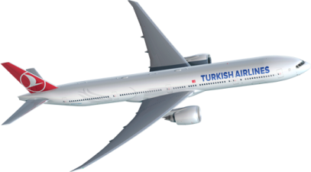


Fleet Development
Fleet Group | Aircraft | Order
Wide Body | A330 | 5
 | B777 | 11
221 aircraft orders
Narrow Body | A320 CEO/NEO | 108
 | B737 NG/MAX | 95
Cargo | A330-200F | 2
13th largest fleet in the world
Turkish Airlines Fleet Size
442
299
Seat Capacity
233
261
202
2000 | 2005 | 2010 | 2015 | 2020 | CAGR (2005-2015)
12k | 15k | 28k | 60k | 84k | 15%
158
179
102
127
133
85
103
Source: Ranking from IATA Wats 2014.

Slide 39
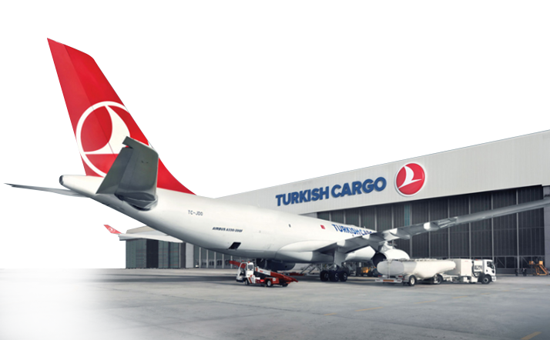



Cargo Development
6th
largest cargo
carrier of Europe
in total cargo
ton km
Operates to 51 destinations with 10 freighters in addition to 264 destinations with passenger aircraft.
Turkish Cargo global market share in revenue has increased from 0.6% in 2009 to 1.6% in 2014
Total Cargo (ton) (x1000)
%17

Slide 40

Financal Performance
Scheduled Passenger Revenue by Geography 2015 H1
EBITDAR Margin %
AVG (2006-2014): 19.5%

Slide 41







Operating Efficiency
Annual
average
growth
2.4%
Annual
average
Fixed a/c rel.
Cost saving
0.5%
2006 - 2014
Annual average
cost saving from
labor
2.6%
2006 - 2014
Annual average efficiency
per employee
6%
Total employees also includes THY Teknik, THY Habom, THY Aydın Çıldır A.Ş..

Slide 42


World Quality Awards
Best Business Class Catering in the world
Best Business Class Catering In Lounge
Source: Skytrax 2015

Slide 43

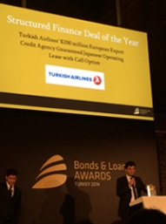
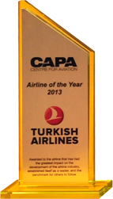
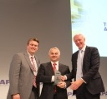



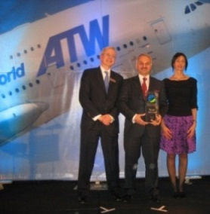

Awards
Airline of the Year Award
(Air Transport News 2015)
Aircraft Financing Award, Structured Finance Deal Of the Year (by Bond and Loans)
Airline of the Year Award
(CAPA ,2013)
Winner of Best Corporate Governance Award in Europe in 2015
Best European Cargo Airline (Air Cargo News)
Winner of Air Transport
World-Market Leadership Award’11

Slide 44









Sponsorships and Brand Ambassadors
DIDIER DROGBA
EUROLEAGUE
BORUSSIA DORTMUND
OLYMPIQUE DE MARSEILLE
TURKISH AIRLINES OPEN
CHIO AACHEN
Notes:
Siyah yerine golf den görsel

Slide 45

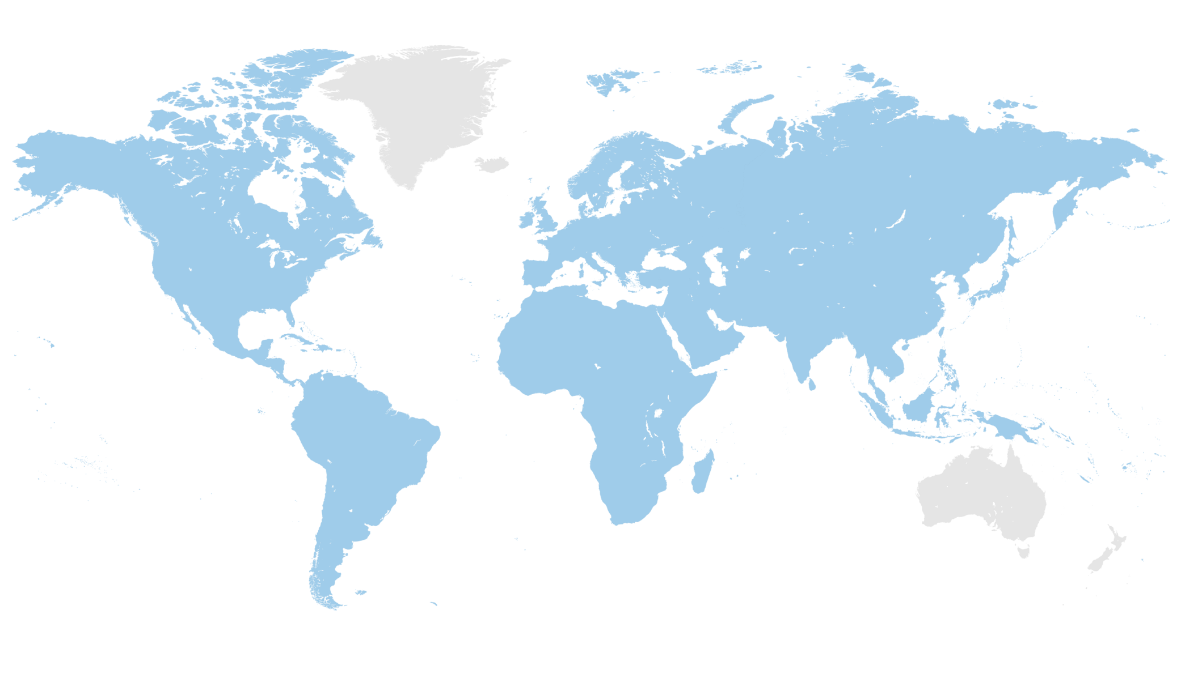

Geographical Advantage
Within narrow body range:
70% of international destinations,
More than 55 countries
OSLO
HELSINKI
Detour advantage
YEKATERINBURG
MONTREAL
MANCHESTER
MOSCOW
UFA
ASTANA
ULAAN BATAAR
SAN FRANCISCO
CHICAGO
BOSTON
WASHINGTON
LISBON
%10
BEIJING
SEOUL
LOS ANGELES
ATLANTA
ORAN
MASHAD
OSAKA
HOUSTON
MIAMI
CASABLANCA
SHANGHAI
HAVANA
NAUKCHETE
SEBHA
%6
HANOI
%17
ASMARA
MUSCAT
MUMBAI
DHAKA
HONG KONG
MEXICO CITY
DAKAR
HO CHI MINH CITY
BOGOTA
ABIDJAN
MALE
SINGAPORE
KIGALI
JAKARTA
CASK (Cost per Avai. Seat km)
LUANDA
DAR ES SALAAM
ANTANANARIVO
Istanbul is in the middle of Europe,
Middle East and Asia regions with
high volume of traffic and growth rate.
SAO PAULO
JOHANNESBURG
MAPUTO
DURBAN
BUENOS AIRES
CAPE TOWN
Flight Time
1 2 3 4 5 6 7 8 9 10 11 12

Slide 46
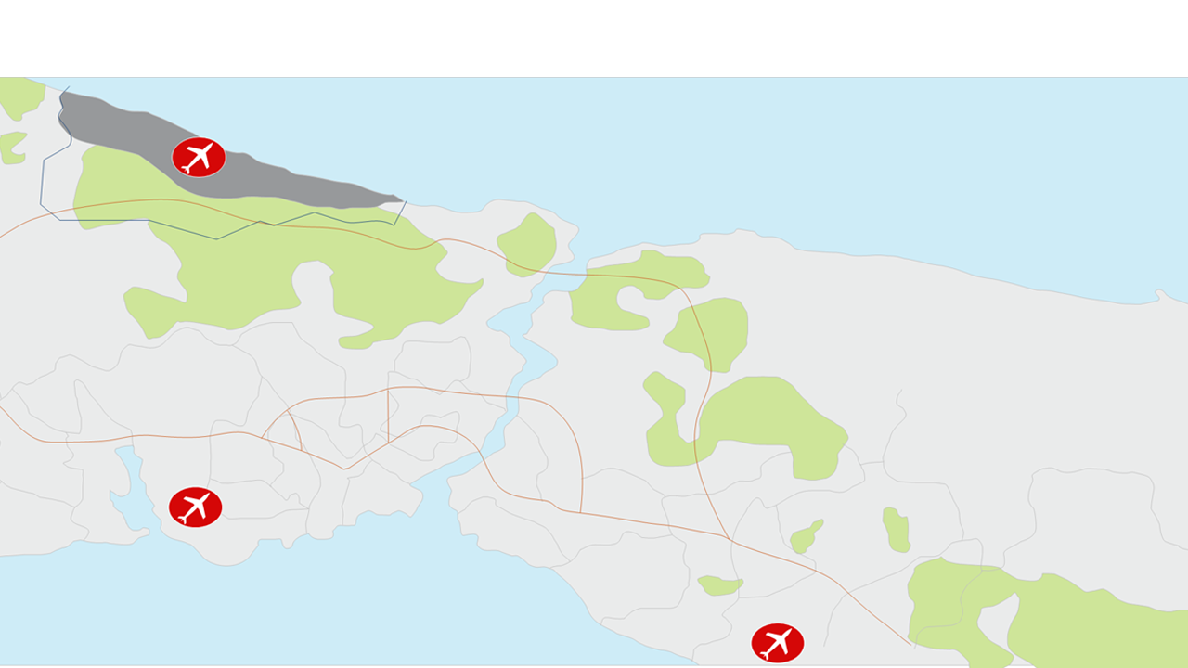
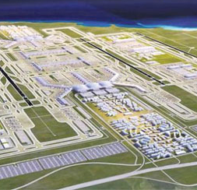
3rd Airport In Istanbul
Third Airport
Black Sea
76.5 km² Area
500 Aircraft Park Positions
6 Runways
4 Terminals
A candidate for 3rd Biggest
(After Phase 1)
& Biggest
(After All Phases)
in the World
150 million
PASSENGERS CAPACITY
(Phase4)
Atatürk International
Airport
Sabiha Gökçen

Slide 47


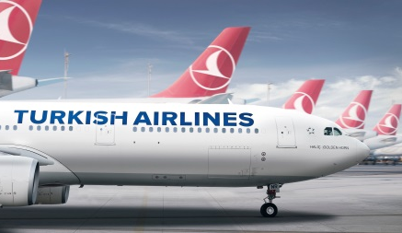


Turkish Airlines In 2015
Fleet
Passenger
Capacity
79.6
61.7 million
299 Aircraft
%15

Slide 48










Turkish Airlines in 2023
Passenger
Revenue
Fleet
120 Million
More than
450
aircraft
24 Billion USD

Slide 49
Disclaimer
Türk Hava Yolları A.O. (the “Incorporation” or ‘’Turkish Airlines’’) has prepared this presentation for the sole purpose of providing information about its business, operations, operational and financial results. The information in this presentation is subject to updating, revision and amendment. This presentation is not, and does not support to be comprehensive and to contain all information related to Turkish Airlines.
This presentation does not constitute or form part of any offer or invitation to sell or issue, or any solicitation of any offer to purchase or subscribe for, any securities of Turkish Airlines nor any of its subsidiaries or their respective affiliates nor should it or any part of it or the fact of its distribution form the basis of, or be relied on in connection with, any contract or investment decision in relation thereto. This presentation is not intended for distribution to, or use by, any person or entity in any jurisdiction or country where such distribution would be contrary to law or regulation. The information contained in this presentation has not been subject to any independent audit or review and may contain forward-looking statements, estimates and projections. Statements herein, other than statements of historical fact, regarding future events or prospects, are forward-looking statements. Although Turkish Airlines believes that the estimates and projections reflected in the forward-looking statements are reasonable, they may prove materially incorrect, and actual results may materially differ. As a result, you should not rely on these forward-looking statements. Turkish Airlines undertakes no obligation to update or revise any forward-looking statements, whether as a result of new information, future events or otherwise, except to the extent required by law. Any forward-looking statement in this presentation speaks only as of the date on which it is made, and Turkish Airlines undertakes no obligation to update any forward-looking statement to reflect events or circumstances after the date on which the statement is made or to reflect the occurrence of unanticipated events, except to the extent required by law.
Industry, market and competitive data and certain industry forecasts used in this presentation were obtained from internal research, market research, publicly available information and industry publications and other market commentaries. Industry publications generally state that the information contained therein has been obtained from sources believed to be reliable at the relevant time, but that the accuracy and completeness of such information is not guaranteed. Similarly, internal research, market research, industry publications and other publicly available information, while believed to be reliable, have not been independently verified, and Turkish Airlines does not make any representation as to the completeness or accuracy of such information.
No representation, warranty or undertaking, expressed or implied, is or will be made by Turkish Airlines or its shareholders, affiliates, advisors or representatives or any other person as to, and no reliance should be placed on, the fairness, accuracy, completeness or correctness of the information or the opinions contained in this presentation (or whether any information has been omitted from this presentation). Turkish Airlines, to the extent permitted by law, and each of its respective directors, officers, employees, affiliates, advisors or representatives disclaims all liability whatsoever (in negligence or otherwise) for any loss however arising, directly or indirectly, from any use of this presentation or its contents or otherwise arising in connection with this presentation.
This presentation should not be construed as financial, legal, tax, accounting, investment or other advice or a recommendation with respect to any investment. Under no circumstances is this information and material to be construed as a prospectus, supplement, offering memorandum or advertisement, and neither any part of this presentation nor any information or statement contained herein shall form the basis of or be relied upon in connection with any contract, commitment or investment decision.
By reading this presentation or attending or listening to any relevant meeting, conference call or webcast organized by the Company, you agree to be bound by the above provisions.

Slide 50

THANK YOU

