Slide 1

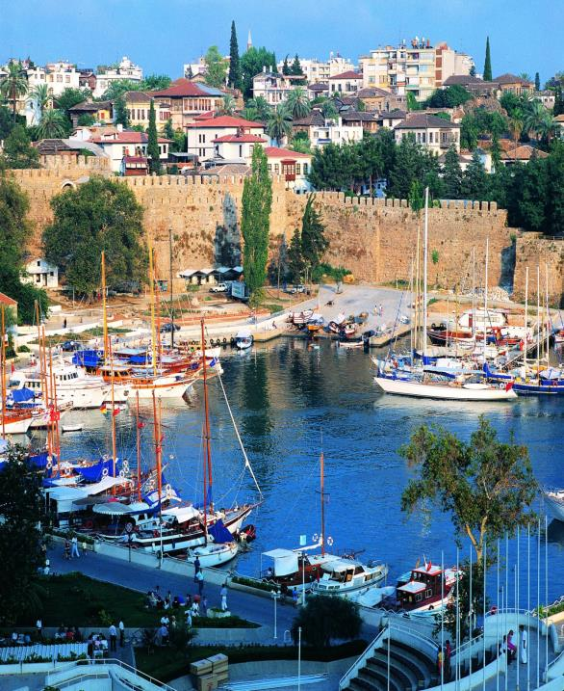
ICAN 2015
ANTALYA, TURKEY
19 Oct 2015
CONNECTIVITY, REGULATORY FRAMEWORK AND ECONOMIC DEVELOPMENT OF AIR TRANSPORT AND TOURISM
MÁRCIO FAVILLA
UNWTO
Executive Director

Slide 2
Actual Trend vs. Tourism Towards 2030
Int’l arrivals to reach 1.4 bn in 2020 and 1.8 bn in 2030
1.8 bn
1.4 bn
1,133 mn
527 mn
Source: World Tourism Organization (UNWTO)
Notes:
2
9% 1st quarter and 4% in the 2nd
0% in April, 7% in May, 6% in June and 5% in July

Slide 3

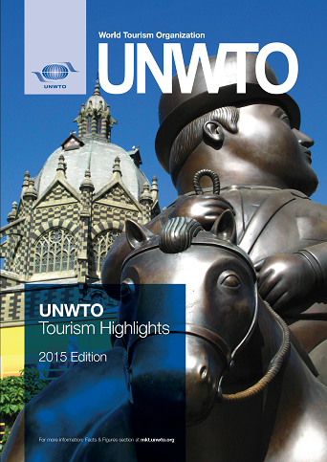
Some highlights 2014
Results 2014
International tourist arrivals
1133 million
+4.3%
International tourism receipts
(BOP Travel)
US$ 1245 billion (€ 937 bn)
+3.7% (real terms)
+
International passenger transport
(BOP Transport, passenger)
US$ 221 billion (€ 161 bn)
www.unwto.org/facts
http://mkt.unwto.org/highlights

Slide 4
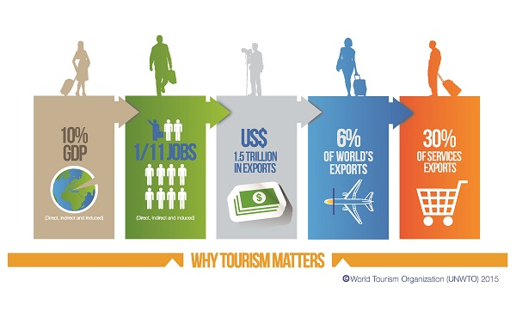
Tourism in the global economy
Notes:
4
“2012 saw continued economic volatility around the globe, particularly in the Eurozone. Yet international tourism managed to stay on course” said UNWTO Secretary-General, Taleb Rifai. “The sector has shown its capacity to adjust to the changing market conditions and, although at a slightly more modest rate, is expected to continue expanding in 2013. Tourism is thus one of the pillars that should be supported by governments around the world as part of the solution to stimulating economic growth,” he added.
A British tourist visiting Madrid, Spain on 13 December has been revealed as the symbolic face of the one billion international tourists travelling in 2012. The tourist was welcomed by the Minister of Industry, Energy and Tourism of Spain, José Manuel Soria, UNWTO Secretary-General, Taleb Rifai, and the Mayor of Madrid, Ana Botella, at an event in Madrid’s Museo del Prado, held to celebrate a record one billion international tourists in 2012. The event, part of the UNWTO One Billion Tourists: One Billion Opportunities campaign, recalled how tourism can create billions of opportunities for growth and development around the world (Madrid, Spain, 13 December 2012).
One billion tourists have travelled the world in 2012, marking a new record for international tourism – a sector that accounts for one in every 12 jobs and 30% of the world’s services exports. On the symbolic arrival date of the one-billionth tourist (13 December 2012), UNWTO revealed the actions tourists can take to ensure their trips benefit the people and places they visit, as voted by the public.
4

Slide 5

Sustainable Development Goals
8.9 by 2030 devise and implement policies to promote sustainable tourism which creates jobs, promotes local culture and products
14.7 by 2030 increase the economic benefits to SIDS and LDCs from the sustainable use of marine resources, including through sustainable management of fisheries, aquaculture and tourism
12.b develop and implement tools to monitor sustainable development impacts for sustainable tourism which creates jobs, promotes local culture and products
Notes:
Moreover, the 10YFP STP provides a great opportunity to monitor progress and report on the SDGs.
Goal 12 is fully focusing on SCP and there are other goals which could be linked to both tourism and SCP as they are cross-cutting (e.g. water use efficiency; energy efficiency; waste water treatment; etc).
Moreover, the three targets shown on the slide which are specifically mentioning tourism imply an enhanced responsibility of the sector which will need to provide evidence on the different targets.

Slide 6

10-YFP - a Global Mandate (SDG 12)
Committed to accelerate the shift towards
Sustainable Consumption and Production Patterns (SCP)

Slide 7


























10-YFP STP Stakeholders
Lead and Co-leads
Multistakeholder Advisory Committee
And 65+ partners

Slide 8

MEASURE TO MANAGE
UNWTO Network of Observatories (INSTO)
http://sdt.unwto.org/content/international-network-sustainable-tourism-observatories-insto
Notes:
There are many synergies between the Observatories and the 10YFP as one key element of the 10YFP STP is the need to promote evidence-based decision making, which requires strong monitoring at the destination level.
Measure to manage: at the heart of UNWTO’s mission.
In order to support destination stakeholders to take focused and coherent action to accelerate the shift towards more SCP patterns, thus turning the goals proposed by the international community into reality, the UNWTO Network of Observatories (INSTO) was launched in 2004 (previously known as GOST –Global Observatories for Sustainable Tourism).

Slide 9



Slide 10
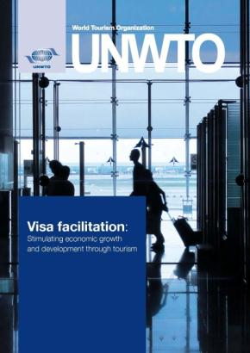
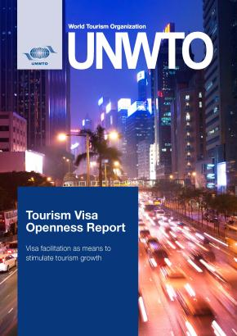
Visa Facilitation
Visa provide essential functions
    Immigration control
    Security
    Limitation of duration of stay and activities
    Application of measures of reciprocity
However … visa also act as a constraint to international travel and its economic benefits

Slide 11
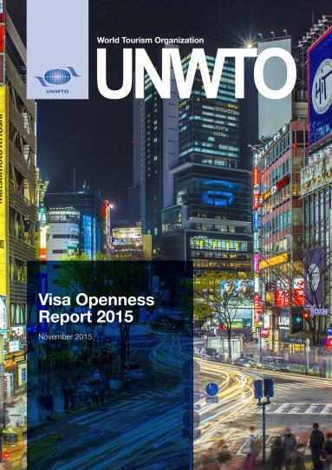
2015 Status

Slide 12
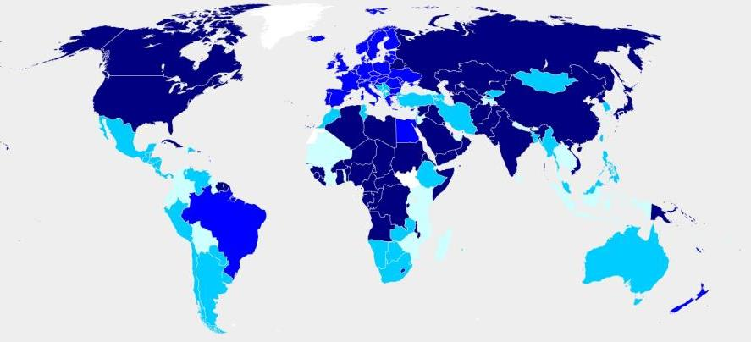
2015 Openness Index
Openness Index
Low openness
High openness
0-21
22-24
25-52
53-100
Notes:
As of 2015, a revision of categories took place where openness index is sorted and grouped in 4 categories with equal number of countries or quartiles.

Slide 13
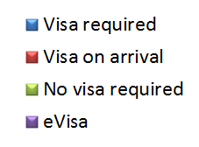
World Population Affected, 2008-2015
Request for traditional visas decreased from 77% to 61%
2008 2010 2012
2013 2014 2015

Slide 14
World Population Affected, 2015

Slide 15
Drivers of Change (2010-2015)
54 destinations significantly facilitated the visa process for citizens of 30 or more countries
Requirements were facilitated for 6,357 destination-source market pairs
Significant changes (30 or more) were predominant
Most common change was towards visa on arrival (62% of all changes)

Slide 16
Research -
Economic Blocs and Thematic Routes

Slide 17
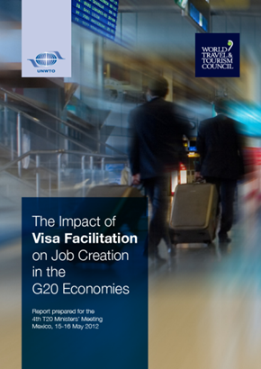
  Visa Facilitation in G20 Economies - 2012
5% to 25% international tourist arrivals growth
Up to US$ 206 billion in additional tourism receipts
Up to 5 million additional jobs in three years’ time

Slide 18
G20 Los Cabos Summit Leaders’ Declaration
The G20 Leaders recognized at their June 2012 Summit, the role of tourism as
“a vehicle for job creation, economic growth and development”
furthermore, they committed to
“work towards developing travel facilitation initiatives in support of job creation, quality work, poverty reduction and global growth.”

Slide 19
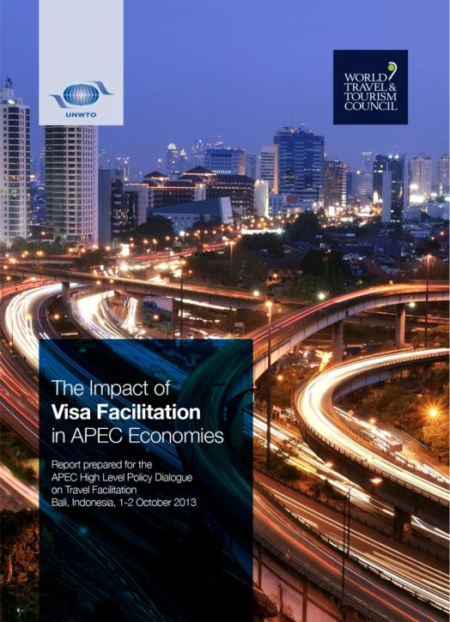
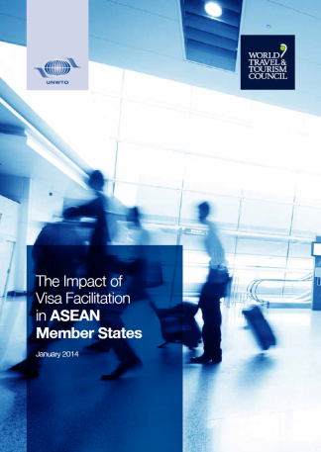
  Visa Facilitation in APEC Economies - 2013
9% to 13% international tourist arrivals growth
From US$ 62 billion to US$ 89 billion in more tourism receipts
1.8 million to 2.6 million additional jobs in three years’ time

Slide 20
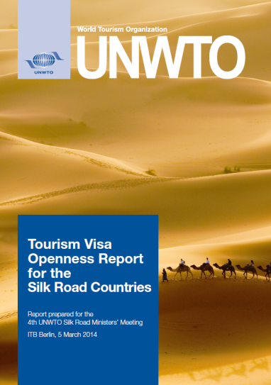
Visa Facilitation in the Silk Road Countries
Presented at the 4th UNWTO Silk Road Ministers’ Meeting at ITB Berlin, 2014
The development of tourism in the Silk Road relies more than usual on a prevailing tourism interest that produces cooperative initiatives and solutions for the tourism sector.

Slide 21
Reciprocity -
Global Status and Selected Economic Blocs

Slide 22

Global Reciprocal Policies, 2015
17% of visa policy pairs between countries are reciprocally open
31% of visa policy pairs between countries reciprocally require traditional visas

Slide 23
Global Reciprocal Policies, 2008-2015
Reciprocal visa restrictions decreased from 57% to 31%
Reciprocal and nonreciprocal visa facilitation measures increased from 43% to 69%

Slide 24
Open Reciprocity, 2008-2015

Slide 25
Recommendations
Improve delivery of information (availability and reliability of information – multiple languages, useful information)
Facilitate processes (reduce bottlenecks, such as personal interviews, needed documents, wait times)
Differentiated treatment to facilitate tourist travel (for means of transportation - e.g. cruise ship passengers - or specified geographical areas or ports of entries)
Establish regional agreements (to move freely between member states once admitted by one of the other member states)

Slide 26
Recent UNWTO/ICAO Collaboration
Memorandum of Understanding, 2010
Joint Statement on Aviation and Tourism, 2013
  Policy convergence
  Connectivity
  Competitiveness
  Travel facilitation
UNWTO/ICAO High-Level Forum on Tourism and Air Transport for Development, Medellín, 2015

Slide 27
Joint High-Level Forum on Tourism and Air Transport for Development, Medellín / Colombia, 2015
Medellín Statement (Sept 2015)
  Economic growth and development
  Travel facilitation
  Evidence-based decision making
  Convergence and compatibility of policies and regulations
  Strengthening cooperation among stakeholders
  Support the Sustainable Development Goals (SDGs)
  Build economic links that bridge the gaps between developed and developing countries (infrastructure development, human resources, promotion and marketing)
Joint strategic framework for strengthening the common path and cooperation of air transport and tourism

Slide 28

Thank you!
Márcio Favilla
World Tourism Organization
(UNWTO)
www.unwto.org

