Slide 1
Pete Cooper
Pavisade, CEO
Cyber Strategy

Slide 2
SAFETY?

Slide 3
Security?

Slide 4
CyberSecurity?

Slide 5
Culture
Safety Culture
Security Culture
Cybersecurity culture
This is about how we work together

Slide 6
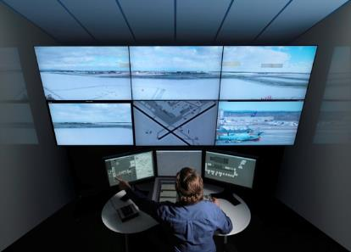
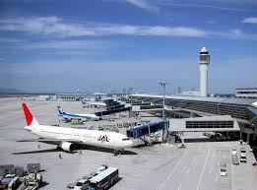
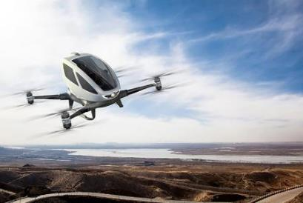
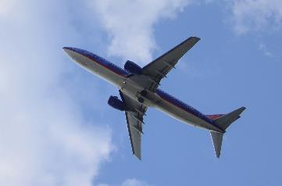
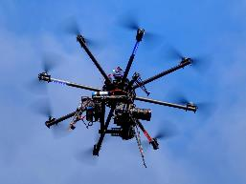
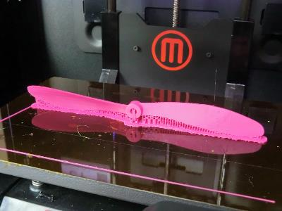
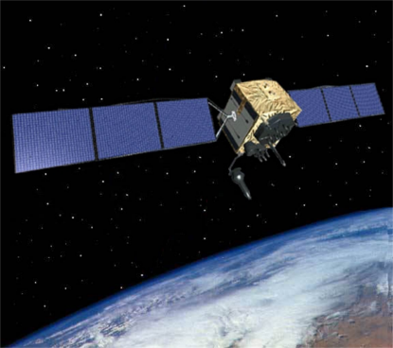
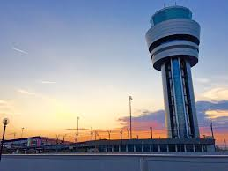
Pictures
Notes:
Enterprise Ops vs Air Ops
IATA Def

Slide 7
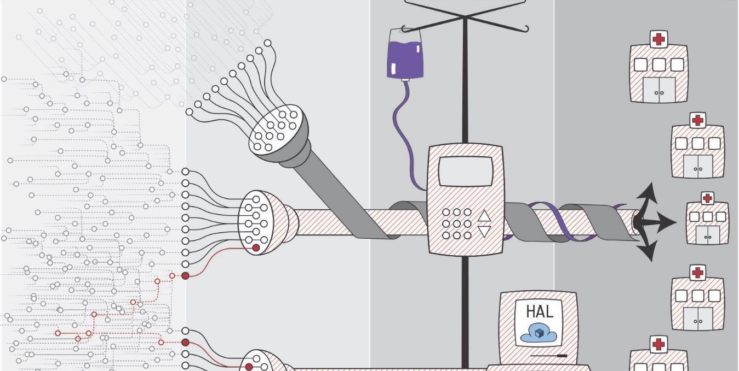

Slide 8
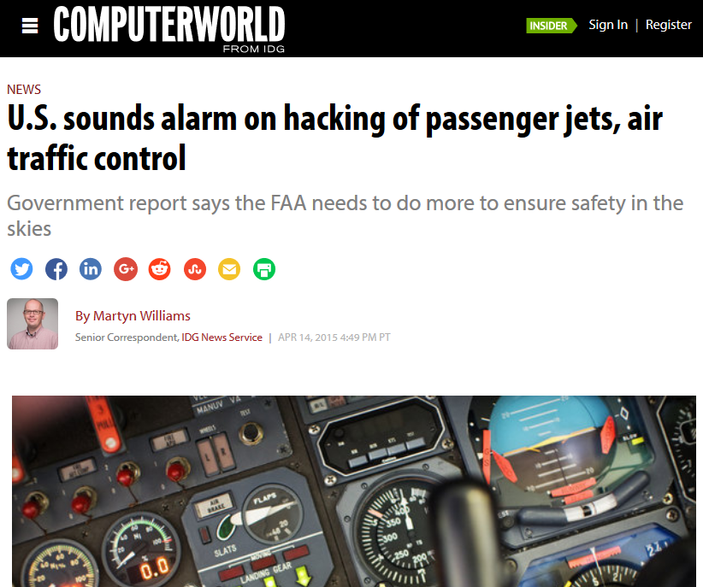

Slide 9

Why do adversaries attack?
Who you are

Slide 10
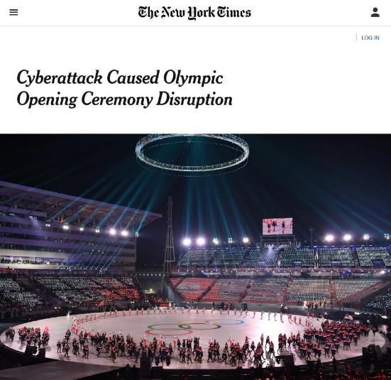
Why do adversaries attack?
Who you are
What you are doing

Slide 11
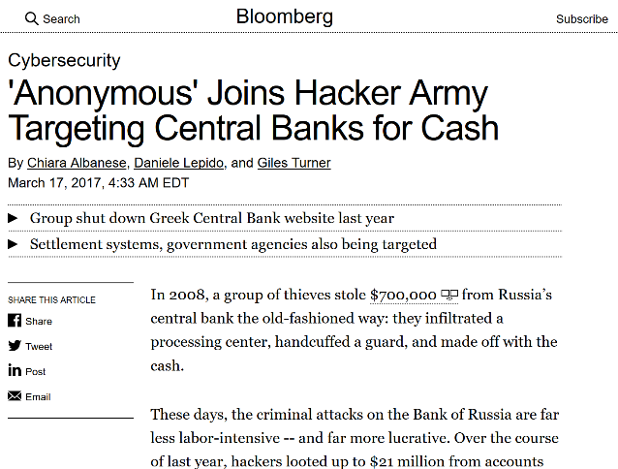
Why do adversaries attack?
Who you are
What you are doing
What you have

Slide 12
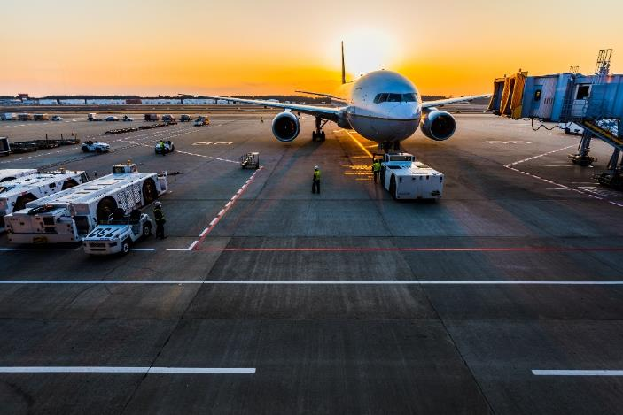
Why do adversaries attack?
Who you are
What you are doing
What you have

Slide 13
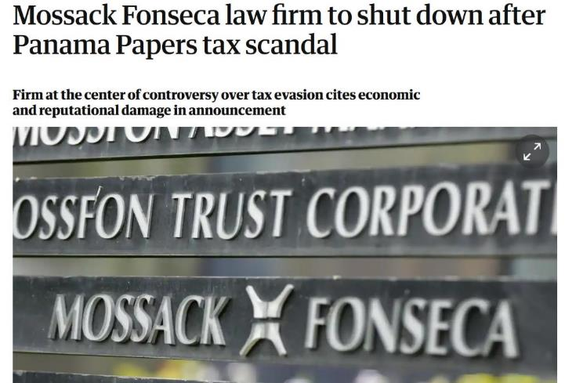
Why do adversaries attack?
Who you are
What you are doing
What you have
Who you partner with

Slide 14
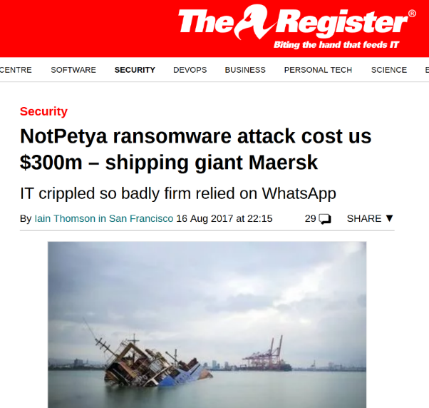
Why do adversaries attack?
Who you are
What you are doing
What you have
Who you partner with
What you are using and how you use it

Slide 15
Why do adversaries attack?
Who you are
What you are doing
What you have
Who you partner with
What you are using and how you use it
Targeted adversary effort to achieve their aims – Which are…..
Technology….
Notes:
Static vs dynamic targeting
Who is you???
Who is the adversary vs the ATM system? States vs Terror vs OCG

Slide 16
How are we being attacked?
Strategy
Operations
Tactics
Adversary leadership & teamwork
Adversary mindset
  Vision / Outcome focussed
  Clear Strategy
  Well defined aims
  Path of least resistance
“Where is the battlefield?”
“…. Everywhere” (Unrestricted warfare, Liang & Xiangsui 1999)
When are we engaged?
…..All the time^{(Me, 2015)}
Notes:
Our adversaries are only limited by their imagination and ethics – they are not limited by capability

Slide 17
Adversaries attack where they
Perceive weakness & gaps
Perceive poor understanding
Perceive poor co-operation
Perceive poor preparation
Notes:
Working together

Slide 18
How attacks will evolve
1st
  Data Integrity
  Safety critical information
  / instructions
generation
  System Availability
  Deny / Disrupt
2nd
  Data Confidentiality
  From air / ground / space data-links to on-board wifi
generation

Slide 19
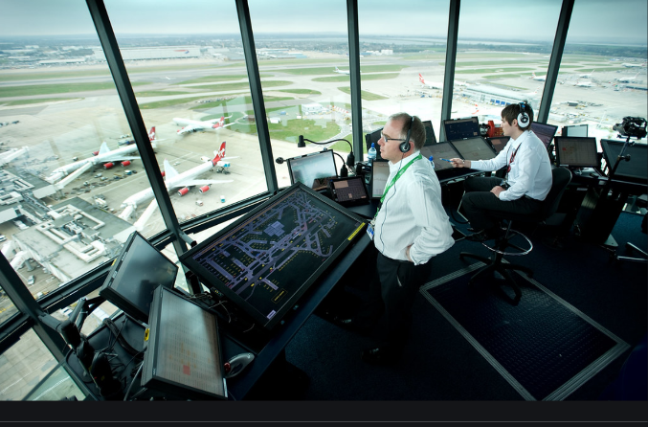
Availability Attacks
Planning for failure
Back-ups
Bandwidth
Notes:
We train for failure – so we should be ok
We have backups but they are generally of reduced sophistication / capability / traffic capacity
What we may struggle with is scale of failure – Bandwidth attacks
GPS

Slide 20
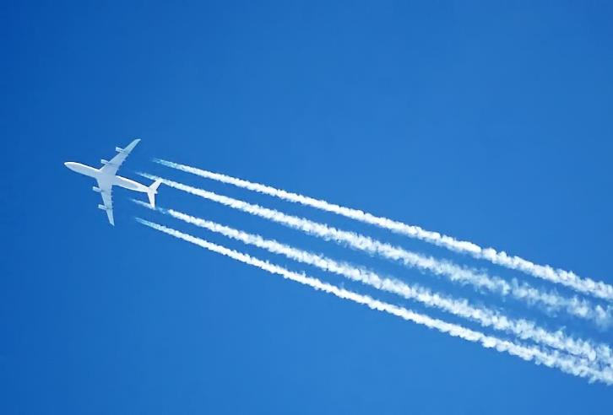
Confidentiality Attacks
Anonymity?
Notes:
Who is flying on what aircraft’

Slide 21
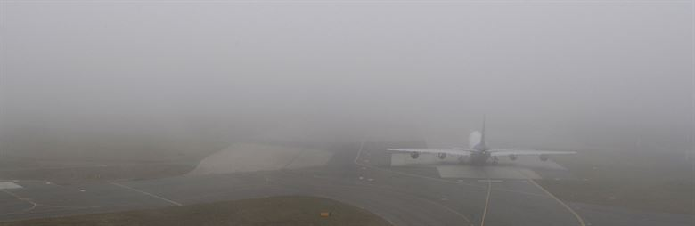
Integrity Attacks
Vs People
Notes:
GPS

Slide 22
Integrity Attacks
Vs People
Vs Technology?
Notes:
GPS

Slide 23
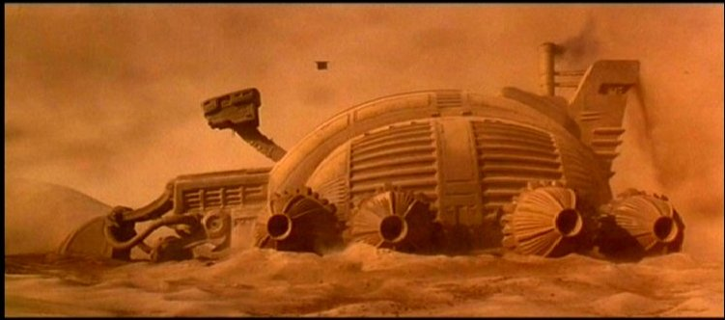
Trust in Aviation
“He who can destroy a thing, controls a thing”
Frank Herbert, Dune, 1965
Attacking it
Securing it
Secure
Demonstrable
Resilient
© 1984 Dino de Laurentiis Corporation
Notes:
Trust is a firm belief in the reliability of someone or something
It’s a two way relationship, if an adversary can destroy the relationship, they control the relationship

Slide 24
Changing our thinking
Culture – Org > national > international
Strategic Foresight vs technical solutions
Strive to find, fix gaps – minimise attack surface
Anticipate and collaboratively train for attacks
Strive for objectivity

