Slide 1
Implementing the surfaces
case study

Slide 2
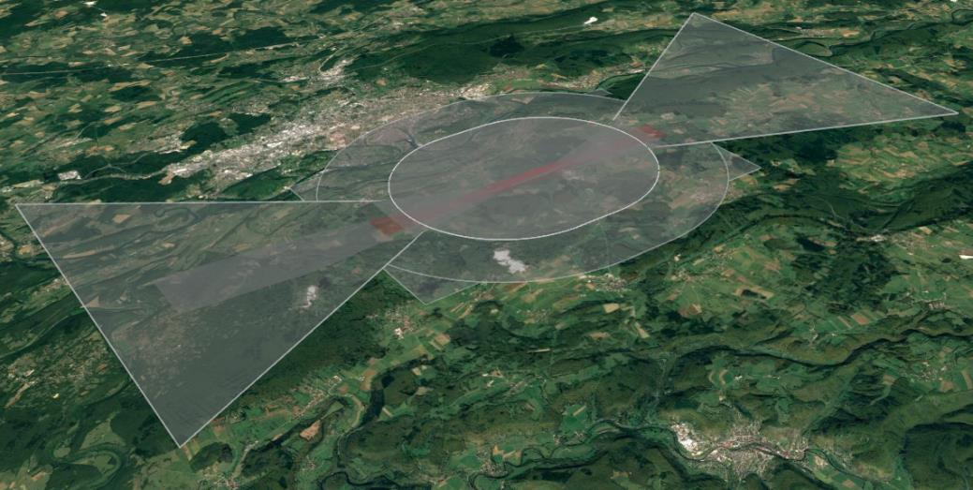
Implementing the surfaces – case study

Slide 3

Identifying the ADG

Slide 4
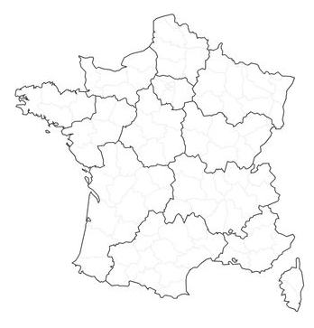

Identifying the ADG
Aeroplane reference code
Aeroplane design group
Reference field length of the demanding aircraft
Indicated airspeed at threshold of the demanding aircraft
Local factors
Expected aeroplanes
Traffic planning

Slide 5
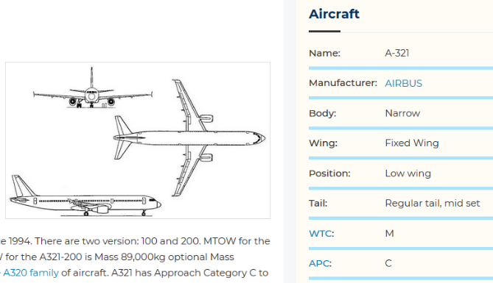
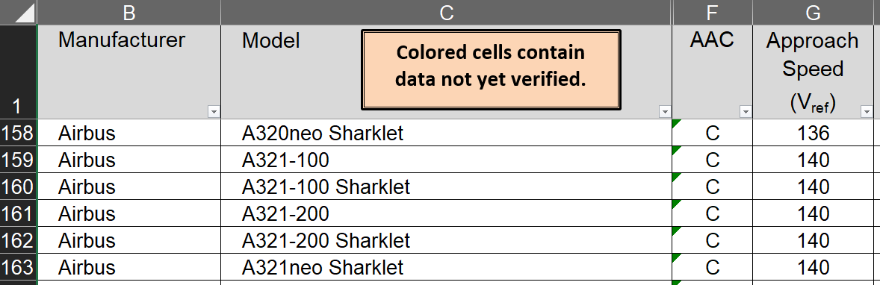
Identifying the ADG
Aeroplane flight manual, aircraft operators, aeroplane manufacturer.
Other examples.
https://www.faa.gov/airports/engineering/aircraft_char_database/
https://skybrary.aero/

Slide 6
Designing the OFS

Slide 7
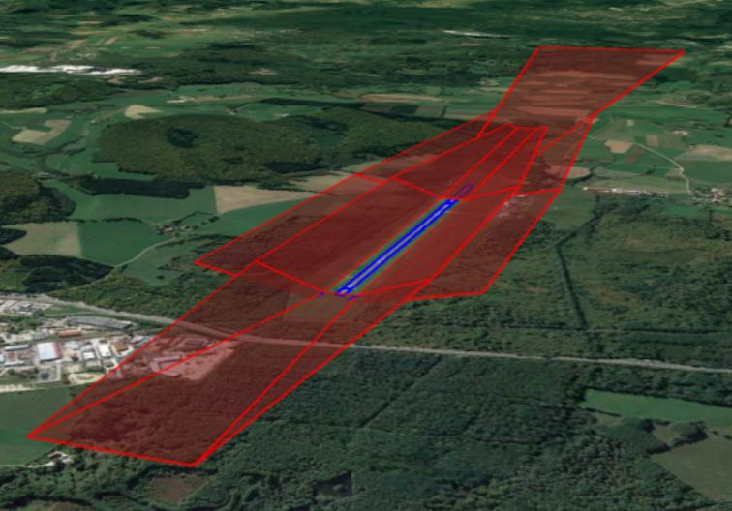
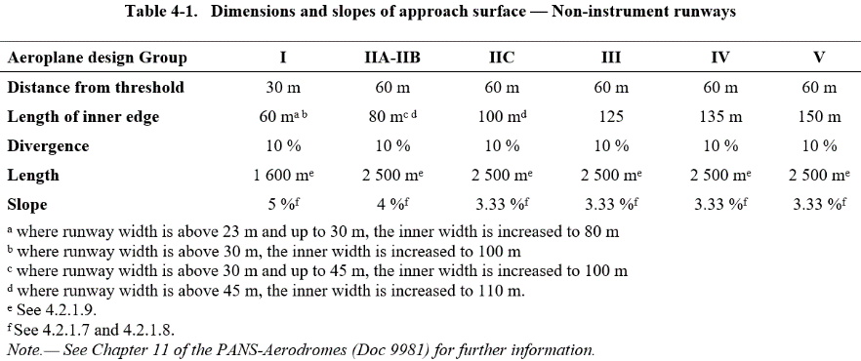
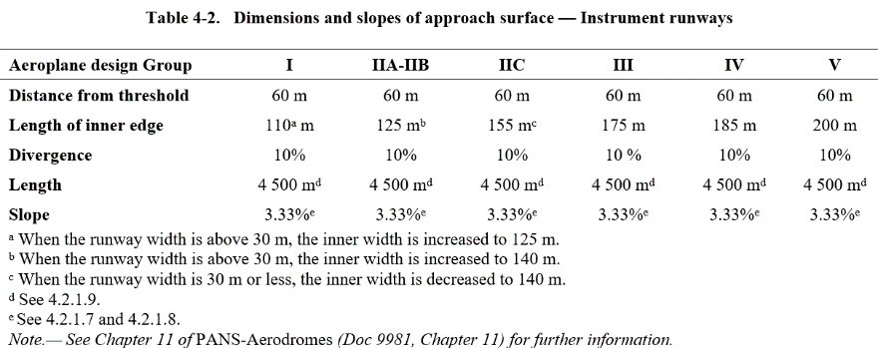
Designing the OFS
Similar to existing OLS: follow the tables

Slide 8
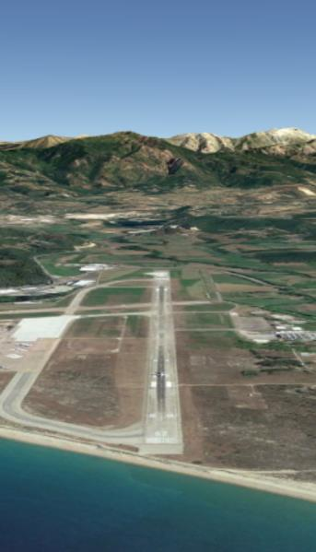
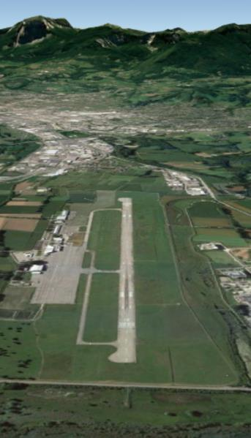
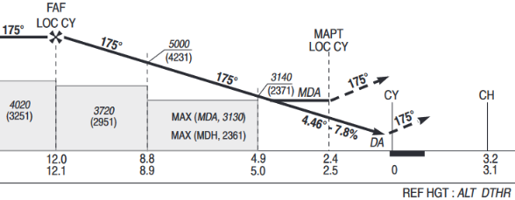
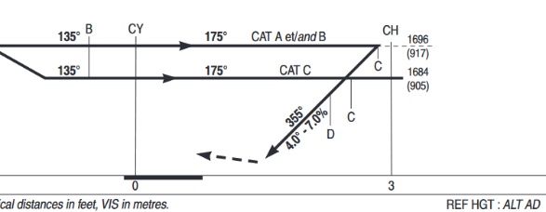
Designing the OFS
Vertical adjustment

Slide 9
Designing and adapting the OES

Slide 10
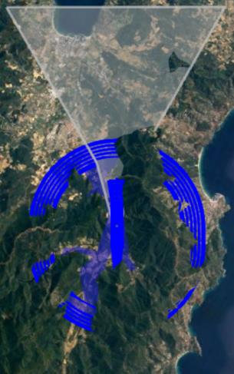
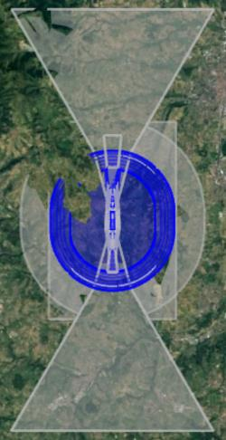
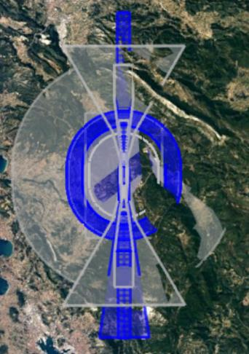
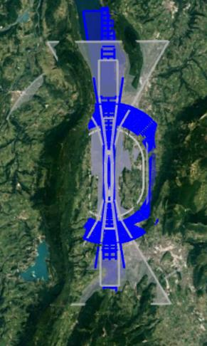
Designing and adapting the OES
Wider surfaces, but possibility to increase the relation to the operations

Slide 11
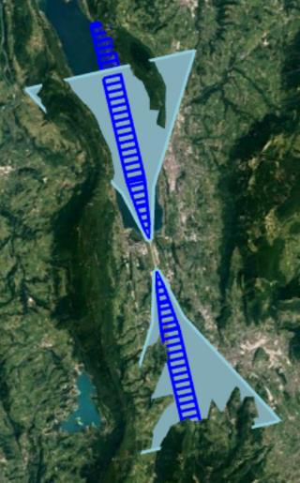
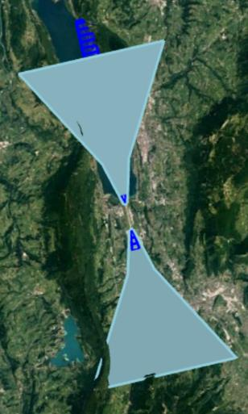
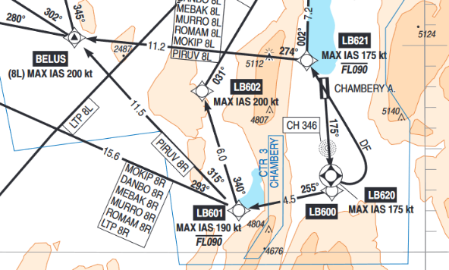
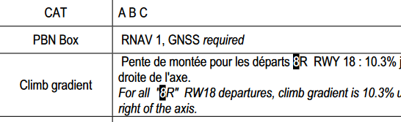
Designing and adapting the OES
Consider the operations

Slide 12
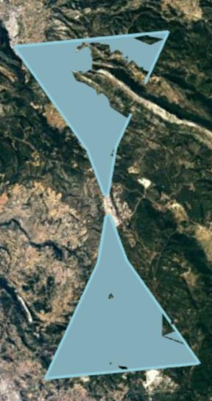
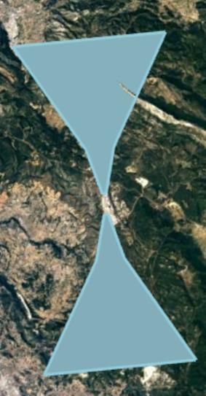
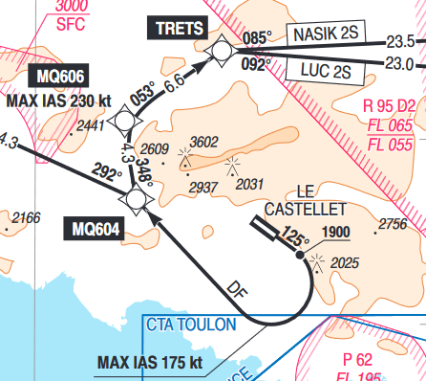
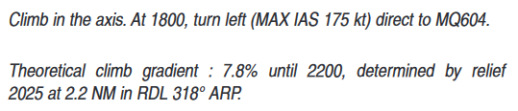
Designing and adapting the OES
Consider the operations

Slide 13
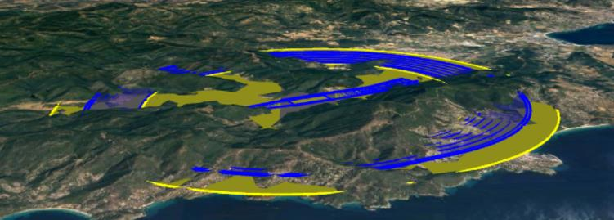
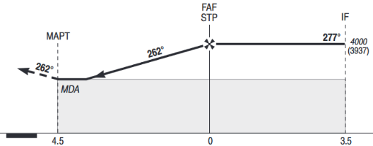
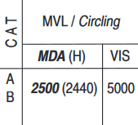
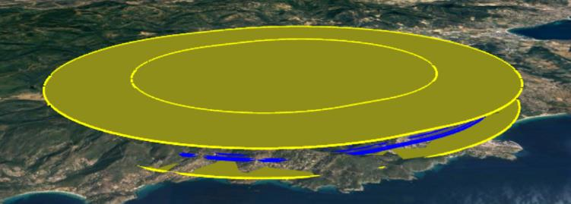
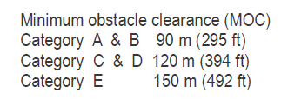
Designing and adapting the OES
Consider the operations

