Slide 2
Latest Developments of Annex 9 - FACILITATION
Ali Alathbi / ICAO

Slide 3
Amendment 29 to Annex 9, 16th Edition
Establishing the expert Working Groups
Annex 9 (WGA9)
Accessibility in Aviation
Assistance to Aircraft Accident Victims and their Families
Doc 9957, The Facilitation Manual , and Doc 10171, Manual on a Comprehensive Strategy for Combating Human Trafficking in the Aviation Sector.
75th Anniversary of Annex 9 / Commemorating 2024 as the Year of Facilitation
Developments pertaining to Annex 9 – Facilitation

Slide 4
High-Level Conference on COVID-19 2021 (HLCC 2021)
HLCC 2021 Facilitation Stream
Five Agenda Items
79 Recommendations – 62 to Member States, 17 to ICAO
State Letter EC 6/7–23/40 (5 June 2023)
Implementation of HLCC FAL Stream Recommendations
Relevant access by CAA to the Electronic Filing of Difference (EFOD) System
Webinar on Implementation of HLCC 2021 FAL Stream recommendations (29 June 2023)
- Accessible for viewing on ICAO TV

Slide 5

ICAO Symposium on Assistance to Aircraft Accident Victims and their Families
AAAVF 2021 – 1-3 December 2021, Canaria, Spain
30 Recommendations, endorsed by ICAO Council and 41st Session of ICAO Assembly
State Letter EC 6/3–23/8 (8 February 2023)
Inviting States to notify ICAO of their interest to host the second Symposium on Assistance to Aircraft Accident Victims and their Families

Slide 6
FAL Assembly Resolutions
A41-11: Declaration on air transport facilitation affirming global commitment to enable the safe and efficient recovery of aviation from the COVID-19 pandemic, and to make aviation more resilient in the future
Facilitation Work Programme 2023-2025
A41-14: Assistance to victims of aviation accidents and their families
A41-15: Accessibility in International Civil Aviation
A41-17: Consolidated statement of continuing ICAO policies related to facilitation
Forty-first Session of ICAO Assembly (A41)

Slide 7
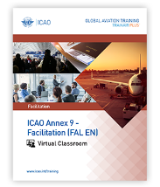
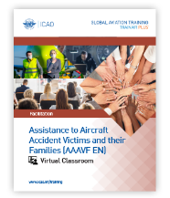

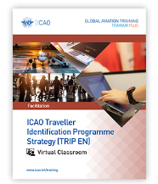
FAL Capacity Building - Training Courses
ICAO Annex 9 - Facilitation
The ICAO Annex 9 – Facilitation is virtual classroom course that develops competencies relevant to staff from Civil Aviation Authorities (CAA) and border control authorities to deal collectively, in an inter-agency manner, with Annex 9’s facilitation provisions.
Assistance to Aircraft Accident Victims and their Families
This course will provide CAA representatives, other government officials, aircraft and airport operators and non-governmental organization with the competencies to effectively support aircraft accident victims and their family assistance efforts, in accordance with ICAO Policy.
Visible Digital Seals for Travel-Related Public Health Proofs
This course provides State authorities with the competencies required to implement a national Visible Digital Seal for Non-Constrained Environments (VDS-NC) solution for travel health proof, in accordance with ICAO Doc 9303, Machine Readable Travel Documents, Parts 9-13.
Traveler Identification Programme (TRIP) Strategy
The course provides to the target audience the competencies to implement the five key elements of the ICAO TRIP strategy, ensuring interoperability and internal cooperation, in accordance with Annex 9.
Managing Air Transport Facilitation Course
In progress, the development of Managing Air Transport Facilitation Training Course. The course provides the target audience with the competencies required to develop a management system whereby the Coordinating Authority (ies) designated by the State is (are) able to coordinate the required national policy framework, coordinate Facilitation matters with relevant government agencies and other stakeholders and to assess the implementation of Annex 9 SARPs and create a national evaluation framework
Notes:
iPacks
FAL Implementation Seminar

