Slide 2
Dion Chamberlain
Digital Travel Credential (DTC)
What is it? What is it NOT?
Co-Chair – ICAO NTWG Policy Sub Group for DTCs
Manager Product Development, Strategy and International Engagement – Department of Internal Affairs, Aotearoa New Zealand
Chairperson – ICAO Implementation and Capacity Building Working Group (ICBWG)
Almaty, 2023

Slide 3
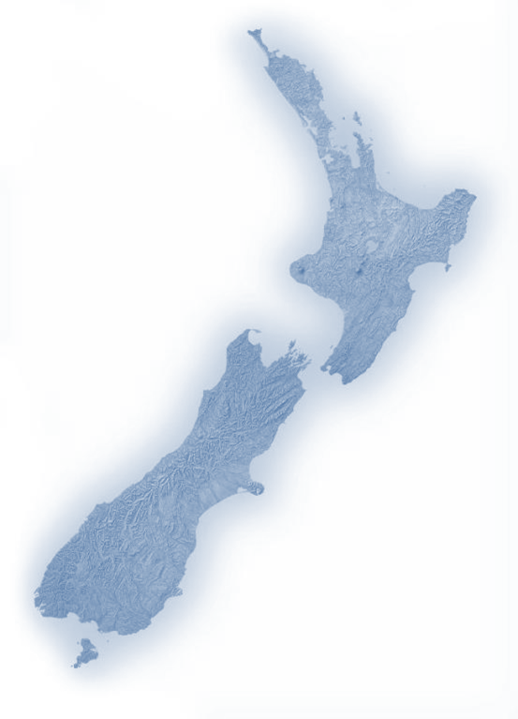
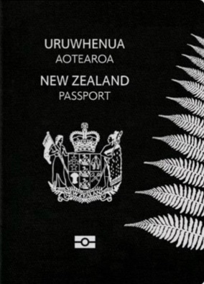
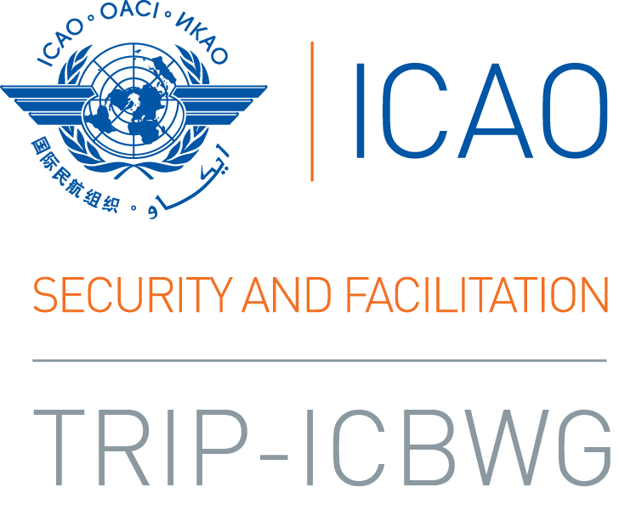


Slide 4
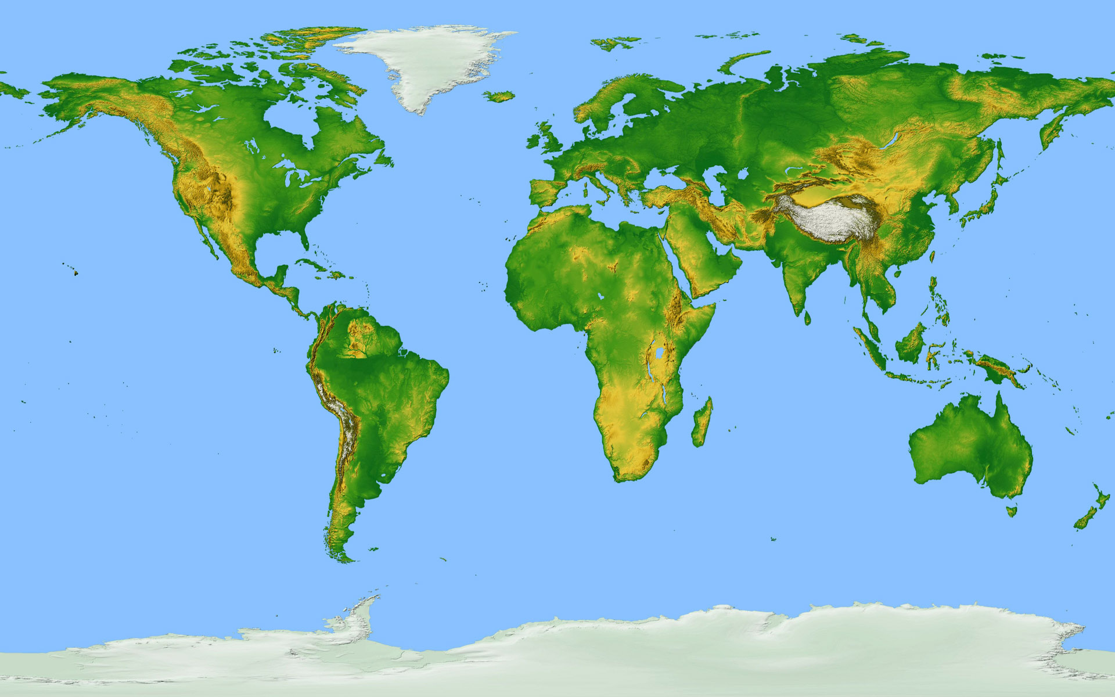
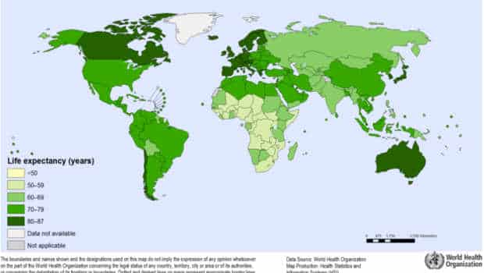
4
New Zealand

Slide 5



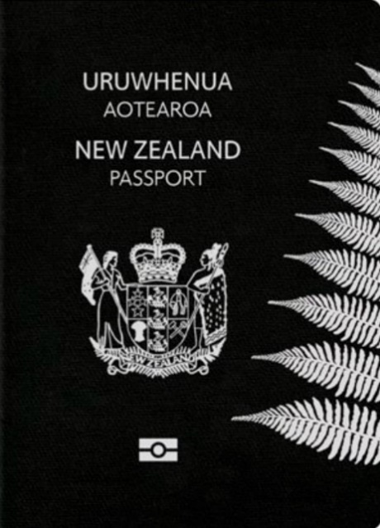
0
5.3
25.3
720
1
6

Slide 6
DIGITAL TRAVEL CREDENTIAL
DTC

Slide 7
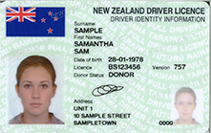
Is this a travel document?
Or document that can be used for travel in some circumstances?
Notes:
Driver licence … who thinks this is a travel document?
Driver’s licence … BUT it happens to be presented for travel in lots of contexts … even international travel. So …
Document that can be presented for travel … but not a travel document.
If I had’ve asked … who thinks this is a passport … no one wouldv’t put their hands up right. So … when we ask what is a DTC? Why so much confusion??

Slide 8

Digital credential
Verifiable credential
ICAO Digital Travel Credential (DTC)
Could be used for travel or in the travel continuum but…
Notes:
Driver licence … who thinks this is a travel document?
Driver’s licence … BUT it happens to be presented for travel in lots of contexts … even international travel. So …
Document that can be presented for travel … but not a travel document.
If I had’ve asked … who thinks this is a passport … no one wouldv’t put their hands up right. So … when we ask what is a DTC? Why so much confusion??

Slide 9
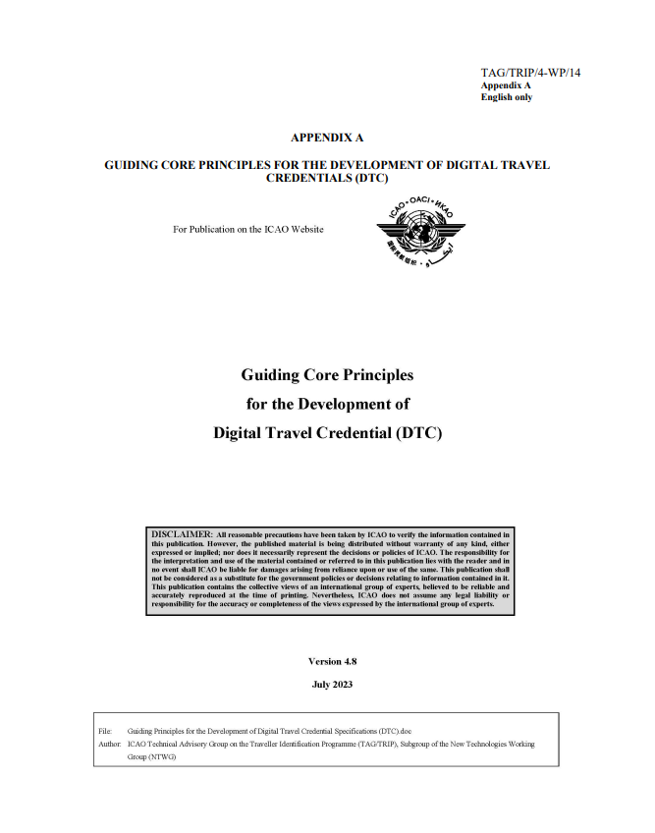

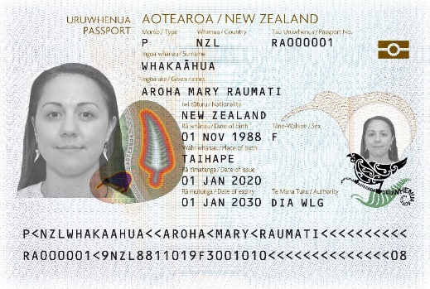
ICAO DTC Characteristics
Intended and specified first and foremost for border clearance (ICAO)
Globally interoperable
Highest security
Signed by the country (ePassports PKI)

Slide 10
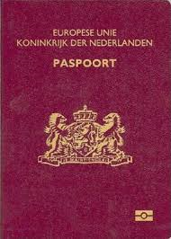


From ePassport to the ICAO DTC-VC and DTC-PC
  Logical Data Structure;
  Security Object.
  Crypto chip;
  Secure memory;
  AA/CA private key.
VC
PC
An ePassport can be viewed as a combination of:
A Virtual Component (VC) consisting of the data contained in the chip;
A Physical Component (PC) consisting of the booklet and/or cryptographic link between the VC and the PC and acts as an authenticator (second factor).

Slide 11
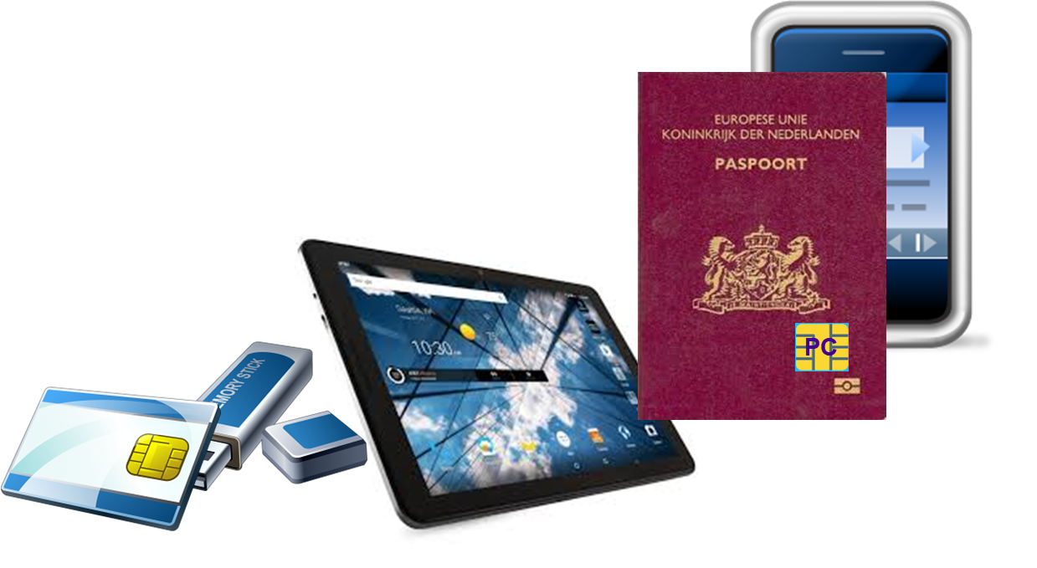
ICAO DTC Hybrid Model
The Data from the chip is enclosed in a file structure and called a Virtual Component (VC);
A device that can be cryptographically linked to the VC and is called the Physical Component (PC).

Slide 12
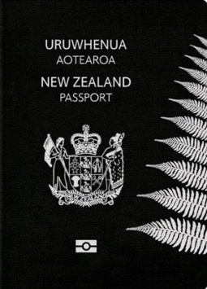
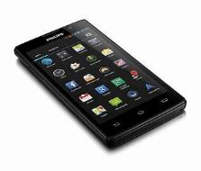
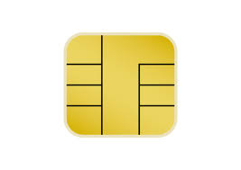
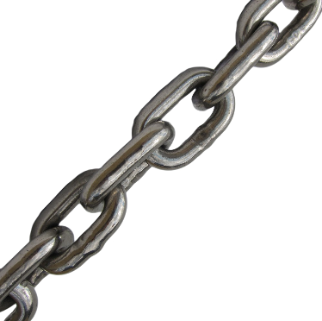

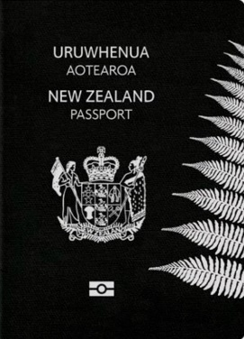


ICAO Digital Travel Credential
DTC-PC Physical Component
(Type 2)
DTC
Unbound
(Type 3)
DTC-VC
Virtual Component (Type 1)
Notes:
Choose the slides you want to use, and delete the rest.

Slide 13
ICAO DTC Types
Three Types
  eMRTD bound DTC
    Chipdata is read from existing travel document creating the VC
    The eMRTD booklet acts as the authenticator and can be considered a PC
    Anyone can create this DTC
  eMRTD-PC bound DTC
    Chipdata is read from existing travel document creating the VC
    Option to cryptographically link to a different physical device(PC) with the eMRTD as a fallback
    Can only be created by the same authority that issued the eMRTD
    DTC can be issued any time after the issuance of the eMRTD
  PC Bound DTC
    No eMRTD is issued, but only a PC with form factor different from an eMRTD
    Can only be created by an eMRTD issuing authority
    No eMRTD available as a fallback

Slide 14
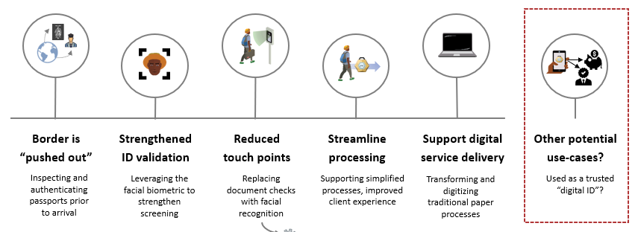
Use Cases :
Seamless Travel
Advance Travel Authorization (ETA/DTA/…)
Improving border processing time
Emergency Travel Document

Slide 15
ICAO DTC Specifications
ICAO DTC-VC Technical Report approved in 2020
ICAO DTC-PC specifications divided into two phases
  Phase 1 – maintain backward compatibility to the extent possible with existing inspection systems and replicate behavior of eMRTD – The Technical Report approved 2023
  Phase 2 – investigate other form factors like mobile phones – currently a gap analysis is being conducted to identify the difference between policy requirements and technology landscape

Slide 16
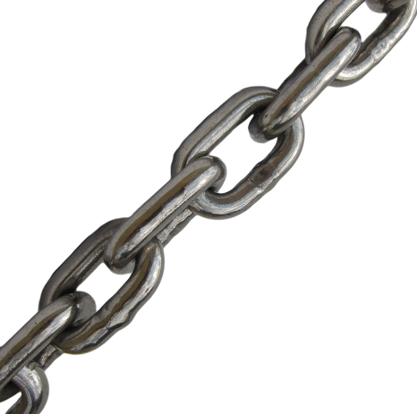
ICAO Digital Travel Credential
Unbroken PKI link to issuing authority
Notes:
Choose the slides you want to use, and delete the rest.

