Slide 2

The Evidence of Identity (EOI) Approach
Dion Chamberlain
Chair, ICAO Implementation and Capacity Building Working Group (ICBWG)
Manager Product Development
Strategy and International
Department of Internal Affairs
Aotearoa New Zealand
ICAO Workshop and Seminar – Namibia 2019

Slide 3
At the end of this presentation ….
Know what ‘Evidence of Identity Approach’ is and how you might apply it to your own context
The importance of robust foundational identity to your work
Biometrics is part of the solution, but not the answer to every identity problem
How investing in EOI can save money and give your citizens a much better service

Slide 4
The problem
As the security and integrity of physical travel documents has improved there has been a move away from counterfeit passports
Weaknesses in passport issuance processes are increasingly being targeted
Genuine passports that have been falsely obtained are much harder to detect at Border

Slide 5




0.01
99.99
Risk
Service
Excellence

Slide 6

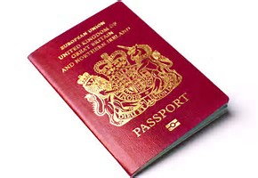


Traditional Identity Chain
Identity Documents Issued and Used (biometrics linked and validated)
Birth Registration
(foundational identity)
Death Registration
(Identity closed)
Notes:
Choose the slides you want to use, and delete the rest.

Slide 7
Weak Links = system of silos
Identity Documents Issued and Used (biometrics linked)
Birth Registration
(foundational identity)
Death Registration
(Identity closed)
X
X
Invented?
Stolen?
Living?
Death linked or searchable?
Notes:
Choose the slides you want to use, and delete the rest.

Slide 8
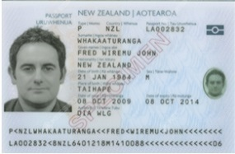

Hold the phone … We have biometric matching
Data clean-up
Deduplication
People’s aptitude for FR manual comparison
Multi-modal biometrics
Morphing/spoofing
Identity Documents Issued and Used (biometrics linked)
Notes:
Choose the slides you want to use, and delete the rest.

Slide 9
Human Factors
Facial Recognition Aptitude - NZ
  All officers evaluated
  20% potential ‘Super Matchers’ (90% or above)
  20% of concern (70% or below)
  Testing is part of recruitment
University of New South Wales (Ongoing FR Study)
  Training makes 5% difference
  How does this affect recruitment and workforce?
  Think about exception processing – FR Matching algorithms are so good the PEOPLE MANUALLY REVIEWING MATCHES CAN UNDERMINE THE SYSTEM
  Can use other information or combine information
Notes:
9

Slide 10

Most important aspect of any identity system
… but not the only one.
Is the biometric anchored to a genuine biographical identity, and does it belong to the claimant?
Still have Fraud? Yes you do.
Unique to your System
Notes:
Choose the slides you want to use, and delete the rest.

Slide 11
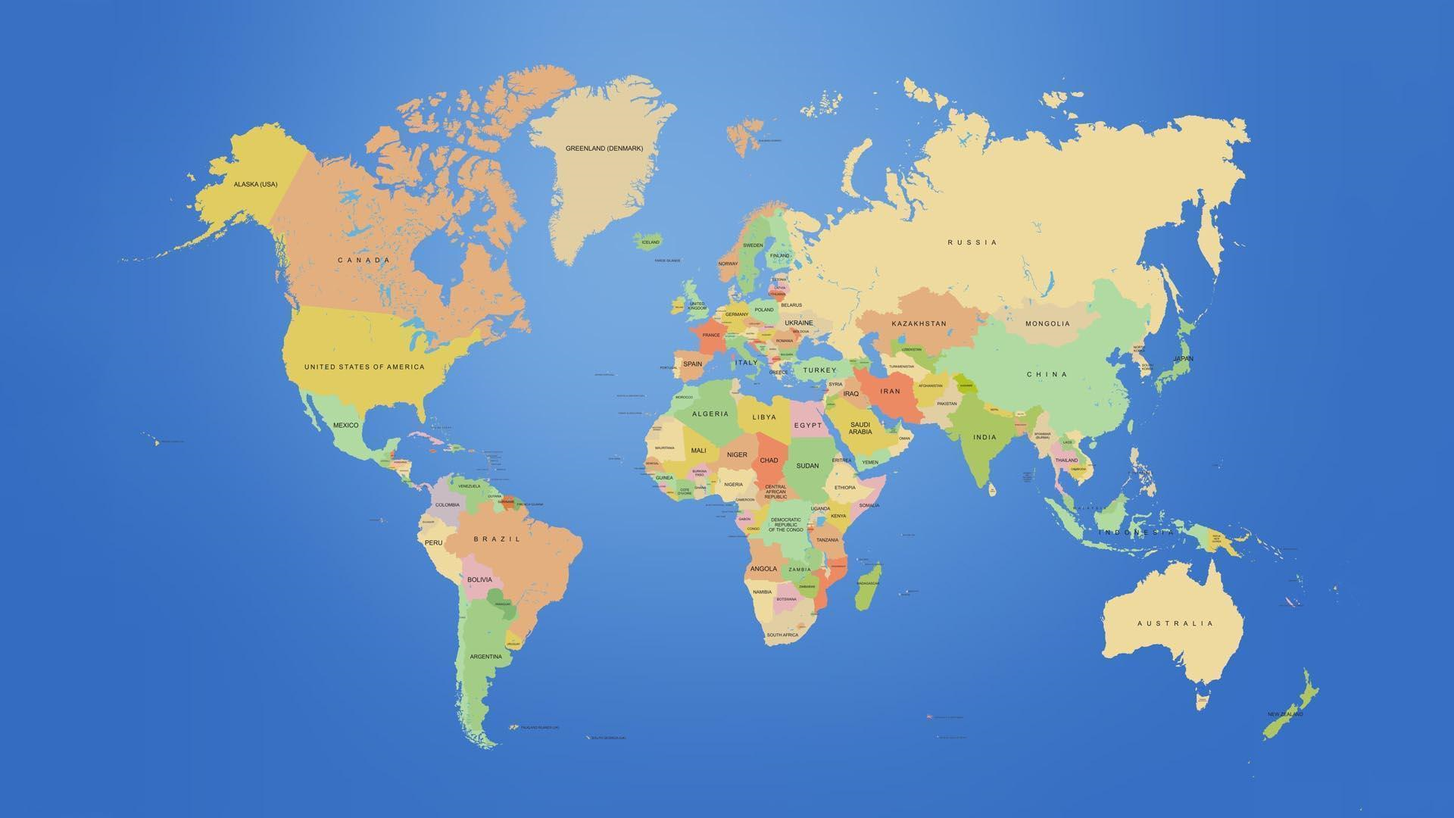
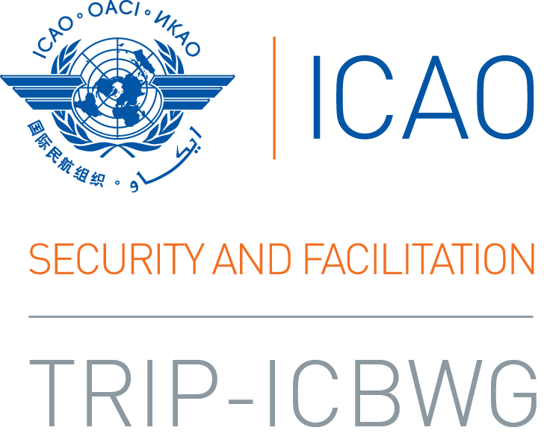
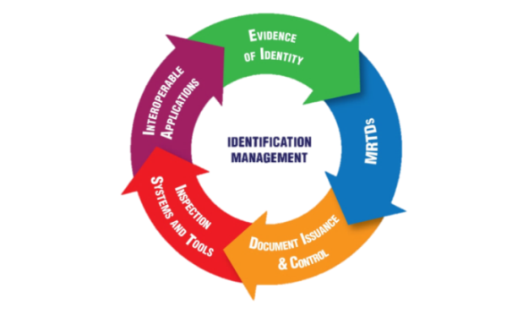
Notes:
Choose the slides you want to use, and delete the rest.

Slide 12
Global View
ICAO is looking for uniquely identified travellers across the global system to increase security and facilitation
Requires improved and more holistic Evidence of Identity processes from individual Passport Issuance authorities, supported by an integrated border approach
Requires a different understanding of the identity system, and an increased understanding of the role biometrics plays
Notes:
Choose the slides you want to use, and delete the rest.

Slide 13
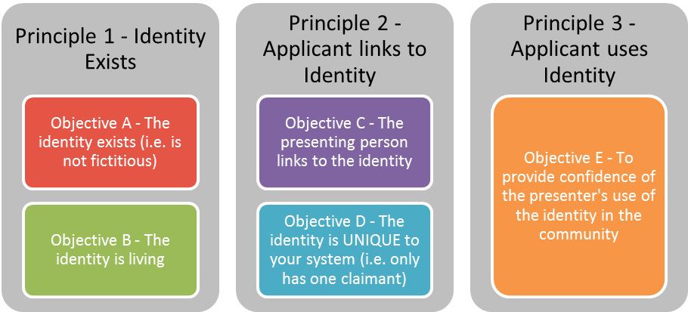
EOI Authentication Principles
Notes:
Choose the slides you want to use, and delete the rest.

Slide 14
The EOI approach
Identity is understood as an eco-system
EOI framework is focussed on understanding and using information to gain a level of confidence rather than proof – NO ABSOLUTES
Establishing and verifying identity is about probabilities
There is no “silver bullet” and no “one-size-fits-all”
Notes:
Choose the slides you want to use, and delete the rest.

Slide 15
The EOI approach (2)
Identity and identity-related information is broad, covering public and private sector, and differs between cultures, countries and geographical regions
Harnessing information beyond the traditional chain to build confidence over time
Importance of aspects such as consistency, distributed information, social footprint and connections between information
Considers continuity and longevity of information
Notes:
Choose the slides you want to use, and delete the rest.

Slide 16
Context is important
There are different risks and mitigations depending on the context
Passport Issuance
Example 1
Passport Issuance
Example 2
Information from village chiefs/elders, educators and employees
Staff knowledge of local accents, dialects and physical features etc.
Evidence from other government sources like social services
Large group of trusted witnesses/referee
Biometrics of every applicant for 1:1/1:M matching
Centralised database of applications
Electronic access to source data from national civil registries
Notes:
Choose the slides you want to use, and delete the rest.

Slide 17

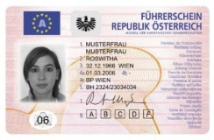
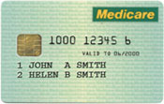
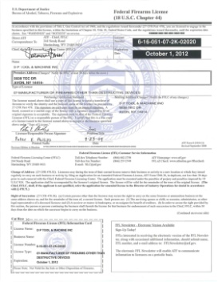
EOI Evaluation
Evaluation: follow EOI principles to systematically document and understand your ‘identity ecosystem’ and key risks
Analyse ALL potential document, record or information sources available and its value in an EOI process (a matrix is helpful)
Understand the security of “foundational” records, data and the issuance process that sits behind them
Identify gaps and look to other areas of EOI to increase confidence … THEN design the approach.
8/10
3/10
4/10

Slide 18
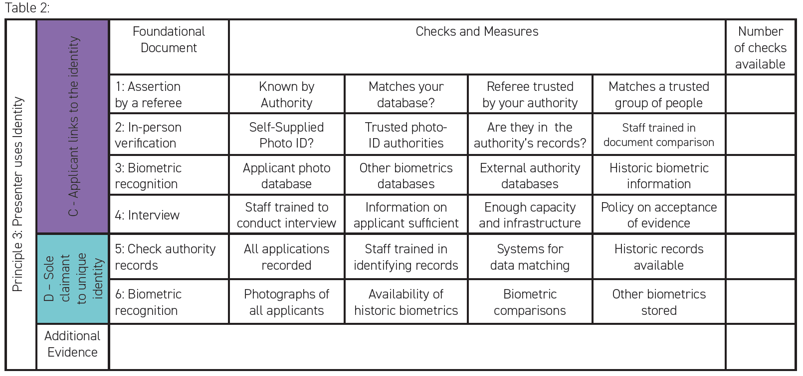
ICAO Guide on EOI: Example Assessment Table

Slide 19
EOI Authentication Principles
Notes:
Choose the slides you want to use, and delete the rest.

Slide 20
Building On Uniqueness: Key
Establishing UNIQUENESS of an identity in your system is key – without using biometrics (one to many match), this is becoming increasingly challenging
Building on uniqueness within system – anchoring to a genuine identity and building confidence in the presenter’s link to the identity by using distributed sources
New technologies emerging that disrupt traditional, and new threats like photo morphing
Notes:
Choose the slides you want to use, and delete the rest.

Slide 21
Integrated approach
API/PNR
ETA
Data Validation
Issuing Authority:
Identification of Travellers
Border Authority:
Risk Assessment of Travellers
INTERPOL
Information Sharing
Biometrics
Risk Assessment of Travellers
Identification of Travellers
Biometrics
UN/CTD
One Person, One Identity
PKI
Notes:
Choose the slides you want to use, and delete the rest.

Slide 22
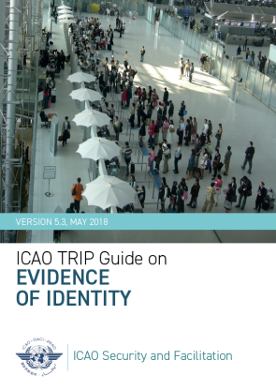
EOI Guidance Material
ISO/IEC TS 29003:2018 – Identity Proofing
ICAO Implementation and Capacity Building Working Group (ICBWG) Guidance on Evidence of Identity
  ICAO Guide on Evidence of Identity
  ICAO Border Management Guide
Guidelines on the Legislative Framework for Civil Registration, Vital Statistics and Identity Management
IOM Legal Identity Work
Notes:
Choose the slides you want to use, and delete the rest.

Slide 23
So what? Why Invest in Foundational ID?
We all face cost pressures – demand for efficiency gains
High confidence in EOI and resulting data assets and systems enables efficiencies, costs savings and new services
Robust first-time interaction for travel documents means subsequent contact can leverage off initial EOI
A well-understood EOI approach will enable more effective targeting of resources (people and system design)
Service
Excellence
Risk

Slide 24
Top Takeaways
Identity verification is not absolute – it is dynamic, based on context, probabilities and levels of confidence
REVISIT your approach to EOI, systems and processes - develop a case for investment in EOI based on security AND efficiency
Develop and maximise your critical EOI data assets – robust first up processes allow automation and more informed risk-based EOI decisions
Look for a flip-side benefit – if there is an EOI technology you are using to guard against something, there is a good chance it will facilitate something too – MAYBE ACROSS GOVERNMENT

