Slide 2

Marie Hauerova
Ministry of Transport, Civil Aviation Department
Czech Republic

Slide 3
Implementation of the NATFC and NATFP
- Experiences of the Czech Republic
01
Regulatory Framework
02
How to start?
03
Members of the NFC
04
Duties of Members and NFP
05
Real Experiences
06
Next steps

Slide 4
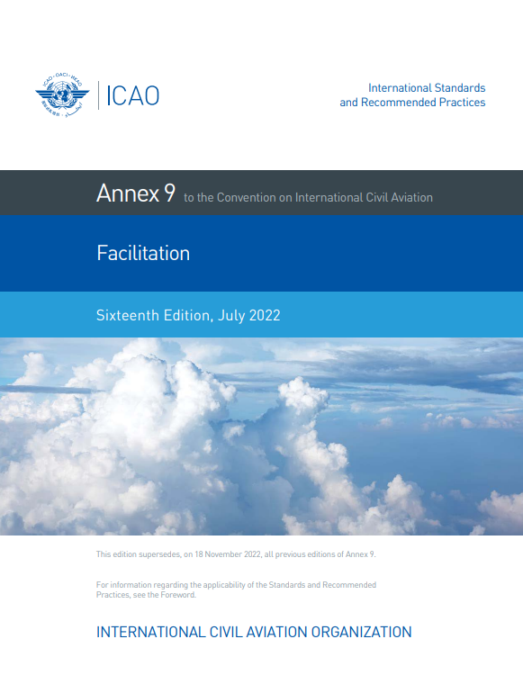
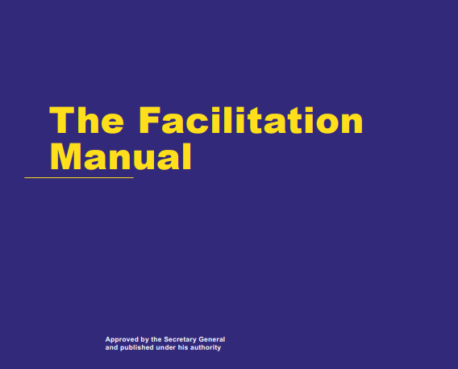
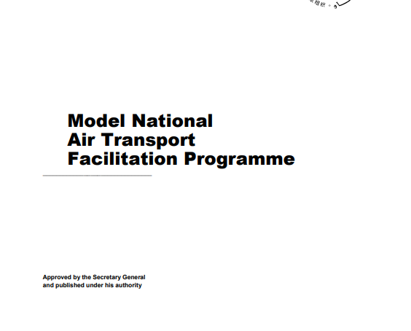
Regulatory Framework
Annex 9
(To the Convention on International Civil Aviation)
Facilitation
DOC 10042 AT/513
Model National Air Transport Facilitation Programme
The Facilitation Manual

Slide 5
How to Start?
To select ministries and organizations whose matters are included in Annex 9
04
01
Terms of reference
National Facilitation Programme
National Facilitation Committee
Nomination of experts, credentials to work in the NFC
03
02
Allocation of responsibilities

Slide 6
Members of the NFC
Customs Office
Prague Ruzyně
Department of
Regulations
Ministry of Transport
CAA
CAD
Ministry of Finance
General Directorate
of Customs
Alien Police
Service
NFC
Ministry of Interior
Ministry of Agriculture
State Veterinary
Administration
PIU
Border protection
Department
Ministry of Health
Ministry of Foreign Affairs
Department of Public
Health Protection
Airport operators
Aircraft Operators

Slide 7






Duties of Members of the NFC
  To implement Annex 9 SARPs and the amendments to proper national regulations.
  To share relevant information, legislation.
  To cooperate on notification of differences of Annex 9 SARPs with national regulations.
  To cooperate on solving arising problems operatively and eliminate these problems.
  Improve their knowledge and awareness of the needs and problems of civil aviation in the facilitation field.

Slide 8
National Facilitation Programme
Definition
Objective and principles of the NFP
International and national legal acts related to the Facilitation
Allocation of responsibilities
Annex 1 – Statutes and rules of procedure of the NFC

Slide 9

Real Experiences
Family Assistance
Annex 9, RP 8.49; 8.50; 8.51; Standard 8.47; Doc 9998 Doc 9973
Common approach, decision, effort
Initiative of NFC – meeting with Integrated Rescue System
Task – upgrade the National Family Assistance Plan
Establishment of the special interdepartmental working group
Set up the Family Assistance Center

Slide 10

Real Experiences
Crew Member Certificate
Annex 9, Standard 3.61; 3.62; 3.64; 3. 65; RP 3.63; 3.63.1
Civil Aviation Department and Civil Aviation Authority
State Printing Works of Securities
Specifications of Doc 9303, Part 5
Procedures for Air Operators

Slide 11

Real Experiences
Covid Measures
Sharing all information from ICAO, EASA, CAPSCA, ECAC, ECDC
Extraordinary NFC meetings
Extensive contact between members of NFC
Responsibility of the Ministry of Health and Central Crisis Staff
Lessons learned from the Covid-19 pandemic

Slide 12

Next steps
To implement the Amendment No 29 of Annex 9
To prepare training program regarding the Human Trafficking
To ensure more competencies for the NFC
To revise and to amend the NFP

