Slide 2

Nurzhan Malayev
Director of the Department of
Facilitation, Passenger and Cargo Services
Stages of development of
the National Committee for Air Transport Facilitation
in the Republic of Kazakhstan

Slide 3











About Aviation Administration of Kazakhstan JSC
Date of Establishment 1 August 2019
Step 68 of the "Plan of the Nation - 100 Concrete Steps"
The Aviation Administration of Kazakhstan JSC was established as part of the implementation of the 68-step Plan of the Nation "100 Concrete Steps". This is a radically new approach to ensuring flight safety in the country in accordance with the best international practices in regulating the industry. The Aviation Administration of Kazakhstan implements measures to ensure technical aviation control and oversight in the field of flight safety.
Control and oversight related to activities in the following areas
Flight operations
Aviation security
Personnel Licensing
Airworthiness
Facilitation, passenger and cargo services
Unmanned aerial systems
Air Traffic Control
Aerodromes and ground handling
Aviation medicine

Slide 4
8.18
9957
Each Contracting State shall establish a national air transport facilitation programme based on the facilitation requirements of the Convention and of Annex 9 thereto.
The Facilitation Manual
8.20
10042
Each Contracting State shall establish a National Air Transport Facilitation Committee, and Airport Facilitation Committees as required, or similar coordinating bodies, for the purpose of coordinating facilitation activities between departments, agencies, and other organizations of the State concerned with, or responsible for, various aspects of international civil aviation as well as with airport and aircraft operators.
Model National Air Transport Facilitation Programme

Slide 5


Stages of development of the National Air Transport Facilitation Committee
Convention on International Civil Aviation
Resolution of the Supreme Council of the Republic of Kazakhstan of 2 July 1992 “On ratification of the Convention on International Civil Aviation”.
Resolution of the Government of the Republic of Kazakhstan No. 243 dated 20 April 2015.
On approval of the International Air Transport Facilitation Programme, which is a set of measures designed to facilitate the establishment of procedures to improve facilitation procedures in civil aviation in the Republic of Kazakhstan.

Slide 6



Stages of development of the National Air Transport Facilitation Committee
Civil Aviation Committee of the MIID RK 2015-2019
CAC is a working body of the NATFC 2015-2019.
Joint work with the NATFC on Aviation Safety.
Working through the COVID-19 pandemic 2020-2022
Interdepartmental Commission on preventing the emergence and spread of coronavirus infection on the territory of the Republic of Kazakhstan.
Department of Facilitation, Passenger and Cargo Services 2022 -2023
AAK is a working body of the NATFC, the list of participants of the NATFC was revised, Maintaining work of the NATFC, Receipt of iPack FAL by Kazakhstan.

Slide 7
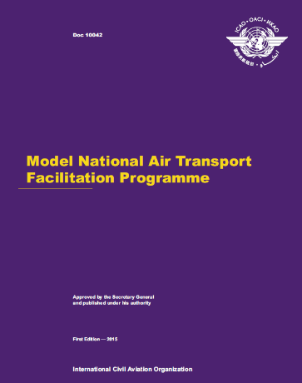
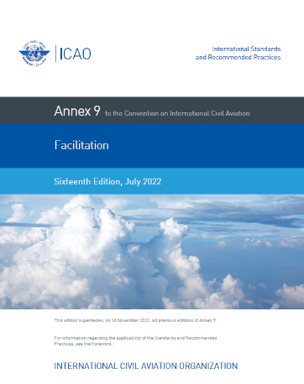
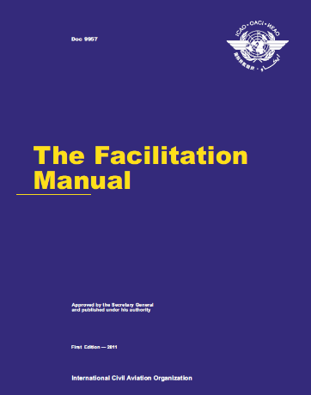
Stages of development of the National Air Transport Facilitation Committee
Key challenges for 2023-2025.
According to the final iPack Facilitation report
Revision of the National Air Transport Facilitation programme based on DOC 10042.
Involve international experts from countries with similar national legislative frameworks in the implementation of the national air transport facilitation programme to share best practices and learn from their experiences.
Encourage airport facilitation programmes at all airports in Kazakhstan.

Slide 8

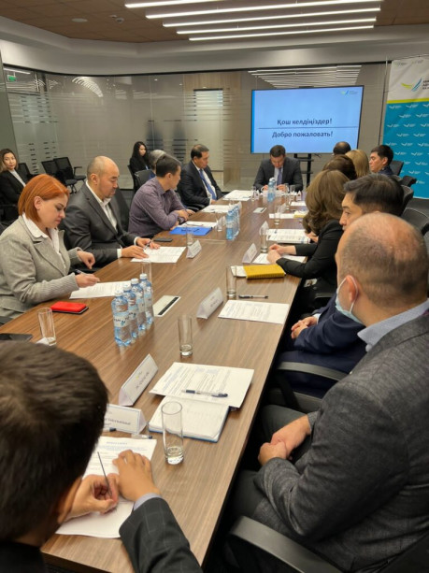

Resumption of the work of the National Air Transport Facilitation Committee of the Republic of Kazakhstan
NATFC structure
Ministry of Industry and Infrastructural Development of the Republic of Kazakhstan;
National Security Committee;
Ministry of Finance;
Ministry of Health;
Ministry of Foreign Affairs;
Ministry of Internal Affairs;
Ministry of Agriculture;
IOM;
IATA Regional Office.
Airport Commissions
Border Control of the National Security Committee RK;
Customs Control of the State Revenue Committee of the Ministry of Finance RK;
Committee of Sanitary and Epidemiological Control of the Ministry of Health RK;
Department of Consular Service of the Ministry of Foreign Affairs RK;
Committee for Veterinary Control and Supervision of the Ministry of Agriculture RK;
Airlines;
Ground service providers.

Slide 9
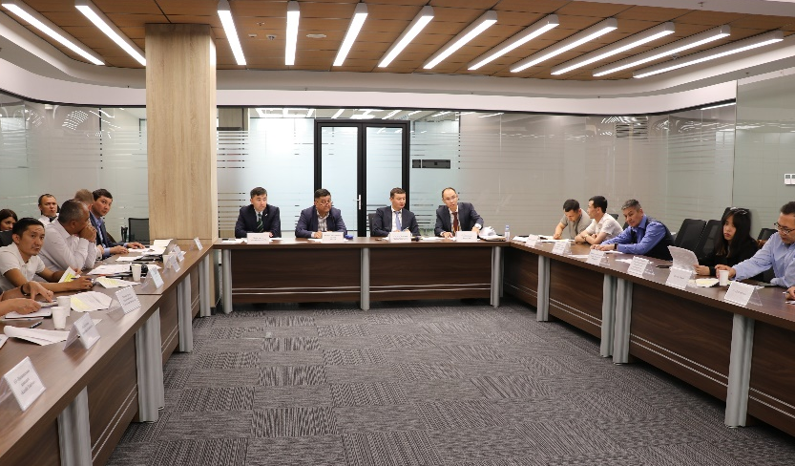



Stages of development of the National Air Transport Facilitation Committee
2023 - 3 meetings
of the National Air Transport Facilitation Committee
Discussion of the latest amendments - 27, 28, 29.
Announcement of TRIP in the RK.
Goals for 2024:
Bringing the national legislation in higher compliance with the SARPs Annex 9;
Implementation of Biometric project at NQZ airport.

Slide 10
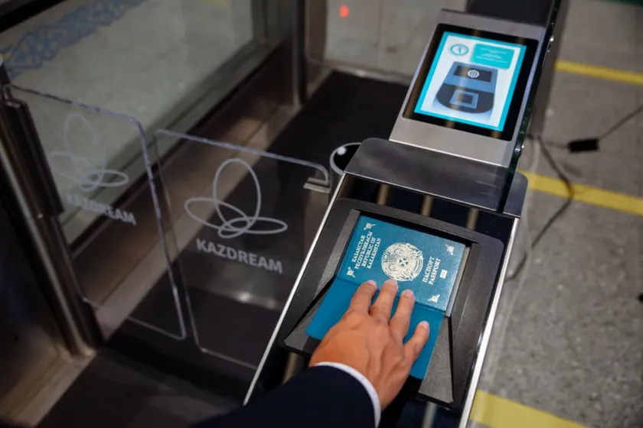

Joint Projects with the State Authorities
RP 3.33.4 Each Contracting State should consider the introduction of Automated Border
Control (ABC) systems in order to facilitate and expedite the clearance of persons entering or departing by air.
ABC systems installed at Nursultan Nazarbayev International Airport.
A joint project of AAK and MDDIAI on domestic flights on digital IDs.

Slide 11



Projects for 2024-2025
Digitalization of Kazakhstani airports for facilitation purposes
The intention of Nursultan Nazarbayev International Airport to introduce Face ID technology
Cancellation of the inspection of representatives of the Ministry of Health on arrival

Slide 12
Aviation works best when we work together
Thank you to all the members of the
National Air Transport Facilitation Committee of Kazakhstan!

